Slide 1
Get Started
Computation graph
Constant, Variable and Placeholder
Concept of Session
Tensor and flow
Use of session.run
Fundamentals of TF programming regulations
Download TF wrapped layers from my GitHub
https://github.com/ddddwee1/sul/
layers.py and model.py

Slide 2
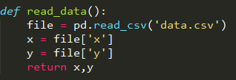
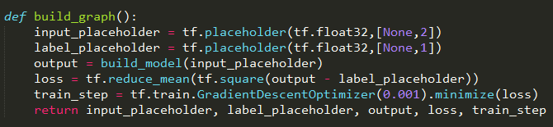

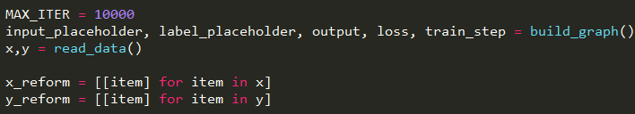

Linear Regression
Read CSV File:
Build computation graph:
Plot data (Visualize):
Main code:
Build model:

Slide 3
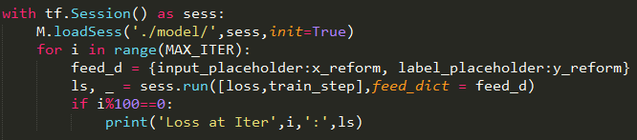
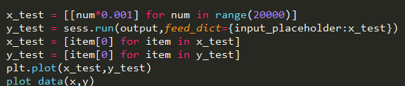
Linear Regression
Training code:
Testing code (draw the approx. line):

Slide 4
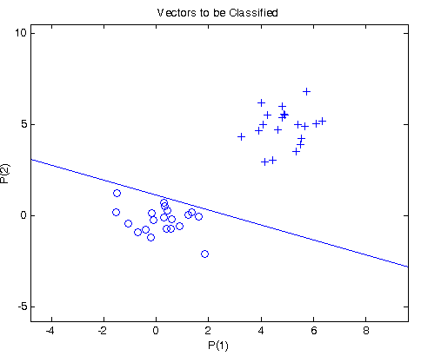
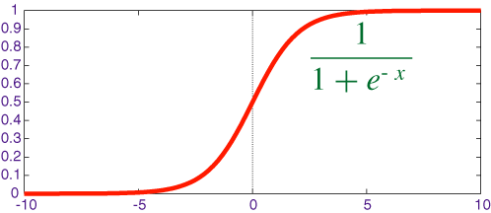
Logistic Regression
Combine x and y together:
Loss function:
Evaluate the accuracy:

Slide 5
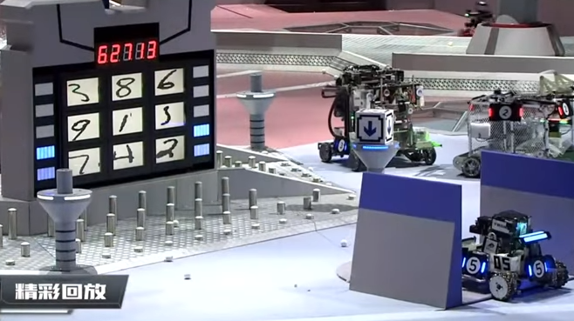
MNIST (Handwritten digits)

Slide 6
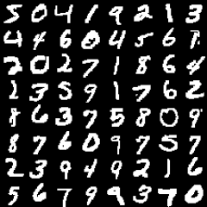

MNIST (Handwritten digits)
Get the MNIST dataset:
Get the training batch:

Slide 7
MNIST (Handwritten digits)
Supervised with 10 separated Sigmoid loss
(Logistic loss)
Input: 28*28
(784)
Hidden: whatever you want
Output: 10

Slide 8
MNIST (Handwritten digits)
Write your code

