Slide 1

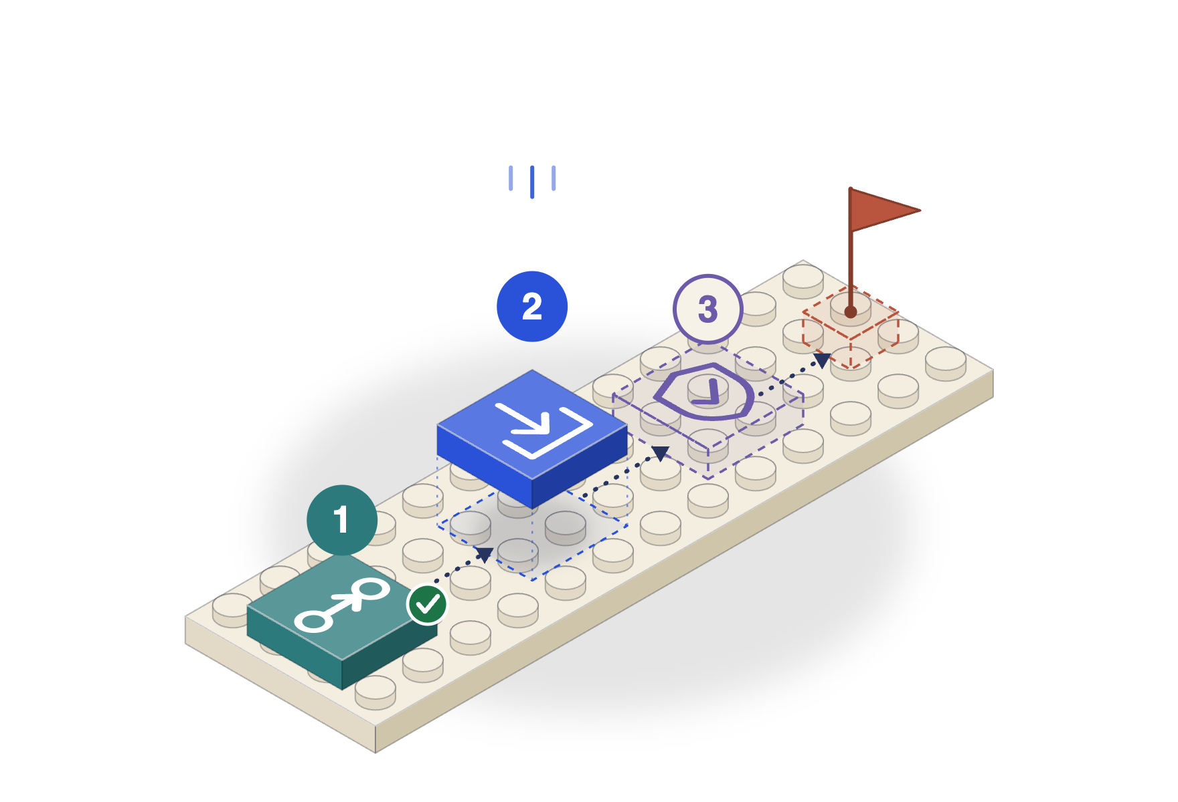
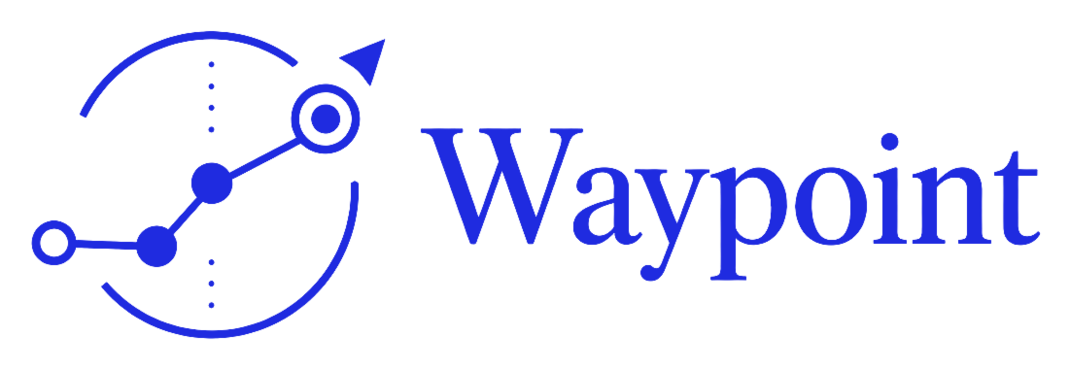
OKX DEV DAY 2026 · BUILD A COMPANY
Your personal onchain agent
for managing your own assets
waypoint.cjlin.com

Slide 2
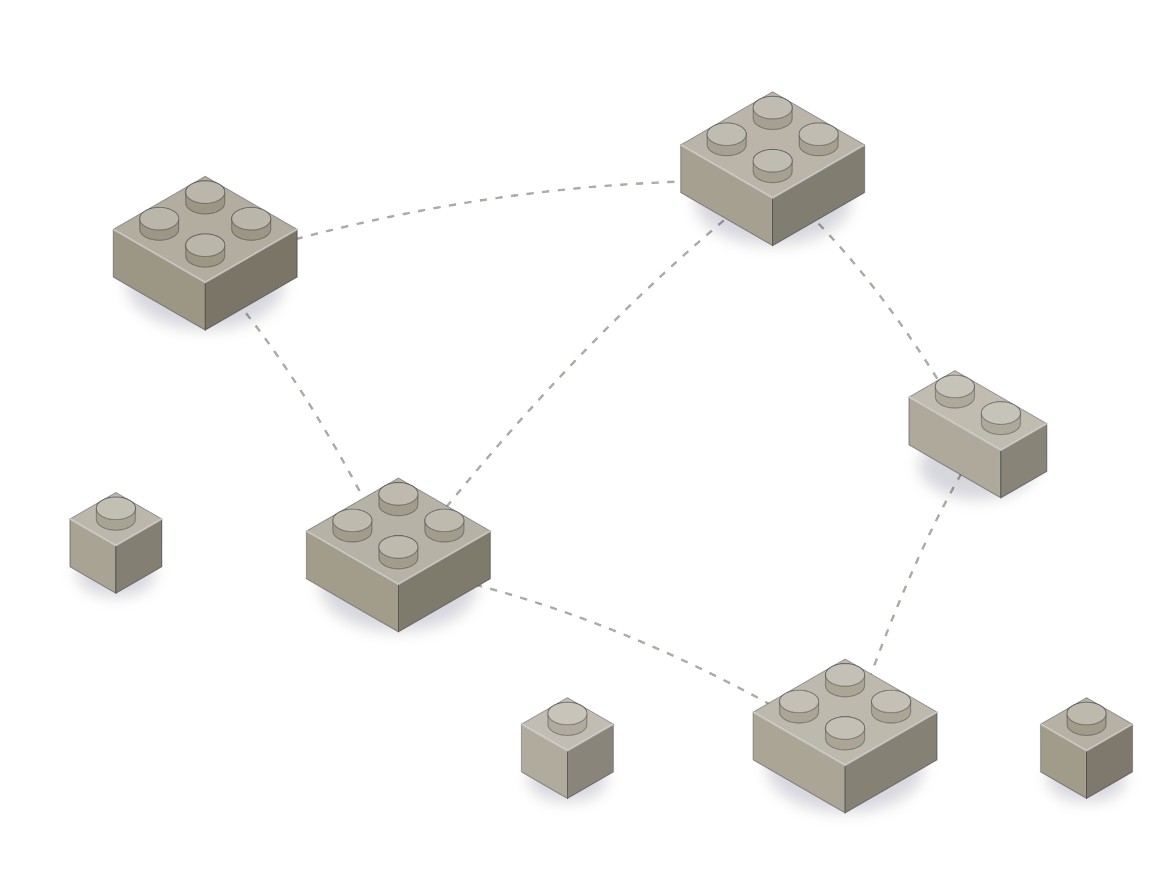
PROBLEM
Humans are still the routing engine.
Base
Ethereum
1
Scattered. Your assets sit on many chains and wallets.
bridge?
wrong network?
Arbitrum
sign again
2
Manual. Swap here, bridge there, approve, sign, repeat.
Polygon
X Layer
approve?
3
Single-step. Most agent wallets run one action, then wait for you to ask for the next.

Slide 3
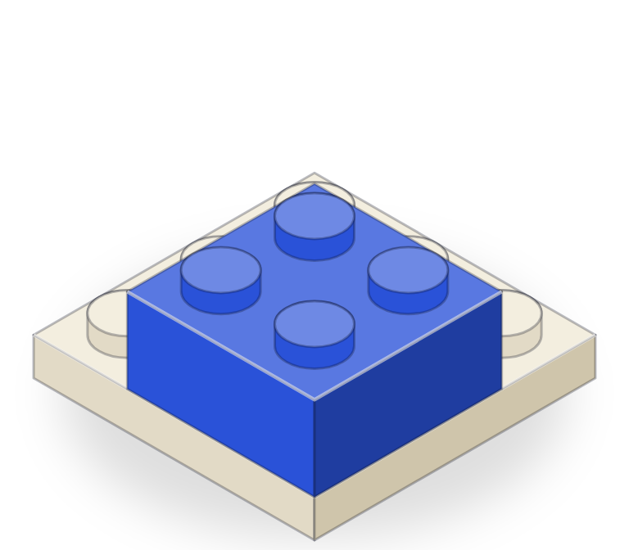
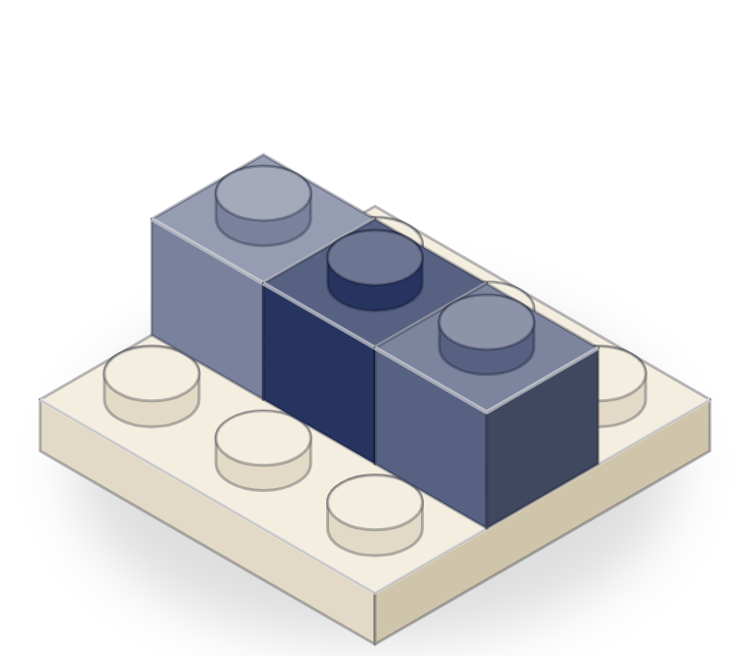
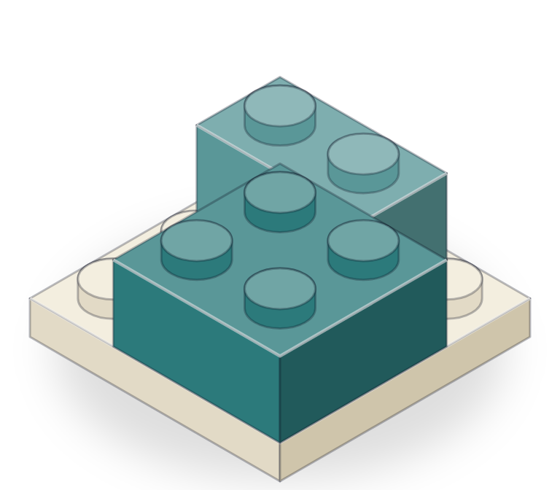
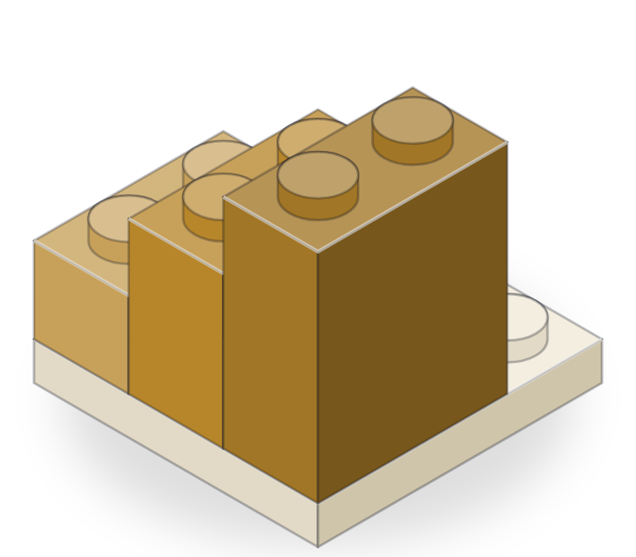
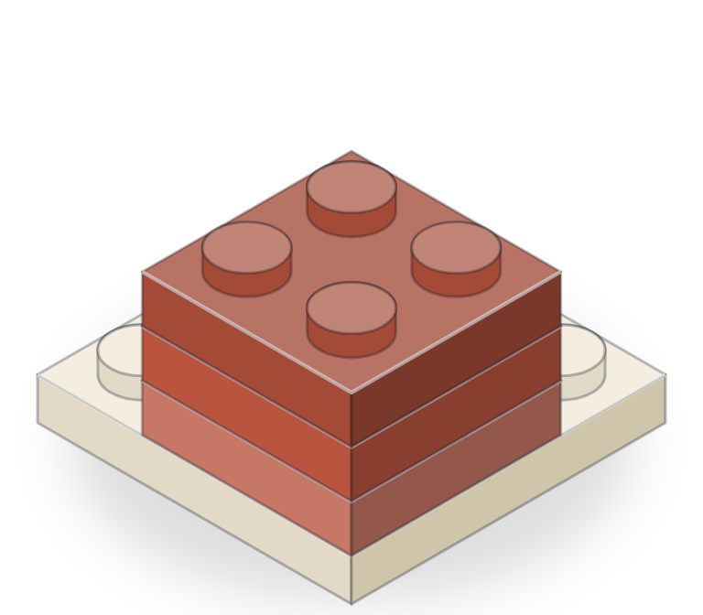
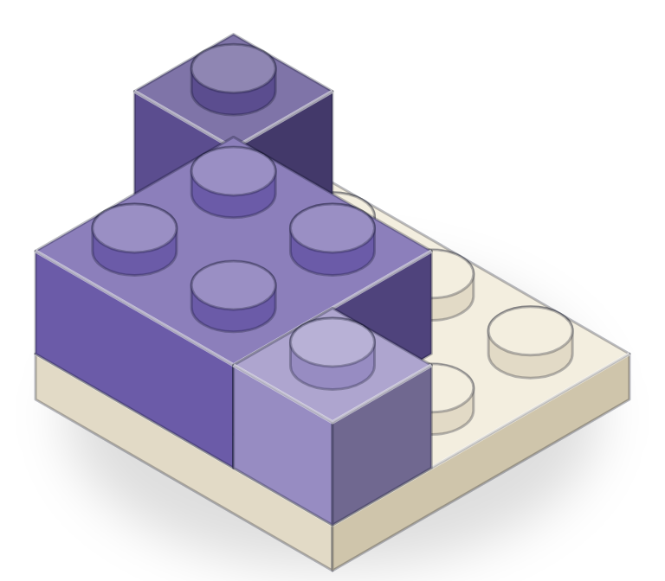
ARCHITECTURE
Built like Lego. Every part is a brick.
Chains
Providers
Capabilities
One config file.
One adapter per service.
One per action.
Ethereum, Base, Arbitrum, Polygon, X Layer …
Swap: OKX DEX, Enso Bridge: Relay, LI.FI
Lend: Aave …
swap, bridge, supply, borrow, transfer, deploy, contract call…
Agent stages
Memory
Signers
Each picks a model.
One interface.
Any wallet that signs.
triage, readiness, intent, plan, review
conversations, preferences, knowledge
Privy, your wallet, OKX Agentic Wallet
Plug in a brick. Nothing else changes.

Slide 4
PLANNING
Any capability. Any order. Across chains.
Ethereum
Base
Arbitrum
Polygon
X Layer
1
Bridge
Swap
1000 USDC, Base to X Layer
Bridge
1
2
Supply
Supply
2
to Aave on X Layer
Withdraw
Borrow
3
Borrow
3
against it, on X Layer
Transfer
4
Automate
Deploy
health-factor protection
Contract call
Confirm & execute
Automate
4
Nobody wrote this path. The planner composed it.

Slide 5
COMPANY
One API. Everyone pays by use.
Gets better with every execution.
Self-directed. You set the goal. Waypoint never pools funds or decides what to buy.
How we earn
Why it compounds
Why usage repeats
Planning: $0.05 per plan paid over x402 on X Layer
Rules run on their own.
Execute
DCA buy, daily
Running
POST /asp/plan
Plan
better
Health factor < 1.5
402 Payment required
Watching
200 Plan returned
Record outcomes
Each rule calls the API on a schedule.

Slide 6
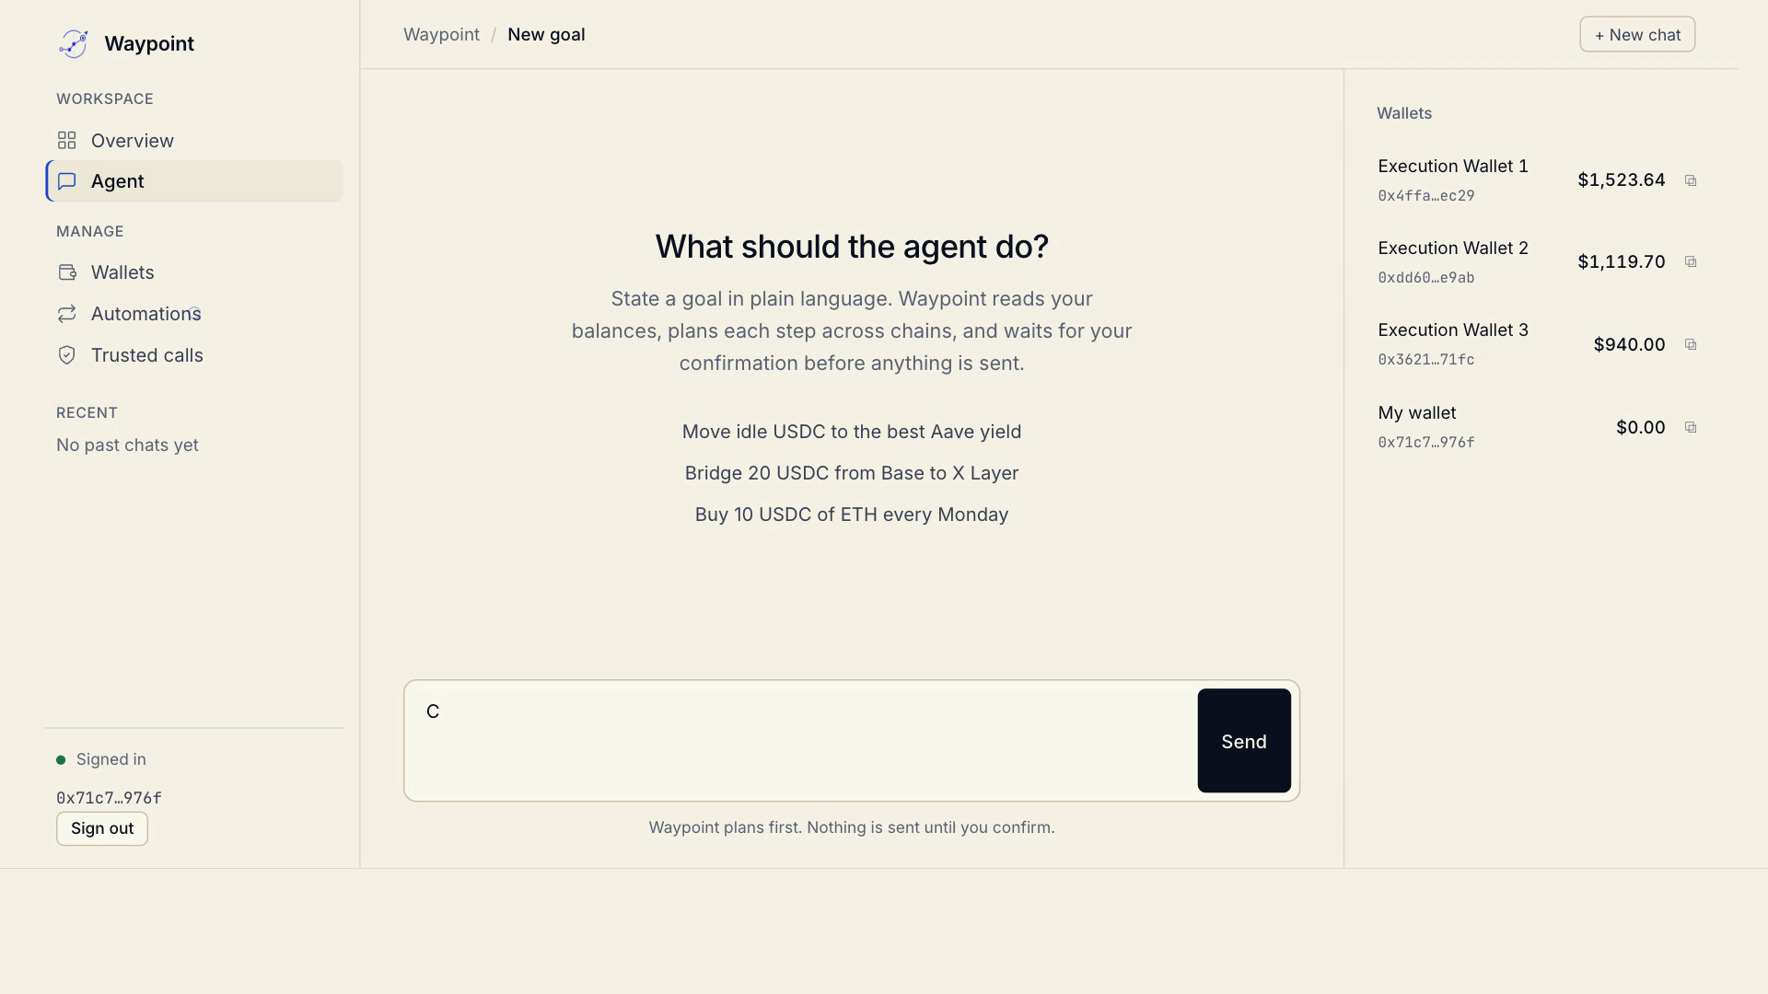
DEMO
One sentence in. Every step confirmed.
From a sentence.
Bridge, supply, and keep the rules running.

Slide 7
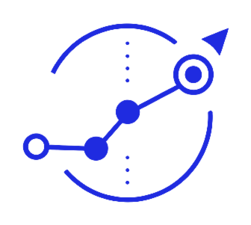
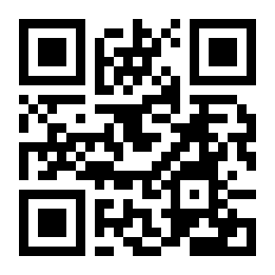
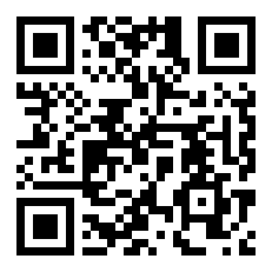
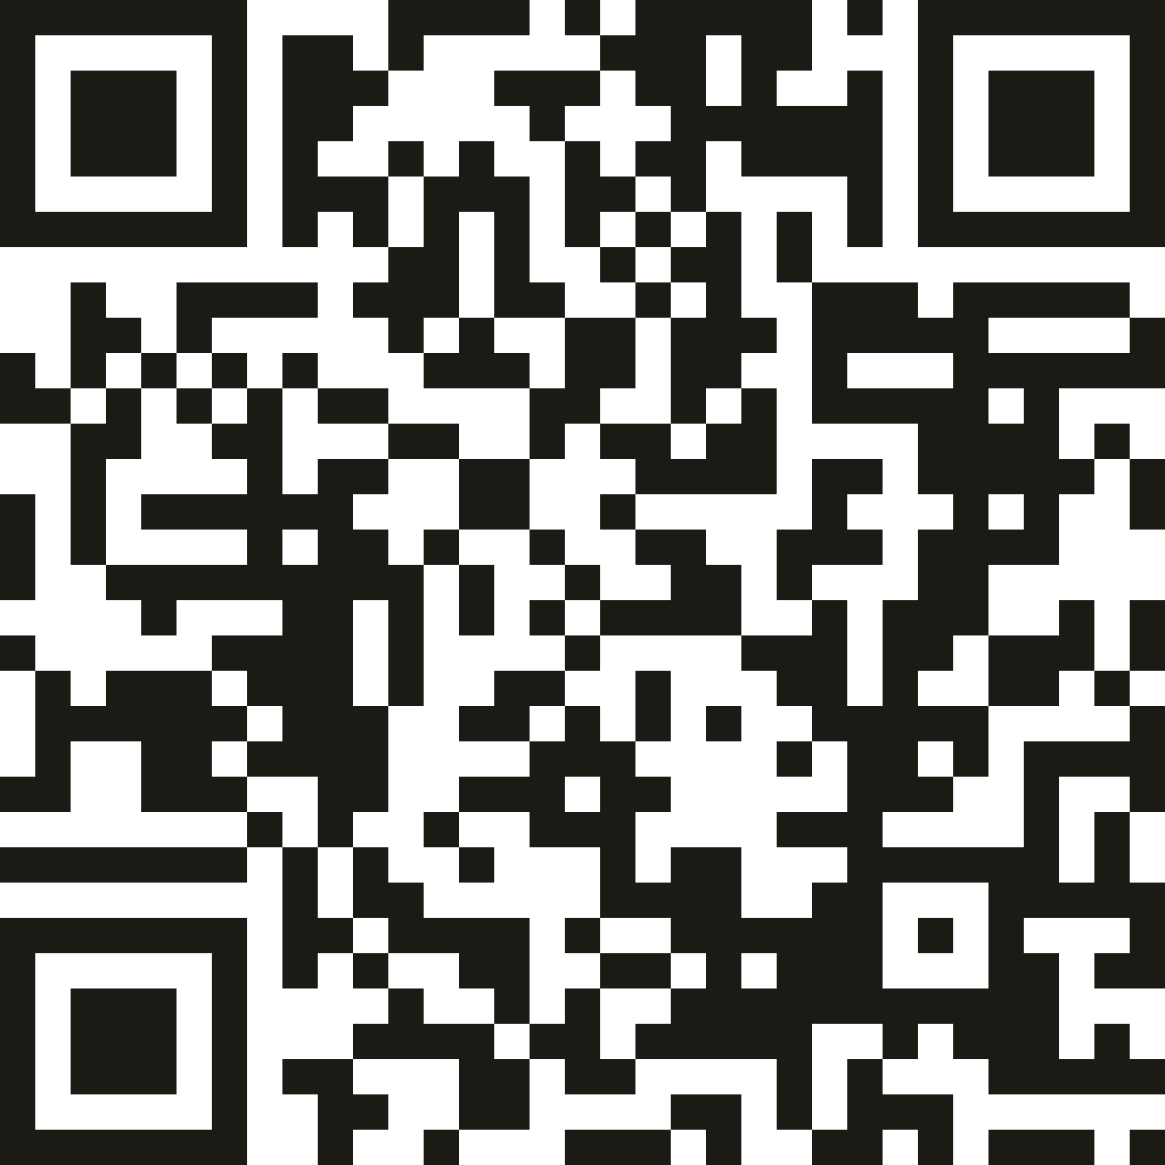
Say the goal. Waypoint executes.
Your personal onchain agent for managing your own assets.
TRY WAYPOINT
WATCH THE DEMO
CODE
waypoint.cjlin.com
youtu.be/6LMw3-1uHQk
Github
https://x.com/waypoint_agent · Built for OKX Dev Day 2026

