Slide 1

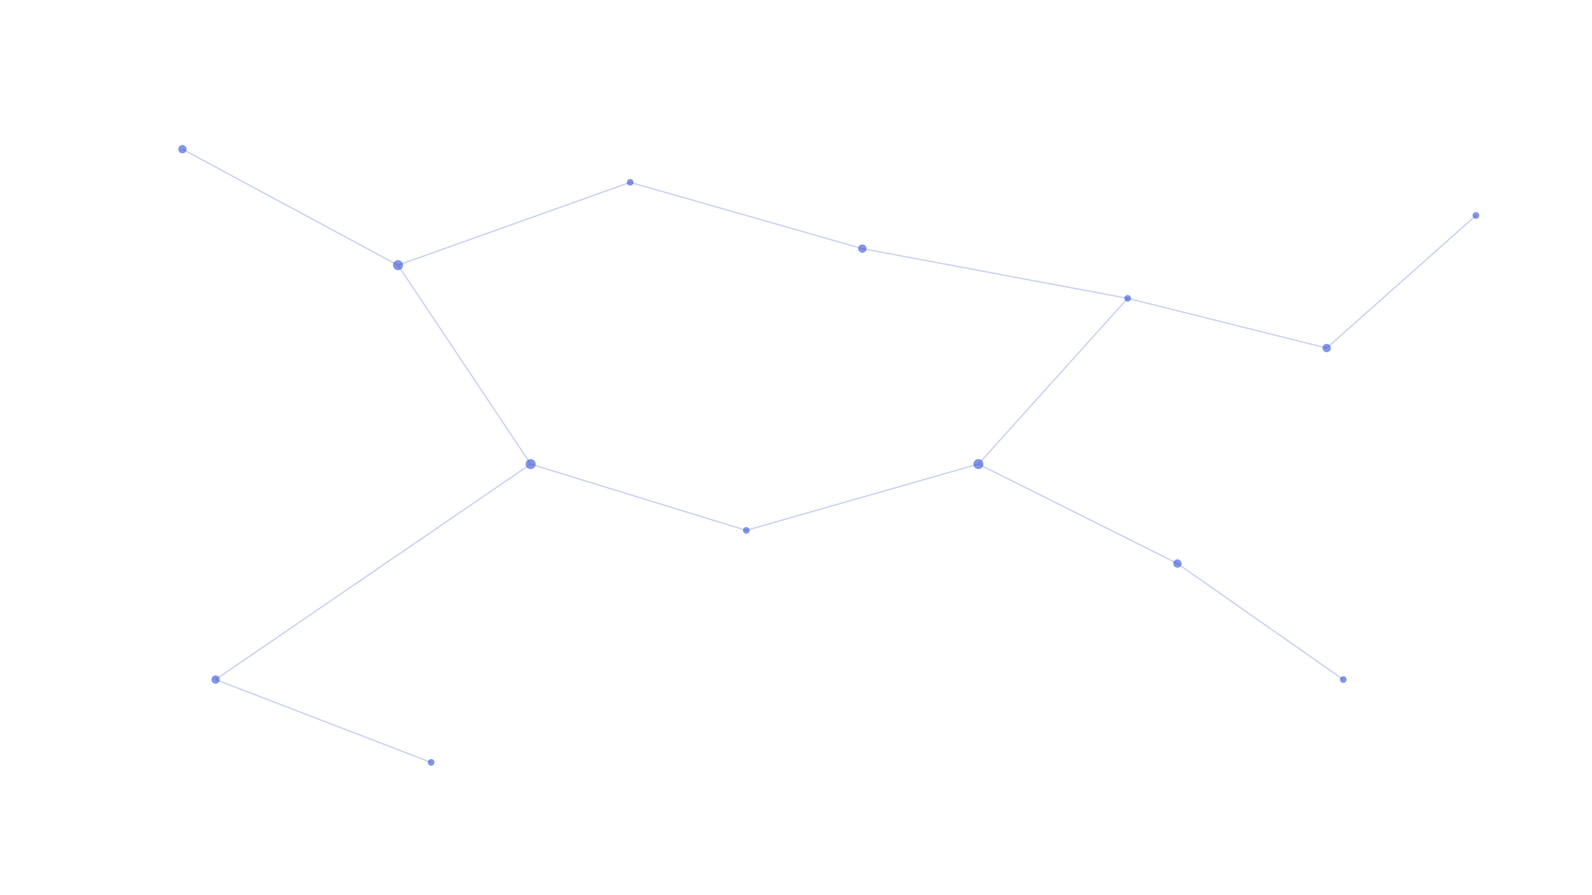
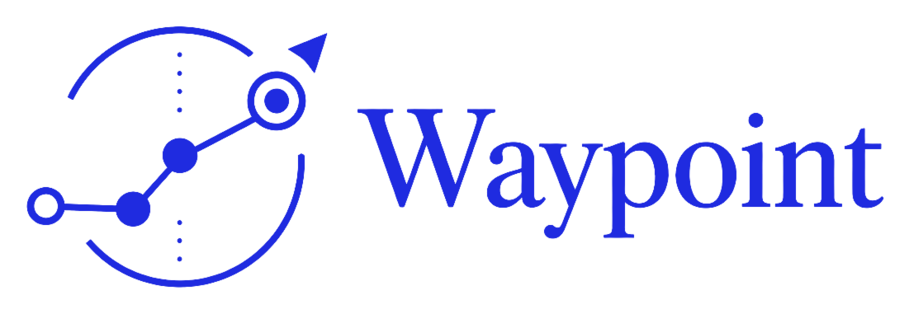
NTU INNOVATEX 2026 · TRACK 2
A goal-driven cross-chain execution agent

Slide 2



PROBLEM
Cross-chain still runs on human routing
Assets scattered across chains
Every detail is a real trap
Existing tools aren't smart enough
Check and move funds chain by chain, by hand.
Gas reserves, decimals, currency slang — each a real bug this project hit, not a hypothetical.
Single-step actions or rigid templates — neither reasons across steps or chains.
Waypoint hands that reasoning to an agent — it's not another wallet.

Slide 3
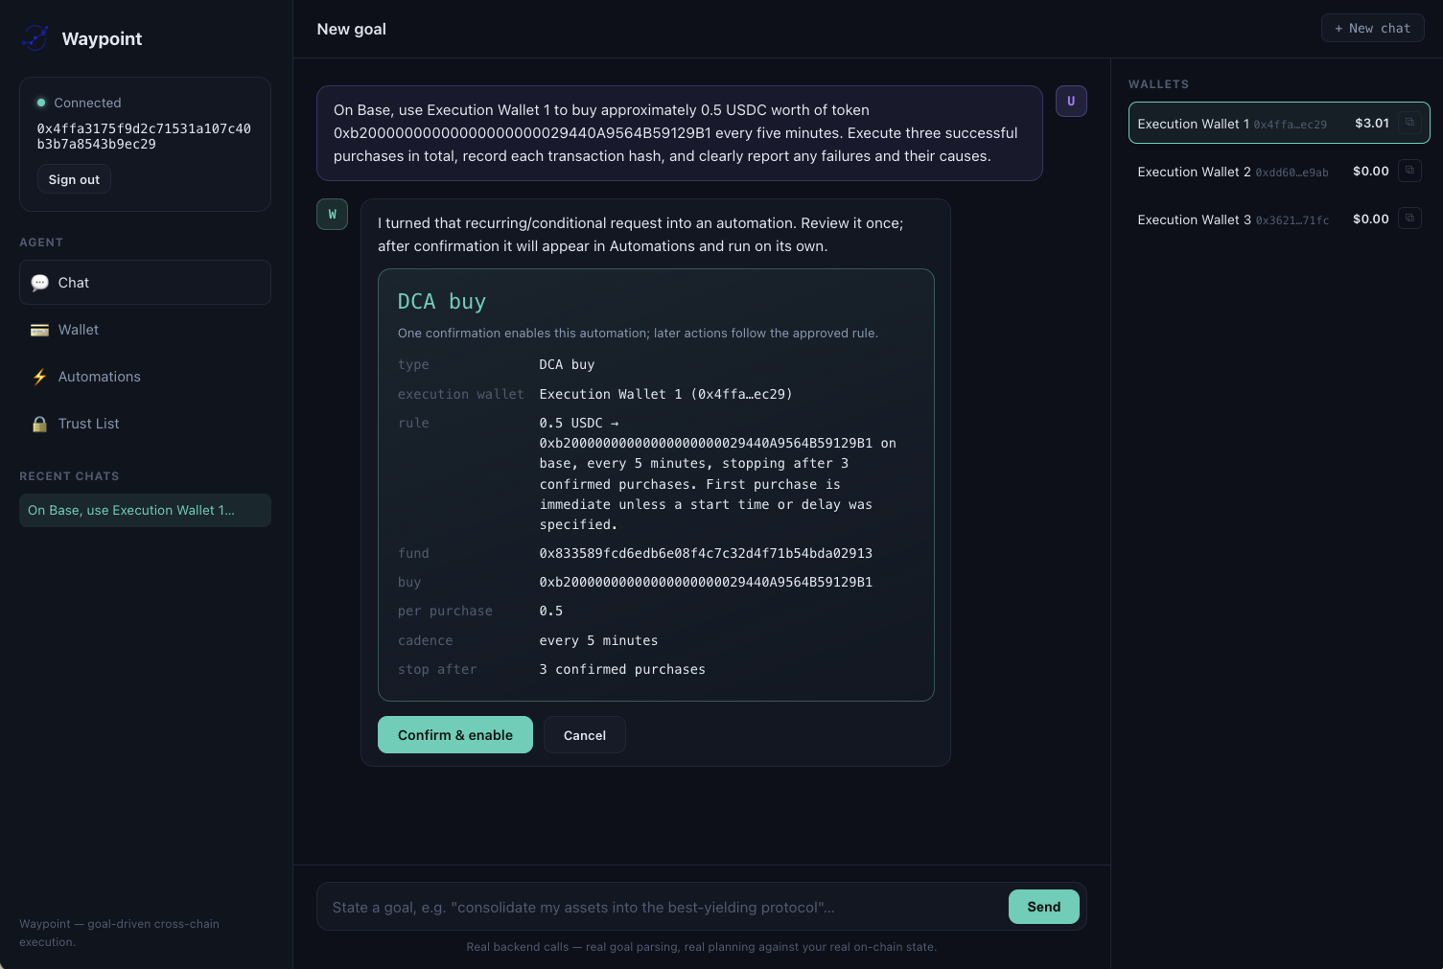



WHAT IS WAYPOINT
What is Waypoint
A goal-driven cross-chain execution agent. Say what you want; it plans, verifies, and really executes it .
Goals, not operations
Real execution, not simulation
Human stays in the loop for final confirmation

Slide 4








PRODUCT
How much this actually covers
The two demo scenarios are just two cells in this grid
Transfer
Swap
Bridge
Deposit (Aave)
Automated triggers
Multi-wallet signing
Simulate-before-sign
custom_call fallback

Slide 5


DESIGN PRINCIPLE
Context Is All You Need
A few years ago it was Attention Is All You Need
Memory
Execution Knowledge Base
Remembers user preferences and past execution outcomes, so the next turn doesn't start from zero.
Real bugs this project hit, turned into retrievable facts — gas reserves, currency slang, live pricing — not hardcoded rules.
Better context, not a bigger model

Slide 6




DESIGN PRINCIPLE
What makes a real agent
Memory
Knowledge
Multi-agent review
Safety rails
Remembers context
Retrieves real facts instead of guessing from training data
Never grades its own homework
Simulate before signing, verify identity before executing

Slide 7

ARCHITECTURE
Six agents, each with one job
Goal-Match
Does the plan match the parsed goal?
Triage
Readiness
Intent
Planning
Does this need real balances?
Enough info yet to act?
goalParser — what do they want?
planner — how to do it?
Feasibility
Against real balances, can it actually run?
Outlined boxes: the main pipeline (agents 1–4). Filled boxes: a different model, reviewing independently (agents 5–6).
Split apart on purpose — each piece can be checked, and can fail, on its own

Slide 8

LIVE DEMO
Real account · Real on-chain state · Real execution

Slide 9
RECAP
What just happened, technically
Multi-chain consolidation + Aave deposit
Monitoring & automation
Detect assets across multiple execution wallets
Consolidate cross-chain into one target wallet
Deposit into the highest-yielding Aave market
Set a condition (health factor / DCA schedule)
Backend polls with no user present
Executes for real when the condition is met, with a real stop condition

Slide 10
POSITIONING
Where we sit
Cobo Agentic Wallet
Bankr
Waypoint
Depth in custody & permissions — MPC key-splitting, Pact-scoped authorization
Depth in social-native, one-line ordering convenience
Depth in real, multi-step, cross-chain reasoning and execution
Not the same race — different depth axes within the same category

Slide 11




BUSINESS MODEL
Business model
We don't sell tokens. Margin rides on top of two real, recurring costs.
Chat UI
Developer API call
AI inference cost
On-chain execution cost
Multi-agent goal parsing + planning calls real LLM APIs; users can bring their own model
Swaps / bridges / deposits route through LI.FI, Relay, Enso
Waypoint API
The chat interface is just one client of this API; a developer calling it directly uses the exact same API
MARGIN
MARGIN
Waypoint takes a margin here
Same logic as OpenRouter marking up someone else's model
Bankr already validated "chat-to-trade, margin on routing" at real volume — this isn't hypothetical.
We don't sell tokens. We sell orchestration. Usage just rides on top.

Slide 12
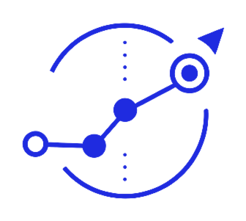
WAYPOINT
Say the goal. Waypoint plans, verifies, executes.
NTU InnovateX 2026 · Track 2 finalist — real account, real chains, real execution.
TRY WAYPOINT
WATCH THE DEMO
CONNECT
yourlink.com
yourlink.com
yourlink.com
Built for NTU InnovateX 2026

