Slide 1
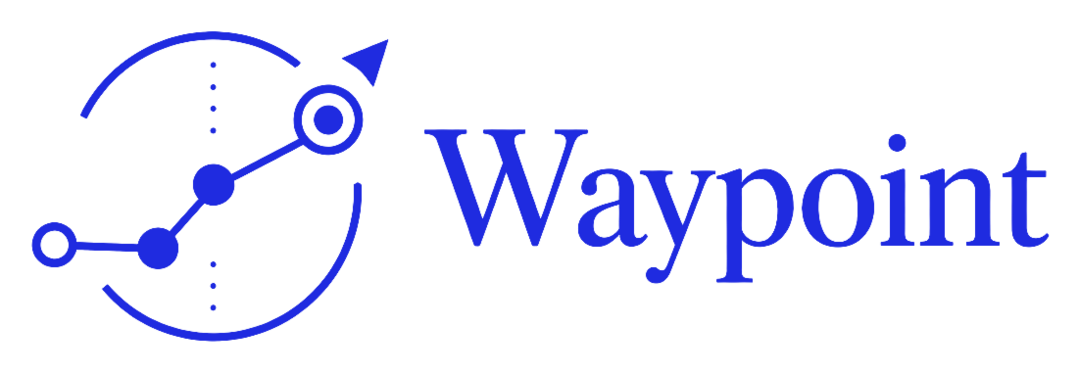
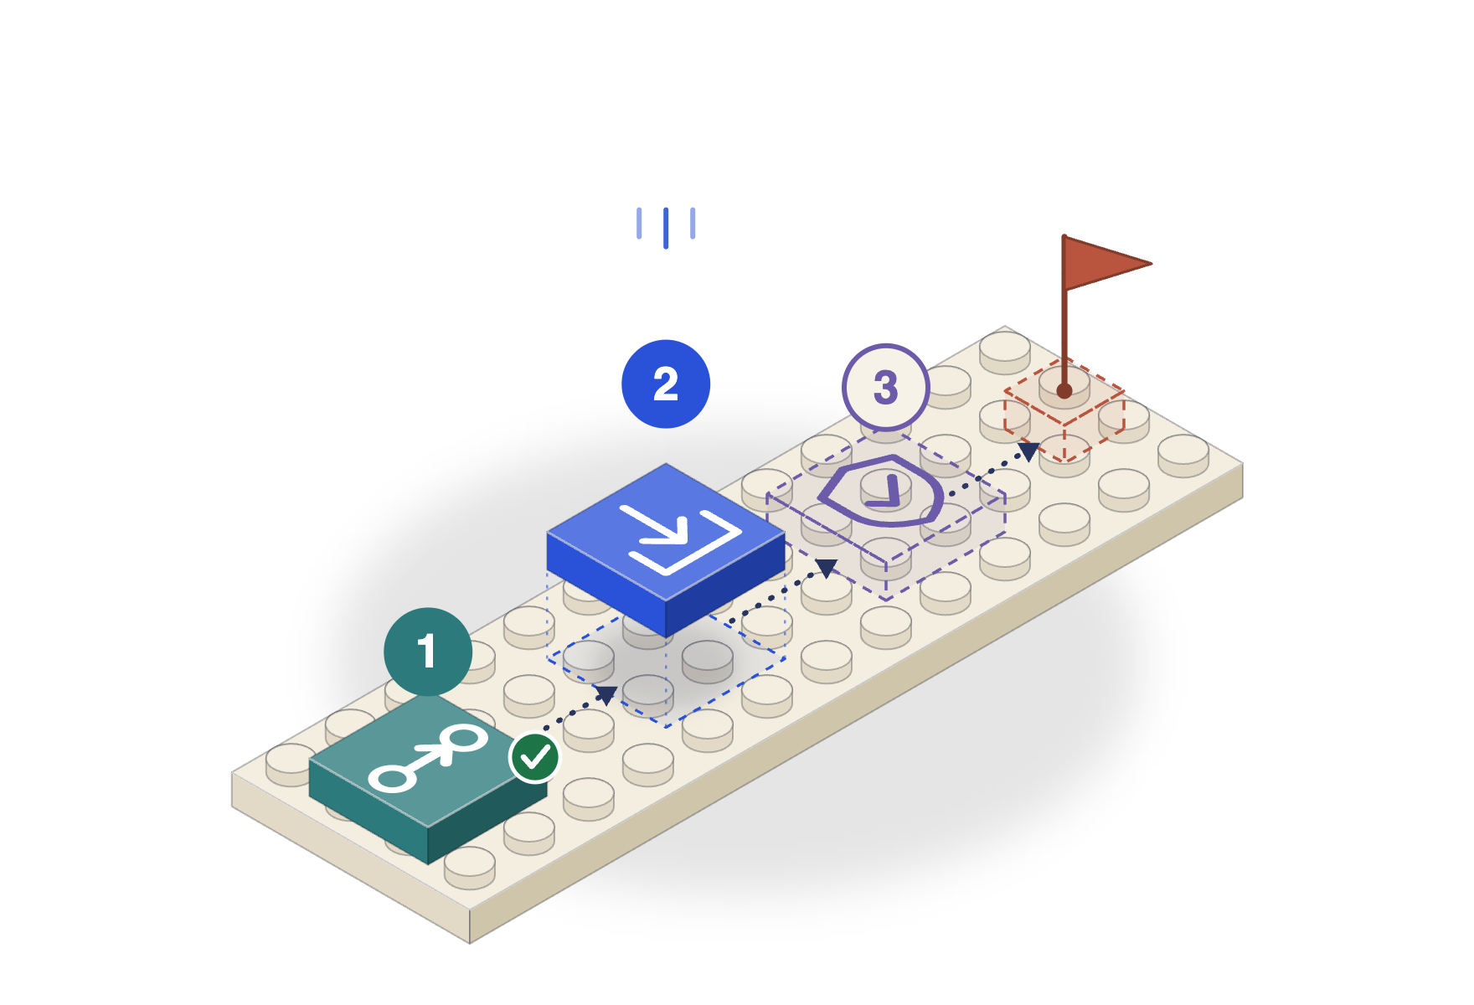
HSK CHAIN HORIZON HACKATHON · TRACK 1 · AI AGENT TRADING
An autonomous trading agent on HashKey Chain
Tell it your view in plain language. It trades HashKey Swap and keeps itself inside hard limits.
Notes:
Waypoint is a goal-driven agent. For this hackathon we built an autonomous trading agent on HashKey Chain: you tell it your view in plain language, it trades HashKey Swap, and it stays inside limits that are enforced in code.

Slide 2
Trading agents are a black box. Or a script.
PROBLEM
1
2
3
You can't see why
Limits in the prompt
You babysit it
A bot says it traded. It rarely says what it saw, what it weighed, or why it skipped.
A model asked to be careful is not a stop-loss. One bad answer breaks the rule.
Scripts need rewriting for every idea. Chat agents need a prompt for every order.
An agent you can read, bound and talk to.
Notes:
Most trading agents fall into two camps. Chat bots that act without showing why, and scripts that do exactly one thing. Limits that only live in a prompt are not limits.

Slide 3
Watches every minute. Acts inside its limits.
THE AGENT
1
2
3
4
5
6
Watch
Analyse
Signal
Decide
Trade
Record
Pool price, market price, depth, swap flow
Gap to market, z-score, slippage
Spread entry, mean reversion, exits
Model confirms, sizes or skips
HashKey Swap, simulated before signing
Ledger, P&L, reasons, on-chain log
Nobody needs to be present.
Notes:
Every minute, with nobody present, the agent reads the pools and the market, finds signals, lets the model confirm or skip an entry, trades through the simulate-then-send pipeline, and writes down what it did and why.

Slide 4
The pool is below the market. The agent trades the gap.
THE EDGE
Market price (CoinMarketCap)
0.0910
$436k
of depth in the WHSK/USDT pool
-3.8%
Buy zone: 3% or more below market
2%
of pool depth: the most one order may take
HashKey Swap pool
0.0875
12 h
longest a position stays open
Spread entry, mean reversion, hard exits.
Notes:
HashKey Swap is a Uniswap V3 venue and the only place with liquidity for these pairs, so this is not cross-venue arbitrage. The agent compares the pool's price with the market price and buys when the pool is cheap by more than its costs. It exits when the gap closes, a stop-loss triggers or the holding limit passes.

Slide 5


The model advises. Code enforces.
RISK
The model can
Hard limits, in code
Confirm an entry
Order cap per trade
Shrink its size
Position cap per asset
Skip it, with a reason
At most 2% of pool depth
It cannot
Cooldown after each trade
Change the asset or side
Daily loss limit
Go above the size caps
Hold back a stop-loss
Stop-loss and maximum hold
Notes:
The model can confirm, shrink or skip an entry. It cannot change the asset or side, cannot exceed the caps, and a stop-loss never waits for it. Every limit on the right is code.

Slide 6
See every decision. Paper and live, side by side.
PRODUCT
HashKey trading agent
running
Paper book
Live book
Total P&L
Asset | Pool | Market | Gap
HSK | 0.08752 | 0.09100 | -3.83%
ETH | 2274.07 | 2242.42 | 1.41%
Time | Side | USDT | Signal
3:59 PM | sell | $25.31 | exit_converged
3:29 PM | buy | $25.00 | spread_entry
+$0.31
Today's loss budget
Buy zone: gap of -3% or more
$0.00 of $20.00 used
Why it acted sold 284.55 HSK for 25.31 USDT (exit_converged): the pool's gap to the market has closed.
Notes:
The panel shows the gap per asset against the buy line, the limits, today's loss budget, positions, P&L, every fill and a log of why the agent acted, including the times it did nothing. Paper and live are separate books.

Slide 7
Rules and fills, recorded on-chain.
ON HASHKEY CHAIN
HashKey Swap
SwapRouter02, trades
Three calls
registerStrategy, recordExecution, stopStrategy.
Waypoint agent
Execution wallet
Holds no funds
Only the wallet that registered a rule can write to it.
WaypointStrategyLog
0xa739…3a9a, records
Linked from every fill
Each live fill in the panel links to its record in the explorer.
Notes:
The strategy log contract is deployed on HashKey Chain mainnet. A live agent registers its rule, records each fill and stops the rule when paused. The contract holds no funds.

Slide 8
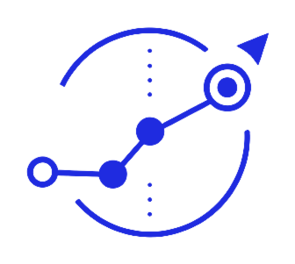
Say the view. Waypoint trades it.
An autonomous trading agent on HashKey Chain: watched, bounded and in your words.
TRY IT https://waypoint.cjlin.com/app.html?demo=1
Notes:
Close: say the view, Waypoint trades it. Link and code.

