Slide 1
Welcome to Core Java Sessions

Slide 2
Agenda/Topics to Be Covered
What is Programming ?
Types of Programming Paradigms.
Identifiers in Java and its rules
Reserved Keywords List
Data Types in Java
Arrays in Java
Operators in Java
Control Flow statements in Java

Slide 3
What is Programming ?
Writing set of instructions to be executed by computer/machine which might be based on some conditions and criteria, which will help to achieve a specific type.
Example 1:- Calculator finds out sum of numbers.
Example 2 :- Alexa turns on light when asked to. Internally it is referring to a program(set of instructions) which are written by some programmer.

Slide 4
Identifier in Java
While programming in Java, we are going to create many variables, methods, classes and interfaces.
And all of these entities must have some name , that name is called as Identifier.
Here in example given the name of class Student, name of variable which holds the student’s name is studentName and the variable which holds the age of student is called “age”.
All of these are called Identifiers in Java.(as they identify something).
class Student {
String studentName;
int age;
}

Slide 5
Rules for Identifier Names:-
Generally as a programmer we decide which identifier should be given to a variable or class or method.
But there are some rules and conventions to decide a name.
Allowed characters – a - z , A - Z and 0 - 9, and two special characters("_" and "$")
An identifier must not start with digit.
Should not use Java reserved keywords and literals for identifier.
Not a rule but recommendation to have meaningful name.
There is no restriction on length of identifier but we should not use length more than 15.
Java identifiers are case sensitive meaning (studentName and STUDENTNAME are not equal).

Slide 6
Variables in Java:-
Variable in Java is a data container that saves the data values during Java program execution. Every variable is assigned a data type that designates the type and quantity of value it can hold.
In Java, all variables must be declared before use.
Examples :- int age;
Here int is data type which represent what type of data will be stored and age is the name of variable which will point to the memory location where data will be stored.
So general way to declare variable is :- dataType varName;
Ex:- String name, int count , double rateOfInt; …etc.

Slide 7
Variable visualization :-
int age;
age = 20 ;
double roi ;
roi = 5.4 ;
Java Memory Area
age
20
roi
5.4

Slide 8
Java Reserved Keywords :-
There are some keywords in Java which has special/specified meaning defined by Java.
DataTypes - (boolean, byte, short, char, int, long, float, double)
Special return type of method - ( void )
Flow Controls - (if, else, switch, case, default, for, do, while, break, continue, return, goto (not used))
Access/Type Modifiers - (public, private, protected, static, final, abstract, synchronized, native, strictfp(1.2 version), transient, volatile).
Exception handling - ( try, catch, finally, throw, throws, assert(1.4 version) )
class/interface related - ( class, package, import, extends, implements, interface)
Object related - (new, instanceOf, super, this)
Literals - true, false -- used for boolean data type values, null - default value for object reference. " " "" --
For Enumerations – Enum.

Slide 9
Software Setup :-
Install Eclipse latest version on your system.
Download and install Java 8.

Slide 10
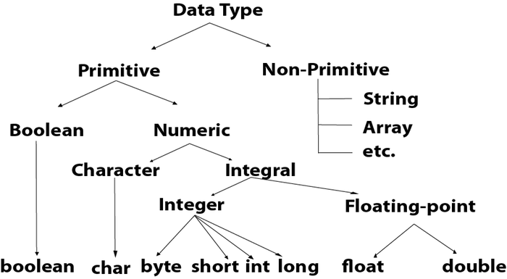
Data Types in Java:-
Java is a strongly typed language. And thus every variable must be declared with a data type.

Slide 11
Primitive Data Types :-
Primitive types are predefined (already defined) in Java, and are the fundamental data types for Java. There are total 8 primitive Data types. All of these will be have name in lower case.
And based on the type of primitive data appropriate memory is allocated in Java memory space.
Primitive Data types are further divided as shown in figure previously.
Programmer must choose appropriate data type as per the need in such a way that, the data type should be able to hold the required data and also there should be no unnecessary wastage of memory.

Slide 12
boolean data Type :-
To represent/save/hold the boolean values the data type provided by Java is boolean. It requires only 1 bit in memory to be stored.
boolean can have only 2 values :- true , false (Note :- all lower case and without and inverted commas.) Default value for boolean type is false.
Examples :-
boolean flag ; // defining a Boolean type variable ,default value - false
flag = true ; // assigning value true to the boolean type variable.
boolean isCorrect = true ; //declaring variable & assign value in 1 statement
isCorrect = False ; //// invalid
isCorrect = “false” ; //invalid

Slide 13
char data type :-
Used to store/hold single character. Needs 16 bits (2 Bytes) in memory. Values are assigned in single inverted comma.
It represents character representation of ASCII values. Integer value can also be assigned, it will hold corresponding ASCII character.
default value is :- \u0000.
Examples :-
char c ; char charcterEx = ‘x’ ; char a = 98 ; | char value = “j” // invalid. char val = q // invalid

Slide 14
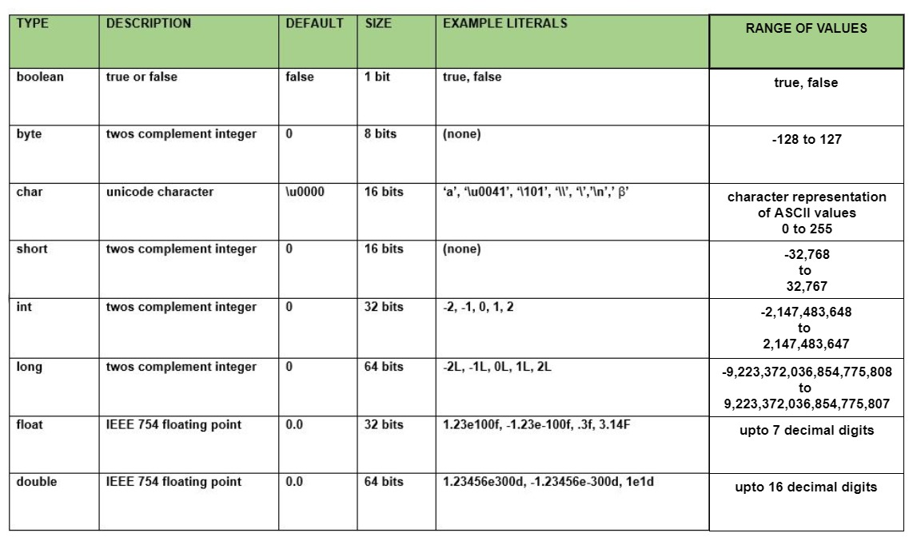
Data Types :-

