Slide 1

Bluetooth Poker
ECE493 - Group # 2
Winter Term 2013
Notes:
Our project was Bluetooth Poker. It is an Android based "app" that was developed to allow a group of people to meet up and play a couple games of poker through their android devices.

Slide 2


Main Features
Texas Holdem Variation
Bluetooth
Offline Mode
Registered Mode
Notes:
Main Features:
- Our application follows the rules and flow of the texas hold'em style of poker.
- application supports between 2 to 6 players. Max liimitation is due to # channels in Bluetooth.
Online
- Registering provides the additional set of statistic based features
- All game actions of registered users are saved along with their context
-Personal, Community and Ranking
-Features "Hand Optimality" Ranking
Offline
-Mobile Ecosystem- Casual Gamers
-Fastest way to play (no account required)
-No network connection required

Slide 3
Architecture
Server - Table Host
Web Server
HTTP
Nexus 4
HTTP
Bluetooth
Clients
Database Server
Online User
Online User
Nexus 4
Nexus 4
Nexus 4
Nexus 4
Nexus 4

Slide 4
User Interface

Slide 5
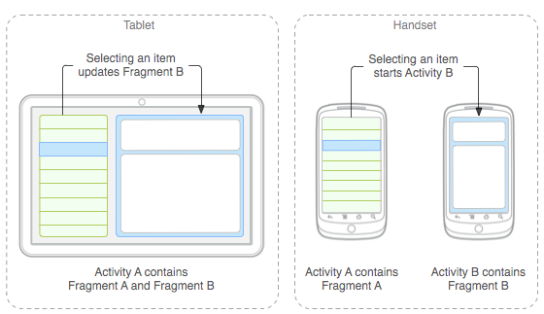
Design Choice
Fragments
"Behaviour or a portion of the user interface in an Activity"
"An activity inside an activity"
Figure 1: Example of Fragments

Slide 6
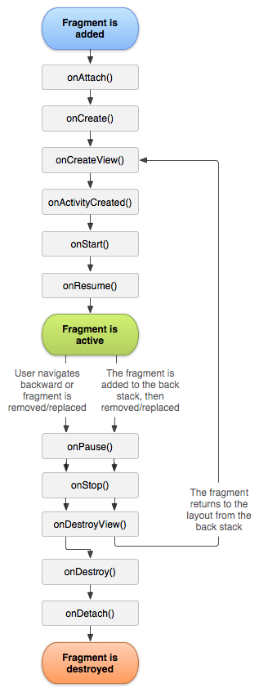
Why Fragments
Combine multiple fragments in a single activity
Easy to communicate
Between other fragments and parent Activity
Scalable, Reusable, Cleaner Code
Figure 2: Fragment Lifecycle
Notes:
Able to programmatically add and remove as needed
Manipulate each fragment independently
Perfect for a Multiplayer Game
FragmentManager (add, remove, replace)
BackStack
`Big application, only 3 Activities

Slide 7
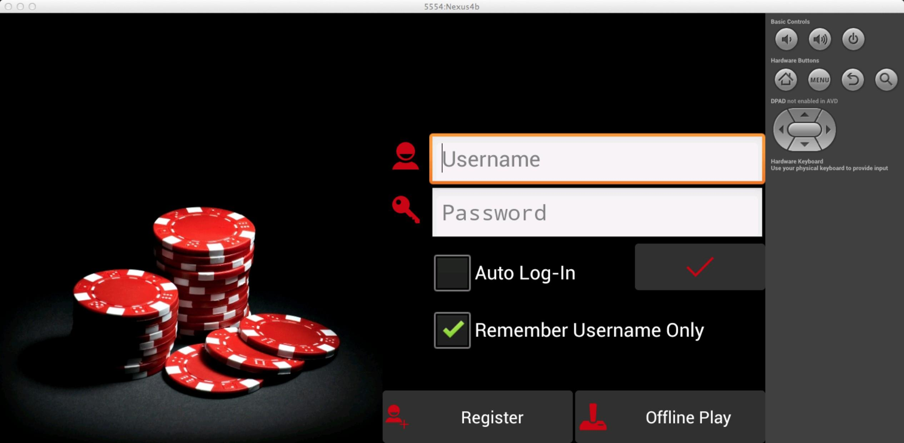
Main Menu
Fragment
Fragments in action in our application
Activity

Slide 8
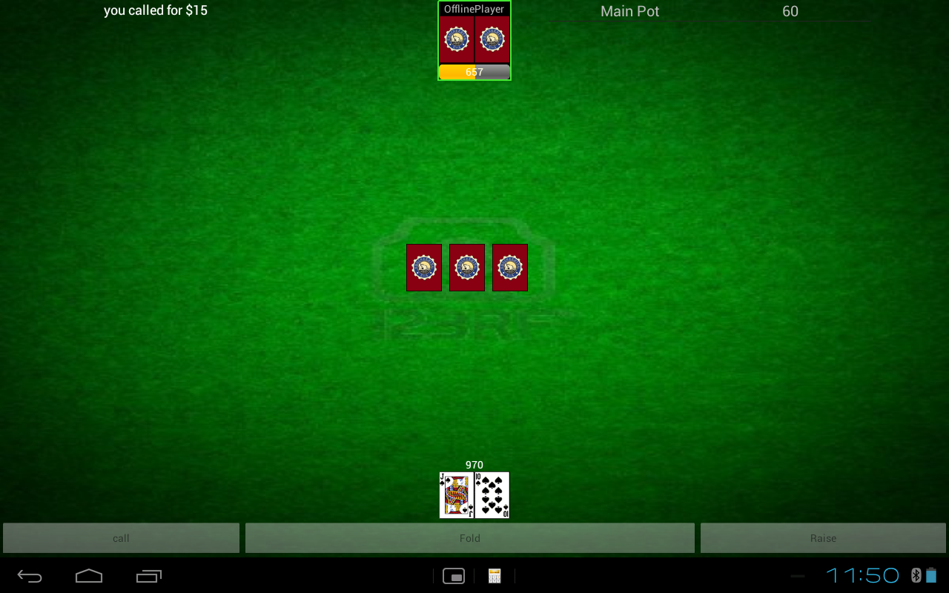
Players and River are Fragments

Slide 10
Other components
Asynchronous Tasks
Performs a task without blocking the UI thread
XML Layouts
CountDownTimer
Notes:
onPreExecute()
doInBackGround()
onPostExecute()
Used for querying servlets
Friendlier interface (show loading spinner, progress, etc)
Primarily used for Layouts ("Screens")
Selectors - Animating ImageButton Clicks
Shapes - For highlighting selected views (ie. current player)
Decreasing ProgressBar in Playing Area

Slide 11
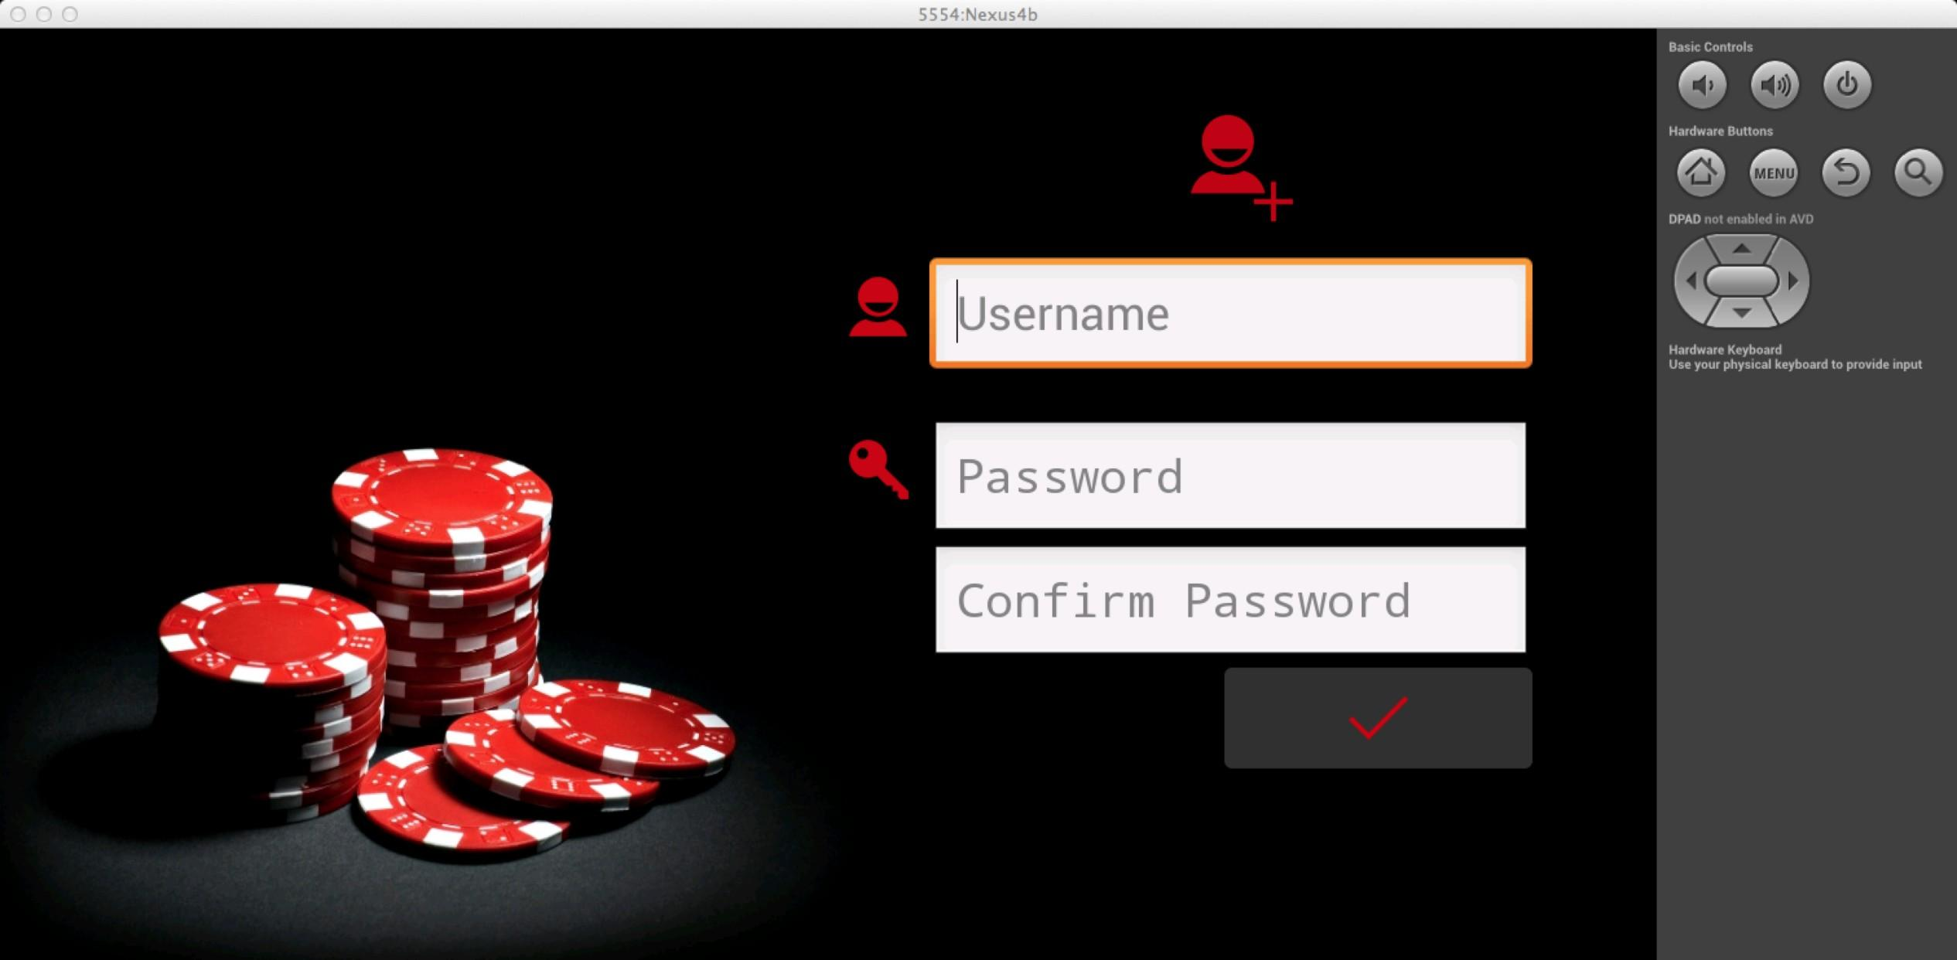
No Account? No Problem, simply select the register option.

Slide 12
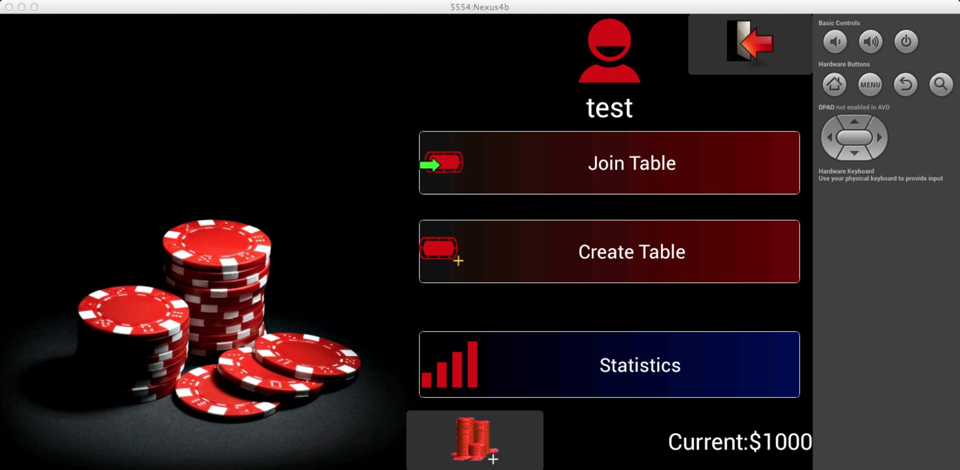
Online Main Menu

Slide 13
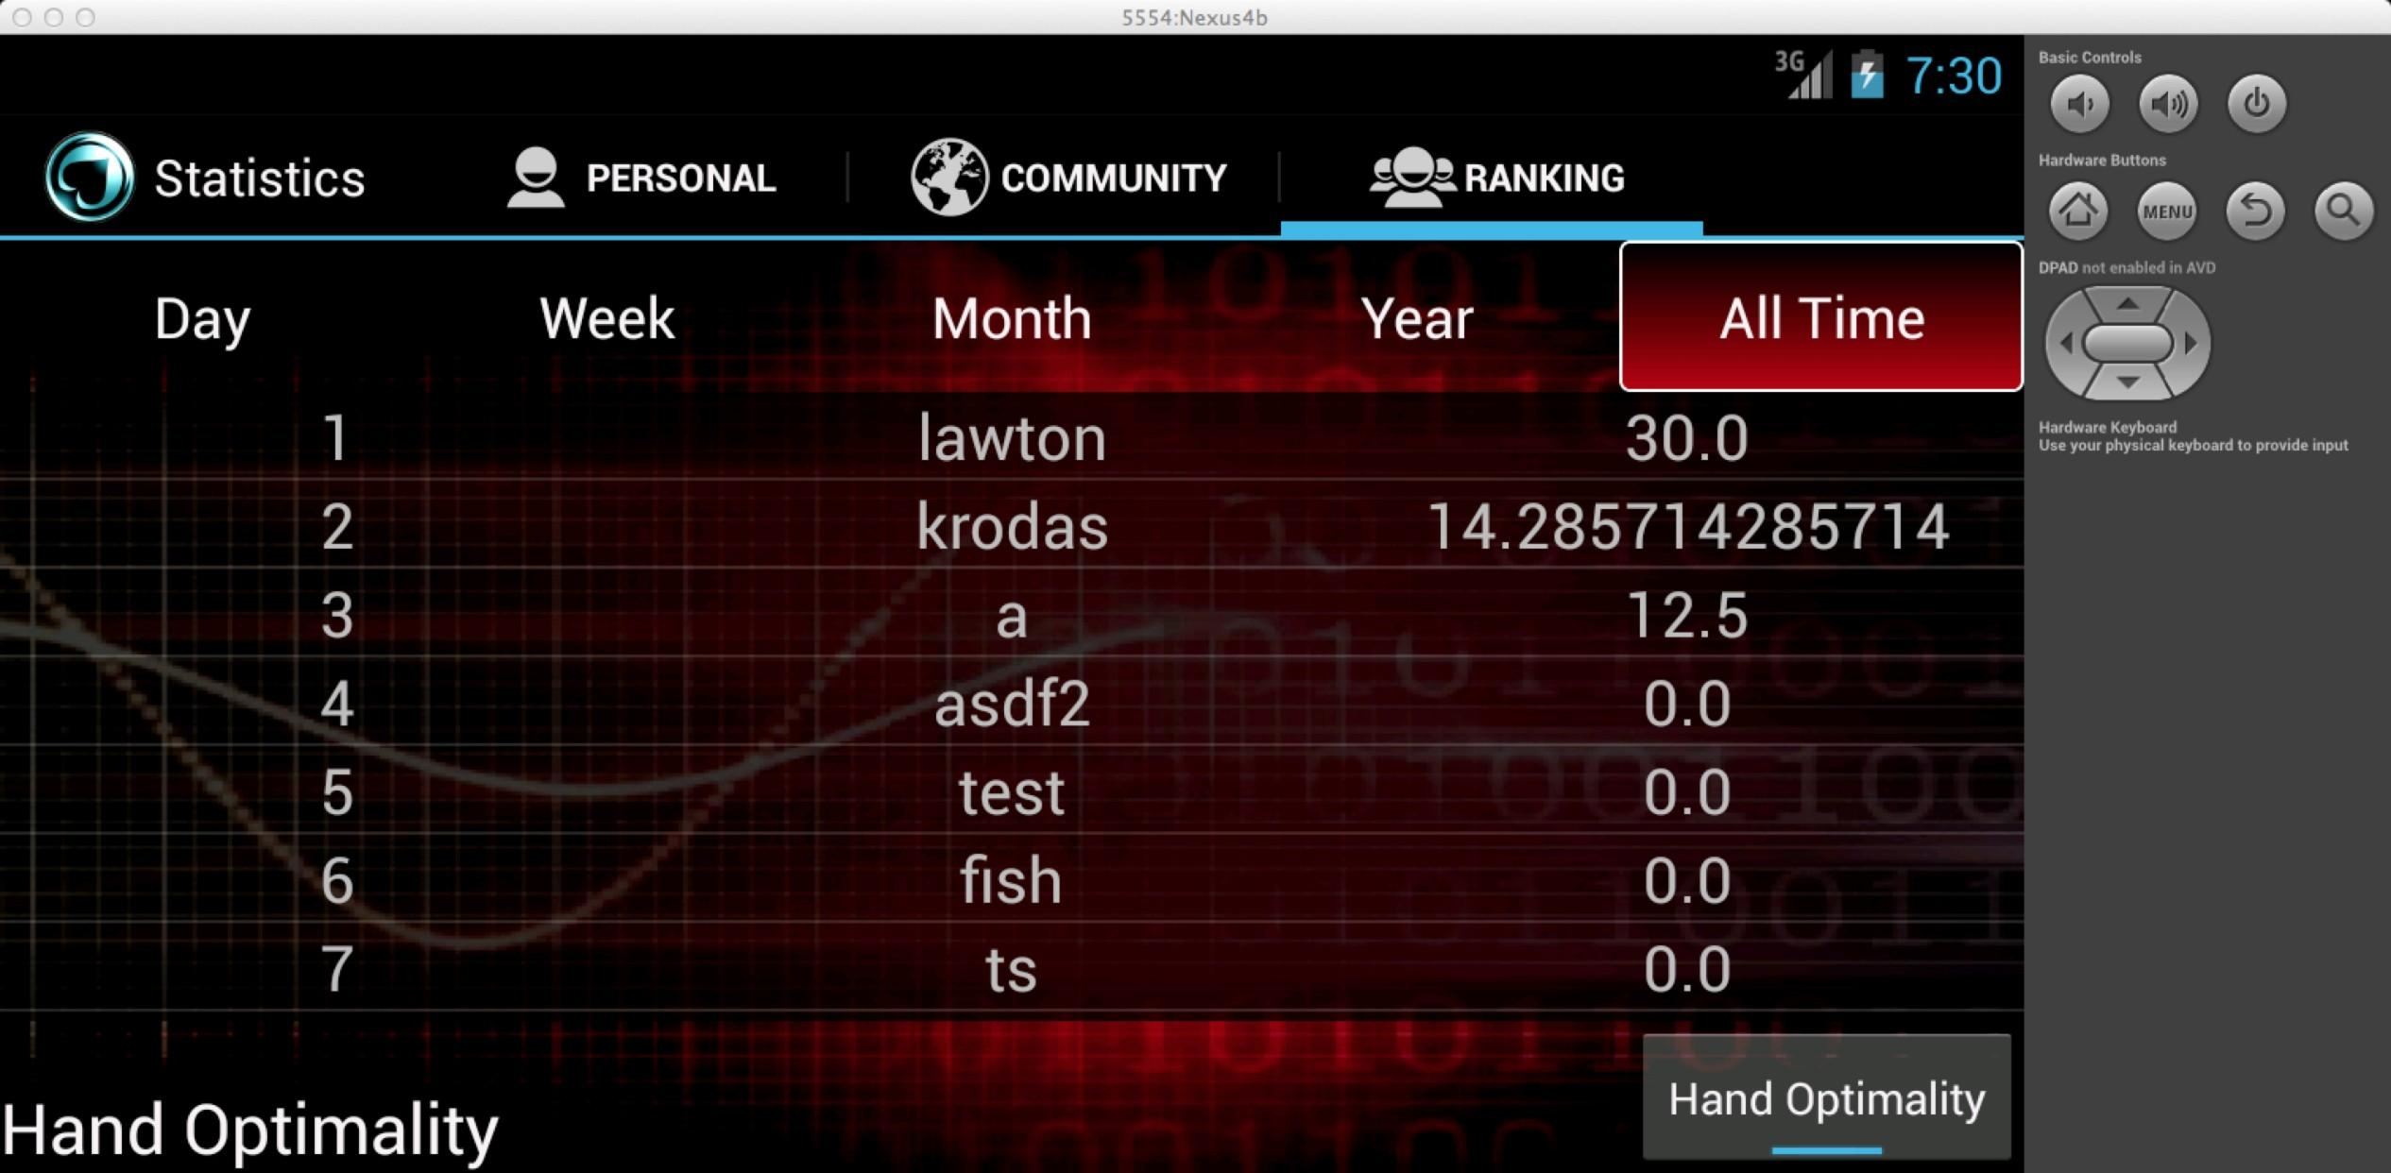
Compare progress with other users...

Slide 14
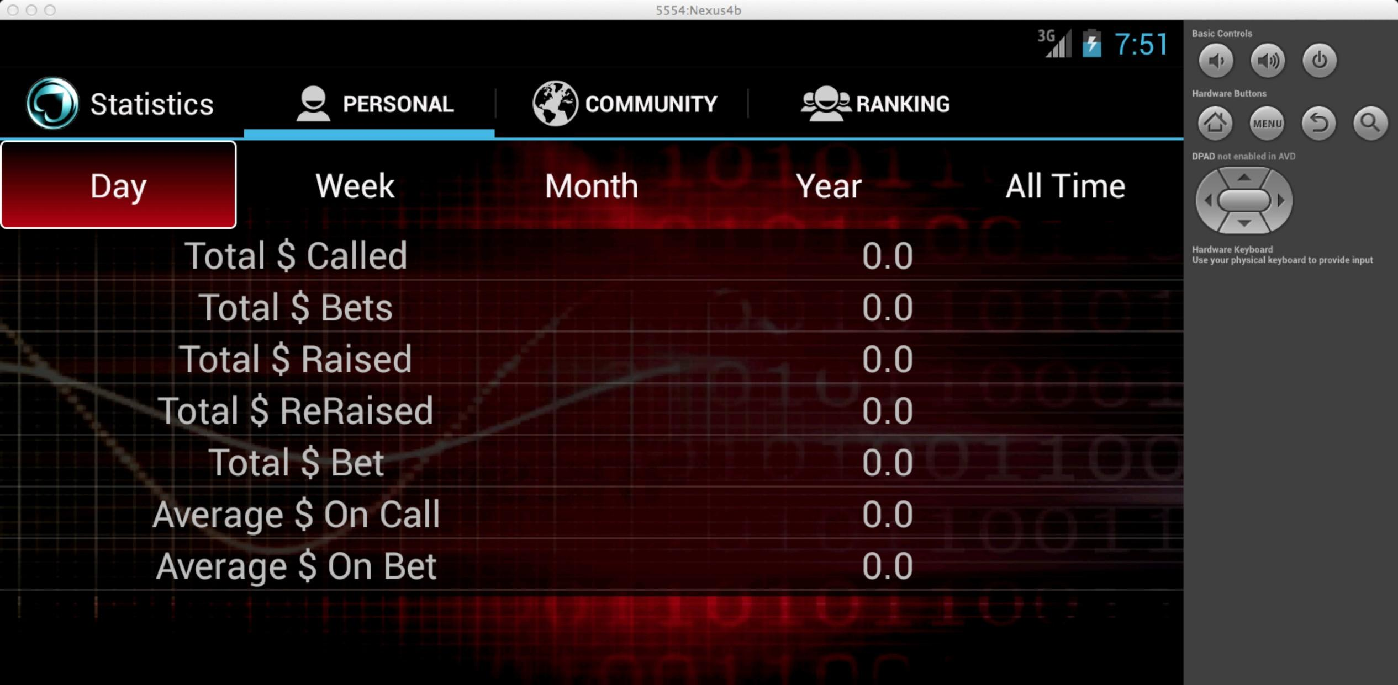
...or simply keep track of yours. Your choice.

Slide 15
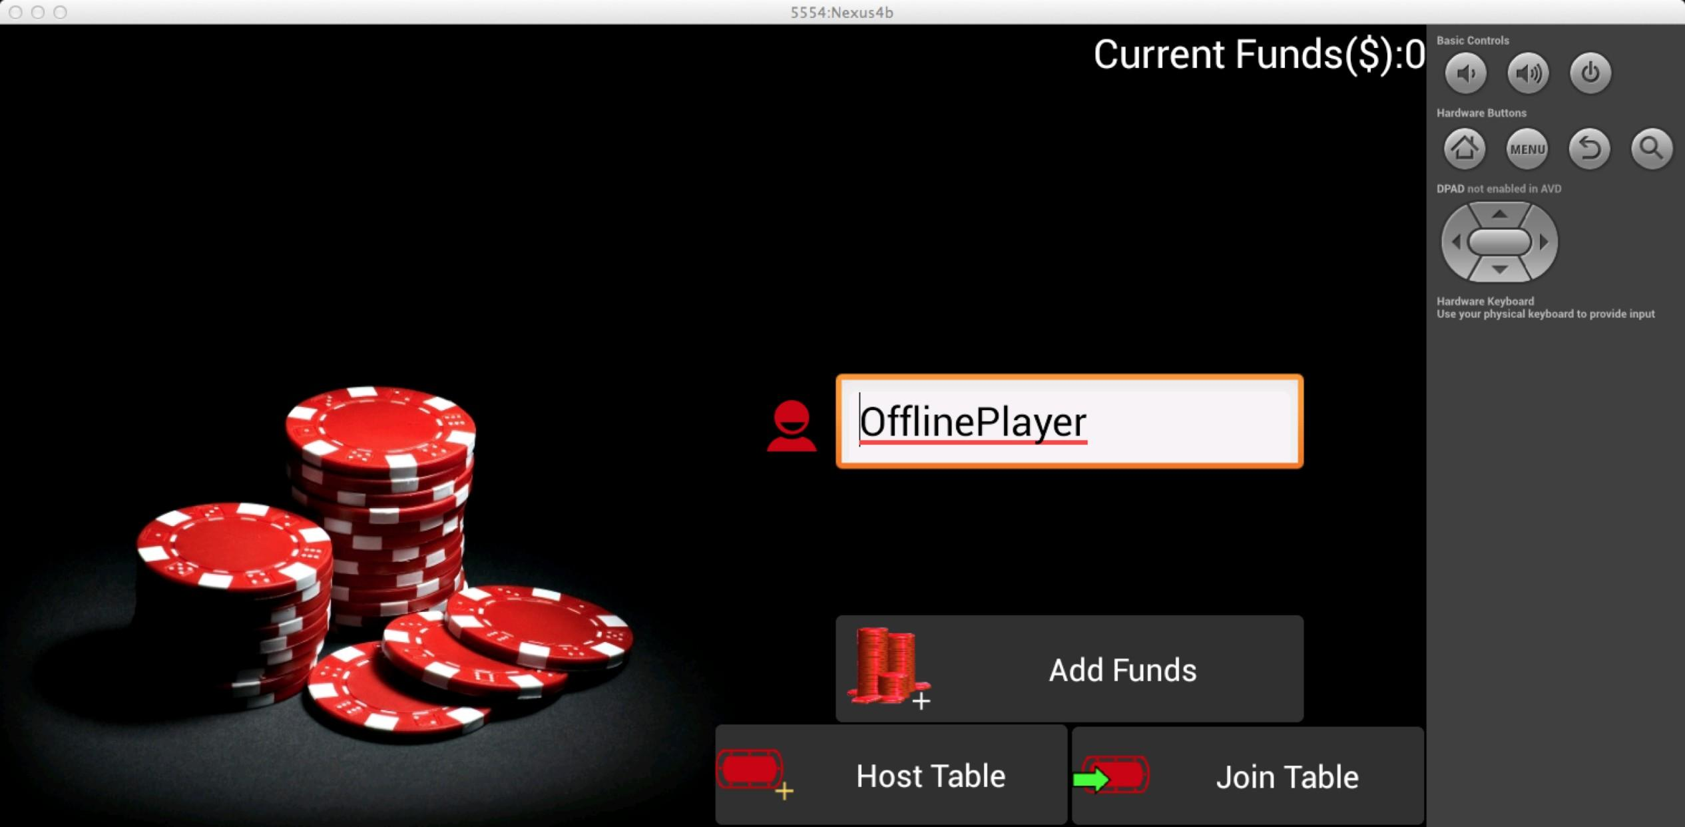
In a rush? Select the offline option to quickly start or join a game.

Slide 16
Game Mechanics

Slide 17
Hand Evaluator (local evaluator)
Two Options:
Binary operations and Lookup Tables
Huge tables to quickly determine the best hand
Use clever binary operations to use hands as key in lookup table
Very fast, but large overhead
Lookup table > 200MB
Slightly impractical for phone
Local walkthrough
Many optimized approaches have been developed over the years
Because speed is not important to program just followed a very simple walkthrough approach
Track hand value and high card

Slide 18
Limited Interface
One public function:
Only one public function to interface
Simplifies tracking moves
prevents clients from making malicious changes to game state
Clients receive updates through Blocking Queue:
Allows for dynamic updates
Clients don't directly touch objects in game mechanics

Slide 19
Bluetooth
Server and Client connection run on separate thread (AsyncTask)
Client can continually attempt connection
Server can continuously listen on socket for client
Main thread isn't blocked
Multiple Server threads
Allows for multiple clients to connect at the same time
Each thread listens on specific socket
Client cycles through sockets to attempt connection

Slide 20
Why Bluetooth?
WIFI
-Wanted gameplay to be available even without any network connection
WIFI DIRECT
- Major interference problems in commercial settings where load balancing wifi nodes are used (personal experience)
-Major disconnect issues
NFC / Android Beam
-Single data transfer - not applicable to our requirements
-Devices must be extremely close (few centimeters)
Bluetooth
-Discovery is slow & expensive problems
-Wanted to promote face to face style of gaming - preserve direct social interaction
Notes:
Android Beam is a feature of the Android mobile operating system to allow data to be transferred via near field communication (NFC)

Slide 21
Web Service
Notes:
- developed alongside the android application to provide a centralized system for:
- for certain functionality, such as authentication services
- storage for game data, accounts etc.
- more demanding processing for statistics

Slide 22



Web Service Overview
Technical Overview
Services
Register
HTTP
HTTP
Logout
Register
Personal Statistics
Login
Rank Statistics
Community Statistics
Database Server
Restful Architecture
Notes:
Restful Architecture
Java Servlet
Apache Tomcat
HTTPd with proxy to Tomcat
JDBC connection to a MySql database
Services
Login,Logout,Upload Game Data,Retrieve Personal Statistics,Retrieve Community Statistics,Retrieve Ranked Statistics,Register

Slide 23
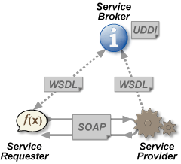
Why Restful Architecture?
Soap
Restful
Enterprise
Tools
XML based
Stateful
Lightweight
Json
HTTP
Stateless
HTTP
POST
Request
Server
Client
HTTP
Response
Notes:
Soap
-Ideal for distributed environments
-Significant tools and middleware
-xml only
-stateful
Rest:
Little need for tools
-allows any data format to be used
-easily consumed by client
-statless
Soap would be overkill for our project
Rest is simpler & more lightweight
But meets our projects needs
Json Format
Simple consumption by clients through HTTP
Minimal State - Username & Authentication Token

Slide 24
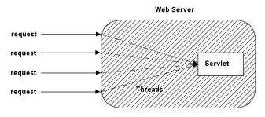

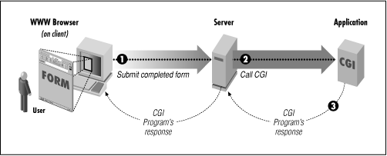
Why Java Servlets?
Java Based Advantages
Old Comparision
Notes:
Portability
Java + Apache Tomcat - Deployment on almost any system
Garbage Collection
OOP
Robust API's & Libraries
Access to Java's core APIs
Access to JavaEE APIs
JDBC
Gson
Old Comparision
CGI
Less efficient
New Process Each Time
Portability
Error Handling

Slide 25
Project Demo

Slide 26
Questions?

Slide 27
References
http://developer.android.com/guide/components/fragments.html
http://developer.android.com/reference/android/os/AsyncTask.html
http://www.ajaxonomy.com/2008/xml/web-services-part-1-soap-vs-rest?utm_source=twitterfeed&utm_medium=twitter
http://java.dzone.com/articles/j2ee-compare-restful-vs-soap
http://weblogs.asp.net/mikeiskiw/archive/2009/03/26/rest-vs-soap-feeling-restful.aspx
http://www.informit.com/articles/article.aspx?p=170963

