Slide 1


A General Framework for Trajectory Optimization with Respect to Multiple Measures
SBIR Phase II AF01-156 (sub-topic b)
Technical Presentation By David Diel 2011 MAR 10
Contract No.: FA8651-09-C-0184
Contractor Name: Scientific Systems Co., Inc. Contractor Address: 500 West Cummings Park, Su. 3000, Woburn, MA 01801 Expiration of SBIR Data Rights Period: September 30, 2016
The Government's rights to use, modify, reproduce, release, perform, display or disclose technical data or computer software marked with this legend are restricted during the period shown as provided in paragraph (b)(4) of the Rights in Noncommercial Technical Data and Computer Software--Small Business Innovative Research (SBIR) Program clause contained in the above identified contract. No restrictions apply after the expiration date shown above. Any reproduction of technical data, computer software or portions thereof marked with this legend must also reproduce the markings.
Notes:
1

Slide 2
Introduction
Do you design multi-sensor navigation systems?
Do you specialize in one sensing modality such as vision?
Are you interested in algorithms that yield greater accuracy from less expensive sensors?
Are you interested in promoting competition among navigation algorithms and sensors?
Do you question the practice of using linearization techniques to solve nonlinear problems?
Would you like to capitalize on open source development?
TOMMAS
Trajectory Optimization Manager for Multiple Algorithms and Sensors

Slide 3
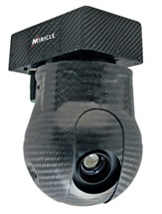
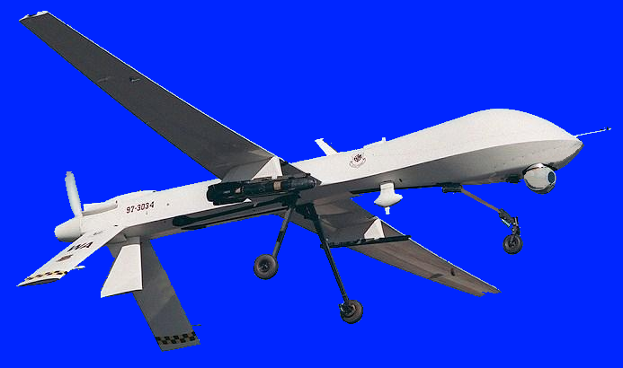
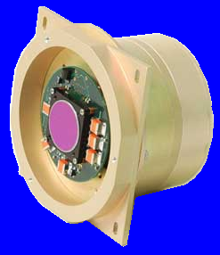
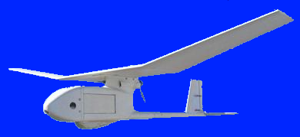
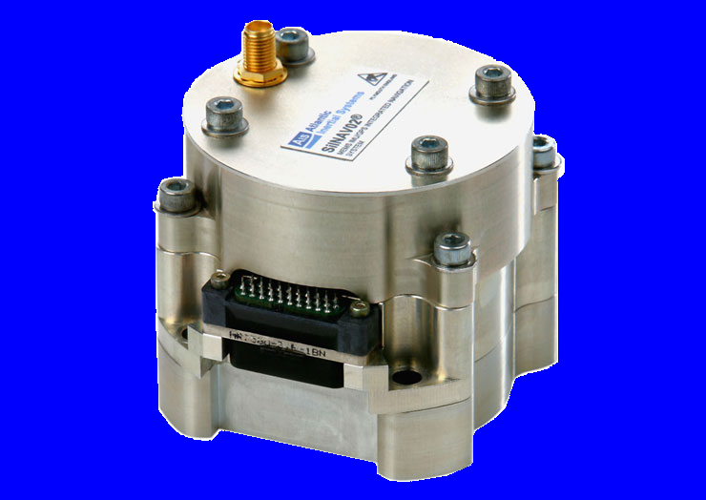

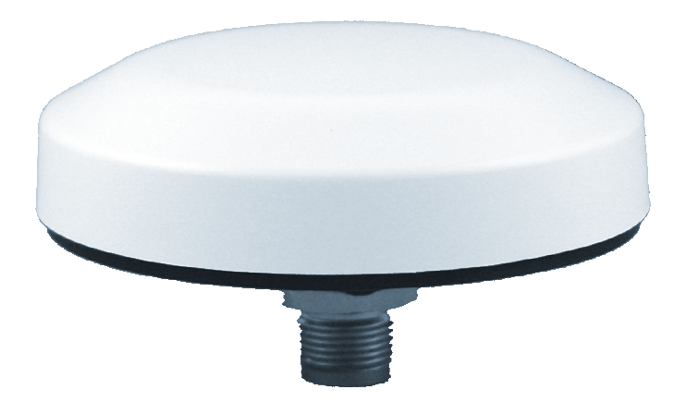
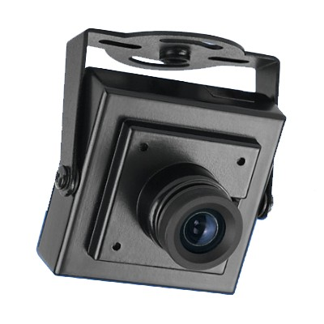
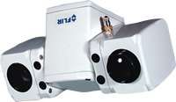
Mission Statement
“Deliver a software testbed that helps users to define optimal for a specific navigation problem by selecting components from a library of dynamic models, sensing algorithms, and optimization algorithms.”

Slide 4
Potential Benefits
For the Systems Engineer
Ease of creating Interface Control Documents (ICDs).
Automated testing of algorithms and sensors together.
Encouraging innovation by leveling the playing field.
Lower cost GOTS devices due to commoditization in the long term.
For the Warfighter
Convenience of device interoperability and potential for hot-swapping.
Mitigates sensor cutouts by augmenting GPS/INS with cameras, altimeters, LIDAR, RF signals of opportunity, etc.
Improved performance from algorithm component updates.

Slide 5
Navigation by Trajectory Optimization
Assumptions
Newtonian mechanics
Global reference frame
Rigid body dynamics
Time domain
6-DoF range in
Finite forces ( continuity)
Given stochastic dynamics
Given data from multiple calibrated sensors
Find the most likely motion that the body experienced
Estimate accuracy of results

Slide 6
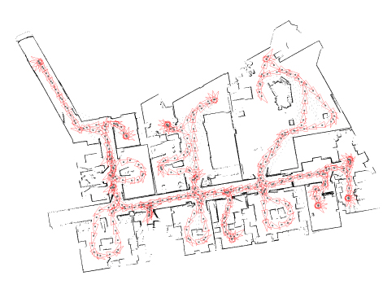
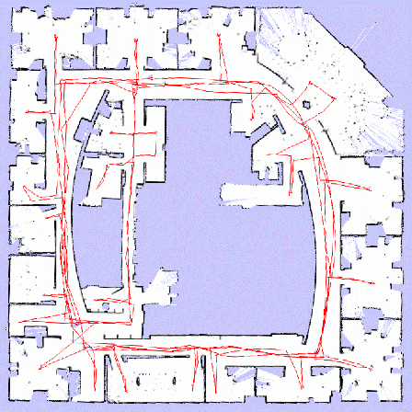
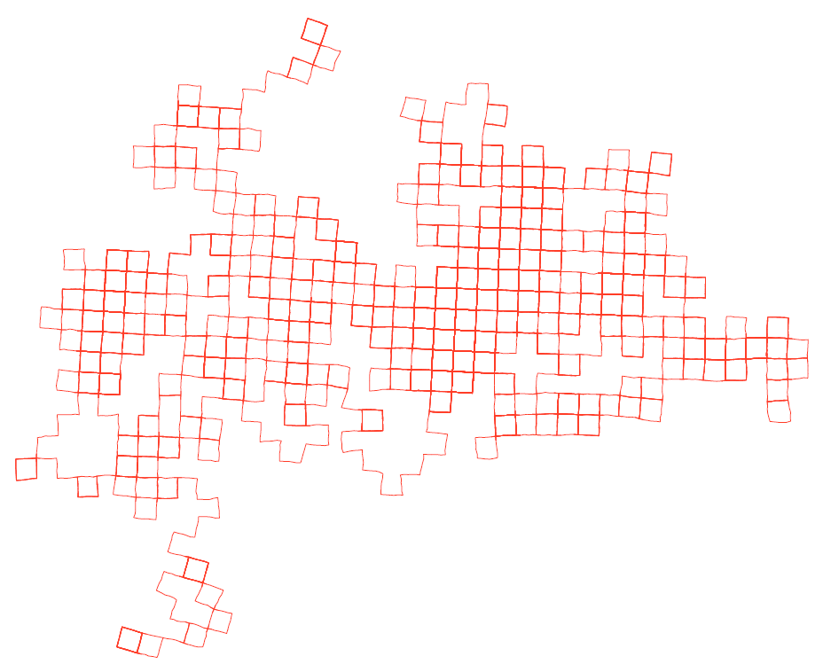
Framing the Navigation Problem
The general problem can be expressed in this form:
Efficient solutions to sub-problems, with or without mapping, already exist in the literature
Michael Kaess
GA Tech / MIT
Giorgio Grisetti
La Sapienza
University of Rome
Paul Newman
Oxford

Slide 7
Visualizing the Problem Structure
off-diagonal edge
diagonal edge
cost
graph
node
hypothetical
trajectories
Each block of parameters corresponds to a discrete time period.
Measurements have a graph structure (node = time, edge = measure).
Trajectories are not required to have a graph structure.

Slide 8
The TOMMAS Approach
Break existing solutions into interchangeable parts using abstract interfaces (polymporphism):
DynamicModel: relates a set of parameters to the rigid body trajectory of a physical system such as a car, airplane, or person. This interface also provides prior stochastic information about the parameters.
Measure: evaluates a given trajectory against navigation-relevant information from one or more sensors. It packages together algorithms, sensors, and calibration information, but does not expose raw data through the interface.
Optimizer: an algorithm that solves for one or more maximum likelihood trajectories by intelligently generating and modifying the parameters of one or more DynamicModel instances and passing them through zero or more Measure instances.

Slide 9
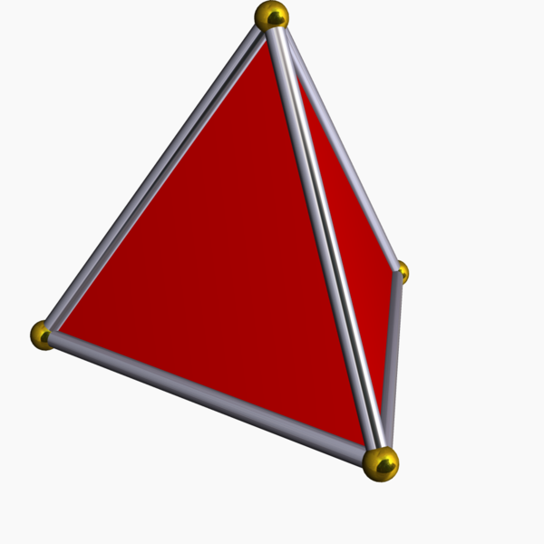
Optimization Concept
Step 1) Generate parameters to initialize one or more DynamicModel instances and one or more Measure instances.
Step 2) Compute prior costs from DynamicModel.
Step 3) Compute costs from each Measure.
Step 4) Generate new parameters.
Within this framework, there are many possible strategies…
?
Gradient Genetic
Simplex Other

Slide 10
DynamicModel Details
Stochastic motion model in nonlinear functional form:
Can depend on sensor data (i.e. strapdown mechanization):
Driven by unknown parameters (i.e. noise, uncertainty, disturbance, perturbation).
Prior statistical information about the relative likelihood of parameters contributes to the objective function:

Slide 11
Measure Details
Sensing model in nonlinear functional form:
The domain of the probability model the space of possible data.
It evaluates how much the data deviates from a statistical model given the trajectory.
As a mathematical measure, it systematically assigns nonnegative numbers (costs) to each element in its domain.
Multiple points in the trajectory space may map to the same point in the measure space, so a measure may not be sensitive to some trajectory deviations.

Slide 12
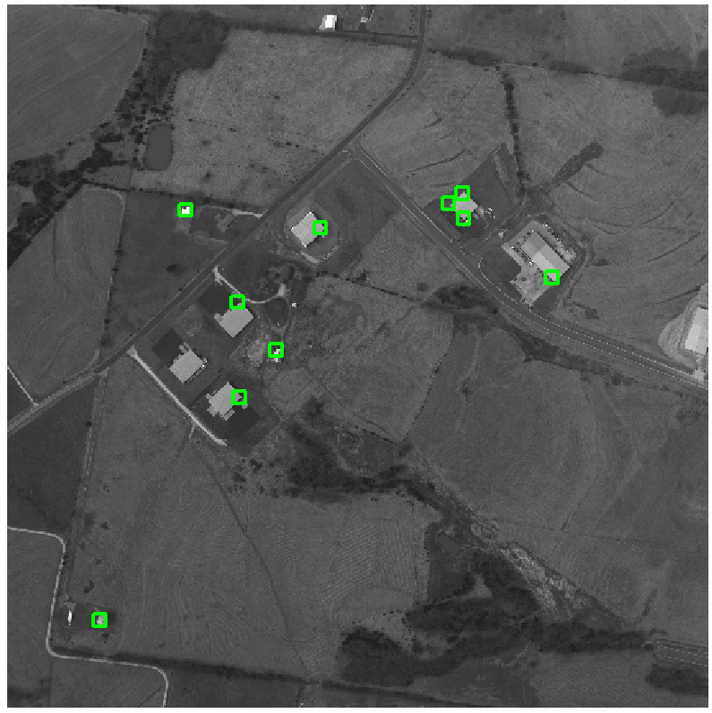
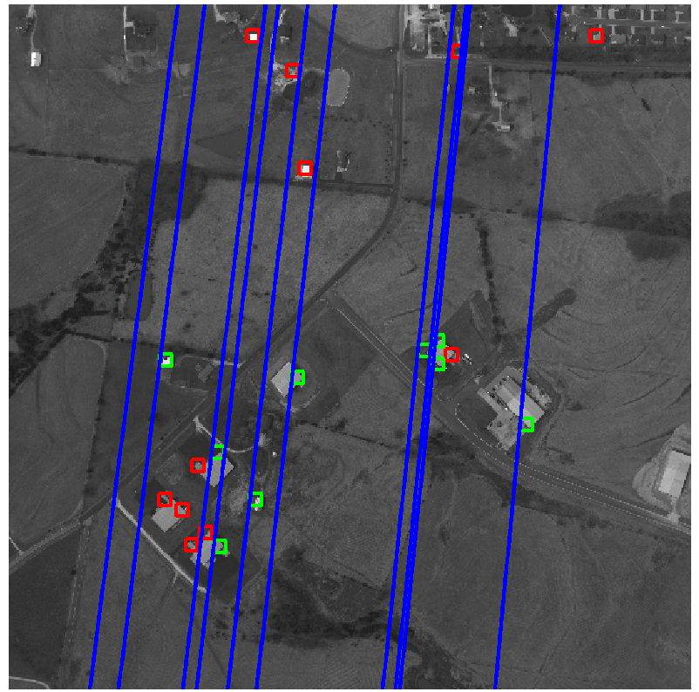
Incremental Measure: Visual Tracking
Feature Sampling
Epipolar Projection
Notes:
12

Slide 13
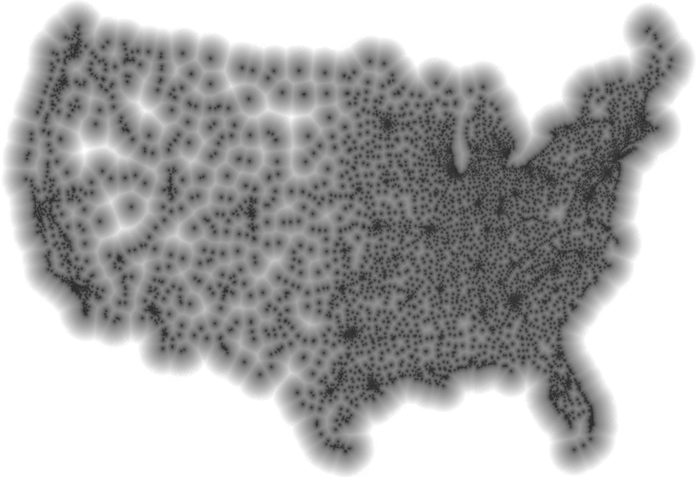
Absolute Measure: “I am near McDonalds”
“Now I see a large Citgo sign and Soverign Bank…”
Reference
Stephen Von Worley. The Contiguous United States Visualized by Distance to the Nearest McDonald's. http://www.datapointed.net. Data courtesy of AggData. http://www.aggdata.com. Used with permission.

Slide 14
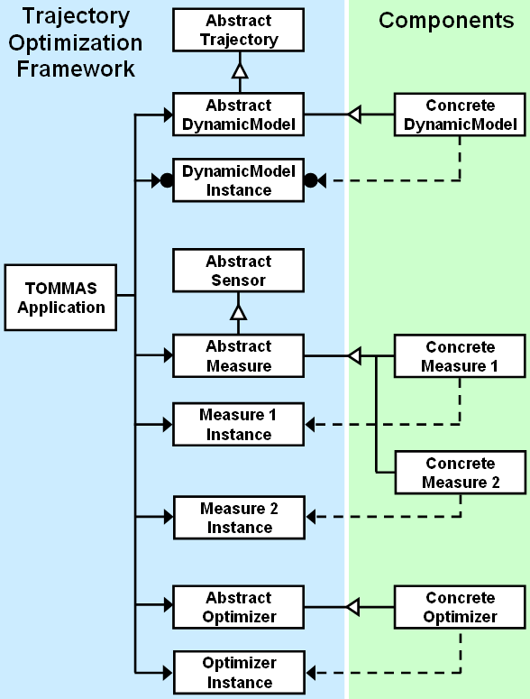
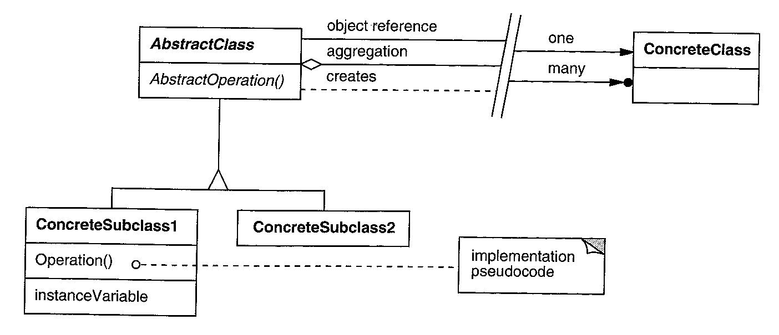
Algorithm Developer Perspective
Object oriented paradigm
Simplifies development
Facilitates maintenance
Encourages code reuse
Notation key from Design Patterns

Slide 15
Participation
Use the framework for free under a permissive license agreement.
Contribute as a developer and stay on the cutting edge.
Own the intellectual property for components that you produce.
Download the code from our open source repository. It comes with wrappers for public data sets and educational demo components. Keyword on Google Code:
functionalnavigation

Slide 16
functionalnavigation

Slide 17
(Additional Slides)

Slide 18
Presentation Overview
Motivation and potential benefits
Key mathematical foundations
Using the open software framework

Slide 19
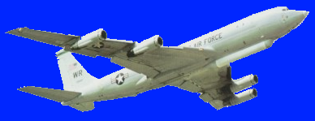
Managing Multiple Algorithms and Sensors
Motion
Stereo
.cpp
SIFT
.dll
Beryl
Altimeter
Optical
Flow
.m
IMU
UAV
LIDAR
LWIR
Camera
MAV
GPS
RGB
Camera
Laser
Rangefinder
System
Integration
Testing &
Validation

Slide 20
Trajectory Optimization: Weighted Least Squares

Slide 21
Trajectory Optimization: Weighted Least Squares

Slide 22
Trajectory Optimization: Generalized Least Squares

Slide 23
Trajectory Optimization: Relative Least Squares

Slide 24
Framework Variables and Functions

Slide 25
Optimizer Details
An optimizer solves the maximum likelihood problem
This is equivalent to the minimization problem (details in the paper)

Slide 26
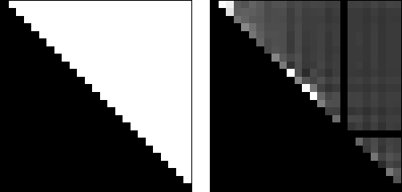
Visualizing the Problem Structure

Slide 27
Software Licensing and Distribution
Goals
Enable collaboration with universities and corporations
Encourage open and closed source development
Policy for optimization framework and demo subsystems
Hosted at http://code.google.com/p/functionalnavigation/
License: BSD
Open source? YES
Copyleft for derivative works? NO
Allow linked code with different licenses? YES
Restrict use of owner’s name by others? YES
Policy for proprietary subsystems developed by SSCI
Hosted at https://svn.ssci.com/repos/functionalnavigation
License: SBIR Data Rights
All rights reserved for 5 years
Contact SSCI with commercial inquiries

Slide 28
System Integrator Perspective
TOMMAS
Configuration Set Solution Set

Slide 29
Layer Diagram for Embedded Systems
Custom
Application
TOMMAS C++ Interface
Custom
Component
Custom
Component
Custom
Component
C++
Operating System Layer
Hardware Layer

Slide 30
Layer Diagram for Developers
Custom
Application
Unit Tests
TOMMAS MATLAB Interface
Custom
Component
Custom
Component
TOMMAS Bridge
MATLAB
TOMMAS C++ Interface
Custom
Component
Custom
Component
Custom
Component
C++
Operating System Layer
Hardware Layer

Slide 31
How to Implement a TOMMAS Component
Review the paper in JNC 2011:
“A General Framework for Trajectory Optimization with Respect to Multiple Measures”
Navigate to the online repository
http://code.google.com/p/functionalnavigation
Review the Wiki pages
Download the TOMMAS framework code
Refer to the internal code documentation in the C++ header files located in the “trunk/+tom” and “trunk/+antbed” directories
Use the components in “trunk/components” as templates
Algorithm library includes: optical flow, bundle adjustment, EKF, gradient descent, genetic algorithm, simplex, SLAM methods, generic dynamics, and flight dynamics

