Slide 1



A General Framework for Trajectory Optimization with Respect to Multiple Measures
SBIR Phase II AF01-156
Technical Presentation By David Diel 2011 JUN 29
Notes:
1

Slide 2
Introduction
Multi-sensor navigation
GPS alternatives such as vision
Competition for better algorithms
Greater accuracy at a lower cost
Nonlinear filtering
Open source development
TOMMAS
Trajectory Optimization Manager for Multiple Algorithms and Sensors
Notes:
Do you design multi-sensor navigation systems?
Do you specialize in GPS alternatives such as vision-aided navigation?
Are you interested in promoting competition among navigation algorithms and sensors?
Are you interested in algorithms that yield greater accuracy from less expensive sensors?
Do you question the practice of using linearization techniques to solve nonlinear problems?
Would you like to capitalize on open source development?

Slide 3
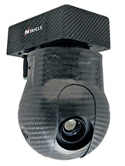
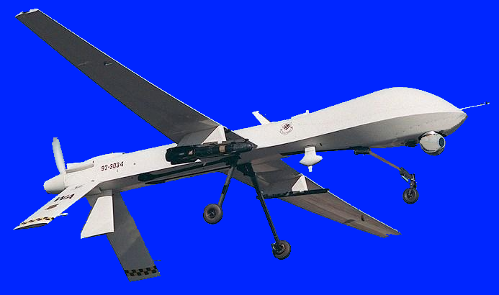
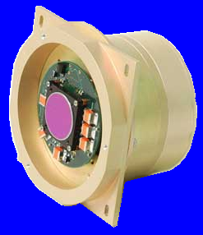
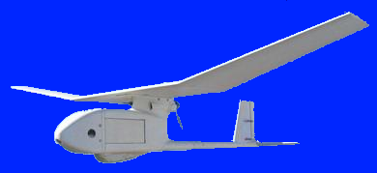
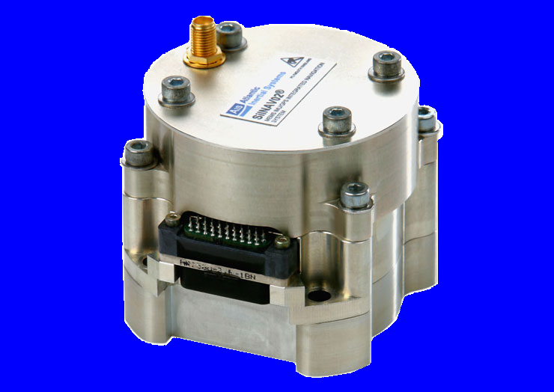

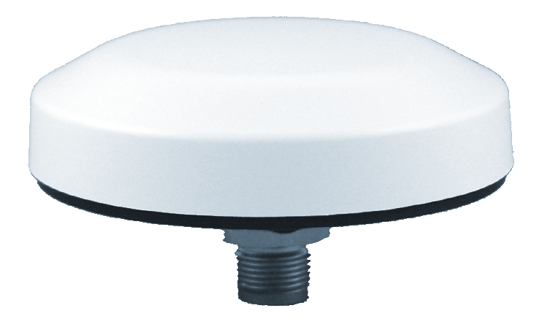
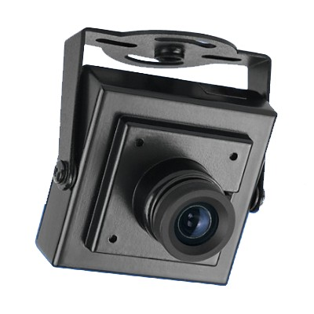
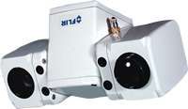
Mission Statement
“Deliver a software testbed that helps a user to define optimal for a specific navigation problem by selecting components from a library of dynamic models, sensing algorithms, and optimization algorithms.”

Slide 4
Potential Benefits
For the Systems Engineer
Ease of creating Interface Control Documents (ICDs).
Automated testing of algorithms and sensors together.
Encouraging innovation by leveling the playing field.
Lower cost GOTS devices due to commoditization in long-term.
For the Warfighter
Convenience of device interoperability and potential hot-swapping.
Mitigates sensor cutouts by augmenting GPS/INS with cameras, altimeters, LIDAR, RF signals of opportunity, etc.

Slide 5
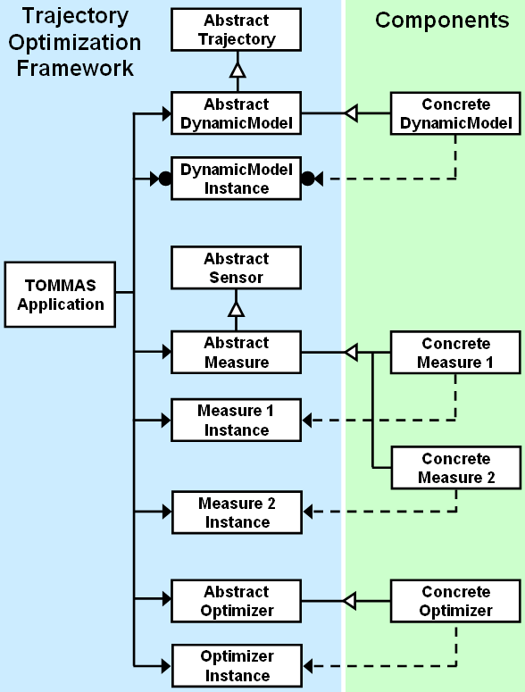
Approach
Break existing solutions into interchangeable parts.
Use object-oriented design to create abstract interfaces in C++, Matlab, and Python.
Implement polymorphism via the Factory Design Pattern.
Notes:
Simplifies development
Facilitates maintenance
Encourages code reuse
DynamicModel: relates a set of parameters to the rigid body trajectory of a physical system such as a car, airplane, or person. This interface also provides prior stochastic information about the parameters.
Measure: evaluates a given trajectory against navigation-relevant information from one or more sensors. It packages together algorithms, sensors, and calibration information, but does not expose raw data through the interface.
Optimizer: an algorithm that solves for one or more maximum likelihood trajectories by intelligently generating and modifying the parameters of one or more DynamicModel instances and passing them through zero or more Measure instances.

Slide 6
Navigation by Trajectory Optimization
Assumptions
Newtonian mechanics
Global reference frame
Rigid body dynamics
Time domain
6-DoF range in
Finite forces ( continuity)
Given
Stochastic dynamics
Multiple calibrated sensors
Find
The most likely motion that the body experienced
Accuracy of results

Slide 7
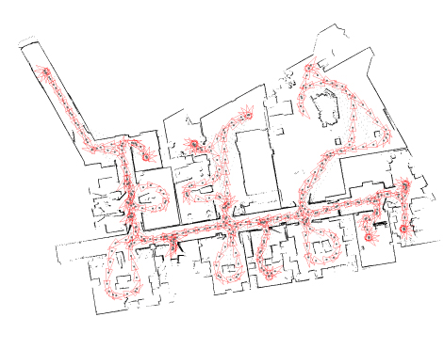
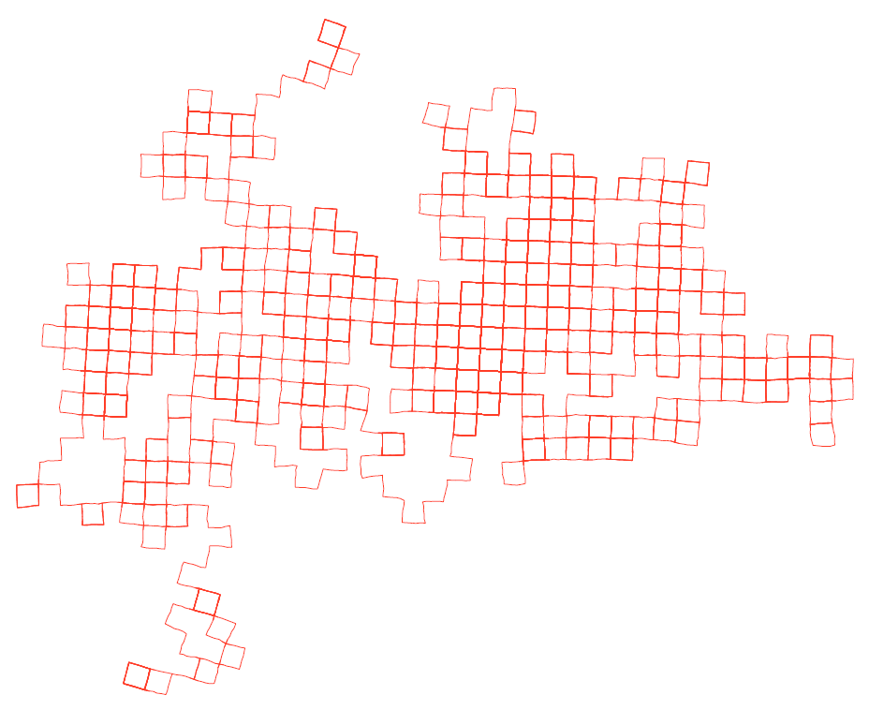
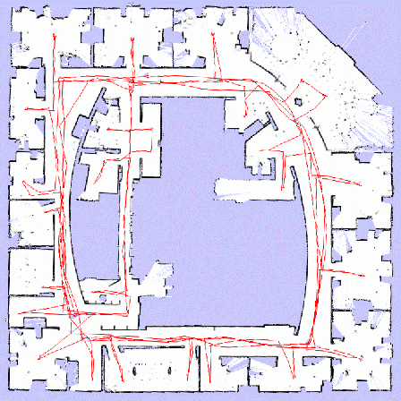
Framing the Navigation Problem
Efficient solutions to various sub-problems exist in the literature (some also map the environment):
The generalized problem can be expressed in this form:
Michael Kaess
GA Tech / MIT
Paul Newman
Oxford
Giorgio Grisetti
La Sapienza
University of Rome

Slide 8
Visualizing the Problem Structure
off-diagonal edge
diagonal edge
cost
graph
node
hypothetical
trajectories
Each block of parameters corresponds to a discrete time period.
Measurements have graph structure (node = time, edge = measure).
Trajectories are not required to have a graph structure.

Slide 9
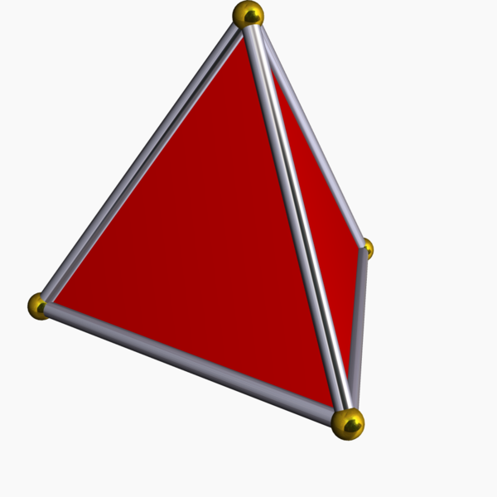
Optimization Concept
Step 1) Generate initial parameters.
Step 2) Compute prior costs from DynamicModel.
Step 3) Compute costs from each Measure.
Step 4) Generate new parameters.
Within this framework, there are many possible strategies…
?
Gradient Genetic
Simplex Other

Slide 10
DynamicModel Details
Stochastic motion model in nonlinear functional form:
Can depend on sensor data (i.e. strapdown mechanization):
Driven by parameters that are not known in advance (i.e. noise, disturbance, perturbation).
Prior statistical information about the parameters:

Slide 11
Measure Details
Sensing model in nonlinear functional form:
It evaluates how much the data deviates from a statistical model given the trajectory.
As a mathematical measure, it systematically assigns nonnegative numbers (costs) to each element in its domain. The domain is the space of possible data.
Multiple points in the trajectory space may map to the same point in the measure space, so a measure may not be sensitive to some trajectory deviations.

Slide 12
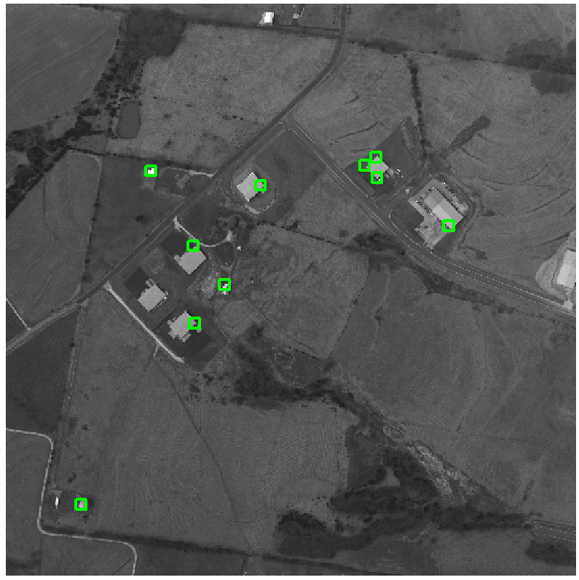
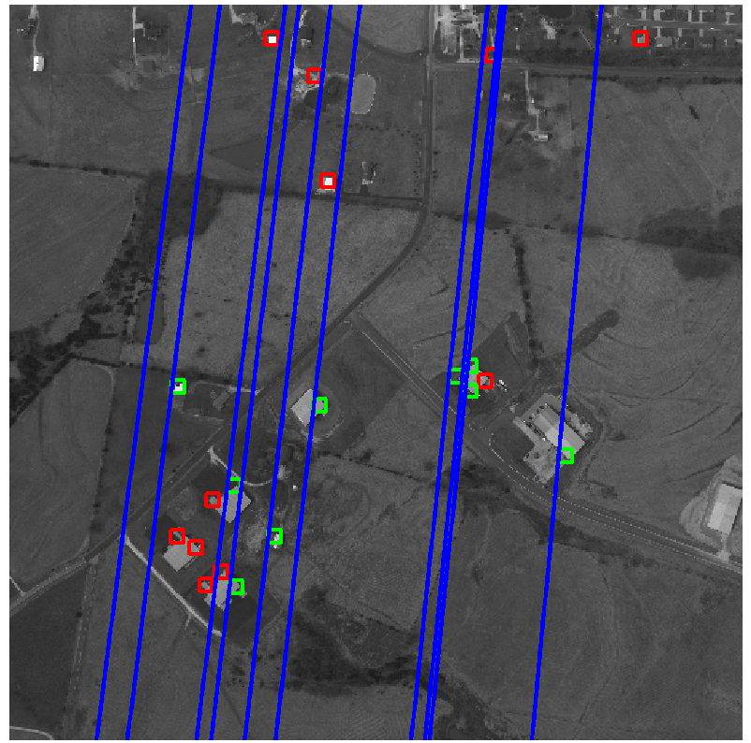
Incremental Measure: Visual Tracking
Feature Sampling
Epipolar Projection
Notes:
12

Slide 13
Participation
Use the framework for free under a permissive license agreement.
Contribute as a developer and stay on the cutting edge.
Own the intellectual property for components that you produce.
Download the code from our open source repository.
Keyword on Google Code:
functionalnavigation
Notes:
Download includes wrappers for public data sets and educational demo components.

Slide 14
functionalnavigation

Slide 16
(Additional Slides)

Slide 17
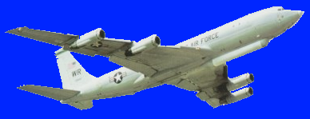
Managing Multiple Algorithms and Sensors
Motion
Stereo
.cpp
SIFT
.dll
Beryl
Altimeter
Optical
Flow
.m
IMU
UAV
LIDAR
LWIR
Camera
MAV
GPS
RGB
Camera
Laser
Rangefinder
System
Integration
Testing &
Validation

Slide 18
System Integrator Perspective
TOMMAS
Configuration Set Solution Set

Slide 19
Trajectory Optimization: Weighted Least Squares

Slide 20
Trajectory Optimization: Weighted Least Squares

Slide 21
Trajectory Optimization: Generalized Least Squares

Slide 22
Trajectory Optimization: Relative Least Squares

Slide 23
Framework Variables and Functions

Slide 24
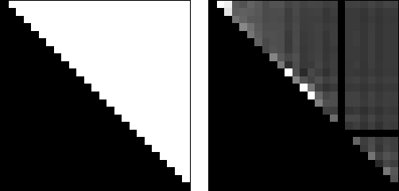
Visualizing the Problem Structure
Adjacency Matrix
Cost Matrix

Slide 25
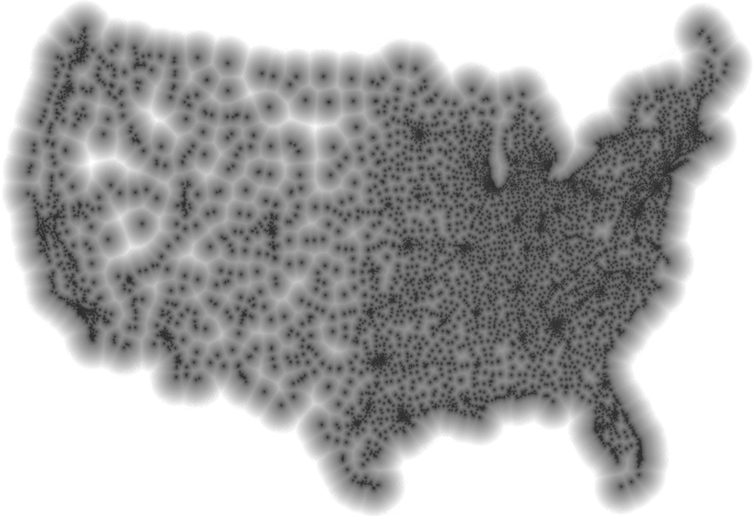
Absolute Measure: “I am near McDonalds”
“Now I see a large Citgo sign and Soverign Bank…”
Reference
Stephen Von Worley. The Contiguous United States Visualized by Distance to the Nearest McDonald's. http://www.datapointed.net. Data courtesy of AggData. http://www.aggdata.com. Used with permission.

Slide 26
Software Licensing and Distribution
Goals
Enable collaboration with universities and corporations
Encourage open and closed source development
Policy for optimization framework and demo subsystems
Hosted at http://code.google.com/p/functionalnavigation/
License: BSD
Open source? YES
Copyleft for derivative works? NO
Allow linked code with different licenses? YES
Restrict use of owner’s name by others? YES
Policy for proprietary subsystems developed by SSCI
Hosted at https://svn.ssci.com/repos/functionalnavigation
License: SBIR Data Rights
All rights reserved for 5 years
Contact SSCI with commercial inquiries

Slide 27
Layer Diagram for Embedded Systems
Custom
Application
TOMMAS C++ Interface
Custom
Component
Custom
Component
Custom
Component
C++
Operating System Layer
Hardware Layer

Slide 28
Layer Diagram for Developers
Custom
Application
Unit Tests
TOMMAS MATLAB Interface
Custom
Component
Custom
Component
TOMMAS Bridge
MATLAB
TOMMAS C++ Interface
Custom
Component
Custom
Component
Custom
Component
C++
Operating System Layer
Hardware Layer

Slide 29
How to Implement a TOMMAS Component
Review the paper in JNC 2011:
“A General Framework for Trajectory Optimization with Respect to Multiple Measures”
Navigate to the online repository
http://code.google.com/p/functionalnavigation
Review the Wiki pages
Download the TOMMAS framework code
Refer to the internal code documentation in the C++ header files located in the “trunk/+tom” and “trunk/+antbed” directories
Use the components in “trunk/components” as templates
Algorithm library includes: optical flow, bundle adjustment, EKF, gradient descent, genetic algorithm, simplex, SLAM methods, generic dynamics, and flight dynamics

