Slide 1
ସୁନିବେ
হ্যালো
سلام
NewsHunt Hack
Broids
Bangalore – 10 May 2015
હેલો
வணக்கம்
Hello
ഹലോ
तेथे
नमस्ते
ਸਤ ਸ੍ਰੀ ਅਕਾਲ
నమస్కారం

Slide 2
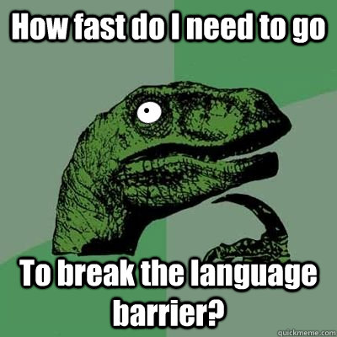
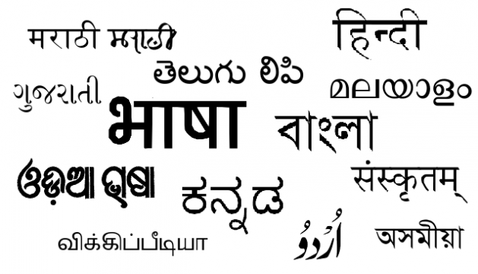
Theme A: Crowning three Cs
Marry Content, Community & Commerce for mobile first, Indian local language users

Slide 3
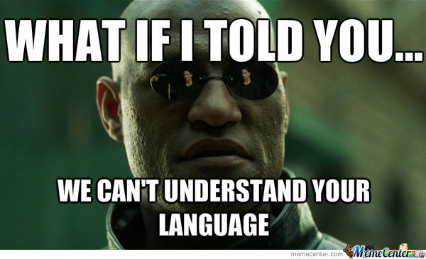

A Problem - How they look at it

Slide 4



Our Approach:
People are literate – just not in English
People think first in their Mother Tongue
Break the “Internet – English” language barrier and leverage the native language skills of millions of Indians there by bringing them into the Information Age
75% None
20% Some
5% Fluent

Slide 5
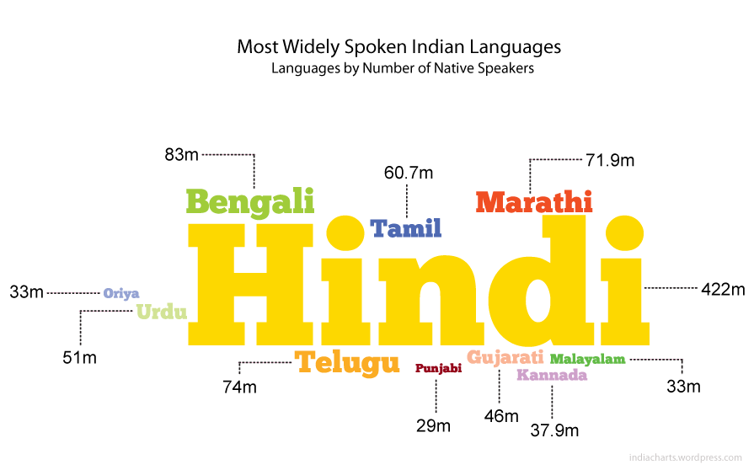
An Opportunity – How we look at it

Slide 6
वार्तapp
Your Content in Your Language

Slide 7


First C: Content
Vernacular Language – Your Content Your Language
Personalized – Content that you want
Easy to Consume – How you want to
Share with your family and friends
DEMO

Slide 8
Second C: Community
Platform
Users
Content Developers
(Publishers)
Develop an Ecosystem
Participative Organic Growth
Take from and Contribute back to the Community
User contributed translations and dictionary

Slide 9
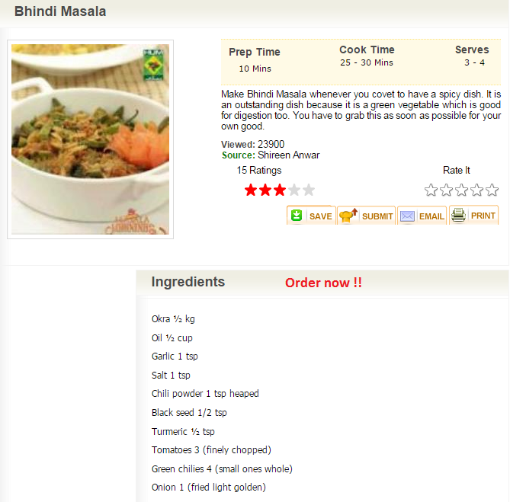
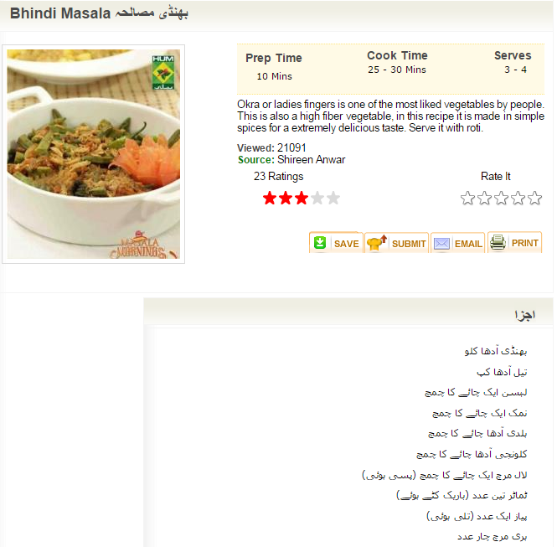
Second C: Community

Slide 10

Third C: Commerce
Content Developers can monetize through Ads or subscriptions
Third Party Partners such as online retailers and home delivery services can plug into the platform seamlessly.
Eg. In the previous screen, the ingredients for the recipe could be ordered online seamlessly.
Growth potential in other contents like Videos, Live Streaming etc.

Slide 11
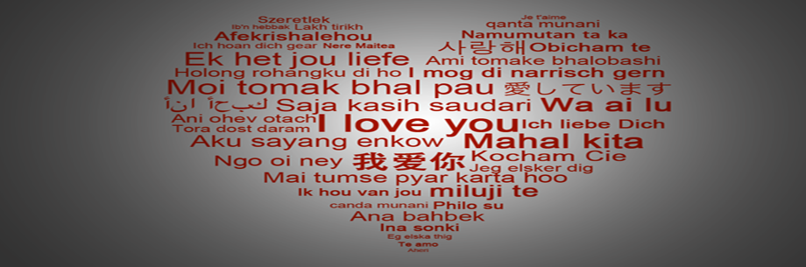
T
H
A
N
K
Y
O
U
For somethings in life language is never a barrier….

