Slide 1

Image Recognition with Neural Nets
Technologies Used
  Python
  PILLOW (PIL branch)
  Anaconda Suite (Distribution of the SciPy stack)
  PyBrain

Slide 2
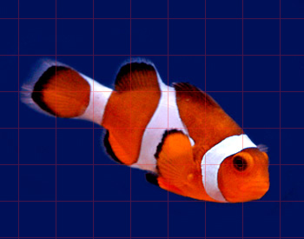

Plan
Sample set of images to train neural net on RGB data.
Experiment and determine what structure of neural nets and the accuracy based on the resolution of the color data.
Ex.)
or

Slide 3
Resources
https://pypi.python.org/pypi/Pillow/2.2.1
http://continuum.io/downloads
http://pybrain.org/
http://www.python.org/download/releases/2.7/

