Slide 1
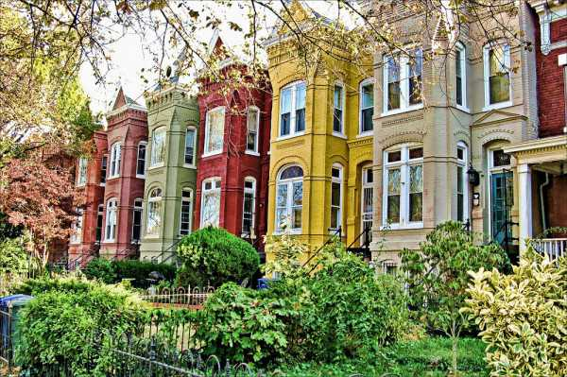
Leo’s House Hunt
Freguenet
Dan Hong
Derek Denning
Mike George

Slide 2
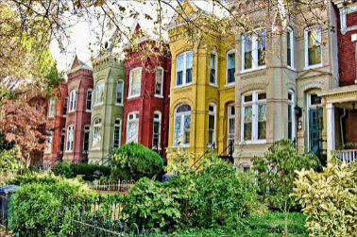
Motivation and Summary
Leo is becoming increasingly frustrated by our basic github questions and ready to retire from an illustrious career in data analytics. He’s intrigued by Washington DC real estate and looking for where best to buy?
Leo is looking for a turn-key property at a modest price point.
Objective: Determine where and what Leo should buy for an optimal return in 10 years assuming current market conditions remain stable
Question: Is there a clear quadrant, ward, and house type that is poised to deliver superior investment returns over the next 10 years?

Slide 3
Questions & Data
We used the D.C. Residential Properties dataset from Kaggle as our sole dataset
We needed key data parameters that would provide insight into a quadrant and wards investment prospects. Some of the data was numerical (sale px, transaction count) while others were qualitative (quad, ward, condition). Some of the key functions we used to cut our data included .groupby, .mean, .count, .agg, .loc.
Important parameters in our data include:
Price Year built Building type
Sale Date Bedroom/bath Square feet
Location (quad/ward) Remodel Year

Slide 4
Data Complication
Sale Date: was a key data point that the project was predicated on, and needed to be extracted from a string
Key Insights:
Upwards of half of the 158,000 records didn’t include price data
Commercial properties included in the “Residential” dataset severely skewed our findings and needed to be removed.
Data prior to 1992 and after 2017 was too sparse to draw any meaningful conclusion and needed to be removed
When all was said and done, we were left with about a third of the original data ~58,000 rows

Slide 5
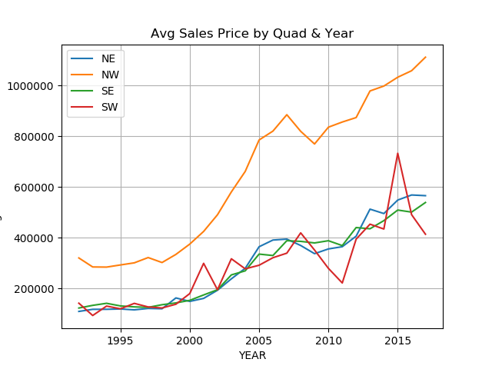
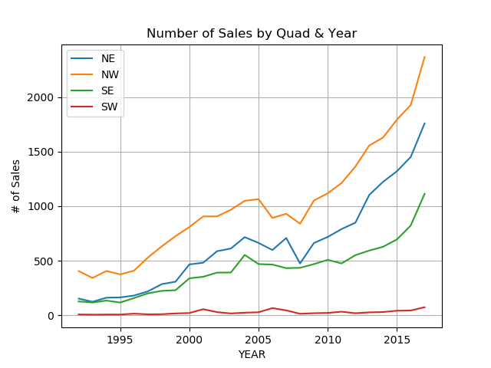
DC Housing by Quadrant
Data Anomaly
Finding: In addition to consistently having the highest average sale price by a wide margin, Northwest also has the highest number of transactions. Currently, Southwest has the lowest
average selling price with the fewest quantity
of homes sold

Slide 6
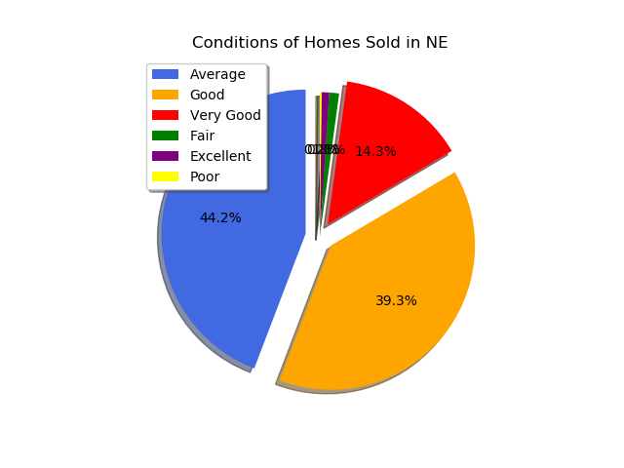
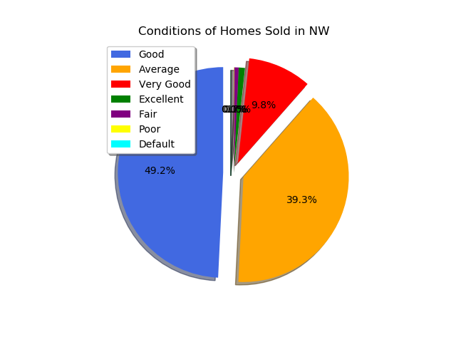
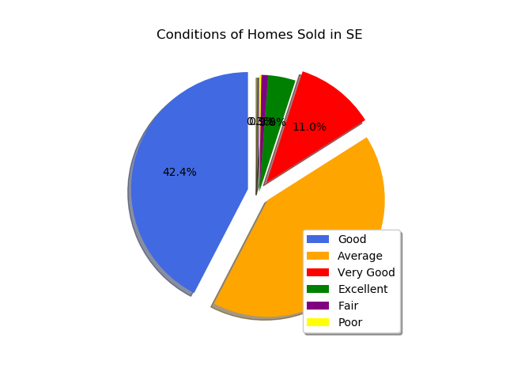
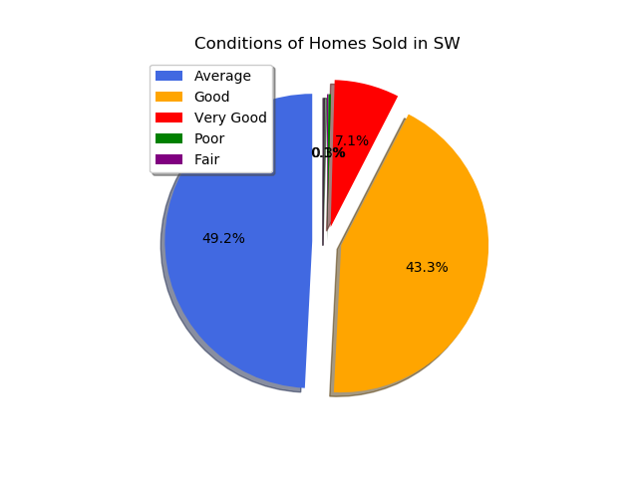
House Conditions by Quadrant
Finding: There is not a wide dispersion of home condition (quality) across quadrants allowing us to conclude any difference in price across quadrants isn’t being driven by house condition

Slide 7
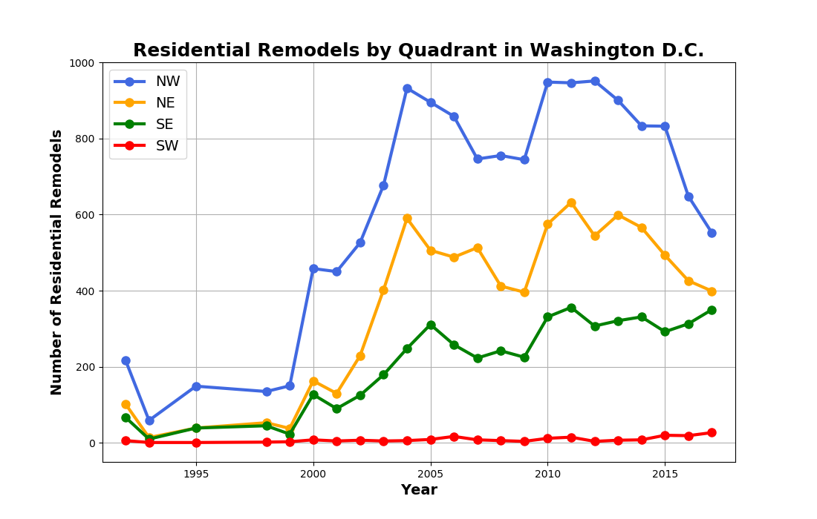
Remodels by Quadrant
Finding: Through time, more homes have been remodeled in Northwest while a relative few are remodeled in Southwest each year
Conclusion: Northwest is a compelling opportunity

Slide 8
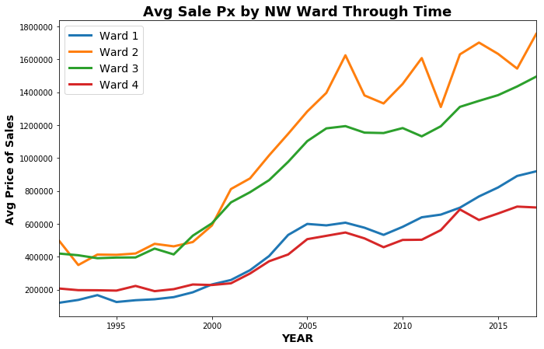
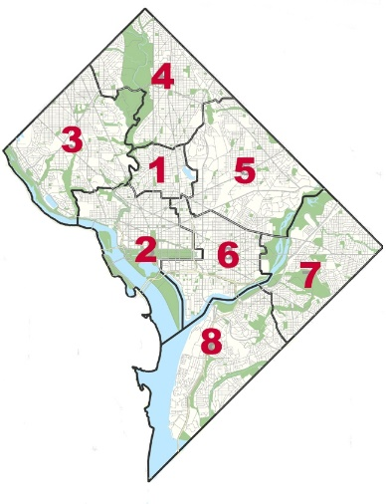
Sale Price by Northwest Wards
Finding: Within Northwest, Ward 2 has the highest, while Ward 4 has the lowest average selling price

Slide 9
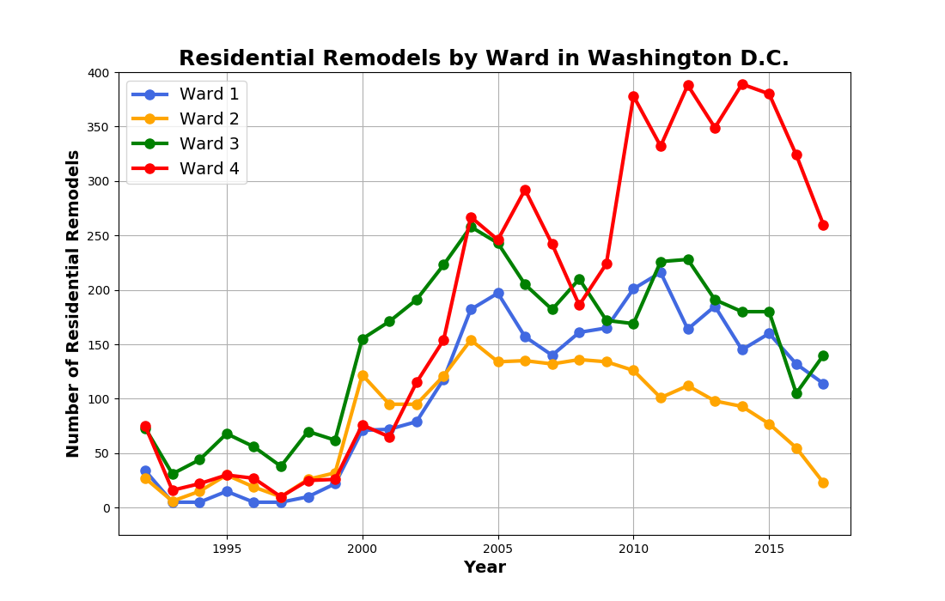
Remodels by Northwest Wards
Finding: Since 2009, homes in Ward 4 are remodeled with greater frequency than any other ward in Northwest

Slide 10
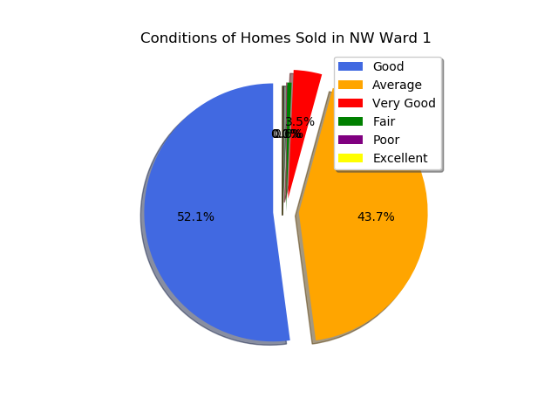
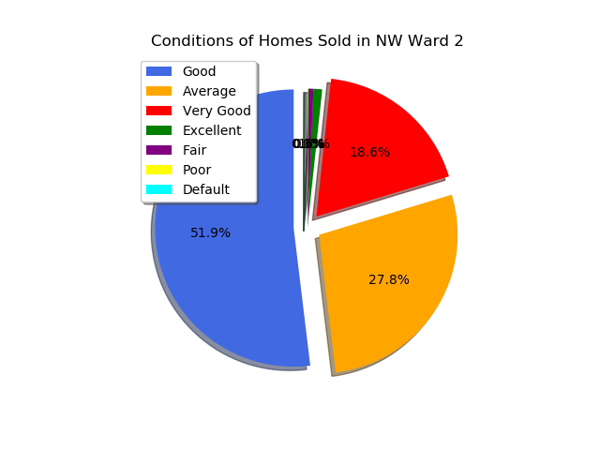
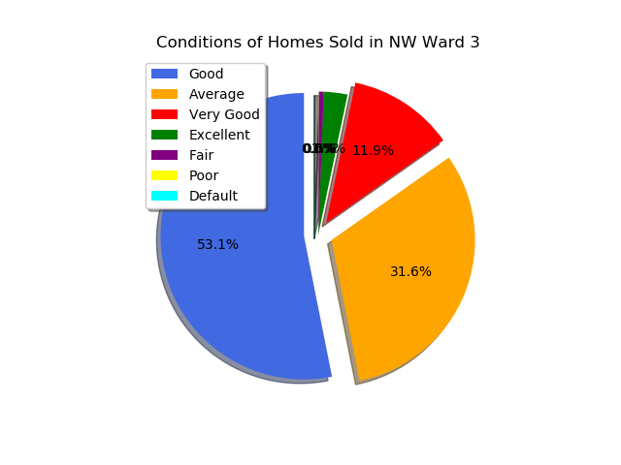

Home Conditions by Northwest Wards
Finding: There is not a wide dispersion of home condition (quality) across wards allowing us conclude the perceived value of Ward 4 is not due to poor quality homes

Slide 11
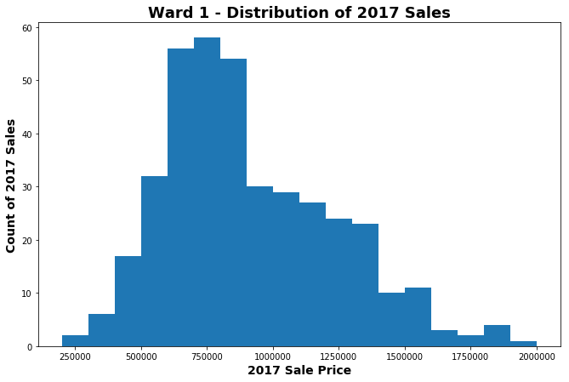
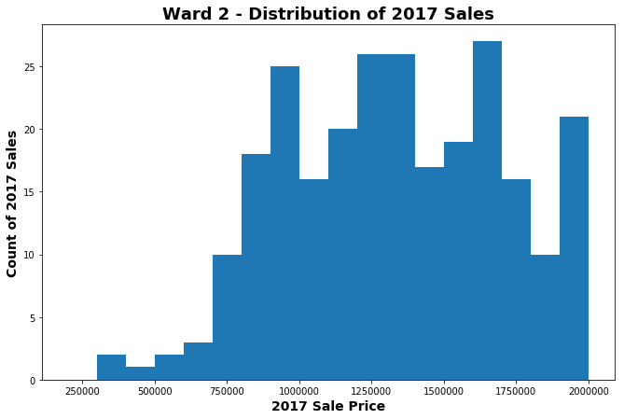
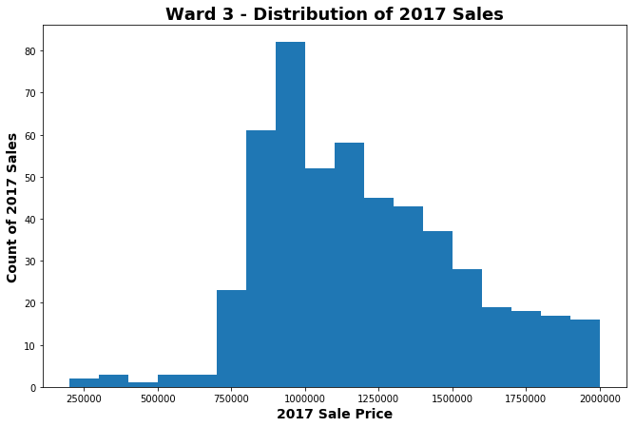
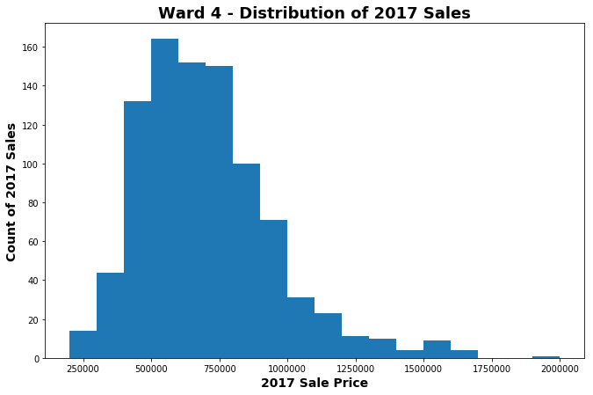
Sale Count by Price in Northwest Wards
Finding: In 2017, Ward 4 had the greatest quantity of homes within a more modest price point

Slide 12
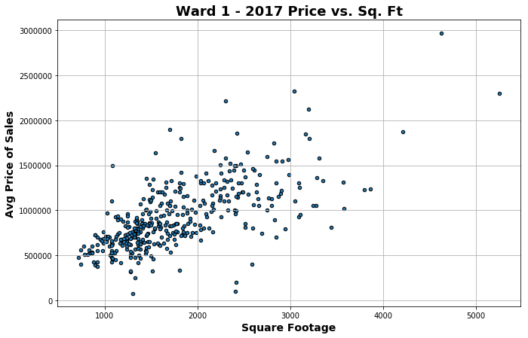
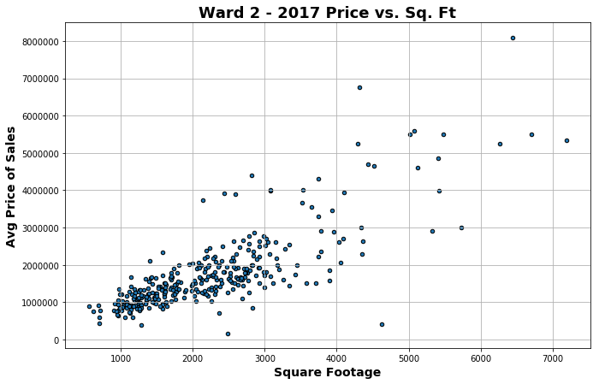
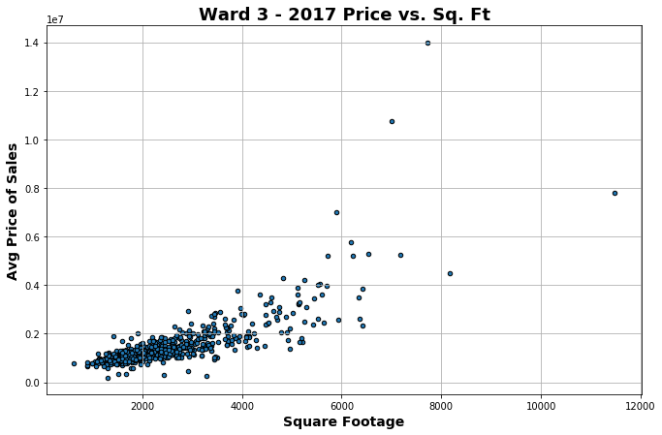
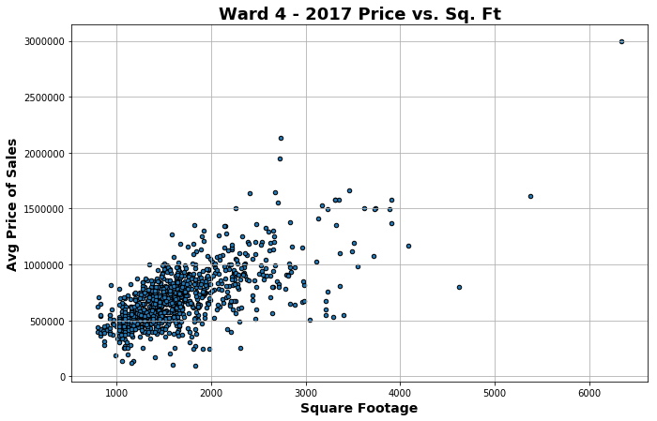
Sq. Footage by Northwest Wards
Finding: In 2017, Ward 4 had the greatest quantity of modest sized homes within a reasonable price point
Conclusion: Ward 4 offers greatest value within the most expensive quadrant (Northwest) serving as a natural hedge against extreme price fluctuations
Additionally, the price pt. is not a function of house condition

Slide 13
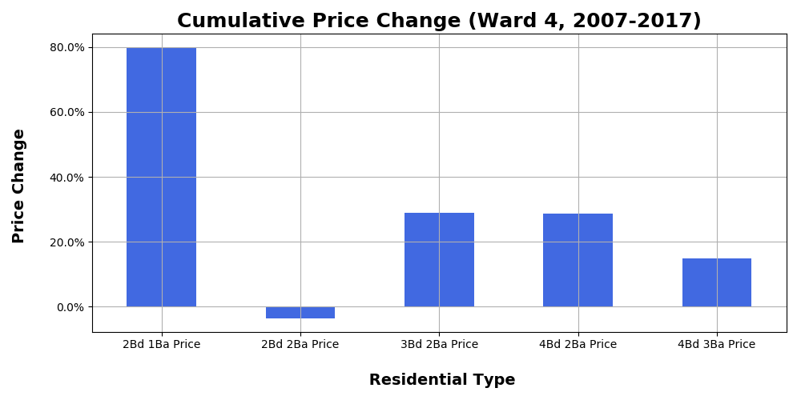
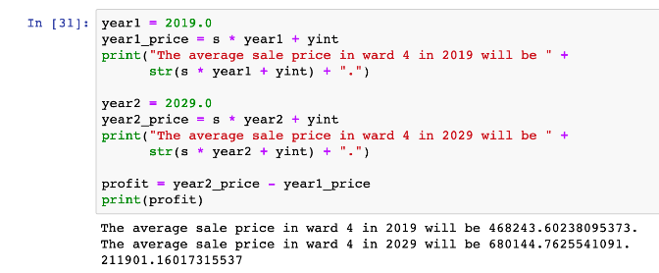
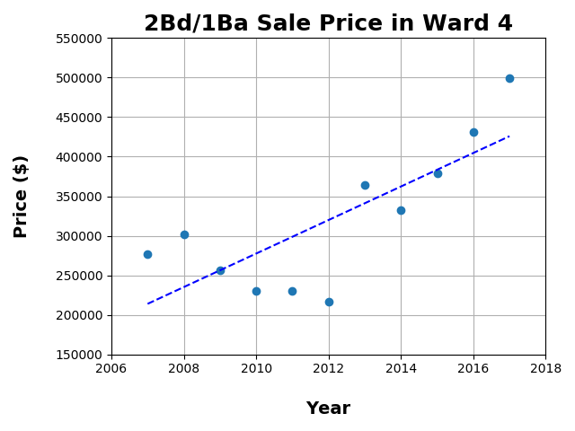
What to buy in Ward 4?
Finding: Over the last decade, a 2 bedroom, 1 bath has delivered far superior returns than any other bed/bath combination
Extrapolating this trend forward, we anticipate valuations of 2bed/1bath to coalesce around $468k this year, and $680k by 2029

Slide 14
Difficulty and Resolutions
After an initial glance of the data set, the group had a general idea of our proposed objective. However, with over 150,000 rows and over 20 columns of data, we were not sure whether the data had the capacity or which data to use to answer our objectives.
There were several difficulties in data cleaning between group members (such as extracting year our from a full date) and coordinating the generation of useful plots between members was challenging. This resulted in making several plots that were of no use to our defined objective.
To remedy these challenges, we scoped the data to be used in our analyses to quadrant and ward, which made our analysis much more manageable.
The group also had frequent communication (class, slack, checking out branches) to know what everyone was working on, and ensure that all of us were marching towards the goal of answering our objective and having presentable data analysis.

Slide 15
Additional Questions to Explore
It would have been interesting to look at the impact additional parameters such as acreage, year built, # of fireplaces have on price
We would have liked to overlay additional datasets such as crime and walkability scores to ensure Leo remains safe and gets his steps in.

