Slide 1
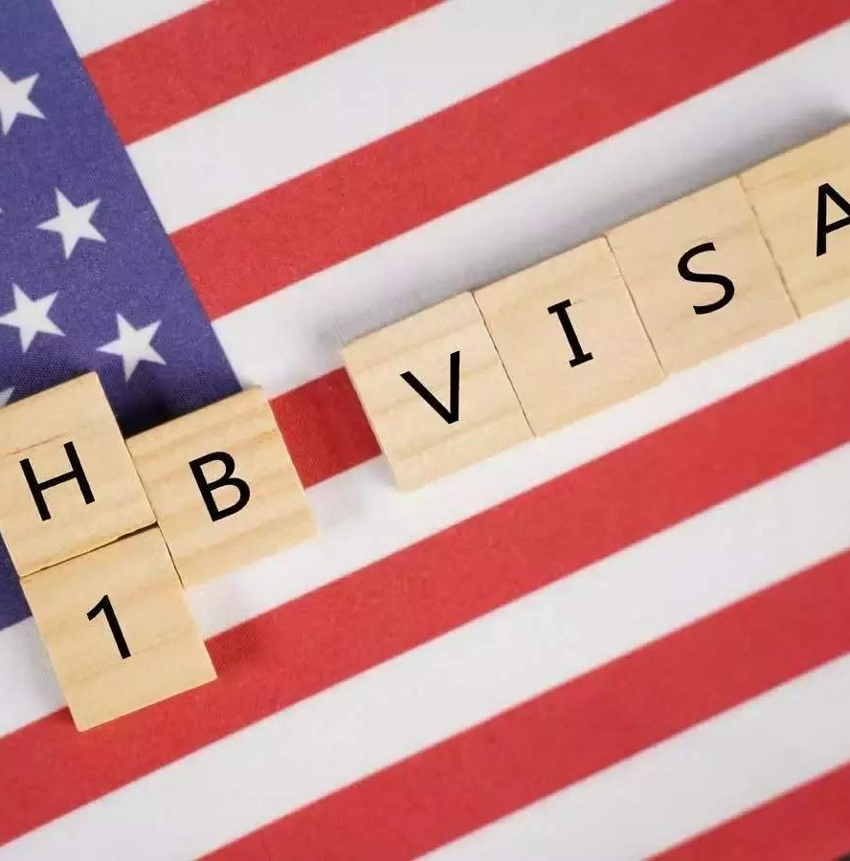
H-1B VISA PREDICTIONS
PREDICTING THE CASE STATUS FOR
H-1B APPLICANTS
By Team – The Elite(CMPE-255)

Slide 2
Introduction
The H1B Visa is a highly desired non-immigrant visa which permits foreign workers in specialty occupations to enter the country. H-1B visas are a category of employment-based, non-immigrant visas for temporary foreign workers in the United States.

Slide 3
Requirements
For a foreign national to apply for H1-B visa, a US employer must offer them a job and submit a petition for a H-1B visa to the US immigration department.
This is also the most common visa status applied for and held by international students once they complete college or higher education and begin working in a full-time position.

Slide 4
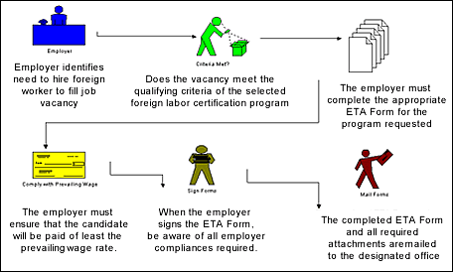
H-1B Application Steps
The first step of the H1B application process is for the U.S. employer to file the H1B petition on behalf of the foreign worker
In the second step, the prevailing and actual wages should be confirmed by the State Employment Security Agency.
The third step of the H1B application process is to file the Labor Condition Application.
The next step is to prepare the petition and file it at the proper USCIS office.

Slide 5
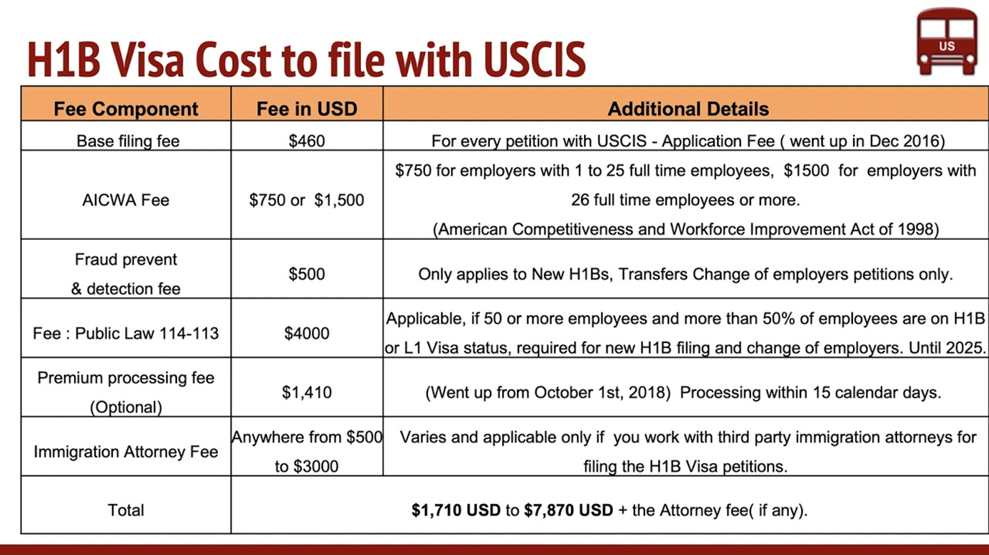
H-1B Processing Time
Processing times for H1B application petitions are subject to vary from location to location.
If you would like your petition expedited you may elect for premium processing.

Slide 6
Predicting H-1B status using ML Classifier
Machine learning (ML) is a category of algorithm that allows software applications to become more accurate in predicting outcomes without being explicitly programmed. The basic premise of machine learning is to build algorithms that can receive input data and use statistical analysis to predict an output while updating outputs as new data becomes available.

Slide 7
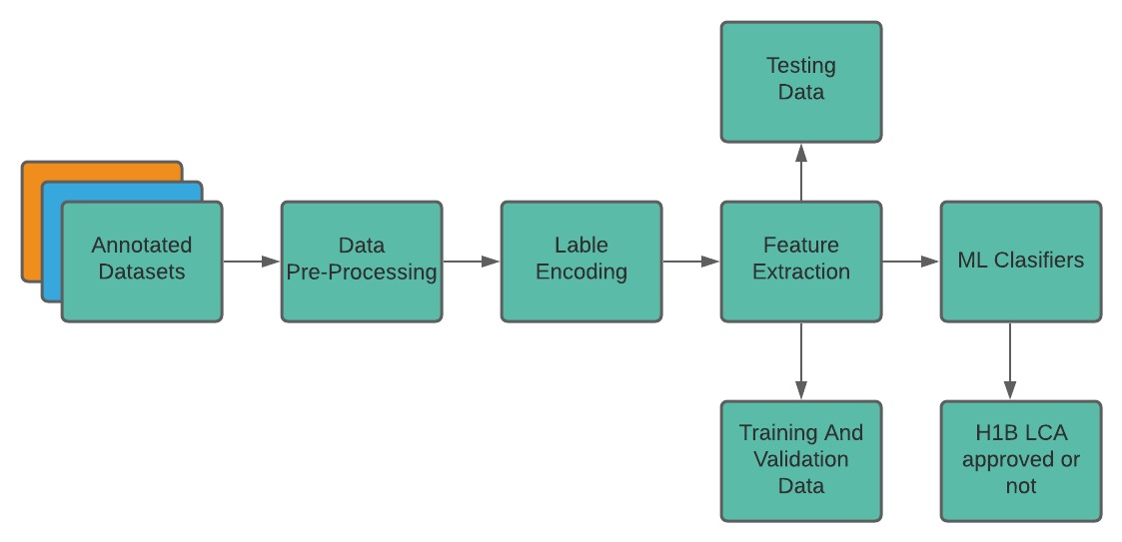
ML Pipeline

Slide 8
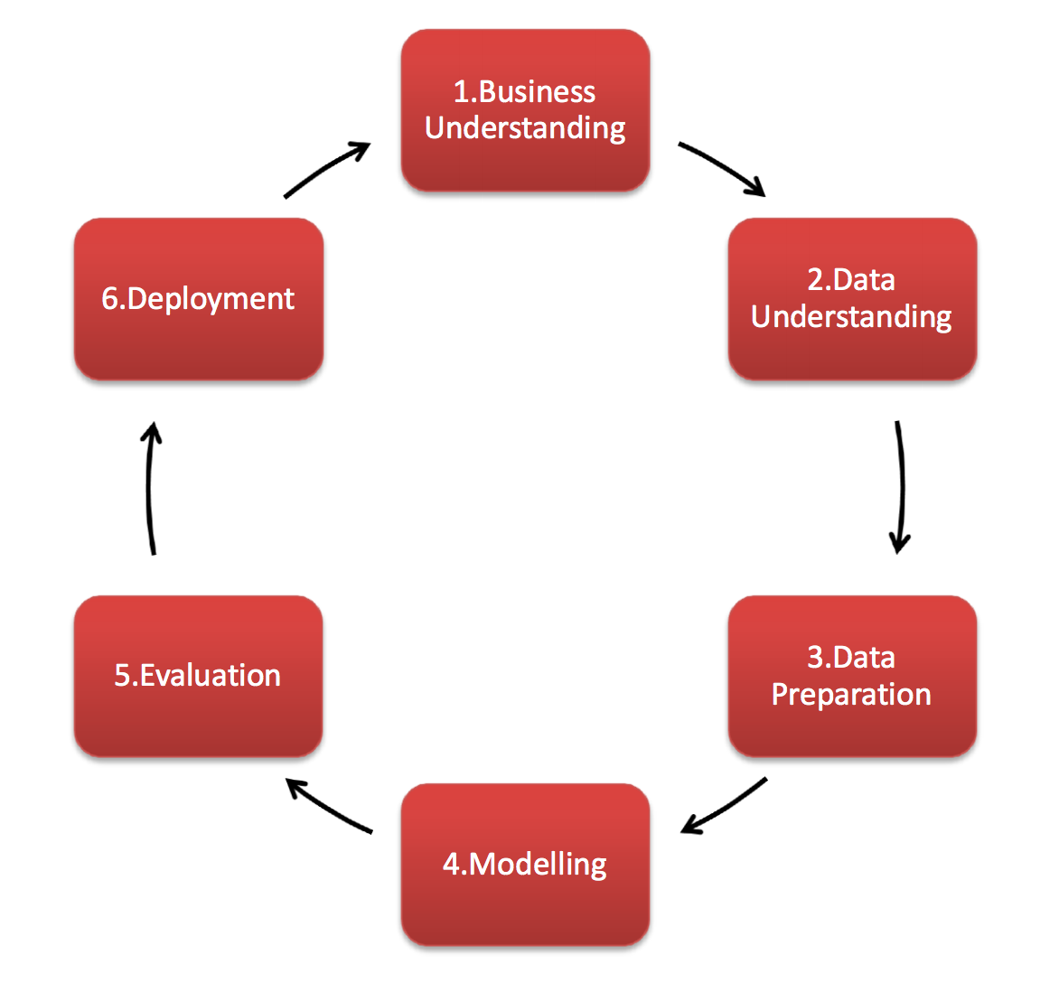
CRISP – DM Stages

Slide 9
STAGE ONE – DETERMINE BUSINESS OBJECTIVES
The goal of this stage of the process is to uncover important factors that could influence the outcome of the project. Neglecting this step can mean that a great deal of effort is put into producing the right answers to the wrong questions.

Slide 10

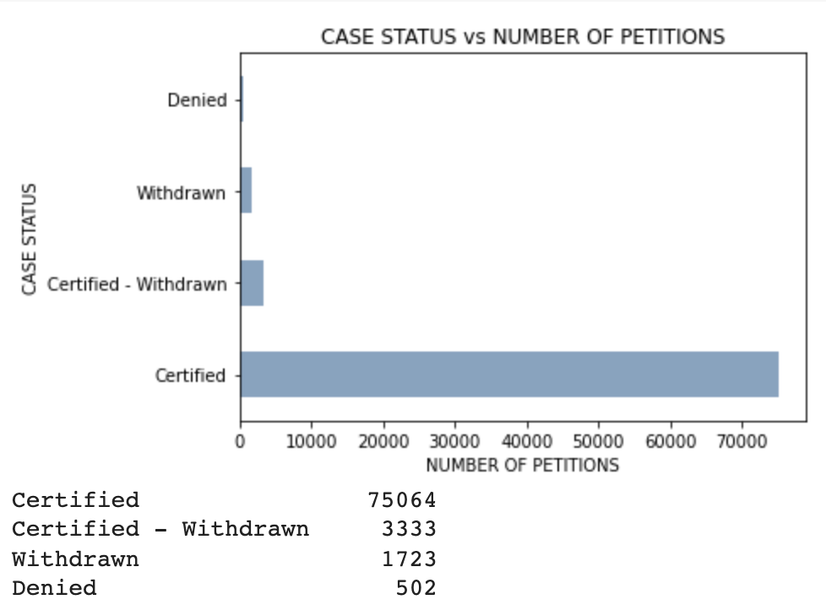
STAGE TWO – DATA UNDERSTANDING

Slide 11

STAGE THREE – DATA PREPARATION
Filter only the required columns into the dataframe, which will be our input to the model.
Checked any null values present in the records.
Converting categorical values of fields WILLFUL_VIOLATOR,SUPPORT_H1B, H1B_DEPENDENT etc, into numerical values for the model training. Also replacing null values with the majority entries.

Slide 12
STAGE FOUR – MODELLING
AdaBoost, Naïve Bayes, QDA
Neural Net, XG, Linear Regression
Decision Tree
Random Forest
Nearest Neighbors

Slide 13
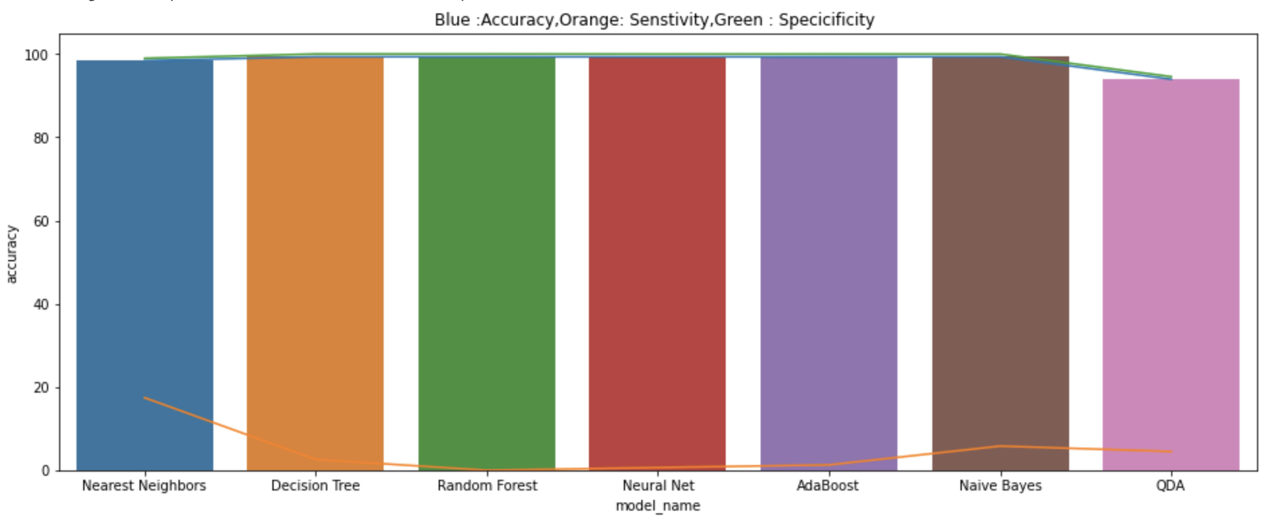
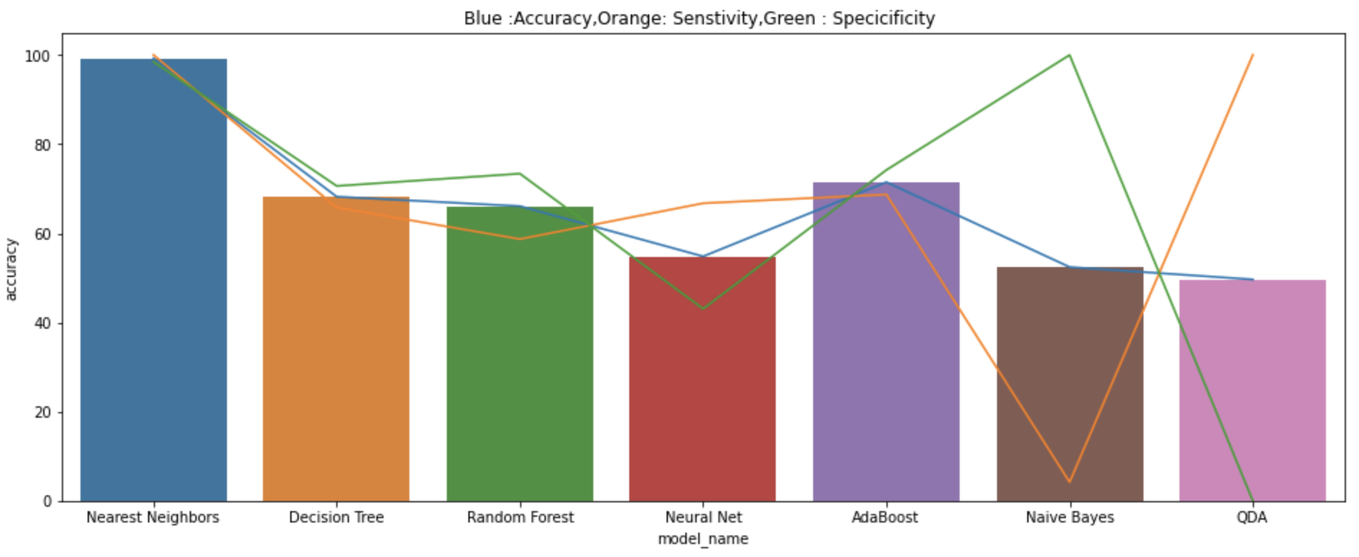
STAGE FIVE – EVALUATION

Slide 14
STAGE SIX – DEPLOYMENT
Application Deployed AWS EC2
Technology Used – Django app

Slide 15
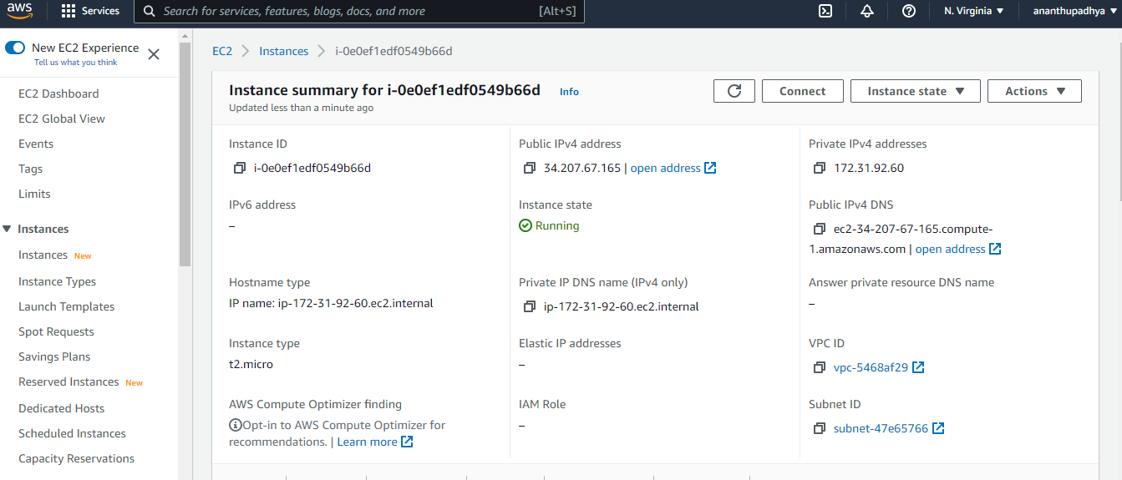
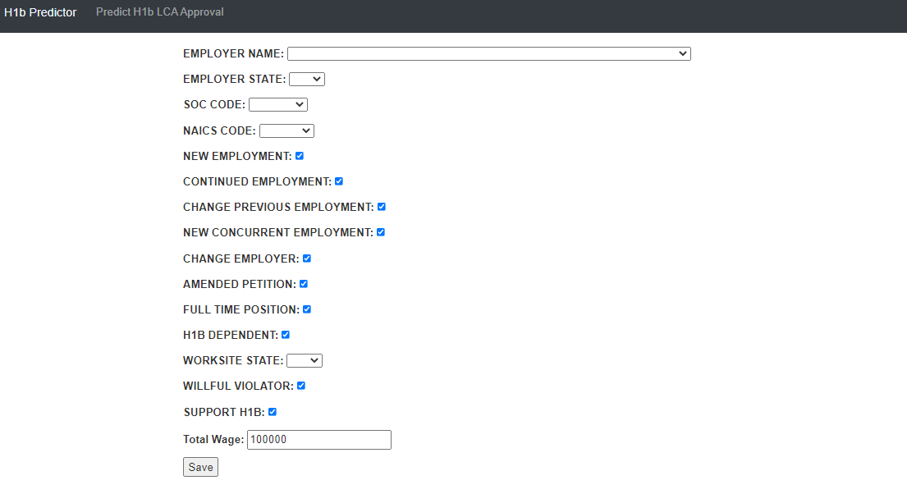
AWS Deployment

Slide 16
Conclusion
H1B Lottery prediction would be highly beneficial for all those H1B aspirants as it would indicate the possibility of their chances of making it to the lottery. The H1B lottery system in USA has been highly competitive and is very vital for one to continue their employment in USA and our H1B-Predictor tool would help all those H1B aspirants.

Slide 17
Future work
At present we do not have dataset related to the nationality of the employer and we have also not considered social media profile and activities as stated in the new policies. If the dataset will be available in future, then we can also take into consideration nationality, social media status to improve the accuracy and give a better prediction.

Slide 18
References
A.Dombe, R.Rewale, D.Swain (2020, March 24), A deep learning-based approach for predicting the outcome of H-1B Visa application
Brownlee, J. (2020, July 24), Train-Test Split for Evaluating Machine Learning Algorithms, https://machinelearningmastery.com/train-test-splitfor-evaluating-machine-learning-algorithms/
Jhanji, D. (2018, June 20), Predicting the status of H1B Visa Applications, https://www.datacamp.com/community/tutorials/predicting-H-1B-visastatus-python

