Slide 1
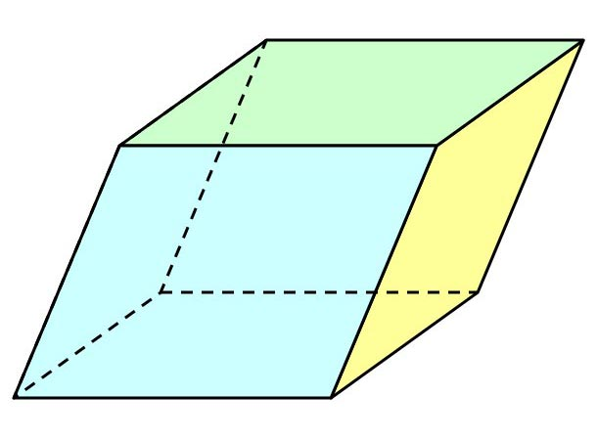
Deon Desir
I really enjoy design
Almost the end of semesteer

