Slide 1

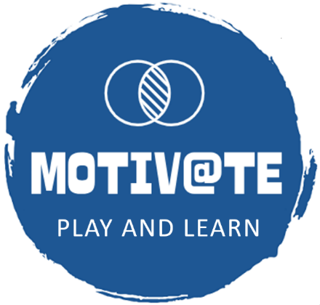


A Serious Game for Teaching Entrepreneurship and Strategic Management
https://i-metode.fmi.uni-sofia.bg/bg
Boyan Bontchev, Sia Tsolova, and Dessislava Vassileva
Faculty of Mathematics and Informatics,
Sofia University “St. Kliment Ohridski”, Bulgaria
FedCSIS 20th Conf. on CS and Intelligence Systems,
Krakow, Poland
September 14, 2025

Slide 2
Agenda
Challenges in designing serious games (SG) for learning
Tailoring SG for learning
Issues of personalization
Recognition of playing styles – the “Rush for Gold” game
Personalization based on learning styles – the STRAMAG game
Lessons learned
Trends in usage of AI for personalization and adaptation of SG
Conclusions

Slide 3
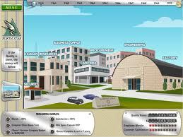
Serious Games (SGs)
3
Digital interactive applications that allow users to create specific experiences that promote active and experiential paths of learning in various domains of human existence,
through virtual/augmented simulations
through ludic and playful formats
“A serious game or applied game is a game designed for a primary purpose other than pure entertainment” (Abt, 1970)
“A serious game is a digital game in which education is the primary goal, rather than entertainment” (Micheal & Chen, 2006)
SGs enable self-controlled, active, and playful learning
Notes:
3

Slide 4
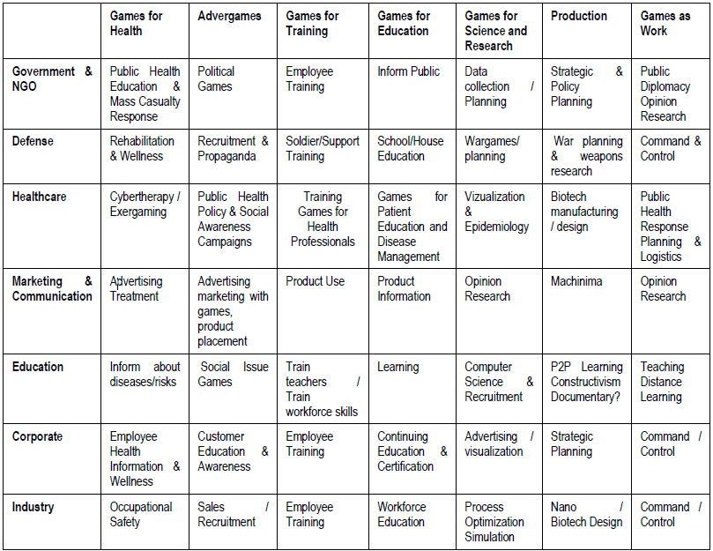
A Taxonomy of Serious Games
Source: Sawyer and Smith, 2008

Slide 5
Serious Problems with the Serious Games
Higher development cost
Lower attractiveness compared to entertainment games
Transition between instructional design and actual game design implementation – how Game Mechanics impact and interact with the Learning Mechanics
Assessment – effectively tracking and analyzing the right parameters related to learners’ progress (knowledge gain, reflection, and application)
How psychological theories should be used in the design of realistic and convincing non-player characters (NPCs)?
How different pedagogical paradigms relate to tailoring SG and their mechanics – by personalization and adaptation!
D1.6 GALA Roadmap 2, Nov. 2011

Slide 6
Goals of Personalization & Adaptation of SG 1/3
Individualized learning pace
Why: Learners differ in prior knowledge, skills, and cognitive load capacity.
How: Adaptive difficulty adjusts tasks, feedback, and prompts to match the learner’s current level, reducing frustration and boredom.
Targeted content and scaffolding
Why: Not all learners need the same support simultaneously.
How: Personalization curates challenges and hints based on learner strengths, weaknesses, and learning goals, providing more support and resolving more complex problems where appropriate.
Enhanced motivation and engagement
Why: Engagement is critical for sustained practice and transfer of learning.
How: Personalization can align game scenarios with the learner’s interests, provide meaningful goals, and offer adaptive feedback that feels relevant and rewarding – by keeping the learner/player in flow.

Slide 7
Goals of Personalization & Adaptation of SG 2/3
Improved cognitive load management => better learning outcomes
Why: Overly complex or too simple tasks can hinder learning.
How: Adaptation helps keep cognitive load within an optimal zone (the “zone of proximal development”), balancing novelty and support.
Just-in-time feedback and reflection
Why: Timely feedback reinforces correct strategies and corrects misconceptions.
How: Adaptive systems deliver feedback tailored to the learner’s current misconceptions and shown performance, plus reflection prompts aligned to content mastery.
Personalized mastery pathways
Why: Learners have different goals and trajectories.
How: Systems map learning progress and suggest personalized challenges, practice sets, or remediation as needed.

Slide 8
Goals of Personalization & Adaptation of SG 3/3
Culturally and demographically responsive design
Why: Diverse backgrounds influence prior knowledge and engagement preferences.
How: Personalization can incorporate culturally relevant scenarios, examples, and language registers to improve relevance and accessibility.
Better assessment and diagnostics
Why: Traditional one-size-fits-all assessments can miss a nuanced understanding.
How: Adaptive assessments infer a learner’s competencies, misconceptions, and knowledge gaps more precisely, guiding both the game experience and external instruction.

Slide 9
Personalization in Video Games for Education
Personalized learning environments are related to efforts to tailor the educational process to meet the different needs of learners. (Murphy, 2016)
User-centered tailoring of educational video game – based on individual and/or group player characteristics such as needs, goals, previous experience, outcomes, learning/playing styles, etc.
Personalization of gaming/learning content, gameplay (incl. game mechanics and dynamics), audio-visual effects, etc.;
Implemented in a static, dynamic, or hybrid way, providing personalized learning experiences.

Slide 10

The Personalization Model
Learning content
Learning style metrics
Learning styles
Learner
Learning performance and efficiency (solved tasks, grades, and gained knowledge)
Choice of predefined properties
Preferences
(age, goals, needs, and initial knowledge)
Performance indicators
Game tasks & GUI
Help and feedback

Slide 11
Core Aspects of Personalization
Learner profiling:
Collects data on knowledge level, learning pace, interests, and behavioral patterns (e.g., time spent, trials and errors made).
Uses techniques like knowledge tracing and cognitive diagnostics to model learner strengths/ weaknesses.
Customized content delivery to match learning preferences:
Adjusting content type (text, visuals, simulations, etc.), learning paths, contextual hints, rewards, and/or corrective guidance tailored to the learner’s needs and preferences.
Approach: static, dynamic, or hybrid.
Multimodal engagement – combined text, audio, visual, and interactive elements.
3. Realization:
The learner actively shapes their own learning experience.
The system supports or enables learner-chosen preferences, goals, and paths.
Emphasizes learner agency, identity, and motivation.

Slide 12
Adaptation in Video Games for Education
Adaptation:
Is directed to dynamic changes to the gameplay according to the player/learner model
The tasks’ difficulty and other game features are tailored to the changes in the properties of the individual player
Games conformed to the specific dynamic changes of different individual learners
Realization:
The system automatically adjusts the learning experience based on the learner’s data.
The goal is to optimize learning outcomes by aligning content, difficulty, pacing, or feedback to the learner’s needs.
Emphasizes system-driven transformations rather than learner control.
Dynamic but not static or hybrid

Slide 13

Player-Centric Adaptation in SG
Our vision at player-centric adaptation in SG aims at investigating how:
cognitive abilities (the cognitive part),
psycho-emotional status (the affective part) and
playing style (the conative part – that of “desire, volition, and striving”)
can be used in a holistic approach for efficient and effective player-centric adaptation

Slide 14
The Adaptation Model
Game dynamics
Player style metrics
Playing styles
Player
Playing performance and efficiency (abilities, skills and knowledge)
Emotional
indicators
Emotions
(flow, immersion &
intrinsic
motivation)
Performance indicators
Game aesthetics
Game mechanics

Slide 15
Learning / Playing Style
Learning style – “characteristic cognitive, effective, and psychosocial behaviors that serve as relatively stable indicators of how learners perceive, interact with, and respond to the learning environment”. (Curry, 1981)
Playing style – persistent traits of the player, whereas defined play styles as treating “motivations as a more temporary state, with an implication that players may adopt different play styles in different games or at different times”. (Magerko et al, 2008)

Slide 16
Style Models
Relationships between Honey and Mumford (1982) learning styles and playing styles of ADOPTA (Bontchev et al., 2018) and Bartle (1996)
Honey and Mumford | Learns by: | ADOPTA | Bartle
Activist | hand–eye coordination, planning and strategizing, problem-solving, teamwork and the ability to think quickly | Competitor | Killer
Theorist | logically entering problems step-by-step, with spatial awareness and verbal & numeracy skills | Logician | Achiever
Pragmatist | planning, decision-making, testing hypotheses, strategic thinking, management skills | Strategist | Explorer
Reflector | Observing and watching reflectively | Dreamer | Socializer

Slide 17
Player Style Measurement
Explicitly through self-report (Bontchev et al, 2018)
A 40 items questionnaire for measuring Competitor, Dreamer (Discoverer), Logician and Strategist style of playing
To be experimented together with the 40 items questionnaire for measuring Honey and Mumford learning styles
Implicitly during game time of playing specific mini-game (Bontchev & Georgieva, 2018)
Based on player’s metrics for specific game tasks including performance (result), efficiency (result/effort), task difficulty and play time
Linear regression coefficients found by qualitative study (structured interviews with gamers)

Slide 18
Adaptable Game Features 1/3
1. Adaptive automation of game tasks (and feedback for next experiments):
explicit tasks - game objectives (to shoot/discover gold bullions or to solve puzzles), adapt to the gameplay;
implicit tasks - not explicitly stated by the game interface but expected to be fulfilled:
Maximize your skills in shooting, discovering, solving, and strategic planning of activities
Collect as many gold bullions as possible
player-driven tasks - created by the player thanks to his/her creativity within the existing limitations of given game mechanics and leading to so-called emergent gameplay
How to find the best position for shooting (depends on gun height and shooting angle)
How to explore the temple with changing visual properties

Slide 19
Adaptable Game Features 2/3
2. Dynamic Difficulty Adjustment (DDA):
DDA by means of automatic level generation - uses methods for procedural content generation
Logic puzzles have dynamically increased their difficulty with higher player results and vice versa
DDA by means of adjusting level content, i.e., game items for player interactions – means dynamic adaptation of the level of inventory interacted by the player for a specific game context, according to the player’s skill acquisition:
Hidden billions are more challenging to find with player progress and higher affect (they are moved to more hidden places)
Flying bullions change velocity & acceleration, plus striking force changes with player efficiency, as well as with the player´s emotions

Slide 20
Adaptable Game Features 3/3
3. Adaptation of audio-visual effects:
according player´s affect (both emotions and arousal) using thresholds of happiness, fear, surprise and disgust level, there are adapted :
ambient illumination change
focus and contrast of game objects such as puzzle panels, buttons, gold bullions, statues, etc.
the volume of sound

Slide 21
Case study 1 – “Rush for Gold” game
A 3D video game using adaptation based on player performance, efficiency and emotional state using the FACE web service of SightCorp (https://face.sightcorp.com/)
Developed by using Brainstorm eStudio (http://www.brainstorm.es/products/estudio/)
Allows implicit recognition of ADOPTA playing styles in order to validate them to ones calculated by using self-report. The implicitly found style will be used for automatic selection of learning content appropriate to that style.
Goal: to collect 12 bars of gold (bullions), which are flying, hidden or inside logic puzzles needed to be solved, all located in a 3D Egypt temple with enhanced audio-visual effects being object of adaptation, as well.
The player can use a Strategy Management Table (SMT):
represents a table with three rows for planning the number of bars of the three groups available in the game
contains data about the average effectiveness of performance in collecting the gold bars of each group, useful for building a strategy for an optimal way of play.

Slide 22
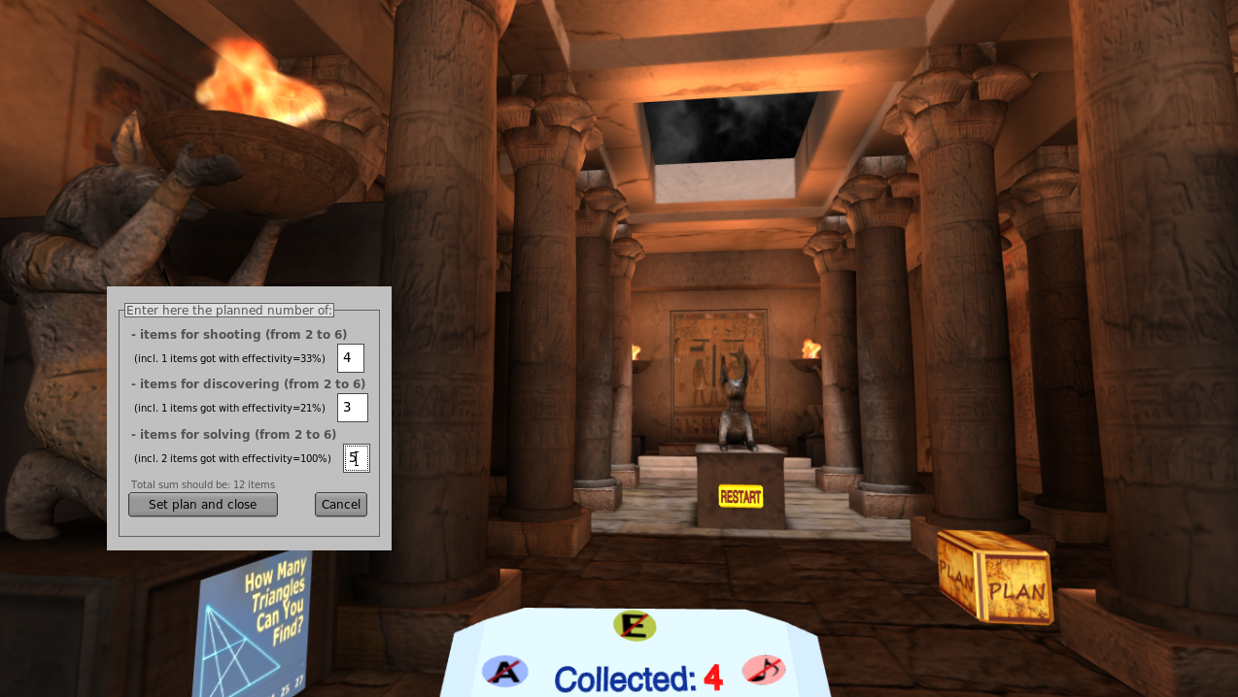
Rush for Gold

Slide 23
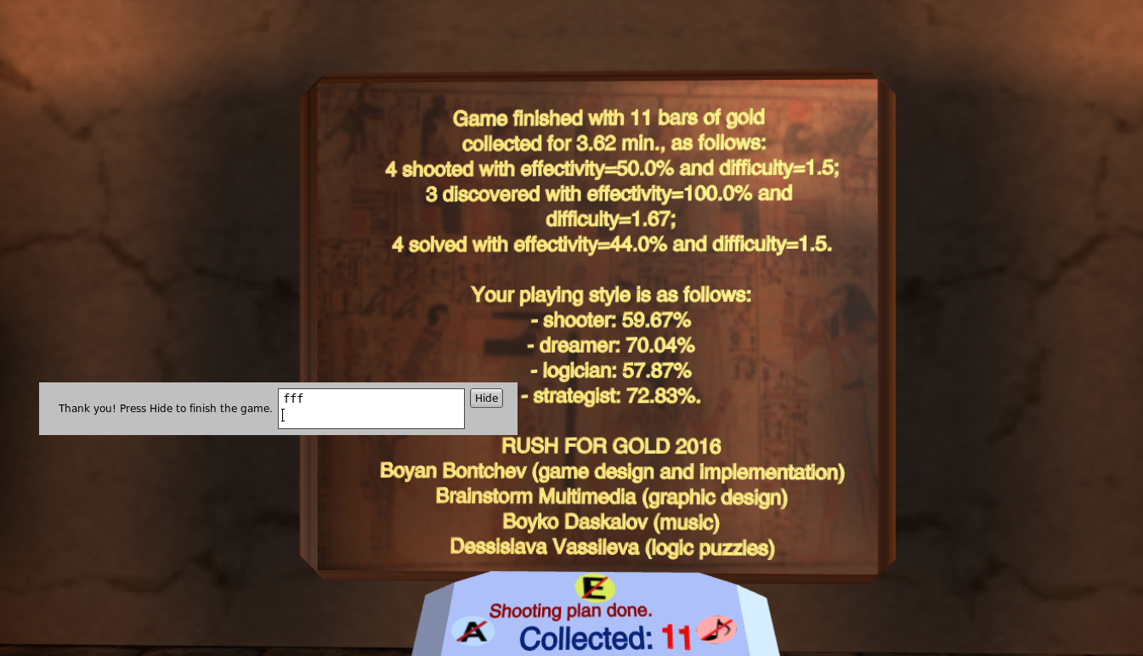
Player Style Measurement
Implicitly during play time of specific mini-game
Based on player’s metrics for specific game tasks:
Performance (result)
Efficiency (result/effort)
Task difficulty
Play time
SMT updates & views (for Strategists)
Rush For Gold, part 2 - https://www.youtube.com/ watch?v=aJe61bUDE40

Slide 24
Case Study 2 –STRAMAG Game
An experiment by playing an action 3D video game for recognition of playing styles and, next, STRAMAG education game with learning content adapted both to styles and affect of the player, plus questionnaires about:
Demographic data – 5 items
Playing style – 40 items
Game engagement questionnaire (GEQ) – 19 items
Attention, relevance, confidence, and satisfaction (ARCS) questionnaire – 15 items – all applied for:
Enhanced recognition of individual playing style using specific game metrics and compared it to the style measured by self-report
A positive effect of affect-based adaptation over:
player´s engagement and attention
learning outcomes
Preference of adaptation control – adaptation strength and affective feedback direction

Slide 25
Results about Playing Styles
Explicitly measured though self-report
40 item questionnaire for measuring Competitor, Dreamer (Discoverer), Logician and Strategist style of playing – filled by 312 subjects, Cronbach alpha 0.527, 0.557, 0.711 and 0.572.
High correlations (r=0.806, 0.778, 0.879, 0.619; p<0.01) between these playing styles and Honey and Mumford learning styles
Implicitly during game time of playing specific mini-game
For playing styles found by linear regression using player´s metrics and coefficients found by qualitative study (structured interviews with gamers) – high correlations with self-reported styles (r=0.802, 0.779, 0.873, 0.633 for C, D, L and S styles; p<0.001)
For regression model coefficients estimated by the least squires method – higher correlations with self-reported styles (r=0.827; 0.792; 0.882; 0.713 for C, D, L and S styles; p<0.001)

Slide 26
Case Study Set-Up
Affectiva SDK
Emotion recognizer
RAGE arousal asset
RAGE arousal asset
.NET
USB
TCP sockets
Brainstorm eStudio
Rush for Gold
STRAMAG maze
3D quiz assessment
Rooms
Rooms
3D zoom ordering
Rooms
Rooms
Rooms
Tunnels

Slide 27
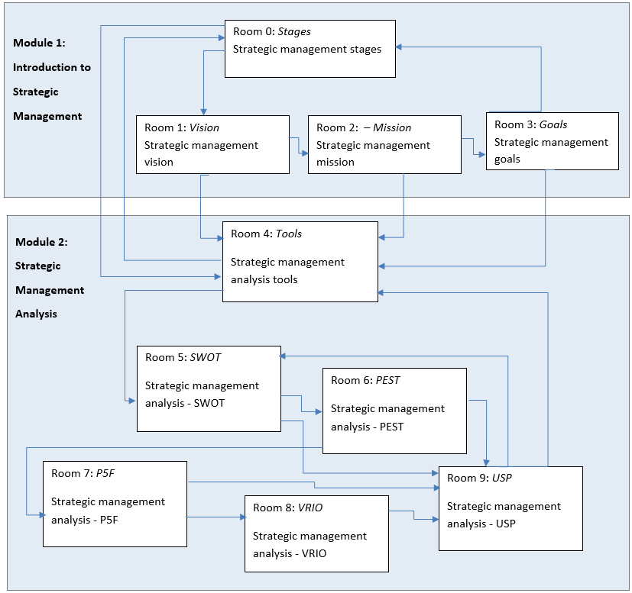
The maze structure of STRAMAG (STRAtegic MAnagement Game)

Slide 28
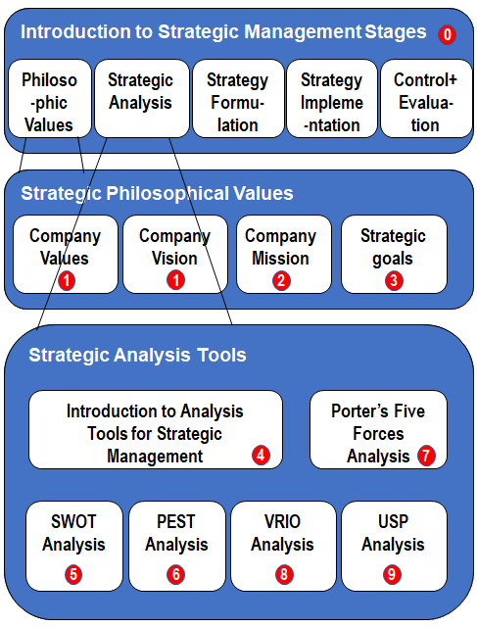
Content Distribution Across Maze Game Rooms

Slide 29
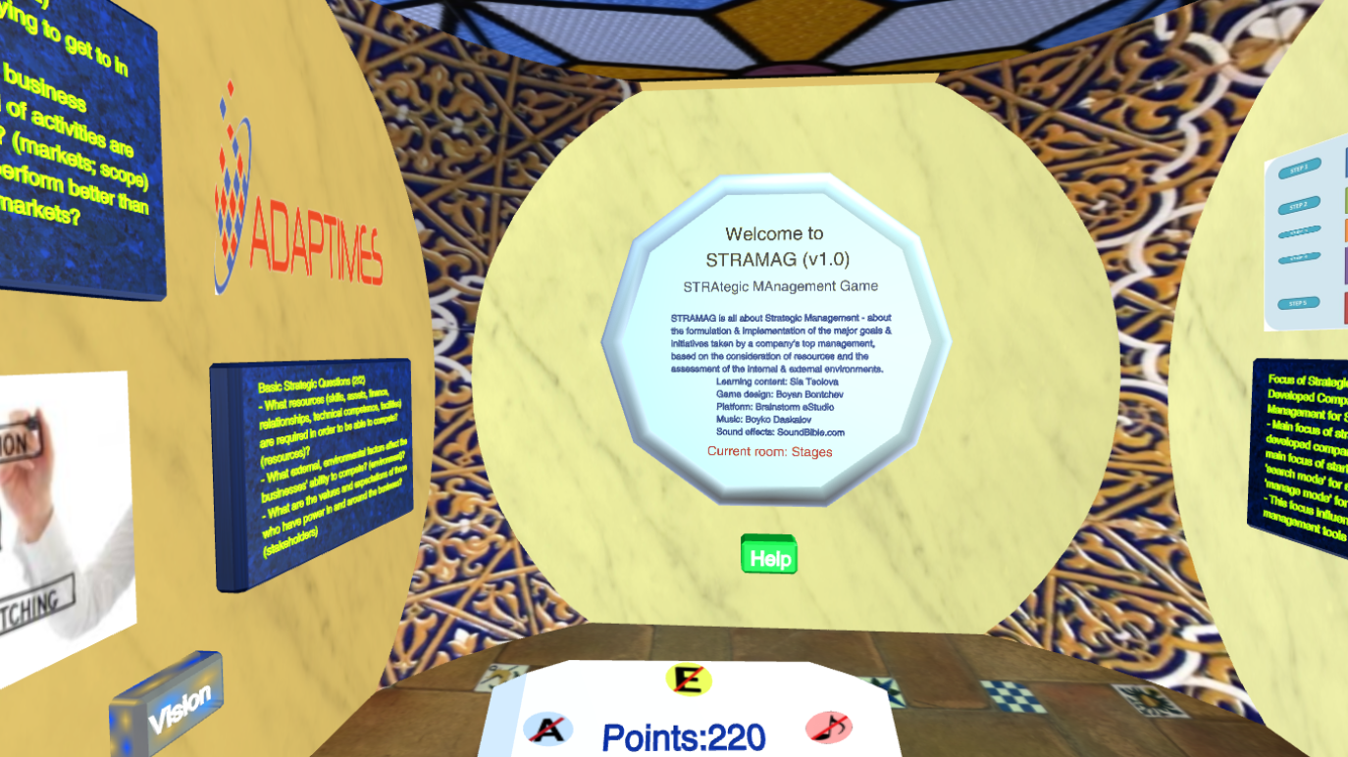
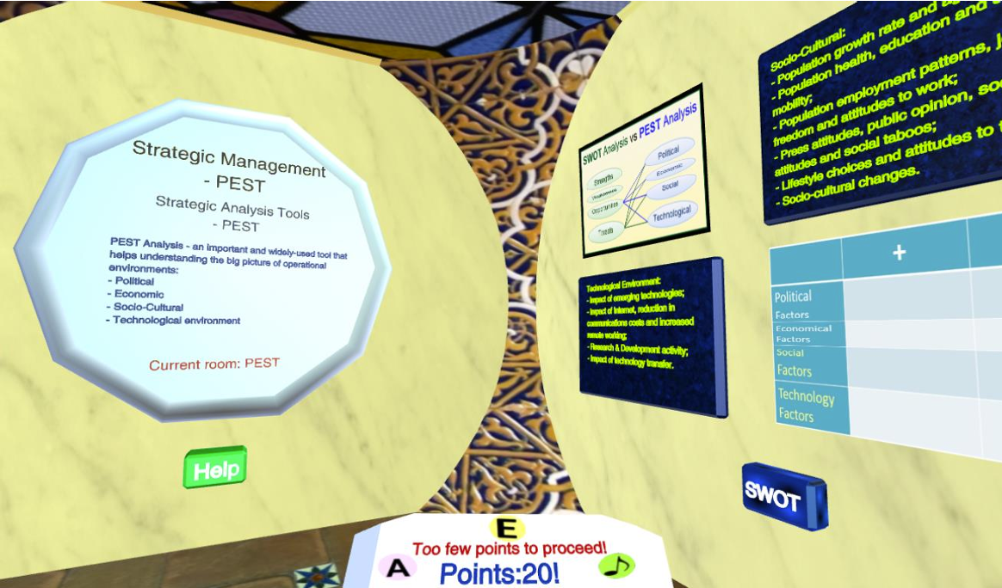
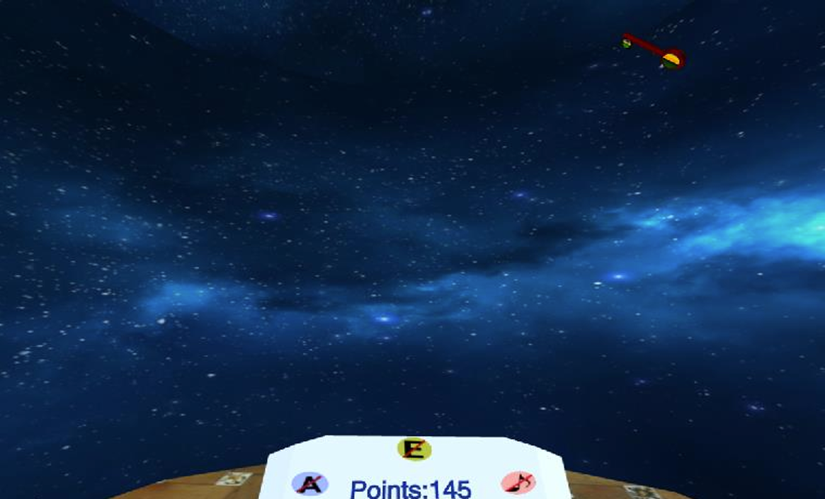
Rush For Gold (playing style found)
STRAMAG maze game – central room
The PEST room
A shooting room with a flying key

Slide 30
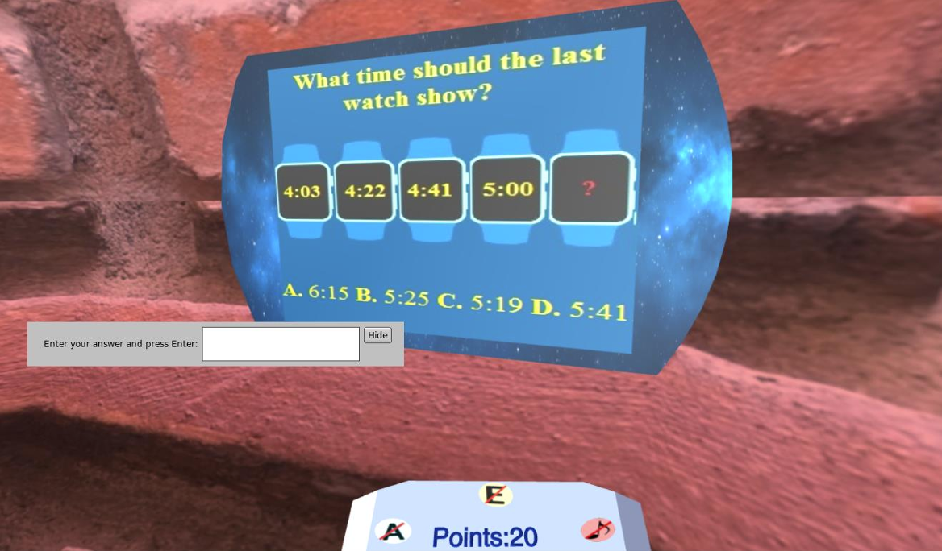
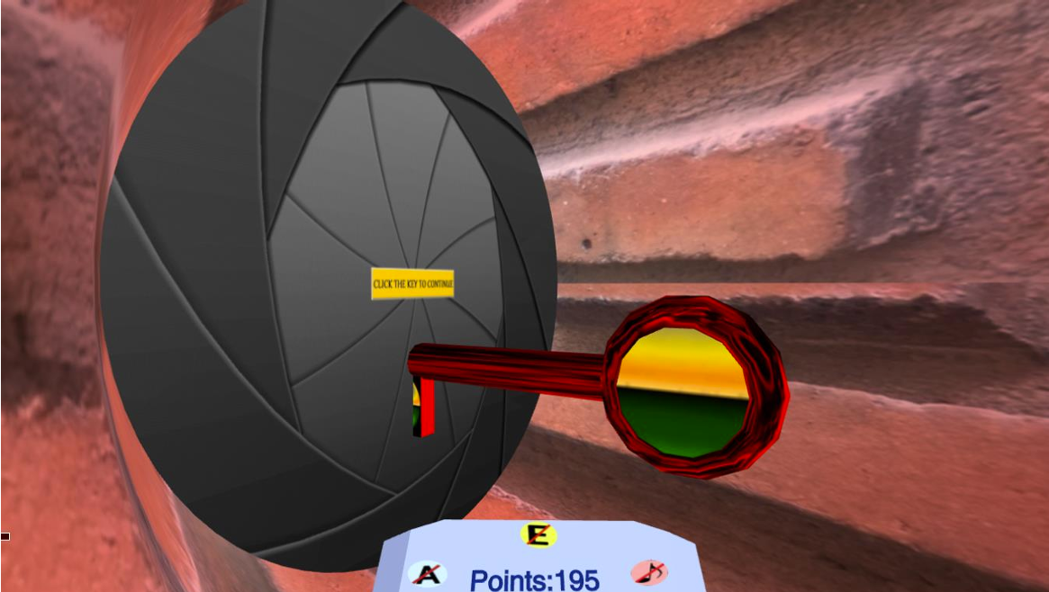
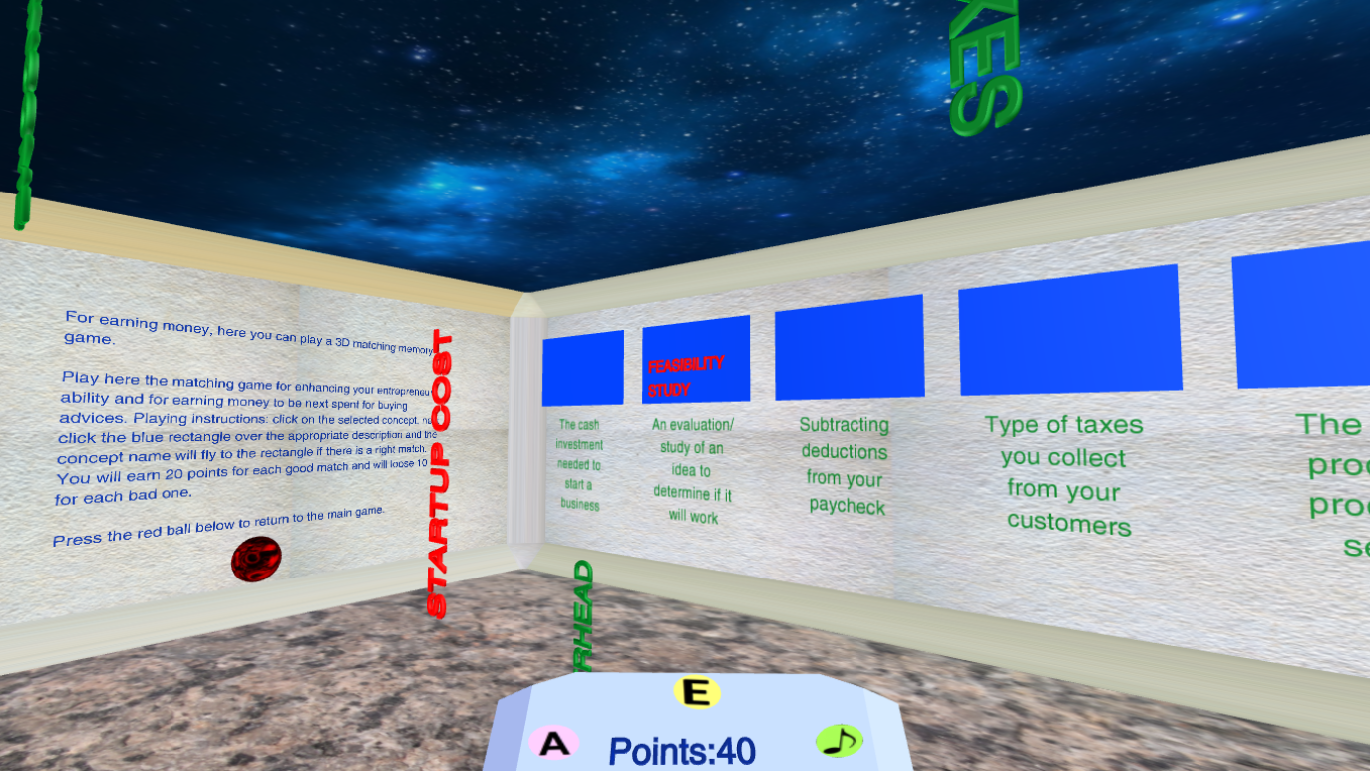
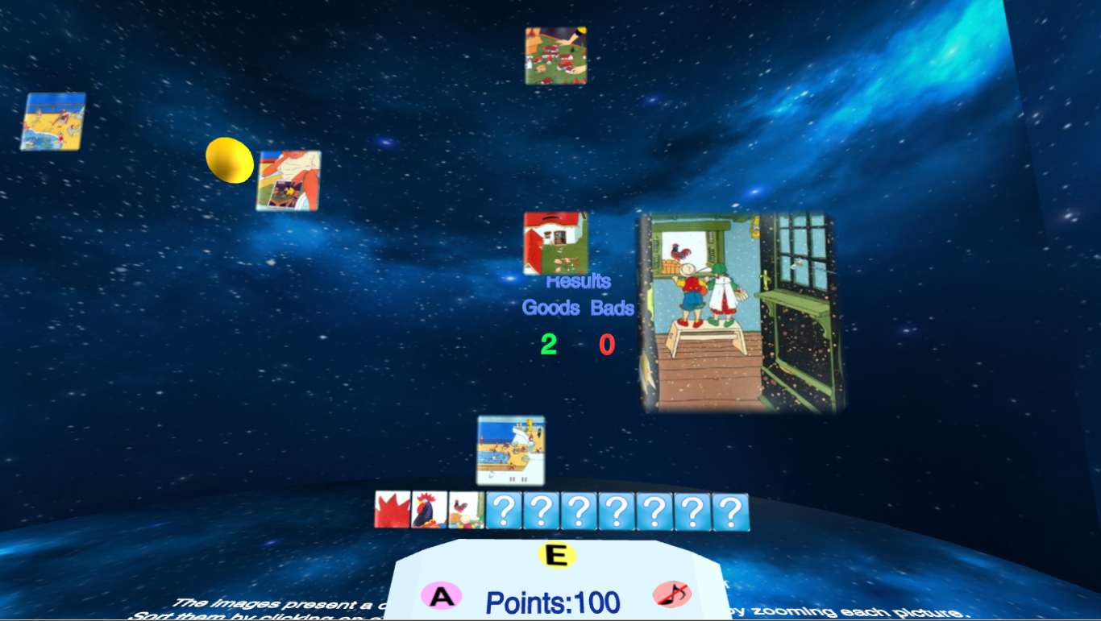
Solving a puzzle to unlock a tunnel
Unlocking a tunnel
3D quiz (assessment)
3D zoom puzzle
FedCSIS'25
A Serious Game for Teaching Entrepreneurship and Strategic Management

Slide 31
Game Experience Questionnaire (GEQ) – Mean Values for 3D Maze, Quiz, and Zoom Games
Dimension | Questions | 3D Maze | 3D Quiz | 3D Zoom
Competence | 2, 10, 15, 17, 21 | 3.91 | 3.74 | 4.09
Immersion (sensory & imaginative) | 3, 12, 18, 19, 27, 30 | 4.35 | 4.13 | 4.17
Flow | 5, 13, 25, 28, 31 | 3.70 | 3.96 | 3.87
Tension/ Annoyance | 22, 24, 29 | 2.32 | 2.04 | 2.17
Challenge | 11, 23, 26, 32, 33 | 2.09 | 2.17 | 2.26
Negative Affect | 7, 8, 9, 16 | 2.14 | 2.06 | 2.36
Positive Affect | 1, 4, 6, 14, 20 | 3.96 | 3.74 | 4.09

Slide 32
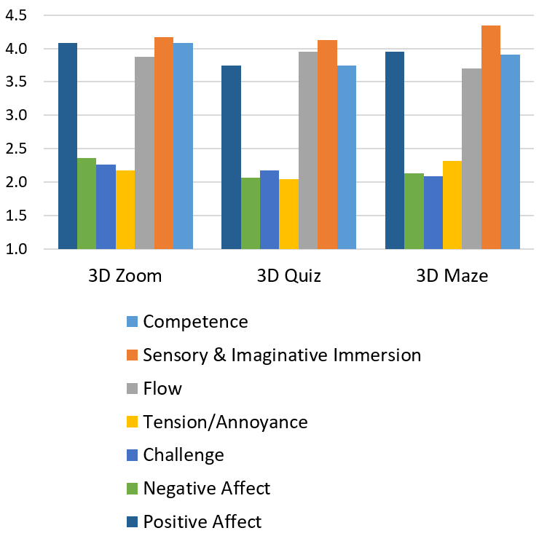
GEQ Responses for 3D Maze, Quiz, and Zoom Games

Slide 33
Lessons Learned
Player-centric adaptive gameplay possesses essential advantages compared to non-adaptive gameplay
The synergy of using players´ performance, emotions, and playing styles is very promising
All they are identified in an implicit way at run time and used for adapting game mechanics, dynamics, and audio-visual content, in a dynamic and implicit way
Emotion-based adaptations affect game experience and playability, learning outcomes, and consequences of flow

Slide 34
Personalization vs Adaptation – Who Drives the Decisions and How?
 | Personalization | Adaptation
Decision Driver | Decisions are primarily driven by the learner. Examples: selecting topics, choosing difficulty level, setting learning goals, choosing interface themes, or opting into certain feedback styles. | Decisions are driven by the system (often using analytics, assessments, or models). Examples: dynamically changing task difficulty, routing to prerequisite content, adjusting pacing, or modifying feedback based on performance.
Customi-zation Subject | Customization of user experience and learning objectives. Includes preferences, goals, and self-directed sequencing. | Customization of instructional design elements to fit the learner’s performance profile. Includes difficulty, tasks, hints, pacing, feedback type, and resource scaffolding.

Slide 35
Personalization vs Adaptation – Goals, Outcomes, Design, and Evaluation
 | Personalization | Adaptation
Goals and Outco-mes | Enhances motivation, engagement, autonomy, and relevance. Supports individual preferences and self-regulated learning. Often aims to improve long-term engagement and persistence. | Seeks to maintain an appropriate challenge and optimize knowledge construction. Often evaluated via learning gains, retention, and mastery.
Design & Evalua-tion | How to authentically capture learner preferences without overwhelming them. Balancing autonomy with seamless guidance | Transparency and explainability of adaptive decisions (to avoid confusion). Evaluating learning outcomes, not just engagement.
Common for both:
Validity and reliability of the learner model
Measuring satisfaction, perceived relevance, and motivation (plus fairness across diverse learners)

Slide 36
Personalization vs Adaptation – Data and Signals Used
 | Personalization | Adaptation
Data and Signals | Signals are typically explicit and user-driven (e.g., chosen topics, preferred feedback style, accessibility options). May also incorporate inferred preferences from past behavior, but the learner has control to adjust. | Signals are primarily inferred from learner data (e.g., response accuracy, response time, knowledge state, engagement metrics, gaze data in some setups). Often relies on models (e.g., mastery learning, Bayesian Knowledge Tracing, reinforcement learning) to guide changes.
Examples | Allowing learners to choose which subject modules to study. Letting users select the level of hints or the type of feedback (textual vs. visual). Choosing the game’s visual theme or avatar, or selecting whether to learn via stories, simulations, or practice modes. | Increasing/decreasing task difficulty based on accuracy & speed. Providing tailored remediation tasks when a learner struggles with a concept. Reordering or routing content to address specific knowledge gaps (adaptive mastery paths). Changing pacing or presentation format (e.g., from text to video explanations) in response to engagement signals.

Slide 37
AI for Smart A&P: Data Sources and Signals
Performance data: task success/failure, time on task, error types, hint usage, and retries.
Behavioral data: action sequences, decision patterns, gaze or click streams (when privacy/tech allows).
Learning state proxies: inferred mastery levels, misconceptions, cognitive load estimates.
Affective and engagement signals: engagement trends, frustration indicators (e.g., rapid error bursts, hesitation).
Contextual data: learner goals, prior knowledge, role preferences, accessibility needs.
Environmental data: device capabilities, network conditions, time-of-day.

Slide 38
AI for Smart A&P: Modeling Approaches 1/2
A. Knowledge tracing and mastery estimation
Bayesian Knowledge Tracing (BKT) and Deep Knowledge Tracing (DKT) - for building temporal models of student learning: estimate a learner’s mastery of skills over time.
Outcome-aware models: incorporate hints, scaffolds, and feedback effectiveness to refine mastery estimates.
B. Adaptive difficulty and content selection
Reinforcement Learning (RL) for sequential decision making: “learns to make optimal decisions through trial and error by interacting with an environment” and chooses next tasks, hints, or scenarios to maximize long-term learning gain.
Multi-Armed Bandits (MAB): “a framework for decision-making under uncertainty, based on the challenge of playing multiple slot machines to maximize cumulative reward over time” - selects among a small set of task variants or instructional strategies with efficient exploration-exploitation.
Item Response Theory (IRT) - latent response theory: tailors item difficulty to the learner’s estimated ability.

Slide 39
AI for Smart A&P: Modeling Approaches 2/2
C. Personalization of content, context, and narrative
Dynamic content generation: procedurally generate scenarios, characters, or worker contexts aligned with learner interests or domain goals.
Narrative adaptation: adjust storylines, goals, and ethical dilemmas to resonate with learner values and motivation.
D. Intelligent feedback and scaffolding
Natural Language Processing (NLP) for conversational tutors and hints.
Rule-based + ML hybrid systems to deliver contextually relevant, timely feedback and remediation.
Emotion-aware agents: adapt feedback style based on inferred affective state.
E. Skill and competency modeling
Ontology- and graph-based models: map skills, sub-skills, and dependencies; reason about prerequisites and remediation paths.
Few-shot and personalized calibration: quickly adapt to rare but critical misconceptions.

Slide 40
AI for Smart A&P: System Architecture
Learner model: stores mastery estimates, preferences, goals, and accessibility settings.
Domain model: encodes skills, progressions, and content taxonomy.
Adaptation engine: selects tasks, hints, and narrative, using AI models.
Content generator: creates or curates tasks, scenarios, and feedback in real time.
Feedback and assessment module: records outcomes, updates models, and triggers reflections.
Privacy and ethics layer: manages consent, data minimization, and transparency.

Slide 41
AI for Smart A&P: Dimensions
Pace and difficulty: adjust task complexity, time constraints, and rate of progression.
Content alignment: tailor problems to learner interests, cultural background, and real-world relevance.
Scaffolding strategies: provide just-in-time hints, scaffolds, or gradual fading based on need.
Feedback modality: switch between visual cues, textual explanations, or verbal/narrative feedback.
Assessment strategy: choose between formative micro-assessments or broader summative checks.
Accessibility and inclusivity: adapt language level, readability, color schemes, and alternative input methods.

Slide 42
AI for Smart A&P: Expected Benefits
Improved learning efficiency: faster mastery by focusing on actual gaps. For example, in a science simulator, an AI-driven physics game senses misconception patterns (e.g., misunderstanding of acceleration), adapts to problems, provides targeted hints, and dynamically adjusts lab scenarios.
Higher engagement and motivation: relevant contexts and adaptive challenges sustain interest.
Better transfer and retention: spaced, scaffolded practice aligned with domain requirements.
Equitable learning experiences: accessibility adaptations and culturally responsive content.

Slide 43
Conclusions: Personalization vs Adaptation – Overlaps and Synergies
Personalization can be a precursor to adaptation (learner sets the frame, then the system adapts within that frame).
Adaptive systems can support personalized experiences by aligning with stated goals and preferences.
Both approaches should be underpinned by sound pedagogy, ethical data practices, and clear articulation of how changes affect learning.

Slide 44
Conclusions: Personalization vs Adaptation – Guidance for Designers
Clarify your primary objective:
Personalization – if the goal is to maximize learner ownership and motivation.
Adaptation – if the goal is to optimize learning outcomes and mastery.
Hybrid approaches – e.g., with default adaptive pathways while allowing learners to customize aspects of their gaming.
Ensure transparency – communicate when and why the game is adapting or offering choices.
Safeguard fairness – avoid biased adaptations that favor some learners over others and might create inequalities in access, outcomes, or engagement

Slide 45

Games create illusions but are reality

Slide 46

Thank you for your attention!
Questions ?
Proposals !
Remarks …
Disappointments ☹
Doubts 😐
Congrats ☺
Donations €
Sth else ®
Write to:
Boyan Bontchev, bbontchev@fmi.uni-sofia.bg

