Slide 1
Calories burnt Prediction
Machine learning course project
Under the guidance of:
Dr. Muneendra Ojha

Slide 2
Literature Review:
Daniel Bubnis [1] The number of energy burned in everyday life is depending upon weight, height, age, and
gender. Amount of calories people need to burn then they eat, cause a lack of calorie. But it is really important to
understand what amount of calories they burn day-to-day life. Calories are the unit of heat or energy that is
required to elevate 1 g (gram) of water to 1 c (Celcius). At the time of working amount calories are burnt day-to-
day, so it is essential for a person trying to maintain their body.
Salvador Camacho [2] universal obesity has been increasing day by day across the whole world and until now not
a single nation has been able to resolve it. The main cause of obesity is an energy imbalance between calories
eaten and calories expended. The concept of calorie imbalance can not be sufficient to control and turn the obesity
pandemic.
The World Health Organization (WHO) [3] There are many factors that affect the calories burned, but anyone can
be modified their diet chart or activity level to get the desired results. There is a study in the literature that used
ml and data mining to diagnose problems. When we compare from today’s scenario some articles are published
earlier with low accuracy of calories burned prediction problems.
Jadhav Kalpesh et al.[5] discussed about the prediction of human activity by considering mobile sensor data and
they used LSTM and Neural Network for predicting human based activity.
Akshit Rajesh Tayadeet al. [4] used logistics regression algorithm for diet recommendation system to support
mental fitness and physical fitness and accuracy of the proposed model was 85.96

Slide 3
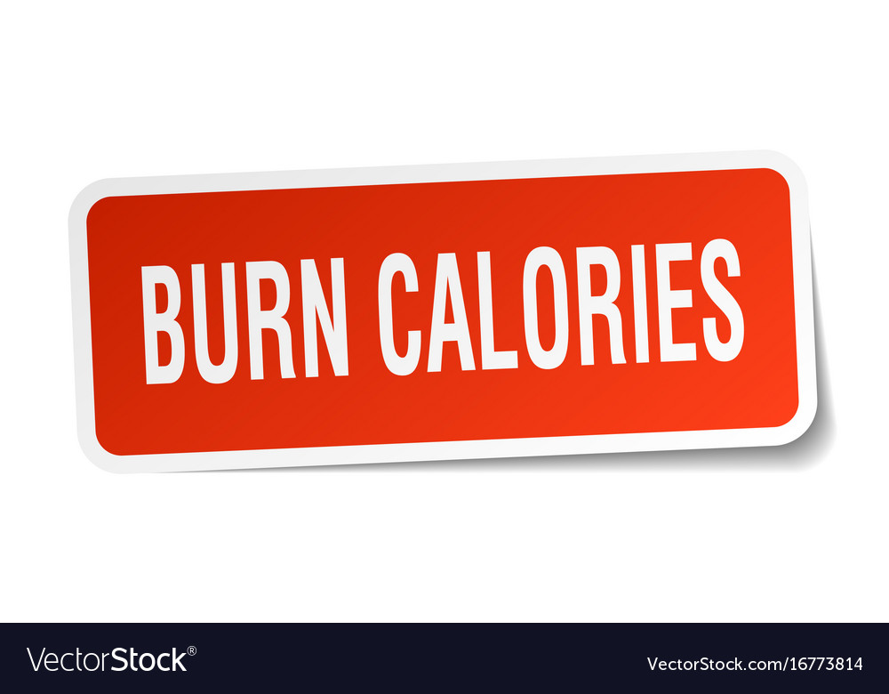
Problem statement:
In the context of health and fitness, accurately predicting calorie expenditure during physical activities is a critical aspect for individuals seeking effective weight management and optimal exercise routines.
Existing methods often rely on generalized models or metabolic equations, which may not account for individual variations in physiology, fitness levels, and other factors influencing energy expenditure. The need for personalized and accurate calorie burn prediction has become more pronounced with the increasing use of wearable devices and the growing awareness of the importance of tailored fitness plans.

Slide 4
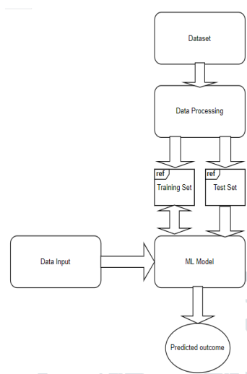
Proposed Methodology:
To determine how many calories an individual will burn, this study involved gathering the right data set to train our machine learning models. Here, we use the RandomForest regressor as the ML (machine learning) model to compare and then evaluate these models.
Random Forest:
"Random Forest is a classifier that contains a number of decision trees on various subsets of the given dataset and takes the average to improve the predictive accuracy of that dataset." Instead of relying on one decision tree, the random forest takes the prediction from each tree and based on the majority votes of predictions, and it predicts the final output.

Slide 5
Analysis of Proposed Model Performance
provides insights into various exercise types and their associated calorie ex-
penditures. You can explore the HealthKaggle dataset at the following link:
https://www.kaggle.com/code/sanchitnamdeo/analysis-calories-consumed/input
prediction-of-calories-burnt-using-xgboost There are a total of 15,000
instances and 7 data attributes in 2 CSV files. The "Kaggle" archive dataset
includes information about a variety of people, including their height, weight,
gender, age, exercise intensity, heart rate, and body temperature. Exercise data
is obtained from the "exercise.csv" and "calories.csv" datasets. In addition, the
target class mapped by the user ID from the second calorie dataset includes
the calories that person burned in the exercise dataset
Data collection:
Dataset:
Dataset consists of features :
Age,Height,Weight,Duration,
Heart_Rate,Body_Temp,Calories

Slide 6
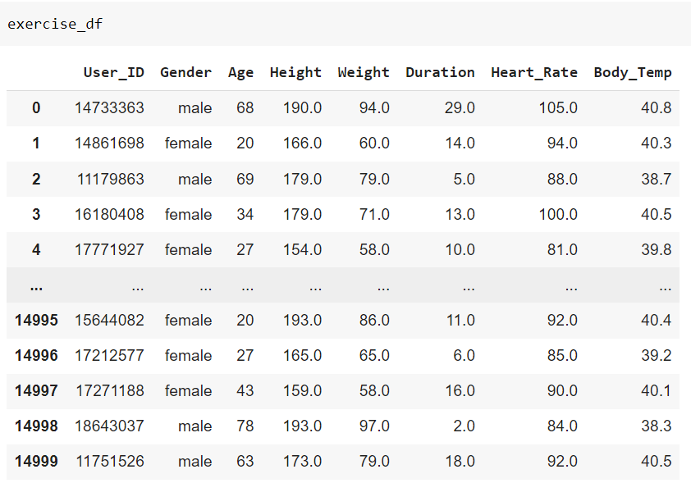
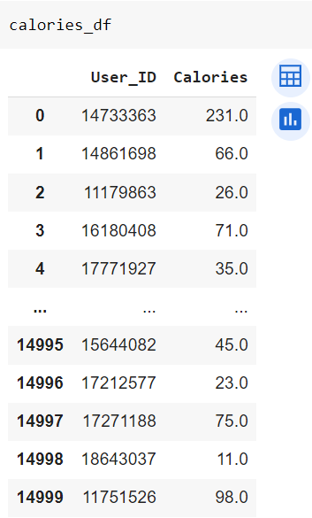
Data preprocessing:
Within this dataset, we discover a treasure trove of valuable information, comprising a substantial collection of 15,000 instances. These instances span across two distinct CSV files, aptly named "exercise.csv" and "calorie.csv." Each entry in this comprehensive dataset corresponds to an individual, encapsulating a wealth of attributes, including but not limited to height, weight, gender, age, exercise duration, heart rate, and body temperature. This meticulously collected dataset forms the bedrock of our analysis, allowing us to delve into the intricate relationships between these attributes and calorie burn

Slide 7
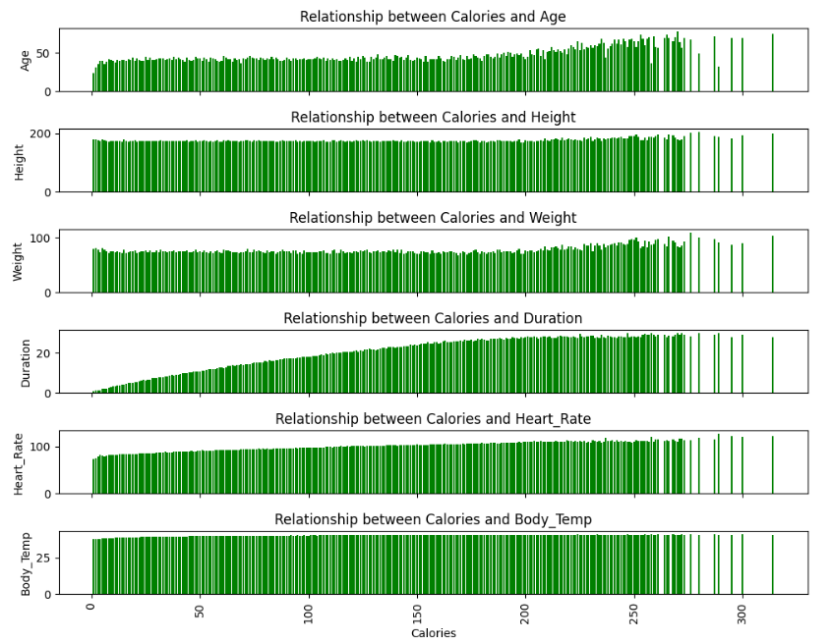
Data visualisation:

Slide 8
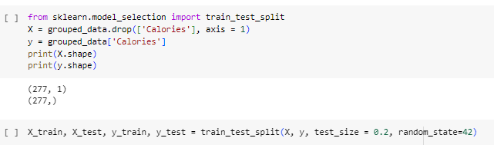
Train and Test the Data:
Now split the data set such that there is training and test set

Slide 9
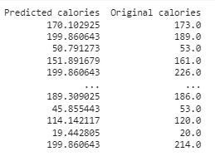
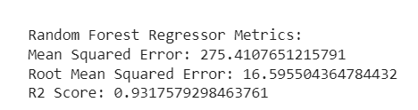
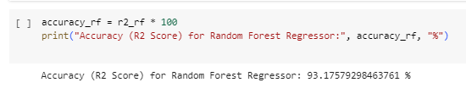
Data Modeling:
Random Forest:
In a random forest classification, multiple decision trees are created using different random subsets of the data and features. Each decision tree is like an expert, providing its opinion on how to classify the data. Predictions are made by calculating the prediction for each decision tree, then taking the most popular result.
Accuracy:

Slide 10
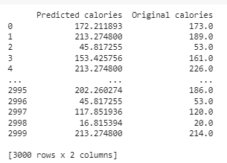
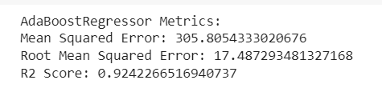
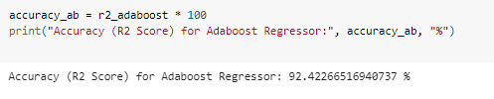
Adaboost:
AdaBoost, also known as Adaptive Boosting, is a Machine Learning approach that is utilised as an Ensemble Method. AdaBoost's most commonly used estimator is decision trees with one level, which is decision trees with just one split. These trees are often referred to as Decision Stumps.
Accuracy:

Slide 11
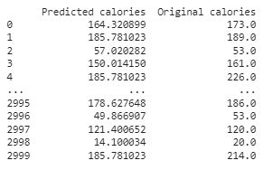

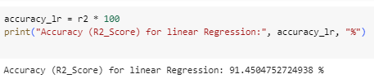
Linear Regression:
Linear regression is a type of supervised machine learning algorithm that computes the linear relationship between a dependent variable and one or more independent features. When the number of the independent feature, is 1 then it is known as Univariate Linear regression, and in the case of more than one feature, it is known as multivariate linear regression. The goal of the algorithm is to find the best linear equation that can predict the value of the dependent variable based on the independent variables.
Accuracy:

Slide 12
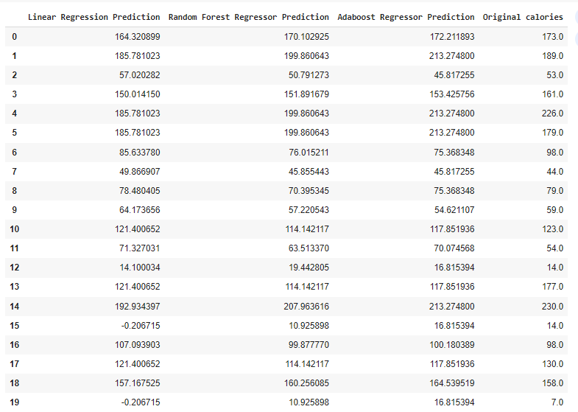
Comparing all the models:

Slide 13
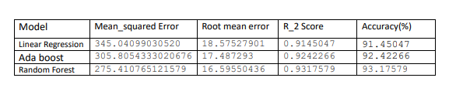
Conclusion:
As we can see mean square error is least for Random forest regression.
so, we use Random Forest
Future work:
Deep learning: This type of machine learning can learn from large amounts of data to identify complex patterns and relationships.
Reinforcement learning: This type of machine learning can learn from trial and error, which could be used to develop models that can adapt to individual user data and preferences.

Slide 14
References:
1.https://www.ncbi.nlm.nih.gov/pmc/articles/PMC5496172/
2. Roberts, K. C., Shields, M., de Groh, M., Aziz, A., & Gilbert, J. A. (2012). Overweight and obesity
in children and adolescents: results from the 2009 to 2011 Canadian Health Measures Survey.
Health rep, 23(3), 37-41.
3. Kalpesh, Jadhav, et al. "Human Physical Activities Based Calorie Burn Calculator Using
LSTM." Intelligent Cyber Physical Systems and Internet of Things: ICoICI 2022. Cham: Springer
International Publishing, 2023. 405-424.
4. Tayade, Akshit Rajesh, and Hadi Safari Katesari. "A Statistical Analysis to Develop Machine
Learning Models: Prediction of User Diet Type."
5. Gour, Sanjay, et al. "A Machine Learning Approach for Heart Attack Prediction." Intelligent
Sustainable Systems: Selected Papers of WorldS4 2021, Volume 1. Springer Singapore, 2022

