Slide 1
Exploring Race Data from the 2024 Monaco Formula 1 Grand Prix
Daniela Melo, 04/2/2026

Slide 2
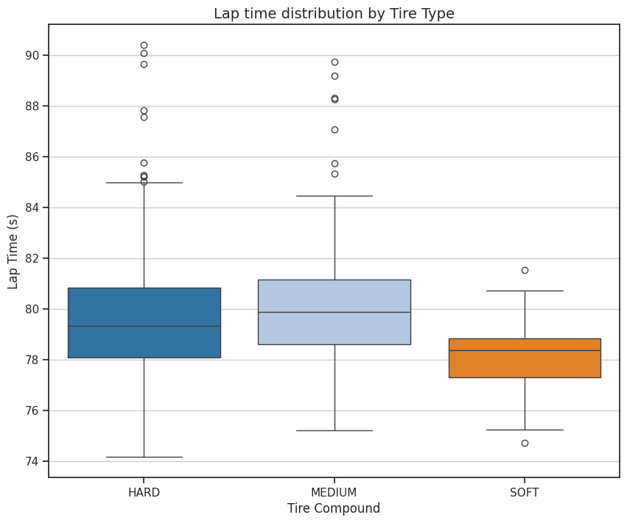
Data Overview and Key Variables
Monaco race data extracted from FastF1 python package.
1187 Laps used in analysis
Variable | Description | Type
Driver | Driver's name. | Categorical
Compound | Type of tire used. | Categorical
TyreLife | Age of tire in number of laps. | Numeric
LapNumber | Lap number in Monaco race. | Numeric
lap_time_s | Lap time in seconds. | Numeric
Notes:
Monaco Grand Prix composed of a total of 78 laps for 20 drivers – I excluded all laps with a pitstop

Slide 3
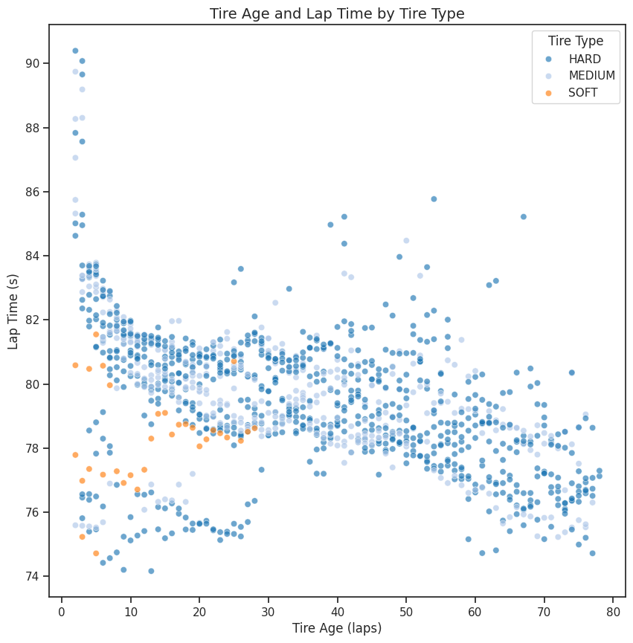
Tire Age and Type As Related to Lap Time
Linear Regression Model:
lap_time_s ~ TyreLife + C(Compound)
R² = 0.245
BUT P-values all below 0.05
 | coef | std err | t | P>|t|
Intercept | 81.18 | 0.119 | 685.02 | 0
C(Compound)[MEDIUM] | 0.3075 | 0.119 | 2.584 | 0.01
C(Compound)[T.SOFT] | -2.1884 | 0.349 | -6.268 | 0
TyreLife | -0.0499 | 0.003 | -18.756 | 0
Notes:
Tire age – how many laps

Slide 4
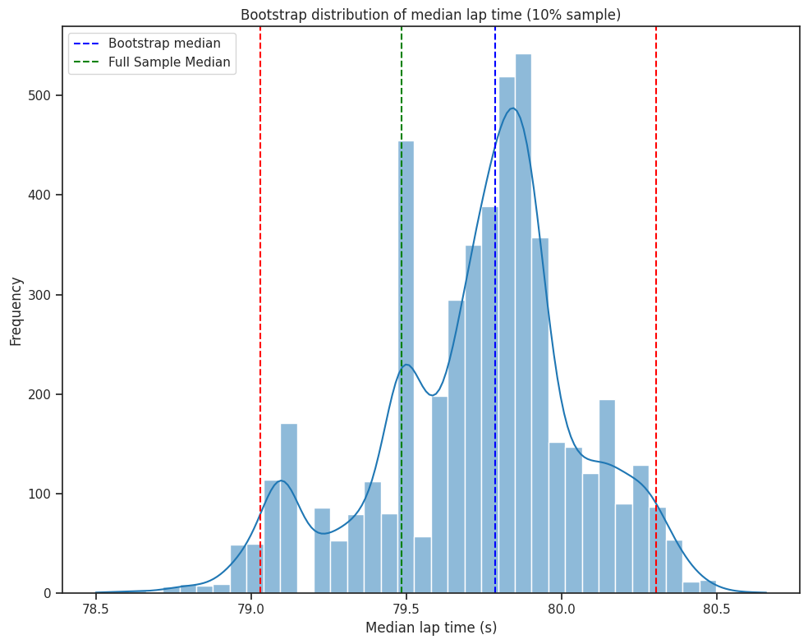
Bootstrap Estimation of Median Lap Time
Extracted 10% subset of the data.
Subset was resampled 5000 times.
95% CI:
Lower: 79.029
Upper: 80.304
Bootstrap median: 79.74500 s Full Sample Median:79.48400 s

