Slide 1
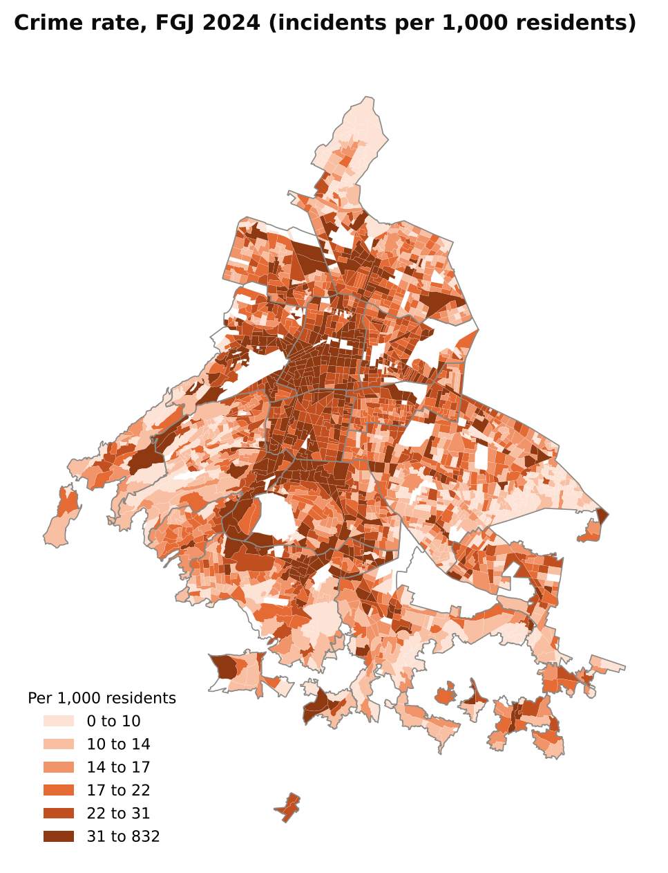
BUSINESS INTELLIGENCE | UNIT 2 PROJECT
Mexico City Urban Intelligence
A PostGIS data warehouse that links population, businesses and crime, and a test of whether their patterns cluster in space.
9.1 M
456,763
197,518
residents, Census 2020
establishments, DENUE 11/2024
crime incidents, FGJ 2024
Diego, Rodrigo, Arturo, Rous and Mauricio - Universidad Politecnica de Yucatan
Notes:
We wanted to know how population, businesses and crime relate across Mexico City and whether those patterns are clustered. The three numbers are what our warehouse holds after cleaning and joining everything by location.

Slide 2
One geographic unit, the urban AGEB, ties the four sources together
Four sources, three geographic shapes
Candidate units compared
Census 2020
Areas (AGEB)
Population, age, activity
16
Alcaldias
too coarse for spatial statistics
DENUE 11/2024
458,228 points
Businesses by SCIAN
2,431
Urban AGEB
official polygons, full Census indicators
FGJ crime 2024
198,007 located points
Crime by type and time
66,456
Blocks
too fine, many values suppressed
Marco Geoestadistico
2,431 AGEB polygons
The geographic unit
99.7% of crime points and of establishments land in exactly one AGEB by spatial join, none in two. The DENUE AGEB code agrees with the join for 99.8%.
Notes:
Each source describes geography differently, so we needed a common unit. Alcaldias are only 16 observations. Blocks are too small, most have no crime and the Census hides many values. The AGEB is the finest unit with complete Census indicators and official polygons. We tested the integration: almost every point lands in exactly one AGEB, and DENUE's own AGEB code agrees with our spatial join.

Slide 3
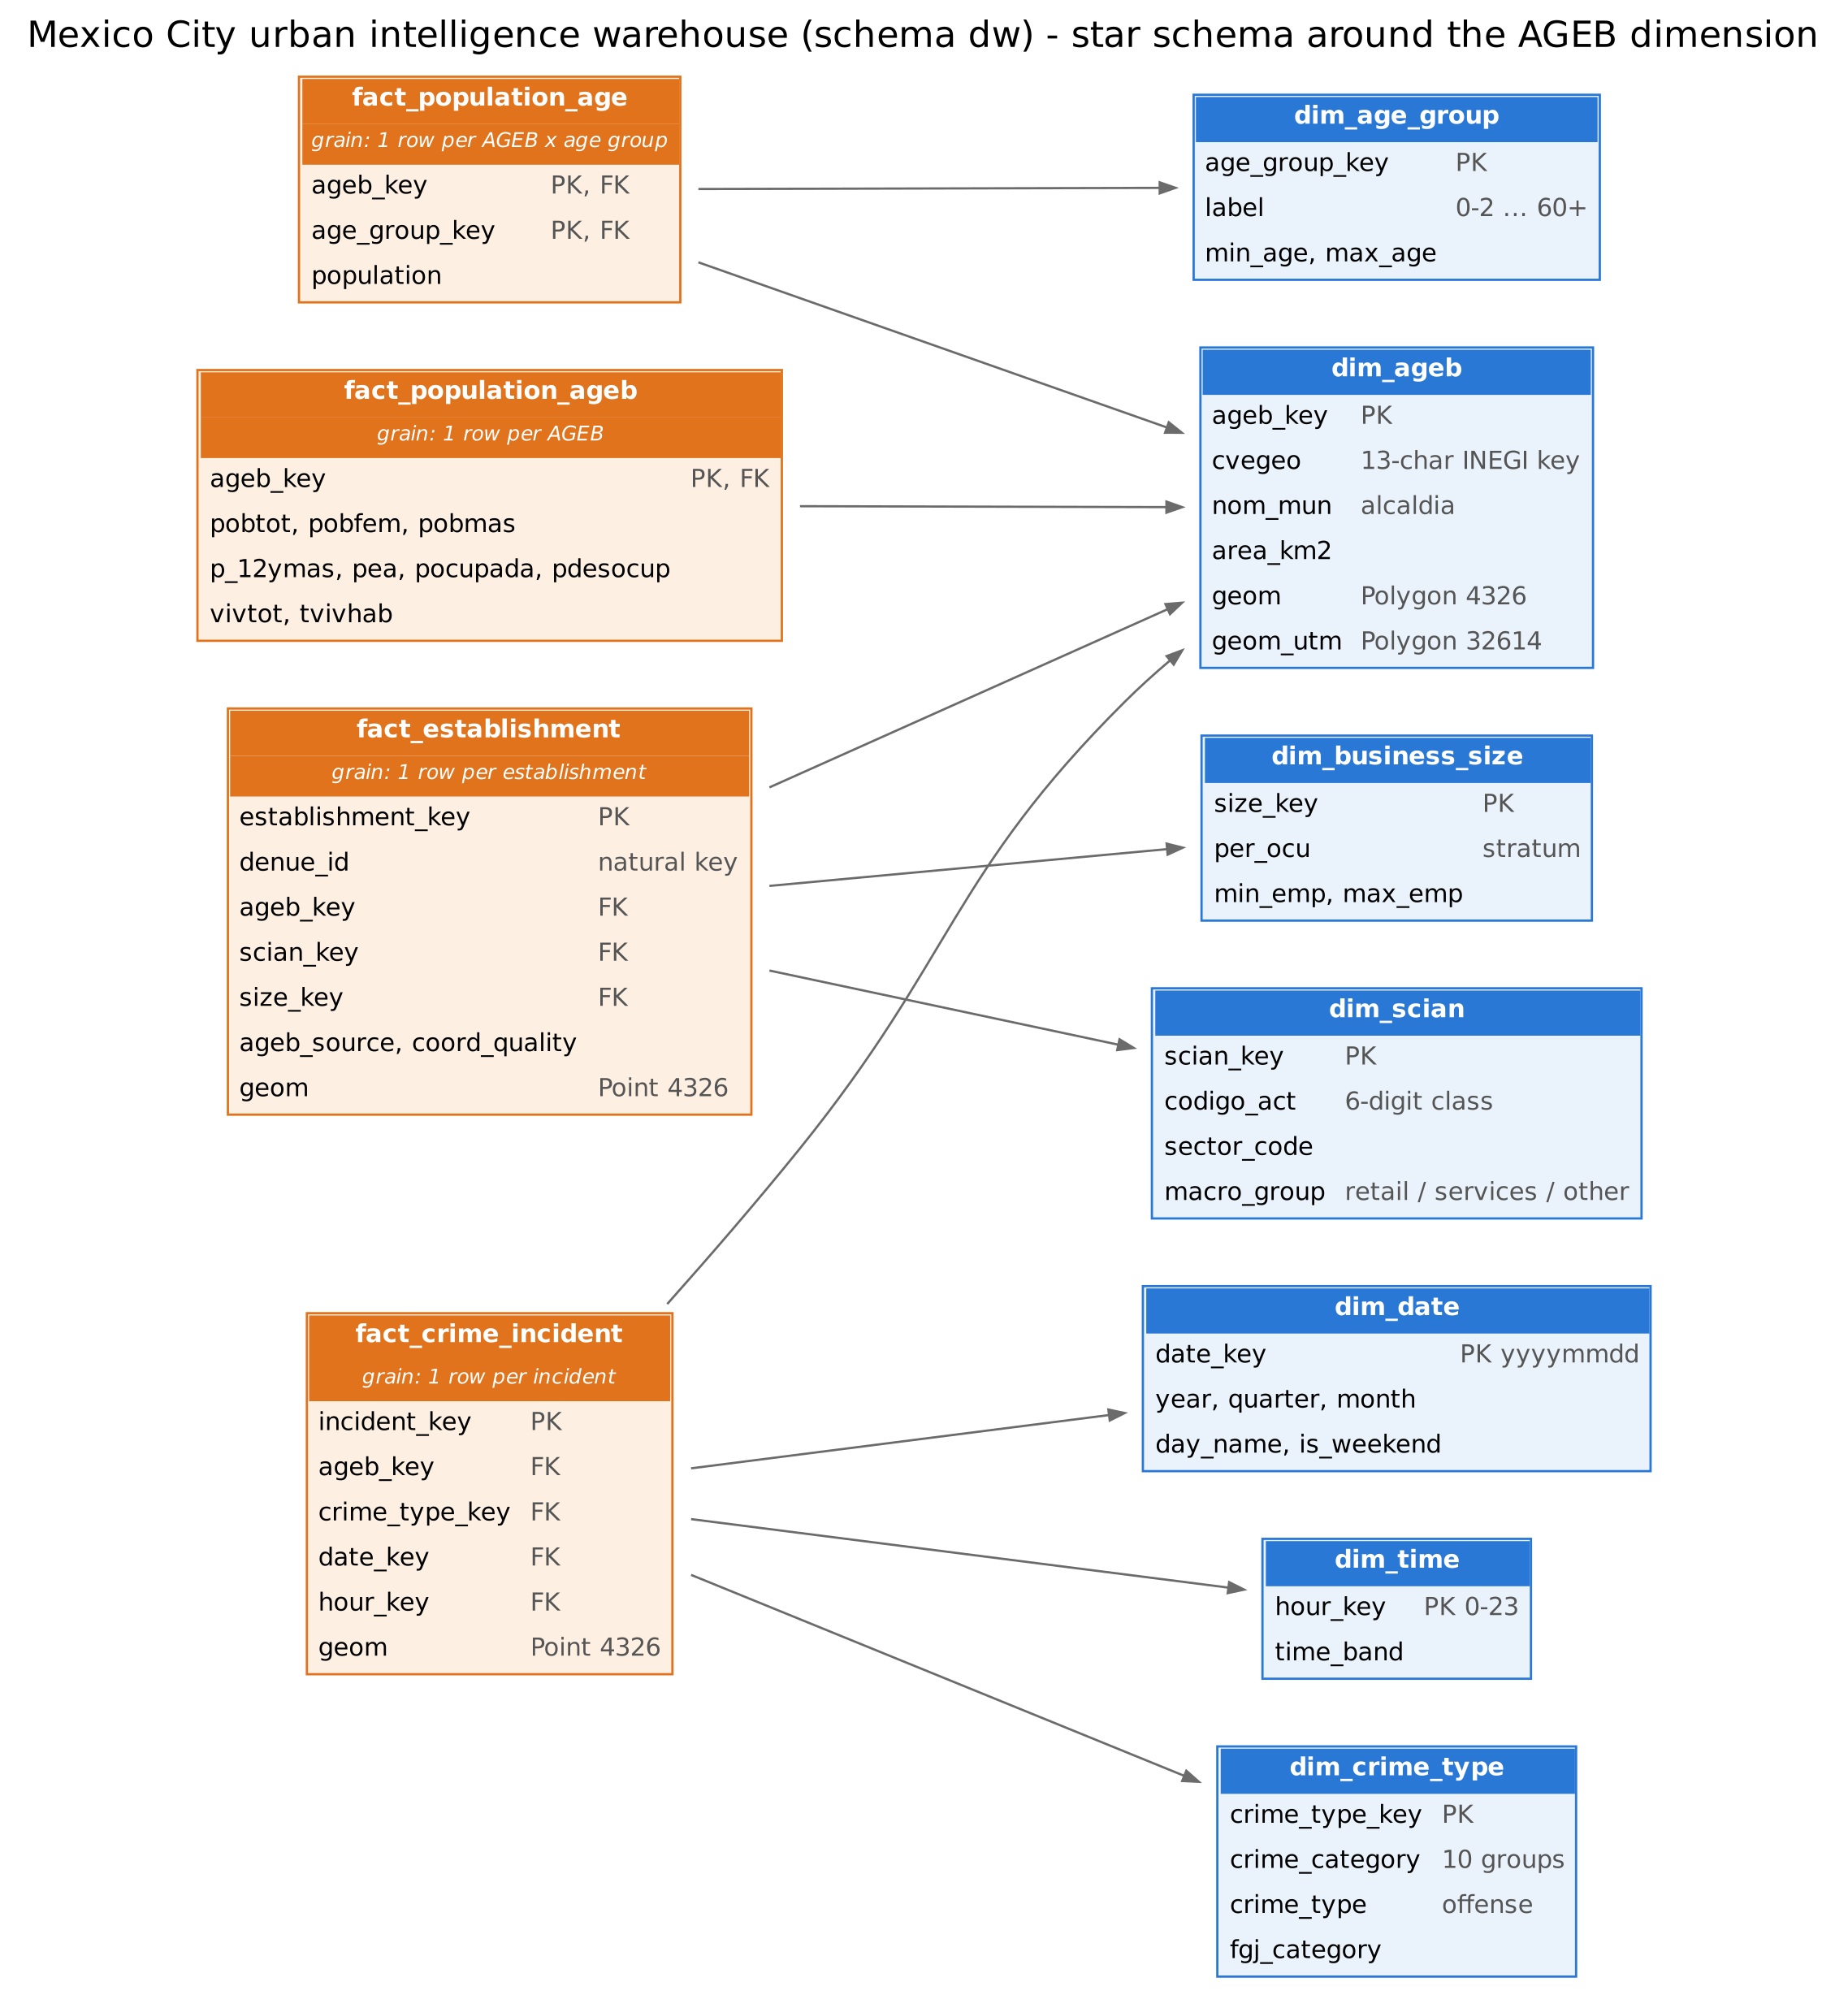
A star schema in PostGIS computes every KPI with SQL
4 + 7
Population, age, establishment and crime facts around one AGEB dimension that stores the polygon in two coordinate systems.
facts and dimensions
6
Clean, stage, then SQL: schema, load, views, validation. Raw files are never modified and the load can be re-run.
numbered ETL steps
14
dw.vw_ageb_kpis plus a crime-by-type-and-time view; 11 integrity checks stop the pipeline if anything does not reconcile.
KPIs in one view
Notes:
The warehouse is a star schema. Facts keep their lowest grain: one row per AGEB for population, per establishment for DENUE and per incident for crime. Because of that we can rebuild any KPI at another level without reloading. The validation script compares the warehouse with the staged data, and the data dictionary is generated from the database comments.

Slide 4
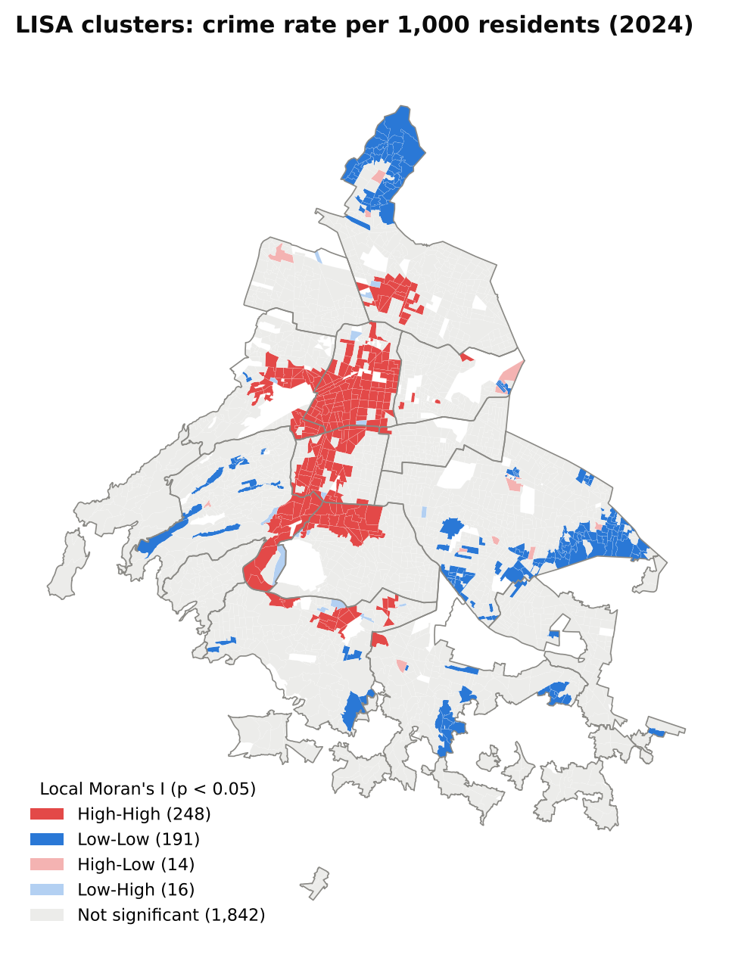
Crime clusters in the centre, and business density helps locate it
Global Moran's I (Queen contiguity, 999 permutations, all p = 0.001)
248
0.19
0.28
hot spots and 191 cold spots (LISA)
bivariate Moran, business vs nearby crime
Spearman, crime vs business density
Cuauhtémoc alone has 95 hot-spot AGEB (67% of its AGEB). Associations describe patterns and do not show cause.
Notes:
Moran's I is positive for every indicator, so neighbouring AGEB are similar. Local Moran finds one connected crime hot spot in the centre. The bivariate Moran says AGEB with many businesses tend to have neighbours with more crime, but it is weaker than the crime pattern itself. We checked with a second neighbour rule and with Empirical Bayes rates, and the result stays positive. These are associations, not causes.

Slide 5
What we found and what to keep in mind
Findings
Limitations
Crime is clustered. Moran's I = 0.49, with 248 hot-spot AGEB mostly in the central alcaldias.
Rates change the ranking. Cuauhtémoc has 53 incidents per 1,000 residents, Iztapalapa only 15.
Business activity is linked to crime nearby. Bivariate Moran = 0.19, a modest but significant association.
The results are robust. Queen and KNN-8 weights, and Empirical Bayes rates, give the same picture.
Different years. Population 2020, businesses and crime 2024.
Reports, not all crimes. About 6% of 2024 files have no coordinates.
Resident denominator. Central AGEB have few residents but many visitors, which probably inflates their rates.
Association only. Moran and correlation do not show that businesses cause crime.
Next step: add a time dimension (monthly crime and a daytime population estimate) to the warehouse.
Notes:
Main message: crime in Mexico City is spatially clustered, and business density is one piece of where it concentrates. Be honest about limits: the years differ, reports are not all crimes, and per-resident rates are inflated in the centre. Everything here is association.

