Slide 1
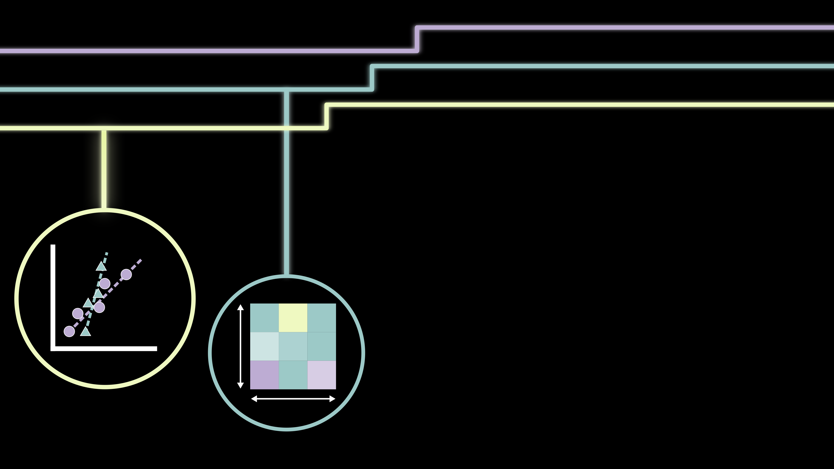
Data visualization
Diego Garay-Ruiz, IMN-CSIC
Helsinki, June 2025

Slide 2
The importance of data visualization
“An image is worth a thousand words”
Scientific data is inherently complex
Visualization of this data is:
Part of the understanding
Kind of an art

Slide 3
The importance of data visualization
Default plot from spreadsheet
x | y
2.0 | 2.6
4.0 | 3.4
6.0 | 7.0
8.0 | 15.3
10.0 | 15.0
12.0 | 23.0
Lacks information
A bit boring

Slide 4
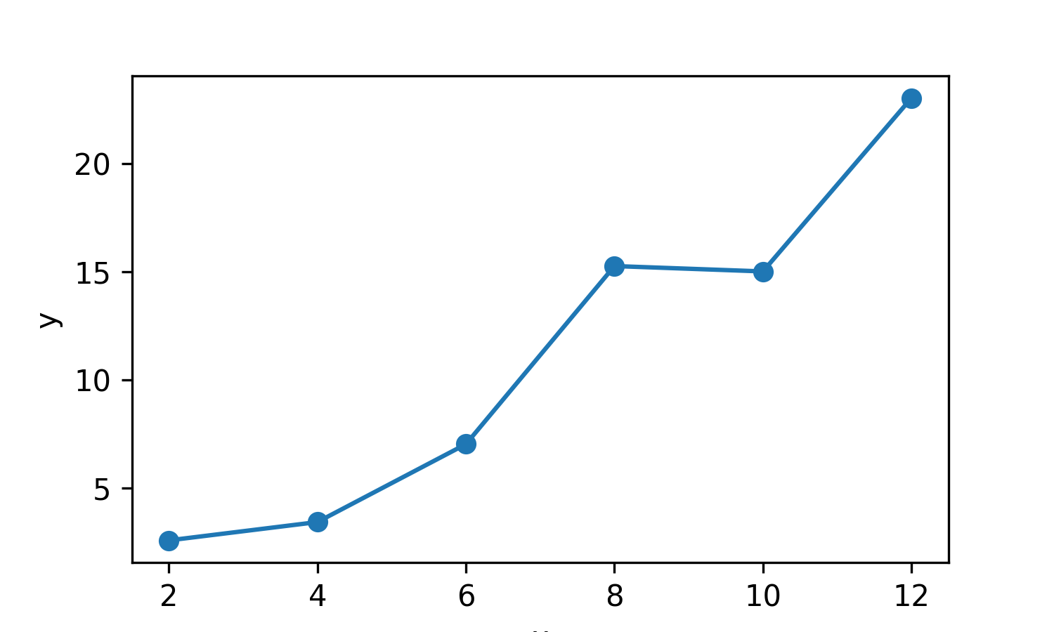
The importance of data visualization
Basic Python plot
x | y
2.0 | 2.6
4.0 | 3.4
6.0 | 7.0
8.0 | 15.3
10.0 | 15.0
12.0 | 23.0
Lacks information
A bit boring
Not much improvement

Slide 5
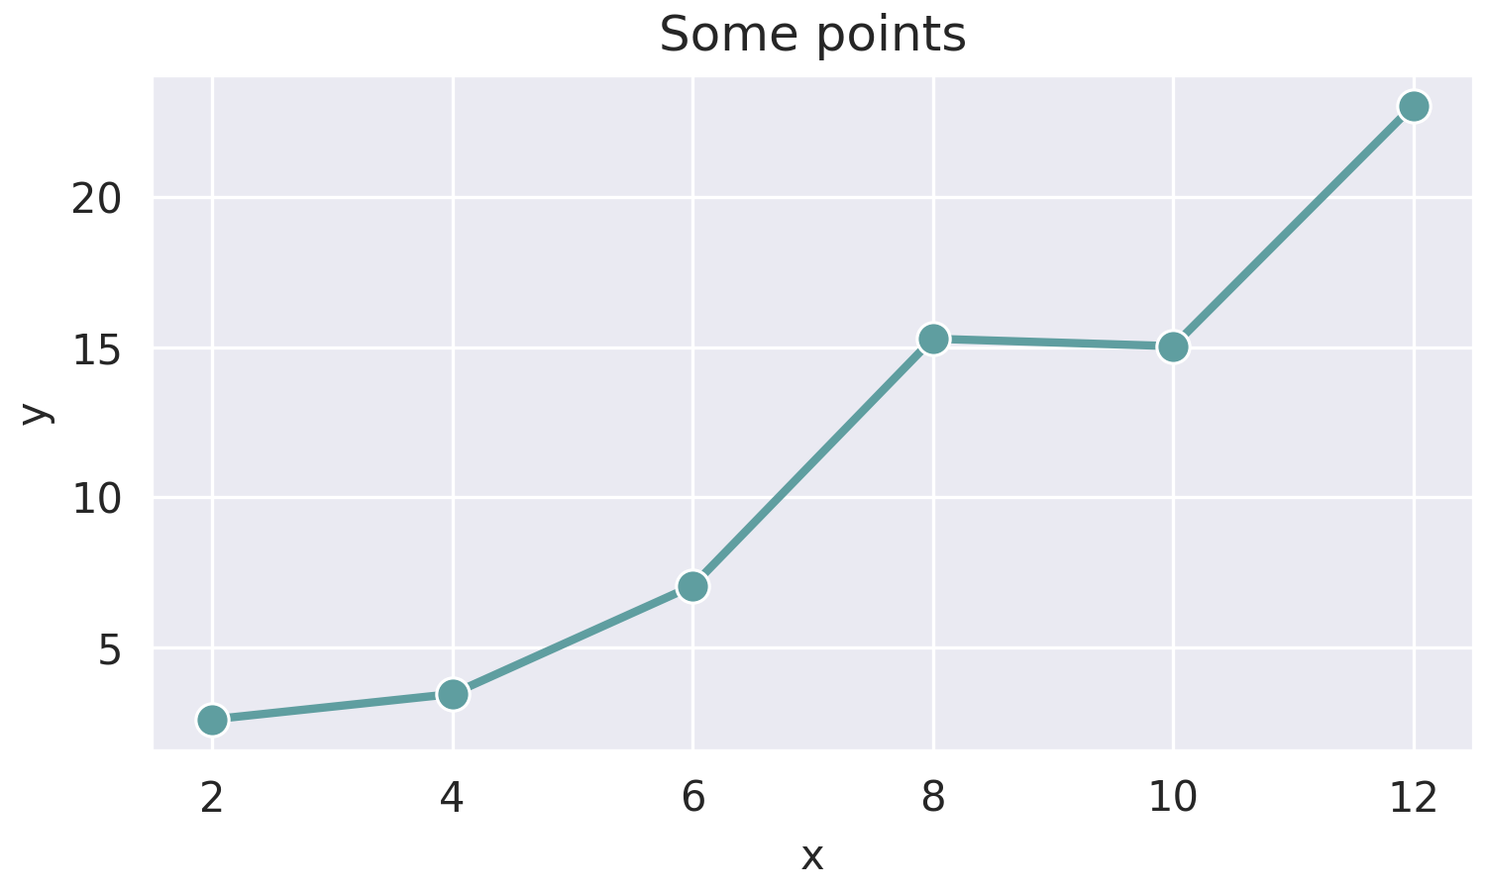
The importance of data visualization
More elaborate Python plot
x | y
2.0 | 2.6
4.0 | 3.4
6.0 | 7.0
8.0 | 15.3
10.0 | 15.0
12.0 | 23.0
Labeled axes and title
A bit nicer… but move to more “real” things

Slide 6
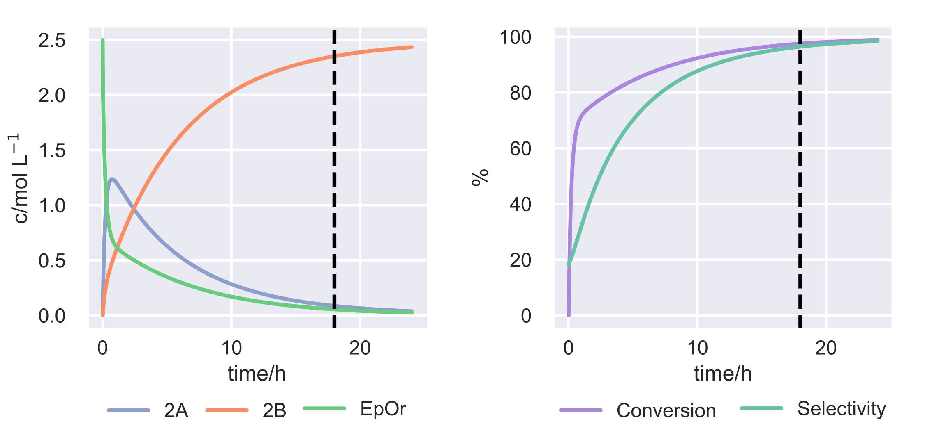
The importance of data visualization
Chemistry data can be quite complex
Multiple data series
Large amount of points (>80k per series)
Additional marks (t = 18 h)

Slide 7
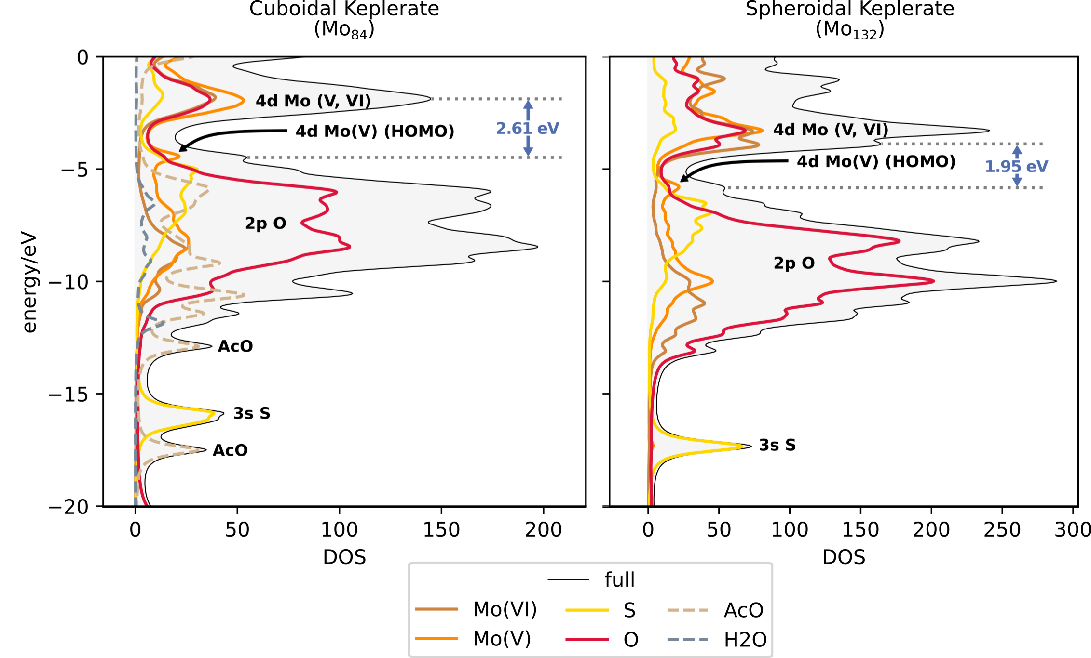
The importance of data visualization
Chemistry data can be quite complex
Color choice: usual code for S and O, similar but distinct shades for Mo oxidation state
Dashed lines for less important contributions
Aligned layout to compare structures

Slide 8
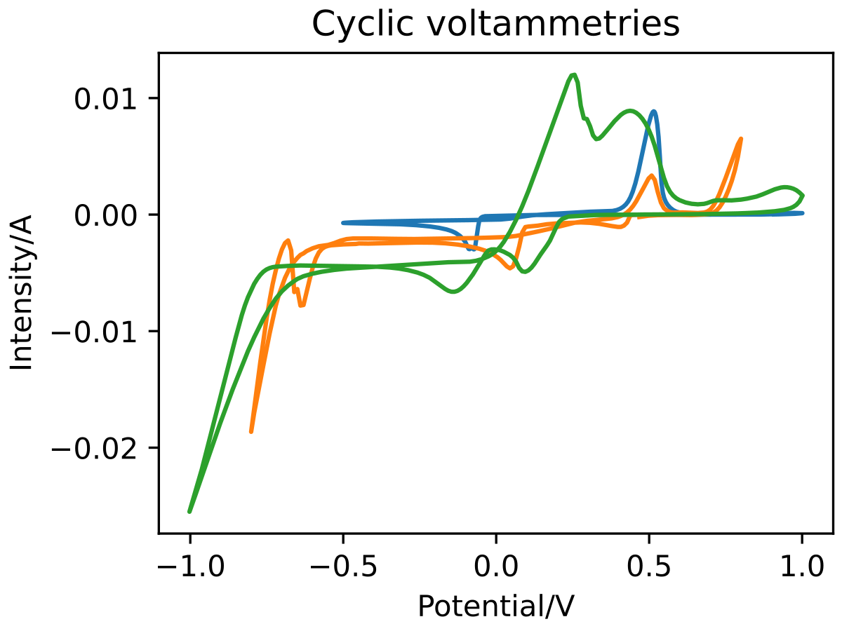
A piece of advice
Coding is ideal for systematic aspects…
… but there are many non-systematic things in figure preparation
Where should the legend go?
How should we mark peaks?

Slide 9
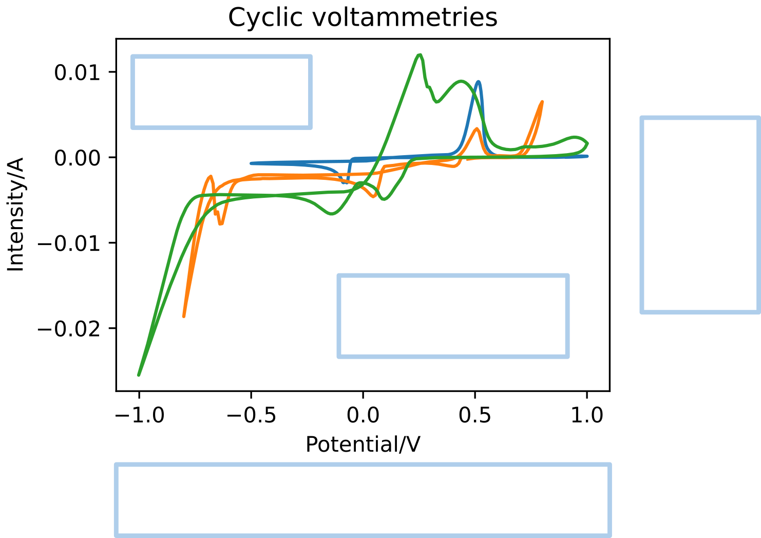
A piece of advice
Coding is ideal for systematic aspects…
… but there are many non-systematic things in figure preparation
Where should the legend go?
How should we mark peaks?

Slide 10
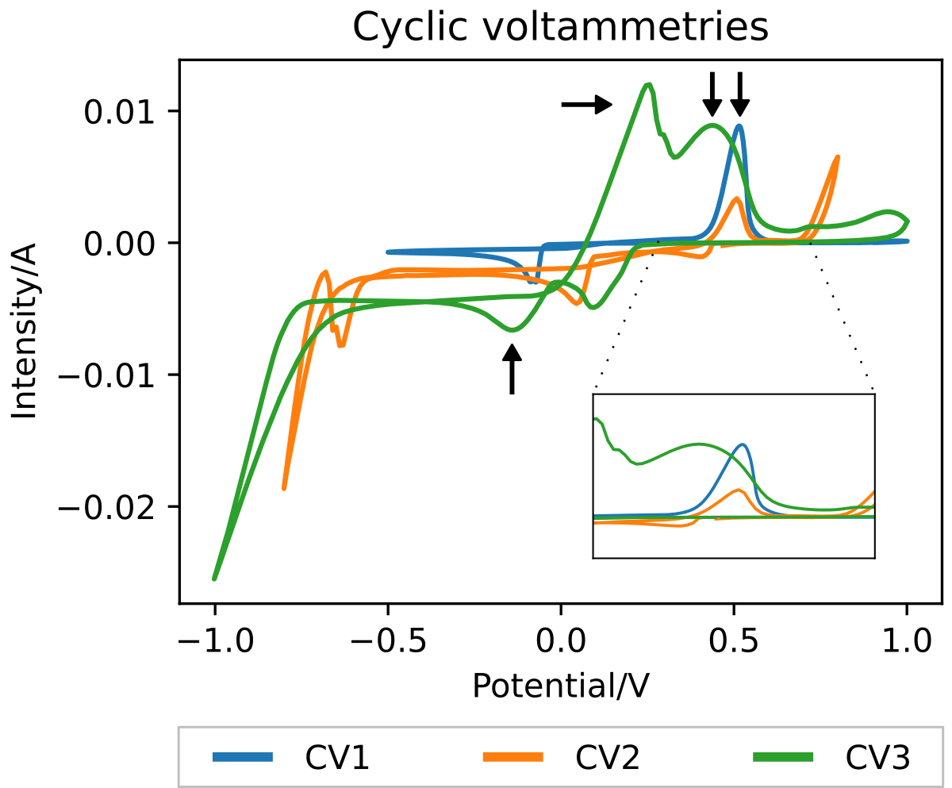
A piece of advice
Coding is ideal for systematic aspects…
… but there are many non-systematic things in figure preparation
Where should the legend go?
How should we mark peaks?

Slide 11
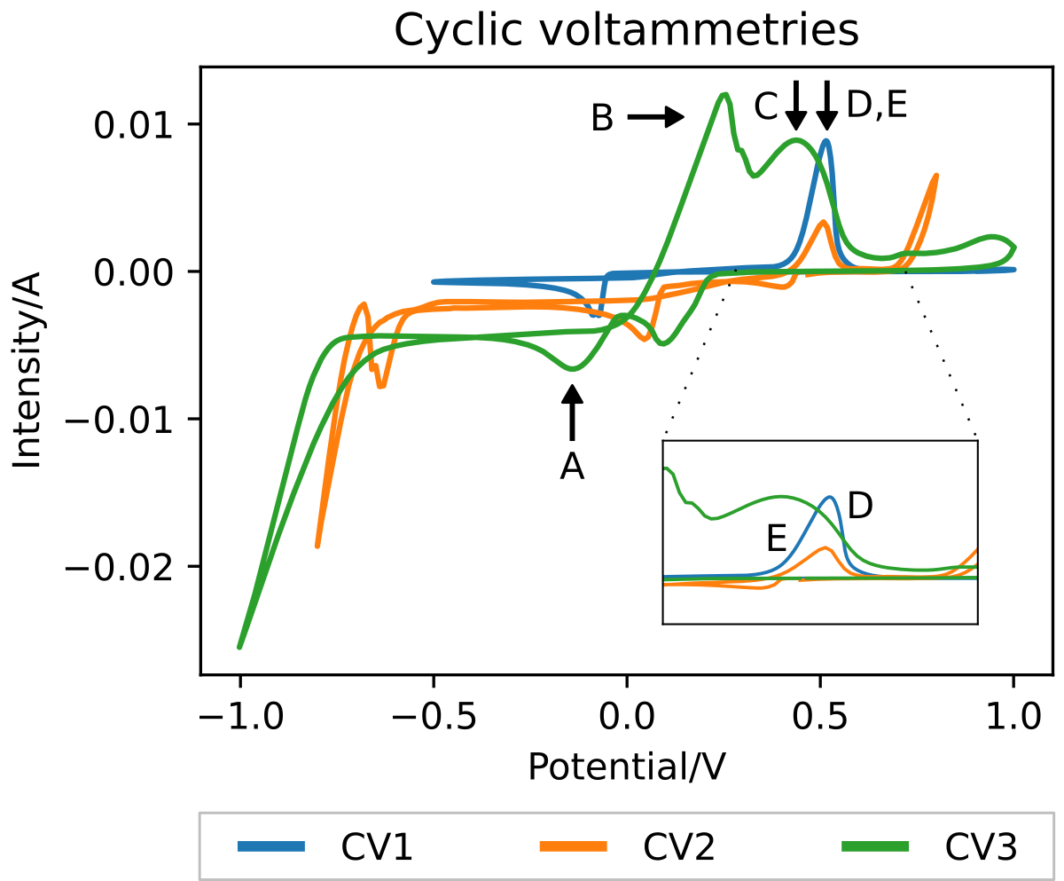
A piece of advice
Coding is ideal for systematic aspects…
… but there are many non-systematic things in figure preparation
Where should the legend go?
How should we mark peaks?
All this can be done in Python, but with a lot of trial and error:
Do we know the coordinates?
How long are our labels?
Do we want to highlight all features?
Will our labels overlap?

Slide 12

A piece of advice
Coding is ideal for systematic aspects…
… but there are many non-systematic things in figure preparation
Combine coding and further editing
Scalable Vector Graphics (SVG)
Vectorial format
Preserves quality, infinite zoom
Access to all plot elements (lines, markers, labels…) for tweaking
Get from Python (see later)
Inkscape
Design program
SVG editor
Free and open-source
For Windows, Linux and MacOS

