Slide 1
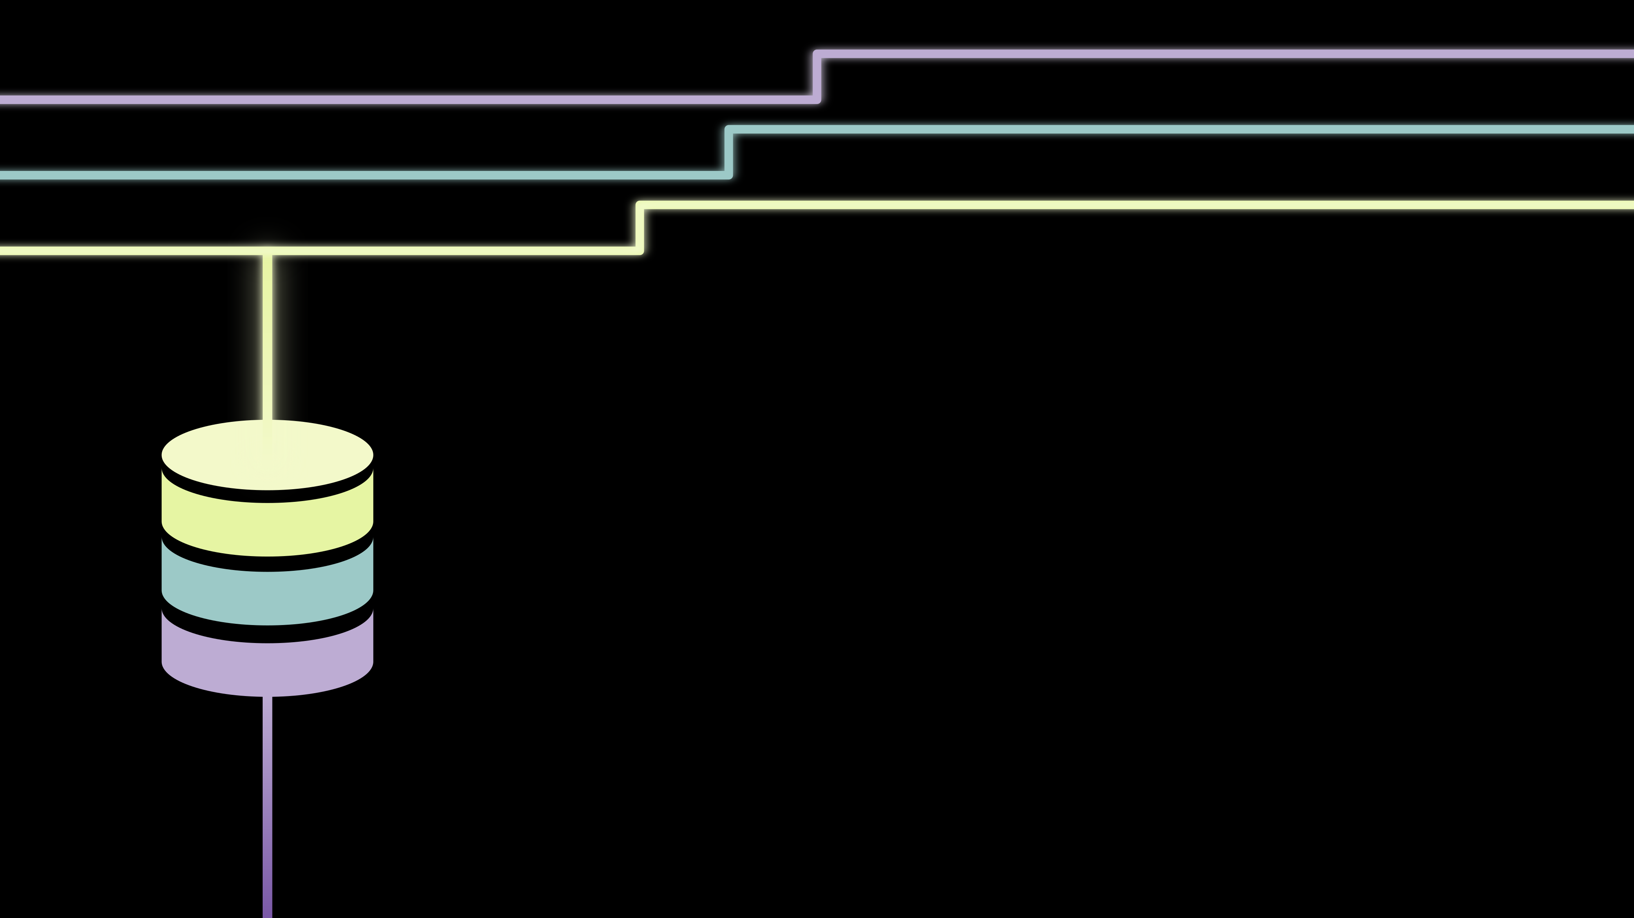
Where to find data? FAIR principles and open-source projects
Diego Garay-Ruiz, IMN-CSIC
Helsinki, June 2025

Slide 2
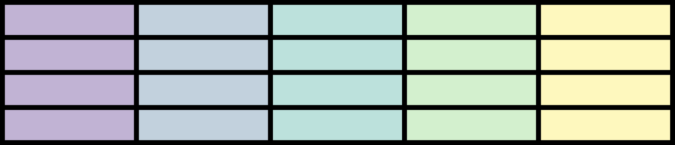

Data, the non-Pythonic way
Spreadsheets, XLSX
Drag & drop formulas
Only as organized as the creator

Slide 3
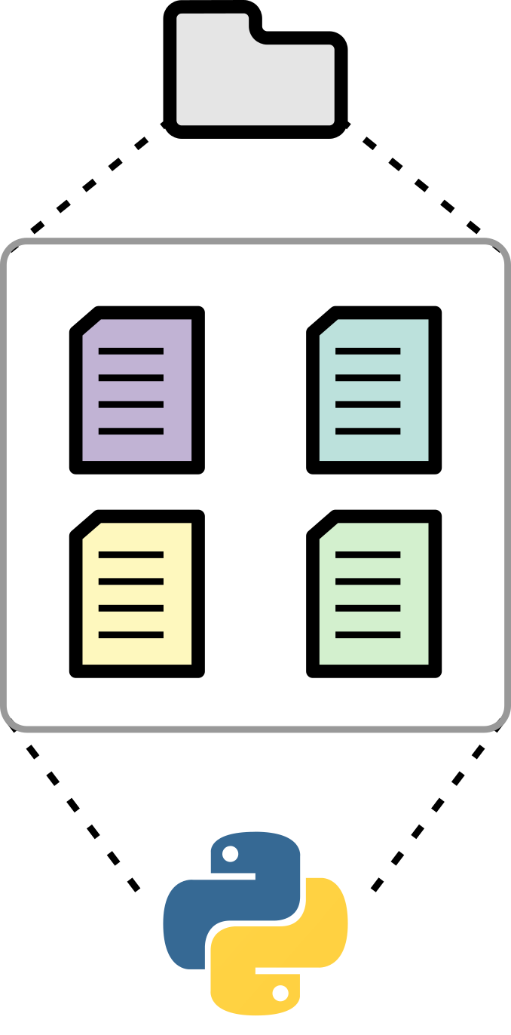
Data, along the Pythonic way
Tables in CSV format
Leave operations to the code
Less messy data, towards a scheme

Slide 4
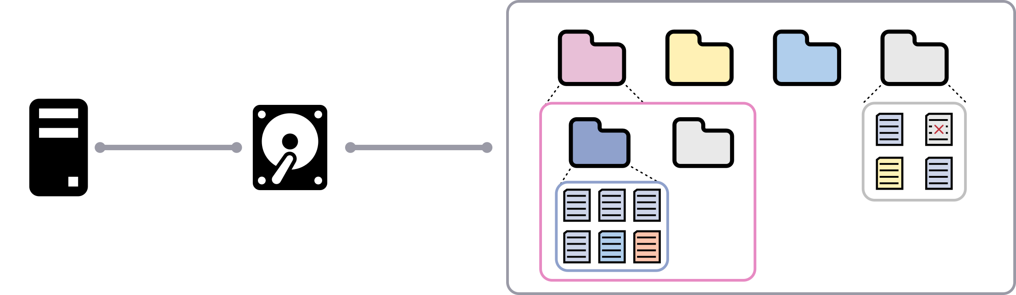
The issues with data in Chemistry
Too much data in local storage ... which can be difficult to locate later on
The “story” does not include the data!

Slide 5
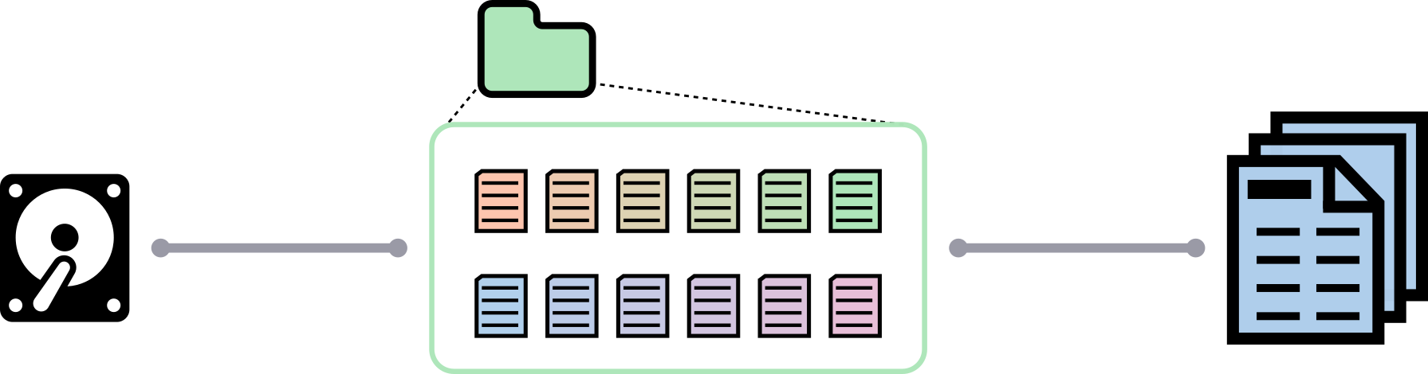
The issues with data in Chemistry
Too much data in local storage ... which can be difficult to locate later on
The “story” does not include the data!

Slide 6

The issues with data in Chemistry
Some data is digital, some is not…
“Notebook archeology”: the longer the project, the more complex it gets

Slide 7

FAIR Data
F → Findable
A → Accessible
I → Interoperable
R → Reusable
Manuscript + Dataset(s)
Open Science
Reproducibility

Slide 8
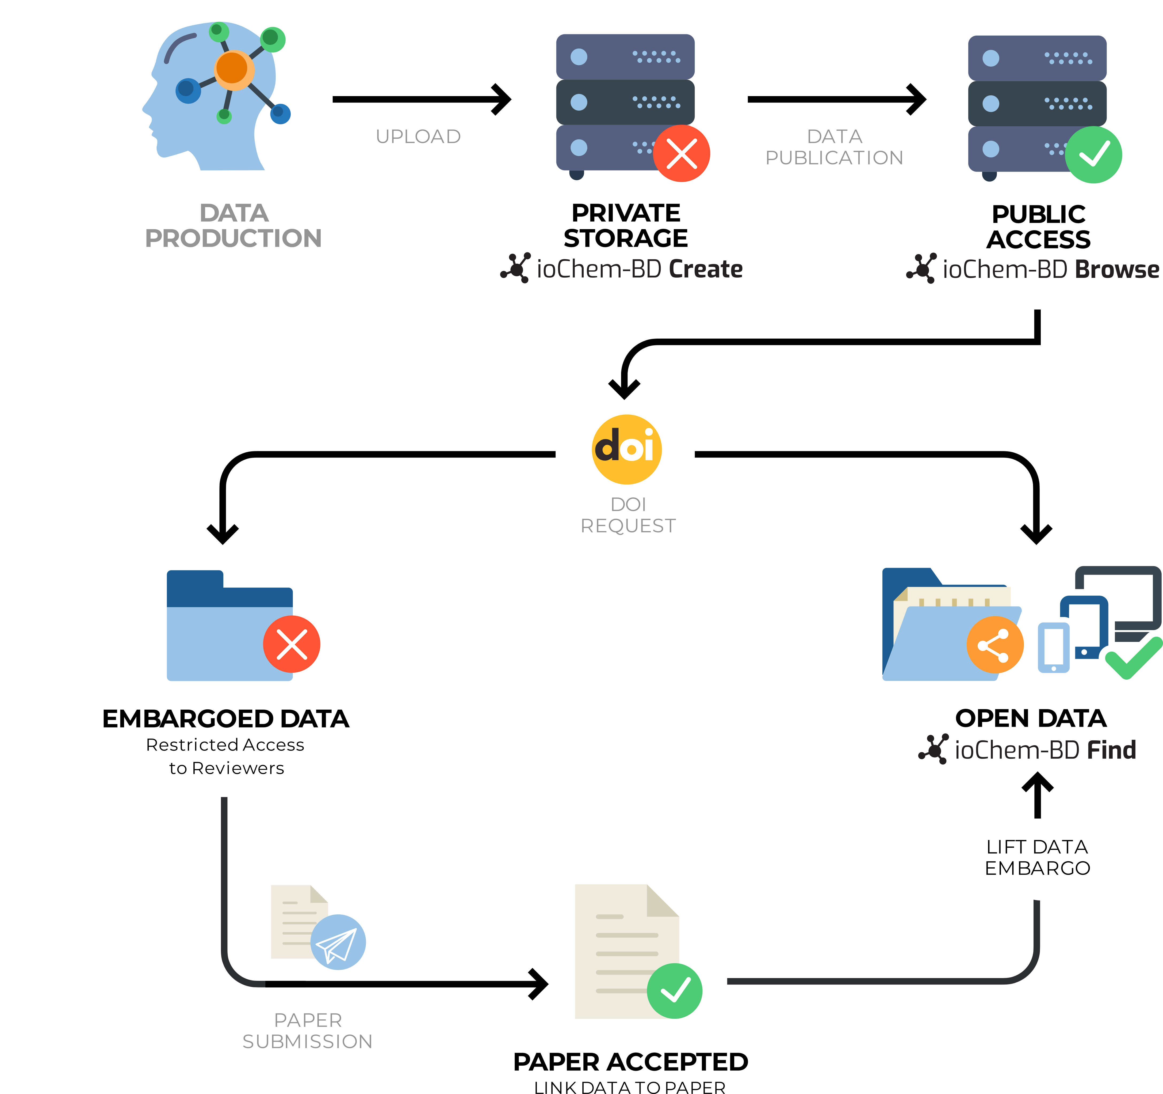
Computational chemistry: ioChem-BD
FAIR approach
Unified format (CML)
Web interface
Link to publications (DOI)
Python interface (py-iochem)

Slide 9
Computational chemistry: ioChem-BD
FAIR approach
Unified format (CML)
Web interface
Link to publications (DOI)
Python interface (py-iochem)

Slide 10
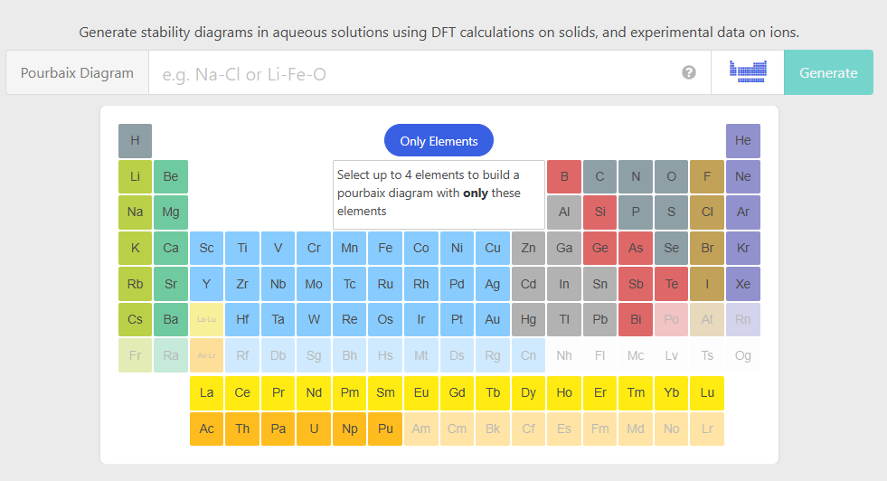
Other sources: Materials Project
Web interface, do it “by hand”…

Slide 11
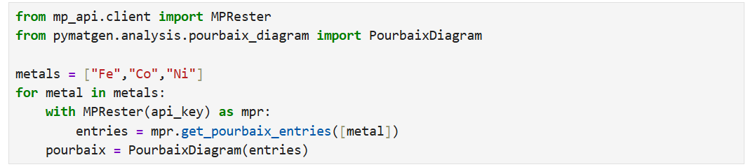
Other sources: Materials Project
.. via API, automated and customizable

Slide 12



Open-source software
The good
The bad
Free & less evil
Anyone can contribute
Customizable
Version control
Less polished (usually)
Fix-it-yourself
Commercial standards
Some important players

Slide 13
Open-source software
The good
The bad
Free & less evil
Anyone can contribute
Customizable
Version control
Less polished (usually)
Fix-it-yourself
Commercial standards
Some important players

Slide 14
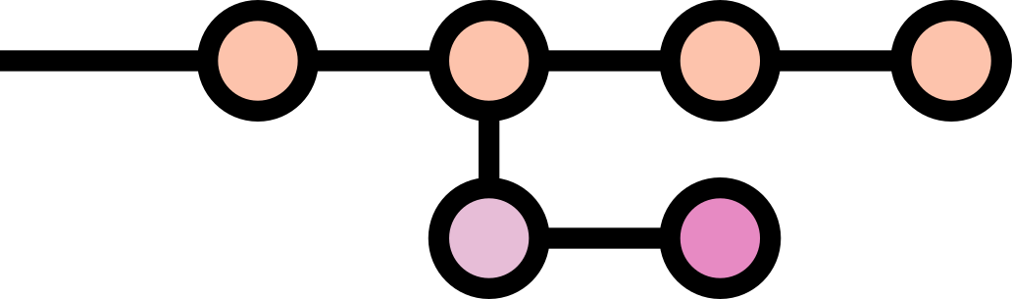
git init
System for version control
Keep the history of a project
we’re here

Slide 15
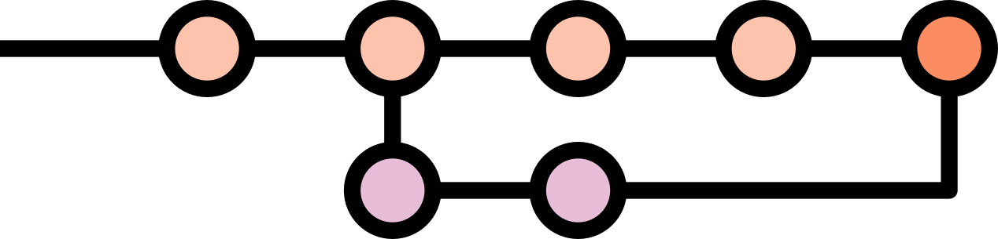
git init
System for version control
Keep the history of a project
we’re here

Slide 16
git init
System for version control
Keep the history of a project
we’re here
And suddenly we realize an important mistake…

Slide 17

git init
System for version control
Keep the history of a project
we’re here
Checkpoint for our project

Slide 18


git init
System for version control
Keep the history of a project
we’re here
GitHub
GitLab
Checkpoint for our project
Synchronize with clouds
Git ≠ GitHub

