Slide 1
Ultra-Sound-Image-Classifier
Deepakraju Rangaraju

Slide 2
Data Collection
Data is obtained from some popular open source resources
1.) ButterflyNetwork
2.) GrepMed
3.) The POCUS Atlas
4.) LITFL
5.) Radiopaedia
6.) CoreUltrasound
7.) University of Florida
8.) Scientific publications
9.) Clarius

Slide 3
Data Preprocessing
Once the videos are downloaded. There are some useless texts and prompts
Cropping the videos where there are unnecessary texts by utilising the meta information given in the dataset.
Extracting frames from the cropped videos
Removing frames where ROI is covered by artifacts.
Removing the markers present in the cropped images by utilising the mask-data and mask-meta information present in the dataset.

Slide 4
Deep learning image classifiers models
VGG_CAM classifier inspired from the below research paper Accelerating Detection of Lung Pathologies with Explainable Ultrasound Image Analysis.
EmergencyNet for balancing latency-accuracy tradeoff.

Slide 5
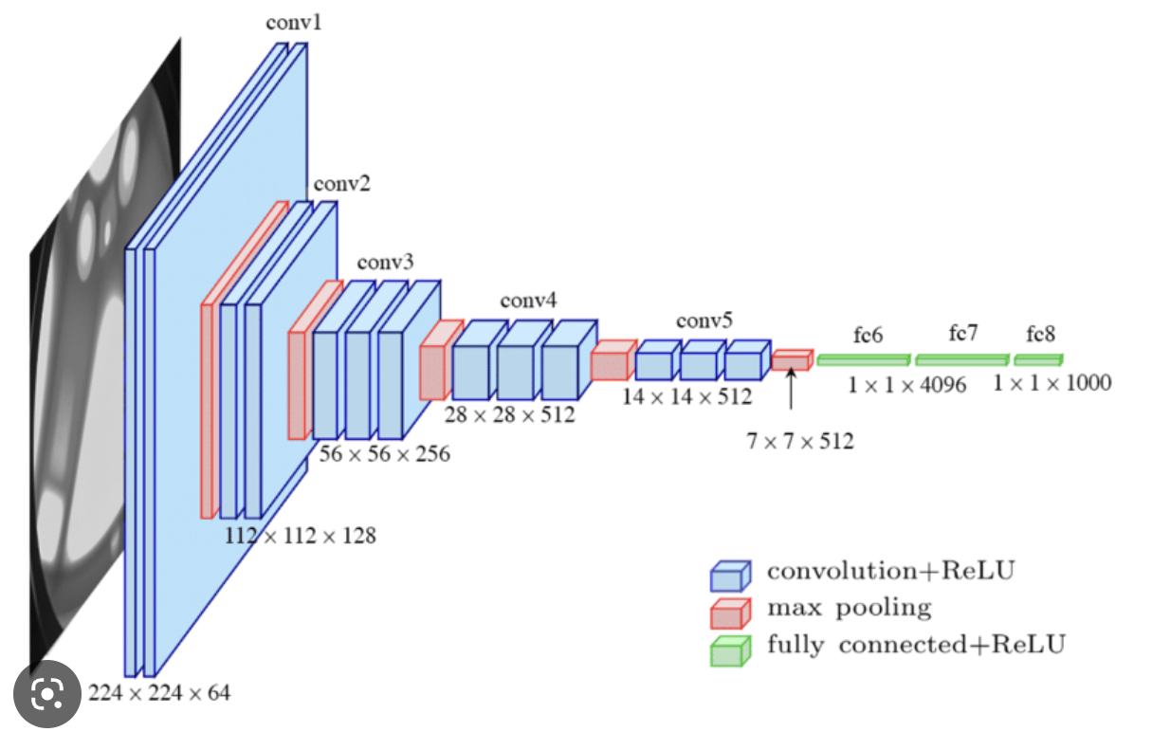
VGG16 Architecture

Slide 6
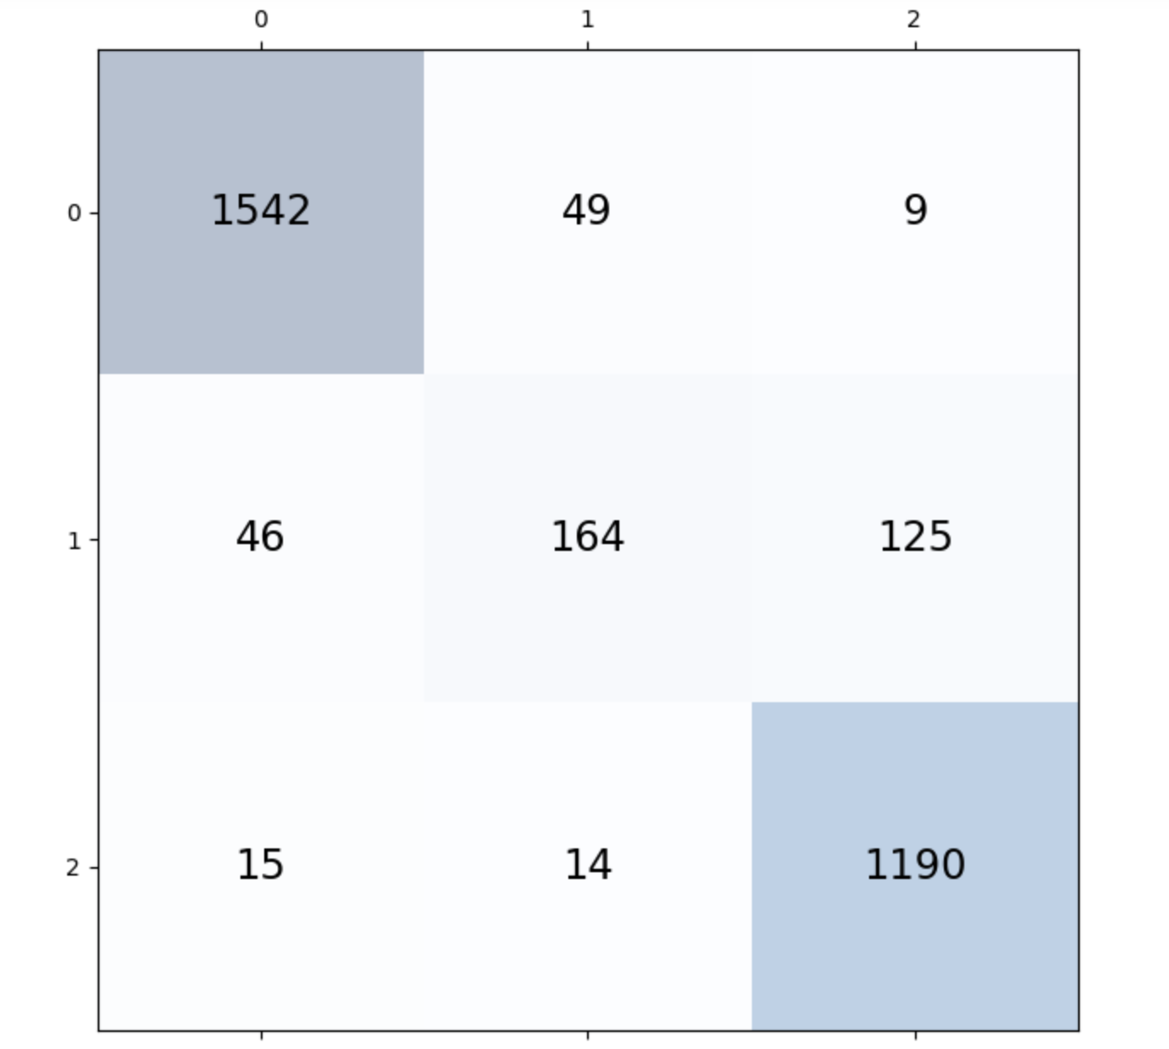
Accuracy for VGG_CAM model
Train-Accuracy: 88.6%
Validation-Accuracy: 91.5%
Confusion matrix {0: 'covid', 2: 'pneumonia', 1: 'normal'}

Slide 7
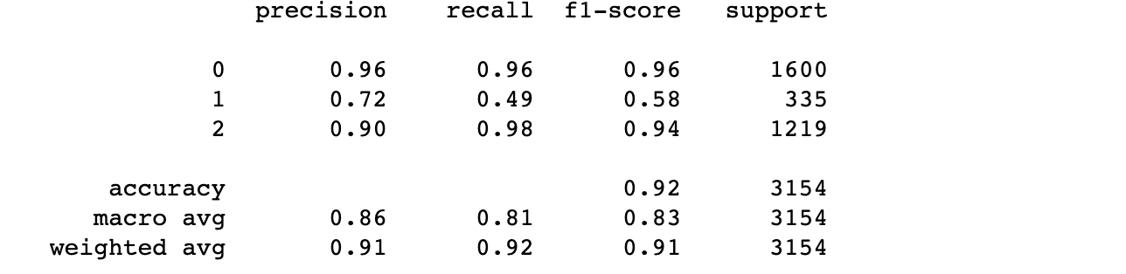
Classification report
Classification report for the validation data
{0: 'covid', 2: 'pneumonia', 1: 'normal'}

Slide 8
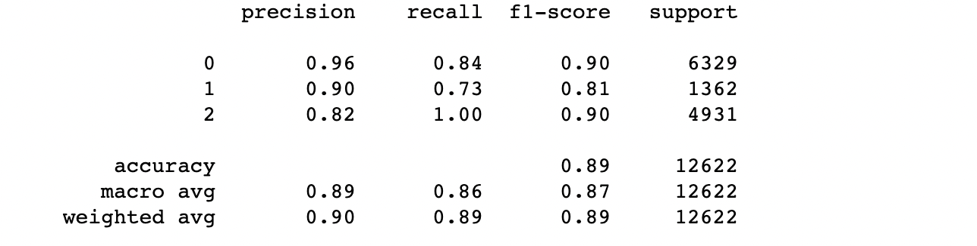
Classification report
Classification report for the train data
{0: 'covid', 2: 'pneumonia', 1: 'normal'}

Slide 9
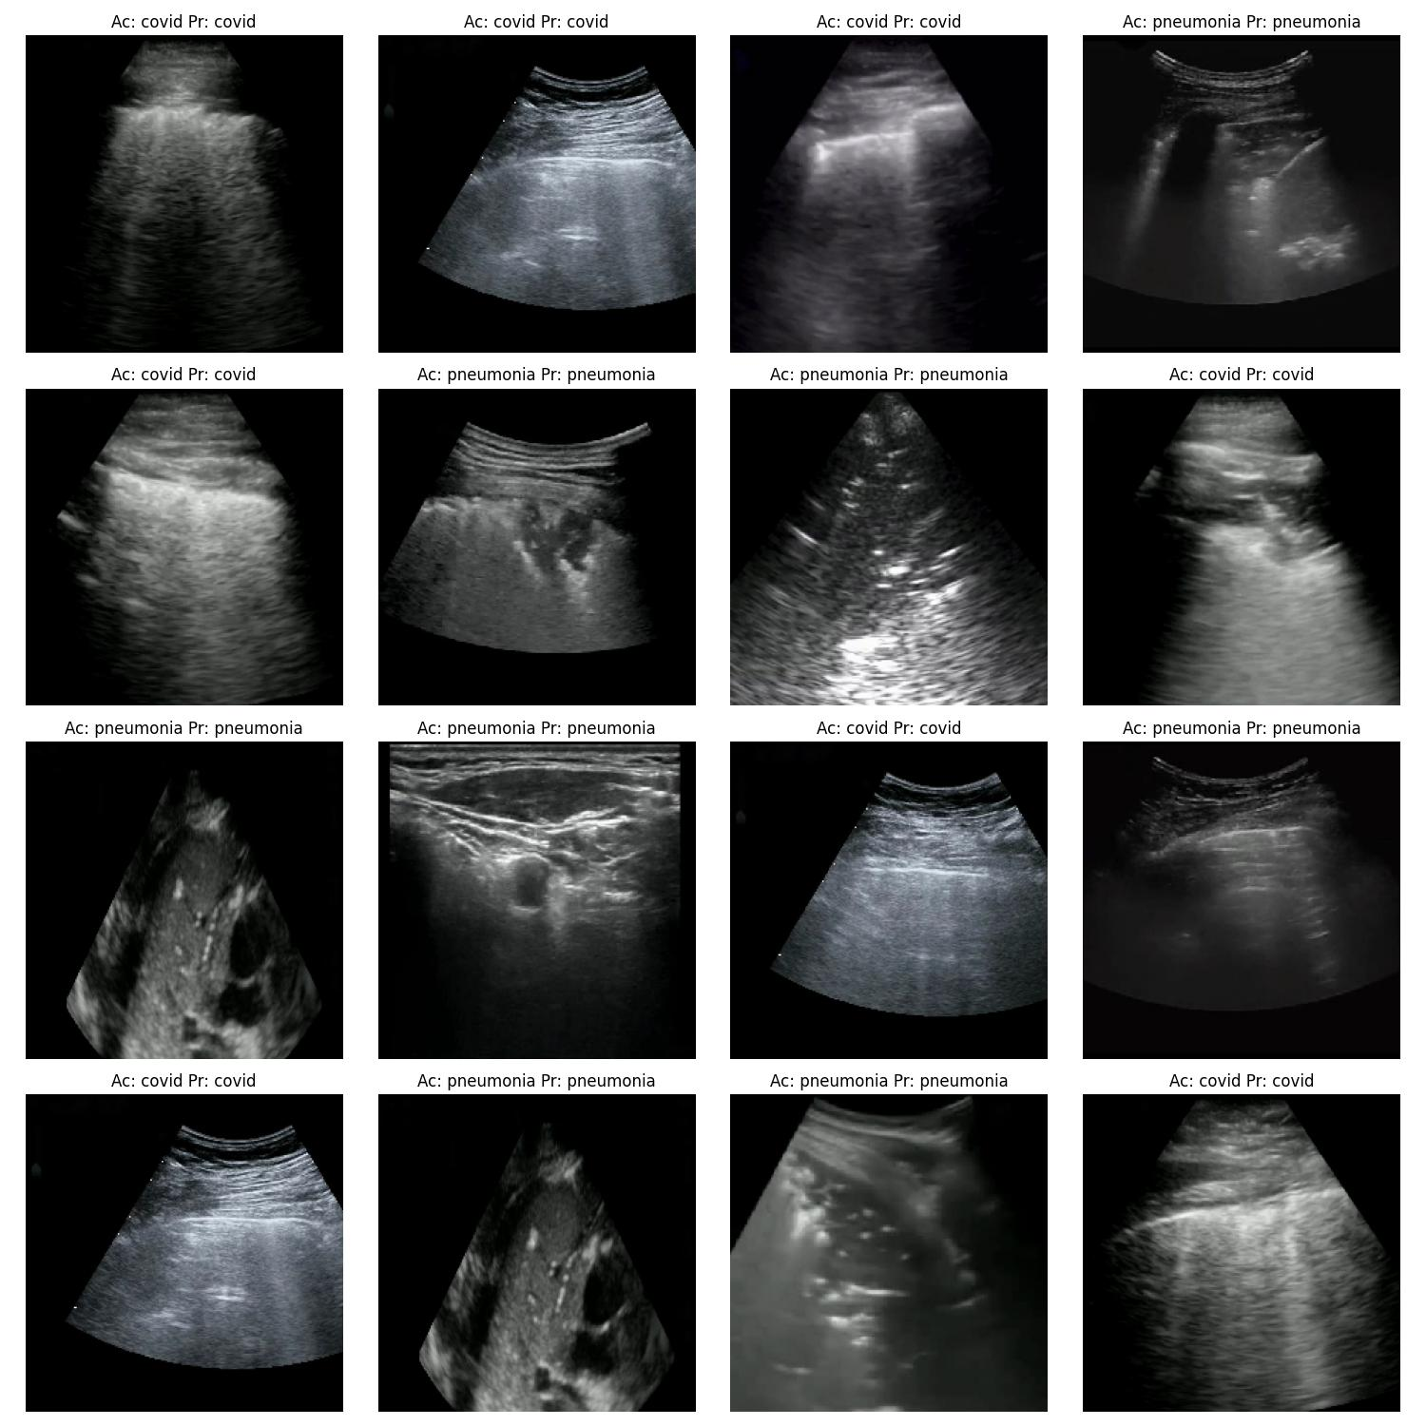
Output Examples of VGG_CAM

Slide 10
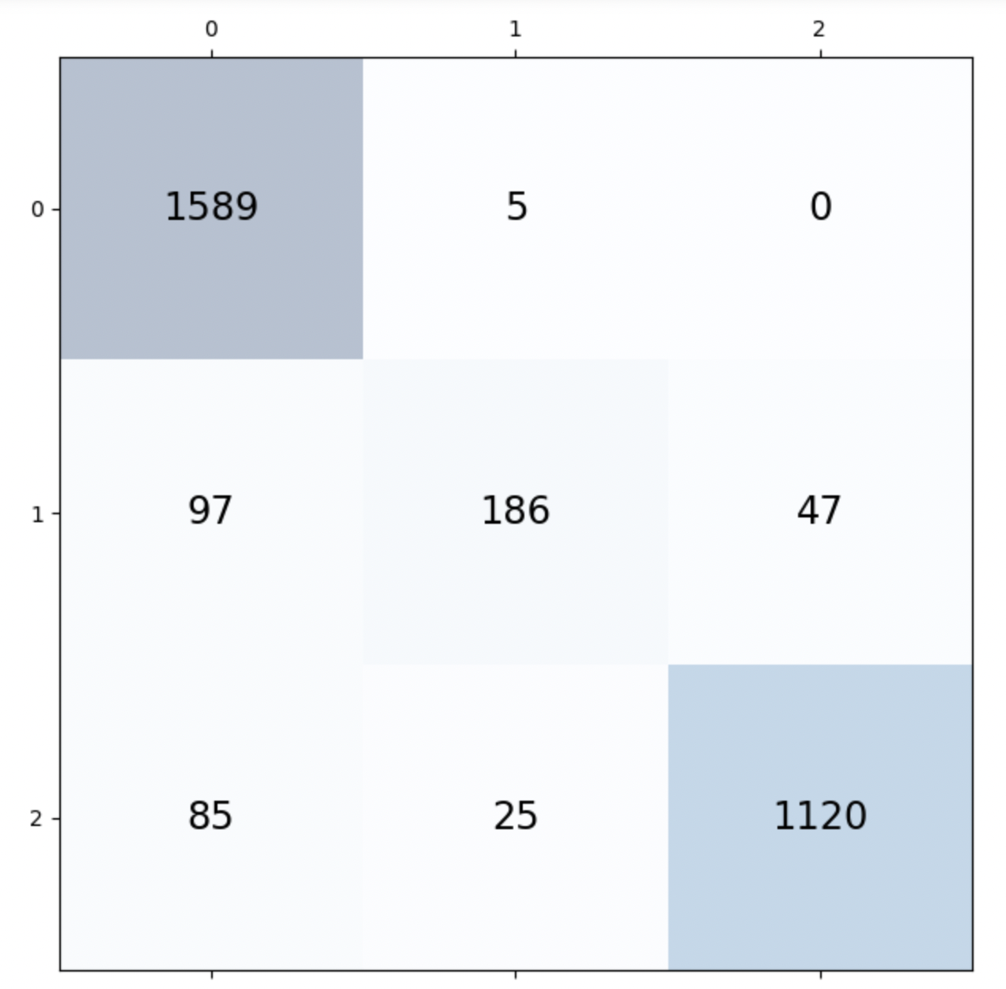
Balanced VGG_CAM
To address the issue of imbalance classes
Train-Accuracy: 93.32%
Validation-Accuracy: 91.76%
Confusion matrix {0: 'covid', 2: 'pneumonia', 1: 'normal'}

Slide 11
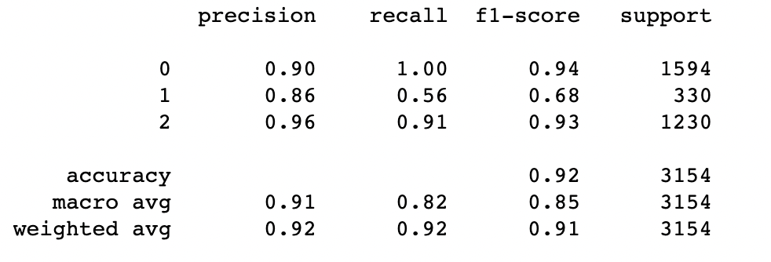
Classification report
Classification report for the validation data

Slide 12
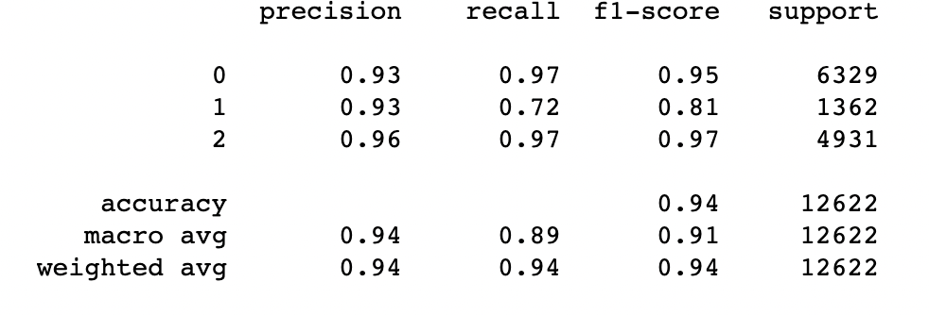
Classification report
Classification report for the train data

Slide 13
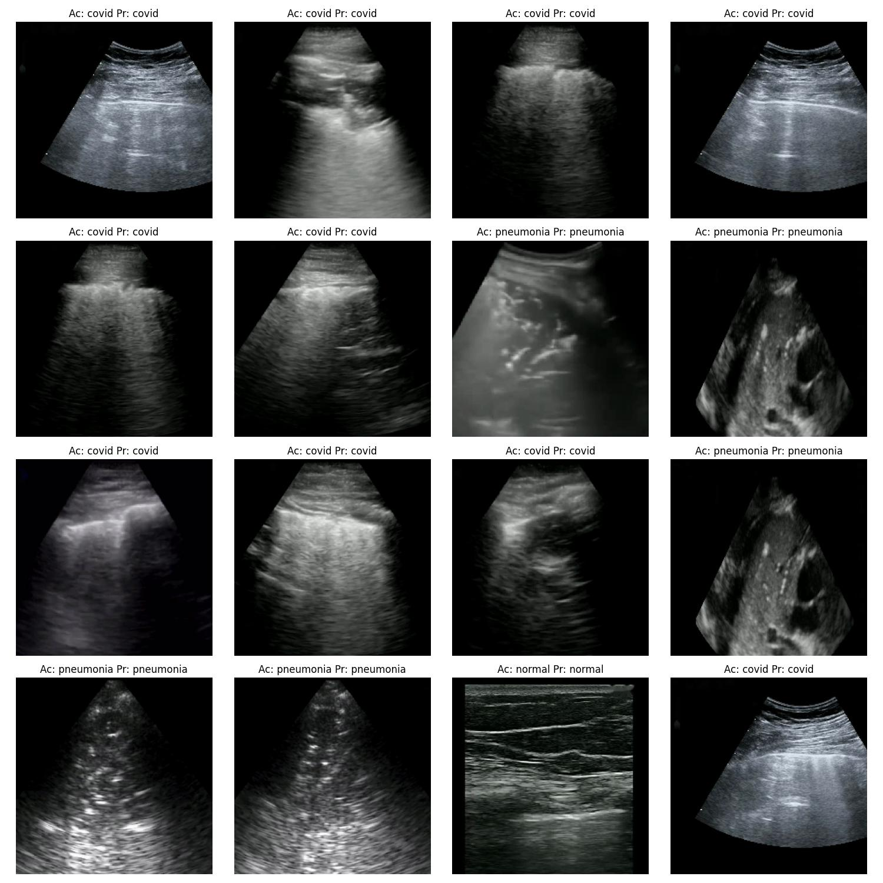
Output Examples of Balanced VGG_CAM

Slide 14
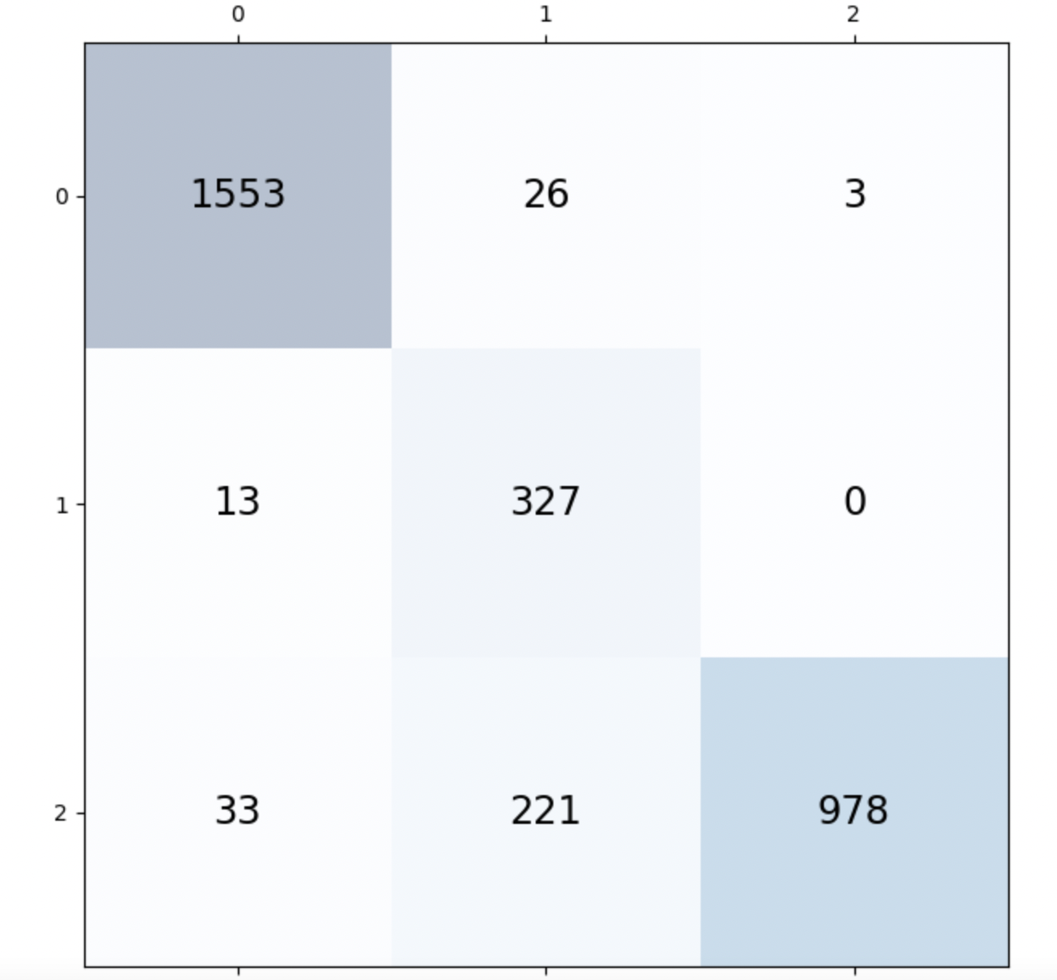
EmergencyNet (Fusion-Average)
Train Accuracy: 99%
Test Accuracy: 91%
Confusion matrix {0: 'covid', 2: 'pneumonia', 1: 'normal'}

Slide 15
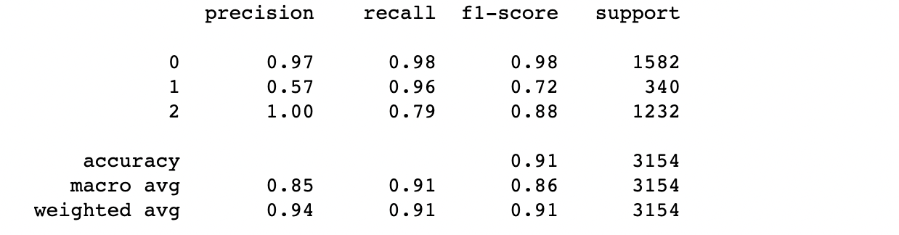
Classification report
Validation classification report

Slide 16
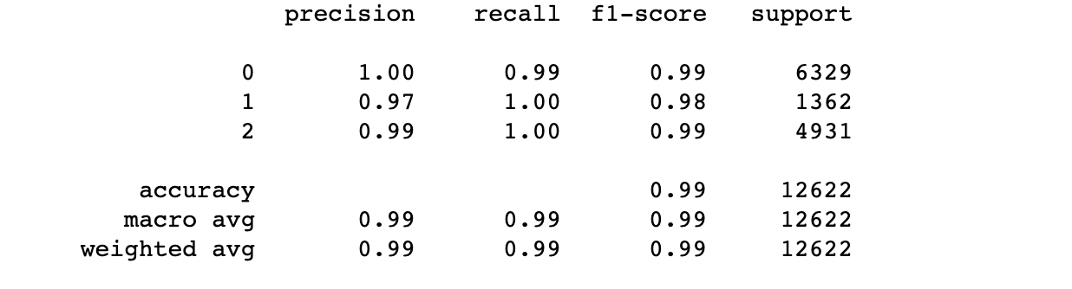
Classification report
Train classification report

Slide 17
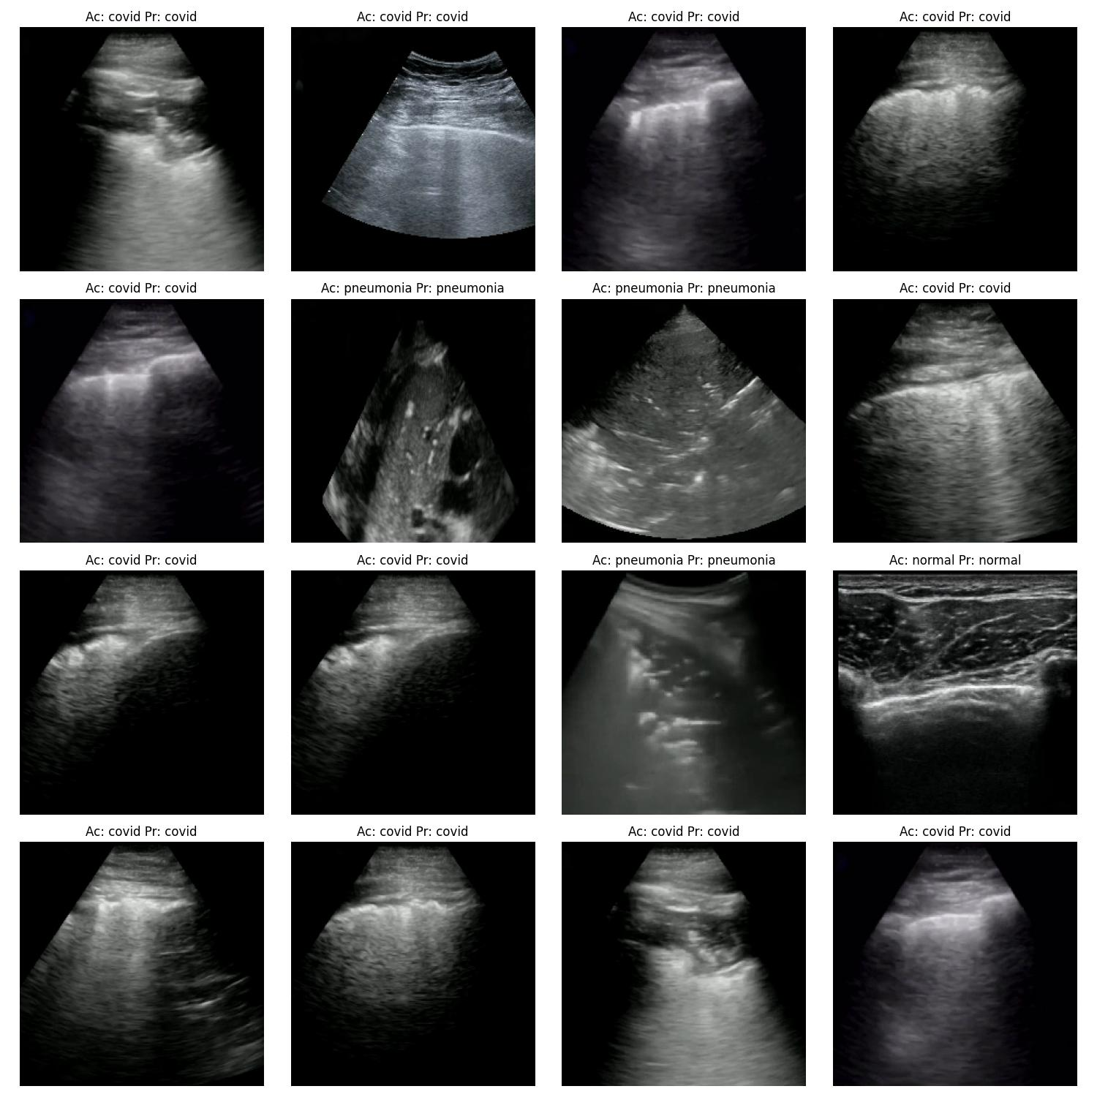
Output Examples of EmergencyNet Avg Fusion

Slide 18
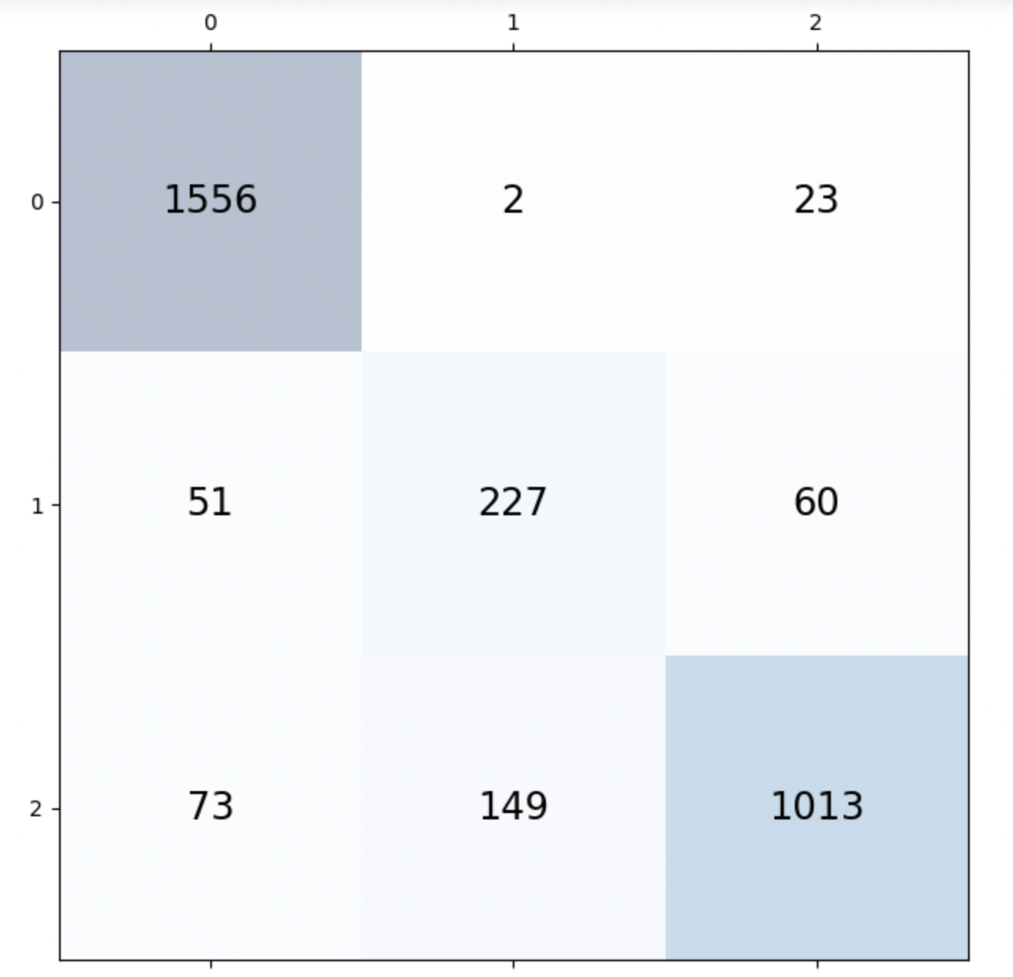
EmergencyNet (Fusion Concatenate)
Train Accuracy: 99%
Test Accuracy: 88%
Confusion matrix {0: 'covid', 2: 'pneumonia', 1: 'normal'}

Slide 19
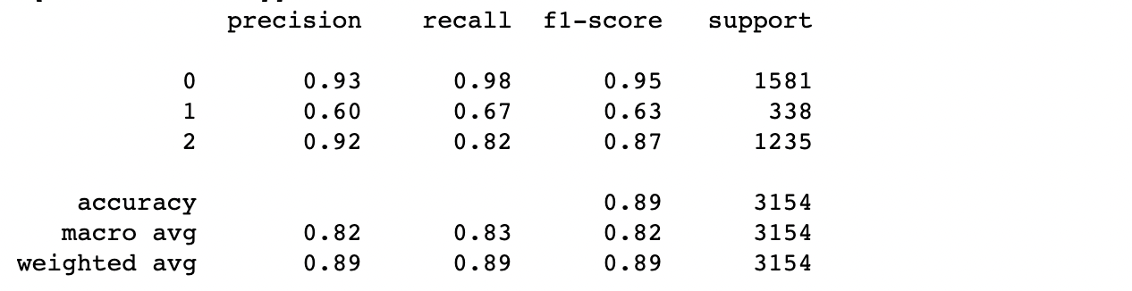
Classification report
Validation classification report

Slide 20
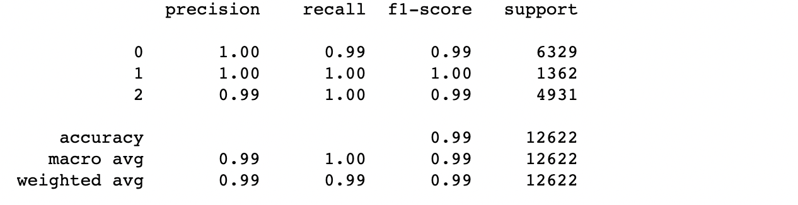
Train Classification report

Slide 21
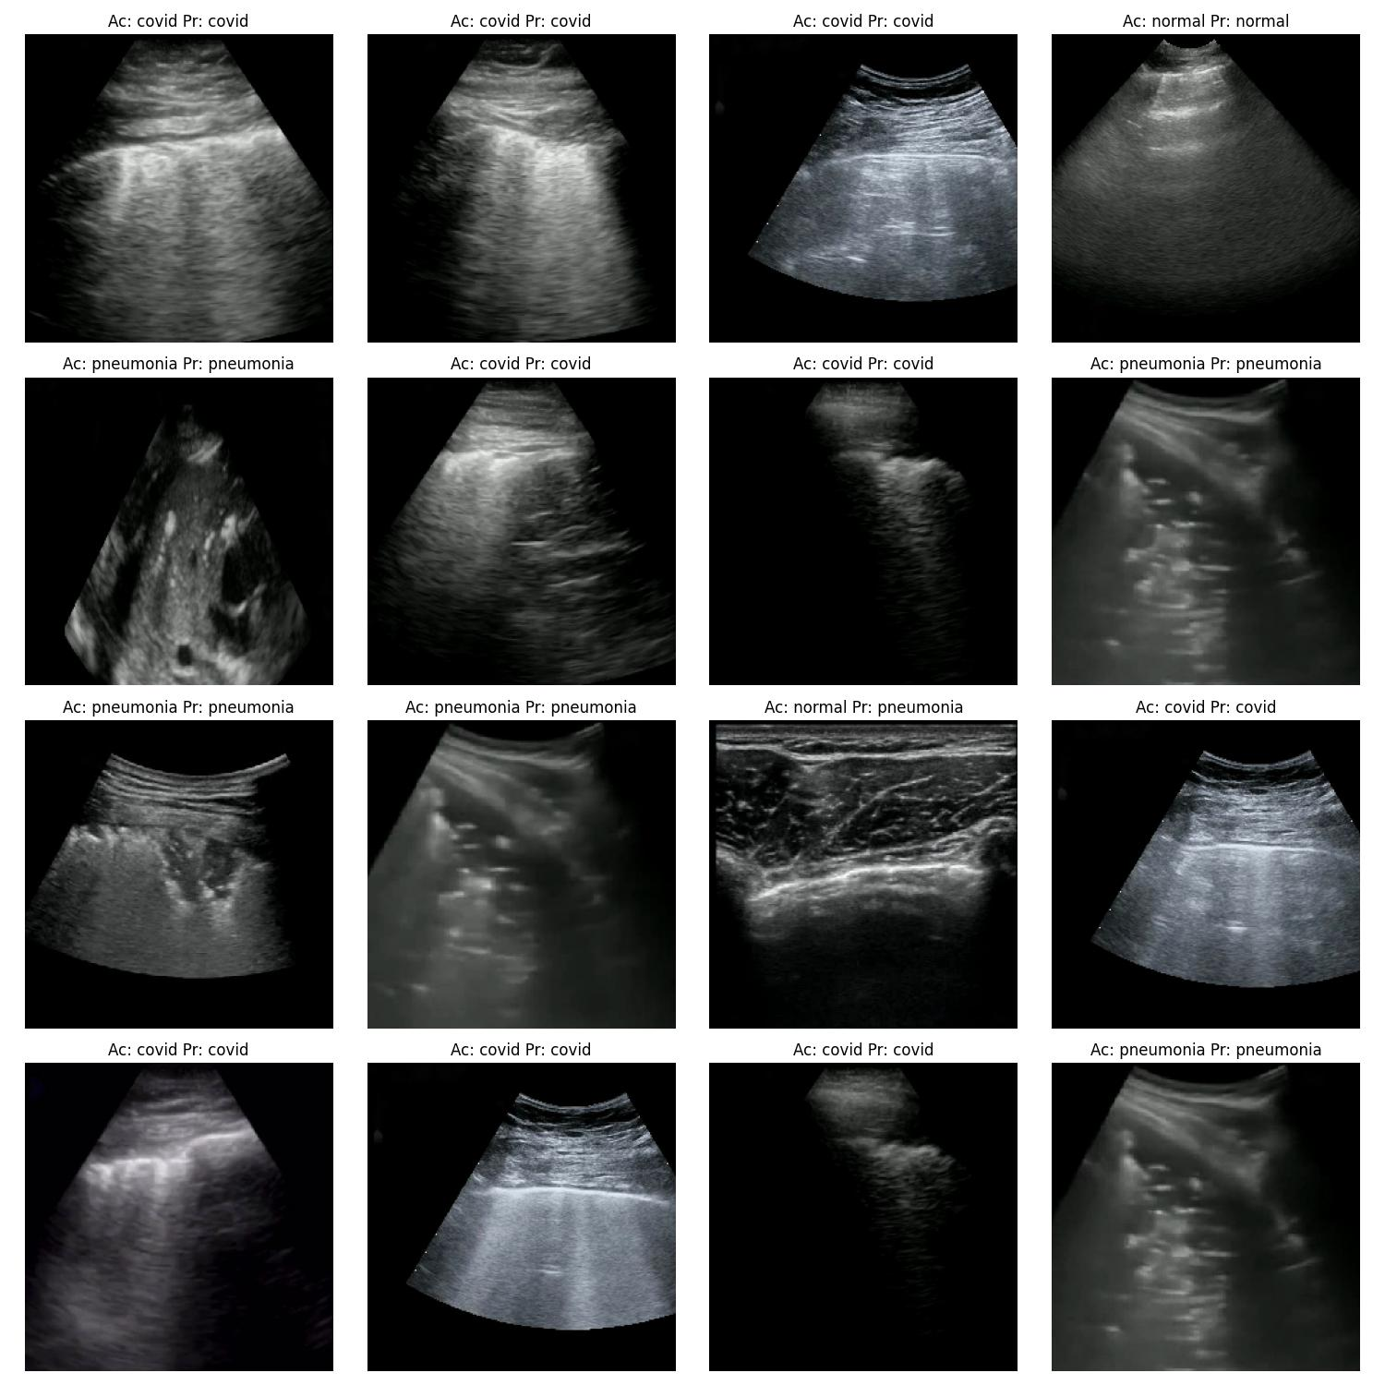
Output Examples of EmergencyNet Fusion - Concatenate

Slide 22
Which model is best?
VGG Cam-Balanced If Accuracy is prioritised
EmergencyNet (Fusion - Avg ) If latency and accuracy is prioritised
VGG Cam has 5 times more trainable variables than EmergencyNet
0.49 milliseconds per image (EmergencyNet)
0.65 milliseconds per image (VGG Cam-Balanced)
Tested on M1-macbook pro

Slide 23
Thank you for your patience!

