Slide 1
Internet Control Message
Protocol

Slide 2
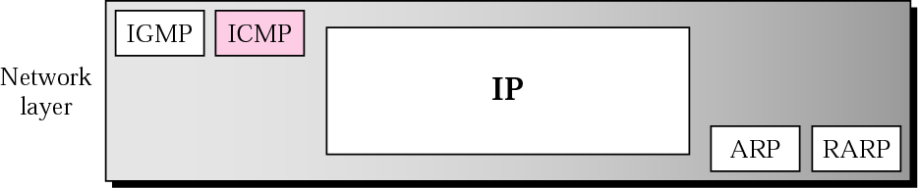
Position of ICMP in the network layer

Slide 3
IP drawbacks:
IP has no error reporting or error correction mechanism
What happens if a router must discard a datagram because it cannot find a router to destination?
What happens if the final destination host must discard all fragments of a datagram because it has not received all fragments within a predetermined time limit?
IP lacks in mechanism for host and management queries
  host may want to know whether a router or another host is alive?
  network manager may need information from another host or router
ICMP is designed to compensate the above deficiencies
The Internet Control Message Protocol (ICMP) is a Network Layer protocol used by network devices to diagnose network communication issues.
ICMP is mainly used to determine whether or not data is reaching its intended destination in a timely manner.
Commonly, the ICMP protocol is used on network devices, such as routers. ICMP is crucial for error reporting and testing

Slide 4
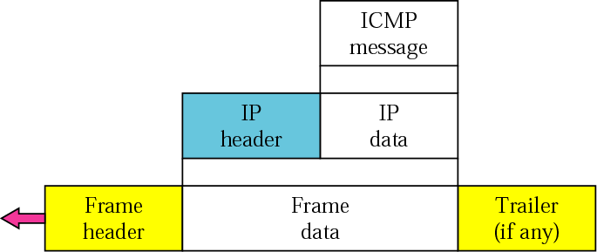
ICMP encapsulation
ICMP is network layer protocol
Its messages are not directly passed to the datalink layer
The messages are encapsulated inside IP datagrams
The value of the protocol field in the IP datagram is 1 to indicate that the IP data is an ICMP message

Slide 5
TYPES OF MESSAGES
ICMP messages are divided into error-reporting messages and query messages. The error-reporting messages report problems that a router or a host (destination) may encounter. The query messages get specific information from a router or another host.

Slide 6
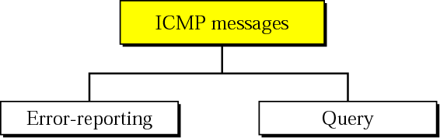
Figure 3 ICMP messages
Error reporting messages report problems that a router or a host may encounter when it processes an IP packet
Query messages (occur in pairs) help host or network manager to get specific information from a router or another host .e.g. nodes can discover their neighbors, host can learn about the routers on their network, routers can help node to redirect its messages.

Slide 7
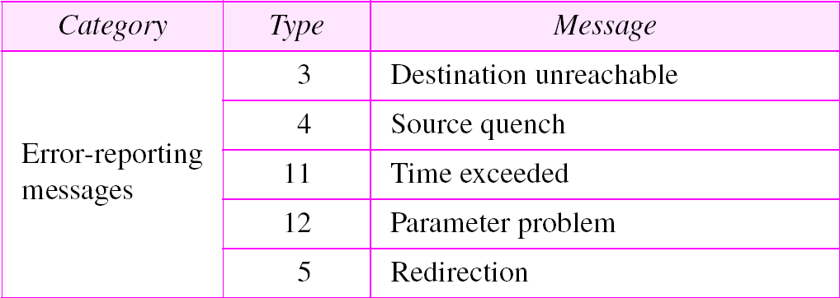
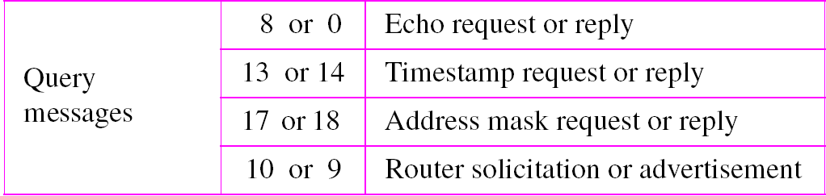
ICMP Messages

Slide 8
MESSAGE FORMAT
An ICMP message has an 8-byte header and a variable-size data section. Although the general format of the header is different for each message type, the first 4 bytes are common to all.

Slide 9
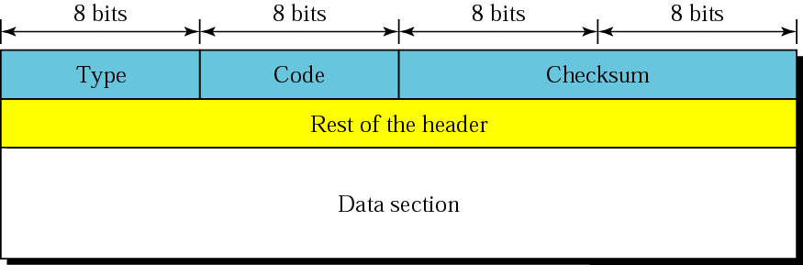
Figure 4 General format of ICMP messages
Type define the type of message
The code field specifies the reason for the particular message type
Checksum field is used for error detection
The rest of the header is specific for each message type
The data section in error messages carries information for finding the original packet that had an error
In query messages, data section carries extra information based on the type of query

Slide 10
ERROR REPORTING
IP, as an unreliable protocol, is not concerned with error checking and error control. ICMP was designed, in part, to compensate for this shortcoming. ICMP does not correct errors, it simply reports them.
Error correction is left to higher level protocols
The topics discussed in this section include:
Destination Unreachable
Source Quench
Time Exceeded
Parameter Problem
Redirection

Slide 11

Note:
ICMP always reports error messages to the original source, because the only information available in the datagram about the route is the source and destination IP address.

Slide 12
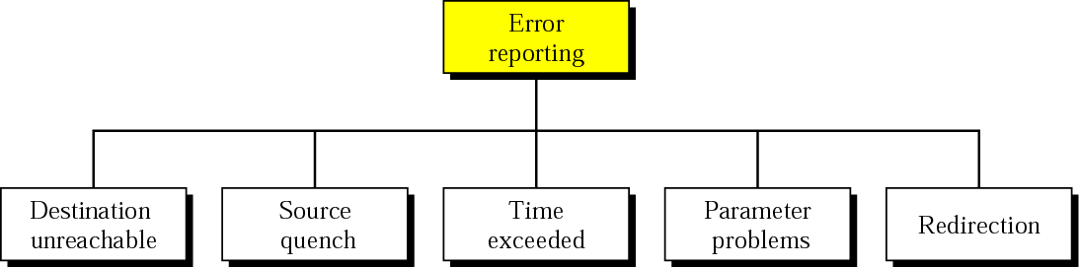
Figure 5 Error-reporting messages

Slide 13
Note:
The following are important points about ICMP error messages:
❏ No ICMP error message will be generated in response
to a datagram carrying an ICMP error message.
❏ No ICMP error message will be generated for a
fragmented datagram that is not the first fragment.
❏ No ICMP error message will be generated for a
datagram having a multicast address.
❏ No ICMP error message will be generated for a
datagram having a special address such as 127.0.0.0 or
0.0.0.0.
Notes:
A 0.0. 0.0 address indicates the client isn't connected to a TCP/IP network, and a device may give itself a 0.0. 0.0 address when it is offline.

Slide 14
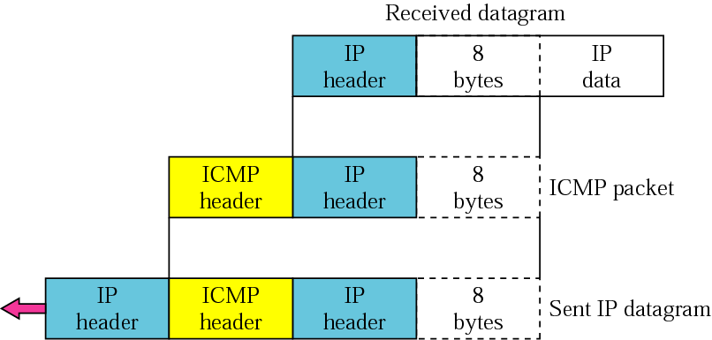
Figure 6 Contents of data field for the error messages
All error messages contain a data section that includes IP header of the original datagram + 8 bytes of data in that datagram
The 8 bytes of data are included because, these bytes define the port numbers (UDP and TCP) and sequence number in (TCP)
This information is needed so the source can inform the protocols (TCP or UDP) about the error

Slide 15
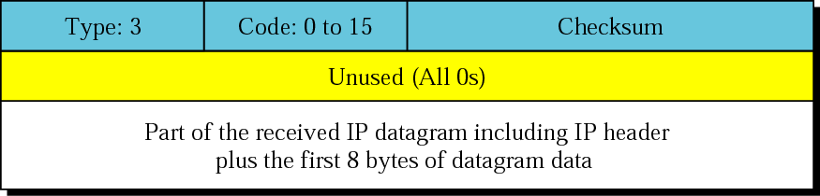
Figure 7 Destination-unreachable format
When a router cannot route a datagram, or a host cannot deliver a datagram, the datagram is discarded and the router or the host sends a destination unreachable message back to the source host that initiated the datagram
Code 0: network unreachable
Code 1: host unreachable
Code 2: protocol is unreachable; data received for TCP ,and TCP is not running at the moment could only be detected by the destination
Code 3: port unreachable (application process)
……
……
……

Slide 16
Note:
Destination-unreachable messages with codes 2 or 3 can be created only by the destination host.
Other destination-unreachable messages can be created only by routers.

Slide 17
Note:
A router cannot detect all problems that prevent the delivery of a packet.
e.g. Datagram travelling through Ethernet

Slide 18
Note:
There is no flow-control mechanism in the IP protocol. (IP is connectionless, no communication between source-generates datagram, router- forwards datagram, destination host-processes datagram)

Slide 19
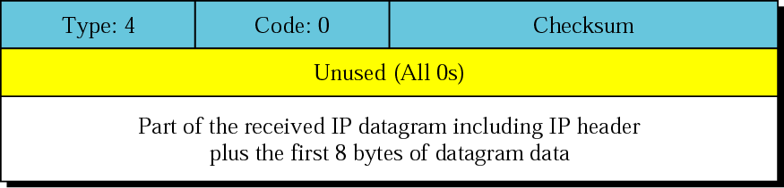
Figure 8 Source-quench format
The source quench message in ICMP was designed to add flow and congestion control to IP
When a router or host discards a datagram it sends a source-quench message to the sender of datagram

Slide 20
Note:
A source-quench message informs the source that a datagram has been discarded due to congestion in a router or the destination host.
The source must slow down (quench) the sending of datagrams until the congestion is relieved.

Slide 21
Note:
One source-quench message is sent for each datagram that is discarded due to congestion.

Slide 22
Source Quench
Router or destination host sends source quench message for congestion in the network
No mechanism to tell source that congestion is relieved or not
So source continues to send data at slower rate until no more source quench messages are received
Congestion may be created by one-to-one or many-to-one type communication
In one-to-one communication if the sender is sending data at a higher rate than the router or destination host can process it, then in this case source quench messages help the sender to slow down its data transfer
In many-to-one type communication many sources create datagram, some transfer at faster rate and some slower. The destination host or router has no clue which source is responsible for congestion , hence the technique fails (it may drop a packet from a very slow source instead of dropping the datagram that has actually created congestion)

Slide 23
Note:
Whenever a router decrements a time-to-live value to zero, it discards the datagram and sends a time-exceeded message to the original source

Slide 24
Note:
When the final destination does not receive all of the fragments in a set time, it discards the received fragments and sends a time-exceeded message to the original source. (timer)

Slide 25
Note:
In a time-exceeded message, code 0 is used only by routers to show that the value of the time-to-live field is zero. Code 1 is used only by the destination host to show that not all of the fragments have arrived within a set time.

Slide 26

Figure 9 Time-exceeded message format

Slide 27
Note:
A parameter-problem message can be created by a router or the destination host.

Slide 28
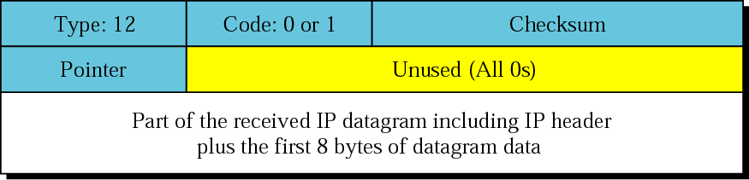
Figure 10 Parameter-problem message format
Any ambiguity in the header part of a datagram can create serious problems as the datagram travels through the internet
If a router or host finds such ambiguity it discards the packet and sends a parameter problem to the source
Code 0: Error in one of the header fields, pointer points to the byte having problem
Code 1: The required part of the option is missing

Slide 29
Redirection Message
A host usually starts with a small routing table that is gradually augmented and updated. One of the tools to accomplish this is the redirection message.

Slide 30
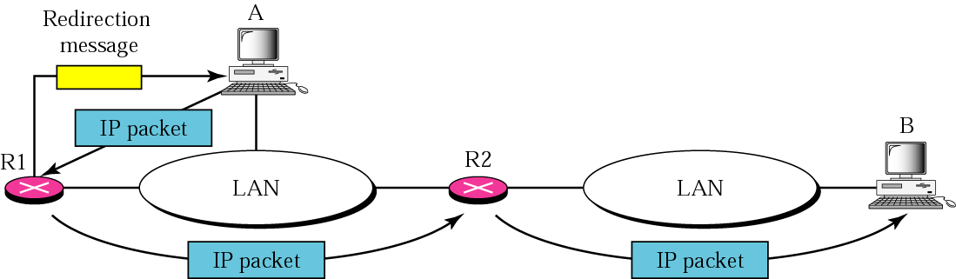
Figure 11 Redirection concept

Slide 31
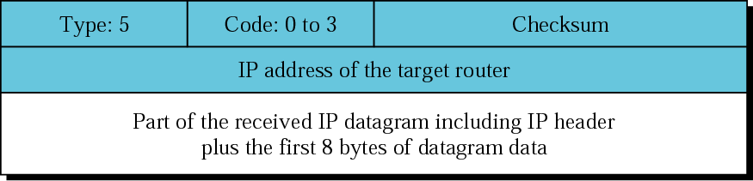
Figure 12 Redirection message format
Code 0: Redirection for a network specific route
Code 1: Redirection for a host specific route
Code 2: Redirection for a network specific route based on specific type of service
Code 3: Redirection for a host specific route based on specific type of service

Slide 32
Note:
A redirection message is sent from a router to a host on the same local network.

Slide 33
QUERY
ICMP can also diagnose some network problems through the query messages, a group of four different pairs of messages. In this type of ICMP message, a node sends a message that is answered in a specific format by the destination node.
The topics discussed in this section include:
Echo Request and Reply
Timestamp Request and Reply
Address-Mask Request and Reply
Router Solicitation and Advertisement

Slide 34
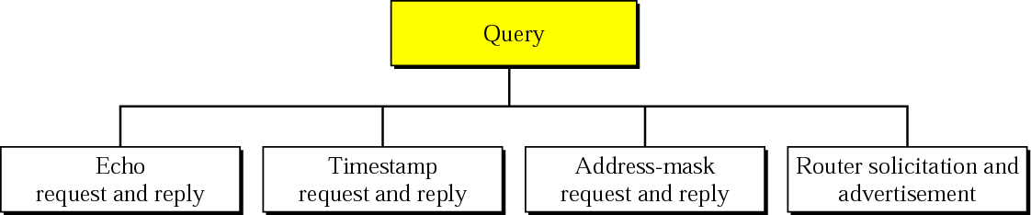
Figure 13 Query messages

Slide 35
Note:
An echo-request message can be sent by a host or router. An echo-reply message is sent by the host or router which receives an echo-request message.(diagnostic purpose)

Slide 36
Note:
Echo-request and echo-reply messages can be used by network managers to check the operation of the IP protocol.(working or not)

Slide 37
Note:
Echo-request and echo-reply messages can test the reachability of a host. This is usually done by invoking the ping (Packet Internet Groper) command.

Slide 38
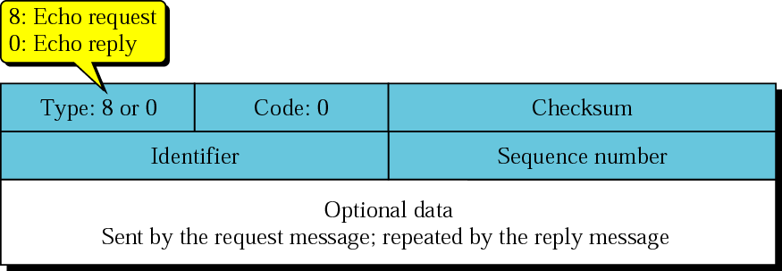
Figure 14 Echo-request and echo-reply messages
An ICMP Echo Request (Type 8, Code 0) is sent to test network reachability, while an ICMP Echo Reply (Type 0, Code 0) is the response from a device confirming it received the request.
Both packets contain an Identifier and Sequence Number to match requests with their corresponding replies, a Checksum for data integrity, and a Data/Payload field of variable length that must be identical in the reply to the original request.

Slide 39
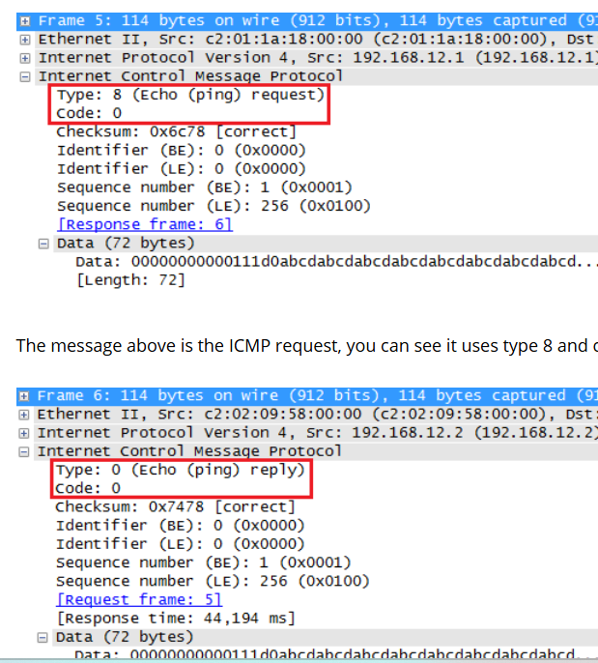
Figure 14 Echo-request and echo-reply messages

Slide 40
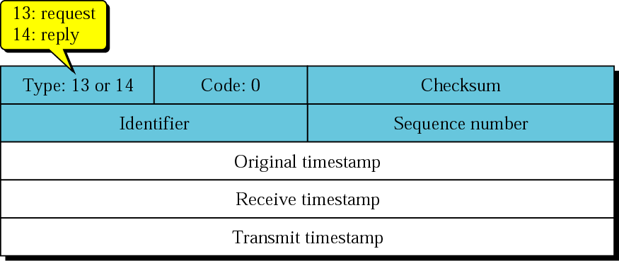
Figure 15 Timestamp-request and timestamp-reply message format
The source creates a time stamp request message, fills original timestamp (at departure time), other two fields are 0
The destination creates a time stamp reply message, copies original ts, fills receive ts, fills transmit timestamp (time at which the packet departs)
Sending time= receive timestamp-original timestamp
Receiving time=returned time-transmit time
Round-trip time= Sending time + Receiving time

Slide 41
Note:
Timestamp-request and timestamp-reply messages can be used to calculate the round-trip time between a source and a destination machine even if their clocks are not synchronized.

Slide 42
Example:
Original timestamp: 46
Receive timestamp:59
Transmit timestamp: 60
Return time:67
Sending time=59-46=13ms
Receiving time=67-60=7ms
Round-trip time=13+7= 20ms

Slide 43
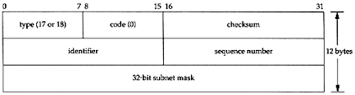
Figure 16 Mask-request and mask-reply message and Router advt.
An Address Mask Request (Type 17) is a query sent by a host to obtain its local subnet mask, typically to the network's broadcast address, and the responding Address Mask Reply (Type 18) message contains the requested subnet mask.
How it Works?
Request: A host that needs its subnet mask sends an ICMP Address Mask Request (Type 17).
The request is usually broadcast to the local network's broadcast address (e.g., 255.255.255.255) to reach any listening routers.
A router or server on the network that receives the request and understands its function responds with an Address Mask Reply.
Reply: The responding device sends an ICMP Address Mask Reply (Type 18) message.
This reply contains the subnet mask for the local network, embedded in the Address Mask field.
The reply is typically unicast directly back to the requesting device, ensuring the correct information is delivered.

Slide 44
Figure 16 Mask-request and mask-reply message and Router advt.
Purpose
Host Configuration: The original intent was for diskless workstations or other hosts to discover their subnet mask during the boot process.
Network Discovery (Reconnaissance): Attackers may use this method to map network topology, discover active subnets, and identify the range of IP addresses within a subnet, as some networks may not block Type 17/18 while blocking other ICMP types like Echo Requests.
Dynamic Host Configuration Protocol (DHCP) and other host configuration protocols have largely replaced the need for these ICMP messages for obtaining subnet information.

Slide 45
Router Solicitation and Advertisement
In computer networking, the ICMP Internet Router Discovery Protocol (IRDP), also called the Internet Router Discovery Protocol, is a protocol for computer hosts to discover the presence and location of routers on their IPv4 local area network.
To enable router discovery, the IRDP defines two kinds of ICMP messages:
The ICMP Router Solicitation message is sent from a computer host to any routers on the local area network to request that they advertise their presence on the network.
The ICMP Router Advertisement message is sent by a router on the local area network to announce its IP address as available for routing.
When a host boots up, it sends solicitation messages to IP multicast address 224.0.0.2. In response, one or more routers may send advertisement messages. If there is more than one router, the host usually picks the first message it gets and adds that router to its routing table. Independently of a solicitation, a router may periodically send out advertisement messages.

Slide 46
IP addresses: how to get one?
Q: How does a host get IP address?
hard-coded by system admin in a file
  Windows: control-panel->network->configuration->tcp/ip->properties
  UNIX: /etc/rc.config
DHCP: Dynamic Host Configuration Protocol: dynamically get address from as server
  “plug-and-play”
Network Layer
4-<number>

Slide 47
DHCP: Dynamic Host Configuration Protocol
goal: allow host to dynamically obtain its IP address from network server when it joins network
  can renew its lease on address in use
  allows reuse of addresses (only hold address while connected/“on”)
  support for mobile users who want to join network (more shortly)
DHCP overview:
  host broadcasts “DHCP discover” msg [optional]
  DHCP server responds with “DHCP offer” msg [optional]
  host requests IP address: “DHCP request” msg
  DHCP server sends address: “DHCP ack” msg
Network Layer
4-<number>

Slide 48



DHCP client-server scenario
DHCP
server
223.1.1.0/24
223.1.1.1
223.1.2.1
223.1.1.2
arriving DHCP
client needs
address in this
network
223.1.1.4
223.1.2.9
223.1.3.27
223.1.2.2
223.1.1.3
223.1.2.0/24
223.1.3.1
223.1.3.2
223.1.3.0/24
Network Layer
4-<number>

Slide 49
DHCP client-server scenario
DHCP server: 223.1.2.5
DHCP discover
arriving
client
src : 0.0.0.0, 68
dest.: 255.255.255.255,67
yiaddr: 0.0.0.0
transaction ID: 654
Broadcast: is there a DHCP server out there?
DHCP offer
src: 223.1.2.5, 67
dest: 255.255.255.255, 68
yiaddrr: 223.1.2.4
transaction ID: 654
lifetime: 3600 secs
Broadcast: I’m a DHCP server! Here’s an IP address you can use
DHCP request
src: 0.0.0.0, 68
dest:: 255.255.255.255, 67
yiaddrr: 223.1.2.4
transaction ID: 655
lifetime: 3600 secs
Broadcast: OK. I’ll take that IP address!
DHCP ACK
src: 223.1.2.5, 67
dest: 255.255.255.255, 68
yiaddrr: 223.1.2.4
transaction ID: 655
lifetime: 3600 secs
Broadcast: OK. You’ve got that IP address!
Network Layer
4-<number>

Slide 50
DHCP: more than IP addresses
DHCP can return more than just allocated IP address on subnet:
  address of first-hop router for client
  name and IP address of DNS sever
  network mask (indicating network versus host portion of address)
Network Layer
4-<number>

Slide 51
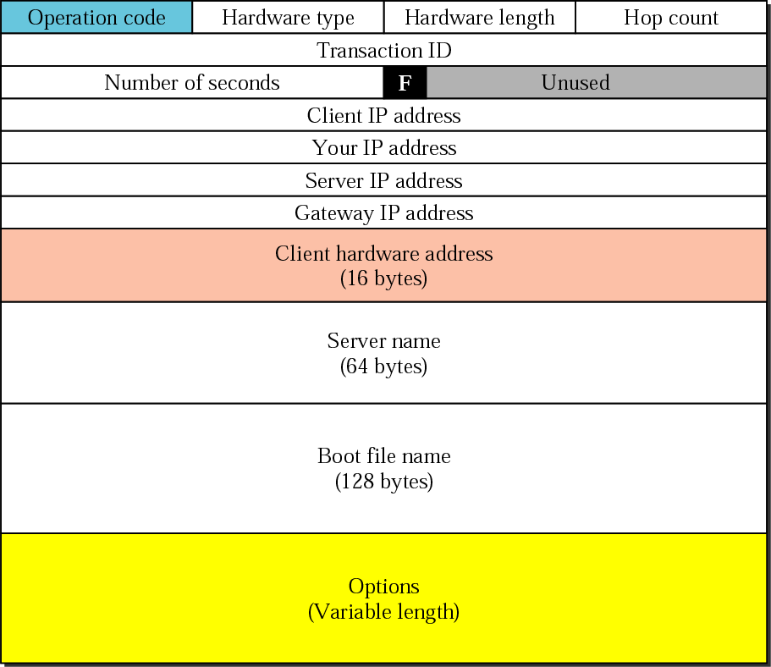
DHCP Packet format
Network Layer
4-<number>

Slide 52
Hardware Length: This is an 8-bit field defining the length of the physical address in bytes. e.g. for Ethernet the value is 6.
Hop count: This is an 8-bit field defining the maximum number of hops the packet can travel.
Transaction ID: This is a 4-byte field carrying an integer. The transaction identification is set by the client and is used to match a reply with the request. The server returns the same value in its reply.
Number of Seconds: This is a 16-bit field that indicates the number of seconds elapsed since the time the client started to boot.
Flag: This is a 16-bit field in which only the leftmost bit is used and the rest of the bit should be set to 0. A leftmost bit specifies a forced broadcast reply from the server.
Client IP Address: This is a 4-byte field that contains the client IP address . If the client does not have this information this field has a value of 0.
Your IP Address: This is a 4-byte field that contains the client IP address. It is filled by the server at the request of the client.
Server IP Address: This is a 4-byte field containing the server IP address. It is filled by the server in a reply message.
Network Layer
4-<number>

Slide 53
Gateway IP Address: This is a 4-byte field containing the IP address of a routers. IT is filled by the server in a reply message.
Client Hardware Address: This is the physical address of the client .Although the server can retrieve this address from the frame sent by the client it is more efficient if the address is supplied explicitly by the client in the request message.
Server Name: This is a 64-byte field that is optionally filled by the server in a reply packet. It contains a null-terminated string consisting of the domain name of the server. If the server does not want to fill this filed with data, the server must fill it with all 0s.
Boot Filename: This is a 128-byte field that can be optionally filled by the server in a reply packet. It contains a null- terminated string consisting of the full pathname of the boot file.
Options: This is a 64-byte field with a dual purpose. IT can carry either additional information or some specific vendor information. The field is used only in a reply message.
Network Layer
4-<number>

Slide 54
DEBUGGING TOOLS
We introduce two tools that use ICMP for debugging: ping and traceroute.
The topics discussed in this section include:
Ping
Traceroute

Slide 55
Example 2
We use the ping program to test the server fhda.edu. The result is shown below:
$ ping fhda.edu
PING fhda.edu (153.18.8.1) 56 (84) bytes of data.
64 bytes from tiptoe.fhda.edu (153.18.8.1): icmp_seq=0 ttl=62 time=1.91 ms
64 bytes from tiptoe.fhda.edu (153.18.8.1): icmp_seq=1 ttl=62 time=2.04 ms
64 bytes from tiptoe.fhda.edu (153.18.8.1): icmp_seq=2 ttl=62 time=1.90 ms
64 bytes from tiptoe.fhda.edu (153.18.8.1): icmp_seq=3 ttl=62 time=1.97 ms
64 bytes from tiptoe.fhda.edu (153.18.8.1): icmp_seq=4 ttl=62 time=1.93 ms
See Next Slide

Slide 56
Example 2 (Continued)
64 bytes from tiptoe.fhda.edu (153.18.8.1): icmp_seq=5 ttl=62 time=2.00 ms
64 bytes from tiptoe.fhda.edu (153.18.8.1): icmp_seq=6 ttl=62 time=1.94 ms
64 bytes from tiptoe.fhda.edu (153.18.8.1): icmp_seq=7 ttl=62 time=1.94 ms
64 bytes from tiptoe.fhda.edu (153.18.8.1): icmp_seq=8 ttl=62 time=1.97 ms
64 bytes from tiptoe.fhda.edu (153.18.8.1): icmp_seq=9 ttl=62 time=1.89 ms
64 bytes from tiptoe.fhda.edu (153.18.8.1): icmp_seq=10 ttl=62 time=1.98 ms
--- fhda.edu ping statistics ---
11 packets transmitted, 11 received, 0% packet loss, time 10103ms
rtt min/avg/max = 1.899/1.955/2.041 ms

Slide 57
The ping command starts the sequence number from 0
This no. is incremented by 1 each time a new message is sent
The TTL field is set to 62 hops
At beginning data bytes are defined as 56 and total number of bytes as 84
56+ 8 bytes of ICMP+ 20 bytes IP
In each probe it defines 64 bytes = 56 data + 8 ICMP

Slide 58
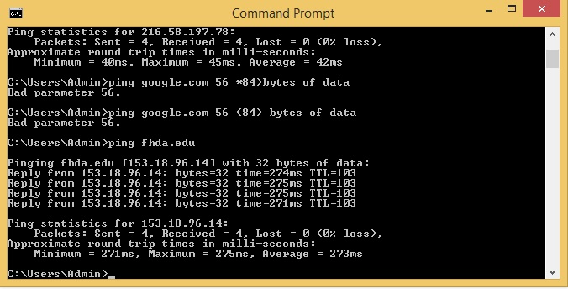

Slide 59
Example 3
For the this example, we want to know if the adelphia.net mail server is alive and running. The result is shown below:
$ ping mail.adelphia.net
PING mail.adelphia.net (68.168.78.100) 56(84) bytes of data.
64 bytes from mail.adelphia.net (68.168.78.100): icmp_seq=0 ttl=48 time=85.4 ms
64 bytes from mail.adelphia.net (68.168.78.100): icmp_seq=1 ttl=48 time=84.6 ms
64 bytes from mail.adelphia.net (68.168.78.100): icmp_seq=2 ttl=48 time=84.9 ms
64 bytes from mail.adelphia.net (68.168.78.100): icmp_seq=3 ttl=48 time=84.3 ms
64 bytes from mail.adelphia.net (68.168.78.100): icmp_seq=4 ttl=48 time=84.5 ms
See Next Slide

Slide 60
Example 3 (Continued)
64 bytes from mail.adelphia.net (68.168.78.100): icmp_seq=5 ttl=48 time=84.7 ms
64 bytes from mail.adelphia.net (68.168.78.100): icmp_seq=6 ttl=48 time=84.6 ms
64 bytes from mail.adelphia.net (68.168.78.100): icmp_seq=7 ttl=48 time=84.7 ms
64 bytes from mail.adelphia.net (68.168.78.100): icmp_seq=8 ttl=48 time=84.4 ms
64 bytes from mail.adelphia.net (68.168.78.100): icmp_seq=9 ttl=48 time=84.2 ms
64 bytes from mail.adelphia.net (68.168.78.100): icmp_seq=10 ttl=48 time=84.9 ms
64 bytes from mail.adelphia.net (68.168.78.100): icmp_seq=11 ttl=48 time=84.6 ms
64 bytes from mail.adelphia.net (68.168.78.100): icmp_seq=12 ttl=48 time=84.5 ms
--- mail.adelphia.net ping statistics ---
14 packets transmitted, 13 received, 7% packet loss, time 13129ms
rtt min/avg/max/mdev = 84.207/84.694/85.469

Slide 61
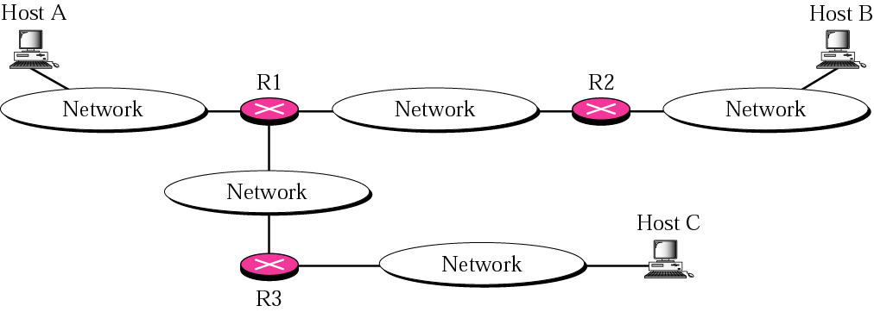
Figure 20 The traceroute program operation

Slide 62
Figure 20 The traceroute program operation
Steps to find a route from Host A to Router R1. It repeats the following steps in order to get better average RTT. First trip may be longer than second or third because ARP program take time to find the physical address of Router R1
  Traceroute at A sends a packet to B using UDP encapsulated in IP with TTL 1.Time is noted (sent time)
  R1 receives packet and decrements TTL to 0; packet is discarded; sends time exceeded message (type:11, code:0) to show TTL is 0
  Traceroute program receives the ICMP message and finds the IP address of router 1 by encapsulating the ICMP
Above steps are repeated to find the address of router R2 and RTT between A and R2 . This time TTL is 2
Traceroute repeats the previous steps to find the address of Host B and RTT between A and B

Slide 63
Figure 20 The traceroute program operation
NOTE: When B recieves the packet it will process it because destination address matches then how A will receive an ICMP message
In this case the destination port of the UDP packet is set to one that doesnot match the destination UDP protocol.
When host B receives the packet, it cannot find an application program to accept the delivery; it discards the packet and error message is sent

Slide 64
Example 4
We use the traceroute program to find the route from the computer voyager.deanza.edu to the server fhda.edu. The following shows the result:
$ traceroute fhda.edu
traceroute to fhda.edu (153.18.8.1), 30 hops max, 38 byte packets
1 Dcore.fhda.edu (153.18.31.254) 0.995 ms 0.899 ms 0.878 ms
2 Dbackup.fhda.edu (153.18.251.4) 1.039 ms 1.064 ms 1.083 ms
3 tiptoe.fhda.edu (153.18.8.1) 1.797 ms 1.642 ms 1.757 ms
See Next Slide

Slide 65
Example 4 (Continued)
The un-numbered line after the command shows that the destination is 153.18.8.1. The TTL value is 30 hops. The packet contains 38 bytes: 20 bytes of IP header, 8 bytes of UDP header, and 10 bytes of application data. The application data is used by traceroute to keep track of the packets.
The first line shows the first router visited. The router is named Dcore.fhda.edu with IP address 153.18.31.254. The first round trip time was 0.995 milliseconds, the second was 0.899 milliseconds, and the third was 0.878 milliseconds.
The second line shows the second router visited. The router is named Dbackup.fhda.edu with IP address 153.18.251.4. The three round trip times are also shown.
The third line shows the destination host. We know that this is the destination host because there are no more lines. The destination host is the server fhda.edu, but it is named tiptoe. fhda.edu with the IP address 153.18.8.1. The three round trip times are also shown.

Slide 66
Example 5
In this example, we trace a longer route, the route to xerox.com
$ traceroute xerox.com
traceroute to xerox.com (13.1.64.93), 30 hops max, 38 byte packets
1 Dcore.fhda.edu (153.18.31.254) 0.622 ms 0.891 ms 0.875 ms
2 Ddmz.fhda.edu (153.18.251.40) 2.132 ms 2.266 ms 2.094 ms
...
18 alpha.Xerox.COM (13.1.64.93) 11.172 ms 11.048 ms 10.922 ms
Here there are 17 hops between source and destination. Note that some round trip times look unusual. It could be that a router is too busy to process the packet immediately.

Slide 67
Example 6
An interesting point is that a host can send a traceroute packet to itself. This can be done by specifying the host as the destination. The packet goes to the loopback address as we expect.
$ traceroute voyager.deanza.edu
traceroute to voyager.deanza.edu (127.0.0.1), 30 hops max, 38 byte packets
1 voyager (127.0.0.1) 0.178 ms 0.086 ms 0.055 ms

Slide 68
Example 7
Finally, we use the traceroute program to find the route between fhda.edu and mhhe.com (McGraw-Hill server). We notice that we cannot find the whole route. When traceroute does not receive a response within 5 seconds, it prints an asterisk to signify a problem, and then tries the next hop..
$ traceroute mhhe.com
traceroute to mhhe.com (198.45.24.104), 30 hops max, 38 byte packets
1 Dcore.fhda.edu (153.18.31.254) 1.025 ms 0.892 ms 0.880 ms
2 Ddmz.fhda.edu (153.18.251.40) 2.141 ms 2.159 ms 2.103 ms
3 Cinic.fhda.edu (153.18.253.126) 2.159 ms 2.050 ms 1.992 ms
...
16 * * *
17 * * *
...............

Slide 69
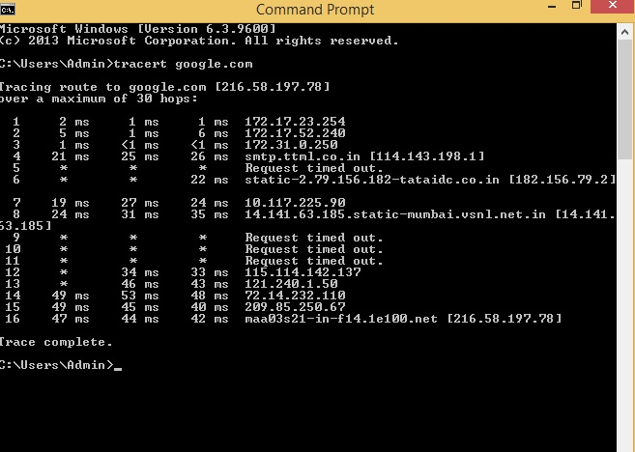

Slide 70
9.7 ICMP PACKAGE
To give an idea of how ICMP can handle the sending and receiving of ICMP messages, we present our version of an ICMP package made of two modules: an input module and an output module.
The topics discussed in this section include:
Input Module
Output Module

Slide 71
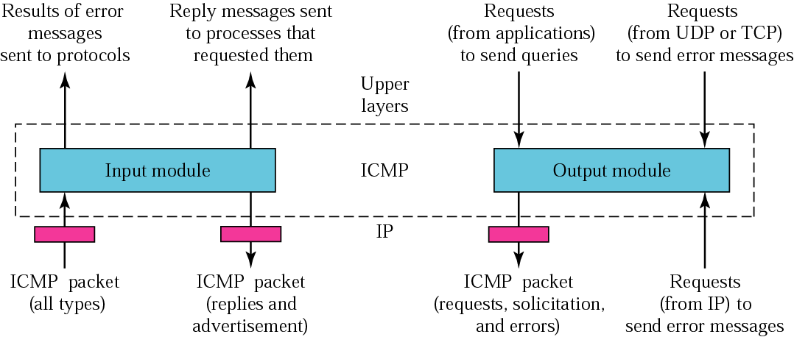
Figure 9.21 ICMP package

