Slide 1
Unit 1: Biomolecules and Enzymes

Slide 2
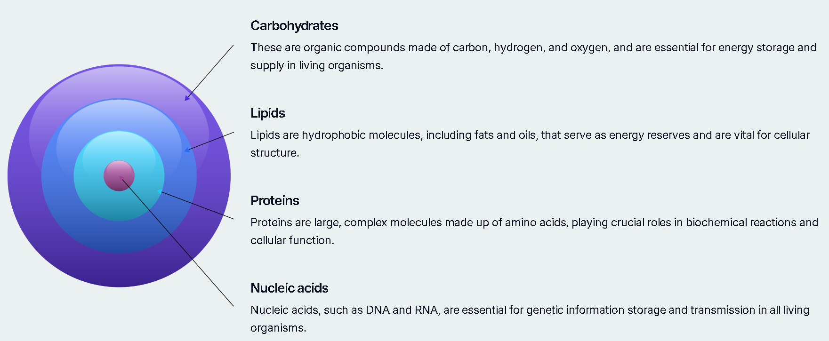
Biomolecules
Occur naturally in living organisms.
Notes:
Think of them like the power, wiring, machinery, and software in a robotic system.”

Slide 3
Carbohydrates
Most abundant biomolecules on earth.
Contains multiple hydroxyl (-OH) groups and either an aldehyde (-CHO) or a ketone (C=O) functional group
Classes of carbohydrates
Monosaccharides | Monosaccharides are simple sugars, classified as aldoses or ketoses, serving as fundamental units for larger carbohydrates. Eg. - Glucose
Oligosaccharides | Disaccharides are formed by two monosaccharides linked via an O-glycosidic bond; key examples include sucrose, lactose, and maltose.
Polysaccharides | Polysaccharides are containing more than 20 or more Monosaccharides can be classified as homopolysaccharides (one type of monosaccharide) or heteropolysaccharides (multiple types), showcasing structural diversity.

Slide 4
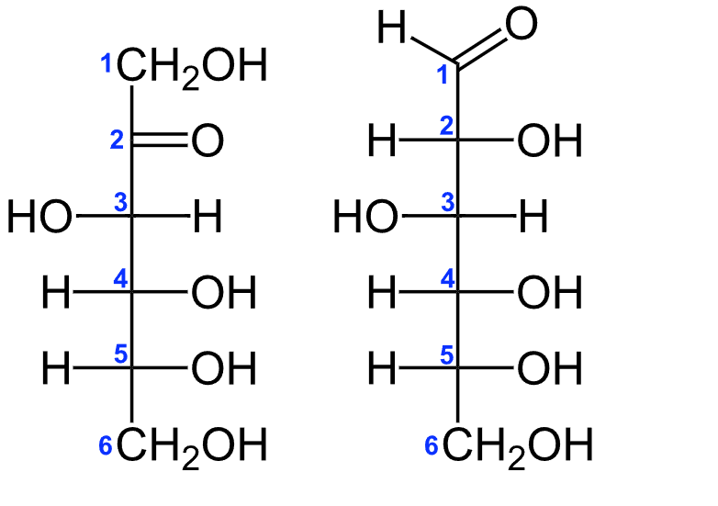
Monosaccharides classification
Monosaccharides are also classified as aldoses or ketoses.
Those monosaccharides that contain an aldehyde functional group are called aldoses
those containing a ketone functional group on the second carbon atom are ketoses.
Fructose
Glucose
Notes:
Lactose- glucose, galactose
Sucrose – glucose , fructose

Slide 5
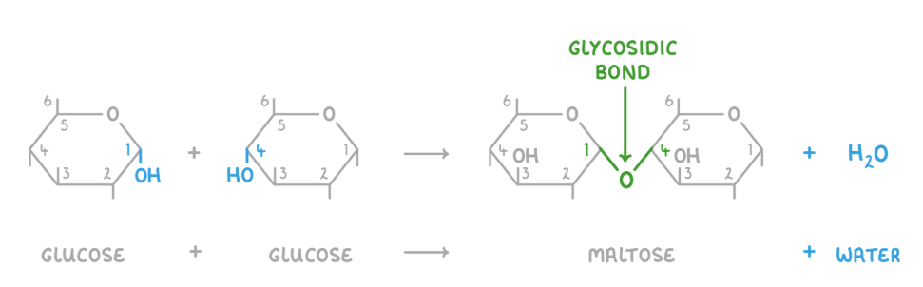
Oligosaccharides: Bridging Simple and Complex
Oligosaccharides are carbohydrates composed of 2 to 10 monosaccharide units linked together by glycosidic bonds.
These covalent bonds are formed through a condensation reaction, where a water molecule is removed between two hydroxyl (-OH) groups.
💡 Analogy: Lego blocks — join to build larger carbs
Common Linkage Types:
Glycosidic Linkages:
1,4-Glycosidic Bond: Linkage between C1 of one sugar and C4 of another.
α-Glycosidic Bonds: Anomeric carbon configuration is alpha.
1,6-Glycosidic Bond: Linkage between C1 of one sugar and C6 of another, creating branches in polysaccharides.
β-Glycosidic Bonds: Anomeric carbon configuration is beta.
These bonds are critical in forming larger carbohydrate structures and determining their physical
and biological properties.

Slide 6
Disaccharides classification
Disaccharides consist of two sugars joined by an O-glycosidic bond.
The most abundant disaccharides are sucrose, lactose and maltose.
The disaccharides can be classified into:
Homodisaccharides: formed of 2 same monosaccharide units
Example – Maltose – 2 glucose units
Heterodisaccharides: formed of 2 different monosaccharide units
Example – Lactose – Glucose + Galactose
Notes:
Maltose – 2 glucose
Lactose- glucose, galactose
Sucrose – glucose , fructose

Slide 7


Polysaccharides: Complex Carbohydrate Polymers
Polysaccharides are high-molecular-weight polymers made of many (up to a million) monosaccharide units. They are typically tasteless and form colloids with water.
Polysaccharides contain hundreds or thousands of carbohydrate units.
Polysaccharides are not reducing sugars, since the anomeric carbons are connected through glycosidic linkages.
Homopolysaccharides:
Heteropolysaccharides:
Composed of a single type of monosaccharide unit.
Key examples include Glycogen, Cellulose, and Starch.
Composed of different types of monosaccharide units.
Examples include Hyaluronic acid and Heparin, often found in connective tissues and as anticoagulants.
These complex carbohydrates serve diverse functions, from energy storage to structural support in living organisms.
🧠 Use in bioplastics, biomedical implants
Notes:
Hyluronic - glucuronic acid and N-acetylglucosamine.

Slide 8
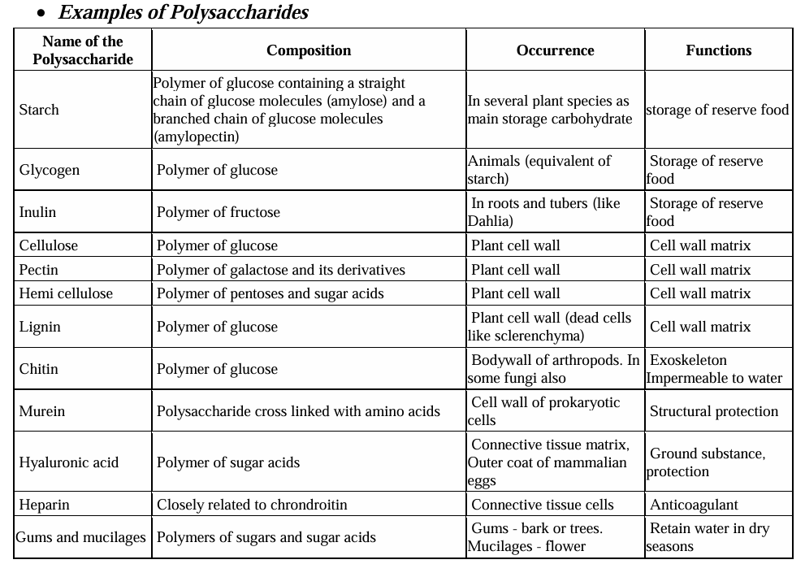

Slide 9
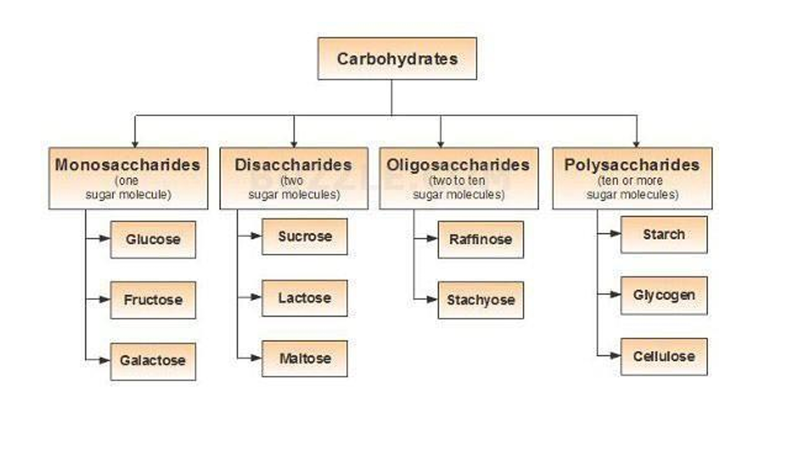

Slide 10
Functions of Carbohydrates
Chief energy source: Carbohydrates act as the primary energy source for many animals, fueling cellular processes and activities essential for survival and growth.
Energy storage: In animals, carbohydrates are stored as glycogen, while in plants, they are stored as starch, serving as a reserve to be utilized when energy is needed.
Biosynthesis intermediates: Carbohydrates play a crucial role as intermediates in the biosynthesis of fats and proteins, aiding in the formation of essential biomolecules.
Nerve tissue regulation: They help in the regulation of nerve tissue and serve as a vital energy source for the brain, crucial for cognitive functions and overall health.
Structural components: In plants and microorganisms, carbohydrates serve as structural components in cell walls, providing rigidity and protection against external factors.
Biological transport: Carbohydrates are involved in biological transport and facilitate cell-cell communication, playing a vital role in the functioning of multicellular organisms.
Notes:
Your brain alone consumes about 120g of glucose per day!”

Slide 11
Applications
1. Glucose Biosensors in Healthcare
Application: Used by diabetic patients to monitor blood sugar levels.
How it works: Enzyme glucose oxidase reacts with glucose → produces an electrical signal proportional to glucose concentration.
Engineering angle: Involves biomedical sensors, enzyme immobilization, microelectronics.
2. Starch in Biodegradable Plastics
Application: Starch-based bioplastics are used in packaging, disposable cutlery, and agricultural films.
Why starch?: It’s cheap, abundant, and forms a film-like structure when processed.
Engineering angle: Material science, green alternatives to petroleum-based plastics, compostable packaging.
3. Cellulose in Paper/Textiles
Application: Major component in making paper, cotton, and viscose fabric.
Structure: Made of β-glucose chains → strong hydrogen bonds → high tensile strength.
Engineering angle: Used in textile engineering, biocomposites, and paper recycling technology.
Notes:
Let’s connect it with engineering:
Glucose biosensors – used in wearable tech like Fitbit
Bioplastics – starch is a low-cost, compostable option
Cellulose – used in textiles, insulation, and biodegradable packaging
Carbohydrates are materials, fuels, and data signals — just like components in engineering systems.”

Slide 12
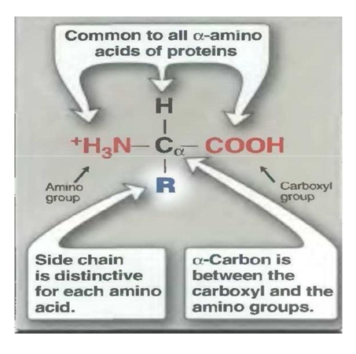
Amino acids and Proteins
Amino acids are the building blocks of proteins.
It has both an amino group (-NH2) and an acid group (-COOH).
The properties of each amino acid are determined by its specific side chain (R-groups).
R- groups vary in structure, size, electric charge and solubility in water from one amino acid to other.
Notes:
Amino acids are the letters of the protein alphabet. Each has a core structure but a unique side chain that defines its behavior.
Just like binary in code — amino acid combinations define biological programs.”

Slide 13
Classification of amino acids
1. Essential amino acids
These amino acids cannot be formed (synthesized) in the body and so, it is essential to be included in the diet.
Their deficiency in the body affects growth, health and protein synthesis
Eg.: Valine, Methionine, Isoleucine, Lysine, Leucine, Tryptophan, Threonine, Phenyl alanine

Slide 14
2. Semi-essential amino acids
These amino acids are formed in the body but not in sufficient amount for body requirements especially in children.
Eg: Arginine, Histidine
3. Non-essential amino acids
The amino acids that can be synthesized in the body by regular metabolism in enough amounts are called as non-essential amino acids.
They need not be included in the diet.
Eg: Glycine, Alanine, Cysteine, Tyrosine, Proline, Serine, Asparagine, Glutamine, Aspartic acid, Glutamic acid.

Slide 15
Proteins
Peptides are short chains of amino acids, the building blocks of proteins. They are formed by linking amino acids together with peptide bonds.
Proteins are polypeptides, which are made up of many amino acids linked together as a linear chain.

Slide 16
Structures of proteins
Primary structure
The linear sequence of amino acids forming the backbone of proteins (polypeptides)
To make a protein, amino acids are connected together by a type of amide bond called a “peptide bond”.
When two amino acids join, the result is called a dipeptide, three gives a tripeptide, etc. Multiple amino acids result in a polypeptide.
The minimum size of a protein is defined as about 50 residues.
Even such small proteins contain hundreds of atoms and have molecular weights of over 5000 Daltons (Da)

Slide 17
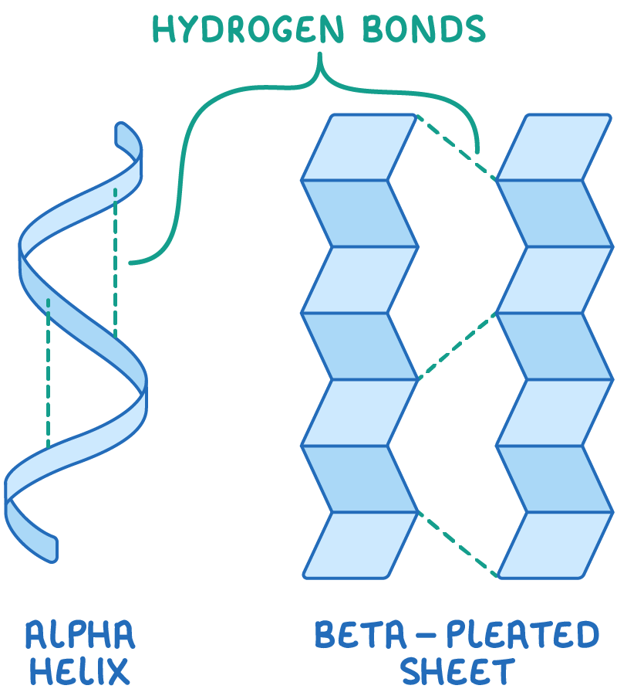
2. Secondary structure
The spatial arrangement of protein by twisting of the polypeptide chain.
2 types of secondary structure: Alpha Helix and Beta Pleated Sheet

Slide 18
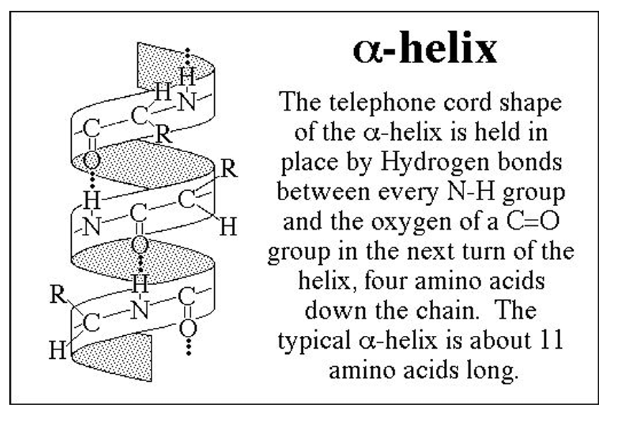
Alpha helix
Helical arrangement of a single polypeptide chain, like a coiled spring.
Each carbonyl is linked by a hydrogen bond to the N-H

Slide 19
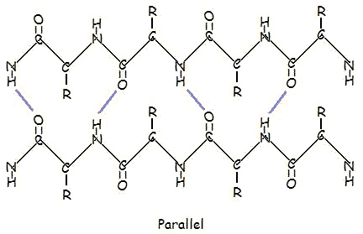
Beta sheets
Polypeptide chain folds back on itself so that polypeptide strands like side by side
Hydrogen bonds are formed in between the neighboring N-H and C=O groups of adjacent peptide chain

Slide 20
Tertiary structure
Regions of secondary structure (alpha helices, beta sheets) fold in the 3D arrangement of a polypeptide chain.
Number of forces act to hold the polypeptide chain in this final configuration:
- Polar/Nonpolar Interactions
- Hydrogen Bonds
- Van der Waals Forces
- Ionic Interactions
- Disulfide Bonds
Polypeptide chains generally contain both hydrophobic and hydrophilic residues
Hydrophobic parts are buried and hydrophilic parts are on the surface, exposed to water.

Slide 21
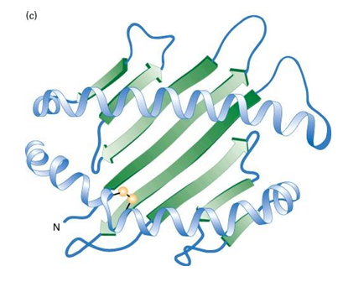

Slide 22
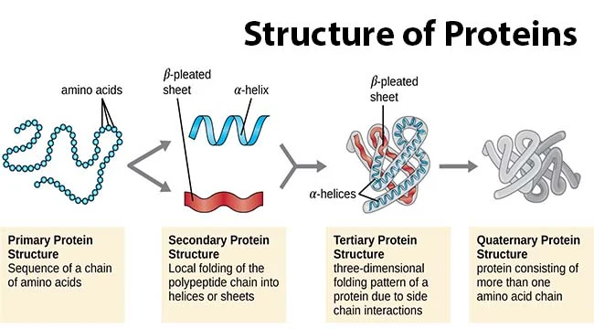
Quaternary structure
Some of the proteins are composed of two or more polypeptide chains referred to as subunits. The spatial arrangement of these subunits is known as quaternary structure.
Each polypeptide is referred to as a subunit of the protein.

Slide 23
Types of proteins – Classification based on shape
Fibrous proteins
They resemble long ribbons or fibres in shape.
They are mostly found in animals, and are not soluble in water or in solution of dilute acids.
Fibrous proteins aid in protection and structural support.
Example: Collagen, Keratin, Elastins, Fibroin

Slide 24
2. Globular protein
They are compactly folded and coiled and possess a relatively spherical or ovoid shape.
They are usually soluble in water and in aqueous media.
Example: Insulin, plasma albumin, globulin enzymes.

Slide 25
Types of proteins – Classification based on Composition and Solubility
1. Simple proteins / Holoproteins
Made of only amino acids
Mostly globular, except scleroproteins (fibrous)

Slide 26
Types of Simple amino acids
Type | Properties | Examples
Protamines & Histones | Basic, small, water-soluble, not heat-coagulable | Protamines: salmine, clupineHistones: nucleohistones, globin
Albumins | Soluble in water and dilute acids/bases | Leucosine, legumeline, serum albumin
Globulins | Two types: • Pseudoglobulins - water soluble • Euglobulins - water insoluble Coagulated by heat | Serum globulin, glycinine
Scleroproteins (Albuminoids) | Fibrous, insoluble in water/acids/bases/salts | Collagen, keratin

Slide 27
2. Conjugated Proteins (Heteroproteins)
Made of amino acids + prosthetic group (non-protein part)
Classified by type of prosthetic group
Type | Prosthetic Group | Examples
Metalloproteins | Metal ions | Casein, collagen, ceruloplasmin
Chromoproteins | Colored pigments | Myoglobin, hemocyanin, cytochromes
Glycoproteins / Mucoproteins | Carbohydrates | Egg albumin, mucin, ovomucoid
Phosphoproteins | Phosphoric acid | Casein
Lipoproteins | Lipids | Lipovitellin, blood lipoproteins
Nucleoproteins | Nucleic acids | Nucleohistones, nuclein
Notes:
Casein - Calcium, zinc, iron

Slide 28
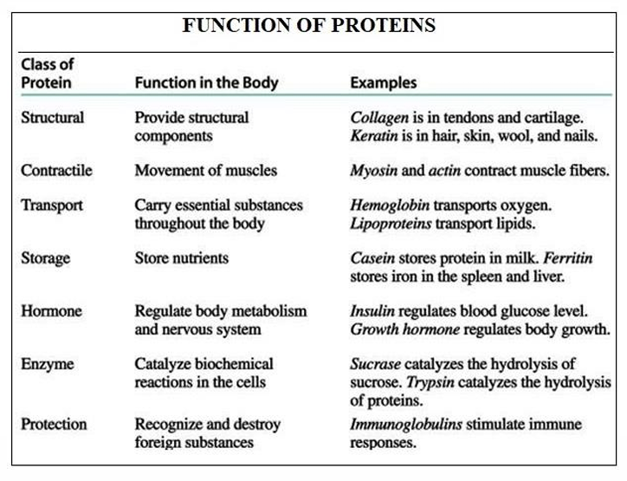
Function of Proteins

Slide 29
Applications
1. Enzymes (Biocatalysts)
Speed up biochemical reactions
Industrial use: detergents, brewing, biotech
2. Structural Proteins
e.g., Collagen (skin, bones), Keratin (hair, nails)
Used in biomaterials, wound healing
3. Therapeutic Proteins
e.g., Insulin, Monoclonal antibodies
Used in diabetes, cancer therapy
🧠 Engineering Insight:
Protein design in biomedical implants
Notes:
collagen-based implants for wound care and tissue regeneration,. Additionally, proteins are incorporated into dental implants and other prosthetics to enhance biocompatibility and integration with surrounding tissues.

Slide 30
Lipids
Lipids are organic compounds formed mainly from alcohol and fatty acids combined together by ester linkage (-COO-).
Lipids are insoluble in water, but soluble in fat or organic solvents (ether, chloroform, benzene, acetone).
Lipids include fats, oils, waxes and related compounds.
They are widely distributed in nature both in plants and in animals.

Slide 31
Biological importance of lipids
Food material: Lipids provide food, highly rich in calorific value. One gram lipid produces 9.3 kilocalories of heat.
Food reserve: Lipids provide are insoluble in aqueous solutions and hence can be stored readily in the body as a food reserve.
Structural component: Lipids are an important constituent of the cell membrane.
Heat insulation: The fats are characterized for their high insulating capacity. Great quantities of fat are deposited in the subcutaneous layers in aquatic mammals such as whale and in animals living in cold climates.
Fatty acid absorption: Phospholipids play an important role in the absorption and transportation of fatty acids.
Hormone synthesis: The sex hormones, adrenocorticoids, cholic acids and also vitamin D are all synthesized from cholesterol, a steroidal lipid.
Vitamin carriers: Lipids act as carriers of natural fat-soluble vitamins such as vitamin A, D and E.
Antibiotic agent. Squalamine, a steroid from the blood of sharks, has been shown to be an antibiotic and antifungal agent of intense activity. This seems to explain why sharks rarely contract infections.

Slide 32
Classification of lipids
1. Simple Lipids (Homolipids)
These are esters of fatty acids with various alcohols.
➤ Types:
Fats and Oils (Triglycerides / Triacylglycerols):
Esters of fatty acids with glycerol (a trihydroxy alcohol)
Fats: Solid at room temperature
Oils: Liquid at room temperature
Waxes:
Esters of fatty acids with high molecular weight monohydroxy alcohols
Typically insoluble and water-repellent

Slide 33
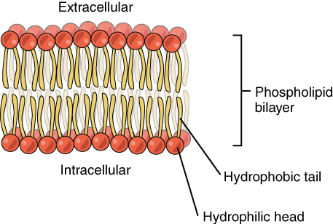
2. Compound (Conjugated) Lipids
These are esters of fatty acids + alcohol with additional groups like sulfur, phosphorus, amino groups, carbohydrates, or proteins.
Type | Additional Group | Examples / Description
Phospholipids | Phosphate group | Major components of cell membranes
Glycolipids | Carbohydrate group | Found in nerve and brain tissues
Lipoproteins | Protein group | Transport lipids in the blood
Sulfolipids | Sulfur group | Found in plant tissues
Aminolipids | Amino group | Found in bacterial membranes

Slide 34
3. Derived Lipids
These are hydrolysis products of simple and compound lipids.
➤ Includes:
Fatty acids
Alcohols
Mono- and diglycerides
Steroids
Terpenes
Carotenoids

Slide 35
Saturated vs unsaturated
Saturated Fats
Structure: No double bonds between carbon atoms
Shape: Straight chains → pack tightly
State: Solid at room temperature
Examples: Butter, coconut oil
Health Note: High intake linked to cardiovascular risks
Unsaturated Fats
Structure: One or more double bonds
Shape: Bent chains → less dense packing
State: Liquid at room temperature
Examples: Olive oil, sunflower oil
Health Note: Considered heart-healthy fats

Slide 36
Applications
1. Biodiesel Production
Feedstock: Triglycerides from vegetable oils or animal fats
Process: Transesterification → Methyl esters (biodiesel)
Engineering Role: Chemical engineering, green energy
2. Liposomes in Drug Delivery
Definition: Small vesicles with phospholipid bilayers
Application: Encapsulate and deliver drugs to specific cells
Engineering Role: Nanotech, biomedical engineering
3. Steroid Hormones in Medicine
Examples: Cortisone, estrogen, testosterone
Used for: Anti-inflammatory drugs, hormone therapy
Engineering Role: Pharmaceutical synthesis, metabolic engineering

Slide 37
Comparison
Feature | Carbohydrates | Lipids | Proteins
Elements | C, H, O (1:2:1) | C, H, O (less O) | C, H, O, N (S sometimes)
Basic Unit | Monosaccharides | Fatty acids + Glycerol | Amino Acids
Function | Quick energy, storage | Long-term energy, membranes | Enzymes, structure, signaling
Solubility | Water-soluble | Insoluble in water | Varies
Polymer Type | True polymer | Not true polymer | True polymer

