Slide 1
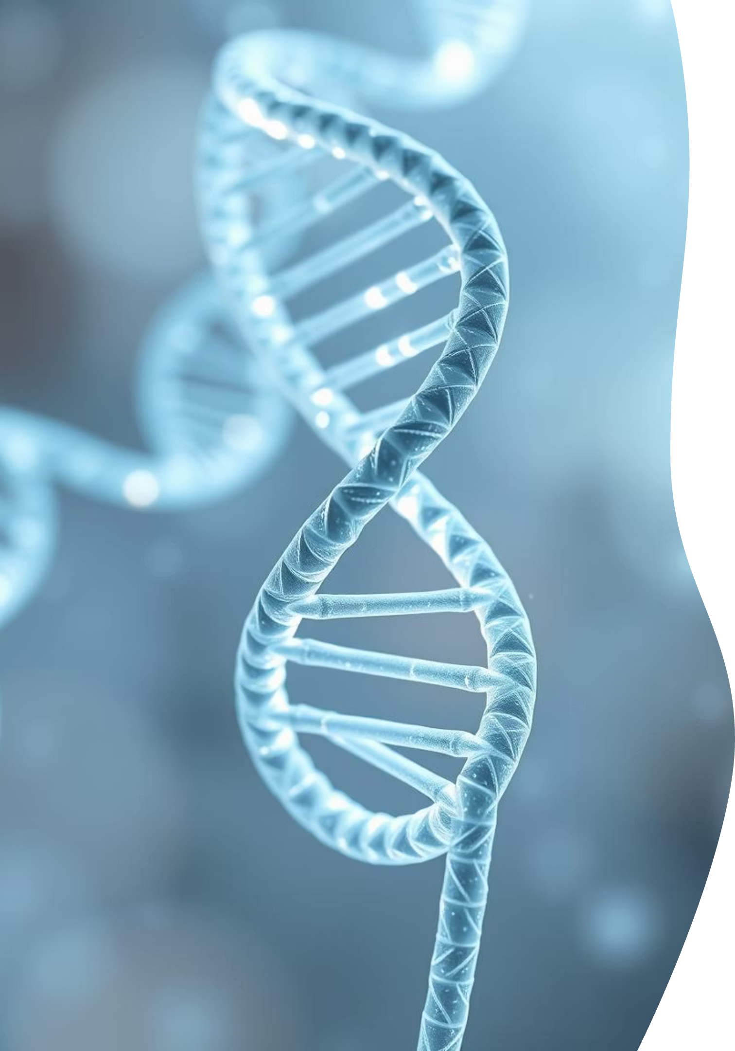
Unraveling Life's Blueprint: An Introduction to Nucleic Acids
Explore the fundamental molecules that dictate life's processes, from genetic inheritance to protein synthesis.
Notes:
What if I told you that the most advanced data storage system in the world is not built by humans, but by nature? It’s more compact than any chip, more energy-efficient than any server, and it has been running for over 3 billion years without a full shutdown.
This system is called DNA — and along with RNA, it forms the molecular blueprint of life.”

Slide 2
Nucleic Acids: The Information Molecules of Life
Nucleic acids are large macromolecules essential for all organisms and viruses. They serve as information molecules, providing the templates for protein synthesis within cells. Their crucial roles include the preservation and expression of genetic data, acting as the genetic material conveyed to progeny during cell reproduction.
1
Genetic Information Storage
2
Protein Synthesis Templates
3
Hereditary Transmission
Pass genetic traits from one generation to the next.
Store the blueprints for all cellular functions.
Direct the creation of essential proteins.

Slide 3

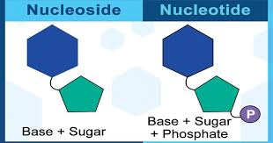
The Building Blocks: Nucleotides
DNA and RNA, the two primary forms of nucleic acids, are polymers made of repeating monomer units called nucleotides. A nucleotide consists of three key components: a nitrogenous base, a pentose (five-carbon) sugar, and a phosphate group. In contrast, a nucleoside only contains a nitrogenous base and a five-carbon sugar.
Nucleoside Composition
Nucleotide Components
Nitrogenous base (purine or pyrimidine)
Nitrogenous Base (purine or pyrimidine)
Pentose (five-carbon) sugar
Pentose Sugar (five-carbon)
Phosphate Group
Notes:
Analogy: If you think of a blueprint:
Paper = sugar-phosphate backbone
Ink = nitrogenous bases
Pages bound together = phosphate linkages

Slide 4
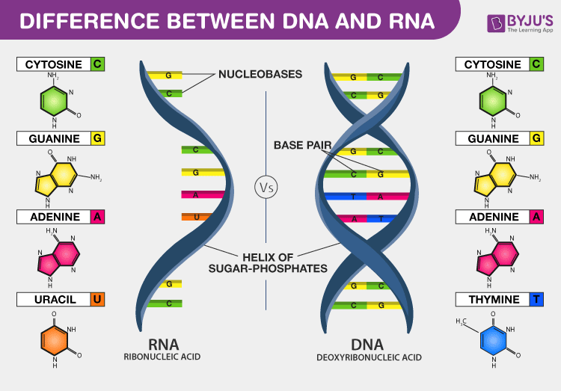


The Nitrogenous Bases: Purines and Pyrimidines
The nitrogenous bases are the informational units within nucleotides, categorized by their distinct ring structures.
Purines
Pyrimidines
These are two-ring structures.
These are one-ring structures.
Adenine (A)
Cytosine (C)
Guanine (G)
Thymine (T) - Found in DNA
Inosine (I) - Less common in nucleic acids, more in metabolism
Uracil (U) - Found in RNA (replaces Thymine)
Both types of nitrogenous bases are synthesized from amino acids and are crucial for forming the genetic code.

Slide 5
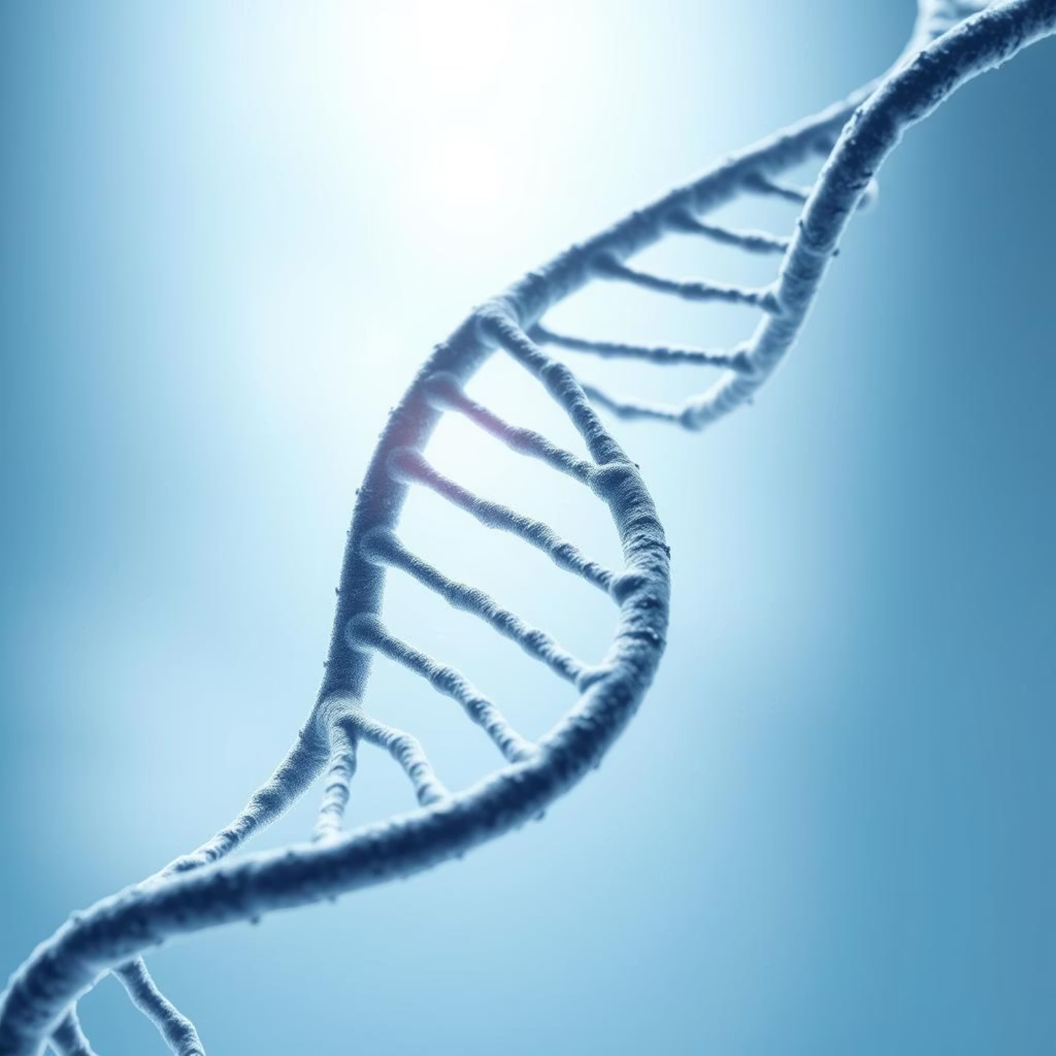
DNA: The Master Blueprint
Deoxyribonucleic acid (DNA) is the genetic material found in all living organisms, encoding the instructions necessary for building and maintaining an organism.
Structure and Location
A double helix, composed of two antiparallel polynucleotide chains.
Eukaryotic cells: primarily in the nucleus, also in mitochondria and chloroplasts.
Prokaryotic cells: located in the cytoplasm, not enclosed within a nucleus.

Slide 6
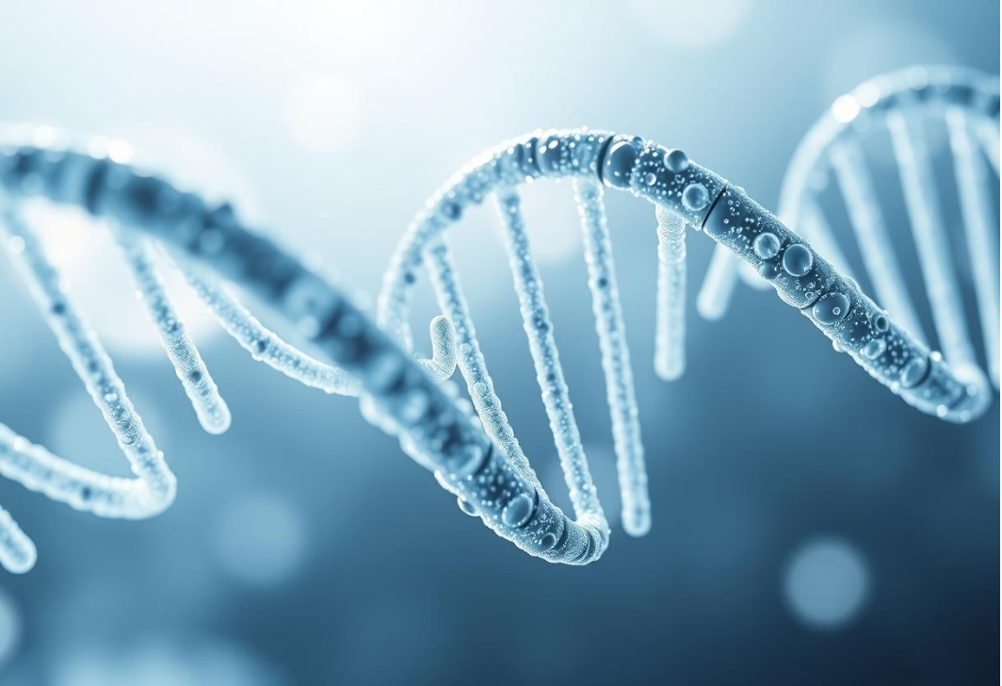
The DNA Double Helix
A DNA double helix consists of two right-handed spiral chains of polynucleotides. Hydrophilic and hydrophobic interactions with cellular water cause DNA to twist. This double-helical structure is crucial for DNA replication and protein synthesis.
Antiparallel Strands
Base Complementary Rule
If one strand runs 3' to 5', the other runs 5' to 3', ensuring proper alignment for replication and transcription.
Adenine (A) always pairs with Thymine (T), and Guanine (G) always pairs with Cytosine (C). This ensures accurate genetic copying.
Hydrogen Bonding
A-T pairs form two hydrogen bonds, while G-C pairs form three, providing stability to the DNA molecule.

Slide 7
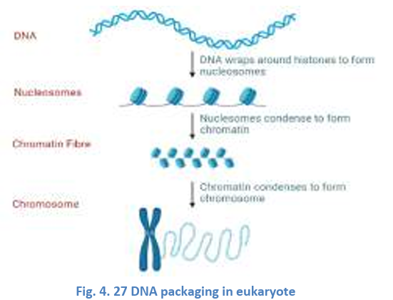
DNA Packaging: From Helix to Chromosome
Given its immense length, DNA must be highly compacted to fit within the confines of a cell, a process facilitated by specialized proteins.
Histones aid in the packaging of chromosomal DNA into tiny nuclei.
These proteins have positive charges that firmly cling to DNA with negative charges to form structures known as nucleosomes.
Eight histone proteins and 1.65 times of DNA make up each nucleosome.
https://www.youtube.com/watch?v=gbSIBhFwQ4s

Slide 8
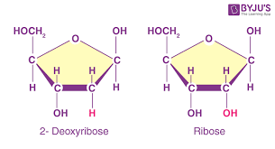
Ribonucleic Acid (RNA)
RNA is primarily involved in protein creation. Unlike DNA, RNA typically has a single strand, but often forms complex three-dimensional structures through internal base pairing. The sugar molecule in RNA is ribose, and Uracil (U) replaces Thymine (T), pairing with Adenine.
Single-Stranded
Ribose Sugar
Uracil instead of Thymine
Generally found as a single polynucleotide chain.
Contains ribose sugar, not deoxyribose.
Uracil (U) pairs with Adenine (A).

Slide 9
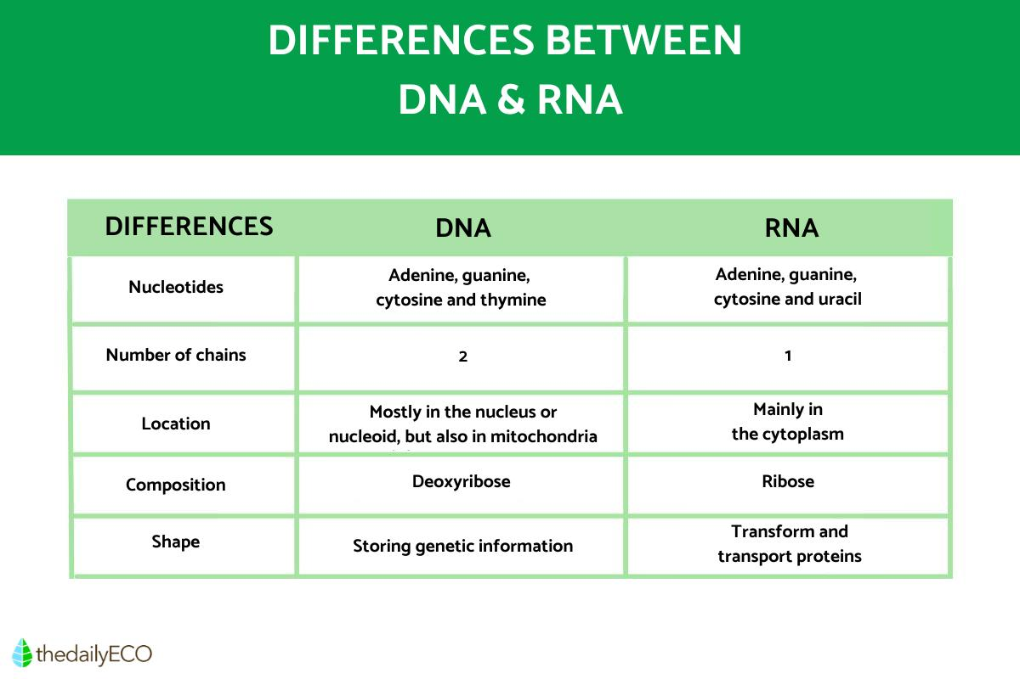

Slide 10




Types of RNA and Their Roles
RNA exists in several forms, each playing a specialized role in gene expression and protein synthesis.
Messenger RNA (mRNA)
Transfer RNA (tRNA)
Carries genetic instructions from DNA to ribosomes for protein synthesis. Undergoes post-transcriptional processing in eukaryotes (5' cap, poly-A tail).
Translates mRNA sequences into proteins by carrying specific amino acids to the ribosome, guided by its anticodon arm.
Ribosomal RNA (rRNA)
MicroRNA (miRNA)
Forms the structural and catalytic core of ribosomes, essential for protein synthesis. Ribosomes have A, P, and E sites for tRNA binding.
Small, non-coding RNA molecules that regulate gene expression by binding to target mRNA and inhibiting protein production.

Slide 11



Messenger RNA (mRNA)
mRNA acts as a crucial bridge, carrying genetic instructions from DNA to the ribosomes for protein synthesis. In prokaryotes, mRNA can directly initiate protein synthesis. Eukaryotic pre-mRNA, however, undergoes post-transcriptional modifications, including 5' capping and 3' poly-A tail addition, to ensure stability and efficient translation.
Information Carrier
Prokaryotic Simplicity
Eukaryotic Maturation
Translates genetic code from DNA.
Direct translation without modification.
Requires 5' cap and poly-A tail for stability and recognition.

Slide 12
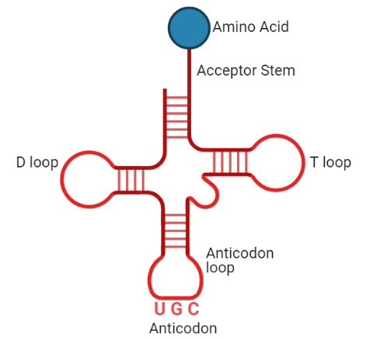
Transfer RNA (tRNA)
tRNAs are responsible for translating mRNA into proteins by carrying specific amino acids to the ribosome. Each tRNA has a unique anticodon that complementarily binds to an mRNA codon, ensuring the correct amino acid is added to the growing polypeptide chain. Aminoacyl-tRNA synthetases attach the appropriate amino acid to the tRNA's 3' acceptor site.
3' Acceptor Site: Where amino acids attach.
Anticodon Arm: Contains a sequence complementary
to mRNA codons.
Aminoacyl-tRNA Synthetase: Enzymes that ensure
correct amino acid attachment.

Slide 13

Ribosomal RNA (rRNA) and MicroRNA (miRNA)
Ribosomal RNA (rRNA)
MicroRNA (miRNA)
rRNA, in conjunction with ribosomal proteins, forms ribosomes—the cellular machinery for protein synthesis. Ribosomes have distinct subunits (e.g., 70S in prokaryotes, 80S in eukaryotes) and three binding sites (E, P, A) for tRNAs to facilitate polypeptide formation.
These small, non-coding RNA molecules regulate gene expression. miRNA binds to target mRNA molecules, often preventing protein creation by inhibiting translation or promoting mRNA degradation. They act as guides within the RNA-induced silencing complex (RISC).
mRNA
rRNA
tRNA
snRNA

Slide 14
https://www.youtube.com/watch?v=gG7uCskUOrA
https://youtu.be/whV_CkKT7F0

Slide 15


Molecular Linkages in Nucleic Acids
The stability and function of DNA and RNA depend on strong covalent bonds and weaker, yet crucial, interactions.
Phosphodiester Bonds
Hydrogen Bonds
These strong covalent bonds form the sugar-phosphate backbone of DNA and RNA, linking the 3' carbon of one nucleotide to the 5' carbon of the next via a phosphate group.
These weak interactions occur between complementary nitrogenous bases (A-T/U, C-G) and are vital for holding the two strands of DNA together. Their reversibility allows for DNA unwinding during replication and transcription.

Slide 16
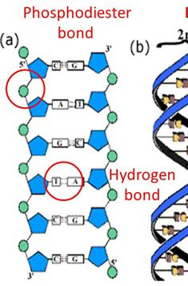
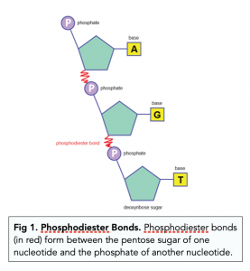

Slide 17
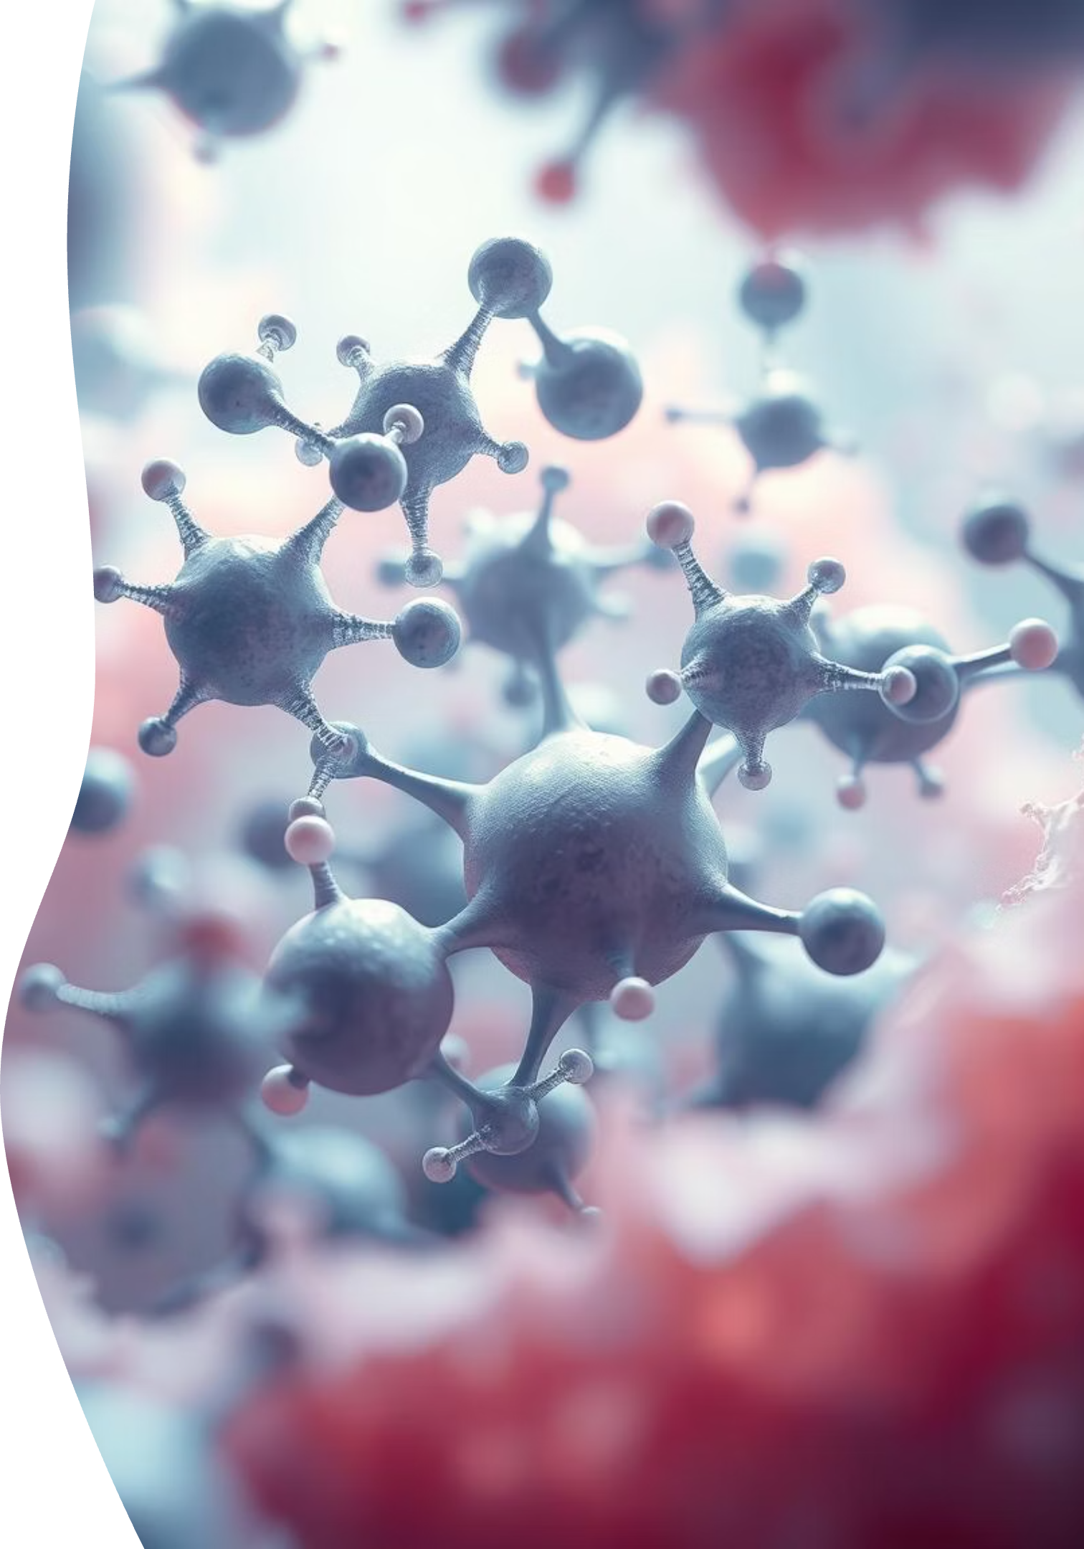
The Dynamic World of Enzymes: Catalysts of Life
Explore the fundamental role of enzymes in biological systems, from their intricate structures to their diverse functions and regulatory mechanisms.

Slide 18
Introduction to Enzymology
Enzymes are indispensable organic catalysts that accelerate biochemical reactions in living organisms.
They ensure reactions occur rapidly and with high specificity.
Chemically, all enzymes are proteins, playing a pivotal role in metabolism by directing and controlling physiological processes within cells.
Any alteration in a cell's enzyme profile directly impacts its biochemical functions, underscoring their critical importance in the living world.
Enzymology, a branch of biochemistry, delves into the study of enzyme kinetics, structure, function, and interrelationships.

Slide 19
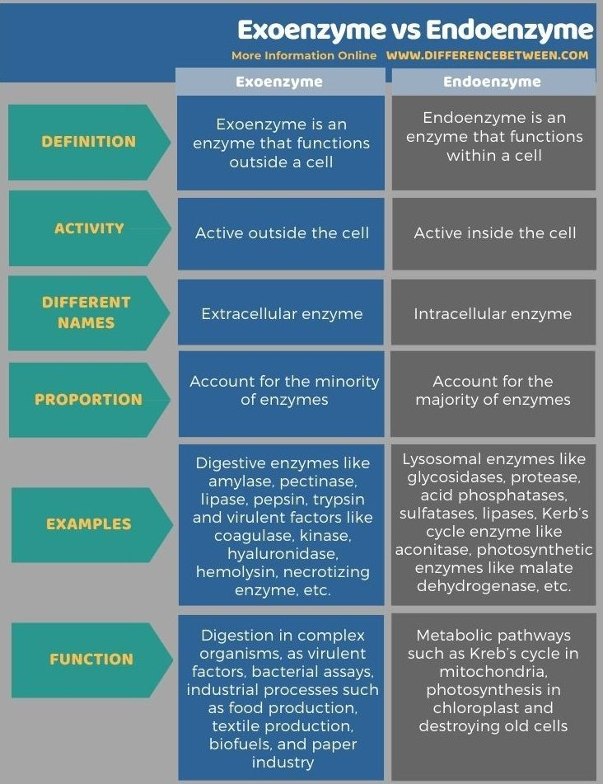

Amylase – Carbohydrate
Pectinase – pectin
Lipase – lipids
Pepsin – smaller peptides
Trypsin – small proteins
Coagulase - blood clotting
Glycosidases – break glycosidic bond
proteases – break peptide bond
Acid phosphatase - remove phosphate groups from molecules
Sulfatases – break sulfate bonds

Slide 20
Enzyme Classification: A Systematic Approach
As the discovery of new enzymes expanded, a systematic classification was developed by the Nomenclature Commission of the International Union of Biochemistry. Enzymes are categorized into six major groups based on the general type of reaction they catalyze. This hierarchical system includes subgroups and secondary subgroups, allowing for precise identification and characterization of enzymatic activities.
1
Oxidoreductases
Catalyze redox reactions. A⁺² + B⁺³ → A⁺³ + B⁺²
2
Transferases
Transfer functional groups. A–X + B → A + B–X
3
Hydrolases
Catalyze hydrolysis reactions. AB + H₂O → AOH + BH
4
Lyases
Break bonds without hydrolysis. A–X + B–Y → A = B + XY
5
Isomerases
Rearrange functional groups. A–X + B–Y → A–Y + B-X
6
Ligases
Join molecules with ATP hydrolysis. A + B + ATP → AB + ADP + Pᵢ

Slide 21
Isozymes: Diverse Forms, Same Function
Isozymes, or isoenzymes, are distinct enzyme forms that catalyze the same reaction but differ in amino acid sequence. These variations often lead to different kinetic parameters (e.g., Km values) or regulatory properties, allowing for fine-tuning of enzymatic activity based on the cellular environment.
Origin of Isozymes
Functional Significance
Gene duplication
Environmental adaptation
Hybridization
Tissue-specific regulation

Slide 22
Lactate Dehydrogenase (LDH) Isozymes
A classic example of isozymes is lactate dehydrogenase (LDH), which catalyzes the conversion of pyruvate to lactate in anaerobic glucose metabolism. LDH exists in two primary forms: H and M isozymes.
H Isozyme (Heart)
M Isozyme (Muscle)
Predominantly expressed in the heart.
Predominantly expressed in skeletal muscle.
Optimized for aerobic environments.
Optimized for anaerobic environments.
Functions efficiently with oxygen present.
Efficient in conditions of oxygen depletion, common during strenuous activity.

Slide 23
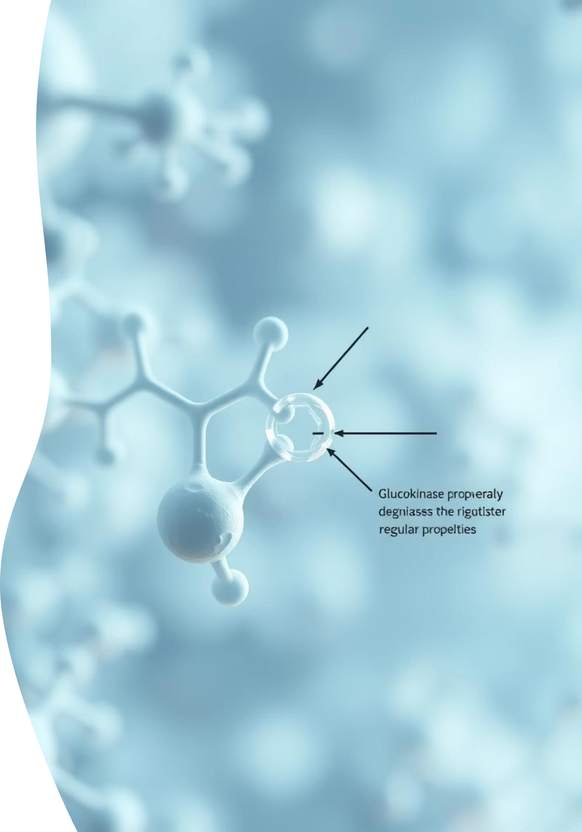
Glucokinase: A Specialized Hexokinase Isozyme
Glucokinase is a notable isozyme of hexokinase, distinguished by its unique regulatory features and lower affinity for glucose. Unlike other hexokinases, glucokinase is not inhibited by glucose 6-phosphate, enabling it to function effectively even when glucose levels are high.

Slide 24

The Enzyme-Substrate Complex: A Crucial First Step
Enzymes initiate their catalytic activity by forming a temporary enzyme-substrate complex (ES). This transient binding is fundamental to enzyme function, bringing the substrate into close proximity with the enzyme's active site and facilitating the chemical transformation.
Active Site Specificity
Bond Deformation
Enzymes possess highly specific active sites, unique three-dimensional pockets tailored for the precise attachment of substrate molecules. This molecular complementarity is crucial for effective binding.
Upon substrate binding, the enzyme-substrate complex often induces subtle conformational changes in the substrate. This deformation weakens existing bonds, making them more susceptible to reaction.

Slide 25
Specificity: The Hallmark of Enzyme Function
The remarkable specificity of enzymes is a cornerstone of their biological role. A given enzyme typically interacts with only one, or a very limited range, of substrate molecules, ensuring precise control over metabolic pathways.
Hydrogen Bonding
Active Site Shape
Crucial for initial recognition and binding.
The three-dimensional geometry of the active site.
Forms reversible interactions between enzyme and substrate.
Excludes molecules that do not possess a complementary shape.
Contributes significantly to binding affinity and orientation.
Ensures a precise "fit" for the intended substrate.
This intricate interplay of intermolecular forces and structural complementarity underpins the high fidelity of enzyme-substrate interactions.

Slide 26
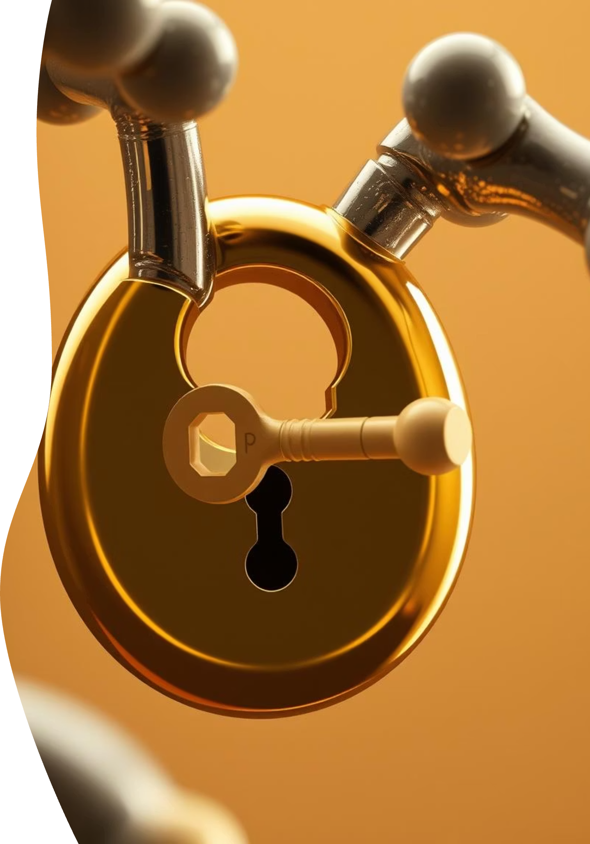
The Lock-and-Key Theory: A Foundational Model
Proposed by Emil Fisher in 1894, the Lock-and-Key Theory was the pioneering model to explain enzyme-substrate interaction. It postulates a rigid active site, perfectly complementary to its specific substrate.
"Here the enzyme is like a lock and substrate is like a key. Only a specific key (substrate) with correctly positioned teeth fits into the keyhole (active site) of the lock (enzyme)."
This theory effectively illustrated the concept of enzyme specificity, where each enzyme (lock) has a uniquely shaped active site that can only bind to a specific substrate (key). While foundational, it did not account for the dynamic nature of enzymes.

Slide 27

Limitations of the Lock-and-Key Theory
Despite its explanatory power for enzyme specificity, the Lock-and-Key theory had a significant limitation: it failed to account for the dynamic flexibility observed in many enzyme structures. Modern understanding reveals that enzymes are not static entities.
The rigid active site concept of the Lock-and-Key theory does not fully encompass the conformational adaptability that enzymes exhibit during catalysis. Many enzymes undergo subtle structural adjustments upon substrate binding.
This rigidity became increasingly apparent as more data emerged regarding enzyme behavior, paving the way for a more nuanced model.

Slide 28
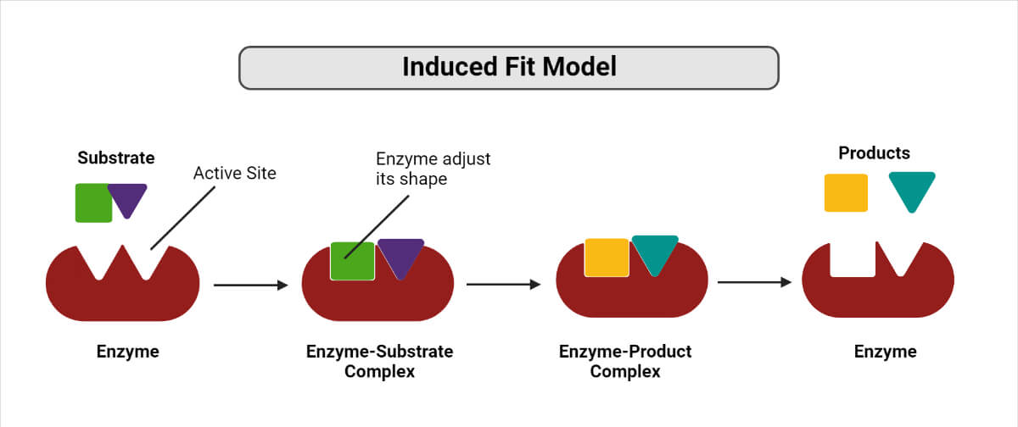
The Induced-Fit Theory: A Dynamic Partnership
In 1966, Daniel Koshland Jr. introduced the Induced-Fit Theory, a more refined model that addresses the limitations of the Lock-and-Key concept. This theory proposes a dynamic interaction where both enzyme and substrate undergo conformational changes.
Flexible Active Site
Substrate-Induced Changes
The enzyme's active site is not rigid but possesses a degree of flexibility, allowing it to adapt its shape in response to substrate binding.
The substrate itself induces specific conformational adjustments in the enzyme, optimizing the fit and aligning catalytic residues for reaction.
This dynamic "hand-in-glove" analogy better explains the intricate molecular dance that occurs during enzyme catalysis, providing a more comprehensive understanding of enzyme function.

Slide 29
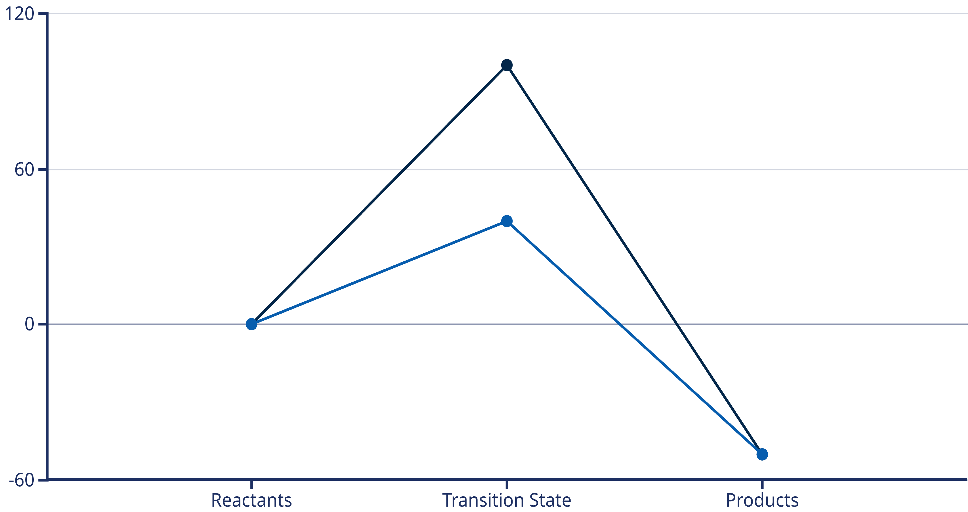
Activation Energy: The Barrier to Reaction
All chemical reactions, whether biological or non-biological, require an initial input of energy to proceed.
This critical energy threshold is known as the activation energy (Ea).
Energy (Enzyme Catalyzed)
Energy (Uncatalyzed)
The graph above illustrates that for an uncatalyzed reaction, a significant energy input is required to reach the transition state, where existing bonds are broken before new ones can form. Enzymes play a vital role in overcoming this barrier.
Notes:
The amount of energy needed for a reactant to undergo a chemical reaction is called activation energy.

Slide 30

Cofactors and Coenzymes: Essential Enzyme Partners
Many enzymes require non-protein components called cofactors for their catalytic activity.
These cofactors can be either complex organic molecules (coenzymes) or metal ions.
Metal Ions
Coenzymes
Inorganic ions like Fe2+, Mn2+, Zn2+, or Mg2+ that assist in catalysis.
Organic molecules, often derived from vitamins, that transiently carry functional groups during catalysis.

Slide 31
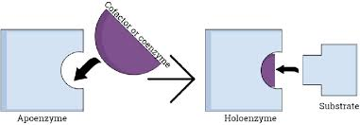
Holoenzymes, Apoenzymes, and Prosthetic Groups
The functional form of an enzyme, including its required cofactor, is known as a holoenzyme.
The protein component of a holoenzyme, which requires a cofactor for activity, is termed an apoenzyme.
When a coenzyme or metal ion is tightly bound to the enzyme protein via a covalent bond, it is specifically referred to as a prosthetic group, indicating an integral and permanent role in enzyme function.
Apoenzyme = inactive protein part
Cofactor/coenzyme = helper
Apoenzyme + cofactor = Holoenzyme (active enzyme)
Prosthetic group = a cofactor that is permanently fixed to the enzyme

Slide 32
The Role of Vitamins in Coenzyme Formation
Most coenzymes are derived from essential vitamins, which are organic nutrients required in small dietary amounts. This highlights a crucial link between nutrition and metabolic function.
Coenzyme
Precursor vitamin
Riboflavin (B2)
FAD, FMN
Niacin (B3)
NAD+, NADP+
Pantothenic Acid (B5)
Coenzyme A
Pyridoxine (B6)
Pyridoxal Phosphate
Thiamine (B1)
Thiamine Pyrophosphate

Slide 33


Key Takeaways from Enzyme Mechanisms
Understanding the mechanism of enzyme action is crucial for comprehending biological processes and for applications in biotechnology and medicine.
Activation Energy Reduction
Molecular Specificity
Dynamic Interaction
The Induced-Fit Theory highlights the flexible nature of enzyme-substrate binding, where both molecules adapt to optimize interaction.
Enzymes dramatically lower the activation energy, enabling vital biochemical reactions to occur rapidly and efficiently at physiological temperatures.
Enzymes exhibit high specificity for their substrates, governed by the precise shape and chemical properties of their active sites.

Slide 34
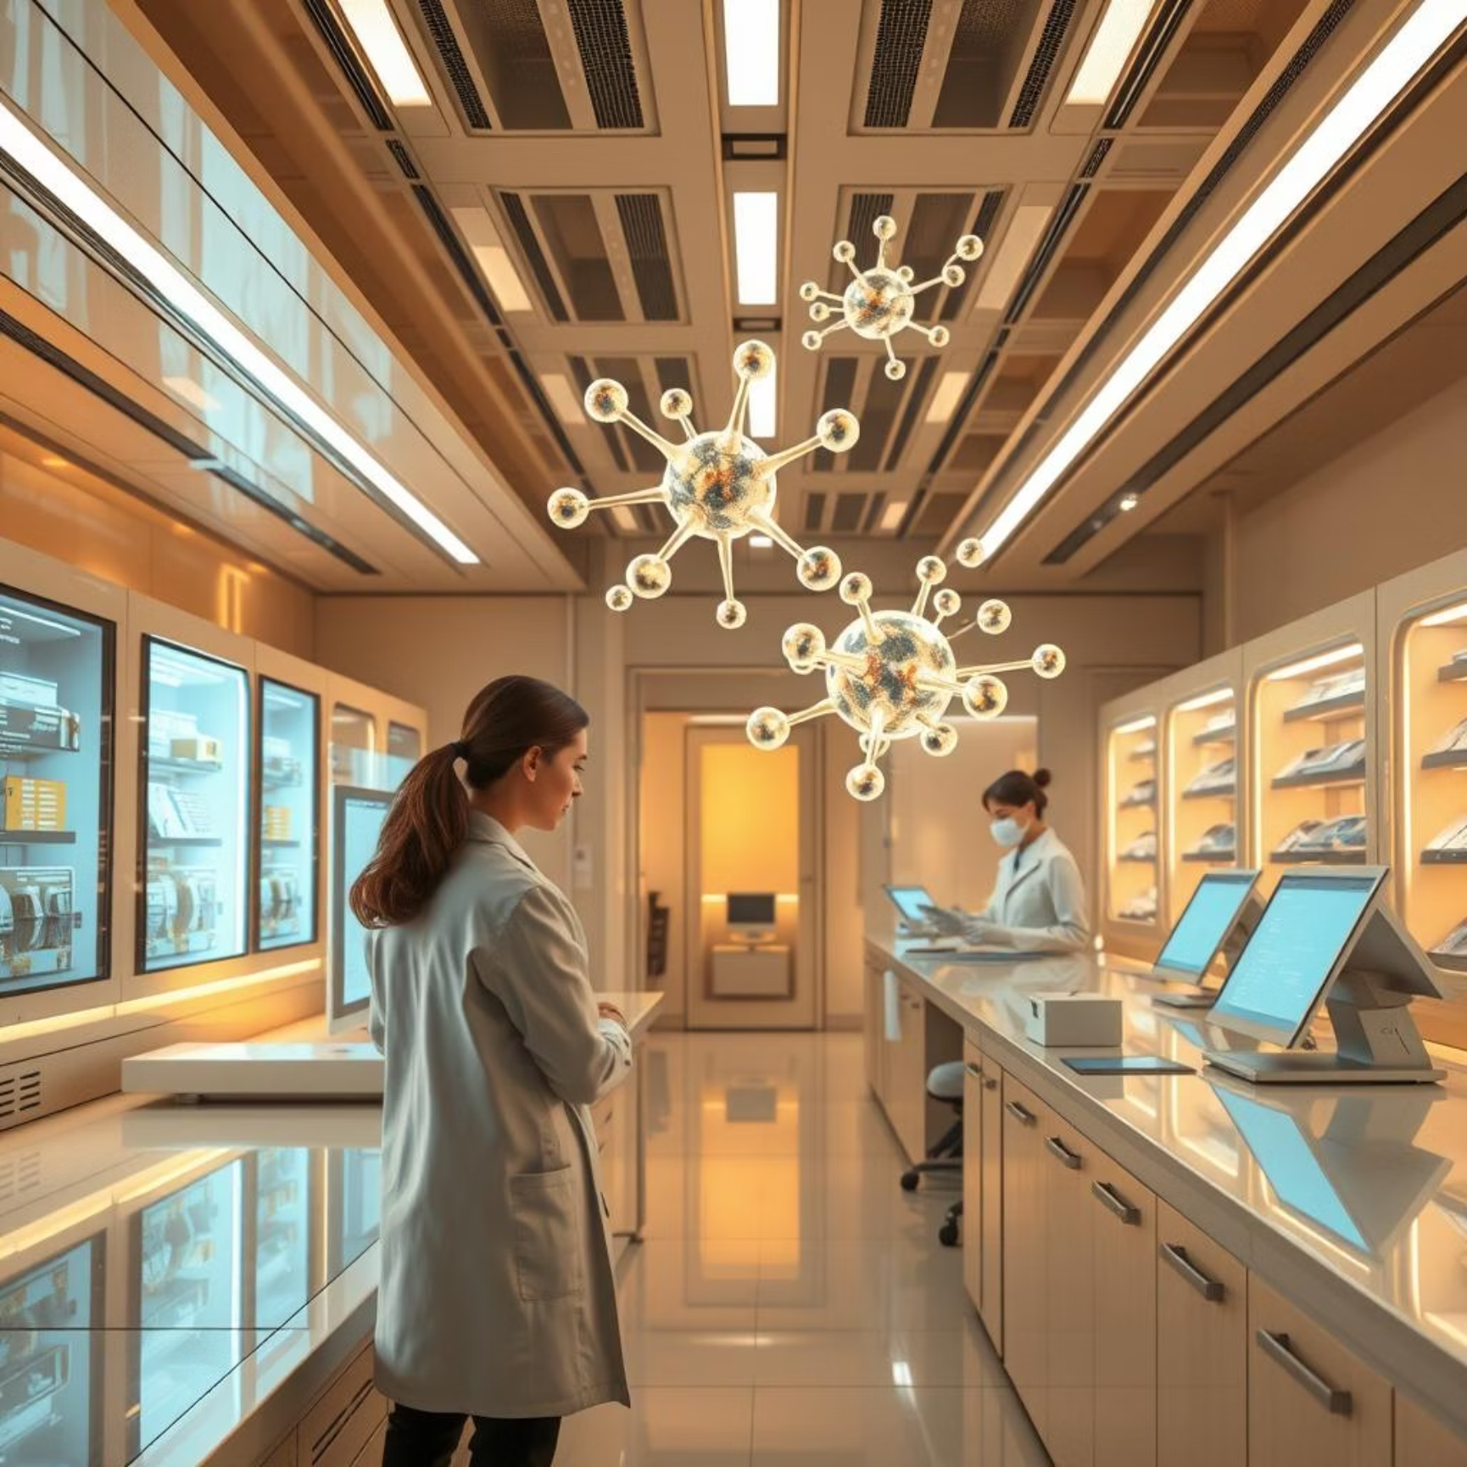
Future Directions in Enzymology
The study of enzyme mechanisms continues to be a vibrant field
of research with immense potential.
Ongoing advancements promise exciting breakthroughs.
Enzyme Engineering: Designing novel enzymes for industrial applications, such as biofuels and pharmaceuticals.
Drug Discovery: Targeting enzyme active sites for the development of new therapeutic agents.
Understanding Disease: Elucidating the role of enzyme dysfunction in various pathologies, from metabolic disorders to cancer.
As our understanding deepens, enzymes will continue
to be central to scientific innovation and
improving human health.

