Slide 1
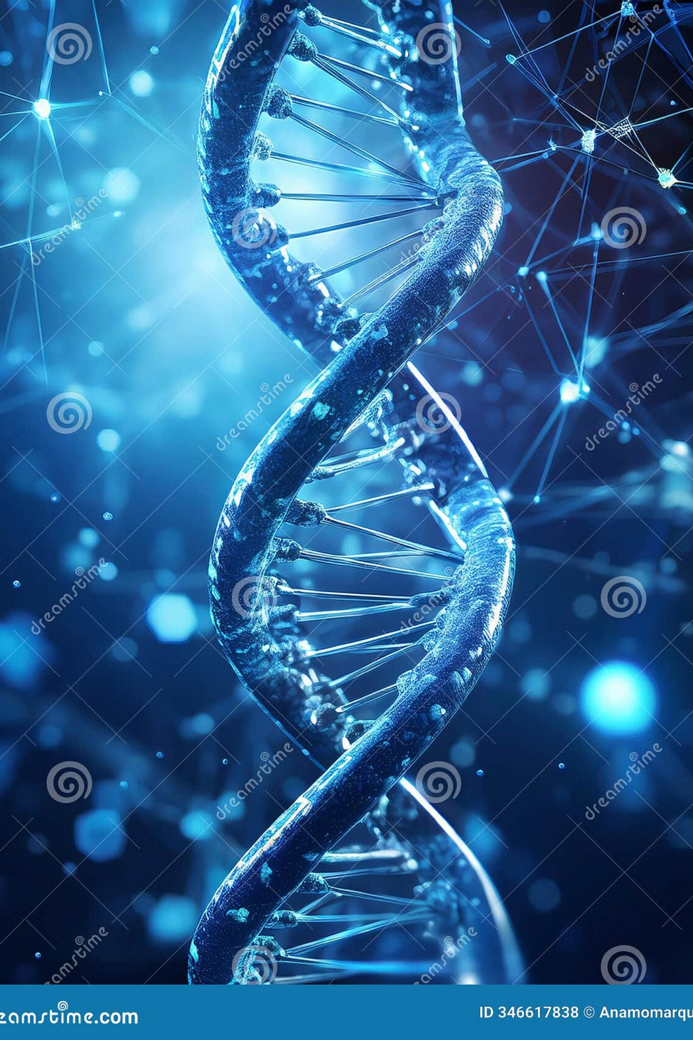
DNA Replication and Transcription: The Blueprint of Life in Action

Slide 2



The Central Dogma of Molecular Biology
DNA
RNA
Protein
Genetic information storage
Information transfer
Functional products
This unidirectional flow of genetic information represents the foundation of molecular biology. Replication ensures DNA copying, while transcription converts DNA sequences into RNA molecules for protein synthesis.

Slide 3
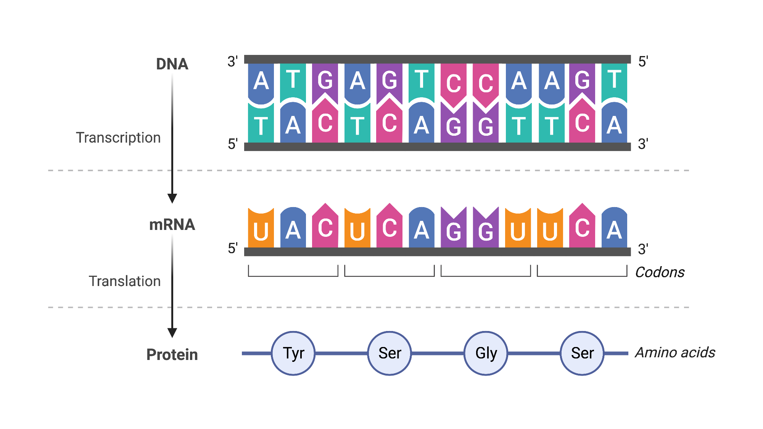

Slide 4
DNA: The Molecular Basis of Heredity
Human Genome by Numbers
Complementary Base Pairing
3Billion
23
Adenine (A) pairs with Thymine (T)
Guanine (G) pairs with Cytosine (C)
Double helix structure ensures stability
Base Pairs
Chromosome Pairs
Base pairing enables accurate replication
Total nucleotides in human genome
Organized genetic material

Slide 5
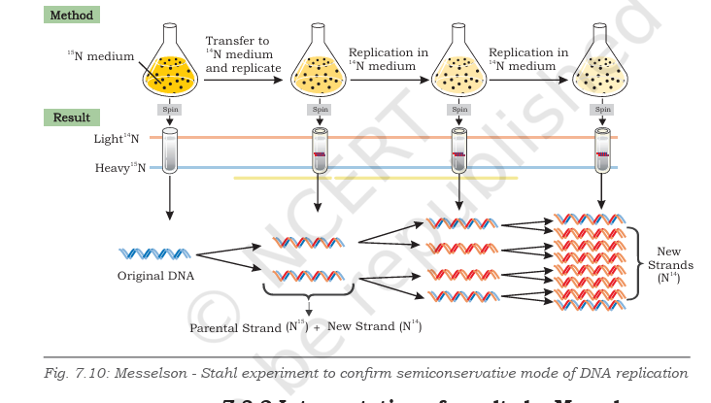
Where Life Copies Itself
DNA replication is semi conservative. Each consists of one parental strand and one newly formed strand.
This model was confirmed by the famous Meselson-Stahl experiment in 1958
Notes:
two isotopes of nitrogen, 14N (the common form) and 15N (a rare, heavy form). They grew E. coli bacteria in a medium containing the heavier isotope

Slide 6
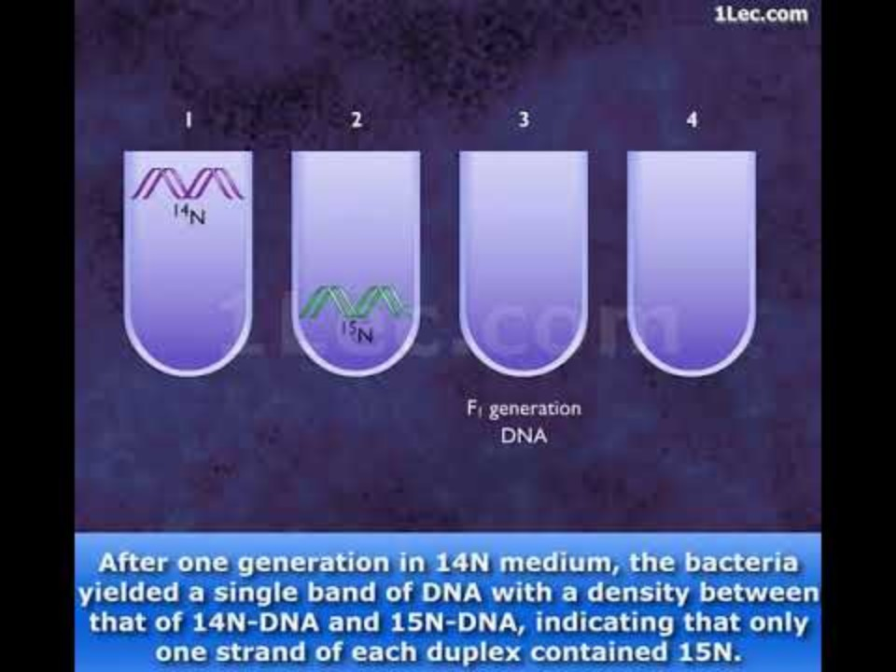

Slide 7
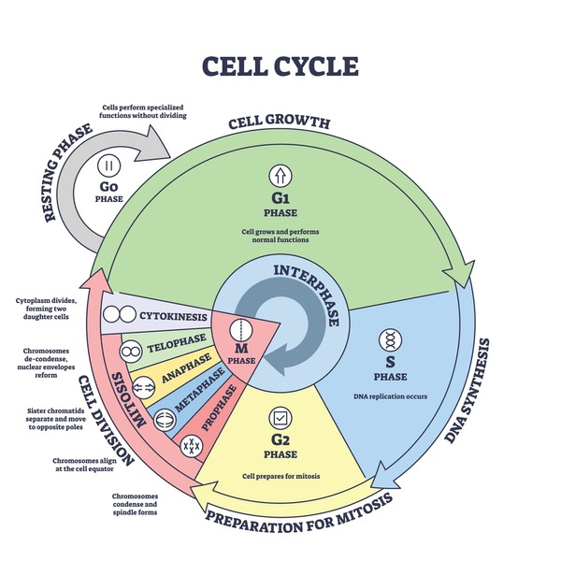
DNA Replication — Copying the Genome
Timing
Method
S-phase of cell cycle before division
Semiconservative replication preserves one original strand
Purpose
Ensures genetic continuity across cell generations

Slide 8
The Machinery and the Enzymes
DNA Polymerase
DNA polymerase is an enzyme that adds nucleotides (the building blocks of DNA) to a growing DNA strand, using an existing strand as a template.
Main Functions
Makes new DNA by adding nucleotides (A, T, G, C).
Reads the old DNA strand and matches each base with its pair.
Checks for mistakes and fixes them (proofreading).
Works only from 5′ to 3′ direction (it adds nucleotides at the 3′ end).
In Bacteria (Prokaryotes)
DNA Polymerase I – Replaces RNA primers with DNA.
DNA Polymerase II – Helps in DNA repair.
DNA Polymerase III – Does most of the DNA copying.
In Humans (Eukaryotes)
DNA Polymerase α (alpha) – Starts DNA synthesis.
DNA Polymerase δ (delta) – Builds the lagging strand.
DNA Polymerase ε (epsilon) – Builds the leading strand.
DNA Polymerase β (beta) – Repairs damaged DNA.
DNA Polymerase γ (gamma) – Copies mitochondrial DNA.

Slide 9
Primase
The DNA polymerases on their own cannot initiate the process of replication. Primer required, an existing segment of nucleotides that provides 3′ OH group to which it can add a new nucleotide
Synthesizes short RNA oligonucleotide chain (about 10-12 nucleotides long) called RNA primer in order to get DNA replication started.
Helicases
In order to generate single strand templates, the DNA double helix must unwind.
DNA helicase breaks hydrogen bonds that exist between the bases of two strands of a DNA molecule by using energy in the form of ATP.
Topoisomerase
As the two strands of DNA separate, torsional strain causes the DNA helix to coil up forming a knot in front of the replication fork. Topoisomerases relieve the tension by nicking and religating the DNA that holds the helix in its coiled and supercoiled structure.
Single stranded binding (SSB) proteins
After unwinding of DNA by helicase, the single stranded nucleotide chains have a tendency to form hydrogen bonds again and reanneal. SSB proteins attach tightly to the exposed single stranded DNA and stabilize them in single stranded form for replication to take place.
DNA ligase
DNA ligase enzyme joins the newly synthesised DNA fragments by forming phosphodiester bond between 3′OH group and 5' phosphate group.

Slide 10
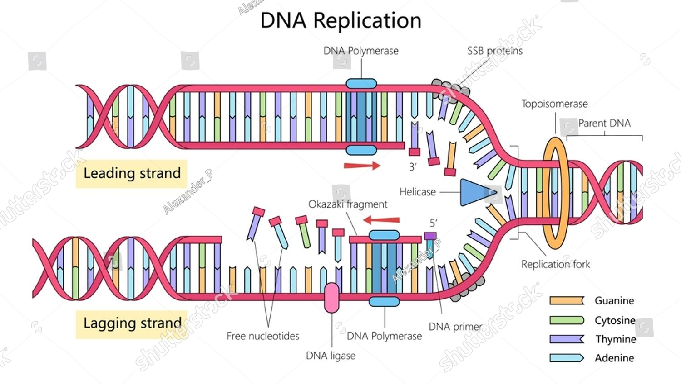
Replication fork
A replication fork is the Y-shaped region on a DNA molecule where the double helix unwinds and new DNA strands are being made.
It’s called a “fork” because it looks like the shape of a “Y” — one old (parental) DNA splits into two single strands, and new strands are built beside them.

Slide 11
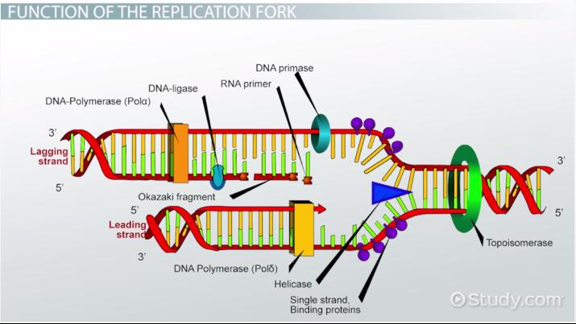
Step 1: Initiation at Origins of Replication
01
02
Recognition
Unwinding
Initiator proteins identify specific DNA sequences at origin sites. – origin of replication (ori)
Helicase enzyme unwinds the double helix, creating replication forks
03
Origins
Prokaryotes use single origin; eukaryotes employ multiple origin for efficiency

Slide 12
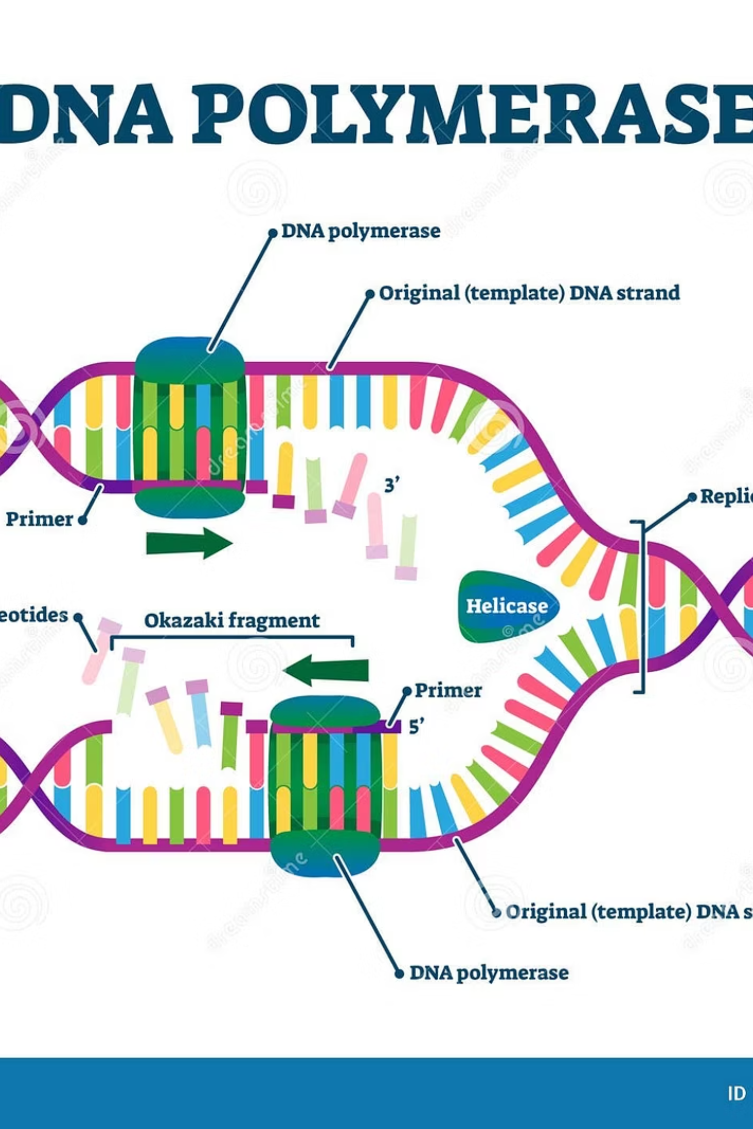

Step 2: Primer Synthesis and Elongation
The Primer Problem
Directional Synthesis
DNA polymerase cannot initiate synthesis de novo and requires a pre-existing 3'-OH group to begin adding nucleotides.
Leading strand: Synthesized continuously 5'→3'
Lagging strand: Synthesized in short fragments
DNA polymerase III performs bulk synthesis
Solution: Primase synthesizes short RNA primers to provide the necessary starting point.

Slide 13
Step 3: Okazaki Fragments and Lagging Strand Synthesis
Fragment Creation
Gap Sealing
Short DNA segments (~1000 bases in prokaryotes) synthesized on lagging strand
DNA ligase connects fragments, forming continuous strand
1
2
3
Primer Removal
DNA polymerase I replaces RNA primers with DNA nucleotides
Named after Reiji Okazaki, these fragments solve the challenge of synthesizing DNA in the 3'→5' direction on the lagging strand.

Slide 14



Step 4: Proofreading and Error Correction
3'→5' Exonuclease Activity
Error Prevention
Disease Prevention
DNA polymerases possess built-in proofreading capability, removing incorrectly incorporated nucleotides immediately after addition.
Mismatched bases are excised and replaced with correct nucleotides, maintaining genomic integrity across cell divisions.
High-fidelity replication is crucial for preventing mutations that could lead to cancer and genetic disorders.

Slide 15
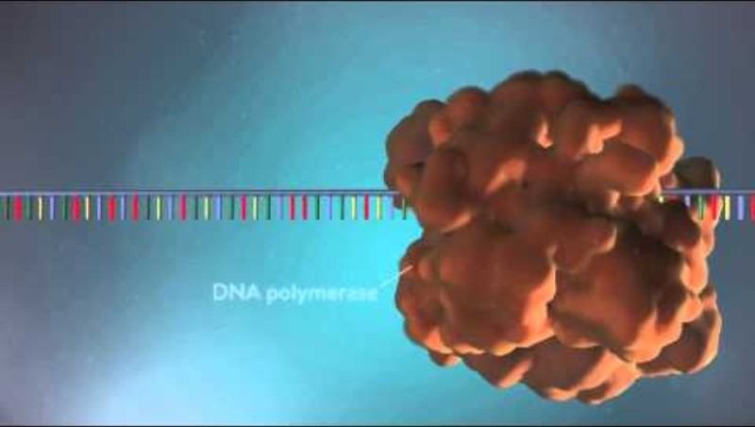

Slide 16
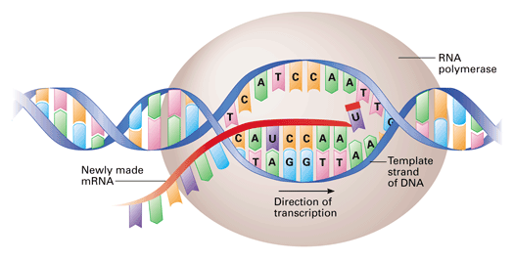
Transcription — From DNA to RNA
Gene Expression
Transcription copies specific gene sequences from DNA into messenger RNA (mRNA)
RNA Polymerase Function
Enzyme binds promoter regions, unwinds DNA, and synthesizes RNA in the 5'→3' direction
Base Substitution
RNA uses uracil (U) instead of thymine (T), pairing with adenine during synthesis

Slide 17
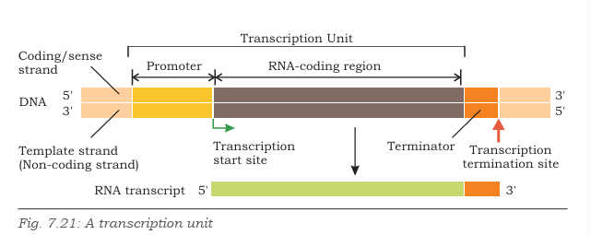
The stretch of DNA on which RNA is transcribed is called a transcription unit.
Each transcription unit has a start site from where transcription start and a terminator site where transcription is to end
Upstream to the start site is a DNA sequence called promoter, which is recognized by the RNA polymerase and binds to it for accomplishing initiation of transcription.

Slide 18

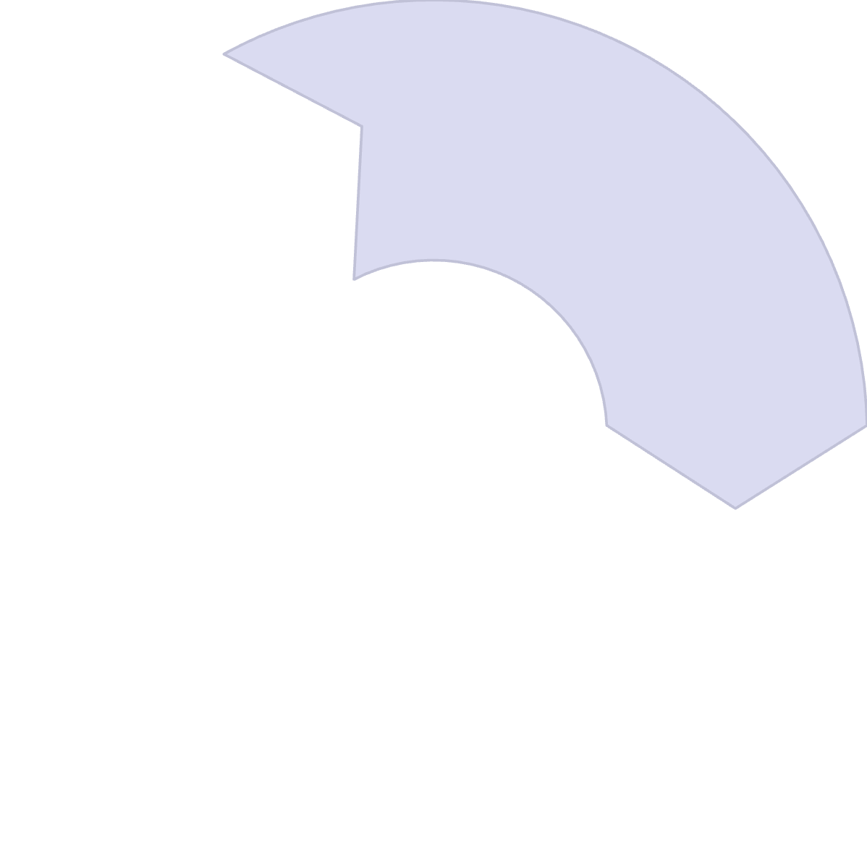




Transcription Process: Initiation, Elongation, Termination
Elongation
RNA strand grows as polymerase moves along DNA template, adding complementary nucleotides
Initiation
RNA polymerase recognizes and binds to promoter sequences upstream of genes
Termination
RNA polymerase encounters terminator sequences and detaches, releasing completed RNA

Slide 19
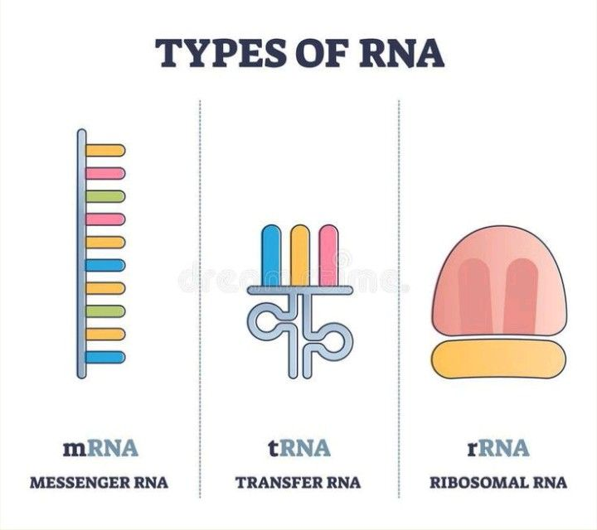



RNA Types and Their Roles
Messenger RNA (mRNA)
Transfer RNA (tRNA)
Carries genetic coding information from nucleus to ribosomes for protein synthesis
Transports specific amino acids to ribosomes during translation process
Ribosomal RNA (rRNA)
Structural and catalytic component of ribosomes, facilitating protein assembly

Slide 20
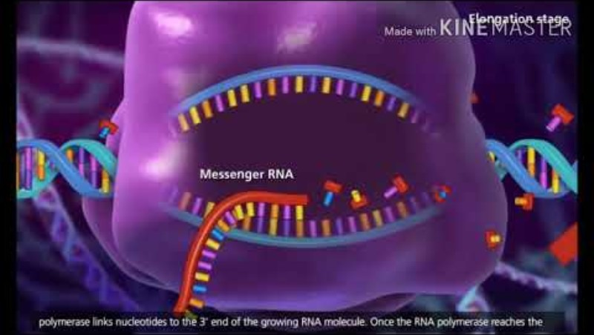

Slide 21
Differences Between Replication and Transcription
Aspect
Replication
Transcription
Scope
Copies entire genome
Copies specific genes
Product
Double-stranded DNA
Single-stranded RNA
Template
Both DNA strands
One DNA strand
Persistence
Permanent copying
Temporary RNA product
Frequency
Once per cell cycle
Multiple times as needed

Slide 22








Biological Significance of Replication and Transcription
Genetic Inheritance
Cell Proliferation
Replication ensures faithful transmission of genetic information to daughter cells
Essential for growth, development, and tissue repair processes
Environmental Response
Gene Expression Control
Regulation allows cells to adapt to changing conditions and stimuli
Transcription enables selective protein production based on cellular needs

Slide 23
https://www.youtube.com/watch?v=gG7uCskUOrA
https://youtu.be/whV_CkKT7F0

Slide 24
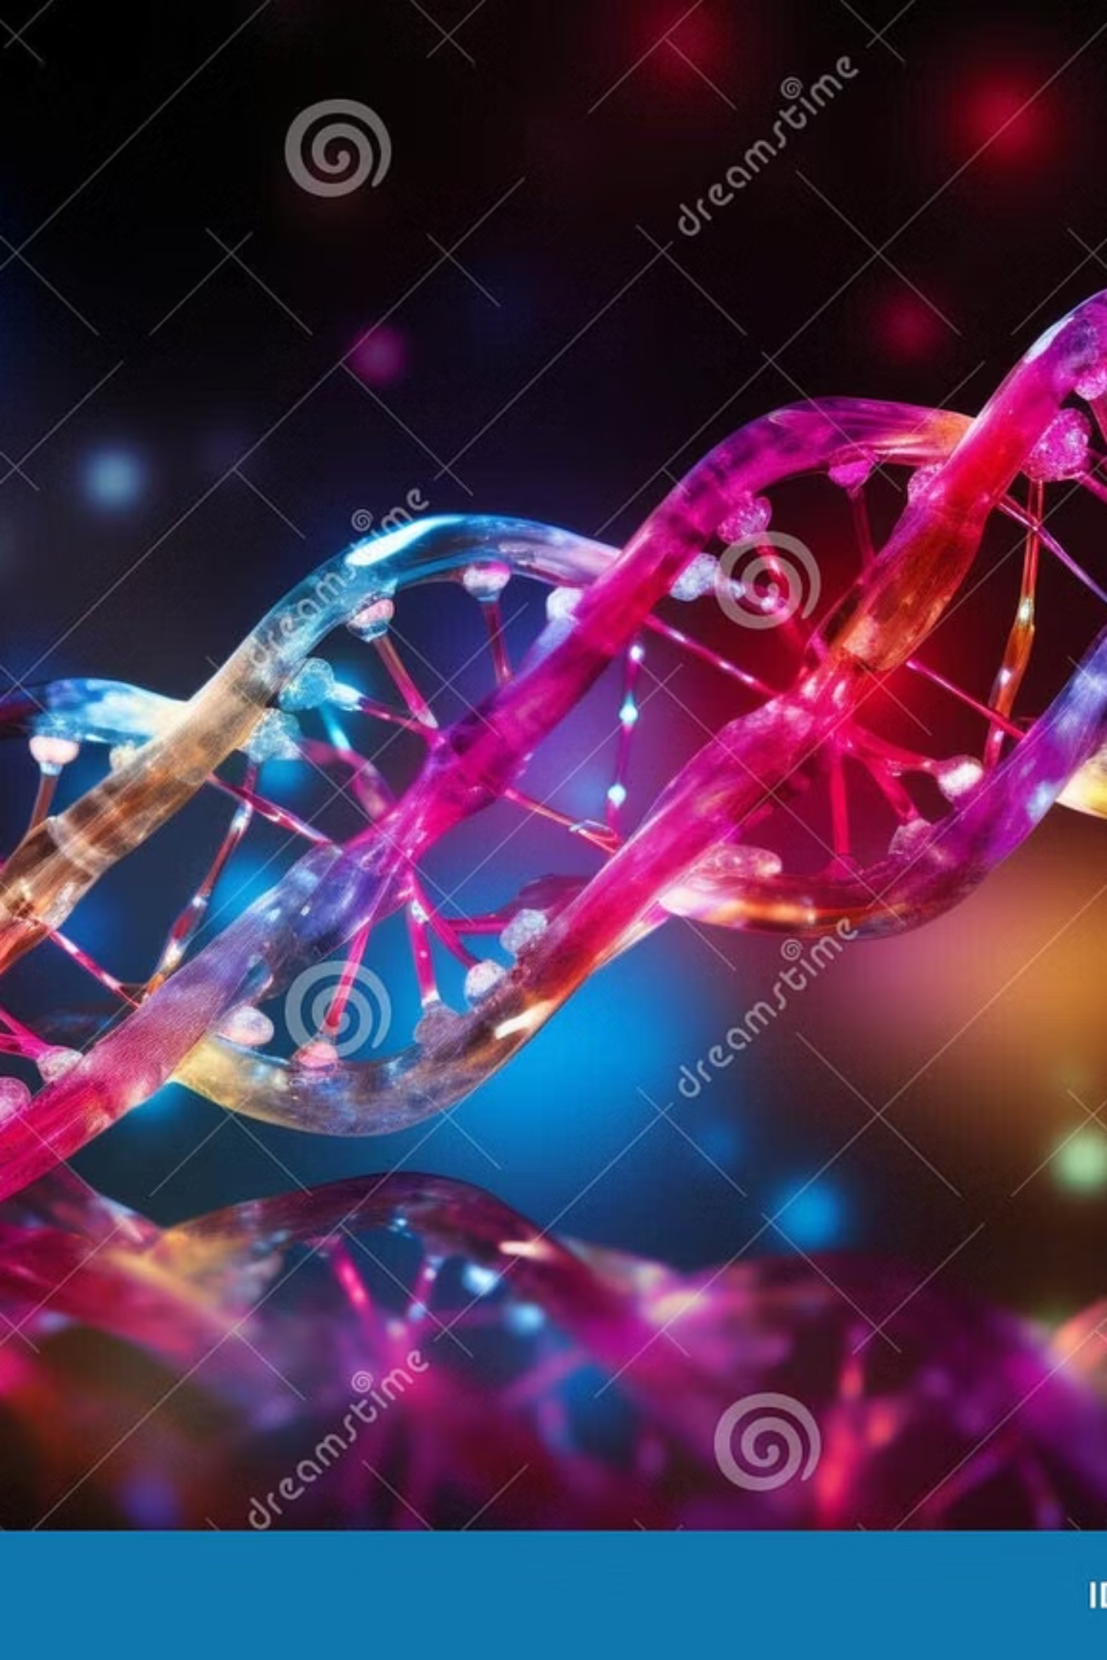
DNA Translation: Decoding Life's Blueprint into Protein

Slide 25
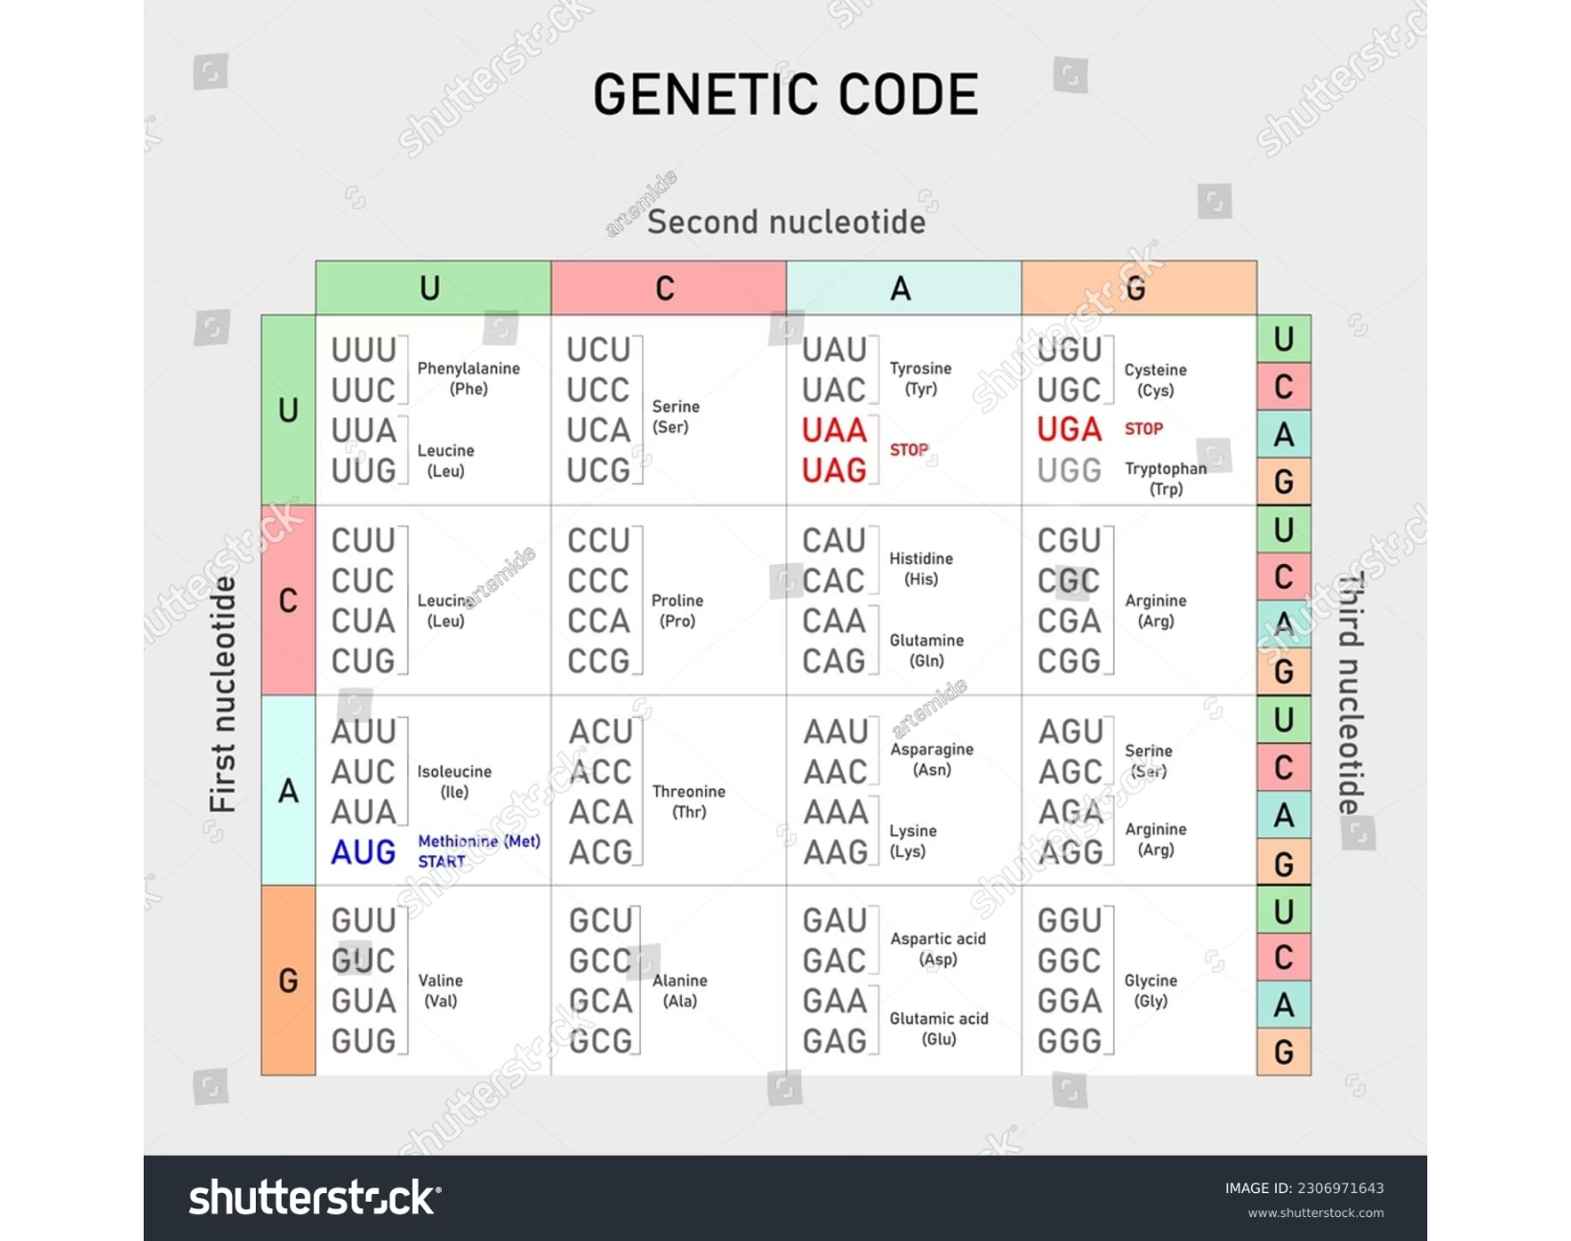
The Genetic Code: Language of Life
The Universal Code
mRNA codons: sets of three nucleotides, each specifying a unique amino acid
Start codon (AUG) signals where translation begins and codes for methionine
Three stop codons (UAA, UAG, UGA) signal precise translation termination
This genetic code is nearly universal across all life forms, from bacteria to humans.
64 codons out of which 61 code for amino acids, other 3 stop codons

Slide 26
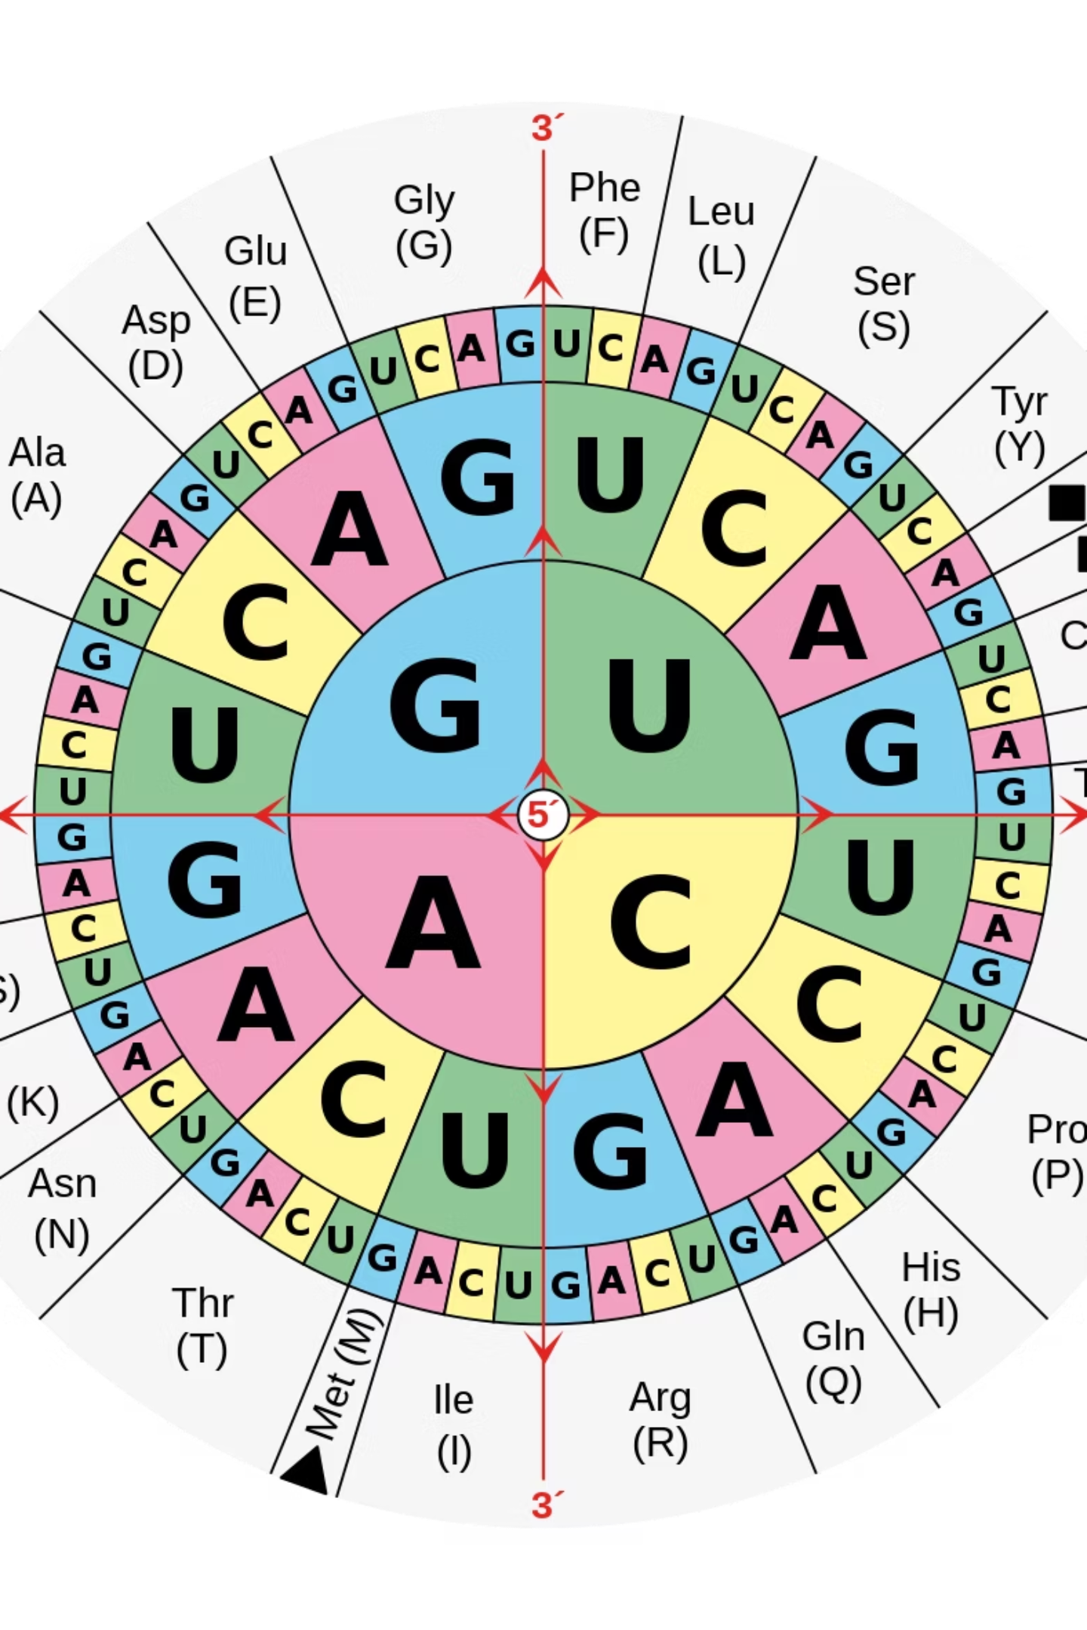
Triplet Codons Dictate Protein Sequence
Each three-nucleotide codon precisely specifies which amino acid will be added to the growing protein chain

Slide 27
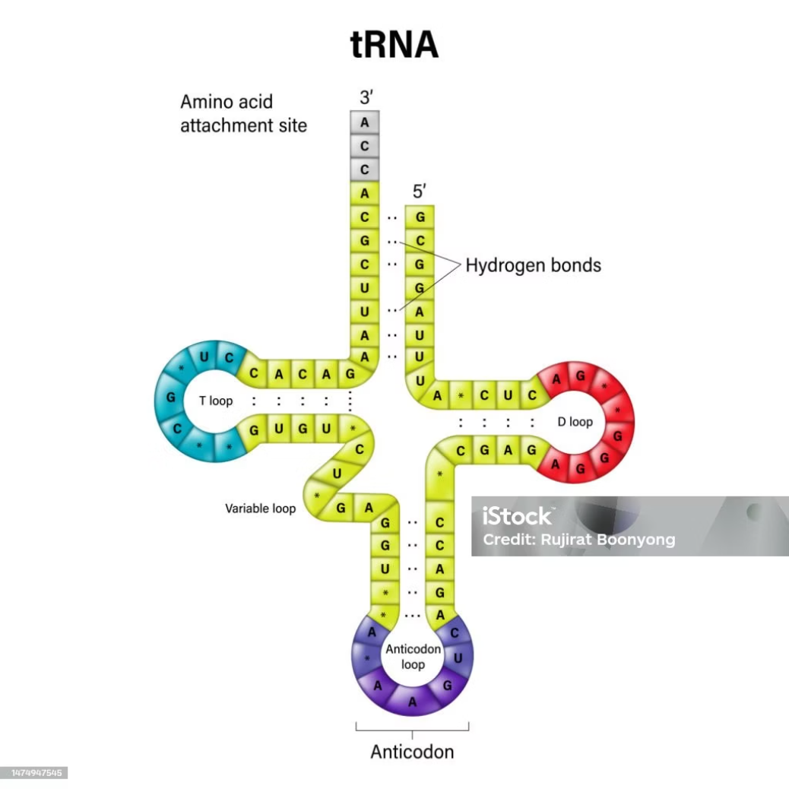
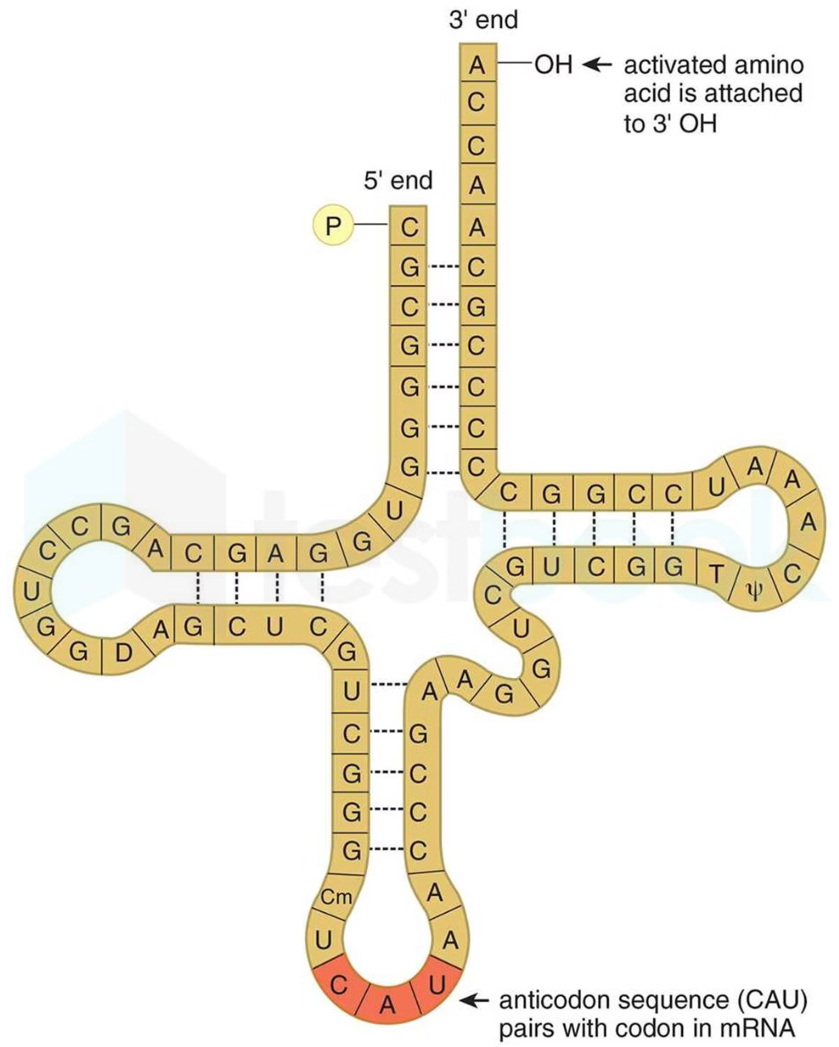
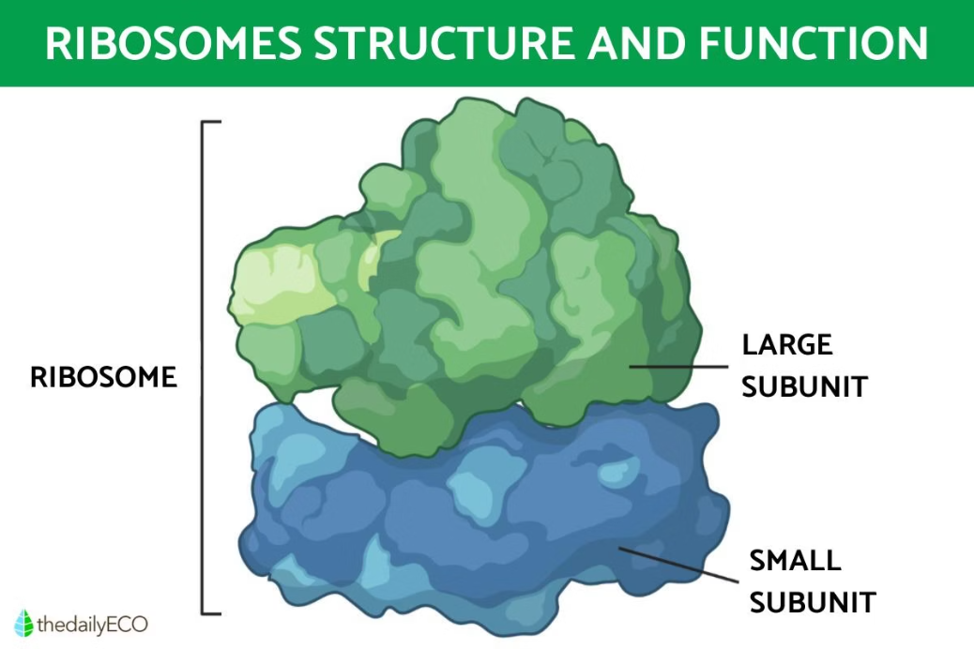
Key Molecular Players in Translation
Ribosome
Transfer RNA (tRNA)
Aminoacyl-tRNA Synthetases
The sophisticated molecular machine that reads mRNA sequences and assembles protein with remarkable precision
Adaptor molecules featuring anticodons that perfectly match mRNA codons while carrying specific amino acids
Highly specific enzymes that charge tRNAs with the correct amino acids, ensuring translation accuracy

Slide 28
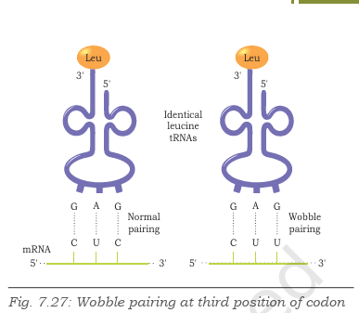
The Stages of Translation
Translation unfolds through three precisely coordinat phases, each essential for accurate protein synthesis
Charging of tRNA
Initiation
Elongation
Termination

Slide 29
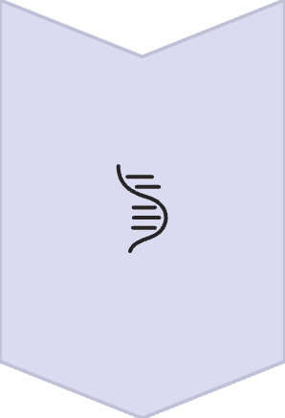
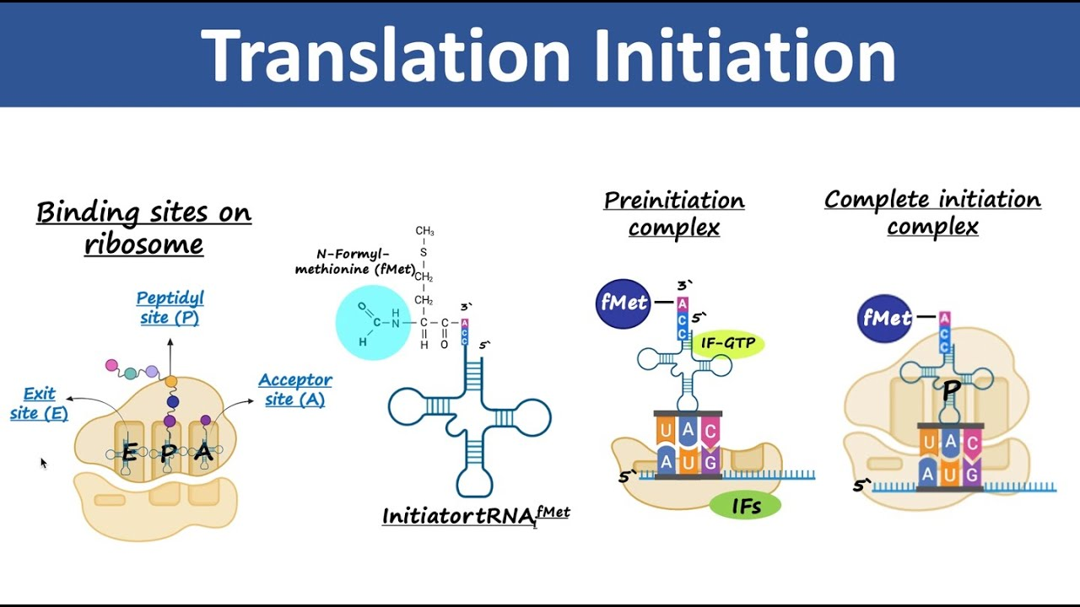


Initiation: Setting the Stage
Ribosome Assembly
Small ribosomal subunit recognizes and binds to
mRNA’s 5’ end at the ribosome binding site
Start Recognition
Initiator tRNA carrying methionine specifically pairs with the start codon (AUG)
Complex Formation
Large ribosomal subunit joins to form a complete, functional ribosome ready for elongation

Slide 30
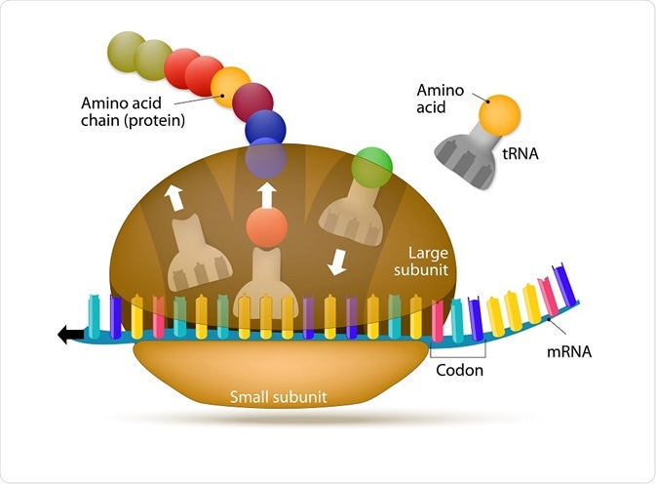
The ribosome acts like a molecular assembly line, precisely coordinating the addition of each amino acid to create functional proteins
There are three sites on a ribosome for binding of tRNA molecules: the A site (aminoacyl tRNA binding site), P site (peptidyl tRNA binding site) and E site (tRNA exit site).
Aminoacyl-tRNA molecules enter into A site one after another during translation.

Slide 31

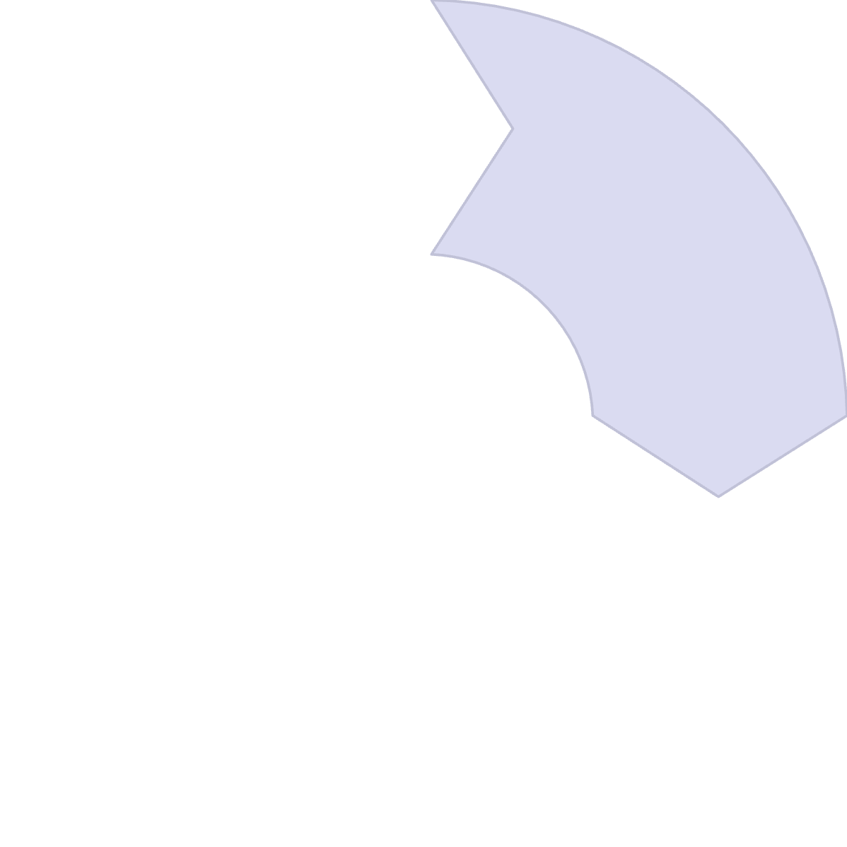






Elongation: Building the Protein Chain
tRNA Binding
Codon Recognition
Ribosome features two key sites:
P site holds the growing peptide chain,
A site accepts new tRNA
Incoming tRNA anticodon precisely pairs with mRNA codon at the A site
Translocation
Peptide Formation
Ribosome advances one codon; empty tRNA exits while cycle repeats, lengthening the polypeptide
Peptide bond forms between amino acids through peptidyl transferase activity

Slide 32




Termination: Ending the Translation
Stop Signal Recognition
Release Factor Binding
Ribosome encounters a stop codon (UAA, UAG, or UGA) in the mRNA sequence
No tRNA matches stop codons; specialized release factors bind to the ribosome instead
Protein Release
Ribosome Dissociation
Completed polypeptide chain is released and begins folding into its functional three-dimensional structure
Ribosome subunits separate and dissociate, becoming available for another round of translation

Slide 33
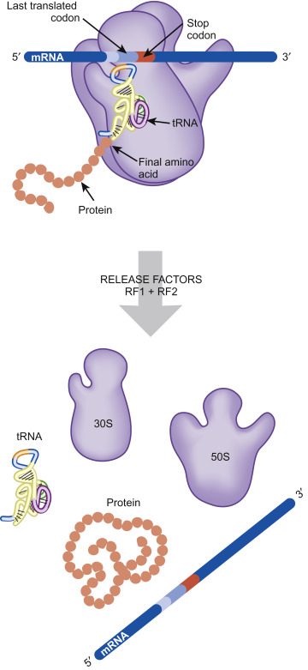
Ribosome Recycling: Preparing for Next Protein
Efficient Cellular Economy
After successful termination, ribosome subunits efficiently separate and disperse throughout the cytoplasm.
These recycled components are immediately available to initiate translation on new mRNA molecules, ensuring continuous protein production.
A single ribosome can translate hundreds of proteins per hour, making cellular recycling essential for efficiency.

Slide 34


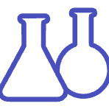
Why Translation Matters: Real-World Impact
Antibiotic Action
Disease Prevention
Biotechnology Applications
Antibiotics like erythromycin and streptomycin specifically target bacterial translation machinery, halting protein synthesis and effectively killing harmful bacteria while sparing human cells.
Translation errors can cause serious diseases or produce dysfunctional proteins. Understanding these mechanisms helps develop treatments for genetic disorders and cancer.
Mastering translation principles enables revolutionary advances in biotechnology, personalized medicine, gene therapy, and genetic engineering applications.

