Slide 1
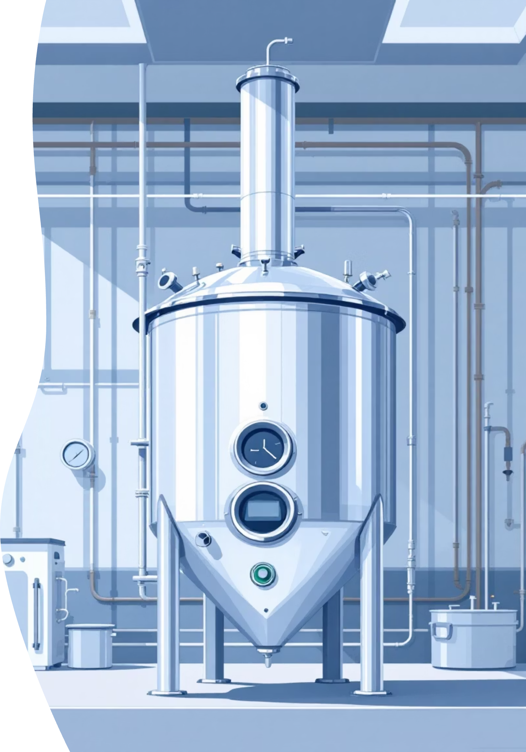
Design of Fermentors and Its Types

Slide 2
What is a Fermentor?
A fermentor, also known as a bioreactor, is a specialized vessel designed to cultivate microorganisms or cells under precisely controlled conditions.
Its primary purpose is to facilitate the production of desired bioproducts by providing an optimal environment for microbial growth and metabolic activity.
These complex systems meticulously regulate parameters such as temperature, pH levels, aeration, and agitation, all crucial for maximizing product yield and ensuring process efficiency.
Applications of Bioreactors
- Medicine → Antibiotics, vaccines, monoclonal antibodies.
- Food Industry → Beer, wine, yogurt, vinegar.
- Energy → Biogas, bioethanol, biodiesel.
- Environment → Wastewater treatment, bioremediation.

Slide 3
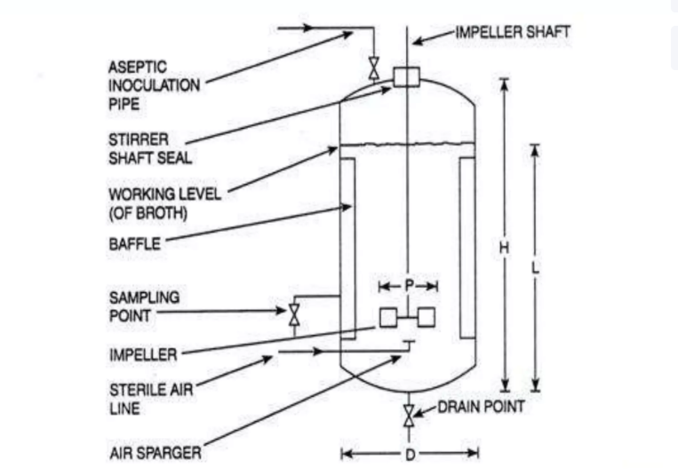
Basic design of a fermenter

Slide 4
Basic functions
The main function of a fermenter is to provide a controlled environment for the growth of microorganisms or animal cells, to obtain a desired product. In designing and constructing a fermenter a number of points must be considered:
Should be capable of being operated aseptically for a number of days and should be reliable in long term operation meeting the requirements of containment regulations
Adequate aeration and agitation
Power consumption should be as low as possible
System of temp, pH control
Sampling facilities
Minimal labor use in harvesting, cleaning and maintenance
Smooth internal surfaces, using welds instead of flange joints
Cheapest material with satisfactory results

Slide 5
Key Design Objectives of Fermentors
Maintain Sterile Environment
Ensure Uniform Mixing & Aeration
Prevent contamination from unwanted microorganisms to ensure product purity and process integrity.
Distribute nutrients, oxygen, and cells evenly throughout the culture, supporting optimal growth and metabolic activity.
Precise Temperature & pH Control
Facilitate Sampling & Product Removal
Maintain stable environmental conditions critical for microbial viability and efficient product formation.
Allow for sterile withdrawal of samples for analysis and efficient harvesting of the final product.

Slide 6
Main Components of a Fermentor
The Vessel
Aeration System
The main body of the fermentor. Industrial-scale vessels are typically made from stainless steel for durability and ease of sterilization, while laboratory-scale fermentors often use glass for visibility.
Comprises spargers (for air introduction) and filters (for sterilization) to supply sterile air or oxygen to the microbial culture.
Temperature Control
Agitator System
Achieved through cooling jackets or internal coils that circulate a cooling or heating fluid to maintain the optimal temperature for microbial growth.
Mechanical impellers or stirrers used to ensure thorough mixing of the culture medium and enhance oxygen transfer, critical for aerobic processes.
Sensors & Probes
Integrated instruments that continuously monitor and feedback key parameters like pH, temperature, and dissolved oxygen levels to the control system.

Slide 7
Construction Materials
Glass Bioreactors
Used for: Lab scale (1–15 L).
Material: Borosilicate glass (inert, transparent).
Advantages:
Easy observation of culture.
Chemically resistant and non-toxic.
Suitable for research and small-scale studies.
Limitation: Fragile, not scalable to industry.
Stainless Steel Bioreactors
Used for: Pilot and industrial scale (100 L – 100,000+ L).
Material: Stainless Steel 316 / 316L (low carbon → corrosion resistant).
Advantages:
Strong, durable, withstands pressure & sterilization.
Resistant to corrosion, smooth surface for cleaning .
Long life and safe for large-scale production.
Limitation: Expensive, opaque (cannot visually observe culture).

Slide 8
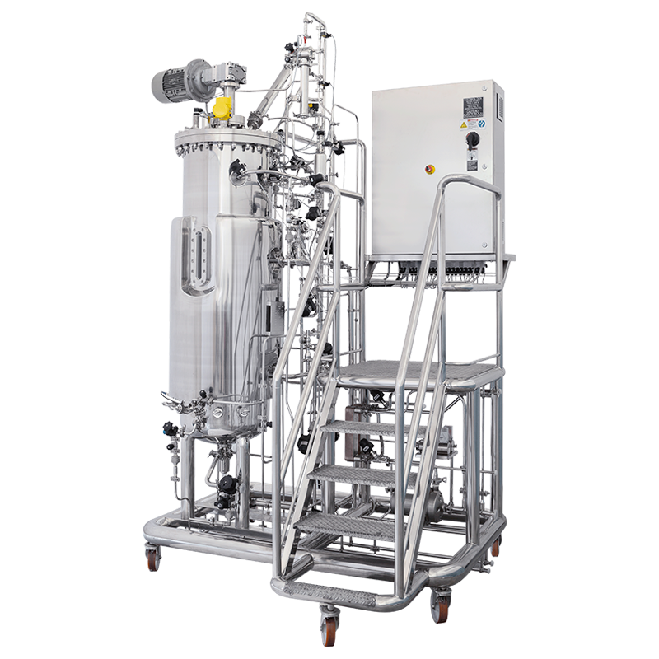
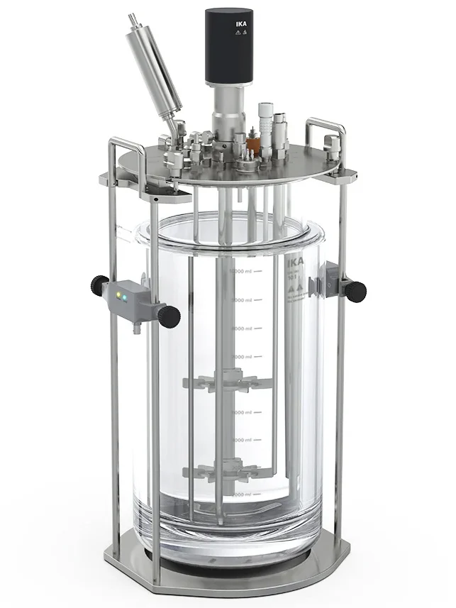

Slide 9
Aeration and agitation
Provide microorganisms with sufficient oxygen, agitation – uniform suspension of cells in a homogenous nutrient medium
Structural components involved:
Agitator
Sparger (aeration system)
Baffles

Slide 10
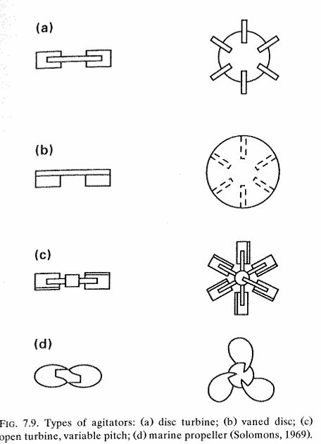
Agitator (Impeller)
A critical component in a bioreactor that provides mechanical mixing to ensure the uniform distribution of nutrients, oxygen, and cells throughout the culture medium. I
t enhances heat and mass transfer, keeps solids suspended, breaks up air bubbles, and maintains a consistent environment for optimal microbial growth and product formation
Disc Turbine (Rushton Turbine)
Flat blades fixed on a disc.
Creates strong radial flow → high oxygen transfer, but high shear.
Best for microbes, not for delicate cells.
Vaned Disc
Similar to disc turbine but with vanes on the disc.
Improves fluid circulation and reduces dead zones.
Good compromise between mixing and shear.
Open Turbine (Variable Pitch Blades)
Blades attached to a central disc, angle (pitch) can vary.
Produces both radial + axial flow → flexible mixing.
Used for different viscosities and balanced oxygen transfer.
Marine Propeller
Curved propeller-like blades.
Gives axial flow (up–down), gentle mixing.
Best for shear-sensitive cells (animal/plant).

Slide 11
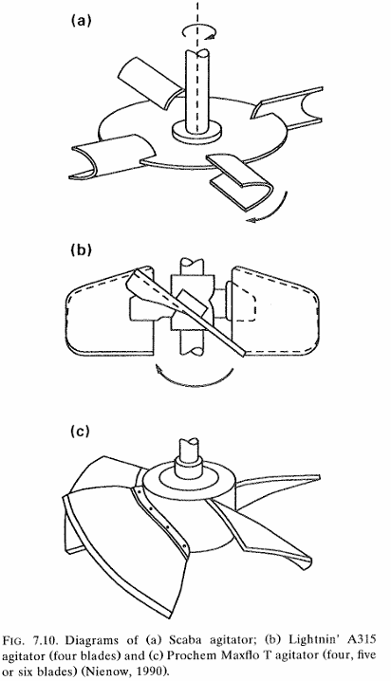
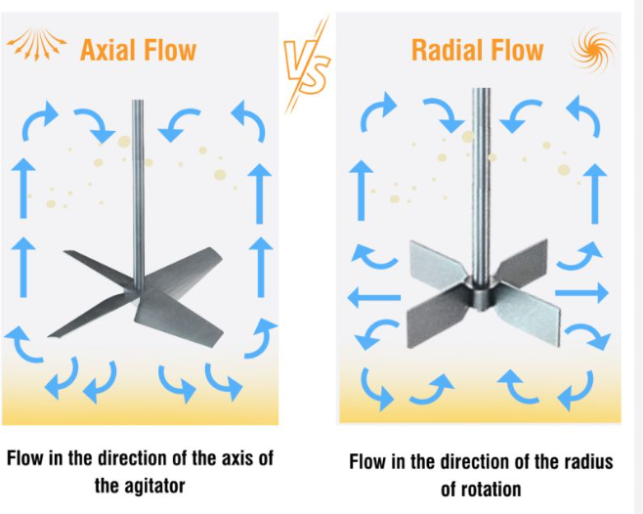

Slide 12
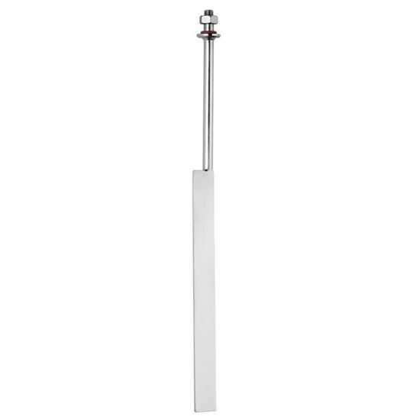
Baffles
Baffles are vertical strips/plates fixed inside the wall of a bioreactor (usually 4, placed equally spaced).
They interrupt the circular liquid flow created by the impeller and promote better mixing.
🔑 Functions of Baffles
Prevent vortex formation – Without baffles, liquid forms a whirlpool (vortex), trapping air and reducing oxygen transfer.
Improve mixing – They break circular flow and create turbulence → uniform nutrient and oxygen distribution.
Enhance oxygen transfer – In aerobic bioprocesses, baffles increase the gas–liquid contact area.
Maintain homogeneity – Ensures even temperature, pH, and nutrient distribution throughout the medium.

Slide 13
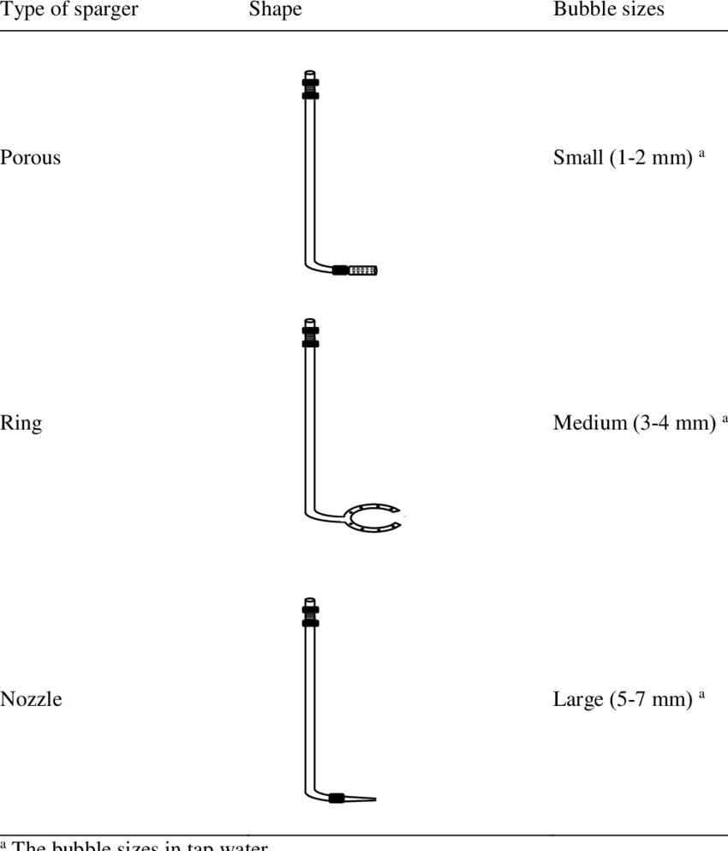
Aeration system (Sparger)
A device for introducing air into the liquid in a fermenter
Three basic types
Porous sparger – sintered glass, ceramics or meal – laboratory scale in non- agitated vessels
The throughput of air is low because of pressure drop across sparger and there is also the problem of the fine holes becoming blocked by microbial growth
Orifice sparger – various arrangements of perforated pipes have been tried
Used in yeast manufacture, effluent treatment, single-cell protein production
Nozzle sparger – modern mechanically stirred fermenter designs have single open or partially closed pipe as a sparger to provide a stream of air bubbles
Causes lower pressure loss than any other sparger and normally does not get blocked

Slide 14
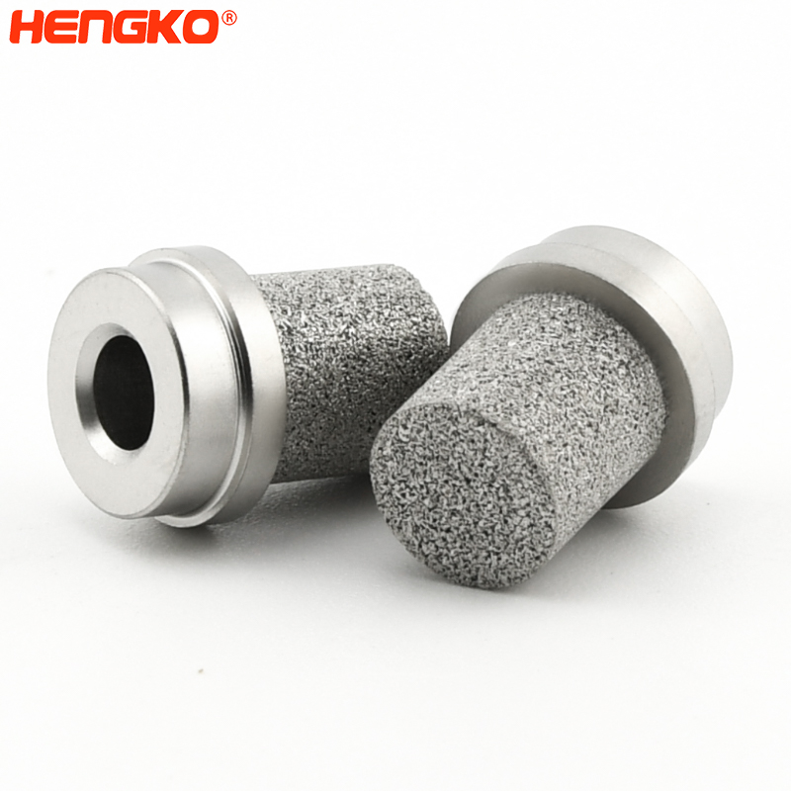
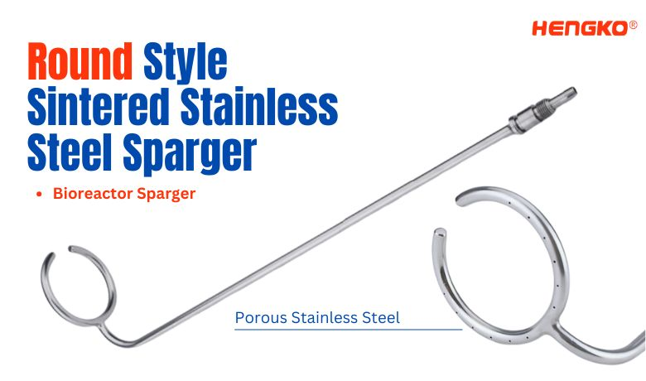

Slide 15
Achievement and maintenance of aseptic conditions
Able to sterilize, and keep sterile throughout the complete growth cycle
Operations to be performed according to certain specifications to achieve and maintain aseptic conditions:
Sterilization of fermenter
Sterilization of air supply and exhaust gas
Aeration and agitation
Addition of inoculum . Nutrients and other supplements
Sampling
Foam control
Monitoring and control of various parameters

Slide 16

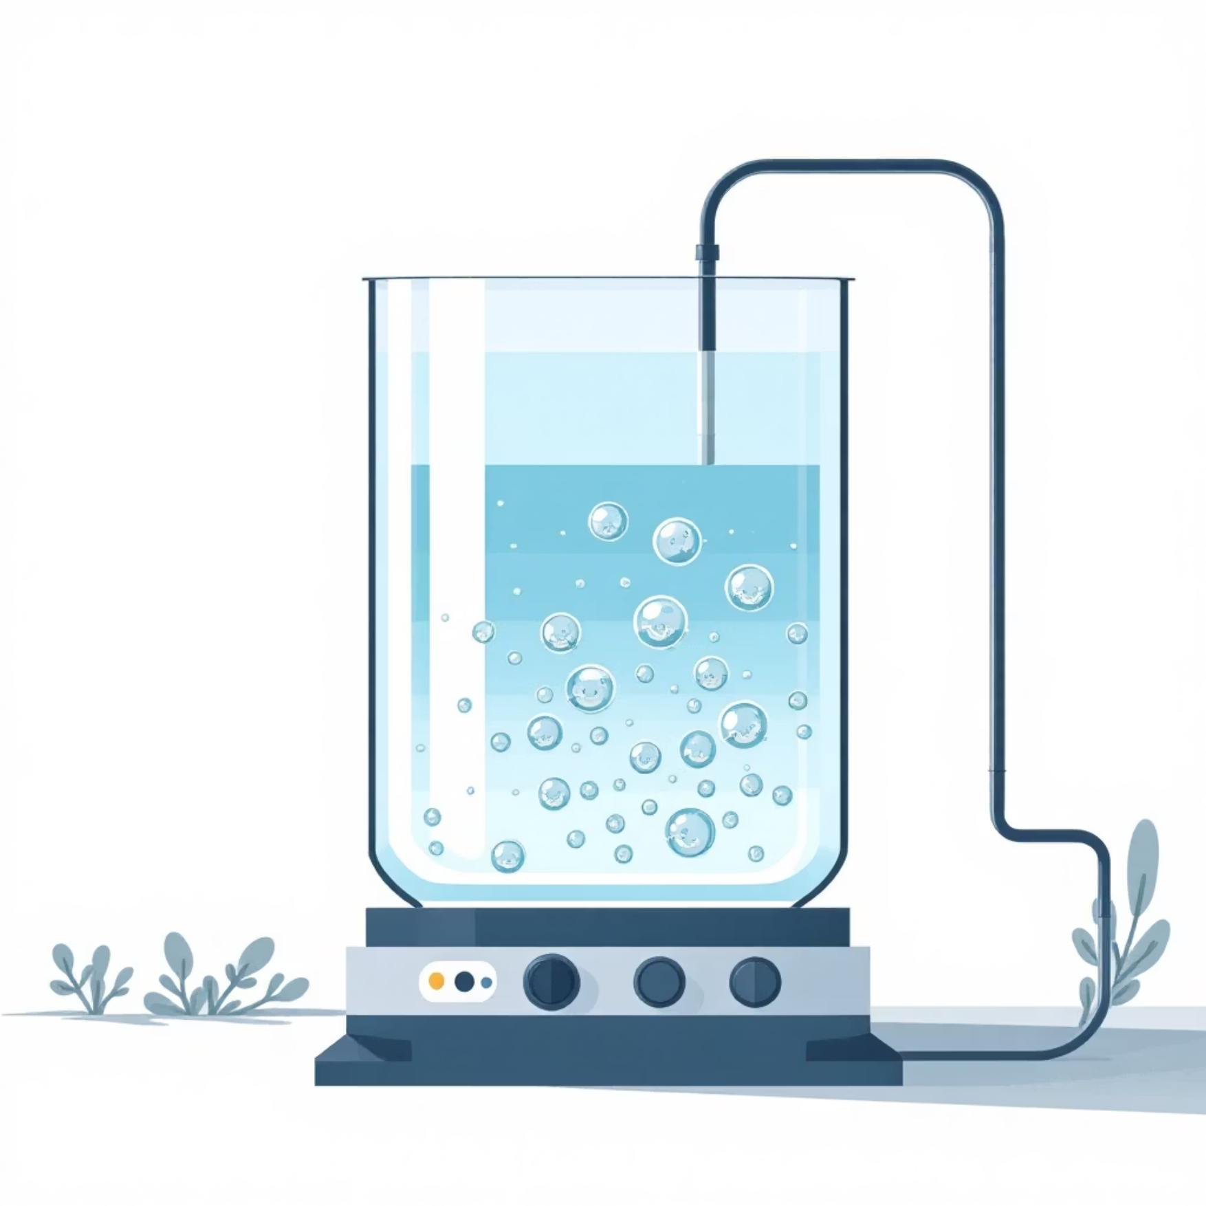
Types of Fermentation Processes
Surface Fermentation
Submerged Fermentation
In surface fermentation, microorganisms grow on the surface of a liquid or solid medium. This method is often used for fungi that require high oxygen concentrations or for processes involving solid substrates, such as traditional food fermentation or enzyme production on agricultural waste.
Submerged fermentation involves microorganisms growing suspended within a liquid medium. This process typically requires continuous agitation and aeration to ensure uniform distribution of nutrients and oxygen. It is the most widely used method in industrial biotechnology due to its scalability and efficiency for producing antibiotics, enzymes, and many other bioproducts.

Slide 17
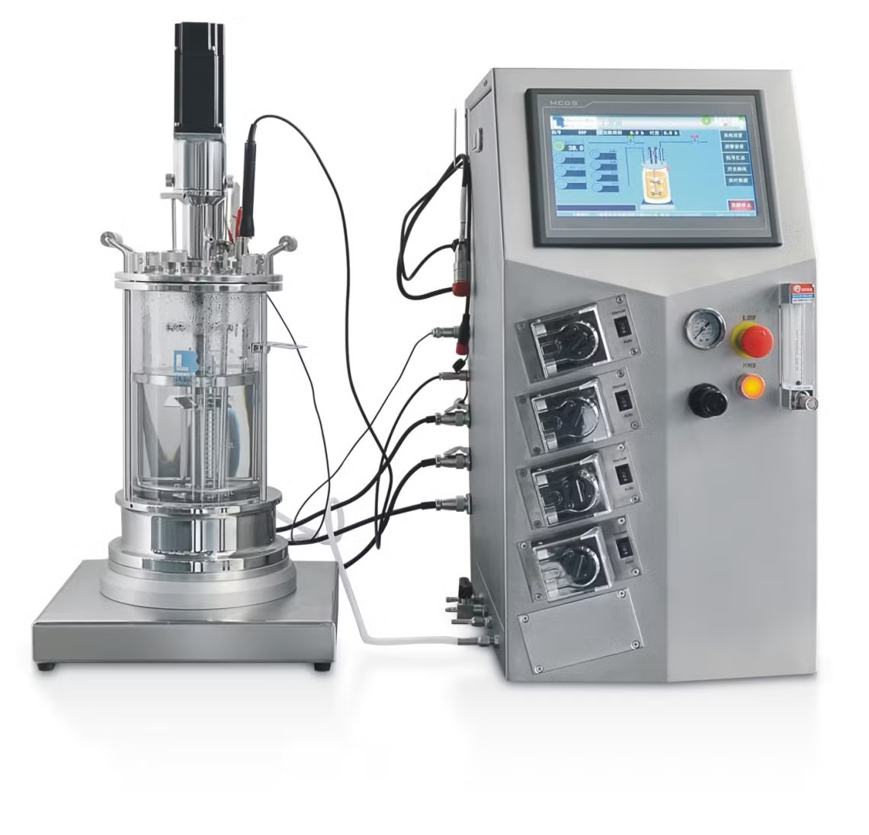
Types of Fermentors: Stirred Tank Fermentor (STF)
Industrial Workhorse
The most common and versatile type of industrial fermentor.
Features a mechanical agitator (impeller) for mixing and a sparger for introducing sterile air.
Highly adaptable for both aerobic (oxygen-requiring) and anaerobic (no oxygen) processes.
Example: Widely used in the large-scale production of antibiotics (e.g., penicillin), enzymes, and various pharmaceutical compounds, showcasing its robust design and operational flexibility.

Slide 18
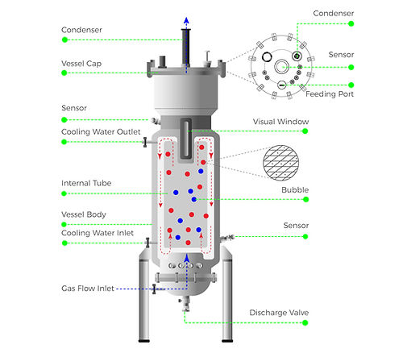
Types of Fermentors: Airlift Fermentor
Gentle & Efficient Mixing
Relies on air bubbles introduced at the base to circulate the medium and cells, eliminating the need for mechanical agitators.
This design significantly reduces shear stress, making it ideal for delicate cell cultures like animal cells or plant cells that are sensitive to mechanical forces.
Offers energy efficiency due to the absence of moving parts, leading to lower operating costs and maintenance.
Example: Frequently employed in the biotechnology industry for wastewater treatment, single-cell protein production, and the cultivation of sensitive mammalian and plant cell lines.

Slide 19
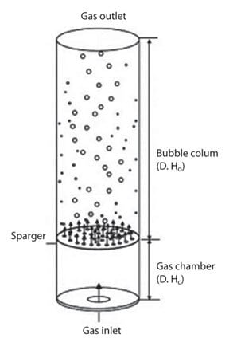
Types of Fermentors: Bubble Column Fermentor
Simplicity & Low Shear
Consists of a simple vertical column where air or gas is sparged through the liquid medium at the bottom.
There is no mechanical agitator; mixing and oxygen transfer are solely driven by the rising gas bubbles.
Suited for aerobic fermentation processes that require low shear environments, making it cost-effective and easy to operate.
Example: Commonly used for the production of organic acids (e.g., acetic acid), alcohols, and in some applications for biomass production where cell damage from agitation needs to be minimized.

Slide 20
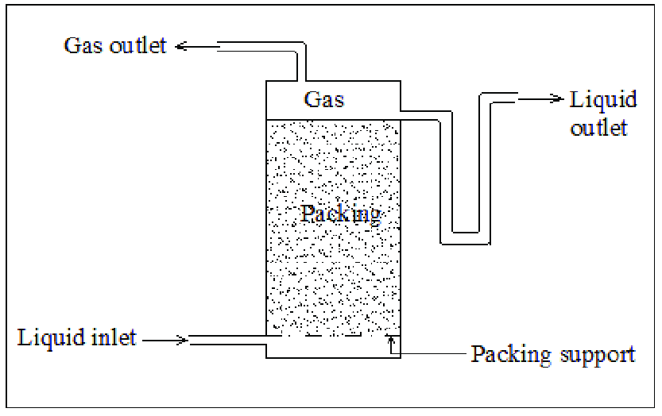
Types of Fermentors: Packed Bed Fermentor
Microorganisms grow on solid particles (like grains, husks, or beads) that are “packed” in a column or reactor.
Nutrient solution flows through the spaces between particles.
Why used:
For microbes that like to attach and grow on surfaces (not freely floating in liquid).
Useful for making enzymes, organic acids, antibiotics, etc.
How it works:
Solid particles = support (surface for microbes).
Microbes stick and grow on them.
Liquid nutrients pass through → microbes eat nutrients → make product.
Example: Yeast on corn cobs → when nutrient solution is poured, yeast grows on the cob and produces ethanol.

Slide 21
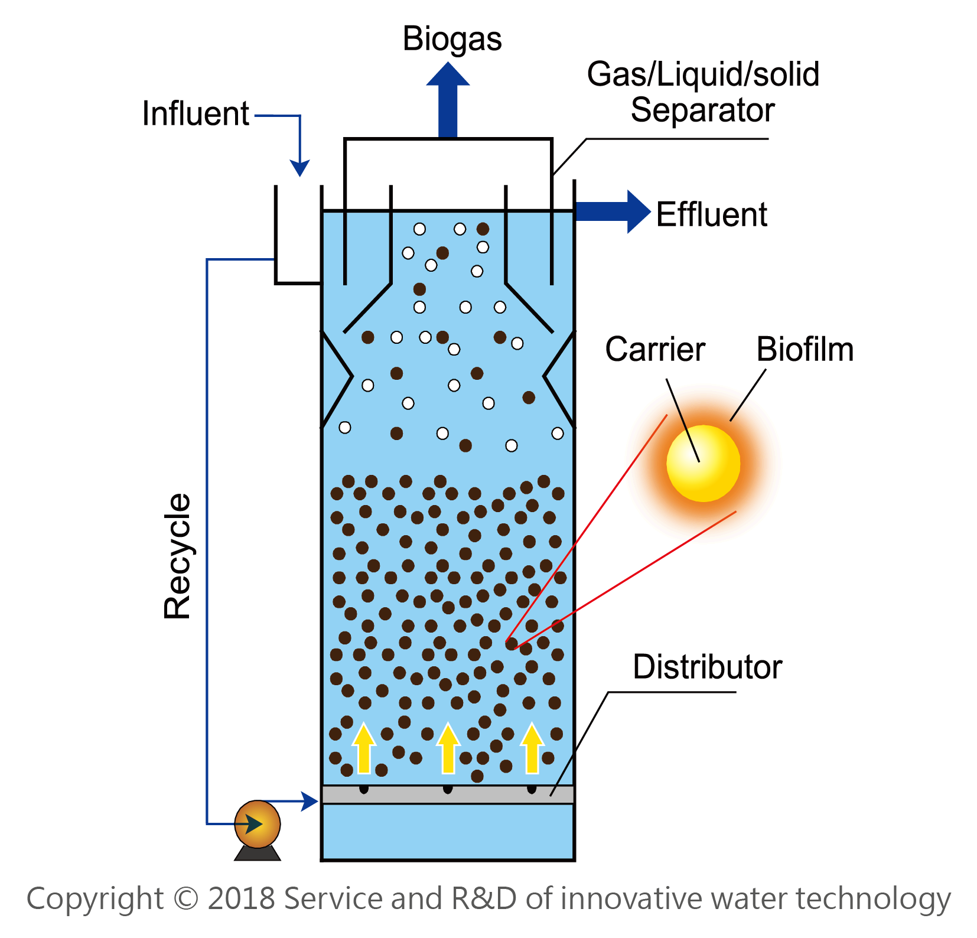
Types of Fermentors: Fluidized Bed Fermentor
Fluidized bed reactors use a solid material as a support for microbial growth.
Solid material may be:
Inert: e.g., sand, coal, plastic.
Active: e.g., granular activated carbon (GAC).
Can operate under aerobic or anaerobic conditions.
In anaerobic systems, microorganisms degrade organic matter without oxygen.

Slide 22

Other Fermentor Types and Applications
Photobioreactors
Solid-State Fermentors
Specialized for cultivating photosynthetic organisms like algae, optimizing light exposure for enhanced biomass production.
Used for processes involving solid substrates, such as fermentation of grains or agricultural residues for enzyme or secondary metabolite production.
The selection of a fermentor type is a critical decision, dependent on the specific microorganism, desired product characteristics, process scale, and economic considerations.

Slide 23
Summary & Key Takeaways
Critical Design
Diverse Types
Optimize Yield
Fermentor design is paramount for efficient, scalable, and high-yield bioprocesses.
Key types include Stirred Tank, Airlift, Bubble Column, and specialized Surface Fermentors.
Understanding design principles enables optimization of product yield and quality.
Your knowledge of fermentor design will be a foundational skill in your biotech career. Always consider the biological and engineering needs for successful biomanufacturing.

