Slide 1
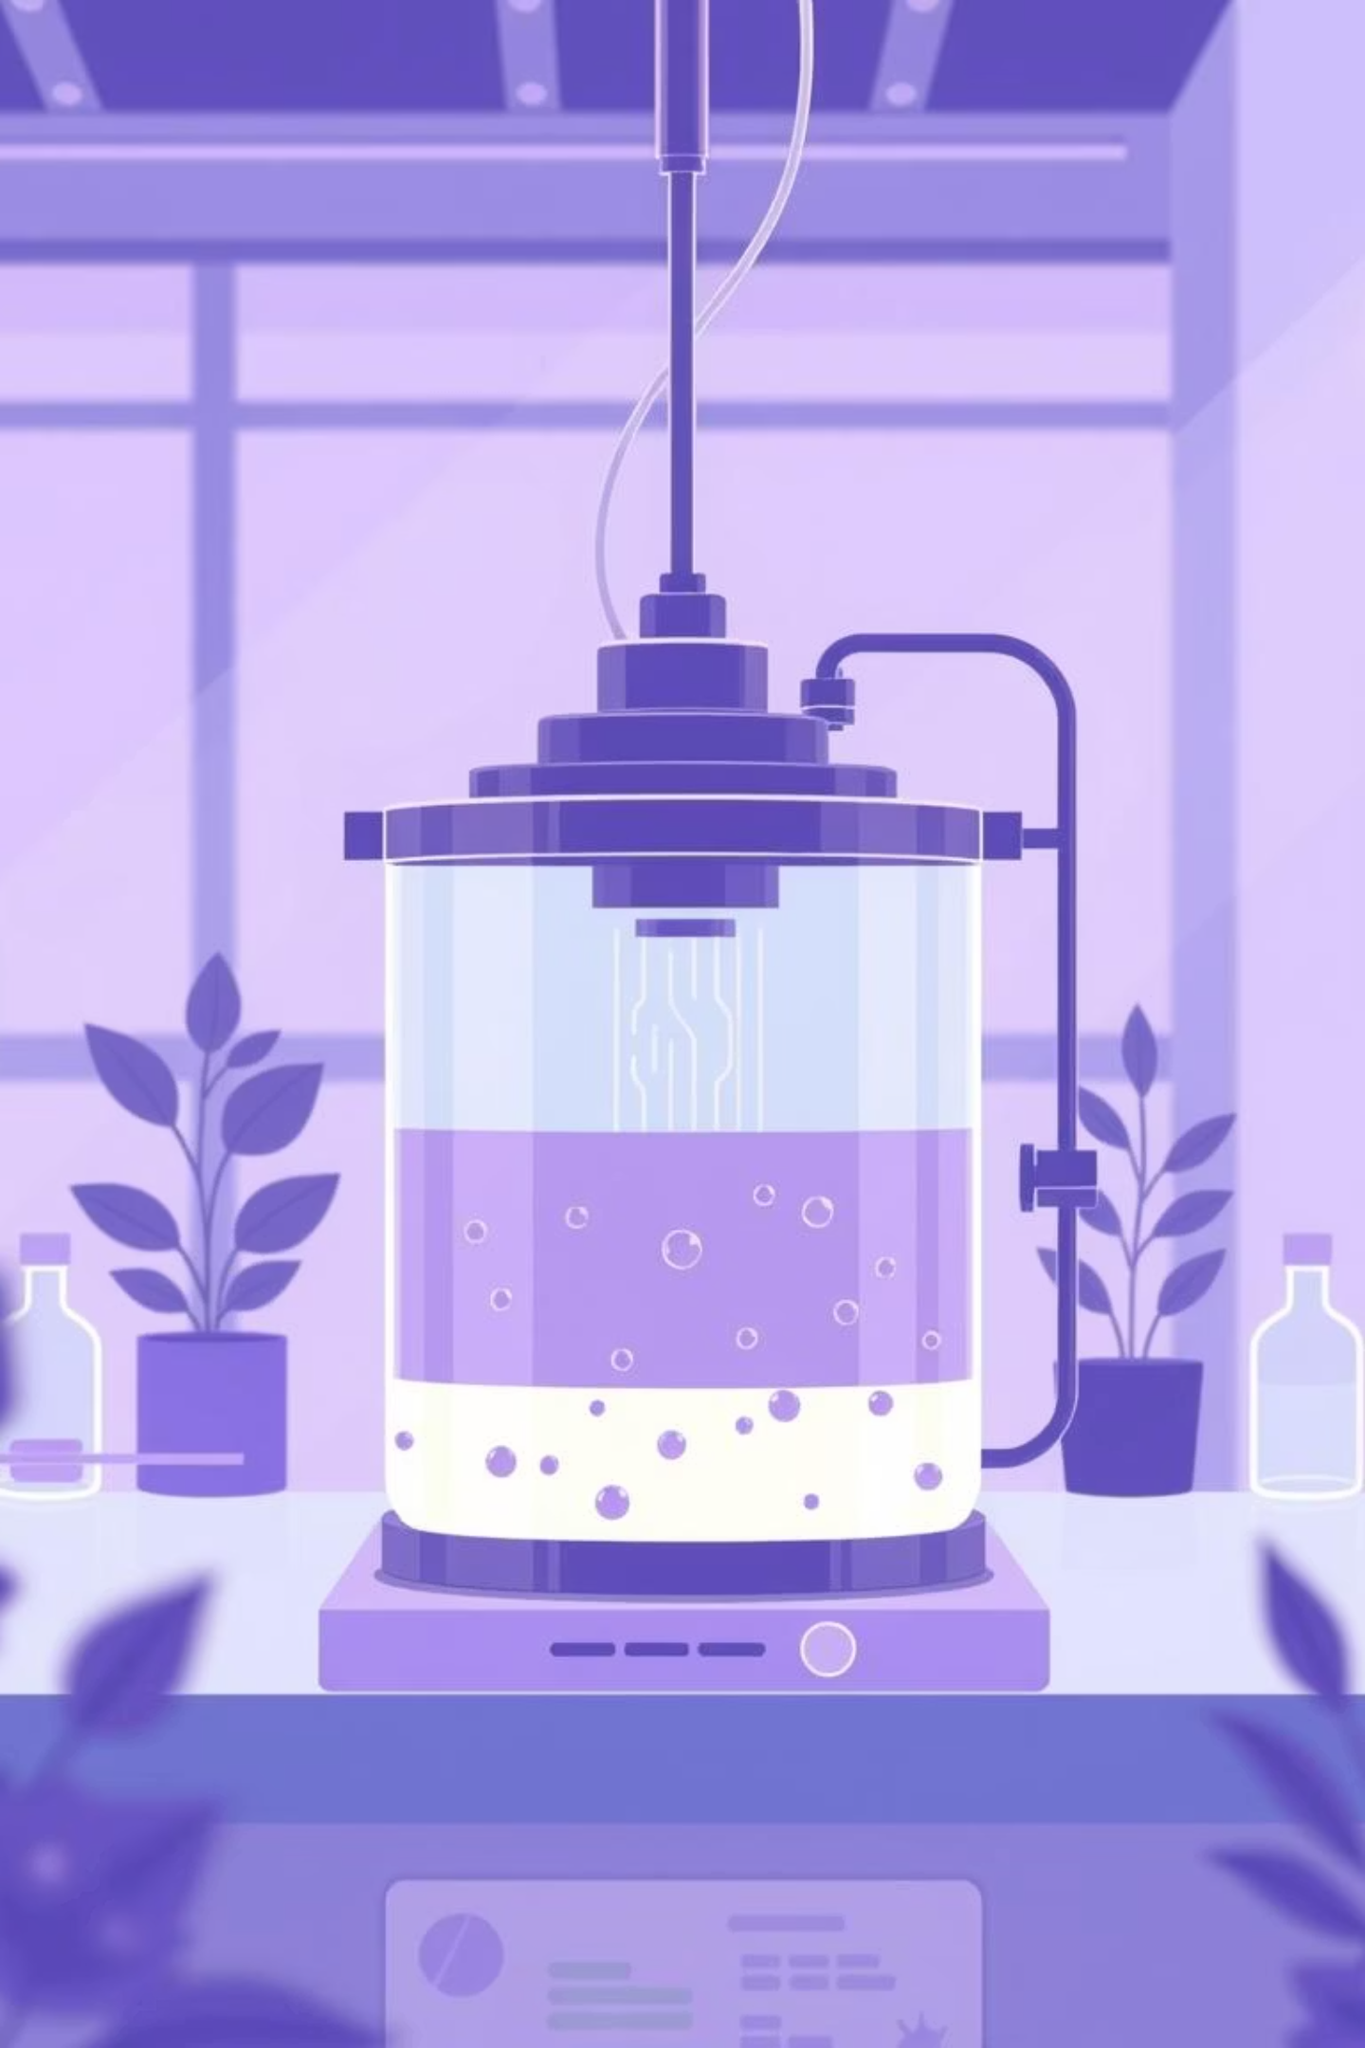
Fermentation Technology
Upstream & Downstream Processing
Lecture 3

Slide 2

Upstream Processing: An Overview
This pre-fermentation phase prepares everything for a successful fermentation run.
1
2
Strain Selection & Improvement
Media Formulation
Finding and enhancing the best microbes.
Creating the optimal nutrient mix.
3
4
Sterilization
Inoculum Preparation
Eliminating contaminants.
Building up the seed culture.

Slide 3

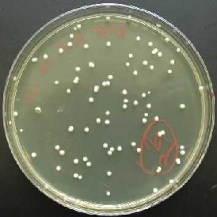
Strain Selection & Screening
Screening Methods
Strain Improvement
Primary (Qualitative): Agar plates identify product-producing microbes.
Mutation
Recombination
Secondary (Quantitative): Liquid media measure product yield.
Gene Cloning
Cell Fusion
Goal: Create super-producer strains!

Slide 4
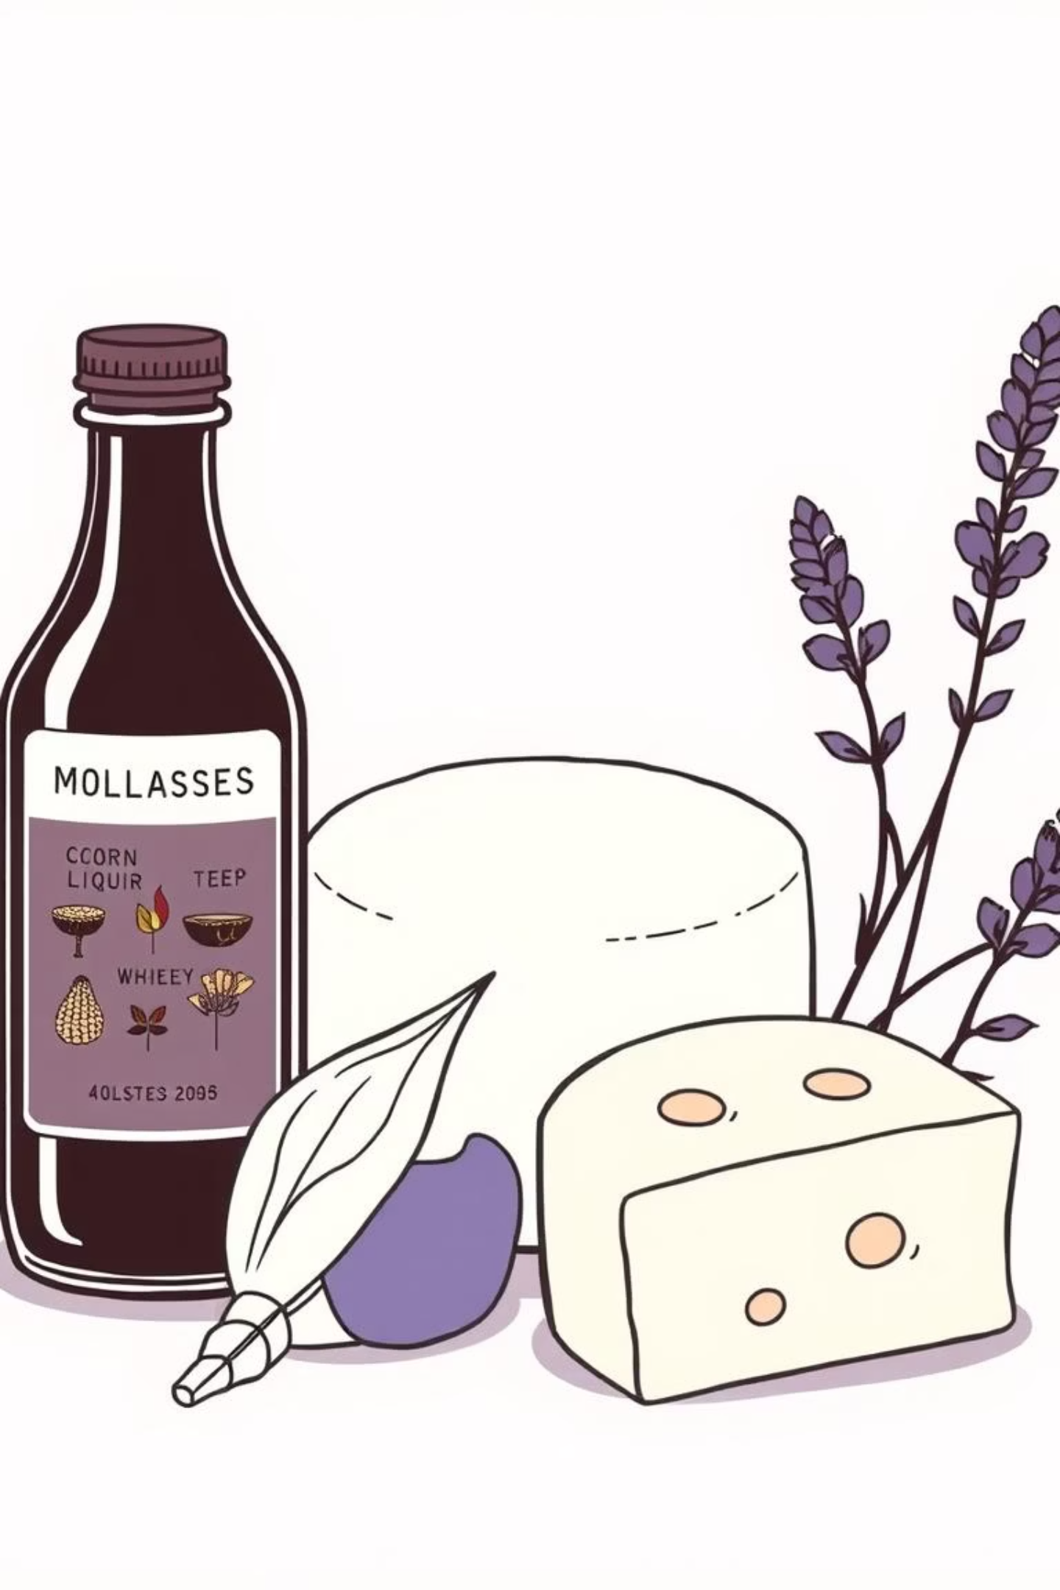
Media Formulation & Raw Materials
The growth medium must contain all essential nutrients to feed the microbes.
Two Types of Media:
Ideal Medium:
Inoculum Media: Rich for culture enrichment.
✅ Cheap & easily available
✅ Maximize growth and product yield
Production Media: Optimal Carbon/Nitrogen for product formation.
✅ Minimize unwanted by-products
Common Raw Materials: Corn molasses, beet molasses, corn steep liquor, cheese whey, lignocellulosic waste.

Slide 5
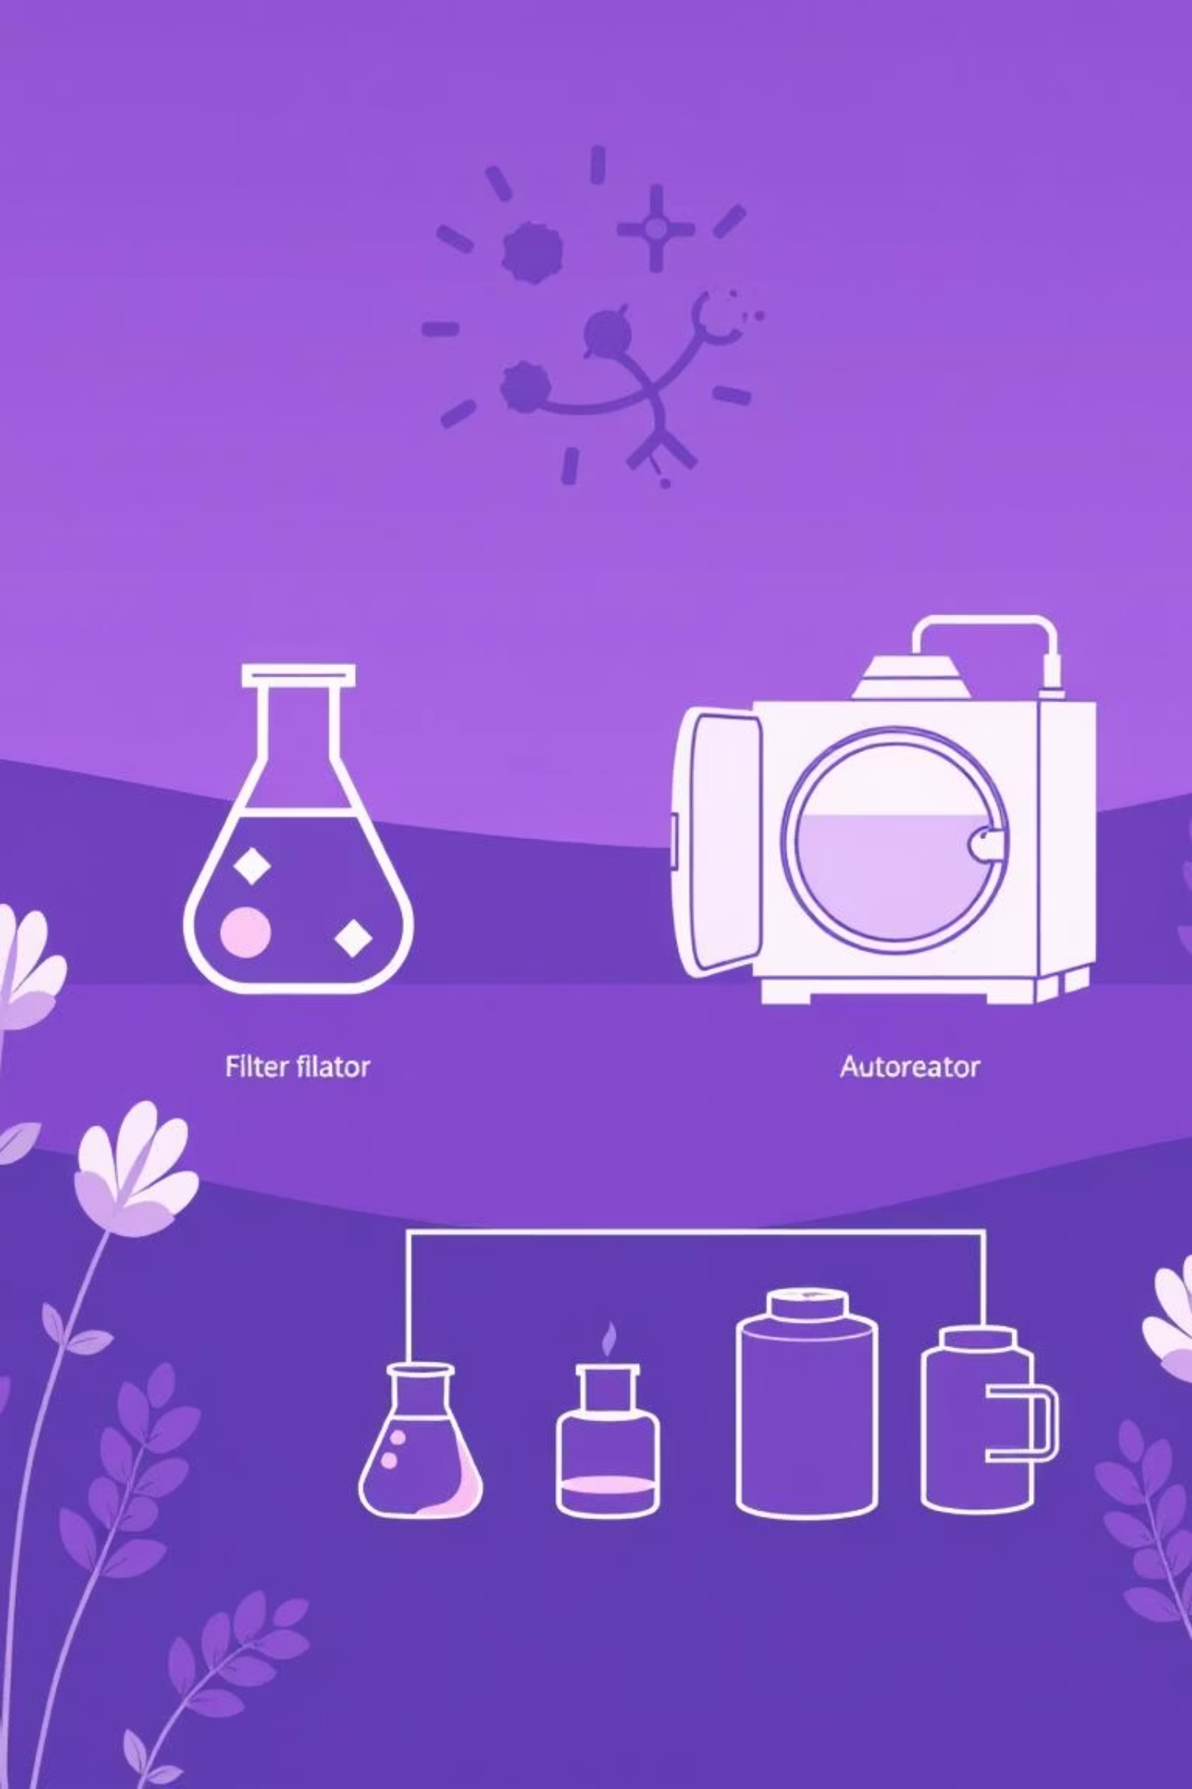
Sterilization & Inoculum Build-Up
Sterilization: Preventing Contamination
Inoculum Build-Up
Preparing a large, active "seed culture" step-wise to reduce lag time and boost productivity in the main fermenter.
Air: Sterilized by membrane filtration.
Medium & Fermenter: Usually sterilized by heat.
Heat-sensitive nutrients: Added via filter-sterilization.

Slide 6
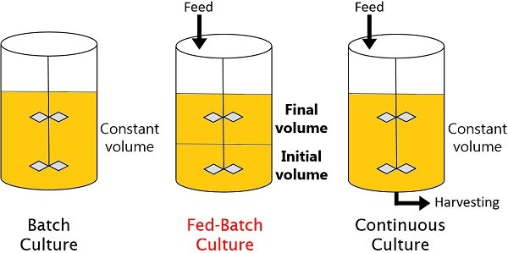
Fermentation Systems
Different bioreactor modes dictate how fermentation is run.
Batch Culture
Closed system; filled, inoculated, and harvested.
Simple, but downtime
Continuous Culture
Fresh medium added continuously; product harvested continuously.
High productivity, steady state.
Fed-Batch Culture
Nutrients added periodically without removing broth.
Controls nutrient levels, common in industry.

Slide 7
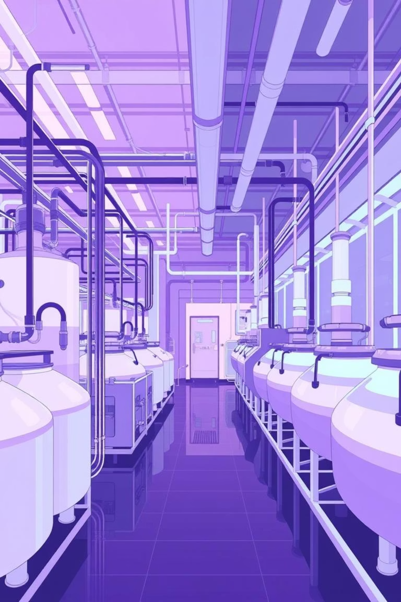
Bioprocess Downstream Processing
This presentation outlines the critical steps involved in downstream processing within biopharmaceutical manufacturing, focusing on the separation, concentration, purification, and final formulation of biological products.

Slide 8
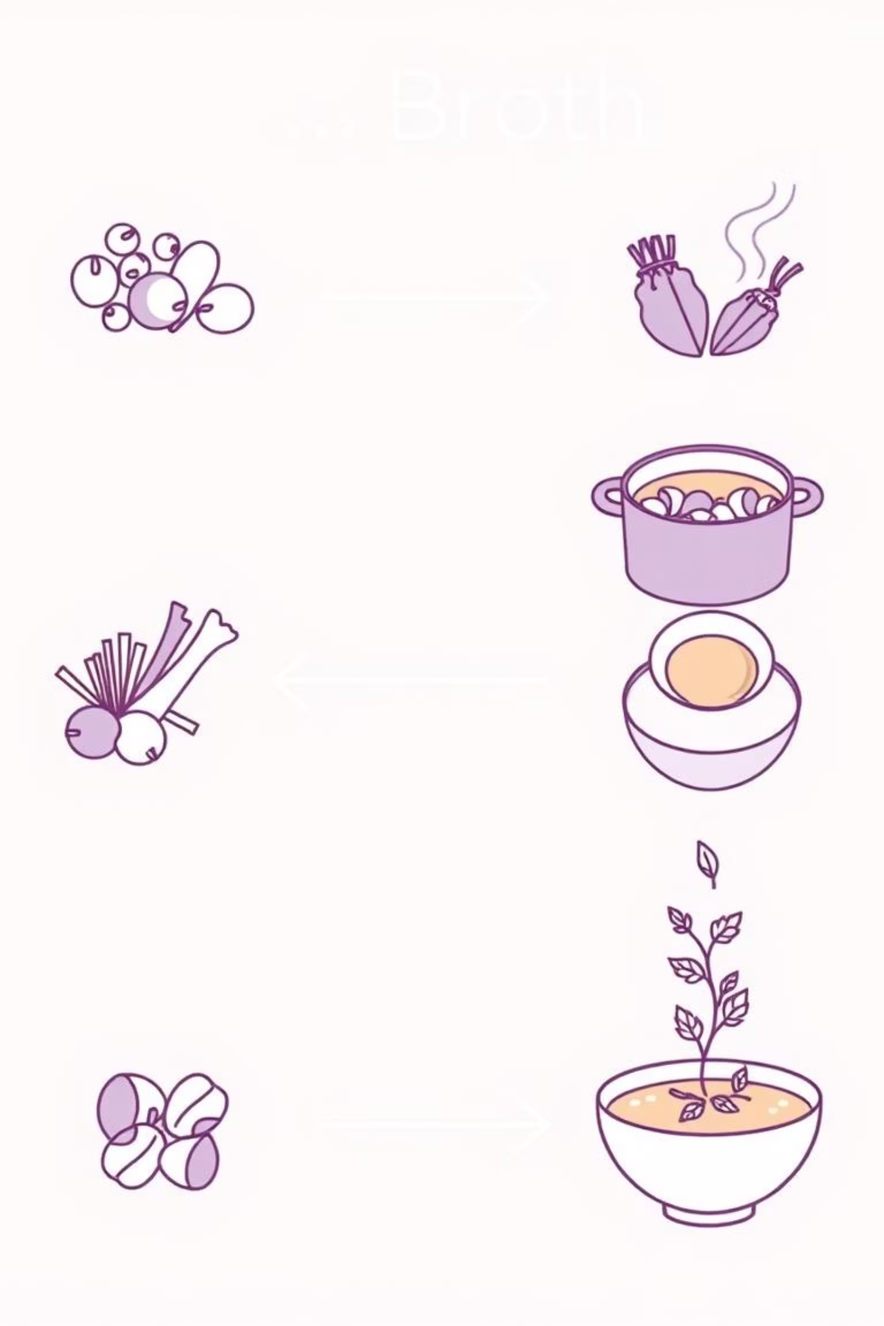




Downstream Processing: An Overview
Also called Product Recovery, DSP is complex and costly but crucial for obtaining a usable product.
Broth
Separation
Purification
Final Product

Slide 9

Initial Recovery & Cell Disruption
The first step depends on the product's location: extracellular or intracellular.
Extracellular Product (Secreted)
Intracellular Product (Inside Cells)
Product is in the liquid broth; proceed directly to Solid-Liquid Separation.
Requires Cell Disruption:
Mechanical: Shear forces (homogenizers).
Non-Mechanical: Chemical (detergents), Physical (freeze-thaw), Enzymatic (lysozyme).

Slide 10



Step 2: Separating Solids from Liquids
The primary goal is to clarify the broth by removing solids (cells or cell debris).
Filtration
Centrifugation
Coagulation & Flocculation
Passing the broth through a filter.
Using high-speed spin to separate by density.
Clump small particles together so they settle.

Slide 11
Common Methods for Solid-Liquid Separation
Beyond the primary techniques, other methods contribute to effective solid-liquid separation.
Flotation
Sedimentation
Membrane Separation
Making particles float to the surface for removal.
Allowing denser particles to settle naturally over time.
Utilizing semi-permeable membranes to separate components based on size.

Slide 12



Step 3: Concentrating and Isolating the Product
This stage focuses on reducing the volume of the solution and making the product more accessible for further purification.
Techniques for Product Concentration
Evaporation
Precipitation
Adsorption
Utilizes heat to remove water, significantly reducing the volume of the product solution.
Induces the product to become insoluble, causing it to separate from the solution as a solid.
Involves the product binding to specialized resins, allowing for its selective capture and concentration.

Slide 13



Purification (Increase Purity)
This is the main process for achieving high purity.
Chromatography: The Gold Standard for Purification
Chromatography techniques are essential for achieving the high purity required for biopharmaceutical products.
Ion-Exchange
Size-Exclusion
Affinity
Separates molecules based on their net charge.
Separates molecules based on their hydrodynamic volume.
Separates based on specific biological interactions.

Slide 14
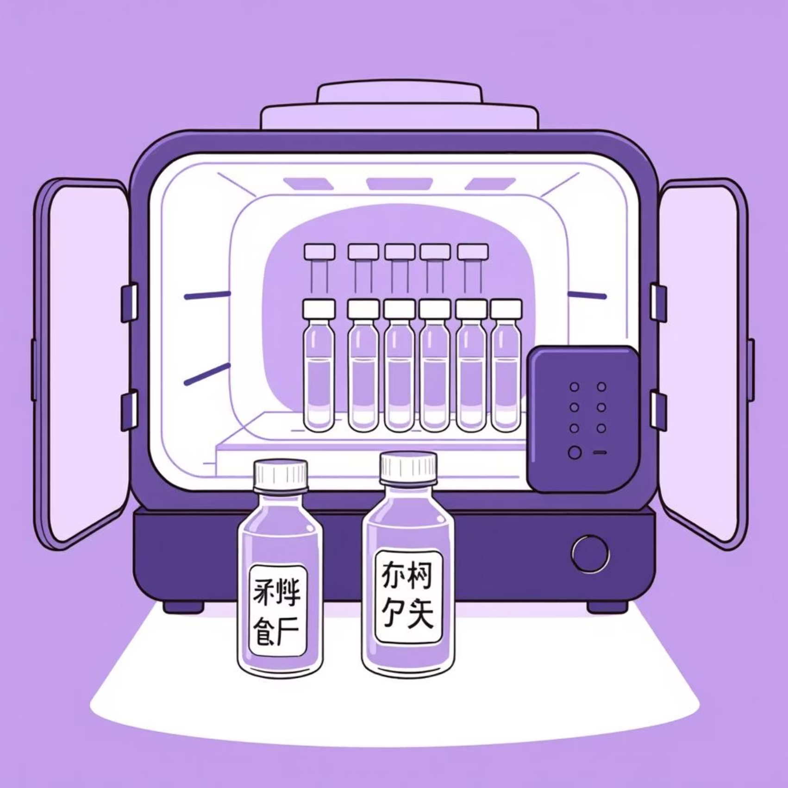
Step 4: Creating the Stable Final Product
The purified product is prepared for storage and distribution.
Key Formulation Processes:
Drying: Withdrawal of water (e.g., Spray drying, Freeze-drying) for stability.
Crystallization: Achieves final purification and creates a stable, solid form.

Slide 15



Ensuring Product Stability and Efficacy
The ultimate goal of final formulation is to ensure the product remains active and stable until it reaches the end-user.
Drying
Crystallization
Packaging
Removes water to prevent degradation and extend shelf life.
Provides a highly pure and stable solid form of the product.
Protects the product from environmental factors and ensures sterility.

Slide 16
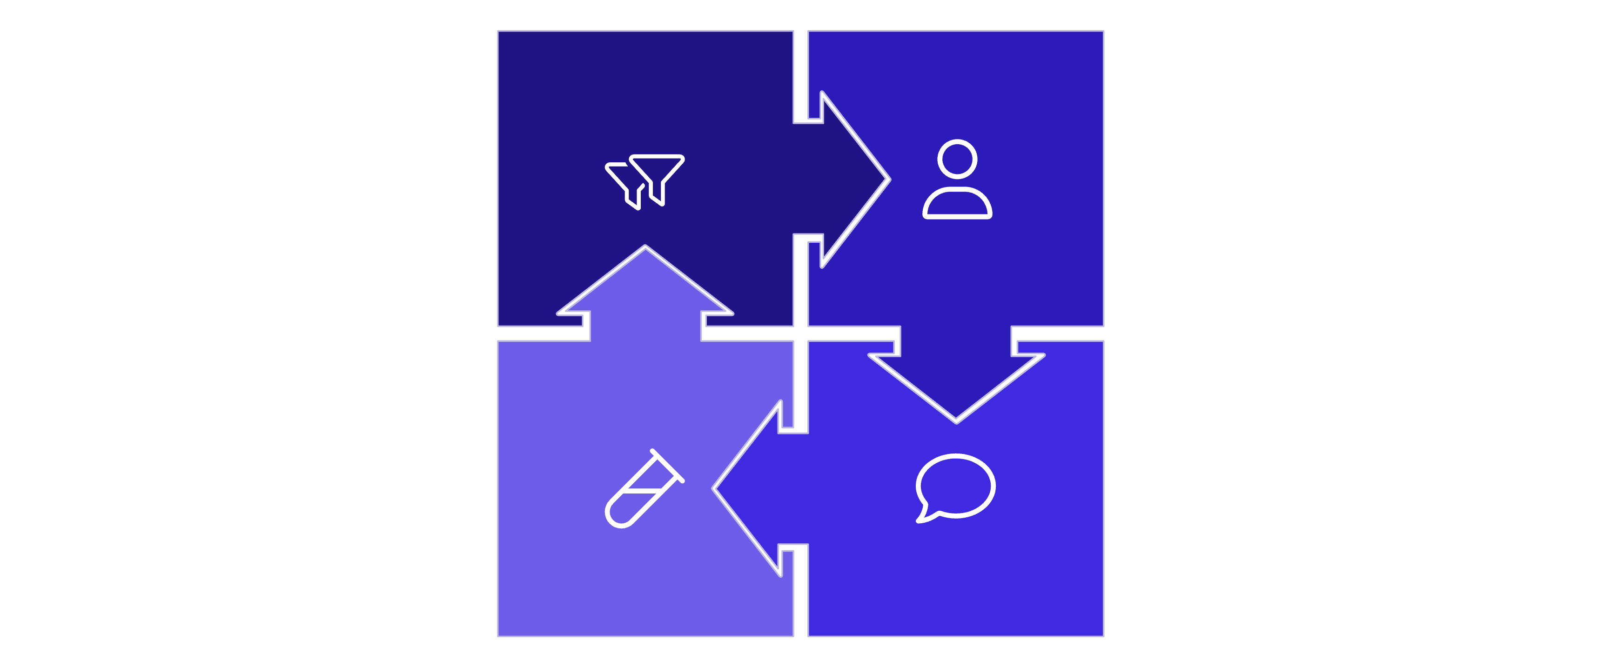




Downstream Processing: A Critical Journey
From initial separation to final formulation, each step is vital for delivering safe and effective biopharmaceutical products.
Solid‑Liquid Separation
Concentration
Final Formulation
Purification
The meticulous execution of these processes ensures the quality and integrity of the final bioproduct.

