Slide 1

Fermentation Kinetics
The study of rates in microbial growth and product formation

Slide 2
The Big Picture
Cell Growth
Substrate Consumption
How microbial populations increase over time
How food sources like glucose are utilized
Product Formation
By-product Formation
How desired metabolites are produced
How waste products are generated
Mathematical framework to optimize and control industrial fermentations for maximum yield and productivity.

Slide 3

Monod Kinetics
The most famous model describing microbial growth rate as a function of limiting nutrient concentration

Slide 4
The Monod Equation
μ (mu)
μmax
Specific growth rate (h⁻¹) - rate of cell division per unit biomass
Maximum specific growth rate when nutrients are abundant
[S]
Ks
Concentration of limiting substrate (e.g., glucose g/L)
Saturation constant - substrate concentration at μ = ½μ_max

Slide 5
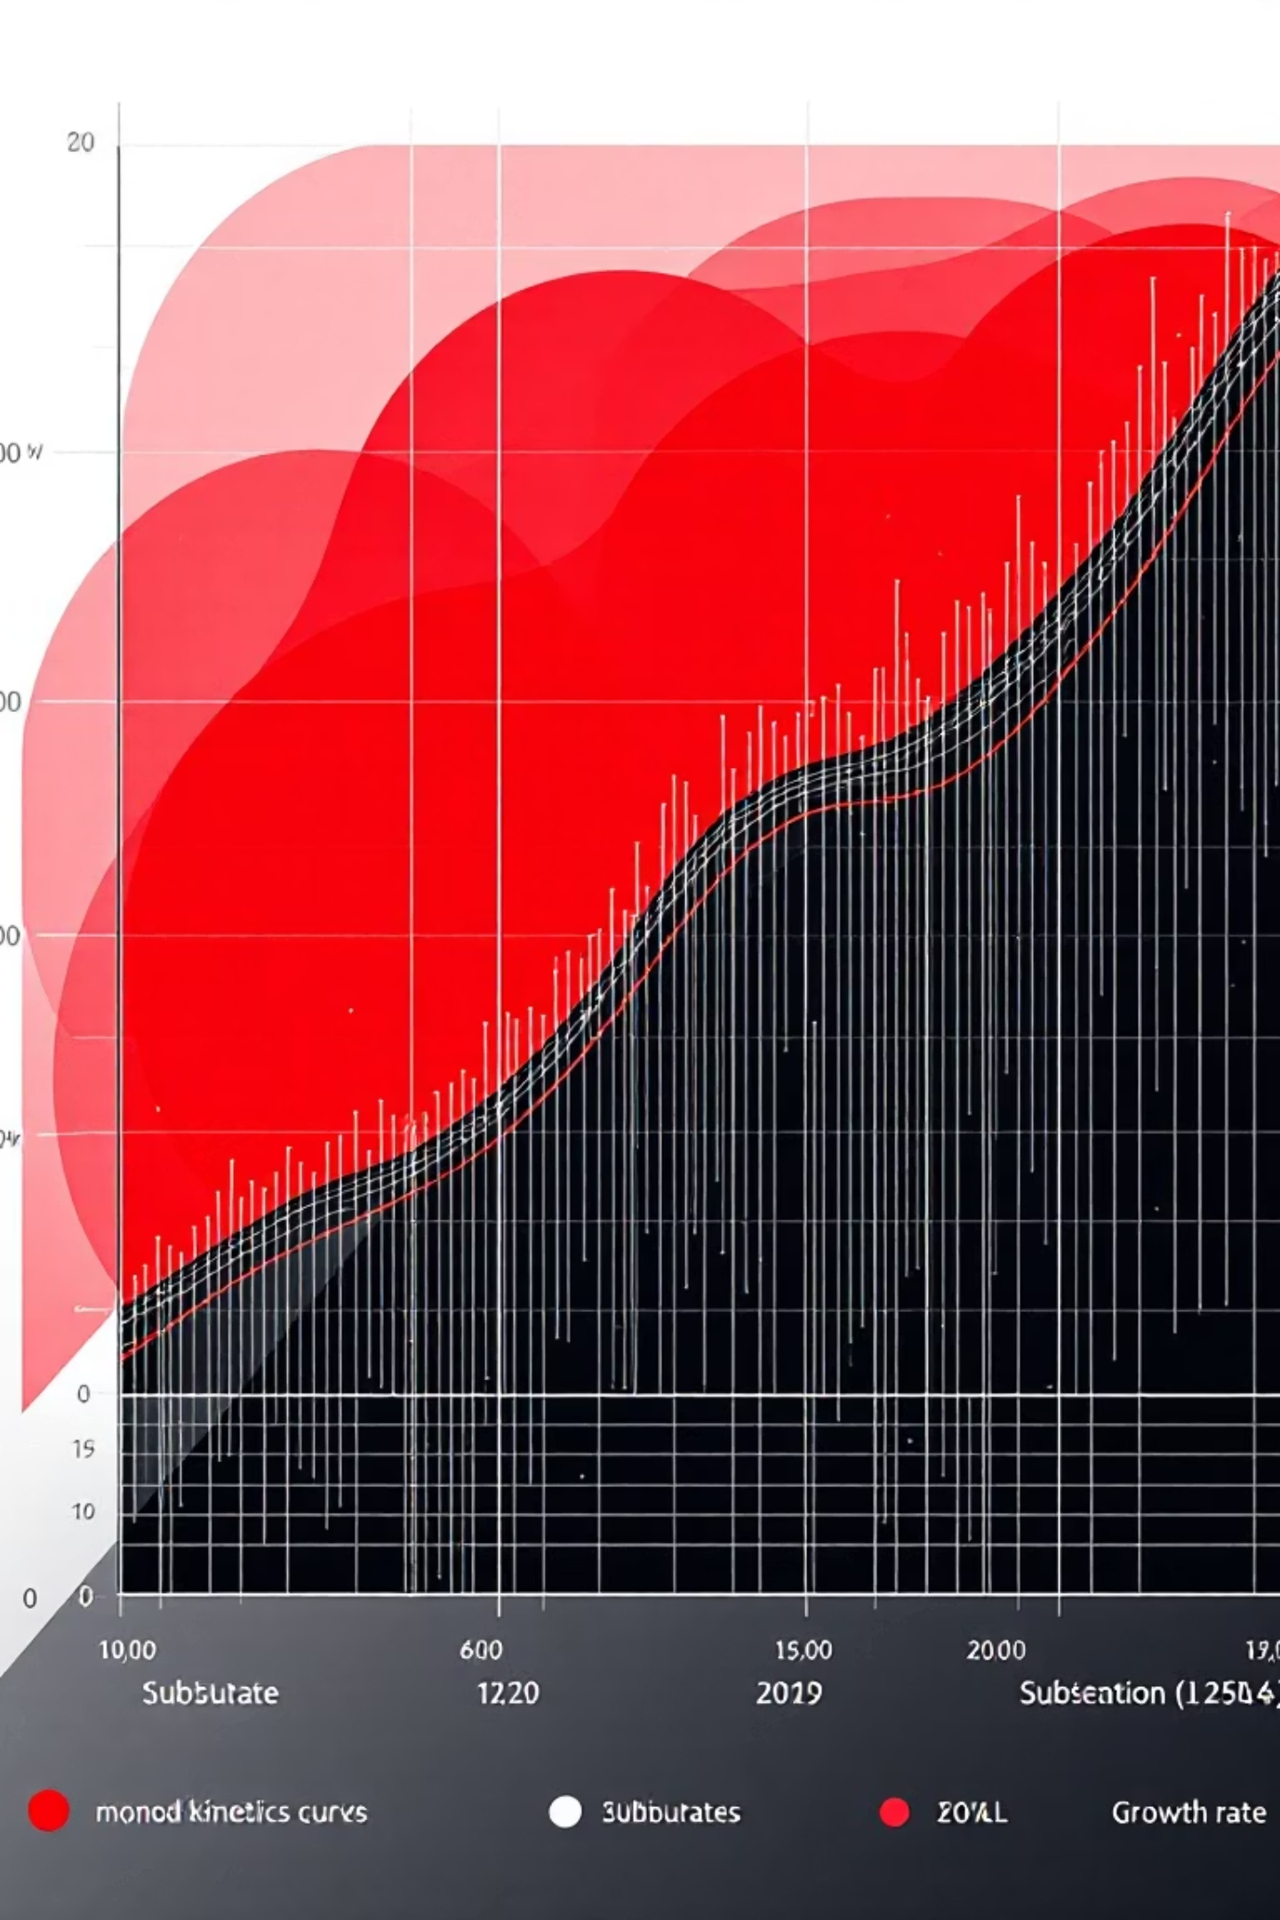
Growth Rate Behavior
Low Substrate [S] << Ks
High Substrate [S] >> Ks
Growth rate is very small, microbes grow slowly.
Growth rate approaches μmax (saturation).

Slide 6
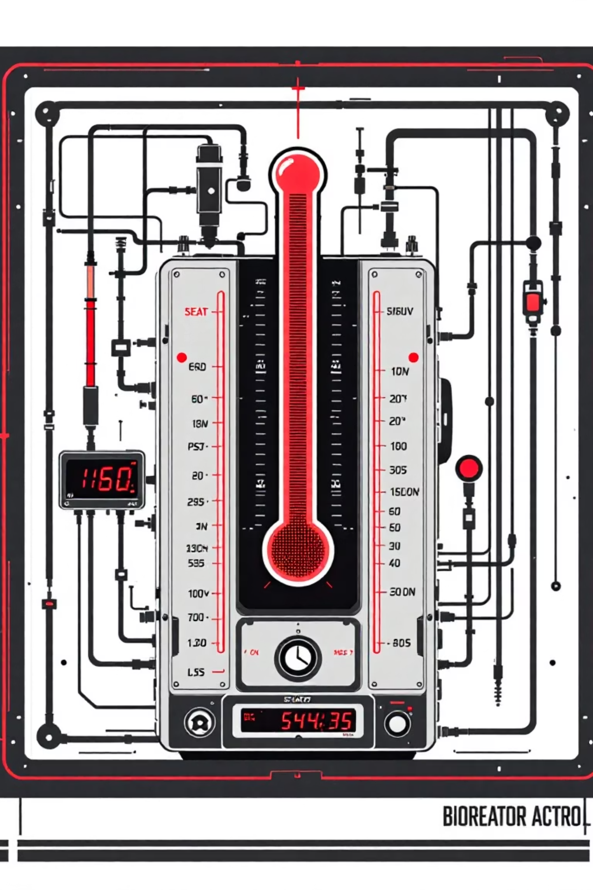
Thermal Kinetics
How temperature affects biochemical reaction rates in fermentation

Slide 7
The Arrhenius Equation
01
02
Rate Constant (k)
Pre-exponential Factor (A)
Could be μmax from Monod equation
Frequency factor for molecular collisions
03
04
Activation Energy (Ea)
Temperature (T)
Energy barrier reactions must overcome
Absolute temperature in Kelvin
Ea (activation energy) = how sensitive microbial growth is to temperature.
Low Ea → growth not very sensitive to temperature.
High Ea → small temperature change causes big changes in μmax

Slide 8



Temperature Effects on Fermentation
Growth Rate Increase
μ_max increases with temperature up to optimum point
Cell Death Risk
High temperatures dramatically increase thermal death rate
Enzyme Denaturation
Excessive heat unfolds enzymes, rendering them inactive
Each microorganism has an optimal temperature range for maximum efficiency.

Slide 9






Engineering Integration
Monod Parameters
Define μmax and growth rates
Thermal Kinetics
Control bioreactor temperature
Fermentation Model
Design and operate process
Biochemical engineers use this integrated approach to optimize industrial fermentation processes for maximum productivity and yield.

