Slide 1
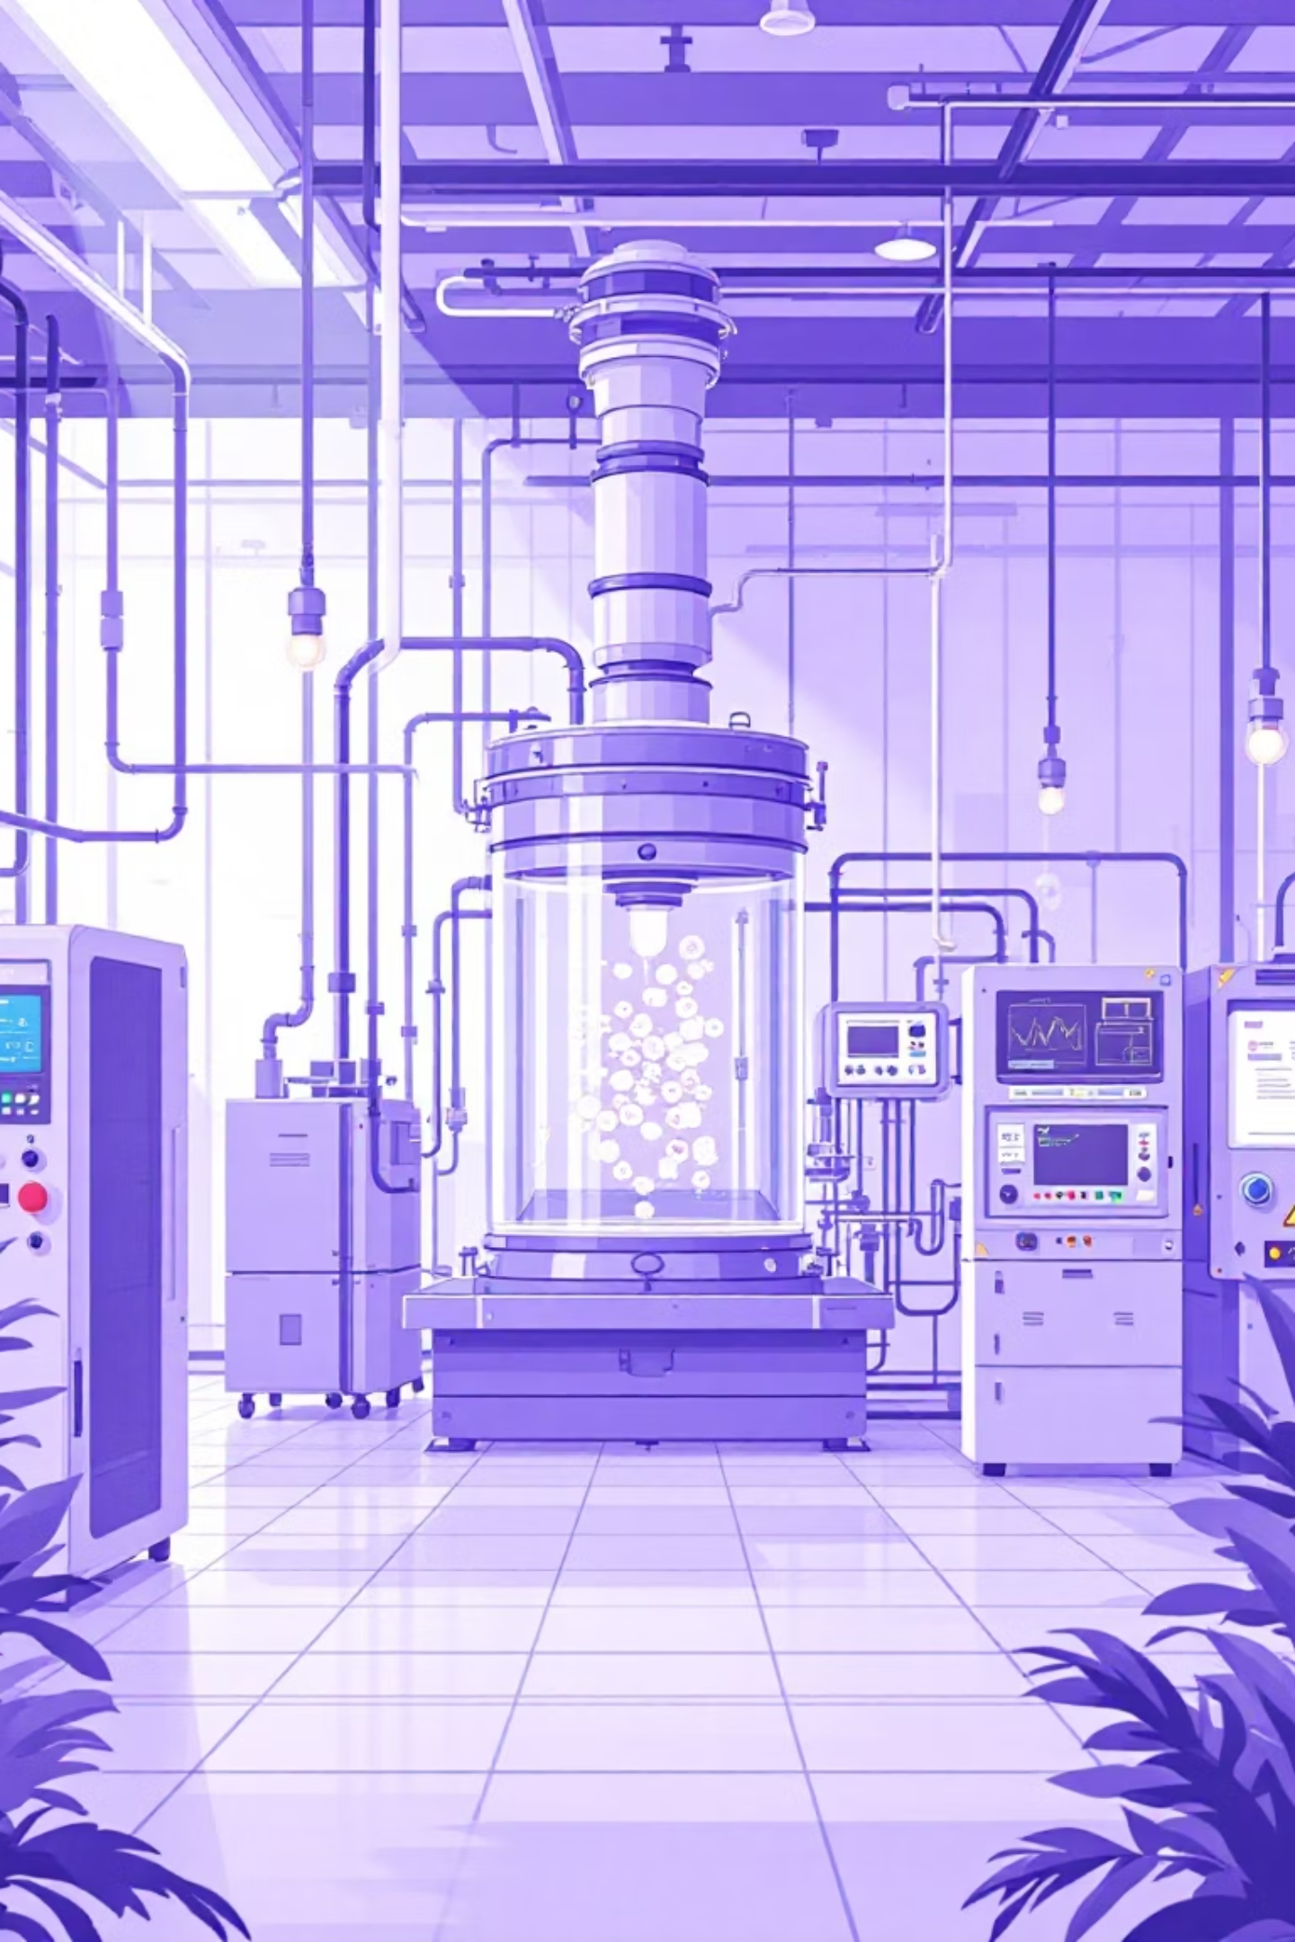
Fermentation Monitoring & Control Systems
Modern bioprocessing relies on sophisticated sensor networks to monitor and control fermentation parameters in real-time. These systems ensure optimal conditions for cell growth, product formation, and process safety while maintaining sterility throughout production.

Slide 2



Physical Parameter Sensors
Physical sensors monitor the fundamental environmental conditions that directly impact cell metabolism and fermentation performance. These parameters form the foundation of process control.
Temperature Control
Pressure Control
Foam Detection
Critical for controlling metabolic rates and maintaining optimal growth conditions for each organism.
Types: Mercury in glass, electric resistance thermometers, Thermistors
Maintain sterility through positive pressure and control dissolved gas levels for safety.
Types: Diaphragm gauge, Bourdon gauge, piezoelectric transducer
Conductivity probes trigger antifoam systems when excessive foam threatens to block filters or cause product loss during fermentation.

Slide 3



Chemical Parameter Monitoring
Chemical sensors provide real-time insight into the metabolic state of the culture by measuring key parameters that directly affect cell viability and productivity.
pH Control
Dissolved Oxygen
Dissolved CO₂
Combination pH electrodes generate voltage proportional to hydrogen ion concentration.
pH drastically affects enzyme activity, nutrient uptake, and cell viability, requiring tight control throughout fermentation.
This is perhaps the most critical parameter for aerobic fermentations, indicating whether cells receive adequate oxygen for respiration.
Types: Galvanic electrode, polographic electrode, fluorometric sterizable oxygen sensor.
Severinghaus-type electrodes monitor CO₂ levels that can inhibit cell growth. Particularly critical in mammalian cell cultures where high CO₂ concentrations affect productivity.

Slide 4

In-Line Sensors: Real-Time Monitoring
In-line sensors are placed directly inside the fermenter vessel, providing continuous, instantaneous measurements without sample removal or process interruption.
01
02
Direct Immersion
Real-Time Data
Sensors are sterilized in-place with the fermenter, maintaining complete aseptic conditions throughout the process.
Provides continuous readings for immediate process control and PID loop adjustments without any time delay.
03
Zero Sample Risk
Eliminates contamination risks and sampling errors by measuring directly in the process stream.
Example: pH probe, DO probe, Temperature probe , Pressure sensor

Slide 5
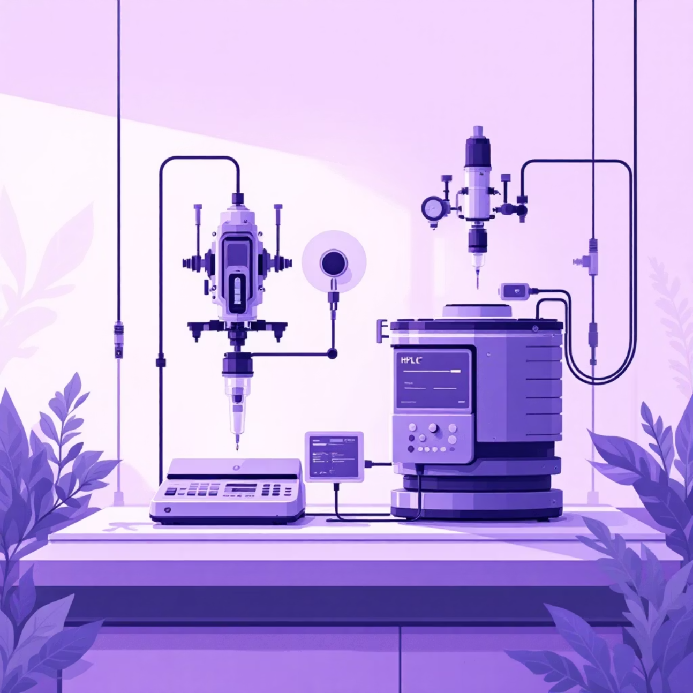
On-Line Analyzers: Automated Sampling
On-line systems automatically withdraw samples through sterile loops, enabling sophisticated analysis while maintaining process integrity.
Automated Sample Handling
External analyzers connect via automated sampling loops that aseptically withdraw broth, analyze it, and return or discard the sample.
Advanced Analytics
Off-gas analysis for O₂ and CO₂ monitoring
HPLC systems for metabolite measurement
Bioanalyzers for glucose and lactate levels
Near Real-Time Results
Small time delays of seconds to minutes due to sample transport, but enables use of powerful analytical instruments.

Slide 6



At-Line Analysis: Manual Sampling
At-line analysis involves manual sample collection for immediate measurement at nearby instruments, providing rapid results for routine monitoring.
Manual Collection
Rapid Analysis
Contamination Risk
Samples taken via sample ports and carried to nearby analyzers for immediate measurement.
Results available in minutes using bench-top instruments like spectrophotometers or cell counters.
Each sampling event poses potential contamination risk and sample alteration from environmental exposure.

Slide 7
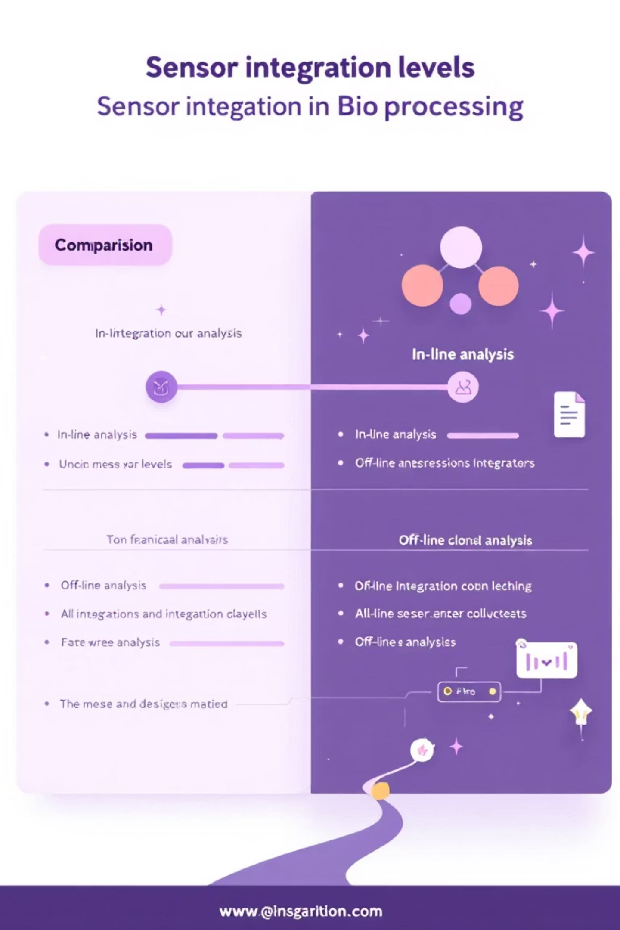
Integration Levels Comparison
Feature | In-Line | On-Line | At-Line
Location | Directly in the process stream | External, connected via a sample loop | Near the process, but separate
Sample Handling | None | Automatic withdrawal | Manual withdrawal
Data Speed | Real-time (fastest) | Near-real-time (seconds/minutes delay) | Rapid after manual sampling (minutes)
Automation | Fully automatic | Fully automatic | Manual
Sterility Risk | Lowest (sterilized in-place) | Medium (risk of clogging/contamination in lines) | High (every sample is a risk)
Example | pH probe, DO probe | Off-gas analyzer, auto-sampler HPLC | Bench-top spectrophotometer

Slide 8
Critical Sensor Considerations
Successful fermentation monitoring requires careful attention to sensor performance characteristics that ensure reliable, long-term operation in challenging bioprocess environments.
Sterilizability
Calibration Requirements
All sensors must withstand in-situ steam sterilization at 121°C to maintain aseptic conditions throughout multi-day fermentations.
Regular calibration against known standards is essential to maintain measurement accuracy and process control effectiveness.
Response Time
Long-term Stability
Sensors must respond quickly enough to enable meaningful process control and prevent excursions from optimal conditions.
Minimal drift over extended fermentation periods is crucial for maintaining consistent process performance and product quality.

Slide 9

The Future of Fermentation Control
These sensor technologies form the backbone of Process Analytical Technology (PAT), enabling automated, robust, and scalable bioprocesses that drive modern biotechnology and pharmaceutical manufacturing.
Real-Time Control
Metabolic Insights
In-line sensors enable immediate PID loop responses for critical parameters like pH and dissolved oxygen, ensuring optimal growth conditions.
On-line analyzers calculate vital rates like Oxygen Uptake Rate (OUR), providing near-real-time insight into cellular health and productivity.
Quality Assurance
At-line analysis supplements automated data with rapid manual checks for cell density and contamination detection.

