Slide 1
Chapter 2
Logic representation and minimization technique
FY. Btech DLD

Slide 2
Computers and Electricity
Gate
A device that performs a basic operation on
electrical signals
Circuits
Gates combined to perform more
complicated tasks

Slide 3
Computers and Electricity
How do we describe the behavior of gates and circuits?
Boolean expressions
Uses Boolean algebra, a mathematical notation for expressing two-valued logic
Logic diagrams
A graphical representation of a circuit; each gate has its
own symbol
Truth tables
A table showing all possible input value and the associated
output values

Slide 4
Gates
Seven types of gates
NOT
AND
OR
XOR
NAND
NOR
EXNOR
Typically, logic diagrams are black and white with gates distinguished only by their shape
We use color for emphasis (and fun)

Slide 5
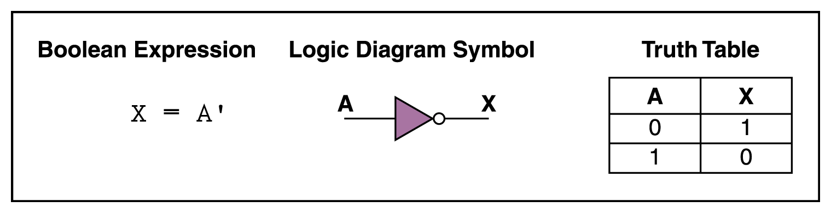
NOT Gate
A NOT gate accepts one input signal (0 or 1) and returns the opposite signal as output
Figure 4.1 Various representations of a NOT gate

Slide 6
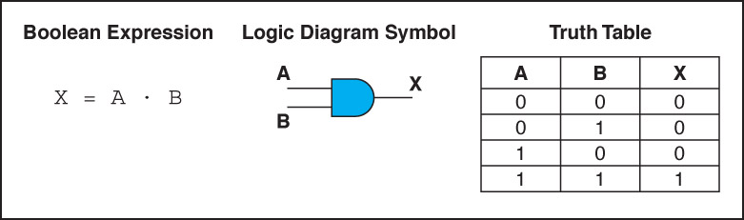
AND Gate
An AND gate accepts two input signals
If both are 1, the output is 1; otherwise,
the output is 0
Figure 4.2 Various representations of an AND gate

Slide 7
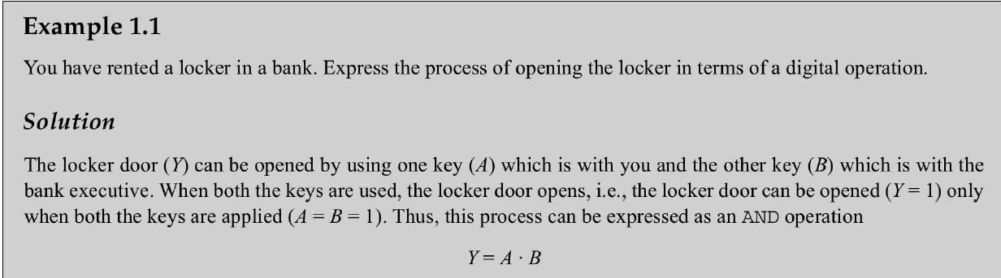
AND Gate Example

Slide 8
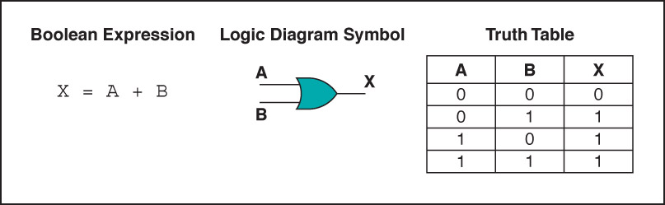
OR Gate
An OR gate accepts two input signals
If both are 0, the output is 0; otherwise,
the output is 1
Figure 4.3 Various representations of a OR gate

Slide 9
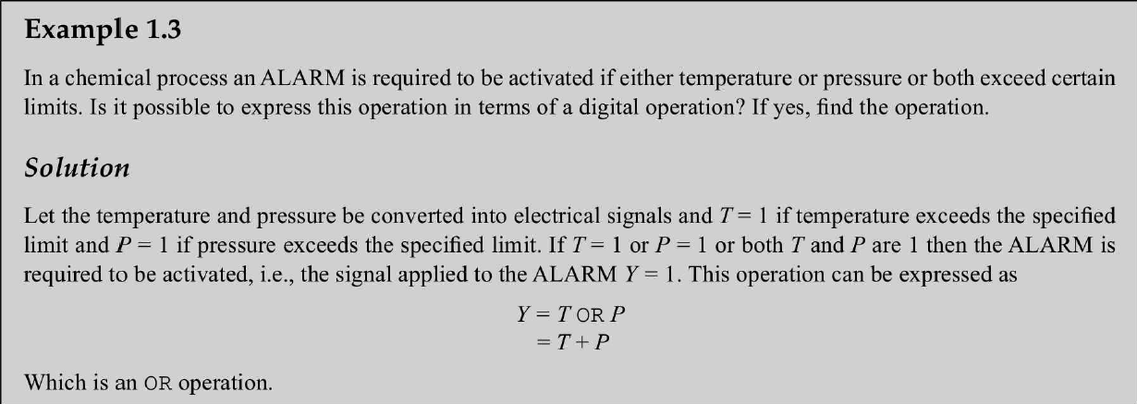
OR Gate Example

Slide 10
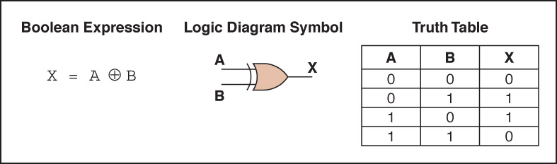
XOR Gate
An XOR gate accepts two input signals
If both are the same, the output is 0; otherwise,
the output is 1
Figure 4.4 Various representations of an XOR gate

Slide 11
XOR Gate
Note the difference between the XOR gate and the OR gate; they differ only in one input situation
When both input signals are 1, the OR gate produces a 1 and the XOR produces a 0
XOR is called the exclusive OR

Slide 12
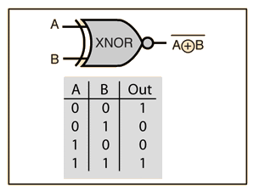
EX-NOR Gate
Like the EX-OR gate, the EX-NOR gate is not a basic operation and can be performed using basic or universal gates.
It is referred to as the coincidence operation because it produces an output of 1 when its inputs coincide in value (both 0 or both 1)

Slide 13
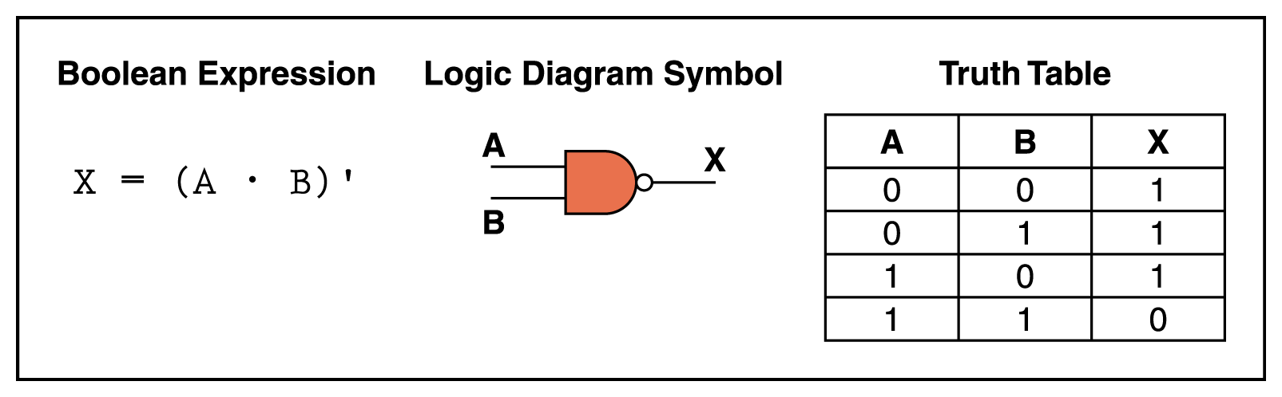
NAND Gate
The NAND gate accepts two input signals
If both are 1, the output is 0; otherwise,
the output is 1
Figure 4.5 Various representations of a NAND gate

Slide 14
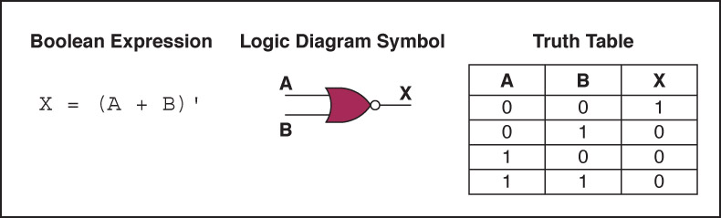
NOR Gate
The NOR gate accepts two input signals
If both are 0, the output is 1; otherwise,
the output is 0
Figure 4.6 Various representations of a NOR gate

Slide 15
De Morgans Theorem
We use De Morgan’s theorems to solve the expressions of Boolean Algebra. It is a very powerful tool used in digital design.
This theorem explains that the complements of the products of all the terms are equal to the sums of the complements of each and every term.
Likewise, the complements of the sums of all the terms are equal to the products of the complements of each and every term.

Slide 16
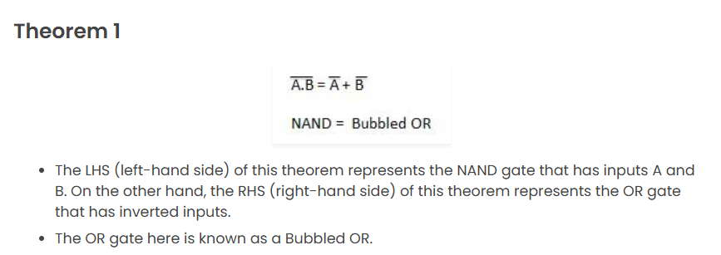
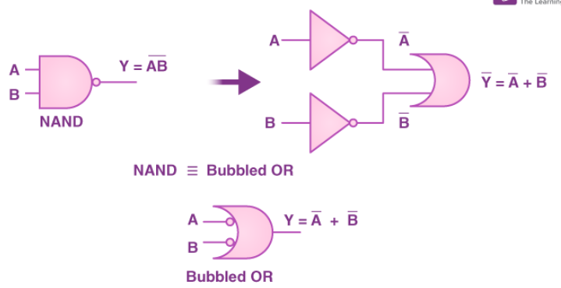
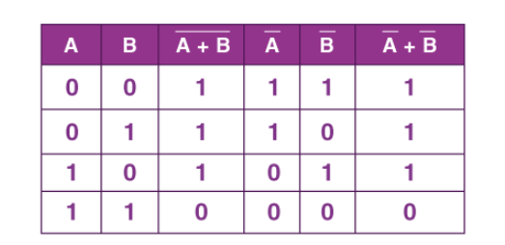
De Morgan’s First Theorem

Slide 17
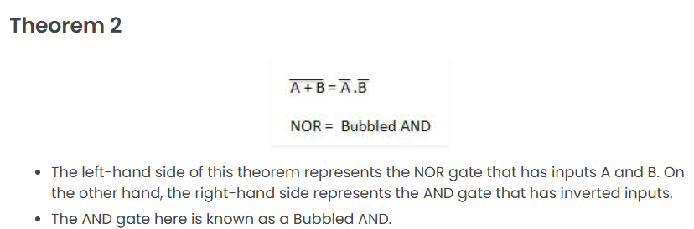
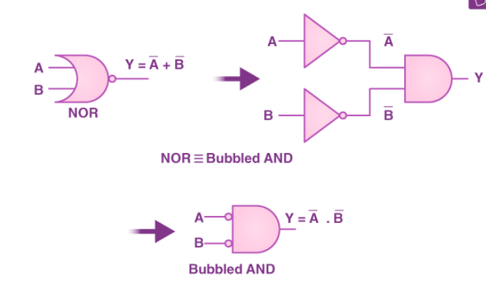
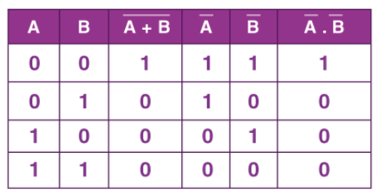
De Morgan’s Second Theorem

Slide 18
Universal gates
In Boolean Algebra, the NAND and NOR gates are called universal gates because any digital circuit can be implemented by using any one of these two i.e. any logic gate can be created using NAND or NOR gates only.
NAND GATE
NOR GATE

Slide 19
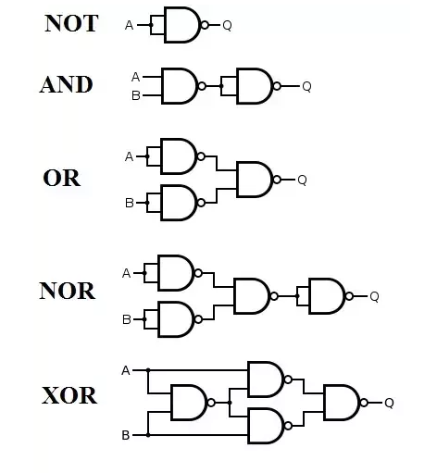
NAND AS A UNIVERSAL GATE

Slide 20
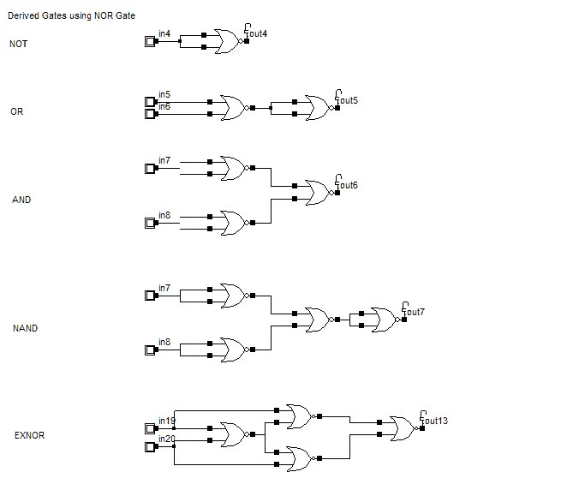
NOR AS A UNIVERSAL GATE

Slide 21
Review of Gate Processing
A NOT gate inverts its single input
An AND gate produces 1 if both input values are 1
An OR gate produces 0 if both input values are 0
An XOR gate produces 0 if input values are the same
A NAND gate produces 0 if both inputs are 1
A NOR gate produces a 1 if both inputs are 0

Slide 22
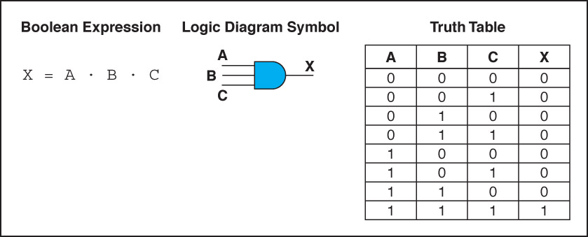
Gates with More Inputs
Gates can be designed to accept three or more input values
A three-input AND gate, for example, produces an output of 1 only if all input values are 1
Figure 4.7 Various representations of a three-input AND gate

Slide 23
Boolean Algebra
Digital signals are discrete in nature and can only assume one of the two values 0 or 1. A number system based on these two digits is known as binary number system.
In the middle of 19th century, an English mathematician George Boole developed rules for manipulations of binary variables, known as Boolean algebra.
This is the basis of all digital systems like computers, calculators, etc. Binary variables can be represented by a letter symbol such as A, B, X, Y,….. The variable can have only one of the two possible values at any time, viz. 0 or 1.
From Boolean algebraic theorems, we observe that the even numbered theorems can be obtained from their preceding odd numbered theorems by (i) interchanging ‘+’ and ‘.’ signs, and (ii) interchanging 0 and 1.Theorems which are related in this way are called duals.

Slide 24
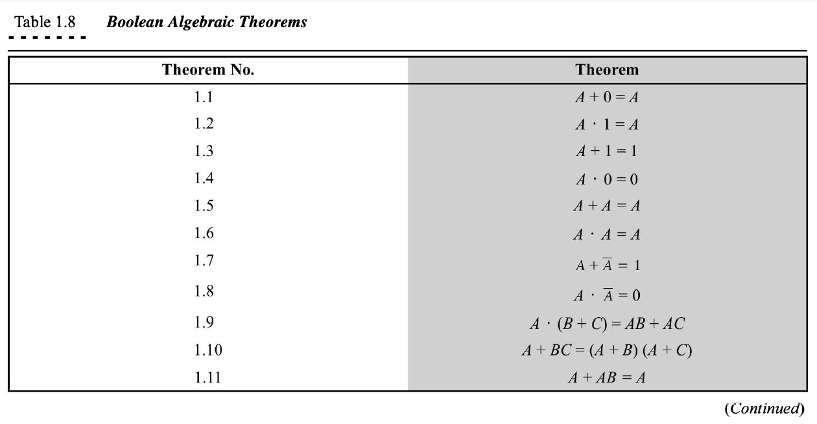
Boolean Algebraic Theorem

Slide 25
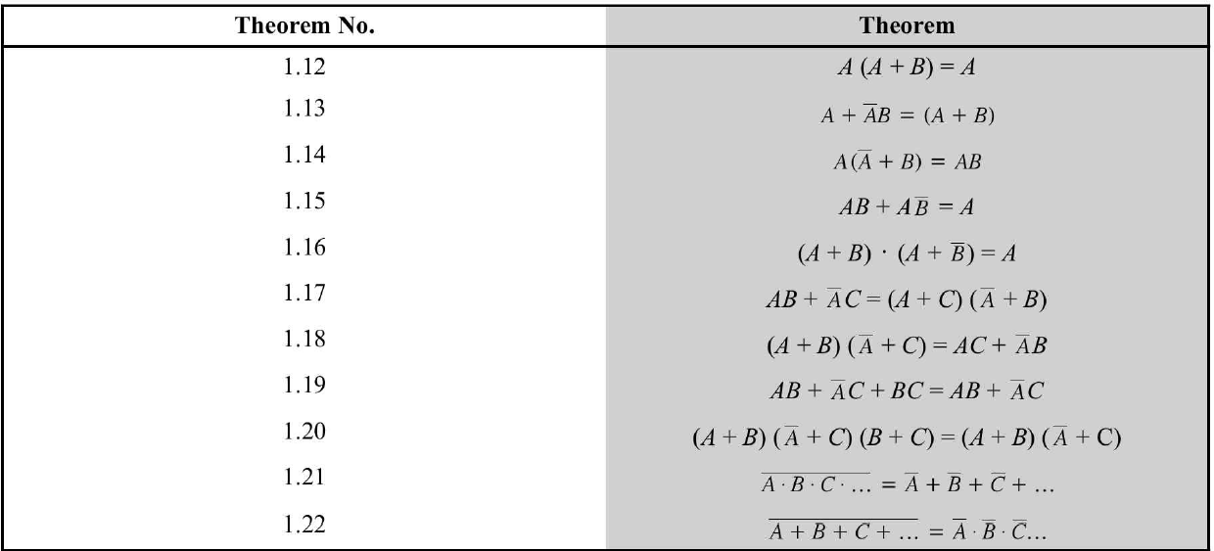
Boolean Algebraic Theorem (cont..)

Slide 26
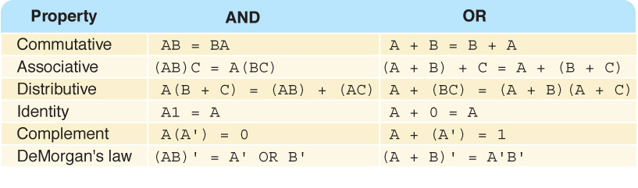
Properties of Boolean Algebra

Slide 27

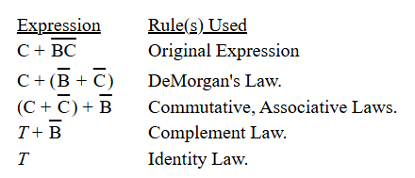

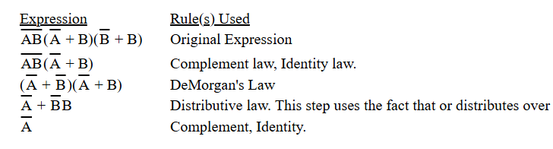
Boolean Algebra Examples

Slide 28
Standard representations for logic functions
Logic functions are expressed in terms of logical variables.
The values assumed by the logic functions as well as the logic variables are in the binary form.
Any arbitrary logic function can be expressed in the following forms:
Sum-of-products form (SOP), and
Product-of-sums form (POS)
This does not mean that the logic function cannot be written in any other form.
It can be written in various forms but the above two forms are conveniently suited in arriving at the standard methods for designing the circuits which will become clear from the following discussions.

Slide 29
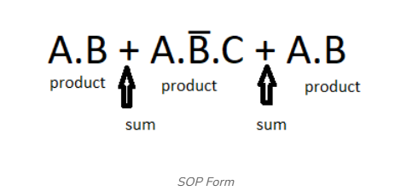
Sum of Product (SOP)
The Sum of Product (SOP) form refers to a Boolean expression where several product terms (involving AND operations) are added up.
Each individual term in SOP is also called as minterm.
This is perhaps the most popular form used in the design and optimization of digital systems.
In SOP format, each of those elements is a combination (ANDing) of some variables (or their negations); all of them are combined by means of disjunction (ORing).
This is very helpful in, for instance, the creation of logic circuits from truth tables or achieving algorithmic simplifications of logic functions.
Example :

Slide 30
SOP (cont..)
The SOP form can be in either canonical form or non-canonical form.
1. Non-Canonical SOP Form
In this form each product term between may or may not contain all the variables of the function.
Example:
F(A,B,C) = A+ B̅.C + A.C
as we can see in above example the function have variables A, B, C but we are not including each variable in each product term.

Slide 31
SOP (cont..)
2. Canonical SOP Form
In canonical SOP form each product term contains all the variables of the function, where variables in each product term can be in true form or complemented form.
Example :
F(A,B) = Ā.B + A.B̅
As we can see in above example each product term contain all the variables which are present in function.
The SOP is written in the format shown below called as short hand for K-map minimization technique
F(A,B,C) = ∑m(2, 4, 5, 6, 7)

Slide 32
Product of Sum (POS)
POS form is the product of all the sums.
Each individual term in POS is also called maxterm.
Here, the sum does not mean traditional addition, the sum here refers to the 'OR' operation, and the product here refers to the 'AND' operation.
Thus, in POS form, we perform the OR of multiple variables and then perform the AND operation between them.
Example: F = (X + Y + Z) . (X + Y + Z') . (X + Y' + Z')

Slide 33

POS (cont..)
We have two types of POS form:
Canonical POS form
Minimal POS form.
In canonical POS form, we have all the variables present in a complimented or un-complimented form in each term.
Example: F = (X + Y + Z) . (X + Y + Z') . (X + Y' + Z')
In contrast, in minimal POS form, we do not have all the variables in the complimented or uncomplimented form.
Example: F = (X + Y) . (X + Z')
The short hand form of POS is given below

Slide 34
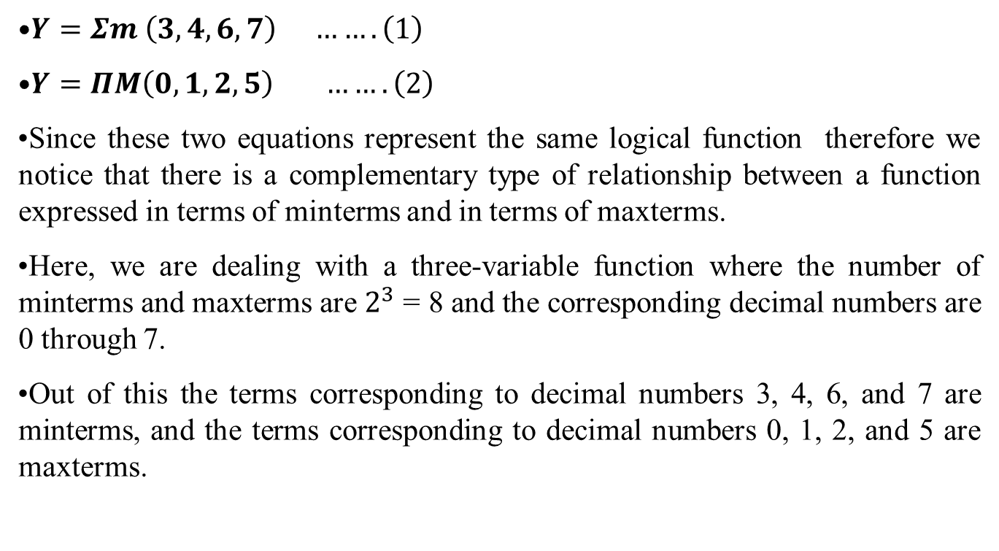
Relation between SOP and POS

Slide 35
Introduction to Karnaugh Maps (K-maps)
A K-map is a graphical technique used for the systematic simplification and manipulation of Boolean expressions.
Information from a truth table, SOP form, or POS form can be directly represented on the map.
It is one of the most extensively used tools for simplifying Boolean functions because it is more intuitive than purely algebraic methods.
Although the technique may be used for any number of variables, it is generally used up to six variables beyond which it becomes very difficult.

Slide 36
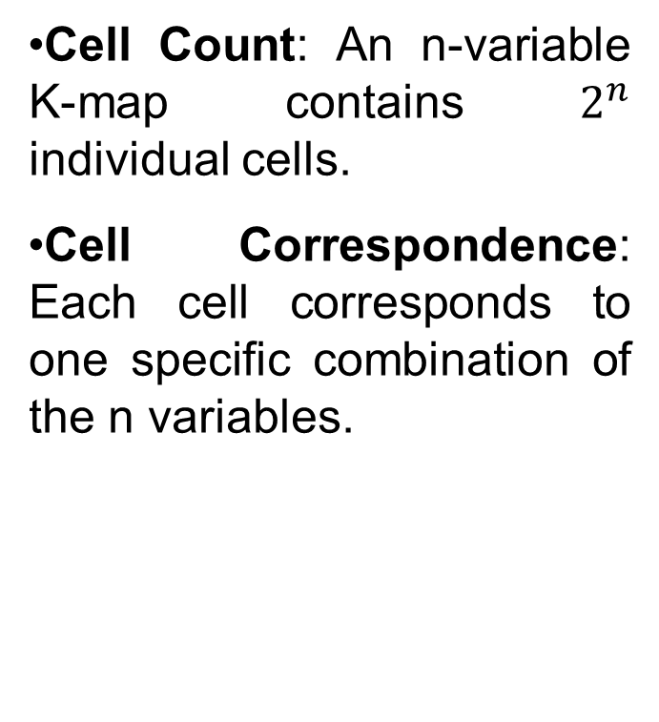
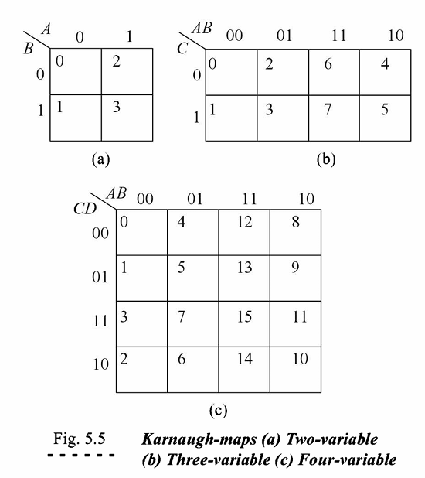
K-map Structure and Scaling

Slide 37
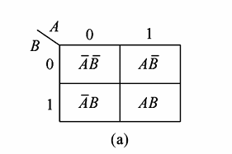
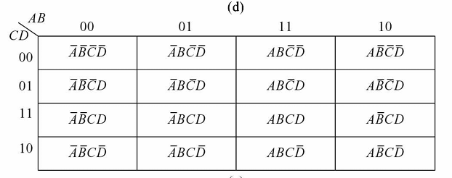
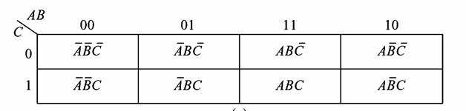
K-map for SOP
2x2 K-map
4x4 K-map
3x3 K-map

Slide 38
Prime Implicants
In choosing adjacent squares in a map, we must ensure that
all the minterms of the function are covered when we combine the squares,
the number of terms in the expression is minimized, and
there are no redundant terms (i.e., minterms already covered by other terms).
Sometimes there may be two or more expressions that satisfy the simplification criteria.
The procedure for combining squares in the map may be made more systematic if we understand the meaning of two special types of terms.
A prime implicant is a product term obtained by combining the maximum possible number of adjacent squares in the map. If a minterm in a square is covered by only one prime implicant, that prime implicant is said to be essential

Slide 39
Prime Implicants (cont..)
The prime implicants of a function can be obtained from the map by combining all possible maximum numbers of squares.
This means that a single 1 on a map represents a prime implicant if it is not adjacent to any other 1’s.
Two adjacent 1’s form a prime implicant, provided that they are not within a group of four adjacent squares.
Four adjacent 1’s form a prime implicant if they are not within a group of eight adjacent squares, and so on.
The essential prime implicants are found by looking at each square marked with a 1 and checking the number of prime implicants that cover it.
The prime implicant is essential if it is the only prime implicant that covers the minterm.

Slide 40
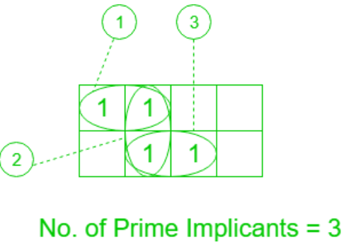
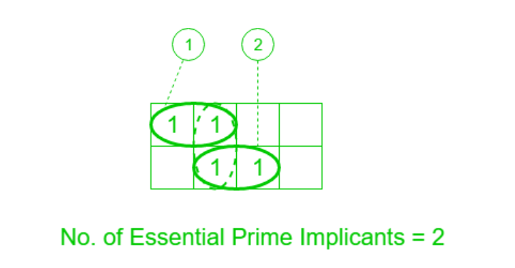
Prime Implicants (cont..)

Slide 41
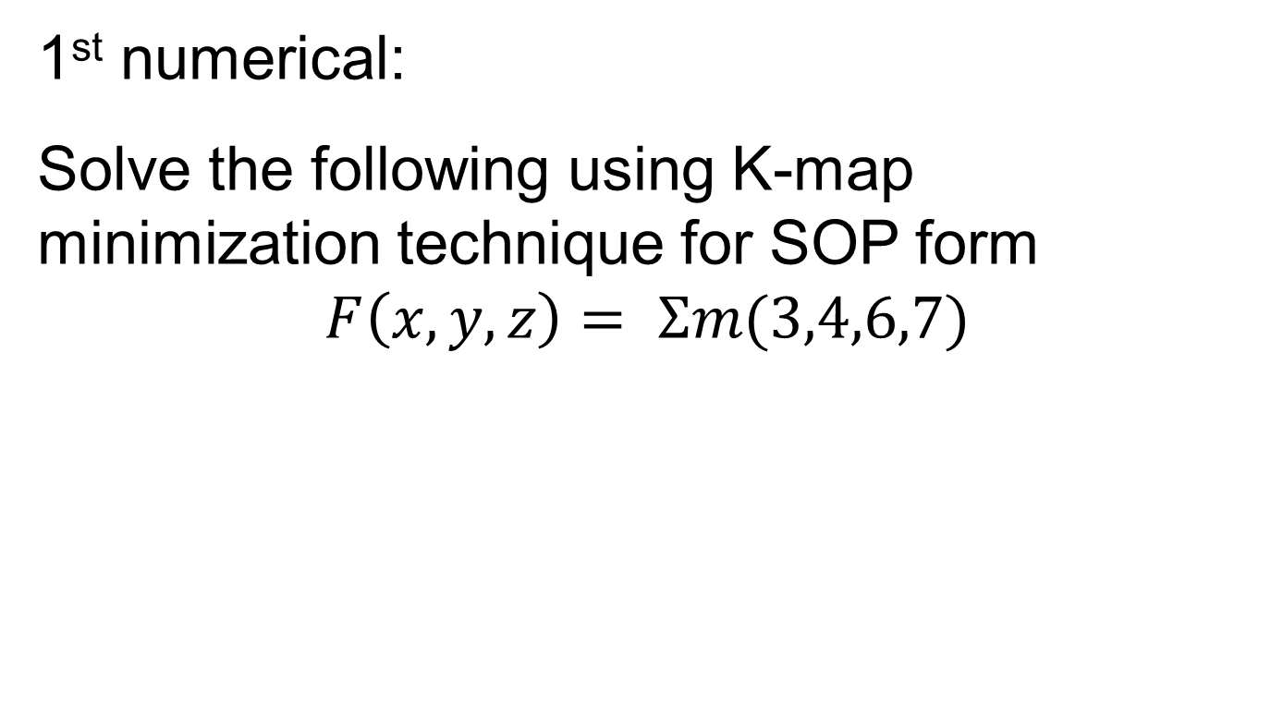
Numerical

Slide 42
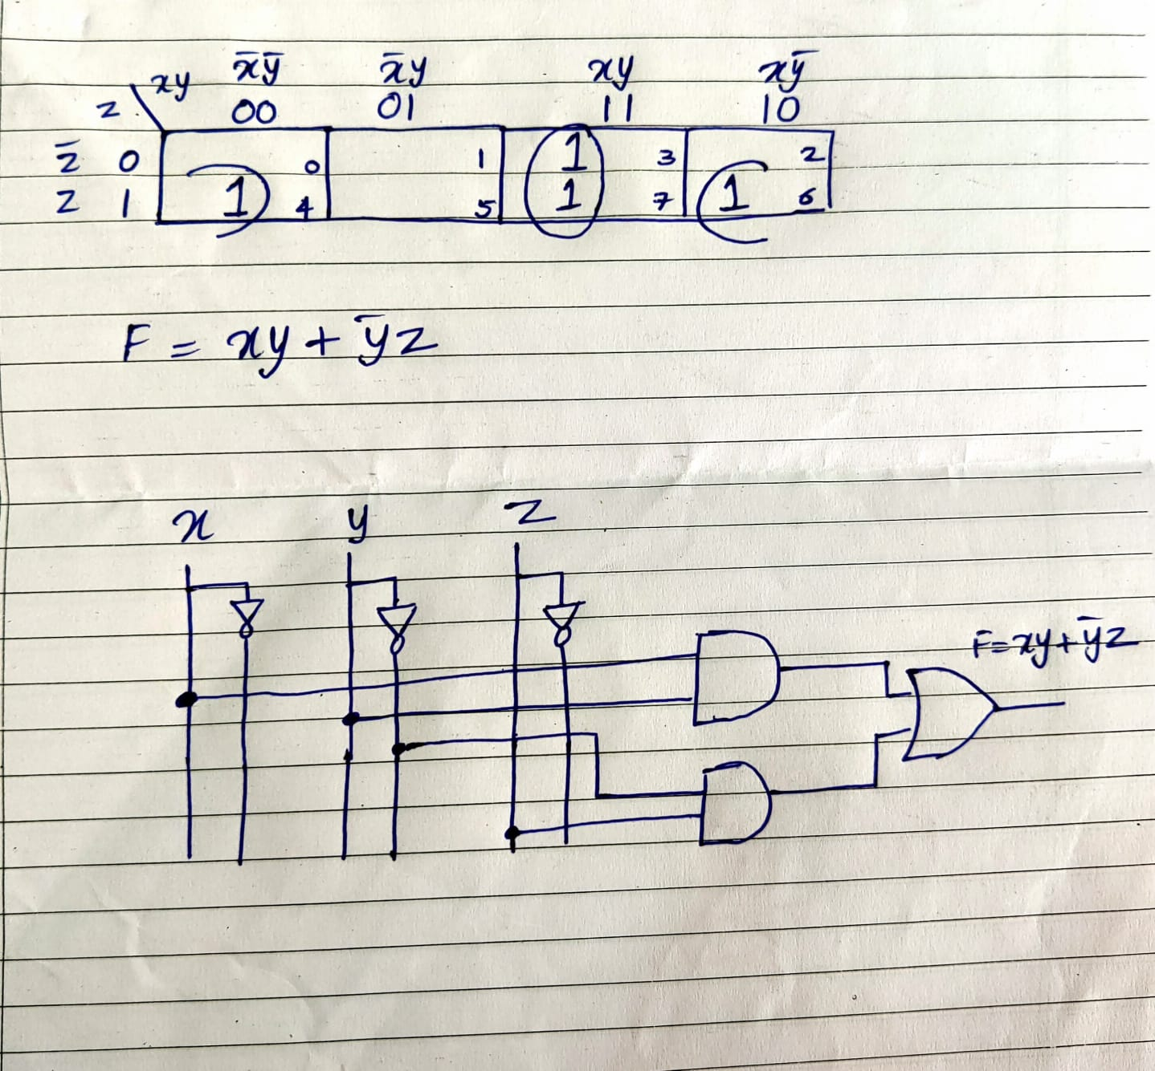
Numerical
Solution to 1st numerical

Slide 43
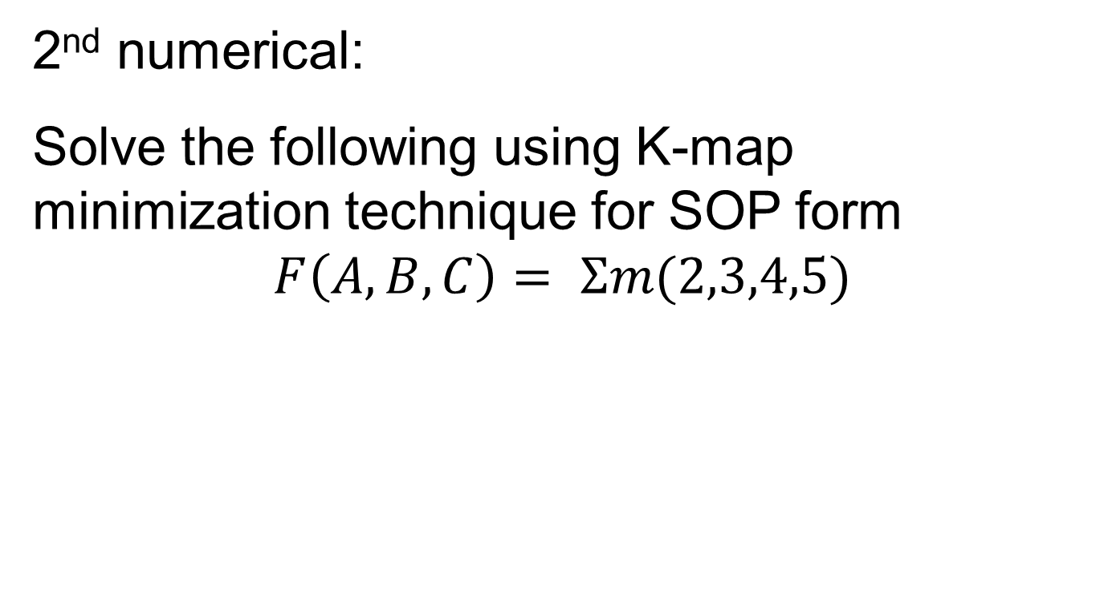
Numerical

Slide 44
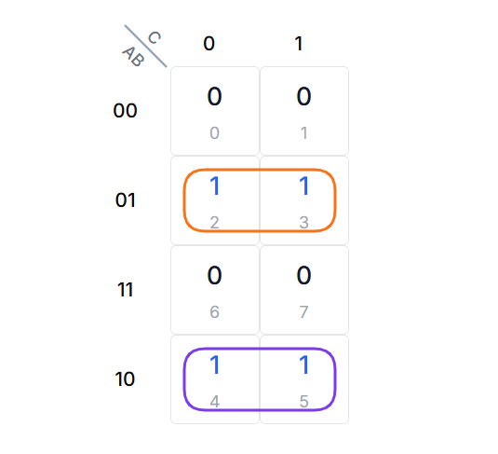
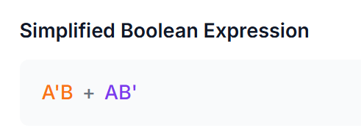
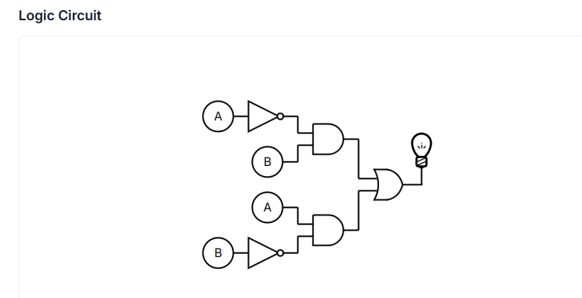
Numerical
Solution to 2nd numerical

Slide 45
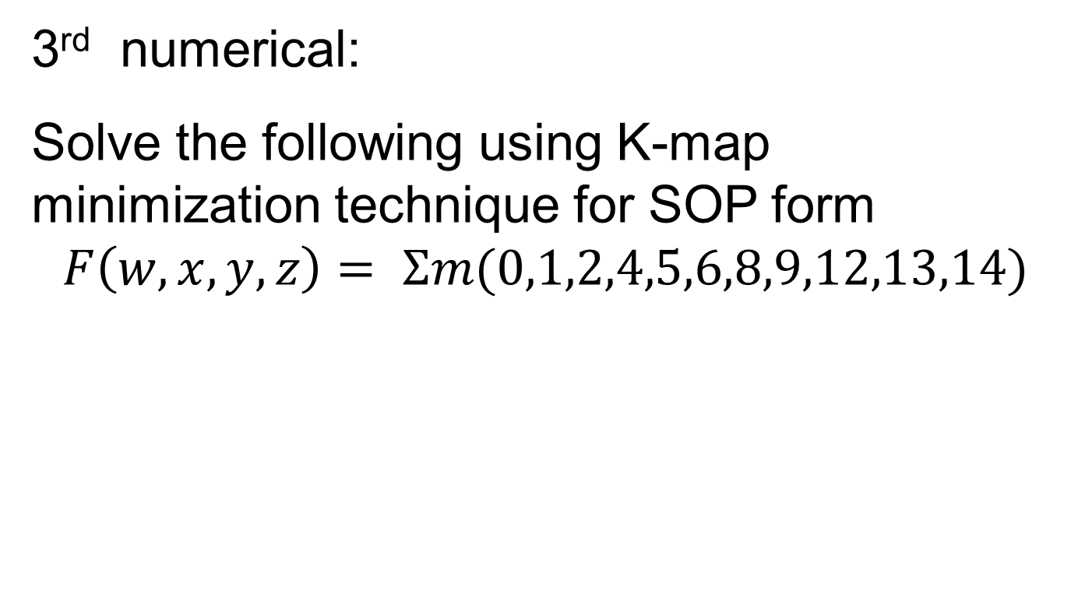
Numerical

Slide 46
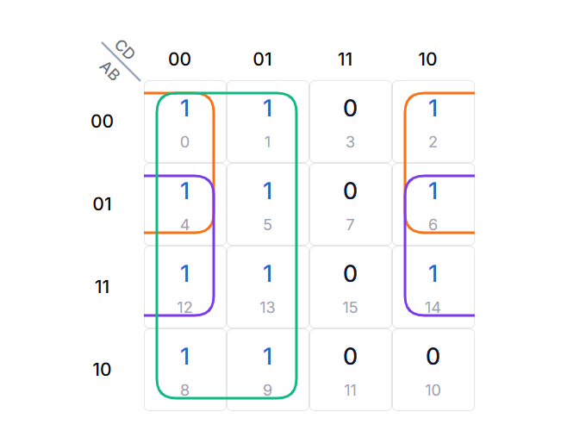
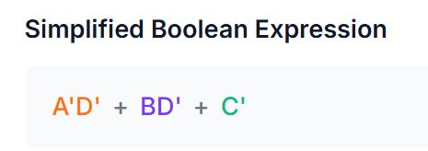
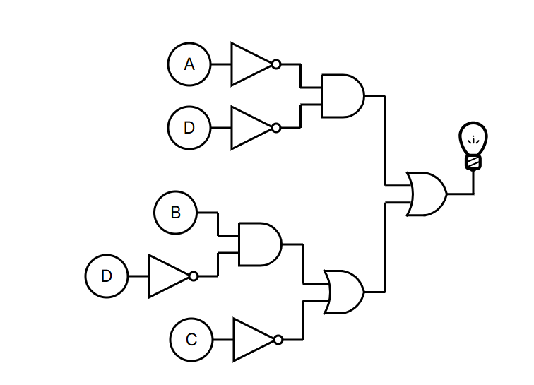
Numerical
Solution to 3rd numerical

Slide 47
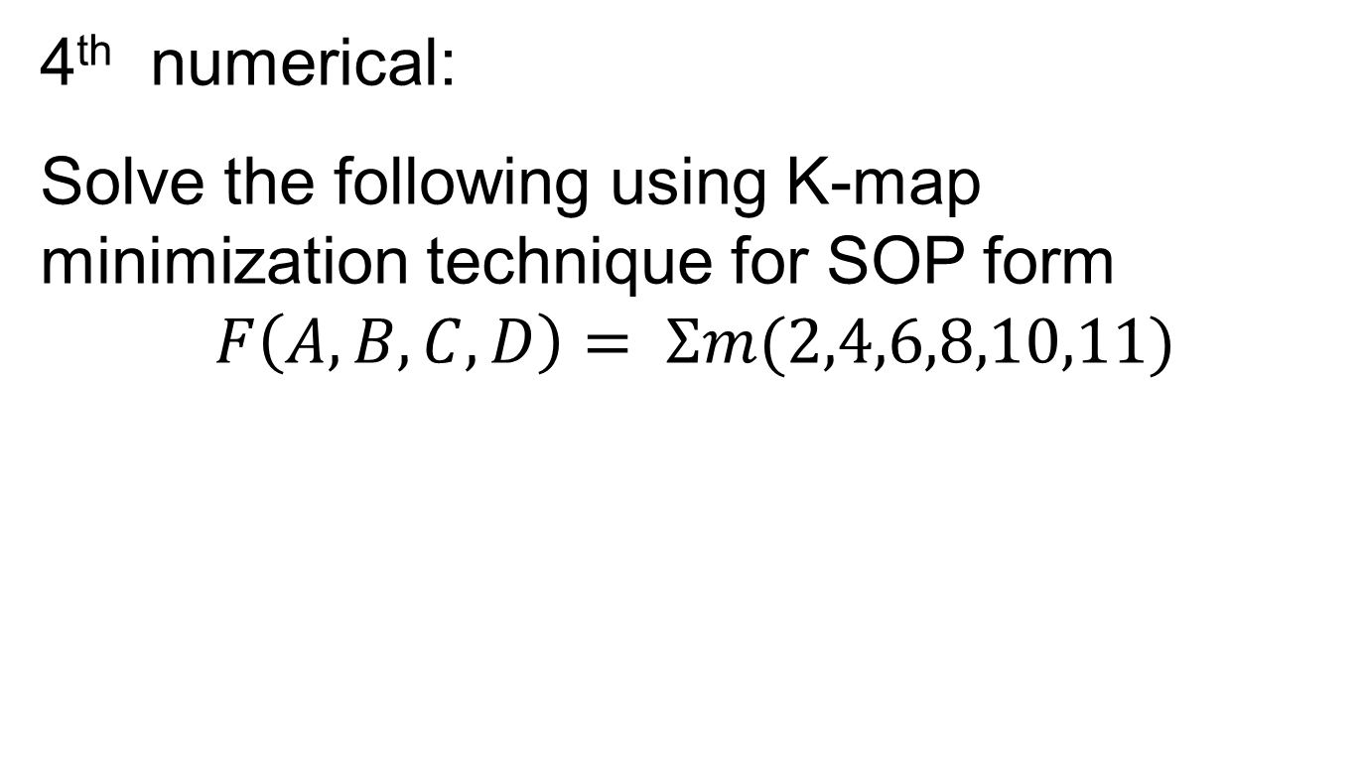
Numerical

Slide 48
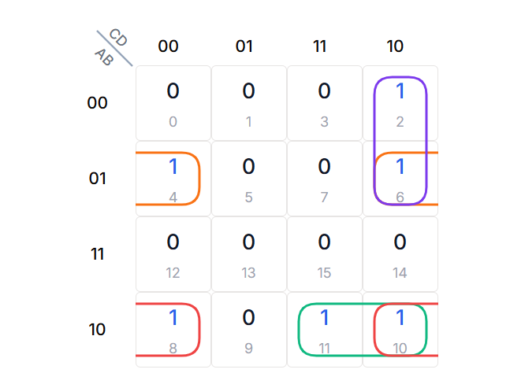
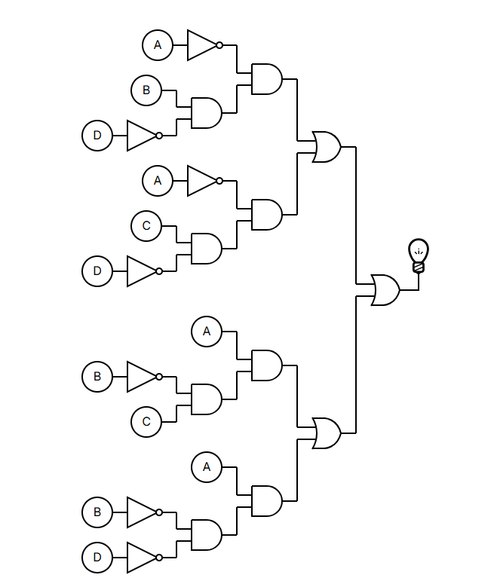
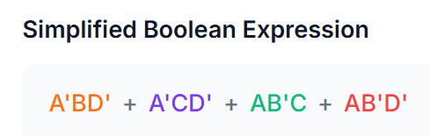
Numerical
Solution to 4th numerical

Slide 49
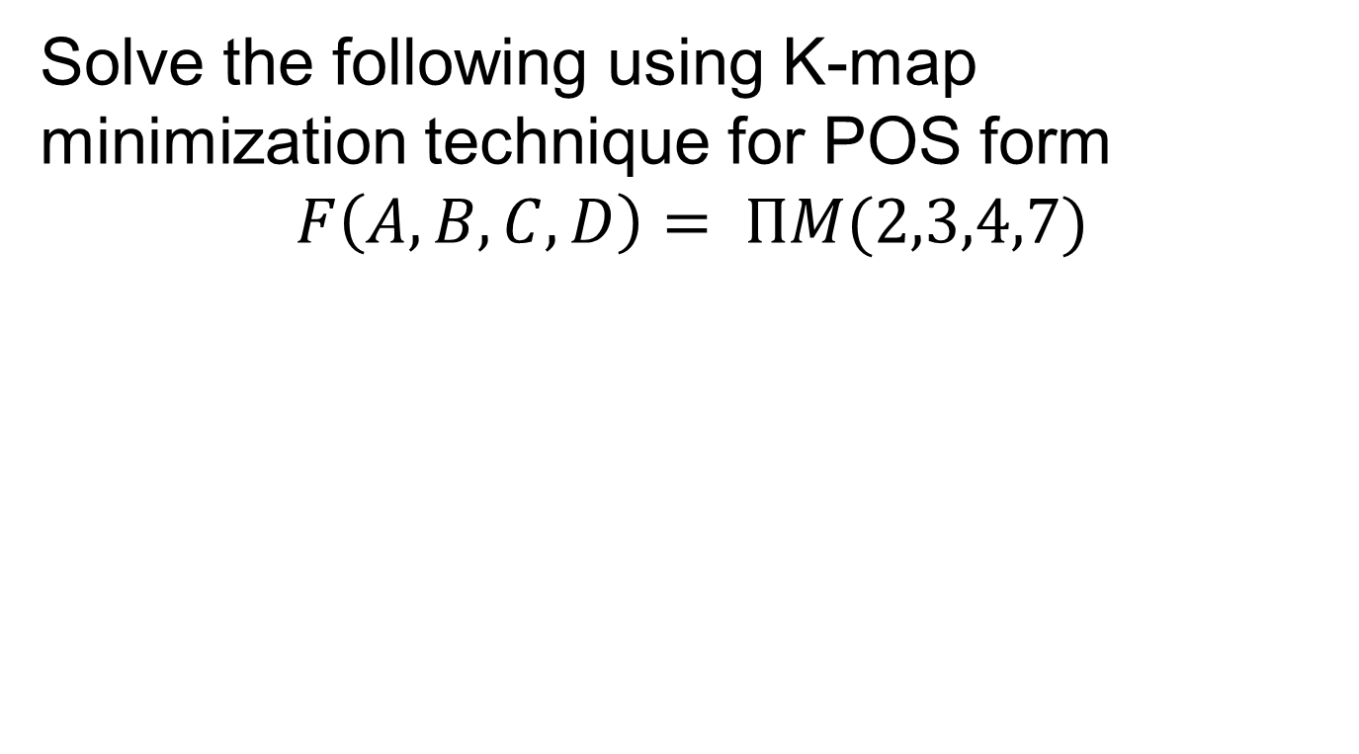
Numerical on POS form

Slide 50
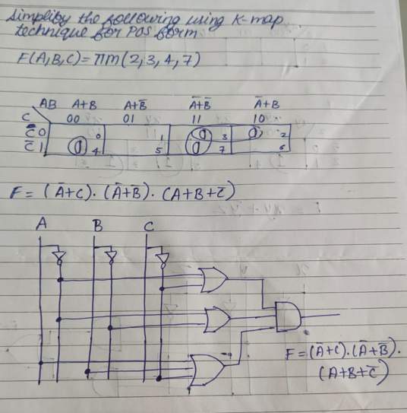
Numerical on POS form

Slide 51
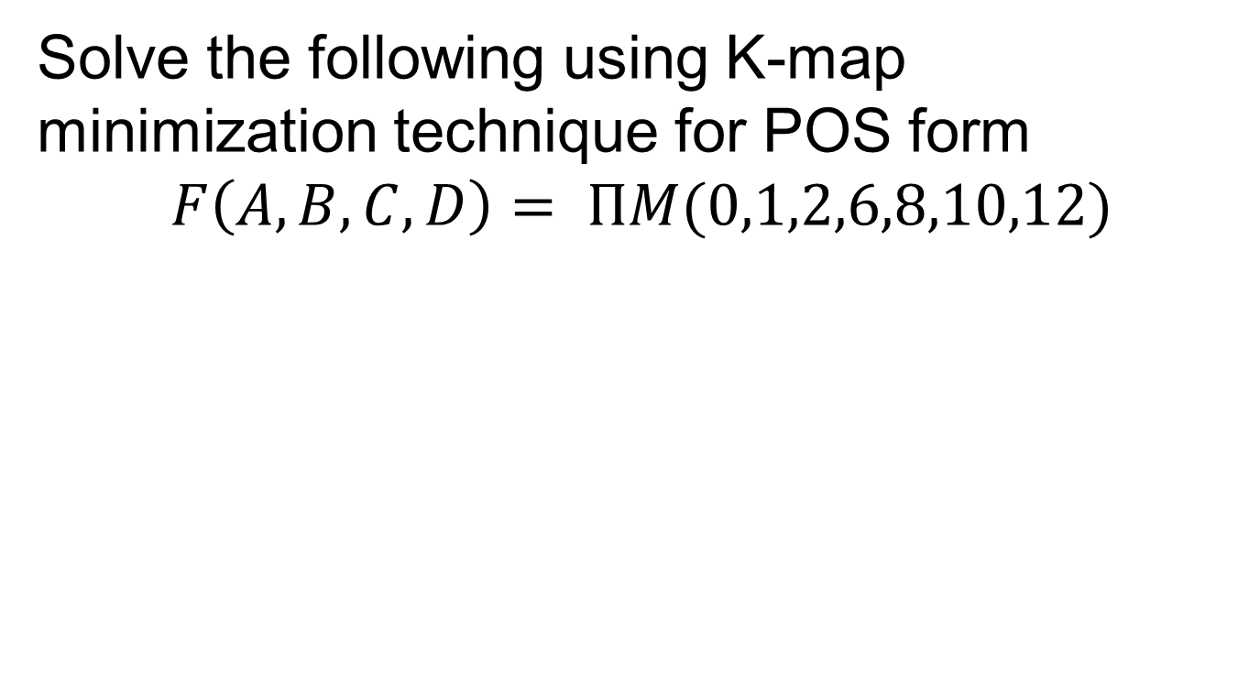
Numerical on POS form

Slide 52
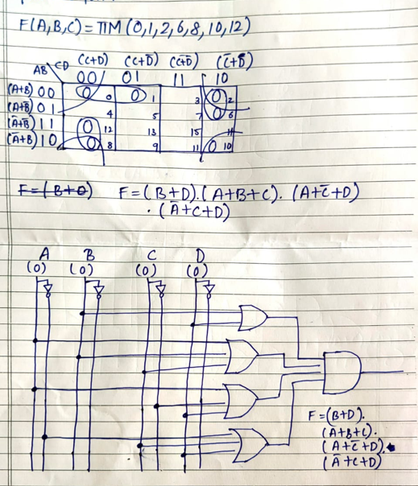
Numerical on POS form

Slide 53
Don’t-Care conditions
A don't care minterm is the is a combination of variables whose whose logical value is not specified.
Such a minterm cannot be marked with a '1' in the map because it will require the function to be always 1
Likewise putting a zero will require the function to be always '0'.
To distinguish don't-care condition from '1' and '0' an 'X' is used. Thus an 'X' inside the square in the map indicates that we don't care weather the value of 0 or 1 is assigned to F for a particular minterm.
In choosing adjacent terms the don't-care terms can be assumed as zero or one.

Slide 54
Numerical
Simplify the following function
F (w,x,y,z) = Σm (1,3,7,11,15)
Which has don't care condition : d(w,x,y,z) = Σ (0,2,5)
The implementation must be using only universal gates

Slide 55

Solution

Slide 56
Numerical
Simplify the following function
F (w,x,y,z) = ΠM (2,3,4,7)
Which has don't care condition : d(w,x,y,z) = Σ (0,5)
Implementation of circuit must be using only universal gates

Slide 57


SOLUTION

Slide 58
Numerical
Implement the Boolean function with NAND Gates and draw the logic diagram of implementation
F (w,x,y) = Σm (0,1,3,5,6,7)

Slide 59

SOLUTION

