Slide 1



Digital Logic Design
Semester II
FY
Course Code
316U06C203
Jan – May 2026

Slide 2

Course Outcomes
At the end of the successful completion of the course, the student will be able to
CO1: Understand the fundamentals of number systems, codes, and arithmetic operations.
CO2: Represent, implement, and minimize logic functions using different techniques.
CO3: Implement combinational logic circuits and their applications using basic gates and MSI devices.
CO4: Implement sequential logic circuits and applications using MSI devices.
CO5: Understand basic principles required for advanced Digital Design

Slide 3
Number Representation and Codes

Slide 4
Number Representation and Codes
Number System for Digital Systems / Computers
Review of Positional Number System
Binary, Octal, Decimal, Hexadecimal Numbers
Conversion of Numbers : Decimal to others , others to decimal
Representation of Numbers
Unsigned
Signed
2’s complement , sign magnitude
Binary Addition
Binary Subtraction: 1’s complement, 2’s complement
Gray Code, BCD Code
Parity for error détection

Slide 5
Positional Number System: Concept
b = base of the number system
POSITIONAL VALUE | b³ | b² | b¹ | b⁰ | Actual value in decimal
Digit representation | d3 | d2 | d1 | d0 | d0xb⁰ +d1xb¹ +d2xb² +d3xb³
Value Decimal | 1000 | 100 | 10 | 1
Value ( Binary) | 8 | 4 | 2 | 1
Value ( Octal) | 512 | 64 | 8 | 1
Value ( Hexadecimal) | 4096 | 256 | 16 | 1

Slide 6
Positional Number System : Decimal Numbers
POSITIONAL VALUE | b³ | b² | b¹ | b⁰ | Actual value in decimal
Representation Decimal | 4 | 2 | 7 | 1
Positional Value | 1000 | 100 | 10 | 1
Value | 4000 | 200 | 70 | 1 | 4271
Representation Decimal | 6 | 5 | 4 | 2
Positional Value | 1000 | 100 | 10 | 1
Value | 6000 | 500 | 40 | 2 | 6542

Slide 7
Positional Number System : Binary, Octal, Hexadecimal
POSITIONAL VALUE | b³ | b² | b¹ | b⁰ | Actual value in decimal
Representation binary | 1 | 0 | 1 | 1
Value ( Binary) | 8 | 0 | 2 | 1 | 11
Representation Octal | 4 | 3 | 1 | 0
Value ( Octal) | 512 | 64 | 8 | 1 | 2248
Representation decimal | 1 | 0 | 2 | 1
Value Decimal | 1000 | 100 | 10 | 1 | 1021
Representation hex | 2 | A | 5 | B
Value ( Hexadecimal) | 4096 | 256 | 16 | 1 | 10843

Slide 8
Conversion from Decimal to Any number system
Base | Given number | Remainder
2 | 19
2 | 9 | 1
2 | 4 | 1
2 | 2 | 0
2 | 1 | 0
 | 0 | 1
Base | Given number | Remainder
8 | 19
8 | 2 | 3
 | 0 | 2
19= (23)₈
Base | Given number | Remainder
16 | 19
16 | 1 | 3
 | 0 | 1
19= (10011)₂
19= (13)₁₆

Slide 9
Conversion from Decimal to Any number system
Base | Given number | Remainder
2 | 75
2 | 37 | 1
2 | 18 | 1
2 | 9 | 0
2 | 4 | 1
2 | 2 | 0
2 | 1 | 0
 | 0 | 1
Base | Given number | Remainder
8 | 75
8 | 9 | 3
8 | 1 | 1
 | 0 | 1
75= (113)₈
Base | Given number | Remainder
16 | 75
16 | 4 | 11 = B
 | 0 | 4
75= (4B)₁₆
75= (1001011)₂

Slide 10
Sample questions
Convert the octal number 157 to its binary equivalent.
Express the hexadecimal number 2C in decimal form.
Convert the decimal number 245 to its octal and hexadecimal equivalents.
Explain the process of converting a binary number 101101 to hexadecimal.
If a number in binary is 111010, what is its value in BCD (Binary-Coded Decimal) code?

Slide 11

Computer Arithmetic
Number System : Binary Numbers
Fixed Numbers (Unsigned numbers )
n bit Binary : 0 to 2^{n} -1...total 2^{n} values
4 bit binary : 0 to 15 ( 2⁴ -1)...total 16 values
Signed Numbers
n bit Binary : 2^{n} values, half values negative, half positive , MSB reserved for indication of Sign
0 - positive , 1 - negative
1’s Complement
2’s Complement

Slide 12
Signed Number Representation
1’s complement Representation
Complement of binary number : replace 1 by 0 , and 0 by 1
0100 ---- 1011
sign bit is a most significant bit
0 = positive number
1 = negative number

Slide 13
Signed Number Representation
1’s complement Representation
Binary Value | Unsigned | Signed 1’s complement
000 | 0 | 0
001 | 1 | 1
010 | 2 | 2
011 | 3 | 3
100 | 4 | -3
101 | 5 | -2
110 | 6 | -1
111 | 7 | -0

Slide 14
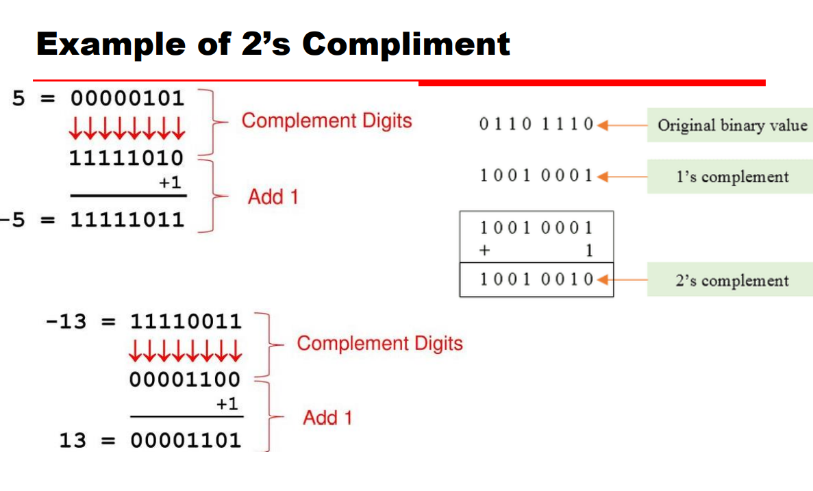
Signed Number Representation
2’s complement Representation
2’s complement = complement of a number + 1
Add 1 to 1’s complement
1011 +1 = 1100

Slide 15
Signed Number Representation
Find 2’s complement Representation and its value
1000
0100
111001
101010
100000

Slide 16
Signed Number Representation
Binary | Unsigned | Signed 1’s complement | Signed 2’s complement
000 | 0 | 0 | 0
001 | 1 | 1 | 1
010 | 2 | 2 | 2
011 | 3 | 3 | 3
100 | 4 | -3 | -4
101 | 5 | -2 | -3
110 | 6 | -1 | -2
111 | 7 | -0 | -1

Slide 17
Signed Number Representation
Binary | Unsigned | 1’s complement | 2’s complement
0000 | 0 | 0 | 0
0001 | 1 | 1 | 1
0010 | 2 | 2 | 2
0011 | 3 | 3 | 3
0100 | 4 | 4 | 4
0101 | 5 | 5 | 5
0110 | 6 | 6 | 6
0111 | 7 | 7 | 7
Binary | Unsigned | 1’s complement | 2’s complement
1000 | 8 | -7 | -8
1001 | 9 | -6 | -7
1010 | 10 | -5 | -6
1011 | 11 | -4 | -5
1100 | 12 | -3 | -4
1101 | 13 | -2 | -3
1110 | 14 | -1 | -2
1111 | 15 | -0 | -1

Slide 18
1's and 2's complement of a Binary Number
The 1's complement of a binary number is obtained by flipping all its bits. 0 becomes 1, and 1 becomes 0. Positive numbers remain unchanged whereas negative numbers are represented by taking the 1's complement of their positive counterparts.
For example, in 8-bit notation:
+9 is represented as 00001001.
-9 is represented as 11110110, which is the 1's complement of 00001001.
The 2's complement of a binary number is obtained by finding the 1's complement (flipping all bits) and then adding 1 to the result. In 2's complement representation, the Most Significant Bit (MSB) represents the sign. A 0 indicates a positive number, while a 1 indicates a negative number. The remaining bits represent the magnitude.
Positive numbers are represented the same way as in 1's complement and sign-bit representation. Negative numbers are obtained by taking the 2's complement of their positive counterparts.

Slide 19
Sample examples
Convert 17 to binary 1’s complement and 2’s complement representation
= 010001
1’s complement form ---- 101110
2’s complement form ---- 101111
Convert 47 to binary 1’s complement and 2’s complement representation
47 = 0101111
1’s complement form ---- 1010000
2’s complement form ---- 1010001

Slide 20
Binary addition
Add 12+ 7 in binary
12 = 01100 , 7 = 0111
10011 = 19
Add 17+ 13 in binary
17 = 10001 , 13 = 1101
11110 = 30
 | 0 | 1 | 1 | 0 | 0
+ | 0 | 0 | 1 | 1 | 1
Cy | 1 | 1
sum | 1 | 0 | 0 | 1 | 1
 | 1 | 0 | 0 | 0 | 1
+ | 0 | 1 | 1 | 0 | 1
Cy | 0 | 0 | 0 | 1
sum | 1 | 1 | 1 | 1 | 0

Slide 21
Binary Subtraction – 1’s complement method
Subtract 12- 7 in binary
12 = 01100 , 7 = 0111
Take 1’s complement of 7
= 11000 and add to 12
If there is carry add to result
00101 = 5 result
Subtract 7-12 in binary
12 = 01100 , 7 = 0111
Take 1’s complement of 12
= 10011 and add to 7
If there is NO carry result is negative , take 1’s complement
1’s complement of 11010 = 00101
hence -5 result
 |  | 0 | 1 | 1 | 0 | 0
+ |  | 1 | 1 | 0 | 0 | 0
Cy |  | 1
sum | 1 | 0 | 0 | 1 | 0 | 0
 |  |  |  |  |  | 1
 |  | 0 | 0 | 1 | 0 | 1
 |  | 0 | 0 | 1 | 1 | 1
+ |  | 1 | 0 | 0 | 1 | 1
Cy |  | 0 | 1 | 1 | 1
sum | 0 | 1 | 1 | 0 | 1 | 0

Slide 22
Binary Subtraction – 1’s complement method
Subtract 15- 11 in binary
15 = 01111 , 11= 01011
Take 1’s complement of 11
= 10100 and add to 12
If there is carry add to result
00100 = 4 result
Subtract 11-15 in binary
15 = 01111 , 11 = 01011
Take 1’s complement of 15
= 10000 and add to 11
If there is NO carry result is negative , take 1’s complement
1’s complement of 11011 = 00100
hence -4 result
 |  | 0 | 1 | 1 | 1 | 1
+ |  | 1 | 0 | 1 | 0 | 0
Cy |  | 1 | 1
sum | 1 | 0 | 0 | 0 | 1 | 1
 |  |  |  |  |  | 1
 |  | 0 | 0 | 1 | 0 | 0
 |  | 0 | 1 | 0 | 1 | 1
+ |  | 1 | 0 | 0 | 0 | 0
Cy
sum | 0 | 1 | 1 | 0 | 1 | 1

Slide 23
Binary Subtraction – 2’s complement method
Subtract 12- 7 in binary
12 = 01100 , 7 = 0111
Take 2’s complement of 7
= 11000 +1 = 11001
and add to 12
If there is carry neglect, the result is positive
00101 = 5 result
Subtract 7-12 in binary
12 = 01100 , 7 = 0111
Take 2’s complement of 12
= 10011 +1 = 10100
and add to 7
If there is NO carry result is negative , take 2’s complement
2’s complement of 11011 = 00101
hence -5 result
 |  | 0 | 1 | 1 | 0 | 0
+ |  | 1 | 1 | 0 | 0 | 1
Cy |  | 1
sum | 1 | 0 | 0 | 1 | 0 | 1
 |  | 0 | 0 | 1 | 0 | 1
 |  | 0 | 0 | 1 | 1 | 1
+ |  | 1 | 0 | 1 | 0 | 0
Cy |  | 0 | 1
sum | 0 | 1 | 1 | 0 | 1 | 1

Slide 24
Binary Subtraction – 2’s complement method
Subtract 14- 6 in binary
14 = 01110 , 6= 00110
Take 2’s complement of 6
= 11001 +1 = 11010 and add to 14
If there is carry , neglect, the result is positive
01000 = 8 result
Subtract 7-14 in binary
14 = 01110 , 7 = 00111
Take 2’s complement of 14
= 10001+1 = 10010 and add to 7
If there is NO carry result is negative , take 1’s complement
2’s complement of 011001 = 00111
hence -7 result
 |  | 0 | 1 | 1 | 1 | 0
+ |  | 1 | 1 | 0 | 1 | 0
Cy |  | 1 | 1 | 1
sum | 1 | 0 | 1 | 0 | 0 | 0
 |  | 0 | 0 | 1 | 1 | 1
+ |  | 1 | 0 | 0 | 1 | 0
Cy |  |  | 1 | 1
sum | 0 | 1 | 1 | 0 | 0 | 1

Slide 25
Gray Code
Gray code is a binary numeral system where each successive value differs by only one bit, which minimizes errors during transitions in digital systems
Decimal | Binary Code | Gray Code
0 | 0000 | 0000
1 | 0001 | 0001
2 | 0010 | 0011
3 | 0011 | 0010
4 | 0100 | 0110
5 | 0101 | 0111
6 | 0110 | 0101
7 | 0111 | 0100

Slide 26
Generation of Gray Code from Binary
Let b3b2b1b0 is a 4 bit binary number
To generate equivalent Gray code
g3 = b3 …retain Most significant bit ( MSB)
g2= b3 xor b2
g1= b2 xor b1
g0 = b1 xor b0
Example :
Binary | b3 | b2 | b1 | b0
 | 1 | 1 | 0 | 0
g3 | 1
g3g2 | 1 | 0
g3g2g1 | 1 | 0 | 1
g3g2g1g0 | 1 | 0 | 1 | 0
Binary | b3 | b2 | b1 | b0
 | 0 | 1 | 1 | 0
g3 | 0
g3g2 | 0 | 1
g3g2g1 | 0 | 1 | 0
g3g2g1g0 | 0 | 1 | 0 | 1

Slide 27
Generation of Binary Code from Gray
Example: Convert Gray Code 1101 to Binary
Gray Code: G3 G2 G1 G0 = 1 1 0 1
Binary (B3 B2 B1 B0):
B3: Same as G3: 1
B2: B3 XOR G2 (1 XOR 1) = 0
B1: B2 XOR G1 (0 XOR 0) = 0
B0: B1 XOR G0 (0 XOR 1) = 1
Result: The binary equivalent of Gray code 1101 is 1001
Binary | g3 | g2 | g1 | g0
 | 1 | 1 | 0 | 1
b3 | 1
b3b2 | 1 | 0
b3b2b1 | 1 | 0 | 0
b3b2b1b0 | 1 | 0 | 0 | 1

Slide 28
BCD Code
Binary-Coded Decimal (BCD) is a numbering system where each decimal digit (0−9) is represented by its own four-bit binary equivalent. ( even if number can be represented in lesser digits it is represented in 4 bit)
0 = 0000
1 = 0001
2 = 0010
3 = 0011
4 = 0100
5 = 0101
6 = 0110
7 = 0111
8 = 1000
9 = 1001

Slide 29
BCD Code
Multidigit numbers are represented by combinations of 4 bit representations of each digit
17 = 0001 0111
259 = 0010 0101 1001
64 = 0110 0100
Representing numbers in binary form is easy as conversion is not required
The value is for each group of 4 bits and this is not positional number system
Write following numbers in BCD form
34 = 0011 0100
182 = 0001 1000 0010
401 = 0100 0000 0001
628 = 0110 0010 1000

Slide 30
Parity for Error Detection
In digital electronics, parity is an error-checking technique that uses an extra binary digit, called a parity bit, to ensure data integrity.
It is added to a binary code so that the total number of '1's in the data is either always even (even parity) or always odd (odd parity).
At the receiving end, the parity bit is checked to detect if any single-bit errors have occurred during transmission.

Slide 31
Parity for Error Detection
Parity generator:
A parity generator adds a parity bit to a block of data.
Even parity: A '0' is added if there is an even number of '1's, and a '1' is added if there is an odd number of '1's, to make the total count even.
Odd parity: A '1' is added if there is an even number of '1's, and a '0' is added if there is an odd number of '1's, to make the total count odd.
Transmission: The data along with the parity bit is transmitted.
Parity checker:
The receiver counts the number of '1's in the received data, including the parity bit.
Even parity: If the count is even, the data is accepted as correct. If the count is odd, a parity error is detected.
Odd parity: If the count is odd, the data is accepted. If the count is even, an error is detected.
Error detection:
If the parity check fails, the data is flagged as corrupted. This method can only detect single-bit errors; if two bits flip, the parity will still appear correct.

Slide 32
Parity for Error Detection
Parity generator:
Given data : 1101
Even parity: Parity Bit = 1 so that total no of ‘1’s even
Odd parity: Parity Bit = 0 so that total no of ‘1’s odd.
Transmission: The data along with the parity bit is transmitted.
Parity checker:
The receiver counts the number of '1's in the received data, including the parity bit.
Even parity: Received Data : 11010 …. Count is odd there is error
Odd parity: Received Data : 11010 ….Count is odd so data is correct

