Slide 1



Digital Logic Design
Semester II
FY
Course Code
316U06C203
Jan – May 2026

Slide 2


Logic Representation and Minimization Techniques

Slide 3
Contents
Basic gates AND, OR, NOT
Derived gates : NAND, NOR, XOR,
Boolean Theorems
Representation of Logic in Boolean Equation
SOP and POS form
Minimization of Boolean equation using Algebra
Minimization using K Map

Slide 4
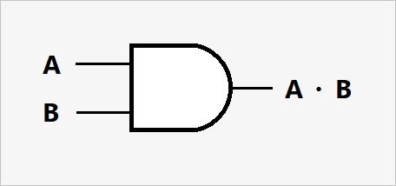
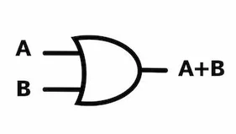
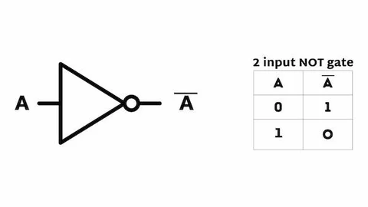
Basic Gates
Gate Name | Symbol | Truth Table
AND
OR
NOT
A | B | Y
0 | 0 | 0
0 | 1 | 0
1 | 0 | 0
1 | 1 | 1
A | B | Y
0 | 0 | 0
0 | 1 | 1
1 | 0 | 1
1 | 1 | 1
A | A’
0 | 1
1 | 0

Slide 5
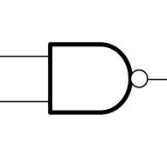
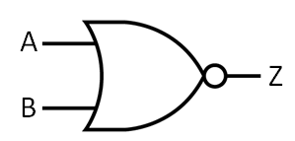
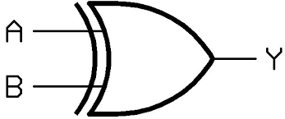
Derived Gates
Gate Name | Symbol | Truth Table
NAND
NOR
XOR
A | B | Y
0 | 0 | 1
0 | 1 | 1
1 | 0 | 1
1 | 1 | 0
A | B | Y
0 | 0 | 1
0 | 1 | 0
1 | 0 | 0
1 | 1 | 0
A | B | Y
0 | 0 | 0
0 | 1 | 1
1 | 0 | 1
1 | 1 | 0

Slide 6
Boolean Algebra Theorems
Identity Laws
A + 0 = A A · 1 = A
2. Null/Annihilation Laws
A + 1 = 1 A · 0 = 0
3. Idempotent Laws
A + A = A A · A = A
4. Complement Laws
A + A′ = 1 A · A′ = 0
5. Double Negation Law
(A′)′ = A
6. Commutative Laws
A + B = B + A A · B = B · A

Slide 7
Boolean Algebra Theorems..
7. Associative Laws
(A + B) + C = A + (B + C) (A · B) · C = A · (B · C)
8. Distributive Laws
A · (B + C) = A·B + A·C A + (B · C) = (A + B) · (A + C)
9. Absorption Laws
A + A·B = A A · (A + B) = A
10. DeMorgan’s Theorems
(A · B)′ = A′ + B′ (A + B)′ = A′ · B′
11. Redundancy Laws
A + A′·B = A + B A · (A′ + B) = A·B

Slide 8
Simplification using Boolean Theorems
Given an Boolean Expression check whether it is optimized
Y = AB+ AB’C+C’+ABC
Circuit requires 2 i/p AND 5 no, NOT 2 No,
2 i/p OR 3 No
Y = AB+ AB’C+C’+ABC +ABC ……A+A =A
= AB + ABC+ AB’C+C’+ABC...commutative
= AB ( 1+C) + AB’C+C’+ABC …. Distributive
= AB + AB’C+ABC+ C’…. 1+A = 1
= AB+ AC(B’+B)+C’ ….. Distributive
= AB + AC + C’
= AB + A+C’ = A(B+1) +C’ = A+C’
A | B | C | Y
0 | 0 | 0 | 1
0 | 0 | 1 | 0
0 | 1 | 0 | 1
0 | 1 | 1 | 0
1 | 0 | 0 | 1
1 | 0 | 1 | 1
1 | 1 | 0 | 1
1 | 1 | 1 | 1
Y = A’B’C’+ A’BC’+AB’C’+AB’C+ABC’+ABC

Slide 9
Simplify
F (A, B, C, D) = (A + B’).(ACB + B’.[C + A]) + ABC’.(A’B + A)
Identify how many inputs...D not required
Always maintain their sequence ( even if it does not matter )
F = (A+B’) . ( ABC+B’C+AB’) + ( AA’BBC’ + AABC’)
= (AABC+AB’C+AAB’+ABB’C+B’B’C+AB’B’) + (AA’BBC’ + AABC’)
= ABC+AB’C+AB’+0+B’C+AB’ +0+ABC’
= ABC+AB’(C+1)+B’C+AB’+ABC’
= AB(C+C’) +AB’ +B’C
= AB+ AB’+B’C
= A(B+B’) + B’C
=A+B’C

Slide 10
Representation of Logic using Boolean Expression
Write a truth table for function which is one when the four digit number is prime number
No of Inputs?
Truth Table
Minterns
Maxterms
Output expressed as a function of inputs
= sum of minterms = sum of Products = SOP
= Product of Maxterms =Product of Sums

Slide 11
Boolean Expression
A | B | C | D | Prime
0 | 0 | 0 | 0 | 0
0 | 0 | 0 | 1 | 0
0 | 0 | 1 | 0 | 1
0 | 0 | 1 | 1 | 1
0 | 1 | 0 | 0 | 0
0 | 1 | 0 | 1 | 1
0 | 1 | 1 | 0 | 0
0 | 1 | 1 | 1 | 1
1 | 0 | 0 | 0 | 0
1 | 0 | 0 | 1 | 0
1 | 0 | 1 | 0 | 0
1 | 0 | 1 | 1 | 1
1 | 1 | 0 | 0 | 0
1 | 1 | 0 | 1 | 1
1 | 1 | 1 | 0 | 0
1 | 1 | 1 | 1 | 0
P = A’B’CD’+ A’B’CD+
A’BC’D + A’BCD+
AB’CD + ABC’D
= A’B’C+ A’BD +
AB’CD +ABC’D
Prime = 1 when input is
2,3,5,7,11,13
Choose rows of truth table having output 1
Look at inputs in that row
Write an expression for the row as product ( AND )
If variable is having value zero write its complement, if it is having value 1 write the variable as it is

Slide 12
Representation of Logic in SOP and POS form
In any Truth Table Output Values are either zero / one
Minterms are used to represent the logic expression for output = 1.
A minterm is a product (AND) of all input variables in either true or complemented form, such that only one combination results in 1.
Maxterms are used to represent the logic expression for output = 0.
A maxterm is a sum (OR) of all input variables in either true or complemented form, such that only one combination results in 0.

Slide 13
Representation of Logic in SOP and POS form
Any Truth Table can be represented as
Sum of Products ( Minterms)
Product of Sums( Maxterms)
P = m2+m3+m5+ m7+ m11+m13 ( SOP)
P = M0. M1. M4. M6. M8. M9. M10. M12. M14. M15 ( POS)
Minterms are represented as Products
m2 = A’B’CD’, m3= A’B’CD m11 = AB’CD etc
Maxterms are represented as Sums
M0 = A+B+C+D, M1 = A+B+C+D’ , M6 = A+B’+C’+D
M12 = A’+B’+C+D M15 = A’+B’+C’+D’ etc

Slide 14
Representation of Logic in SOP and POS form
SOP form of boolean expression can also be written as
P = ∑ m(2,3,5,7,11,13) …SOP
POS form as
P = π M( 0,1,4,6,8,9,10,12,14,15) …POS
Total terms ( rows of the truth table) are dependent on number of inputs
For n inputs terms = 2**n

Slide 15
Representation of Logic in SOP and POS form
SOP form of boolean expression can also be written as
P = ∑ m(2,3,5,7,11,13) …SOP
POS form as
P = π M( 0,1,4,6,8,9,10,12,14,15) …POS
Total terms ( rows of the truth table) are dependent on number of inputs
For n inputs terms = 2**n
SOP (Sum of Products) | POS (Product of Sums)
Minterms (Output = 1) | Maxterms (Output = 0)
OR of ANDs (e.g., A·B + C) | AND of ORs (e.g., (A + B)·(C + D))
Logic implementation via AND-OR networks | Logic implementation via OR-AND networks

Slide 16
Representation of Logic in SOP and POS form
Consider function Y( A,B,C,D) = ∑ m(2,3,5,7,8,10,11,13) …SOP
Y = A’B’CD’+A’B’CD +A’BC’D+A’BCD +AB’C’D’+AB’CD’+AB’CD+ABC’D
= A’B’CD’+A’B’CD +A’BC’D+A’BCD +AB’C’D’+AB’CD’+AB’CD+ABC’D
= A’B’C(D’+D ) + A’BD ( C’+C) + AB’ D’ (C’+C) +AB’CD+ABC’D
= A’B’C + A’BD+AB’D+AB’CD + ABC’D
=B’C(A’+AD) +A’BD +AD(B’+BC’) …………A’+AD = A’+D, B’+BC’ = B’+C’
= B’C(A’+D) + A’BD+ AD(B’+C’)
= A’B’C+B’CD+A’BD +AB’D+AC’D

Slide 17
Representation of Expression in Karnaugh Maps
Consider function Y( A,B,C) = ∑ m(1,2,3,4,7,) …SOP
Y = A’B’C+A’BC’+A’BC+AB’C’+ABC = A’C(B’+B)+A’B(C+C’)+BC(A’+A) +AB’C’
= A’C+A’B+BC+AB’C’
A’C+A’B+BC+AB’C’
AB/C | 00 | 01 | 11 | 10
0 | 0 | 1 | 0 | 1
1 | 1 | 1 | 1 | 0

Slide 18
Minimization using Karnaugh Maps
Consider function Y( A,B,C,D) = ∑ m(1,2,3,4,7,8,11,13,15) …SOP
A’B’D + A’B’C + CD + ABD + A’BC’D’ + AB’C’D’
AB/CD | 00 | 01 | 11 | 10
00 | 0 | 1 | 0 | 1
01 | 1 | 0 | 1 | 0
11 | 1 | 1 | 1 | 1
10 | 1 | 0 | 0 | 0

Slide 19
Karnaugh Maps Minimization Rules
Identify all minterns in the given funtion. ( or maxterms)
Group adjacent minterms for SOP ( maxterms for POS)
Groups having 1,2,4,8…upto 2**n for n variable K Map
K-maps are cylindrical: the left and right edges are adjacent, as are the top and bottom. This allows wrap-around groupings.
A cell can be part of multiple groups if it helps make larger groups.
Make Largest Possible Groups First
All minterms must be covered even if it is a group of 1 term
Make sure that no group is redundant ( redundant group is the one in which all minterms are part of some other group)
For each group:
Eliminate the variables that change within the group.
Keep variables that are the same for all cells in the group.
To represent each group consider a product with variable (for 1) and
its complement (for 0) for SOP

Slide 20
Minimization using Karnaugh Maps
Consider function Y( A,B,C,D) = ∑ m(0,1,2,3,4,6,7,8,11,13,15) …SOP
A’B’ + A’D’ + CD + ABD + B’C’D’
AB/CD | 00 | 01 | 11 | 10
00 | 1 | 1 | 0 | 1
01 | 1 | 0 | 1 | 0
11 | 1 | 1 | 1 | 1
10 | 1 | 1 | 0 | 0

Slide 21
Karnaugh Maps with Don’t care terms:
Consider function Y( A,B,C,D) = ∑ m(0,1,2,4,6,11,15) + d(3,9,13)…SOP
Y = A’D’+A’B’C’+ACD …without considering don’t care terms
Y = A’D’+A’B’+AD …with Don’t cares
AB/CD | 00 | 01 | 11 | 10
00 | 1 | 1 | 0 | 0
01 | 1 | 0 | X | X
11 | X | 0 | 1 | 1
10 | 1 | 1 | 0 | 0
AB/CD | 00 | 01 | 11 | 10
00 | 1 | 1 | 0 | 0
01 | 1 | 0 | X | X
11 | X | 0 | 1 | 1
10 | 1 | 1 | 0 | 0

Slide 22
Minimization using Karnaugh Maps (POS)
Consider function Y( A,B,C,D) = ∑ m(0,1,2,3,4,6,7,8,11,13,15) …SOP
= π M(5,9,10,12,14) …POS
Y=(A+B’+C+D’).(A’+B+C+D’).(A’+B’+D).(A’+C’+D)
A’B’ + A’D’ + CD + ABD + B’C’D’
AB/CD | 00 | 01 | 11 | 10
00 | 1 | 1 | 0 | 1
01 | 1 | 0 | 1 | 0
11 | 1 | 1 | 1 | 1
10 | 1 | 1 | 0 | 0

Slide 23
Minimization using Karnaugh Maps
F(A,B,C,D) = Σ m(0, 2, 4, 5, 8, 10, 12, 14, 15)
F(A,B,C,D) = ∑m(0,1,4,5,10,11,13,14,15)
F(A,B,C,D) = πM(0,1,4,5,10,11,13,14,15)
F(A,B,C,D) = π M(0,1,6,7,9,11,12,13,15)
AB/CD | 00 | 01 | 11 | 10
00
01
11
10

