Slide 1
Approaches in Cheminformatics and Bioinformatics
Dr. Deepali Kanekar

Slide 2
Cheminformatics vs bioinformatics:
Both fields make use of computer software to simplify research &
development in respective fields. Let’s compare how both field emerges with use of computer technology

Slide 3
Cheminformatics is a field at the intersection of chemistry and information science, involving the use of computational and statistical methods to analyze, visualize, and interpret chemical data. It integrates techniques from computer science, data science, and chemistry to store, manipulate, and predict the behavior of chemical compounds, molecules, and materials.
Cheminformatics plays a crucial role in modern chemical research and industry, enabling scientists to analyze large chemical datasets, model molecular properties, and make predictions about new compounds, materials, and drugs.

Slide 4
Key Aspects of Cheminformatics:
Data Representation: Converting chemical structures into computer-readable formats (e.g., SMILES, InChI) and storing them in databases like PubChem or ChEMBL.
Molecular Modeling: Using simulations (e.g., molecular docking, dynamics) to study molecular interactions and predict behavior.
QSAR Modeling: Relating chemical structure to biological or physicochemical properties to predict compound activity.
Virtual Screening: Computationally searching large compound libraries to identify potential drug candidates.
Predictive Toxicology: Using models to predict the toxicity of chemicals and improve drug safety.

Slide 5
Applications:
Drug Discovery: Identifying and optimizing new drugs.
Environmental Chemistry: Predicting the impact of chemicals on the environment.
Agriculture: Designing pesticides and fertilizers.
Materials Science: Developing new materials with specific properties.
Challenges:
Data Quality: Ensuring accurate and reliable chemical data.
Big Data: Managing and analyzing large datasets.
Model Interpretability: Making complex models more understandable and transparent.
Cheminformatics plays a vital role in accelerating chemical research and innovation across various industries.

Slide 6
Bioinformatics
Bioinformatics is an interdisciplinary field that combines biology, computer science, and information technology to analyze, interpret, and manage biological data, particularly large datasets such as genetic sequences, protein structures, and biological networks. It plays a crucial role in understanding biological processes and advancing fields like genomics, proteomics, and systems biology.

Slide 7
Key Areas of Bioinformatics:
Genomics: Analyzing and interpreting DNA sequences to understand genes, their functions, and their roles in health and disease.
Proteomics: Studying proteins, their functions, structures, and interactions, to gain insights into cellular processes and disease mechanisms.
Transcriptomics: Analyzing RNA sequences (e.g., mRNA) to understand gene expression and regulation.
Systems Biology: Integrating data from various biological sources (genomics, proteomics, metabolomics) to model complex biological systems and networks.
Computational Biology: Developing algorithms, databases, and tools to process and analyze biological data.

Slide 8
Applications:
Personalized Medicine: Tailoring treatments based on genetic information.
Drug Discovery: Identifying drug targets and designing new drugs.
Disease Research: Understanding genetic causes of diseases.
Agriculture: Improving crops through genetic analysis.
Bioinformatics accelerates biological research and supports advances in healthcare, agriculture, and disease prevention.

Slide 9
Distinguish between Cheminformatics and Bioinformatics

Slide 10
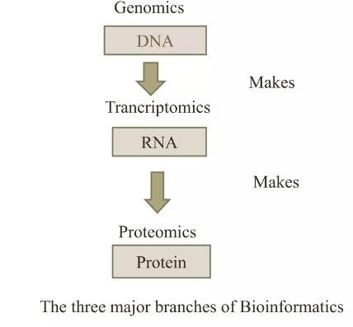
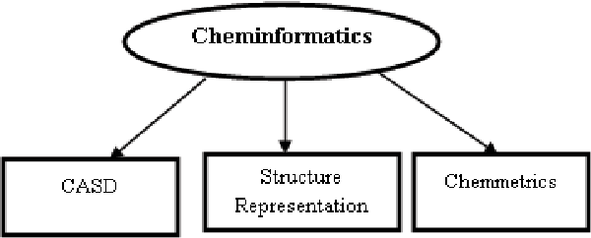
Cheminformatics | Bioinformatics
Cheminformatics is the combination of chemical synthesis, biological screening & data mining approaches used to guide drug discovery & development. It also uses computer software to assist in acquisition, analysis & management of data information relating to the chemical compounds and their properties. | Bioinformatics concerned with the development & application of computer hardware/software to the acquisition, storage, analysis & visualization of biological information.
CI deals with small molecules that are synthesized in chemical processes. | BI deals with large molecules like proteins, DNA OR RNA

Slide 11
Components of cheminformatics-
Components of Bioinformatics-
CI applies IT to chemical data and includes topics such as chemical database, structure-activity relationships & structure based drug design.
The CI offers programs and database (mainly for organic and sometimes for inorganic applications) related to small molecules, complementing the activities of the bioinformatics group who concentrate on biological macromolecules.
The development of new algorithms and statistics for assessing the relationship among large set of biological data. Eg. DNA sequencing
Application of the tools() for analysis and interpretation of various biological data. Eg. Nucleotide sequences, amino acids sequences
The development of database for an efficient storage, access and management of various biological information's.
Applications:- Mainly in
Applications:- In development of Molecular medicine, personalized medicine, bioweapon creation and antibiotic resistance studies.
Pharmaceutical industry for QSAR Studies & Drug development. Also
used to maintain records of
chemicals in the form of chemical information systems (CIS)

