Slide 1
Chemistry & Computers
By Dr. Druman Utekar Dr. Deepali Kanekar

Slide 2
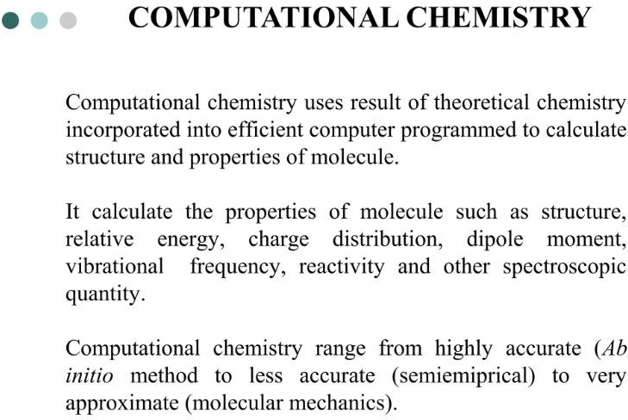

Slide 3
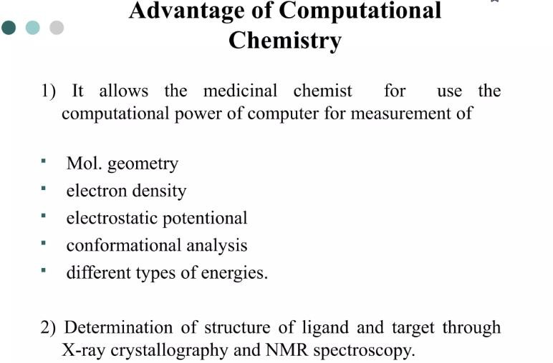

Slide 4
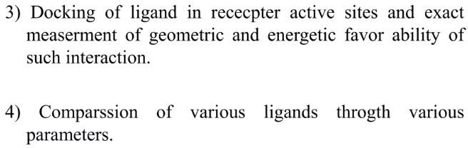

Slide 5
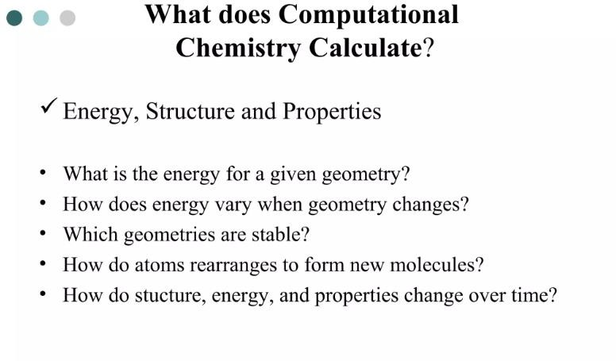

Slide 6
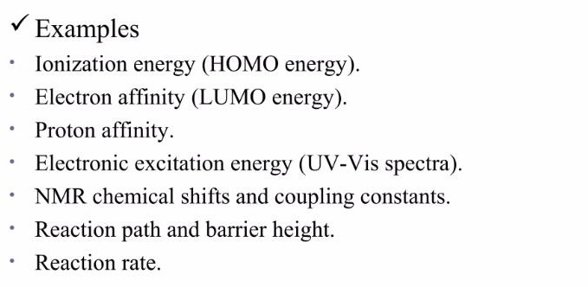

Slide 7
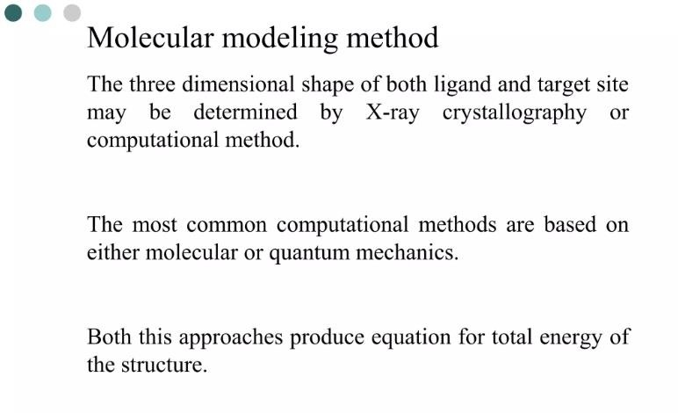

Slide 8
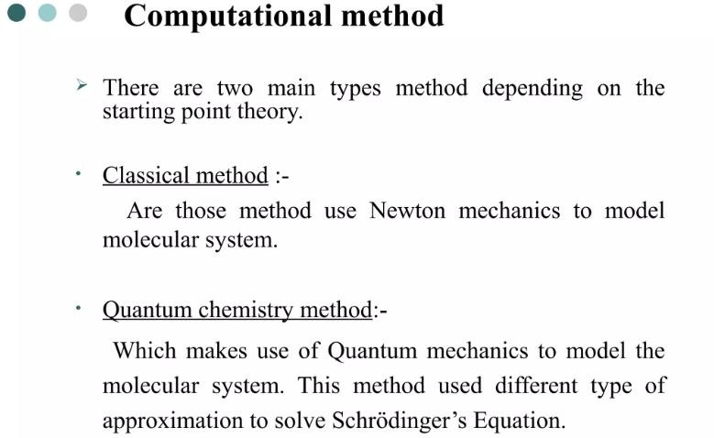

Slide 9
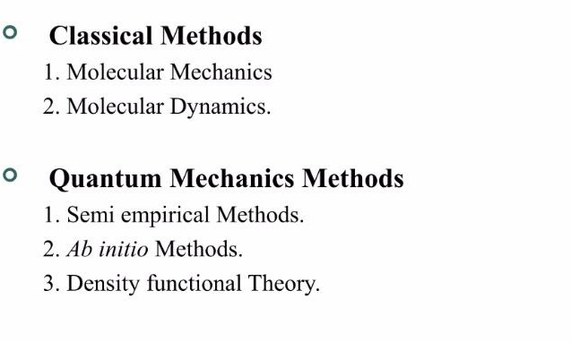

Slide 10
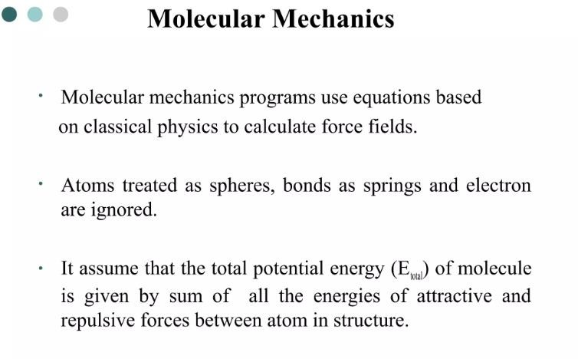

Slide 11
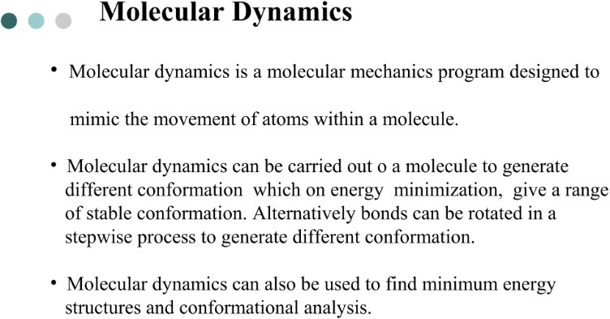

Slide 12
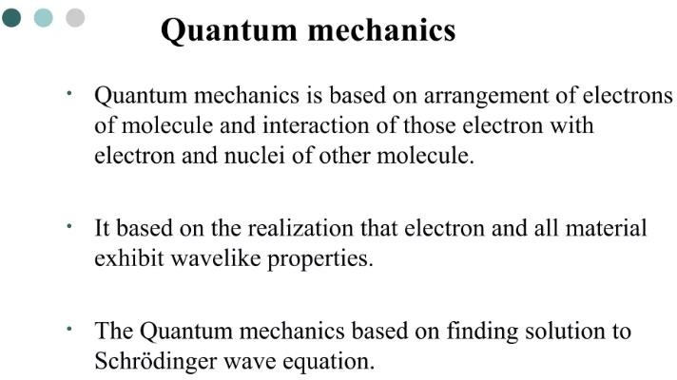

Slide 13


Slide 14
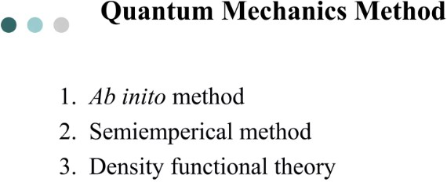

Slide 15
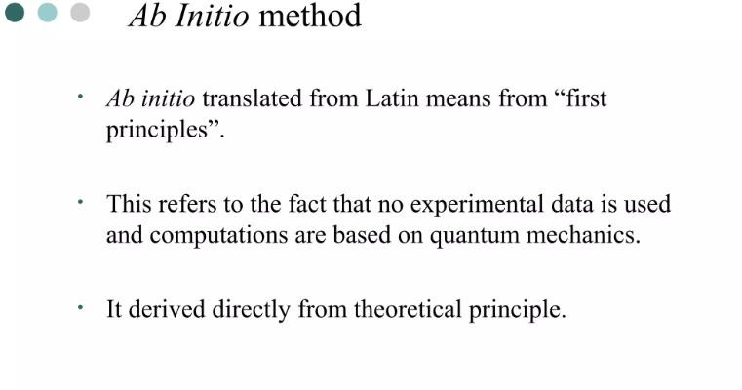

Slide 16
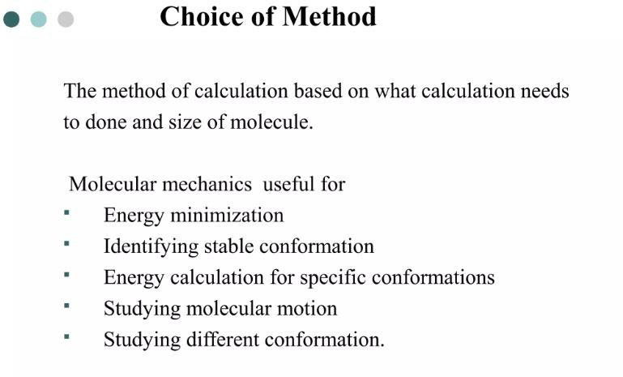

Slide 17
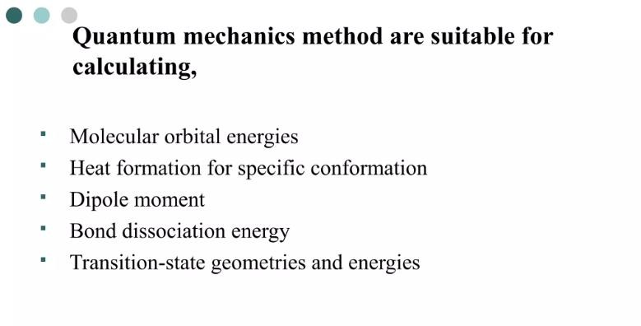

Slide 18
Computational approach in cheminformatics and
bioinformatics
Computational Approaches in Cheminformatics and Bioinformatics covers:
Data sources available for modelling and prediction purposes.
Developments of conventional Quantitative Structure-Activity Relationships (QSAR).
Computational tools for manipulating chemical and biological data.
Novel ways of probing the interactions between small molecules and proteins.
The invaluable applications for drug discovery, cellular and molecular biology, enzymology, and metabolism make computational approaches in Cheminformatics and Bioinformatics the essential guidebook for evolving drug discovery research and alleviating the issue of chemical control and manipulation of various systems.

Slide 19
Thank you

