Slide 1



Slide 2

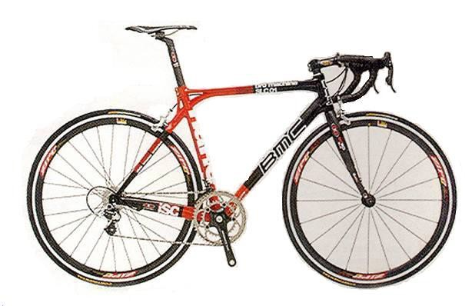
is already making today’s products:
Lighter
Stronger
Faster
Smaller
More Durable

Slide 3

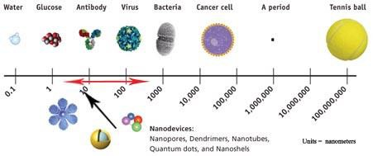
Units in nanometers (µm)

Slide 4
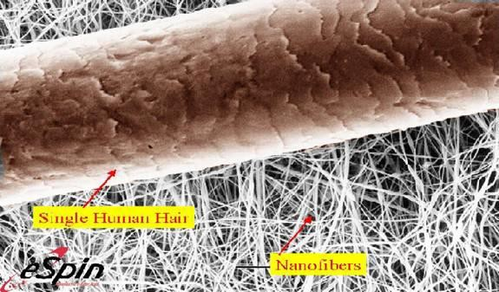
A Human Hair is about 100,000 µm wide

Slide 5
Nanoscale materials are defined as a set of substances where at
least one dimension is less than approximately 100 nanometers.
A nanometer is one millionth of a millimeter- approximately 100,000 times smaller than the diameter of a human hair.
Properties of Nanomaterials-
large fraction of surface atoms;
high surface energy;
spatial confinement;
reduced imperfections,
Two principle factor causing properties of significantly from bulk materials.
Relative surface area
Quantum effects
nanomaterials to differ
These property can change or enhance property such as reactivity, strength, electric and magnetic behaviour.

Slide 6

As the size of particle decreases greater proportion of atom are
found at the surface for e.g.
Size 30 nm- 5% of atom on its surface Size 10 nm- 20% of atom on its surface Size 3 nm- 50% of atom on its surface
To understand the effect of particle size on surface area, consider an American Silver Eagle coin. This silver dollar contains 31 grams of coin silver and has a total surface area of approximately 3000 square millimeters. If the same amount of coin silver were divided into nanoparticles– say 10 nanometer in diameter– the total surface area of those particles would be 7000 square meters (which is equal to the size of a soccer field

Slide 7

The quantum confinement effect can be observed once the diameter of particle is of the same magnitude as the wavelength of electron
Quantum confinement effect is responsible for increase of energy gap between energy state and band gap.
When particles are small there electric, optical and magnetic properties differ significantly from bulk materials
Notes:
Quantum size effect refers to the phenomenon that when particle size drops to a certain value, the electron energy level near Fermi level changes from quasi-continuous energy level to discrete energy level, that is, energy level splitting or energy gap widening.

Slide 8
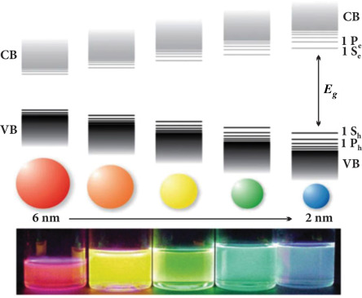

Slide 9
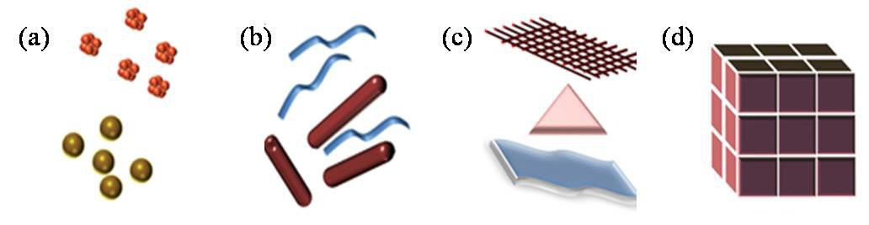
Zero dimension (quantum dots)
One dimension (quantum wires, rods)
Two dimension (plates, network, quantum wells)
Three dimension (fullerenes- C60, haeckelites)
Classification of Nanomaterials (a) 0D spheres and clusters, (b) 1D nanofibers, wires, and rods, (c) 2D films, plates, and networks, (d) 3D nanomaterials.
Notes:
quantum-dot is a well that confines the particles in all 3Ds such as a small sphere or a cube, a quantum wire confines the particles in 2Ds, and a quantum-well confines in 1D.

Slide 10
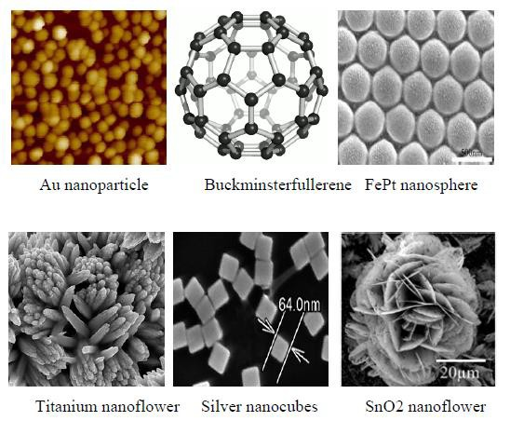

Slide 11
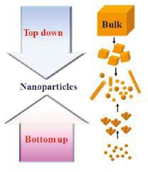
Nanomaterial - synthesis and processing
Nanomaterials deal with very fine structures: a nanometer is a billionth of a meter. This indeed allows us to think in both the ‘bottom up’ or the ‘top down’ approaches to synthesize nanomaterials.
Schematic illustration of the preparative
methods of nanoparticles.

Slide 12
Bottom up
assemble atoms (sol-gel method, precipitation etc.)
Example, synthesizing nonmetallic inorganic materials like glasses, glass ceramics or ceramic materials at very low temperatures)
Top down
dis-assemble
For example, the synthesis of porous silicon by electrochemical etching
This domain is encompassing medicine.
a pure example of physics, chemistry,
interdisciplinary
work upto
and engineering

Slide 13
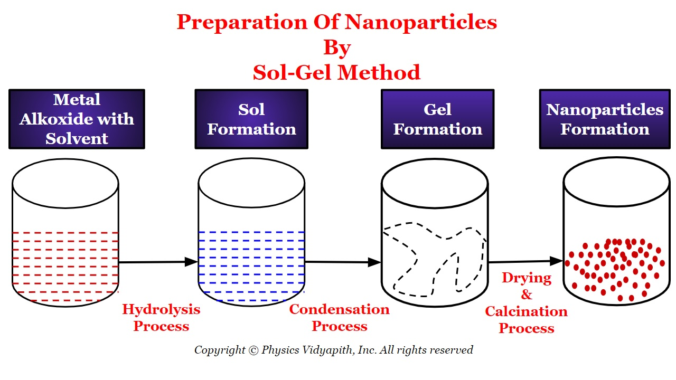

Slide 14
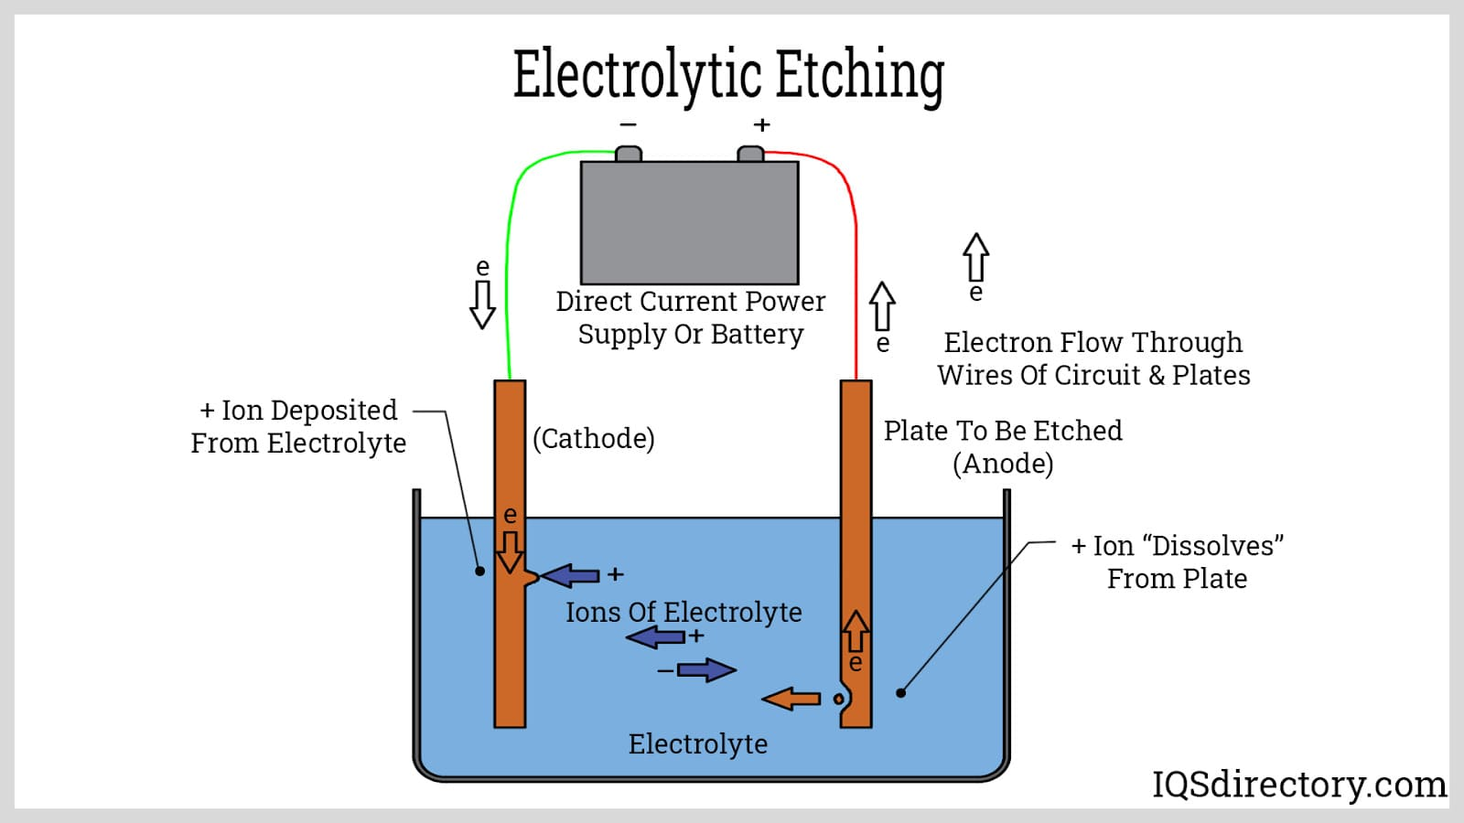

Slide 15

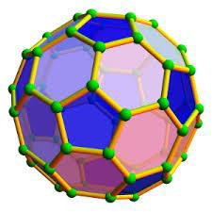

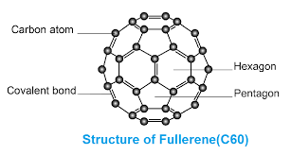
Fullerenes are spherical carbon-cage molecules with sixty (C60) or more carbon atoms.
The molecule was named after R. Buckminster Fuller, who confirmed structural formula .
A hollow pure carbon molecule in which atom lies at the vertices of polyhedron with 12 pentagonal faces and any number of hexagonal faces.
Each carbon is bound to other three carbon in pseudo spherical arrangement of alternating pentagonal and hexagonal rings in the manner of soccer ball . Hence the nick name Bucky ball.
They measure about 0.7-1.5 nm in diameter.

Slide 16
Properties:
They are fascinating for scientists because they show unusual properties for carbon materials.
Fullerenes are studied for potential medical use: they are strong antioxidants; one could also bind specific antibiotics to the structure to target resistant bacteria and even target certain cancer cells such as melanoma.
Heat resistance and superconductivity are some of the more heavily studied properties of fullerenes in mechanical engineering.

Slide 17





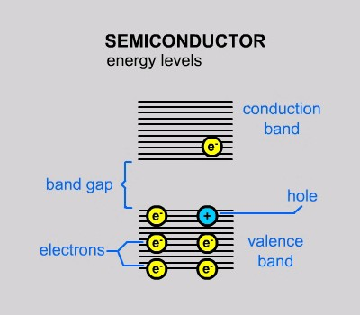
The average distance between an electron and a hole in a exciton is called the Excited Bohr Radius.
When the size of the semiconductor falls below the
Bohr Radius,
the semiconductor is called a quantum dot.

Slide 18
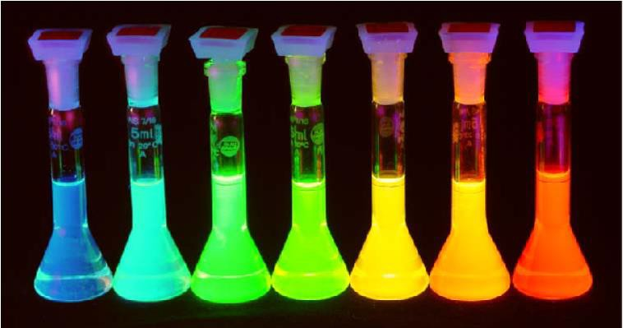
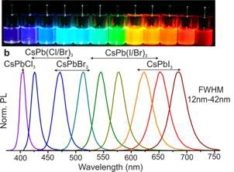
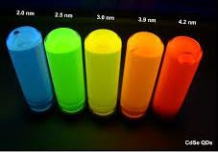
By changing size, shape, and composition, quantum dots can change their absorptive and emissive properties dramatically

Slide 19
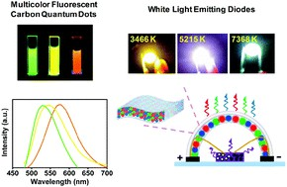
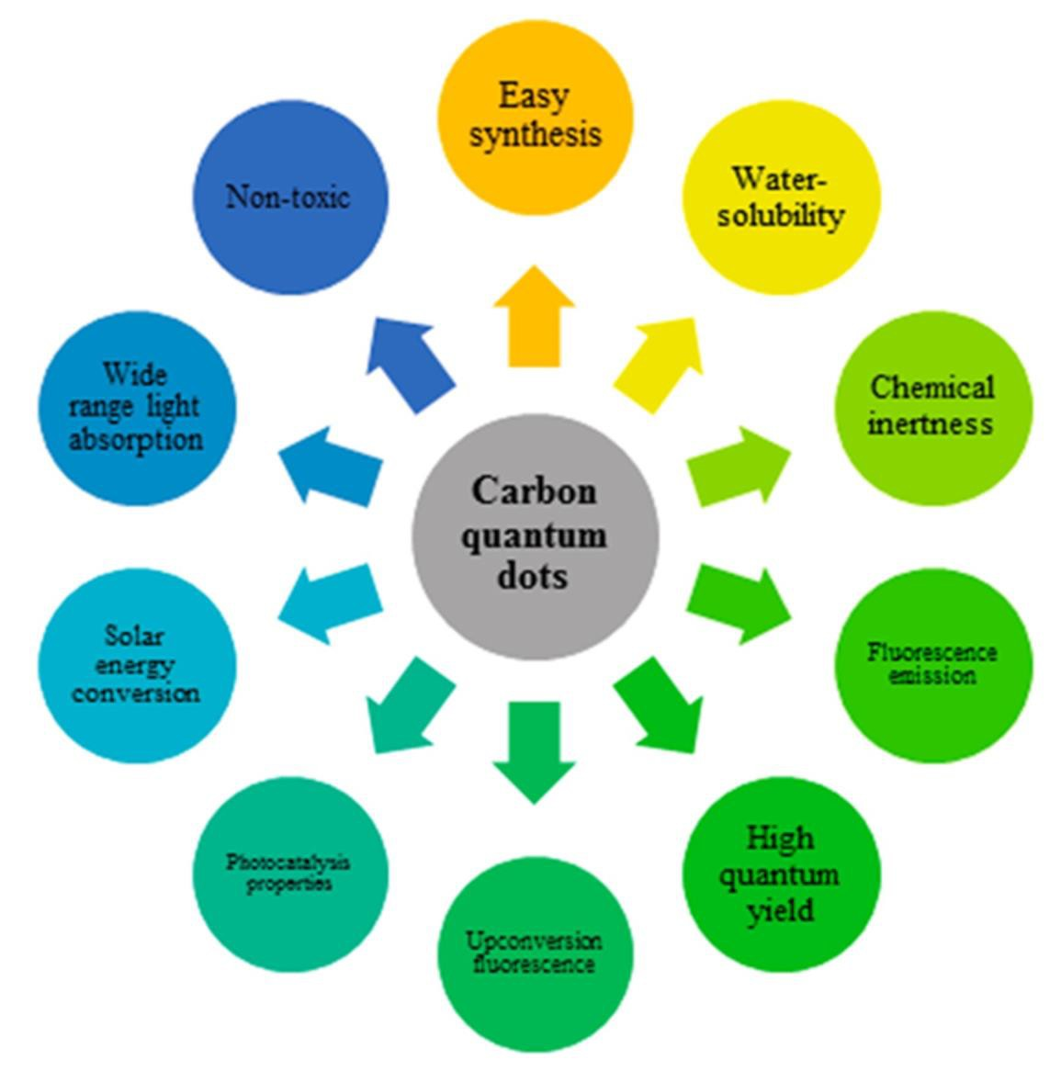

Slide 20

Medicine-
Can be set to any arbitrary emission spectra to allow labeling and observation of detailed biological processes.
Quantum Dots can be useful tool for monitoring cancerous cells and providing a
means to better understand its evolution.
In the future, Qdots could also be armed with tumor-fighting toxic therapies to provide the diagnosis and treatment of cancer.
Qdots are much more resistant to degradation than other optical imaging probes
such as organic dyes, allowing them to track cell processes for longer periods of time.
Quantum dots offer a wide broadband absorption spectrum while maintaining a distinct, static emission wavelength.
LED-
Used to produce inexpensive, industrial quality white light.
Marked improvement over traditional LED–phosphor integration by dot’s ability to
absorb and emit at any desired wavelength.
Produce white light by intermixing red, green, and blue emitting dots homogenously within the phosphor difficult to accomplish with the traditional LED-phosphor set up.

Slide 21


Traditional solar cells are made of semi-conductors and expensive to produce. Theoretical upper limit is 33% efficiency for conversion of sunlight to electricity for these cells.
Utilizing quantum dots allows realization of third-generation solar cells at
~60% efficiency in electricity production while being $100 or less per square meter of paneling necessary.
Effective due to quantum dots’ ability to preferentially absorb and emit
radiation that results in optimal generation of electric current and voltage.
Other Future Quantum Dot Applications…
•
Anti-counterfeiting capabilities: inject dots into liquid mixtures, fabrics,
polymer matrices, etc. Ability to specifically control absorption and emission spectra to produce unique validation signatures. Almost
impossible to mimic with traditional semi-conductors.
Counter-espionage / Defense applications: Integrate quantum dots into dust that tracks enemies. Protection against friendly-fire events.
Research continues. The possibilities seem endless…
•

Slide 22

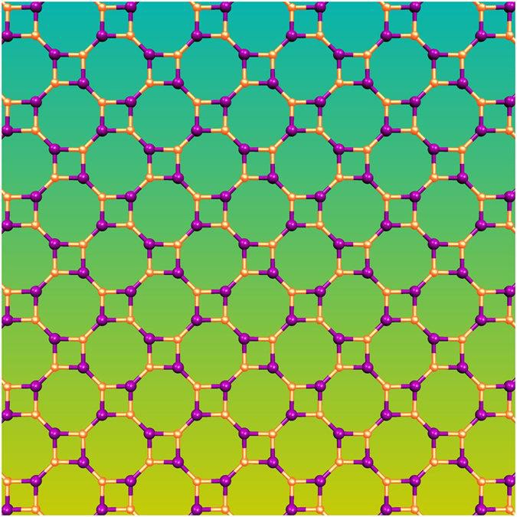












Starting from a planar Haeckelite array, tubular structures are obtained by applying the same wrapping procedure as for the usual nanotubes, which are rolled up sheets of graphene.
The Haeckelite nanotubes may adopt
GaN Hacekelite 8-4
A planar structure containing
various shapes, among which coiled
structures, corrugated necklace-like spectacular.
doublescrew molecules, cylinders, and
pearl- most
square and octagonal rings which is called Haeckelites 8–4
nanotubes are the

Slide 23



Slide 24
Applications of hacekelites:
* Potential to be incorporated in various nano-technology devices as mechanical components in the form of resonating elements or nano-springs and in novel reinforcement composites.
carbon-based material that can be used as carbon fillers in reinforcement composites.
tactile sensors incorporating carbon micro-coils had better discrimination abilities when compared to conventional sensors, making haeckelites novel tactile sensors.
ability to inhibit the breeding of keloid fibroblast, i.e., cancer cells associated with leukaemia of the uterus.
useful as electromagnetic nano-transformers or nano-switches.
useful as a tool to detect mass change as small as a few tens of attograms.

Slide 25
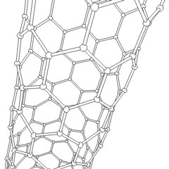
There name is derived from long hollow structure with wall formed by one atom thick sheets of carbon called graphene. These sheets are rolled at specific and discrete (chiral) angle. The combination of rolling angle and radius decides the nano tubes properties For e.g. Whether nano tube shell is metal or semi conductor.
They have outstanding mechanical and electronic properties and are good thermal conductors..

Slide 26
The tensile strength, or breaking strain of CNTs is 6-7 times that of steel.
They are among the stiffest and strongest fibers known. CNTs can be metallic or semiconducting depending on their structure.
Some CNTs are the most efficient electrical conductors ever made, while others behave more like silicon.
These properties, coupled with the lightness of carbon nanotubes, give them great potential for use in reinforced composites, nanoelectronics, sensors and nanomechanical devices

Slide 27
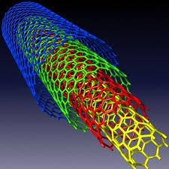
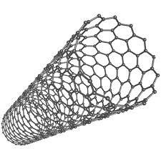
Carbon nano tubes are categorized as,
Single walled nano tubes (SWNT) Multi walled nano tubes (MWNT)
Nanotubes have been constructed with length-to-diameter ratio of up to 132,000,000 :1 significantly larger than for any other material. These cylindrical carbon molecules have unusual properties, which are valuable
for nanotechnology, electronics, optics and other fields of materials science and technology

Slide 28
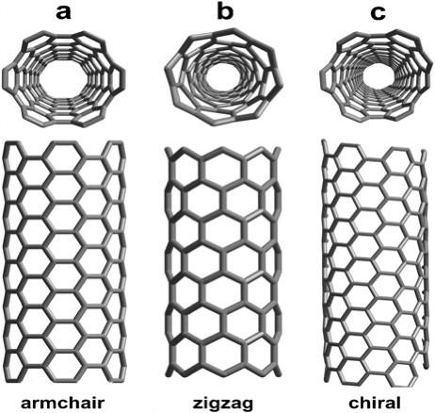
Single-walled
carbon nanotubes:
armchair - metallic
zigzag - semiconducting
chiral - semiconducting
multi-walled - metallic

Slide 29
Arc Method
Laser Method
Chemical deposition method

Slide 30

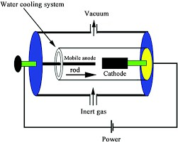
The carbon arc discharge method, initially used for producing C60 fullerenes, perhaps its most common method to produce CNTS
1. This method creates CNTs through arc- vaporization of two carbon rods placed end to end, separated by approximately 1mm, in an enclosure that is usually filled with inert gas at low pressure.
2. Recent investigations have shown that it is also possible to create CNTs with the arc method in liquid nitrogen. A direct current of 50 to 100A, driven by a potential difference of approximately 20V, creates a high temperature discharge between the two electrodes.
3. The discharge vaporizes the surface of one of the carbon electrodes, and forms a small rod-shaped deposit on the other electrode.
4. Producing CNTs in high yield depends on the uniformity of the plasma arc, and the temperature of the deposit forming on the carbon electrode.
Notes:
Plasma is a state of matter along with solids, liquids and gases. When a neutral gas is heated such that some of the electrons are freed from the atoms or molecules, it changes state and becomes a plasma. It consists of a partially-ionized gas, containing ions, electrons, and neutral atoms.

Slide 31
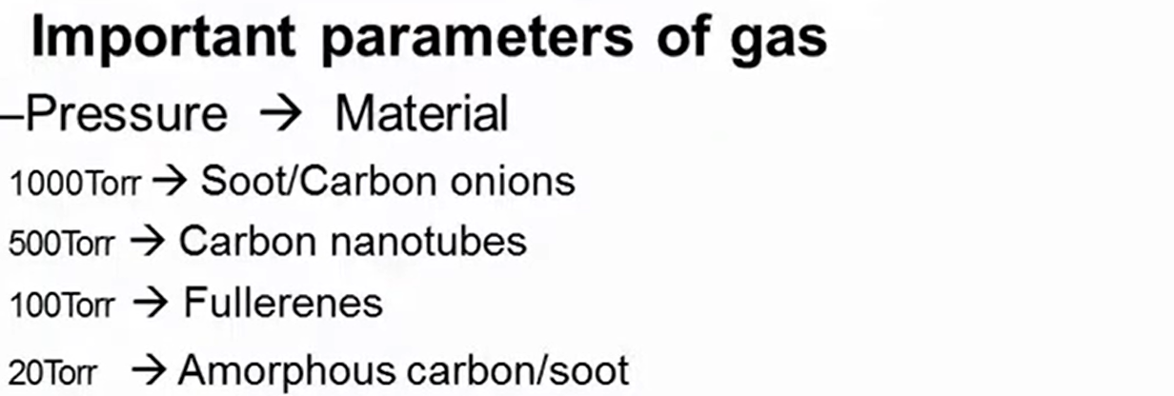

Slide 32
The carbon arc discharge method, initially used for producing C60 fullerenes, is the most common and perhaps easiest way to produce CNTs, as it is rather simple. However, it is a technique that produces a complex mixture of components, and requires further purification- to separate the CNTs from the soot and the residual catalytic metals present in the crude product. This method creates CNTs through arc- vaporization of two carbon rods placed end to end, separated by approximately 1mm, in an enclosure that is usually filled with inert gas at low pressure. Recent investigations have shown that it is also possible to create CNTs with the arc method in liquid nitrogen. A direct current of 50 to 100A, driven by a potential difference of approximately 20V, creates a high temperature discharge between the two electrodes. The discharge vaporizes the surface of one of the carbon electrodes, and forms a small rod-shaped deposit on the other electrode. Producing CNTs in high yield depends on the uniformity of the plasma arc, and the temperature of the deposit forming on the carbon electrode.

Slide 33

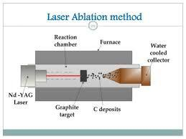
In 1996 CNTs were first synthesized using a dual-pulsed laser. Samples were prepared by laser vaporization of graphite rods with a 50:50 catalyst mixture of Cobalt and Nickel at 1200°C in flowing argon, followed by heat treatment in a vacuum at 1000°C to remove the C60 and other fullerenes. The initial laser vaporization pulse was followed by a second pulse, to vaporize the target more uniformly. The use of two successive laser pulses minimizes the amount of carbon deposited as soot.
Notes:
Nd:YAG (neodymium-doped yttrium aluminum garnet; Nd:Y₃Al₅O₁₂) is a crystal that is used as a lasing medium for solid-state lasers. The dopant, neodymium in the +3 oxidation state, Nd(III), typically replaces a small fraction (1%) of the yttrium ions in the host crystal structure of the yttrium aluminum garnet (YAG), since the two ions are of similar size.^{[1]} It is the neodymium ion which provides the lasing activity in the crystal, in the same fashion as red chromium ion in ruby lasers.^{[1]}

Slide 34
The second laser pulse breaks up the larger particles ablated by the first one, and feeds them into the growing nanotube structure.
The material produced by this method appears as a mat of "ropes", 10-20nm in diameter and up to 100µm or more in length.
Each rope is found to consist primarily of a bundle of single walled nanotubes, aligned along a common axis.
By varying the growth temperature, the catalyst composition, and other process parameters, the average nanotube diameter and size distribution can be varied.

Slide 35
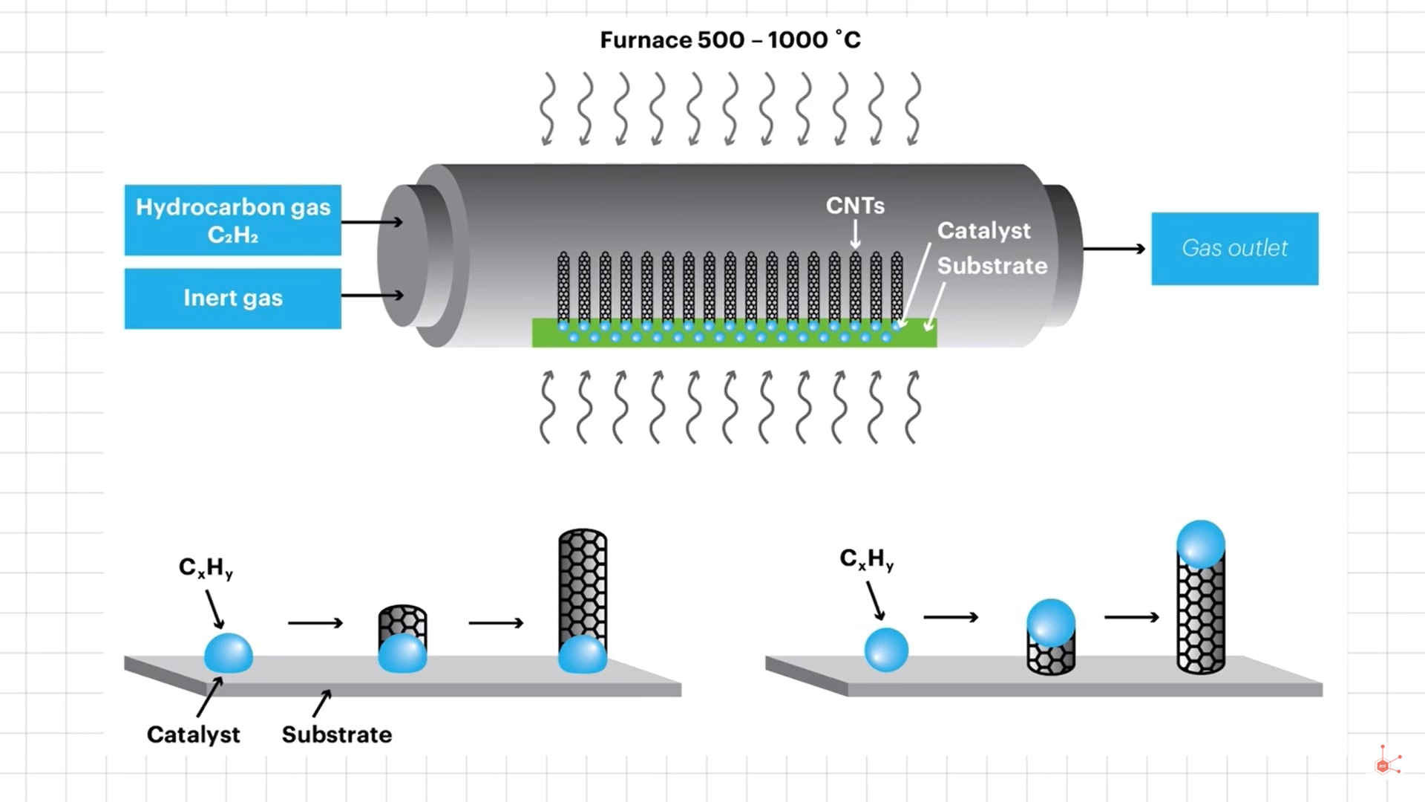
The simplest method to produce nanoparticles is by heating the desired material in a furnance containing the desired material.

Slide 36
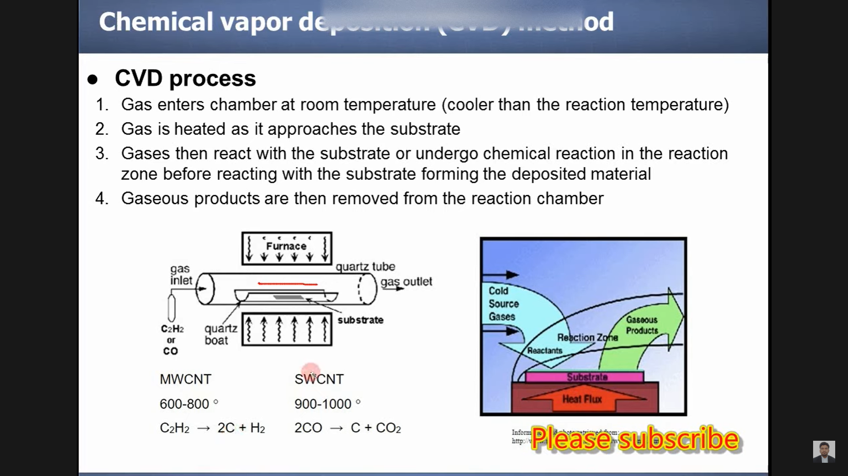

Slide 37
The simplest method to produce nanoparticles is by heating the desired material in a furnance containing the desired material.
Large amounts of CNTs can be
formed by catalytic CVD of
acetylene over Cobalt and iron
catalysts supported on silica or
zeolite. In this method gases like
CH₄ and C₂H₆are cracked under
the pressure of 10⁴ Pa in presence
of catalyst like Fe, Co, NI, Pt .
Catalyst plays very important role
in formation of carbon nanotubes.
Both MWNT and SWNT can be obtained by this method. SWNT can be produced at 600-1150⁰C and MWNT are produced at low temperature of 300-800⁰C.

Slide 38
Electrical Conductivity
Strength and Elasticity
Thermal Conductivity
High aspect ratio and Field emission

Slide 39
The conductivity of CNT have been found to be function of their chirality, degree of twist as well as diameter. CNTs can be either metallic or semi conductor. The resistivity of single walled nanotubes ropes was of the order of 10⁻⁴ ohm-cm at 27°C. This means they are the most conductive carbon fiber known. The current density that was possible to achieve was 10⁹ A/cm² (while copper burn at 10⁶ A/cm² ) It has been reported that SWNT may contain some defects. This defects allow the SWNT to act as transistors, rectifying diodes. It has also been reported that single wall nanotubes can route electrical speed up to 10 GHz.

Slide 40
CNTs are expected to be ultimate high strength fiber. Single walled nanotubes are stiffer than steel and are resistant to damage from physical forces. Pressing on the tip of nanotubes will cause it to bend without damage to the tip. This property make CNTs very useful as probe tip for high resolution scanning probe microscopy. The current Young’s modulus value for single walled nanotubes is about 1 teraPascal but this value is highly disputed and a value as high as 1.8 TPa(tera Pascal). Young modulus depend on size and chirality of single walled nano tube.

Slide 41
CNTs have been shown to exhibit superconductivity below 20°K. Preliminary experiments and simulation studies on thermal property of CNT show very high thermal conductivity. It is expected therefore nanotube reinforcement in polymeric materials may also significantly improve the thermal and thermo mechanical properties of composites. CNTs represent very high aspect ratio. The high aspect ratio means that lower loading of CNTs is needed than to other conductive material. CNTs have proven to be excellent additives to impart electric conductivity in plastics.

Slide 42

Biotechnology
Information Technology
Mechanical Engineering/ Robotics
Transportation
Advance Materials & Textiles
Nanomaterials
National Security & Defense
Energy & Environment
Medicine / Health
Food and Agriculture
Aerospace

Slide 43
Carbon nanotubes are stiff and hard like diamond but flexible due to this they find several mechanical application.
Cutting tools made up of Nano crystalline materials such as tungsten carbide, titanium carbide are more wear resistant than convectional counter parts. They find application in drill, helmets, bullet proof cloth, etc.
At present fastest known oscillators are made up of nanotubes. Nanotubes develop material which are slicker than Teflon and also waterproof.
Membrane made up of CNTs allow liquid flow up to five times faster than conventional membrane.
Nano sphere of inorganic material can act as nano sized ball bearing. They also find application in high performance engine and drivers.

Slide 44

Nanomaterials are of the size 10⁻⁹. Hence the are smaller or comparable than single cell, virus, protein. Thus materials can freely move through tissue or bind to biological system. Endothelium layers are porous thus nano particle can penetrate through them and can be used as medicine or carrier. Many of magnetic nano particles have been used in cancer therapy like hyperthermia. Magnetic particle are also used for tagging cancer cells, bacteria red blood cells. They are also used in contrast enhancing agent in MRI. Thus they can used to detect brain tumor liver tumor and lymph nodes.

Slide 45



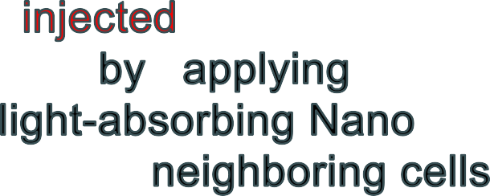















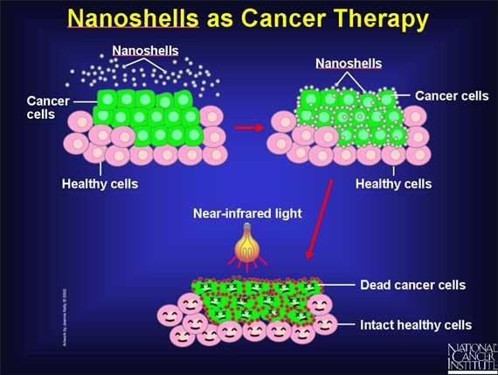

Slide 46
Nano porous aluminum silicates(zeolites) are used in water treatment. Nano porous membrane with definite and desired pore are used as nano filters for dust and impurities from air and water.
Gold nano particles are used for degradation of toilet odor.
Nano ZnO is used for degradation of chlorinated phenol.
Nano photo catalyst are used for degradation of pollutant present in waste water.
Nanomaterials are used as catalysts to react with such noxious and toxic gases as carbon monoxide and nitrogen oxide in automobile catalytic converters and power generation equipment to prevent environmental pollution arising from burning gasoline and coal.

Slide 47

Electronic miniaturization has been the true driving force for nanotechnology research and applications.
Nano electronics can help us to improve the capabilities of electronics devices while we reduce their weight and power consumption.
Nanotechnologies are therefore expected to enable the production of smaller, cheaper devices with increasing efficiency. CNTs are being used for low voltage field emission displays.
Nano crystalline nickel and metal hydrides are envisioned to require less frequent recharging and last longer.
Nano scale fabricated magnetic material find application in data storage.
Nanowires for junctionless transistors.

Slide 48
Importance of Nanomaterials in various applications-
These materials have created a high interest in recent years by virtue of their unusual mechanical, electrical, optical and magnetic properties. Some examples are given below:
Nano-phase ceramics are of particular interest because they are more ductile at
elevated temperatures as compared to the coarse-grained ceramics.
Nano-structured semiconductors are known to show various non-linear optical properties. Semiconductor Q-particles also show quantum confinement effects which may lead to special properties, like the luminescence in silicon powders and silicon germanium quantum dots as infrared optoelectronic devices. Nanostructured semiconductors are used as window layers in solar cells.
Nano-sized metallic powders have been used for the production of gas tight materials, dense parts and porous coatings. Cold welding properties combined with the ductility make them suitable for metal-metal bonding especially in the electronic industry.
Single nano-sized magnetic particles are mono-domains and one expects that also in magnetic nanophase materials the grains correspond with domains, while boundaries on the contrary to disordered walls. Very small particles have special atomic structures with discrete electronic states, which give rise to special properties in addition to the super-paramagnetism behaviour. Magnetic nanocomposites have been used for mechanical force transfer (ferrofluids), for high density information storage and magnetic refrigeration.

Slide 49
Nano-structured metal clusters and colloids of mono- or plurimetallic
Ccomposition have a special impact in catalytic applications. They may serve as precursors for new type of heterogeneous catalysts (Cortex-catalysts) and have been shown to offer substantial advantages concerning activity, selectivity and lifetime in chemical
transformations and electro-catalysis (fuel cells). Enantioselective catalysis was also achieved using chiral modifiers on the surface of nanoscale metal particles.
Nano-structured metal-oxide thin films are receiving a growing attention for the realization of gas sensors (NOx, CO, CO2, CH4 and aromatic hydrocarbons) with enhanced sensitivity and selectivity. Nanostructured metal-oxide (MnO2) finds application for rechargeable batteries for cars or consumer goods. Nano-crystalline silicon films for highly transparent contacts in thin film solar cell and nano-structured titanium oxide porous films for its high transmission and significant surface area enhancement leading to strong absorption in dye sensitized solar cells.
Polymer based composites with a high content of inorganic particles leading to a high dielectric constant are interesting materials for photonic band gap structure.

Slide 50
Nano-Aluminium is used as solid fuel in rocket propulsion.
Sun-screen lotions containing nano-TiO2 provide enhanced sun protection factor (SPF) by blocking UV radiation while eliminating stickiness.

Slide 51
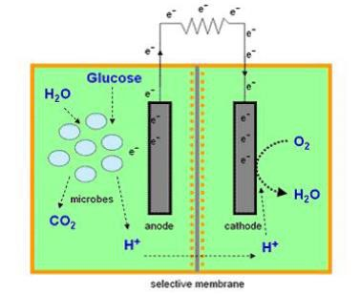
Carbon nanotubes- Microbial fuel cell
Microbial fuel cell is a device in which bacteria consume water-soluble waste such as sugar, starch and alcohols and produces electricity plus clean water. This technology will make it possible to generate electricity while treating domestic or industrial wastewater.
Microbial fuel cell can turn different carbohydrates and complex substrates present in wastewaters into a source of electricity.
The efficient electron transfer between the microorganism and the anode of the microbial fuel cell plays a major role in the performance of the fuel cell. The organic molecules present in the wastewater posses a certain amount of chemical energy, which is released when converting them to simpler molecules like CO2. The microbial fuel cell is thus a device that converts the chemical energy present in water-soluble waste into electrical energy by the catalytic reaction of microorganisms.

Slide 52
Carbon nanotubes (CNTs) have chemical stability, good mechanical properties and high surface area, making them ideal for the design of sensors and provide very high surface area due to its structural network. Since carbon nanotubes are also suitable supports for cell growth, electrodes of microbial fuel cells can be built using of CNT.
Due to three-dimensional architectures and enlarged electrode surface area for the entry of growth medium, bacteria can grow and proliferate and get immobilized.
Multi walled CNT scaffolds could offer self-supported structure with large surface area through which hydrogen producing bacteria (e.g., E. coli) can eventually grow and proliferate. Also, CNTs and MWCNTs have been reported to be biocompatible for different eukaryotic cells. The efficient proliferation of hydrogen producing bacteria throughout an electron conducting scaffold of CNT can form the basis for the potential application as electrodes in MFCs leading to efficient performance.

Slide 53
Disadvantages of Nanomaterials
Instability of the particles - Retaining the active metal nanoparticles is highly challenging, as the kinetics associated with nanomaterials is rapid. In order to retain nanosize of particles, they are encapsulated in some other matrix. Nanomaterials are thermodynamically metastable and lie in the region of high-energy local-minima. Hence, they are prone to attack and undergo transformation. These include poor corrosion resistance, high solubility, and phase change of nanomaterials. This leads to deterioration in properties and retaining the structure becomes challenging.
Fine metal particles act as strong explosives owing to their high surface area coming in direct contact with oxygen. Their exothermic combustion can easily cause explosion.
Impurity - Because nanoparticles are highly reactive, they inherently interact with impurities as well. In addition, encapsulation of nanoparticles becomes necessary when they are synthesized in a solution (chemical route). The stabilization of nanoparticles occurs because of a non-reactive species engulfing the reactive nano-entities. Thereby, these secondary impurities become a part of the synthesized nanoparticles, and synthesis of pure nanoparticles becomes highly difficult.

Slide 54
Formation of oxides, nitrides, etc can also get aggravated from the impure environment/ surrounding while synthesizing nanoparticles. Hence retaining high purity in nanoparticles can become a challenge hard to overcome.
Biologically harmful - Nanomaterials are usually considered harmful as they become transparent to the cell-dermis. Toxicity of nanomaterials also appears predominant owing to their high surface area and enhanced surface activity. Nanomaterials have shown to cause irritation, and have indicated to be carcinogenic. If inhaled, their low mass entraps them inside lungs, and in no way they can be expelled out of body. Their interaction with liver/blood could also prove to be harmful (though this aspect is still being debated on).
Difficulty in synthesis, isolation and application - It is extremely hard to retain the size of nanoparticles once they are synthesized in a solution. Hence, the nanomaterials have to be encapsulated in a bigger and stable molecule/material. Hence free nanoparticles are hard to be utilized in isolation, and they have to be interacted for intended use via secondary means of exposure. Grain growth is inherently present in nanomateirals during their processing. The finer grains tend to merge and become bigger and stable grains at high temperatures and times of processing.

Slide 56
(vi) Recycling and disposal - There are no hard-and-fast safe disposal policies evolved for nanomaterials. Issues of their toxicity are still under question, and results of exposure experiments are not available. Hence the uncertainty associated with affects of nanomaterials is yet to be assessed in order to develop their disposal policies.

