Slide 1
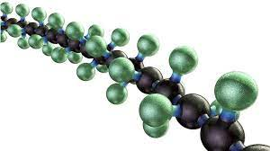

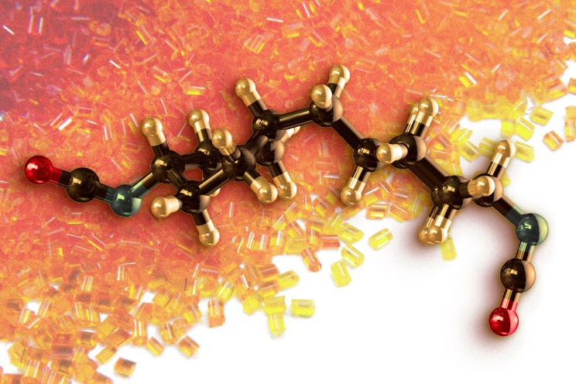
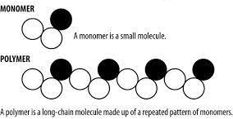
Polymer
By Dr. Deepali N. Kanekar
Assistant Professor Chemistry
Notes:
A polymer is a large molecule composed of repeating subunits called monomers.
These monomers are chemically bonded together to form a long chain or network structure. Polymers can be found in various forms, including natural substances like proteins, cellulose, and DNA, as well as synthetic materials such as plastics, rubber, and fibers.

Slide 2
Q. What distinguishes polymers from other types of compounds?
ANS: THEIR extremely large size of the molecules. (Which measured as Molecular weight)
Polymers have average molecular weights ranging from tens of thousands up to several million atomic mass units.
It is to this vast molecular size that polymers owe their unique properties, and
it is the reason that the German chemist Hermann Staudinger first referred to them in 1922 as macromolecules, or “giant molecules.”

Slide 3
What is the need to study polymer?
Polymers can be found in a variety of natural and synthetic materials and play a crucial role in our everyday lives.
Natural polymers (derived from biological sources) like proteins, nucleic acids like DNA and RNA.
Synthetic polymers: used for numerous applications due to their versatility, durability, and customizable properties. Common synthetic polymers include polyethylene, polypropylene, polyvinyl chloride (PVC), polystyrene, and polyethylene terephthalate (PET). These polymers are used in various industries, including packaging, textiles, construction, automotive, electronics, and more.

Slide 4
How we can classify polymer?

Slide 5
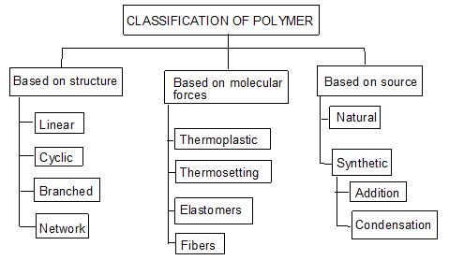

Slide 6
Classification based on source
Naturally occurring Polymers: These occur in plants and animals and are very essential for life e.g. starch, cellulose, amino acids, etc.
Synthetic polymers: These polymers are prepared in laboratory they are man made polymers e.g. plastics, synthetic rubbers, etc.
Semi synthetic polymers: These are derived from naturally occurring polymers by chemical modification. e.g. vulcanized rubber, Cuprammonium silk and Cuprammonium rayon, etc.

Slide 7
Classification of Polymers as below
Nature of Repeat Units
Structural Characteristics
Stereochemistry
Physical properties
Molecular (Functional Group) Classification
Polymerization Process
All highlight certain aspect or property of the polymer.

Slide 8
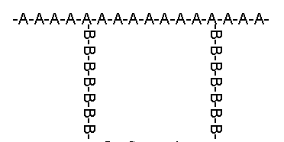
On the basis of Nature of Repeat Units
Homopolymer- A-A-A-A-A-A-A-A-A-A-A-
(identical repeat units)
Copolymer - Different repeat units
Alternating Copolymer- A-B-A-B-A-B-A-B-A-B
Block Copolymer - AAAAAAAA-BBBBBBBBB
Random Copolymer- AA-B-A-B-B-A-A-A-B-B-A
Graft Copolymer-
Notes:
In polymer chemistry, graft polymers are segmented copolymers with a linear backbone of one composite and randomly distributed branches of another composite.

Slide 9
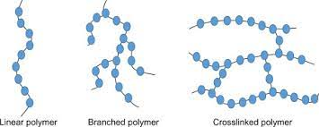
The structure of macromolecules
Polymers are manufactured from low-molecular-weight compounds called monomers by polymerization reactions, in which large numbers of monomer molecules are linked together. Depending on the structure of the monomer or monomers and on the polymerization method employed, polymer molecules may exhibit a variety of architectures.
Linear, branched, and network

Slide 10
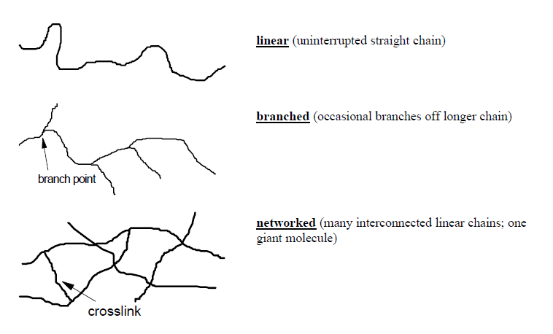
Structural characteristics-closely related to materials properties

Slide 11
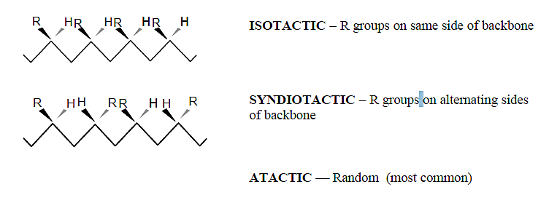
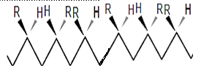
Stereochemistry of Linkages
Polymers can classified on the basis of configuration of macromolecule known as tacticity.
Notes:
The stereoregularity affects properties like crystallinity, melting point, and mechanical strength. Isotactic and syndiotactic polymers tend to have higher melting points and greater crystallinity, leading to improved stiffness and strength compared to atactic polymers.

Slide 12
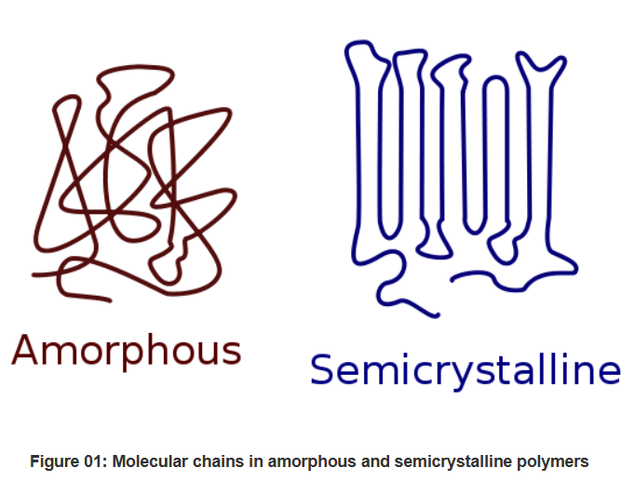
Classification of Polymers : On the basis of Physical Properties
Amorphous Polymers: exhibit a random arrangement of polymer chains, transparent, low chemical resistance, have lower melting points, and are generally more flexible. Eg. polystyrene and amorphous polyethylene terephthalate (APET).
Semi-Crystalline Polymers: have regions of ordered, crystalline structure interspersed with amorphous regions. High melting points, greater stiffness, opaque and better dimensional stability eg. polyethylene (PE), polypropylene (PP), and polyamide (nylon).

Slide 13
Elastomers: Elastomers are polymers that exhibit high elasticity and can return to their original shape after being stretched or deformed. They have a low modulus of elasticity and are characterized by their ability to undergo large deformations. Eg. styrene-butadiene rubber (SBR) and polyurethane.
Thermoplastics: Thermoplastic polymers can be melted and remoulded multiple times without undergoing significant degradation. They have a linear or branched polymer structure and can be processed using various techniques like injection moulding, extrusion, and blow moulding. Eg. polyethylene (PE), polypropylene (PP), and polyvinyl chloride (PVC).
Thermosetting Polymers: These polymers undergo a chemical cross-linking reaction during curing, resulting in a rigid and infusible network structure. Once thermosetting polymers are cured, they cannot be melted or remoulded. Eg. epoxy resins, phenolic resins, and melamine formaldehyde.

Slide 14
Conducting Polymers: have ability to conduct electricity. They possess a conjugated molecular structure that allows for the movement of charge carriers (electrons or holes). Conducting polymers find applications in electronics, sensors, and energy storage devices. Eg. polyaniline, polypyrrole, and poly(3,4-ethylenedioxythiophene) (PEDOT).
Barrier Polymers: Barrier polymers have low permeability to gases, liquids, or vapours, Used in packaging applications to prevent the transmission of oxygen, moisture, or other substances. Eg. polyethylene terephthalate (PET) and ethylene vinyl alcohol (EVOH).

Slide 15
Molecular (Functional Group) Classification
Polymers are conveniently represented by the repeating chain formula, which shows the arrangement of bonds and atoms.
The repeat units contain functional groups that describe the polymer.
This terminology emphasizes the functional groups involved in the synthesis of the polymer from its monomers, although the usage is seldom exact.

Slide 16
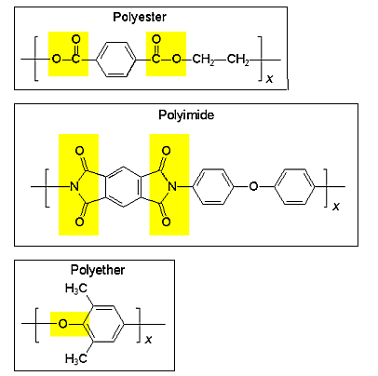

Examples
A polymer is often named according to the monomer that was used to form it. This is why the polymer consisting of only a long chain of CH₂ groups is called polyethylene, not polymethylene.

Slide 17
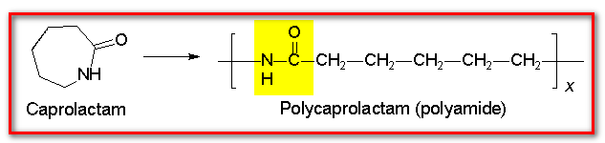
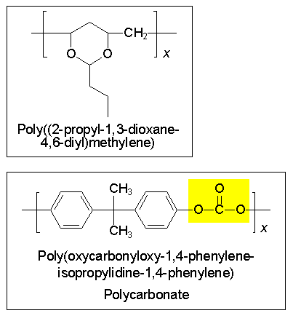
A polyamide containing 6 carbons is known as polycaprolactam.
Of course, there are systematic rules for polymer nomenclature set forth by the IUPAC, but for polymers with any complexity, the names are too cumbersome for common usage. IUPAC Polymer Nomenclature: see examples
Pure Appl. Chem. 1976, 48, 373.
Macromolecules 1973, 6, 149

Slide 18
Polymer Families
Polyolefins: made from olefin (alkene) monomers
Polyesters, Amides, Urethanes, etc.: monomers linked by ester, amide, urethane or other functional groups
Natural Polymers: Polysaccharides, DNA, proteins

Slide 19
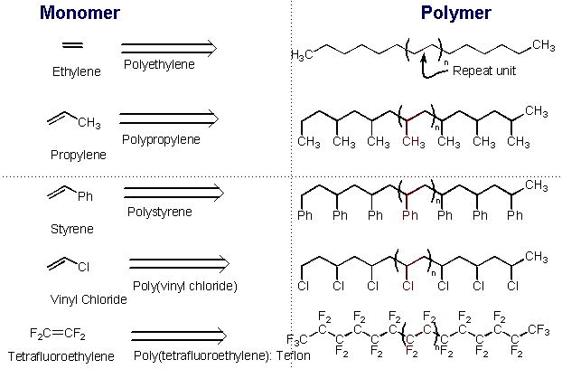
Common Polyolefins

Slide 20
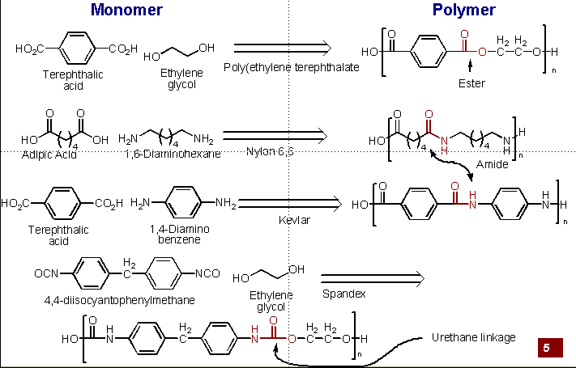
Polyesters, Amides, and Urethanes
Notes:
PTPH: CLOTHING AND CONTAINER
Kevlar: Para-armid fibre (aromatic polyamide)
Spandex: generic name elastane or Lycra® (a brand name), is a synthetic fiber known for its exceptional elasticity and stretchability. It is a segmented polyurethane polymer composed of long chains of alternating rigid and flexible segments.

Slide 21
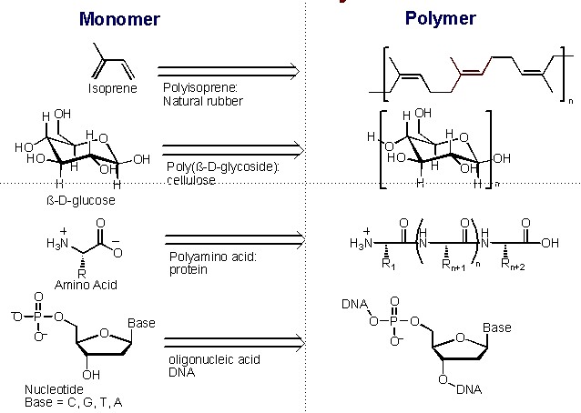
Natural Polymers

Slide 22
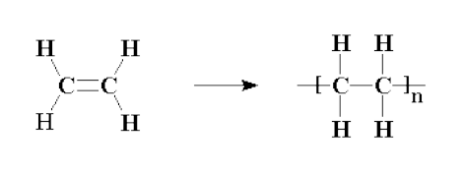
Q. What is polymerization? What are the common types of polymerization?
Polymerization is the process of chemically joining monomer units to form a polymer chain. There are different types of polymerization processes, each characterized by the mechanism and conditions under which the monomers are polymerized. Here are some common types of polymerization:
Addition Polymerization: This type of polymerization occurs when unsaturated monomers, such as alkenes, undergo a chain reaction to form a polymer. The monomers add to the growing polymer chain without the elimination of any byproducts. Examples of addition polymerization include the formation of polyethylene, polypropylene, and polystyrene.

Slide 23
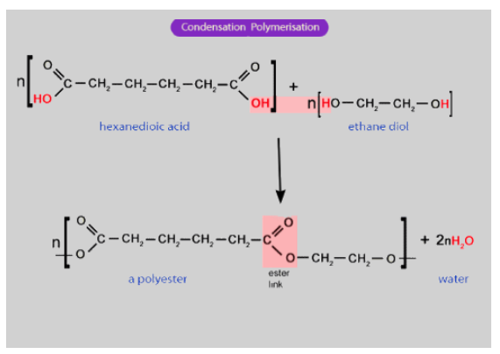
2. Condensation Polymerization: In condensation polymerization, monomers join together, releasing a small molecule like water, alcohol, or carbon dioxide as a byproduct. This reaction occurs between monomers with two different functional groups, such as carboxylic acids and alcohols. Examples of condensation polymers include nylon, polyester, and polyurethane.

Slide 24
Difference between condensation and addition polymerisation:-
 | Condensation polymerisation |  | Addition polymerisation
(1) | It is also known as step growth | (1) | It is also known as chain growth
 | polymerisation |  | polymerization
(2) | It takes place in monomers having | (2) | It takes place only in monomers
 | reactive functional groups |  | having multiple bonds.
(3) | It takes place with elimination of | (3) | It takes place without elimination of
 | simple molecule like H₂O,NH₃,HCl |  | simple molecule.
 | etc.,
(4) | Repeat units of monomers are | (4) | Repeat units & monomers are same.
 | different
(5) | The polymer is formed in gradual | (5) | Reaction is fast and polymer is formed
 | steps |  | at once.
(6) | The molecular mass of polymer | (6) | There is very little change in the
 | increases throughout the reaction |  | molecular mass throughout the
 |  |  | reaction
(7) | Product obtained may be | (7) | Product obtained are thermoplastic
 | thermosetting/thermoplastic
(8) | E.g.:- Bakelite, polyester ,polyamides | (8) | E.g:-Polyethylene, PVC, poly styrene.
 | etc.,

Slide 25
Molecular Mass of Polymer
The molecular mass of polymer is an important property of polymer because many important properties are influenced by molecular mass. Polymers with higher molecular mass are tougher and more resistant. Their viscosities and softening temperature are also higher. Thus polymers with molecular mass are often required for particular purposes.
Molecular mass of polymer is not a fixed or constant value like organic compound. Their molecular mass is controlled by polymerization reaction, which in turn depend upon availability of functional group, charge carrier, life time of charge carriers. Because of random nature of growth process, the product of polymerization process is mixture of chains of different length.
Hence polymers are poly disperse mixture of various molecular mass polymers. Therefore molecular mass of polymers is average molecular mass.

Slide 26
Average molecular mass of polymers can be expressed in following ways
__
1. Number Average Molecular Mass (Mn)
2. Weight Average Molecular Mass (Mw)
3. Z-Average Molecular Mass (Mz)
4. Viscosity average Molecular Mass (Mv)

Slide 27
Methods for determining the molecular weights of polymer
A) Primary or Absolute methods, which are capable of determining molecular weights from first principles like colligative property measurements(Which gives Mn) , light scattering measurements (which gives Mw)
B) Secondary or relative methods, Which require calibration with samples of known molar mass. Examples Viscosity measurements which gives Mv.

Slide 28
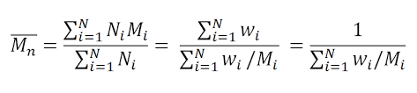
Number average Molecular Mass ( Mn)
In this number of molecules are involved in the molecular weight measurements.
Hence the molecular weight is obtained by colligative property measurements and
known as number average molecular weight.
Let us consider N1,N2, N3….. be the number of molecules of polymer in a sample solution.
And M1, M2, M3 …be the their molecular weight then Number average molecular weight
is given by
Polymer solution of polyethene | Number of molecules | Their molecular weight
Sample has | 100 N1 | 150 M1
 | 200 N2 | 200 M2
 | 300 N3 | 300 M3

Slide 29
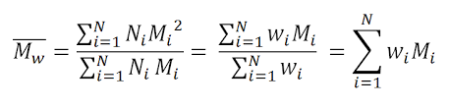
Weight Average molecular Weight
Let us consider N1,N2, N3….. be the number of molecules of polymer in a sample solution.
And M1, M2, M3 …be the their molecular weight
And W1, W2, W3 …be the their weight(mass) then Weight average molecular weight is given by
Polymer solution of polyethene | Molecular weight | Their weight
Sample has | 100 | 15g
 | 200 | 20g
 | 300 | 30g

Slide 30
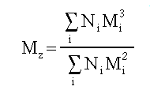
Z-average molecular Weight
Let us consider N1,N2, N3….. be the number of molecules of polymer in a sample solution.
And M1, M2, M3 …be the their molecular weight, then Z-average molecular weight is given by

Slide 31
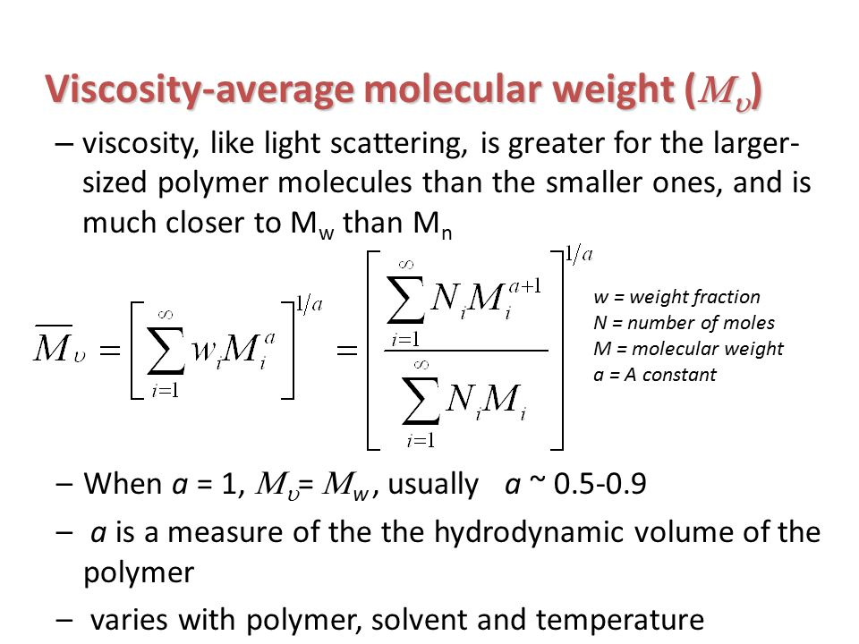

Slide 32
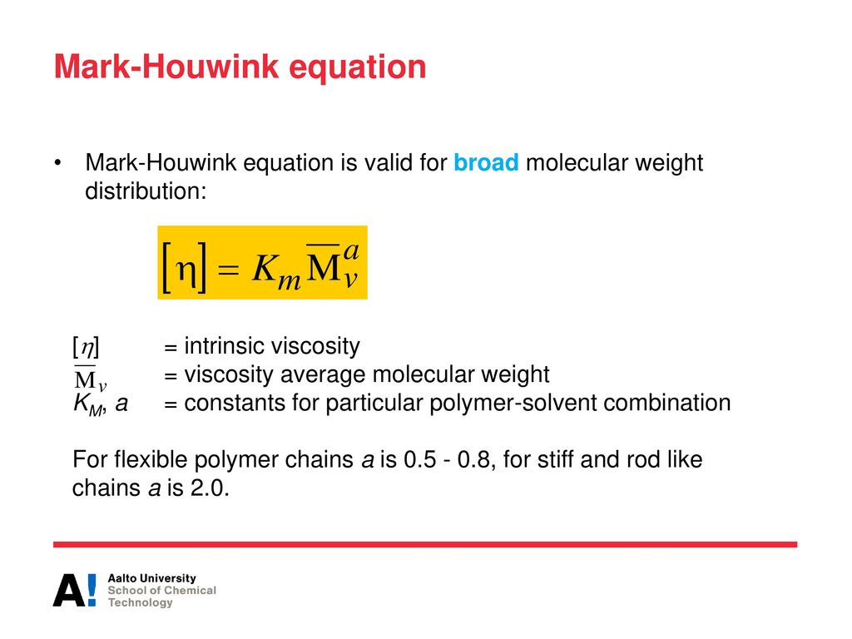
Viscosity Average molecular weight
By Mark Howick Equation

Slide 33
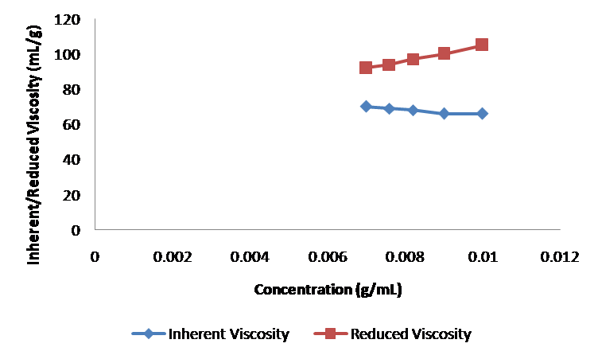

Slide 34
Compounding of Plastics
In order to impart certain definite properties to the finished products, resins are compounded with certain other substances. The process is called as compounding of plastics.

Slide 35
1. Binders or Resins
The product of polymerization is called resins and this forms the major portion of the body of plastics.
It is the binder, which holds the different constituents together.
Thermosetting resins are usually, supplied as linear – polymers of comparatively low molecular weight, because at this stage they are fusible and hence, mouldable.
The conversion of this fusible form into cross-linked infusible form takes place, during moulding itself, in presence of catalysts etc.
A binder may compose of 30-100%.
The binders used may be natural or synthetic or cellulose derivatives.

Slide 36
2. Fillers
Fillers are generally added to thermosetting plastics to increase elasticity and crack resistance.
Fillers improve thermal stability, strength, non combustibility, water resistance, electrical insulation properties & external appearance.
E.g.:- Mica(Hardness), cotton(Shock resistance) , carbon(electrical conductivity) black, graphite, BaSO4 etc. Asbestos ( Heat resistance)

Slide 37
3. Plasticizers
Plasticizers are substances added to enhance the plasticity of the material and to reduce the cracking on the surface.
Plasticizers are added to the plastics to increase the flexibility & toughness. Plasticizers also increase the flow property of the plastics.
Commonly used plasticizers are vegetable oils, camphor, esters of steric, oleic acid, tributyl phosphate, triphenyl phosphate etc.

Slide 38
4. Dyes and Pigments
These are added to impart the desired colour to the plastics and give decorative effect.
e.g.:-Inorganic Pigments: Lead chromate (yellow), ferro cyanide (blue)
Organic Pigments: Alizarin Red, Indigo Dye, Azo dyes.

Slide 39
5. Lubricants
Includes Oils, waxes and soaps.
They help in easy moulding and glossy finish to final product.
The lubricant prevent the plastic materials from sticking to the mould.

Slide 40
6. Catalysts
They are added to plastics to accelerate polymerizations reaction.
ZnCl2, CaO, ammonia, benzoyl peroxides

Slide 41
7. Stabilizers
They are added to improve thermal stability during processing. Eg. Polymers of vinyl chloride show a tendency to undergo decomposition at moulding temperatures. So during their moulding heat stabilizers are added.
i) Opaque moulding stabilizers: Salts of lead, like white lead, lead chromate, red lead, lead silicate etc.
Ii) Transparent Moulding stabilizers: Stearates of Lead, chromium and barium.

Slide 42
In addition small quantitates of antioxidants, antiseptics, fungicides, flame retardants etc. are added as ingredient of plastics.

Slide 43
Learning Outcome
Assign the stereochemistry of a polymer structure – (Atactic, Isotactic etc)
Assign compositional features- homo, copolymer etc
Assign chain architecture- linear, branched, dendrimer
Identify type of polymerisation – (Polypropylene, Polyamide)

Slide 44
Industrial Application of Polymer:

Slide 45
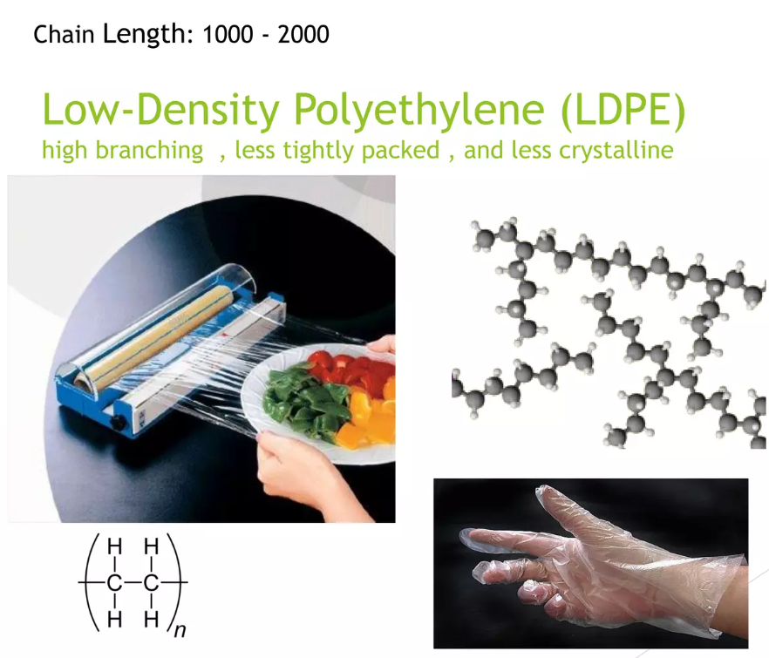
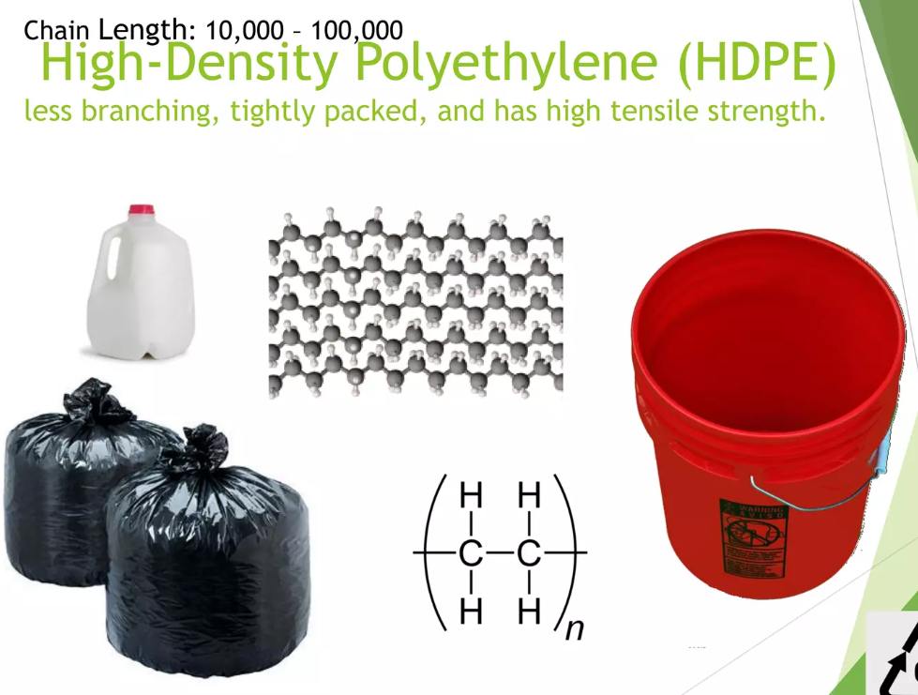

Slide 46
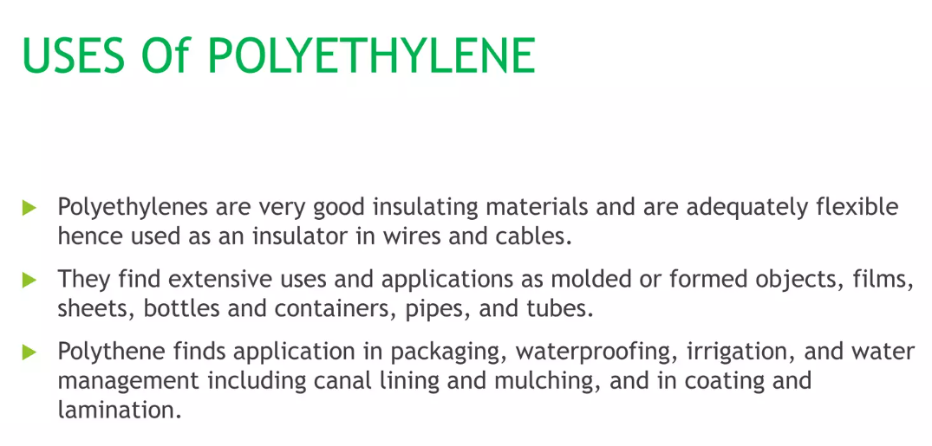

Slide 47
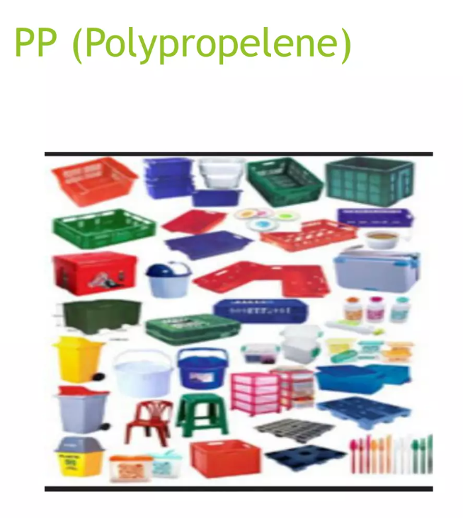
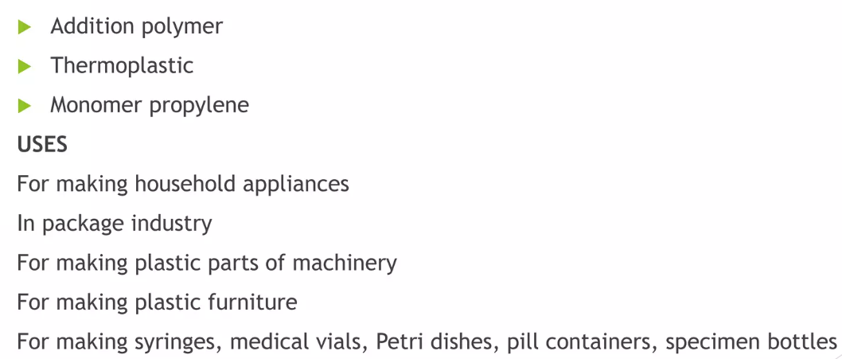

Slide 48
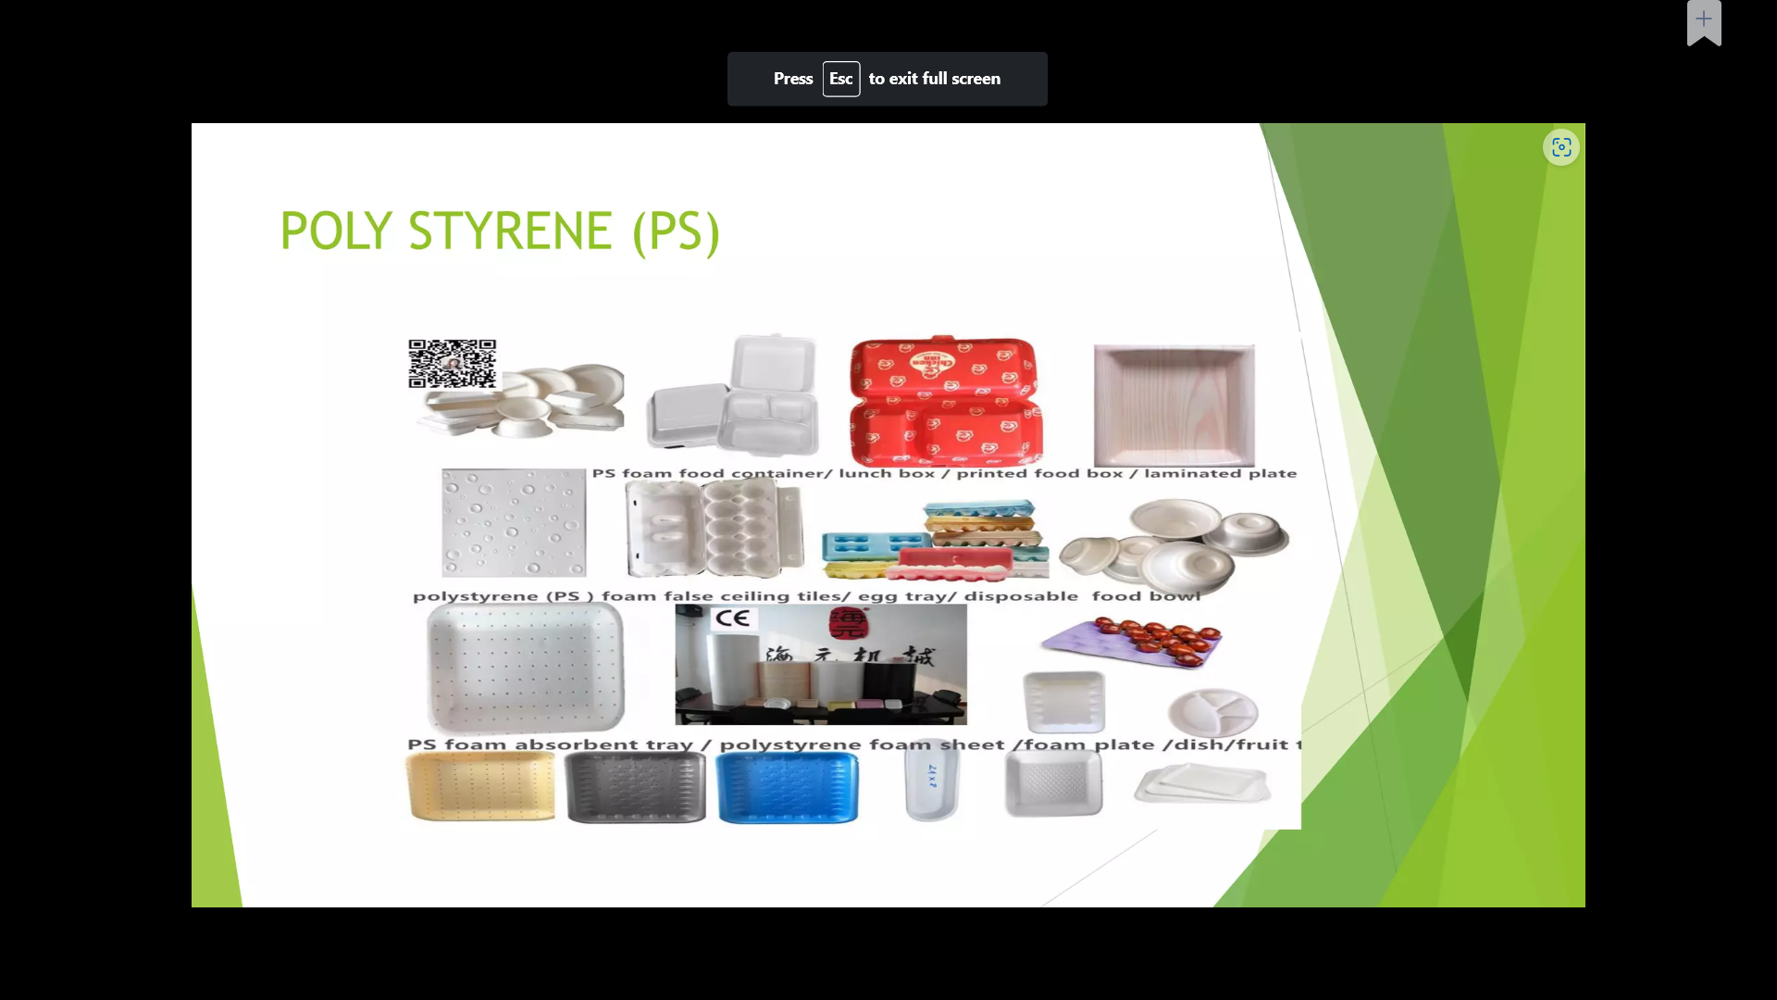
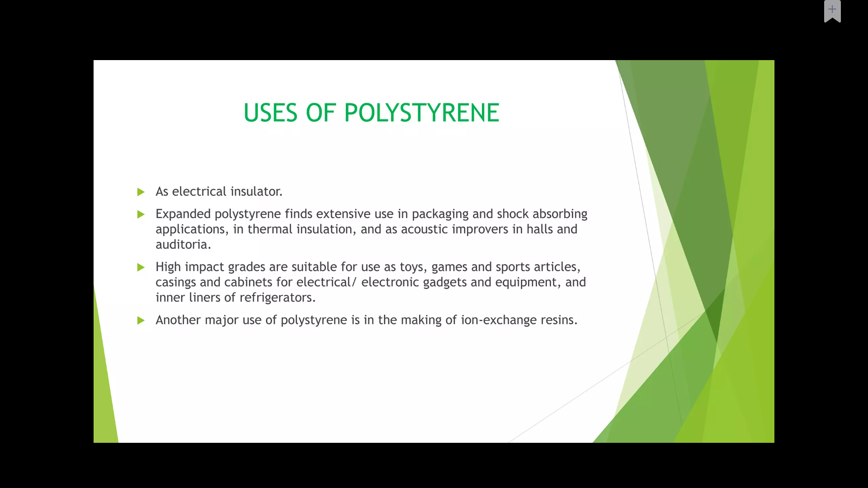
Polystyrene:
Amorphous and Transparent, Addition Polymer

Slide 49
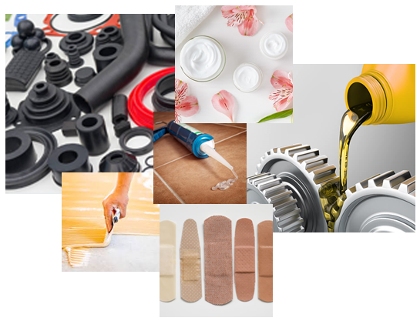
POLYBUTENE:
Polybutenes are used in lubricants, adhesives, sealants, coatings, rubber, oils, liquids, packaging films and a whole host of other applications.
Liquid polybutene is also used as a thinner in the manufacture of many hot-melt adhesives (otherwise known as hot glue) at a specific melting point.
In addition, it acts as a processing aid when added to sealants.
Polybutene is able to enhance the adhesive properties and flexibility of glues and sealants and is often used in conjunction with resins in such applications.
Notes:
Sealant is a substance used to block the passage of fluids through openings in materials, a type of mechanical seal.

Slide 50
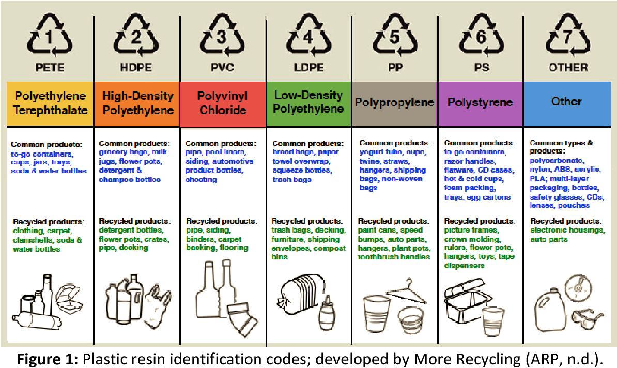

Slide 51
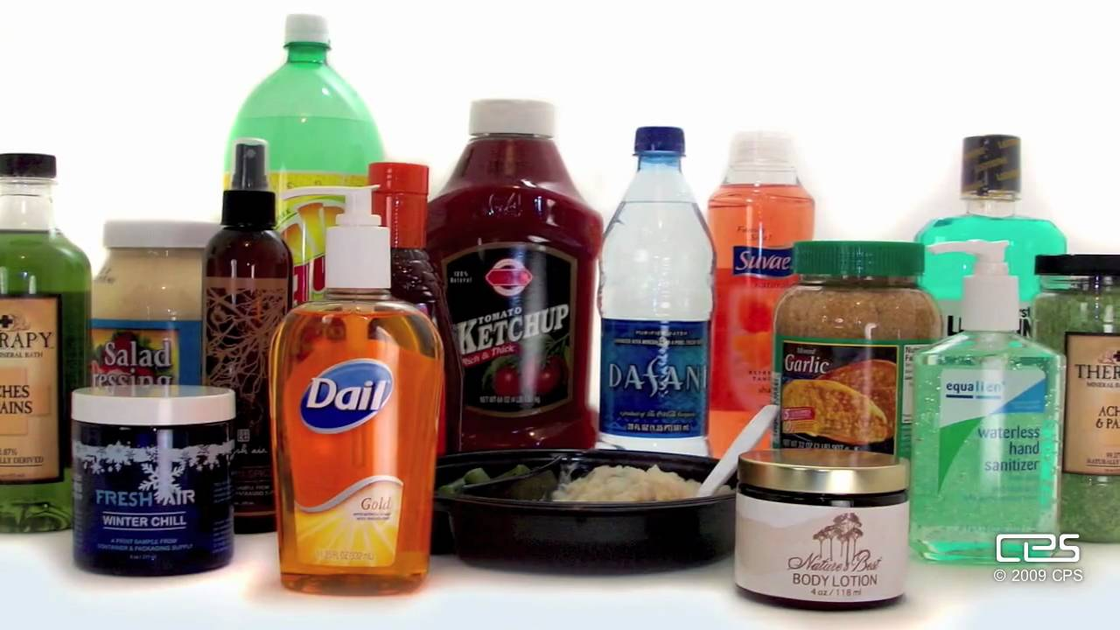
Polyethylene terephthalate
For the manufacturing of shopping bags, water bottles, videotapes.
For manufacturing of, containers and bags.
For the manufacturing of clothes and housing material.
For manufacturing of water bottles.
For manufacturing of microwaves containers.
For the manufacturing of carpets.
For the manufacturing of packaging films.

Slide 52
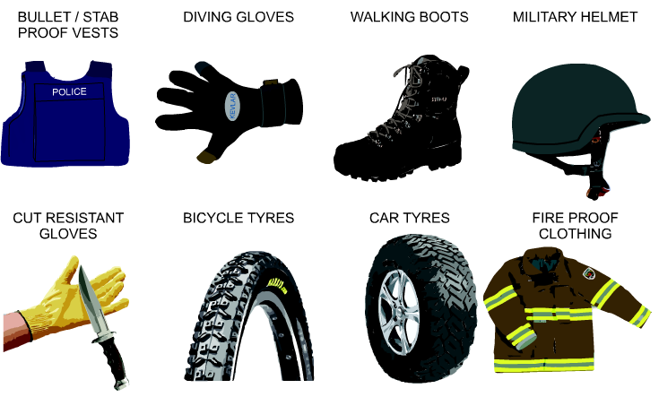
Kevlar:
Para-armid fibre (aromatic polyamide)
It is woven into textile materials and is extremely strong and lightweight, with resistance toward corrosion and heat. It is used in vast applications such as aerospace engineering (such as the body of the aircraft), body armor, bulletproof vests, car brakes, and boats.

Slide 53
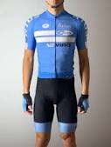
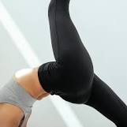
Spandex
It is woven into textile materials and is Spandex, Lycra, or elastane is a synthetic fiber known for its exceptional elasticity.
It is a polyether-polyurea copolymer that was invented in 1958 by chemist Joseph Shivers at DuPont.
Elastic material used in the fabrics of a summer cycling attire comprising a jersey, bib shorts and gloves.

Slide 54
FABRICATION OF PLASTICS
Notes:
https://semesters.in/introduction-and-applications-of-conducting-polymers-notes-pdf-ppt/

Slide 55
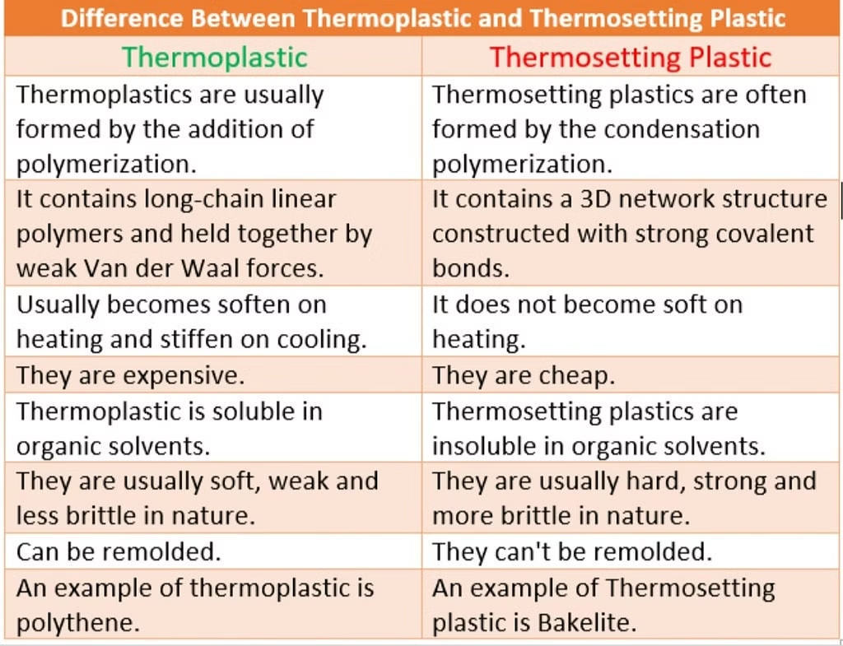

Slide 56
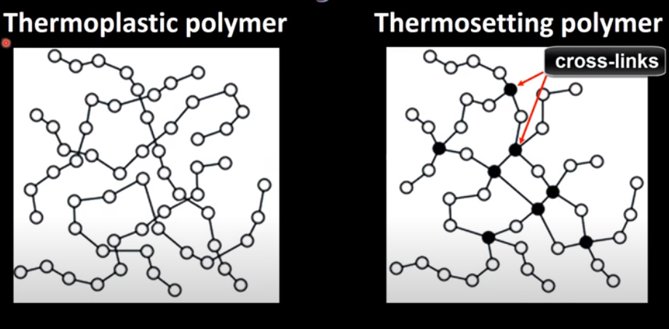

Slide 57
FABRICATION OF PLASTICS
Giving any desired shape to the plastics (granules or powders) by using mould under the application of heat and pressure.
A proper method is to be selected depending on the shape and type of resin used.
Methods involves partial melting of resinous mass by heating.
In case of thermo-plasts molten resin is introduced in die/mould and desired shape could be achieved by compression and further cooling.
In case of thermo-sets partially polymerized mass or raw materials are introduced in the die/mould, which further cured at high temperature in the mould itself to achieve desired shape.
In case of thermoplasts, curing is done at room temperature (low temperature)
2. In case of thermosets, curing is done at high temperature to obtain desired cross-linking

Slide 58
TYPES OF FABRICATION
[I} Compression Molding (Suitable for Thermosets / Thermoplasts)
[II] Injection Molding (Suitable for Thermoplasts)
[III] Transfer Molding (Suitable for Thermosets)
[IV] Extrusion Molding (Suitable for Thermoplasts)

Slide 59
COMPRESSION MOULDING
Common and oldest method for molding thermosetting / thermoplastic materials
Compression of raw materials or soften resinous mass is done in the mould /die under heat and pressure

Slide 60
COMPRESSION MOULDING
Predetermined quantity of raw materials is introduced carefully in the mould, further compressed by hydraulic pressure (2000 to 10000 psi)
Molten or soften resinous mass gets filled in the cavity of mould.
Curing is done by heating (Thermosetting) or by cooling (Thermoplastics)
Finally moulded article is separated from the mould by opening the mould apart.
Applications : Electric switch boxes, Ash trays, cabinets for radio, television, computers etc.

Slide 61
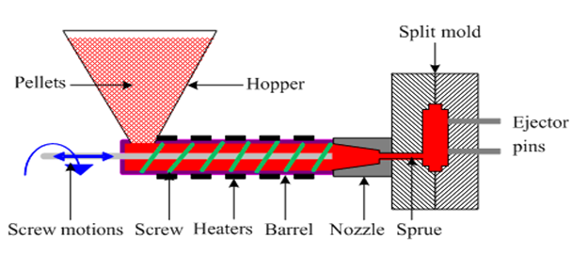
INJECTION MOULDING

Slide 62
INJECTION MOULDING
This method is especially used for thermoplastic materials
Powder or granular resin is heated in a cylinder and injected at a controlled rate in a mould with the help of piston plunger or screw.
Piston plunger or screw is used to force the material in mould.
Pressure up to 2000 kg/cm2 (100 psi) is used
Once the article is formed mould is cooled and half mould is opened to remove the finished article.
Disadvantage of the method is formation of air bubbles or cavities in the articles
Applications: Smaller but large volume articles such as, pen caps, bottle caps, cups, containers, mechanical parts

Slide 63
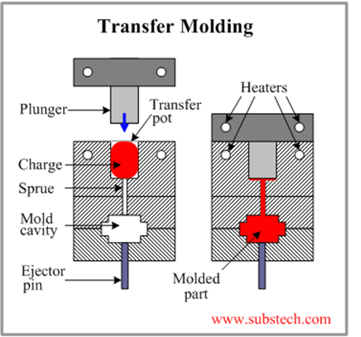
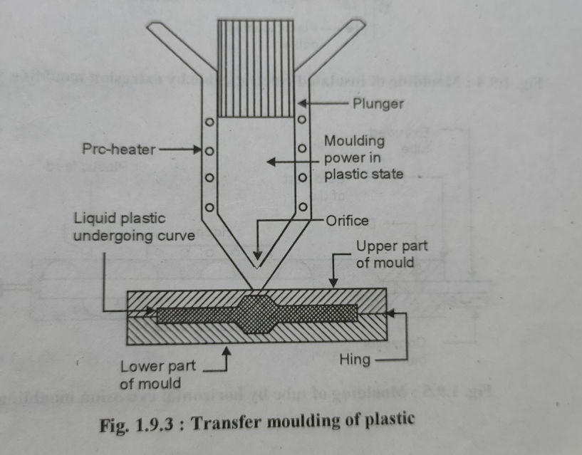
TRANSFER MOULDING
OR
Fig : Schematic diagram of Transfer molding.

Slide 64
TRANSFER MOULDING
The method combines features of both Compression Molding (hydraulic pressing of molding materials - thermosets) and Injection Molding (ram-plunger and filling the mold through a sprue).
The method is used especially for molding thermosetting resins (thermosets)
Products with relatively intricate designs could be fabricated with this method
Powdered raw materials are heated at certain low temperature to soften and then introduced through an orifice or sprue in the mould
Then it is cured in the mould at high temperature for certain time
Finally the moulded article is removed by separation of mould
Advantages:
Articles with intricate shapes could be designed
Aerospace and automobile parts, car body, helmets
The articles produced are blister free
Fine wires and glass fibers can be inserted in the mould
Even thick pieces can be cured completely and uniformly

Slide 65
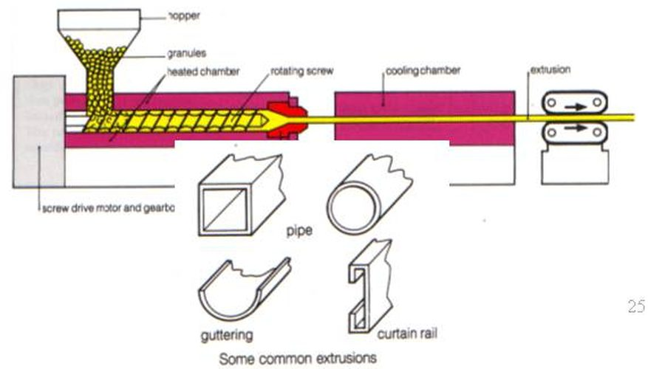
Extrusion Molding

Slide 66
Extrusion Moulding
Whenever continuous molding of material like wires, cables, and sheets is required extrusion molding is used. The thermoplastic materials are molded by this method. They undergo continuous molding to form articles of uniform cross section. In this method, the thermoplastic material are heated to plastic condition and pushed by means of screw conveyor in to a mould cavity having required outer shape of articles to be manufactured. Here the plastic mass gets cooled due to atmospheric exposure. A long conveyor carries away the cooled products continuously.

Slide 67
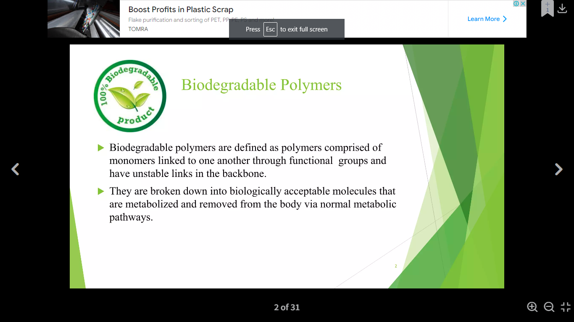
BIODEGRADBALE POLYMER
By Dr. Deepali N. Kanekar

Slide 68
Biodegradable Polymer
Biodegradable polymers are polymers in which monomers are joined to one another by functional group linkage and has unstable link in backbone.
They are broken down to biologically accepted molecules that are metabolized and removed from the body via normal metabolic pathway.

Slide 69
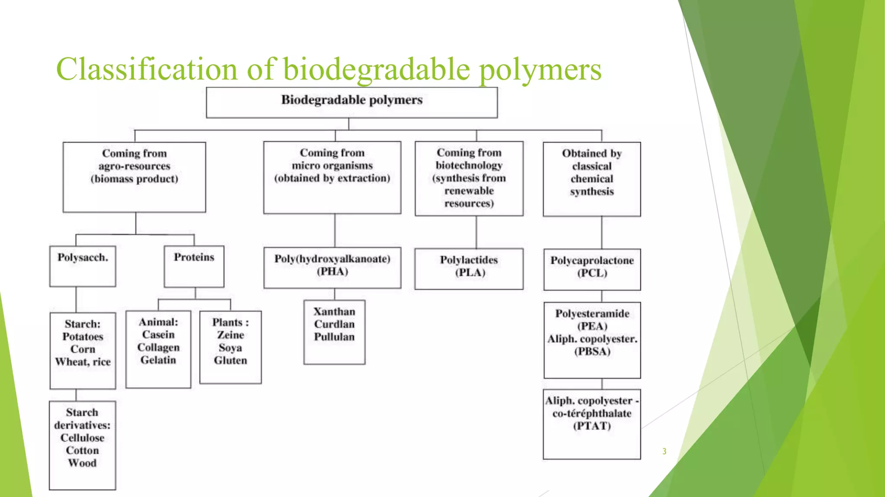

Slide 70
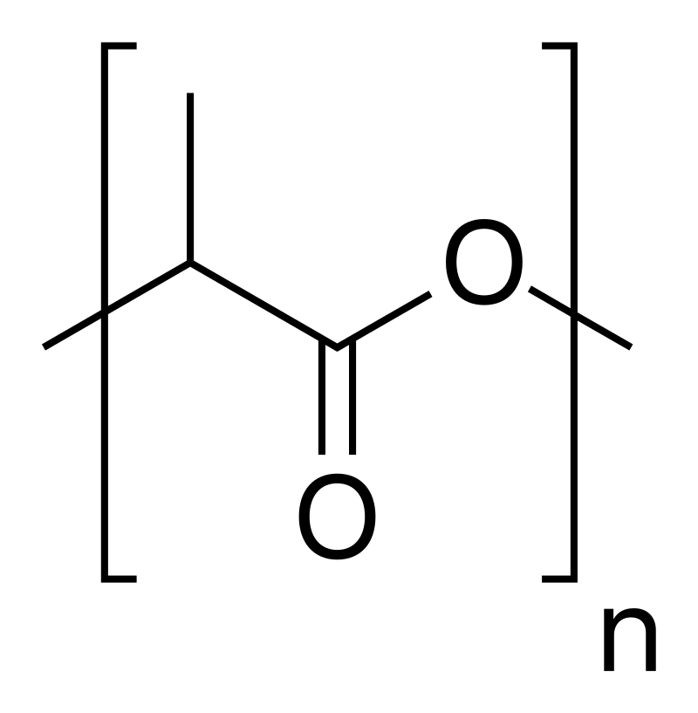
Biodegradable polymers-Polylactic acid
Polylactic acid, also known as poly(lactic acid) or polylactide (abbreviation PLA) is a thermoplastic polyester with backbone formula (C3H4O2)n or [–C(CH3)HC(=O)O–]n,
formally obtained by condensation of lactic acid C(CH3)(OH)HCOOH with loss of water (hence its name).
It can also be prepared by ring-opening polymerization of lactide [–C(CH3)HC(=O)O–]2, the cyclic dimer of the basic repeating unit.

Slide 71
Synthesis
The monomer is typically made from renewable resources such as from corn, cassava, sugarcane or sugar beet pulp.
Lactic acid is produced from bacterial fermentation of sugarcane, which further oligomerized and then catalytically dimerized to make the lactide monomer.
High MW PLA is produced from the lactide monomer by ring opening polymerization using a stannous octonate catalyst.
Several industrial routes afford usable (i.e. high molecular weight) PLA. Two main monomers are used: lactic acid, and the cyclic di-ester, lactide. The most common route to PLA is the ring-opening polymerization of lactide with various metal catalysts (typically tin octoate) in solution or as a suspension. The metal-catalyzed reaction tends to cause racemization of the PLA, reducing its stereoregularity compared to the starting material (usually corn starch).

Slide 72
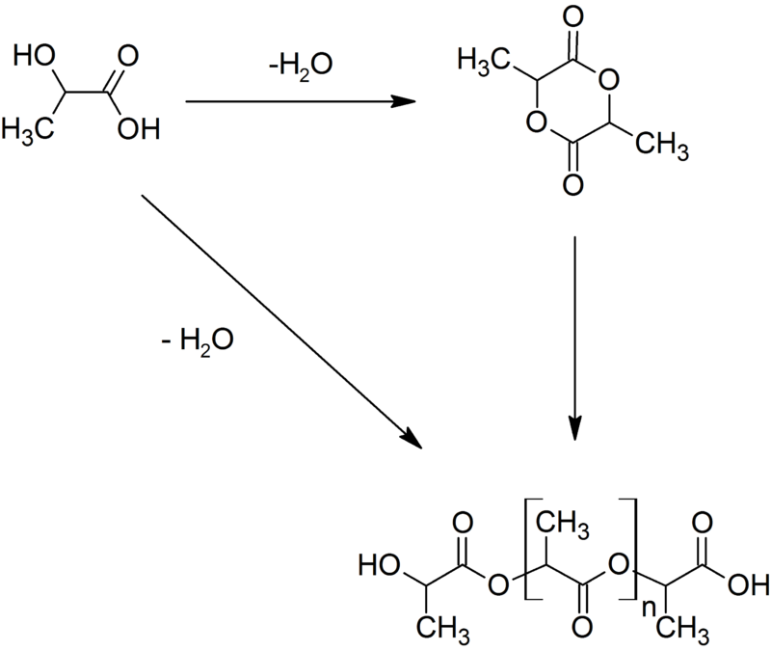

Slide 73
Biodegradation:
It is process of converting polymer material into harmless, simple and gaseous products by the action of enzymes, micro-organism and water

Slide 74
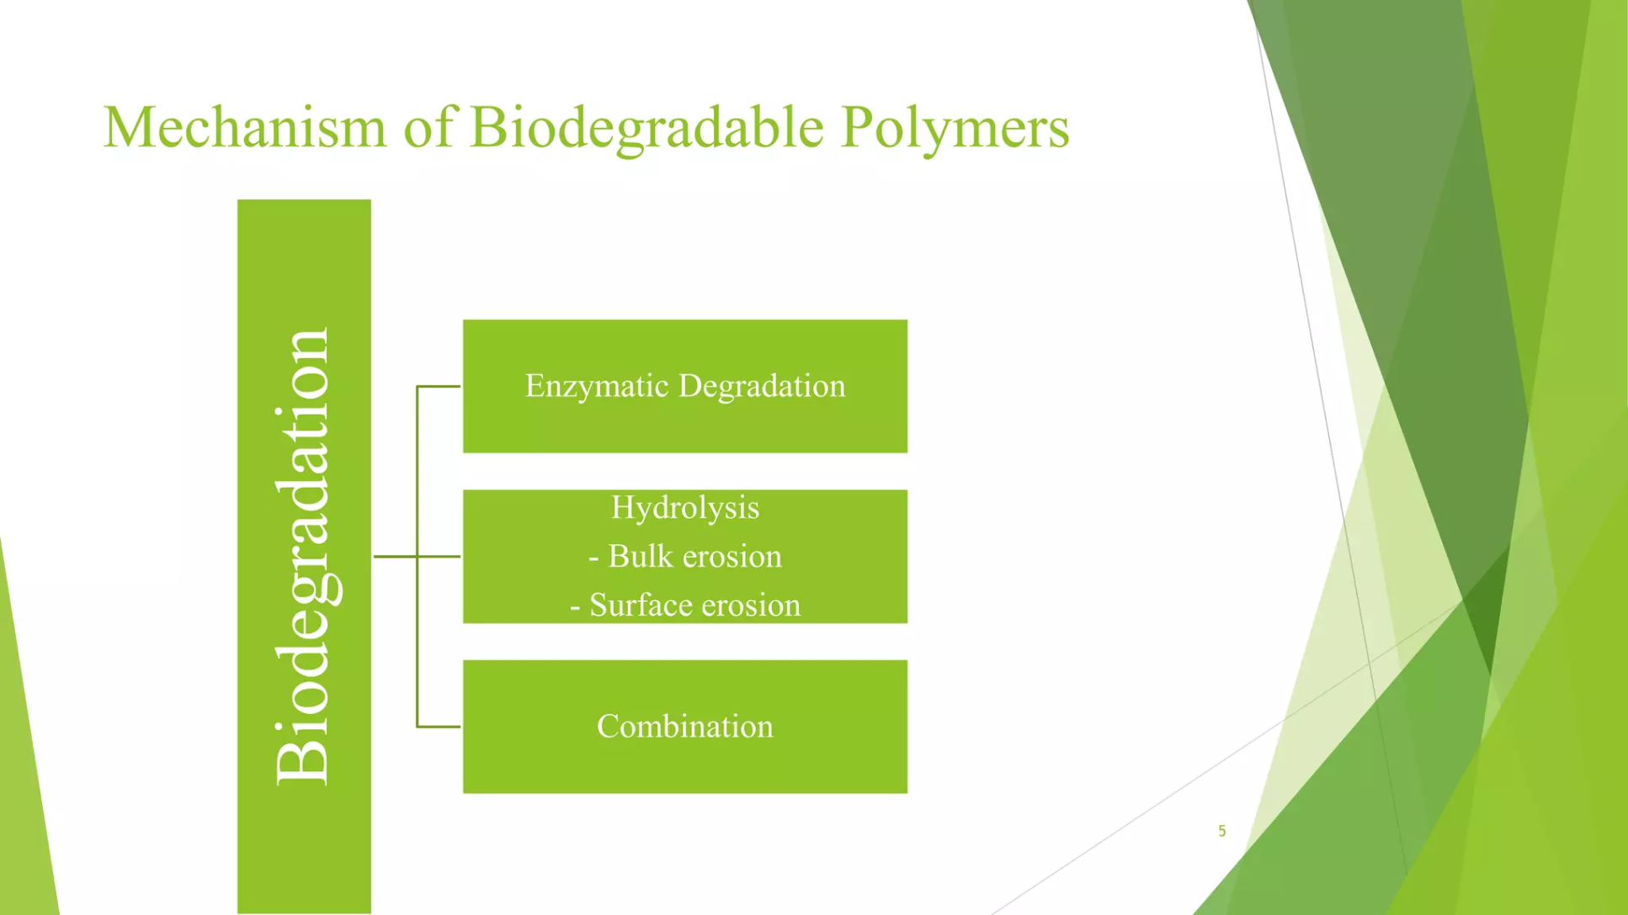
Notes:
In bulk erosion, mass loss occurs throughout the material following polymer hydration; water penetrates the polymer at a faster rate than it is broken down.
In surface erosion, degradation reactions are limited to the surface of the polymer material or occur at a significantly higher rate relative to diffusion rate of water into the bulk.

