Slide 1
Reaction Mechanism
Dr. Druman Ramesh Utekar

Slide 2
Aldol condensation
Aldol condensation is an organic reaction where two carbonyl compounds, typically aldehydes or ketones with an alpha-hydrogen, react to form a β-hydroxy aldehyde or ketone (the "aldol"). This initial product can then undergo a dehydration step to form an α,β-unsaturated carbonyl compound. The reaction requires a base or acid catalyst and involves an enolate ion intermediate to create a new carbon-carbon bond.

Slide 3
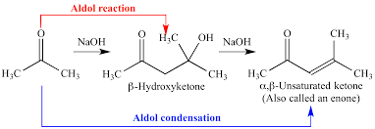
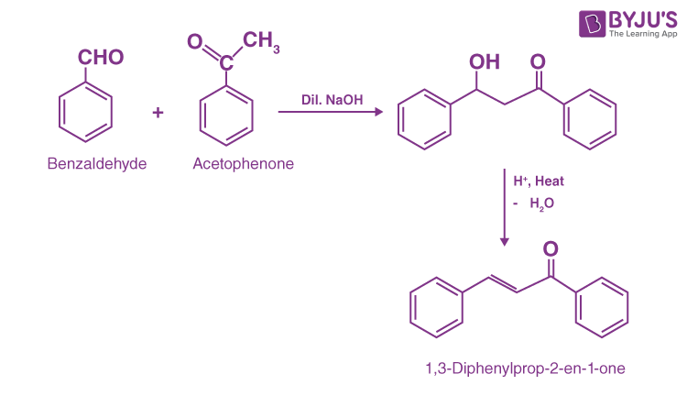

Slide 4
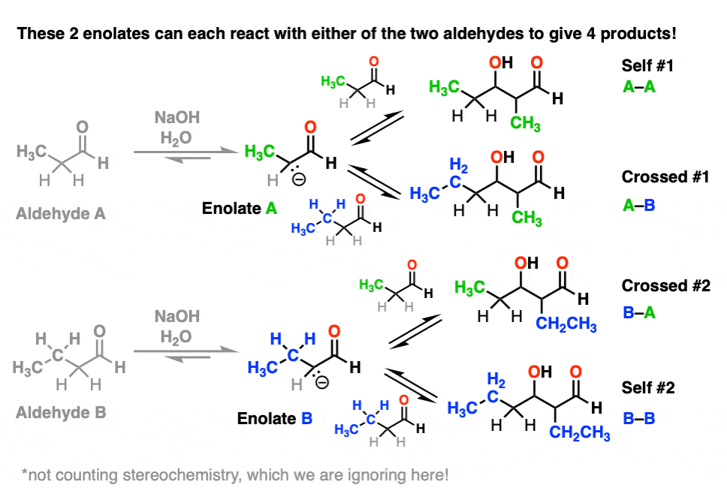

Slide 5
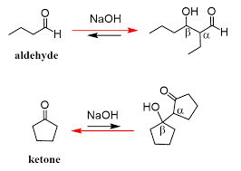

Slide 6
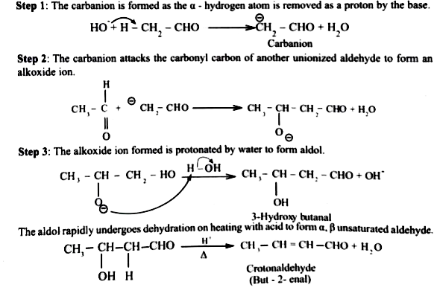
Mechanism

Slide 7
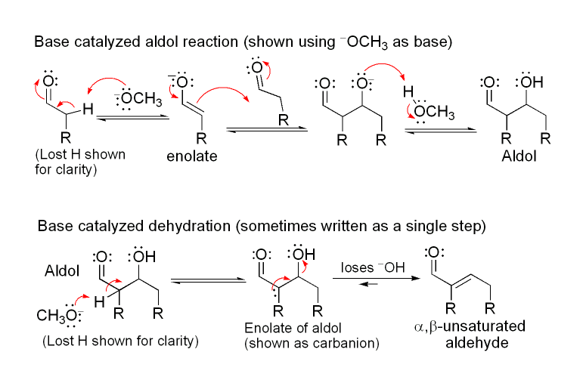

Slide 8
Baeyer-Villiger Oxidation
The Baeyer-Villiger oxidation, which is a chemical reaction that converts a ketone into an ester or a cyclic ketone into a lactone using a peroxyacid.
The reaction involves inserting an oxygen atom between the carbonyl group and an adjacent carbon atom, with the specific group that migrates determined by its migratory aptitude (tertiary > secondary > phenyl > primary > methyl).
This reaction is important in the synthesis of various organic compounds, including pharmaceuticals and flavors.

Slide 9
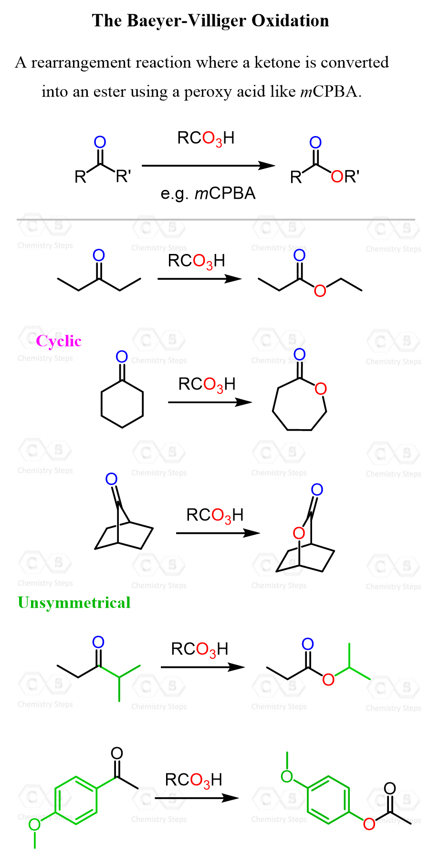

Slide 10
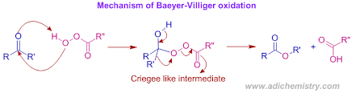
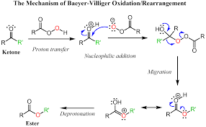

Slide 11
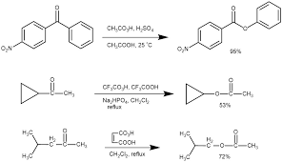
Examples

Slide 12
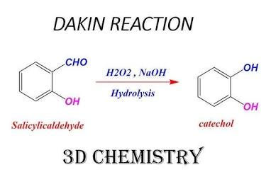
Dakin reaction
The Dakin reaction is an organic chemical reaction where an ortho- or para-hydroxylated phenyl aldehyde or ketone is oxidized by hydrogen peroxide in a basic solution to produce a benzenediol and a carboxylate.
The reaction involves a nucleophilic addition, an aryl migration, and a subsequent hydrolysis of an intermediate ester. This process converts the aldehyde or ketone group into a hydroxyl group.

Slide 13
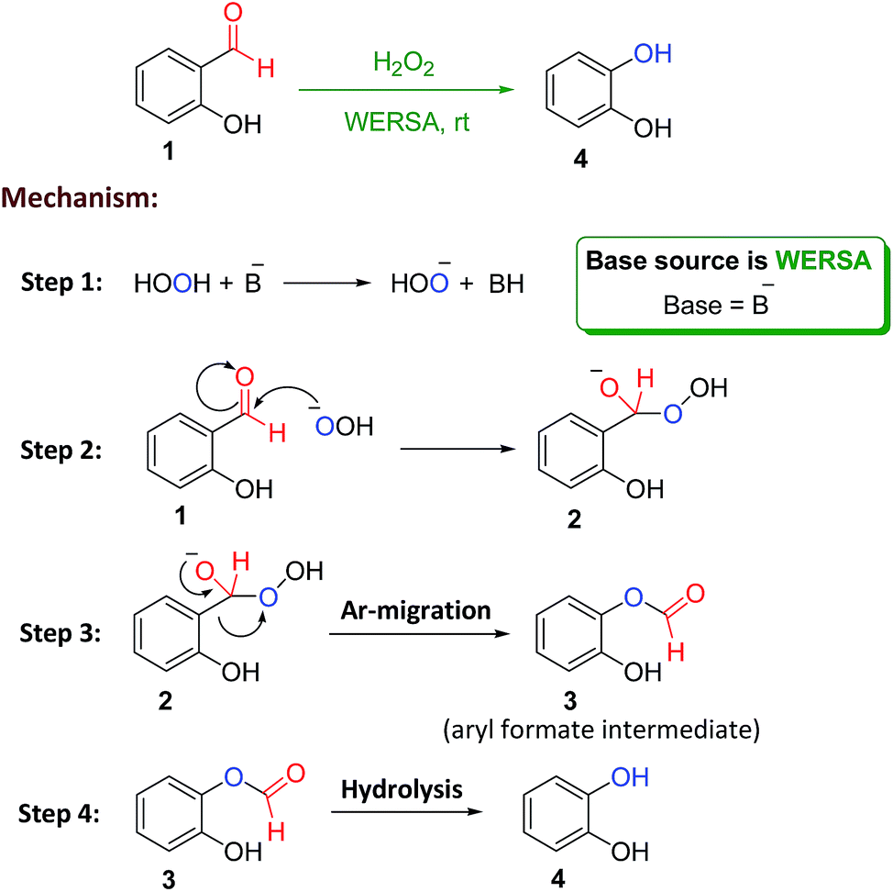

Slide 14
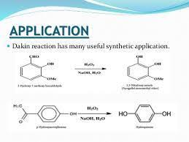

Slide 15
Haloform Reaction
The haloform reaction is a chemical reaction where a methyl ketone or a methyl-bearing aldehyde is converted into a haloform (𝐶𝐻𝑋3) and a carboxylate salt.
It involves treating the organic compound with a halogen (such as chlorine, bromine, or iodine) in the presence of a strong base, like sodium hydroxide.
The reaction works on compounds with a methyl group bonded to the carbonyl carbon, and the products are a haloform and the corresponding salt of the carboxylic acid

Slide 16
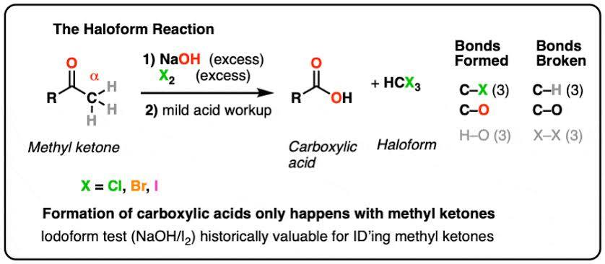

Slide 17
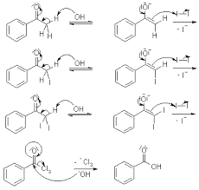
Mechanism

Slide 18
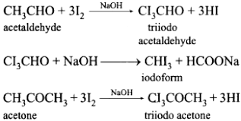

Slide 19
Sharpless Epoxidation
The Sharpless epoxidation reaction is an enantioselective chemical reaction to prepare 2,3-epoxyalcohols from primary and secondary allylic alcohols. The oxidizing agent is tert-butyl hydroperoxide. The method relies on a catalyst formed from titanium tetra(isopropoxide) and diethyl tartrate.

Slide 20
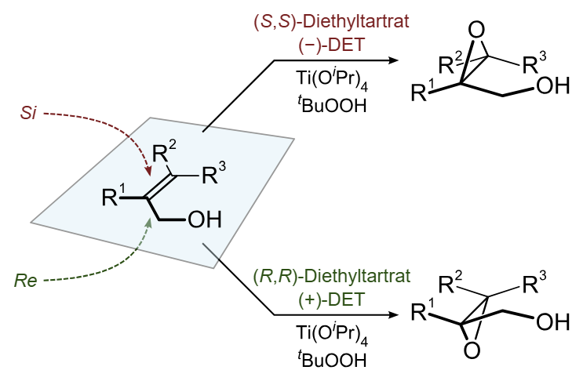

Slide 21
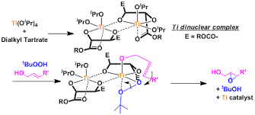
Mechanism

Slide 22
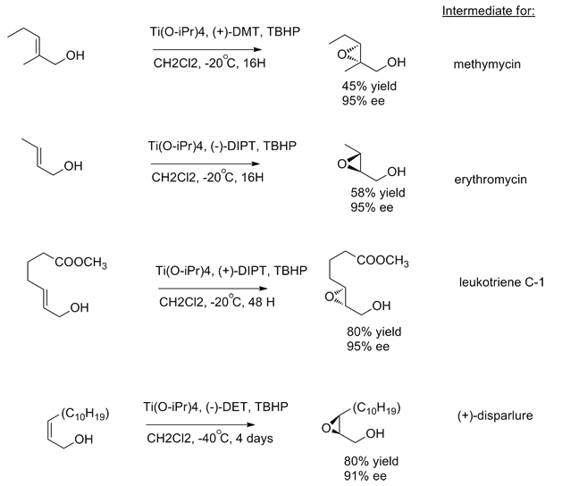

Slide 23
Wurtz Synthesis
Wurtz synthesis is a reaction that couples two alkyl halides with sodium metal to form a higher alkane, often a symmetrical one. It is performed using dry ether as a solvent to prevent unwanted side reactions. A variation, the Wurtz-Fittig reaction, couples an alkyl halide with an aryl halide to produce substituted aromatic compounds.

Slide 24
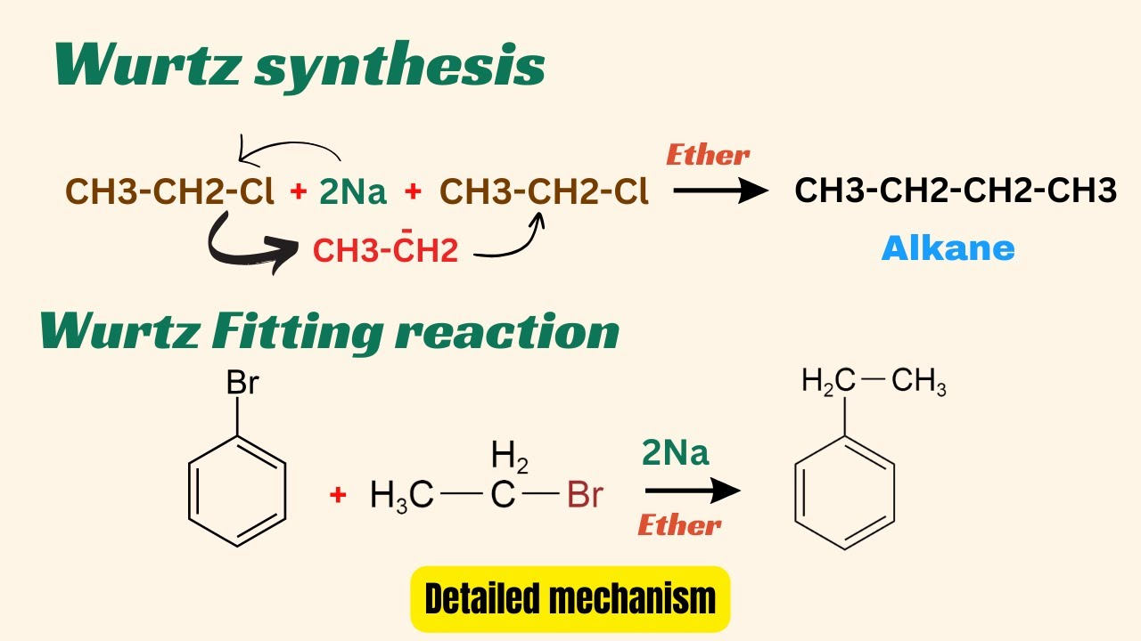

Slide 25
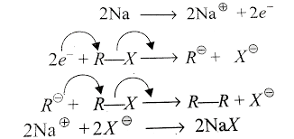
Mechanism

Slide 26
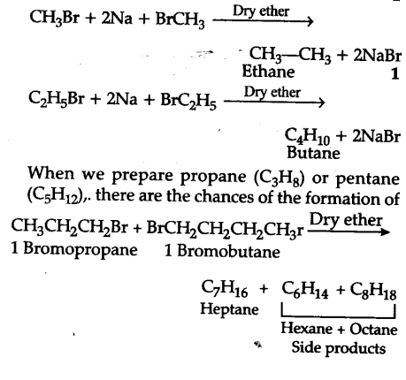

Slide 27
Benzil Benzilic acid rearrangement
The benzil benzilic acid rearrangement is a base-catalyzed reaction where a 1,2-diketone, like benzil, rearranges to form an α-hydroxycarboxylic acid. This classic organic reaction involves a strong base (like KOH) attacking one of the carbonyl groups, followed by a 1,2-migration of an aryl group and proton transfer, ultimately producing the rearranged carboxylate salt, which can be acidified to form the final acid product.

Slide 28
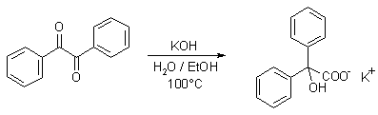
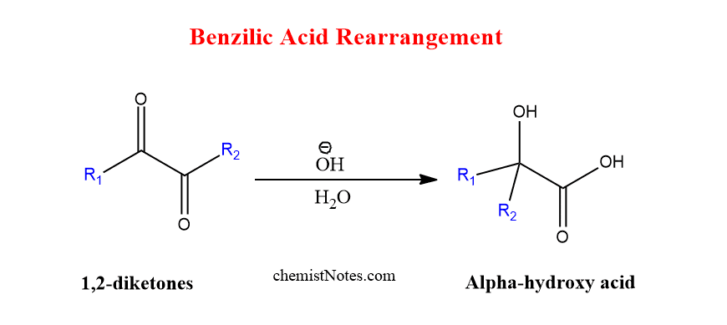

Slide 29
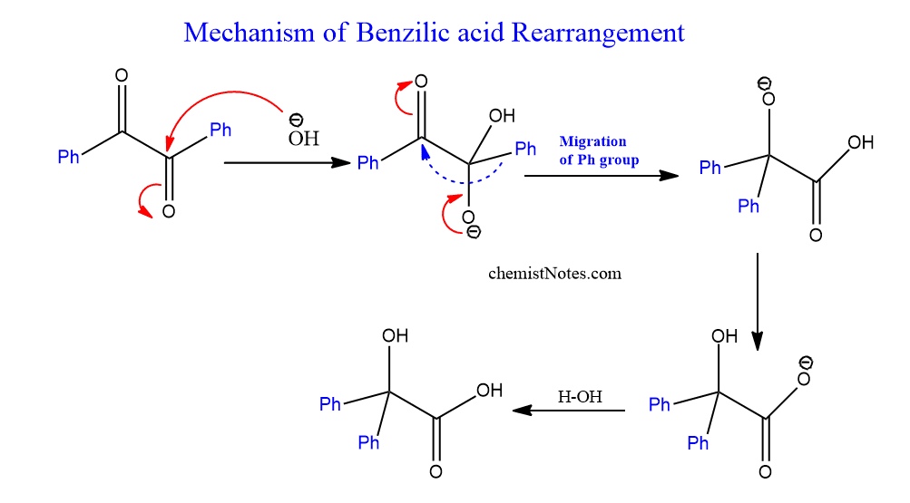

Slide 30
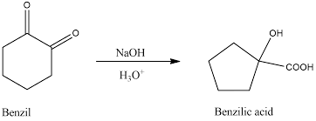
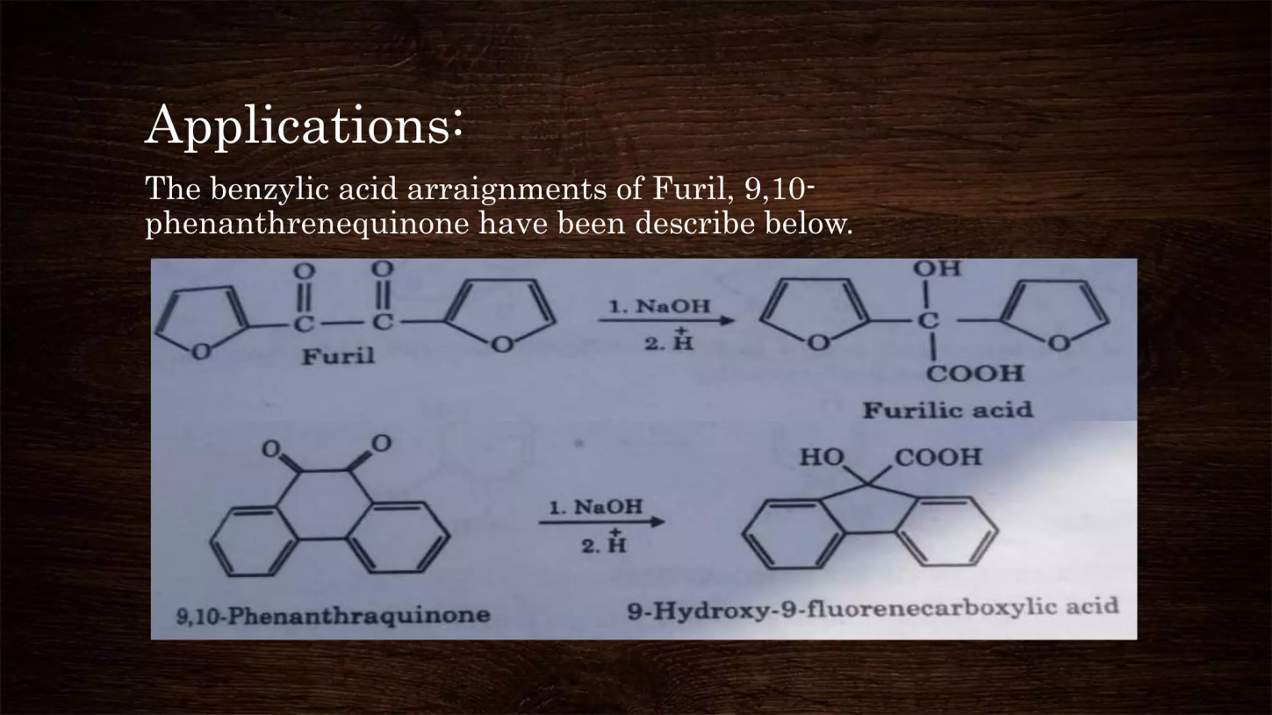
Examples

Slide 31
Pinacol to Pinacolone rearrangement
The pinacol to pinacolone rearrangement is an acid-catalyzed reaction where a 1,2-diol (pinacol) is converted into a carbonyl compound (ketone) by eliminating water and undergoing a molecular rearrangement. The mechanism involves protonation of one hydroxyl group, loss of water to form a carbocation, a 1,2-alkyl shift to form a more stable carbocation, and finally, deprotonation to yield the ketone product.

Slide 32
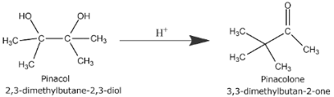

Slide 33
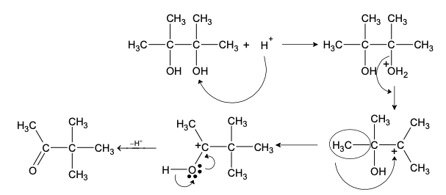
Mechanism

Slide 34
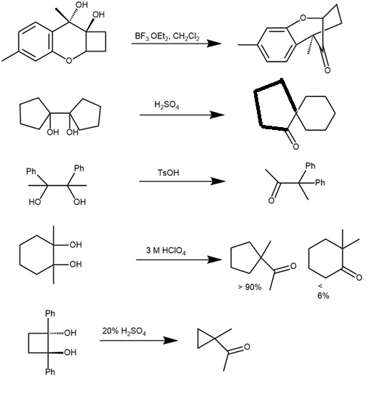

Slide 35
Fries Rearrangement
The Fries rearrangement is an organic reaction where an aryl ester is converted into a hydroxy aryl ketone by the migration of an acyl group to the aryl ring, using a Lewis acid catalyst like 3𝐴𝑙𝐶𝑙3
This reaction is selective for the ortho and para positions on the aryl ring, and the product ratio can be controlled by adjusting reaction conditions like temperature. Lower temperatures favor the para product, while higher temperatures favor the ortho product.

Slide 36
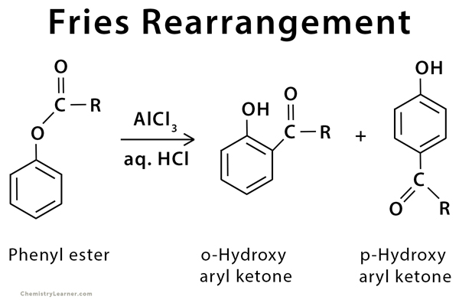

Slide 37
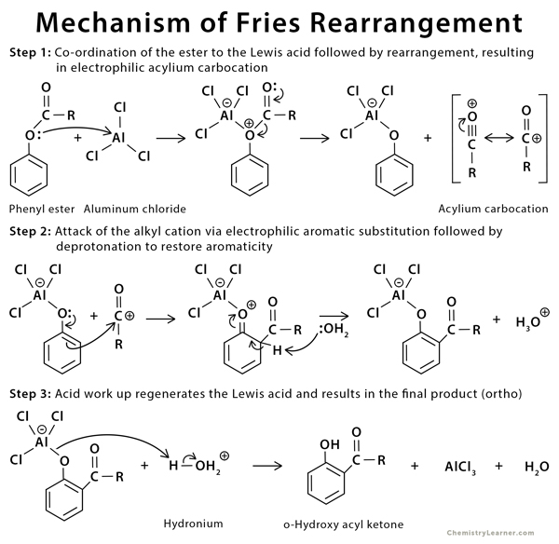

Slide 38
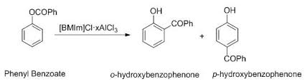
Applications

