Slide 1

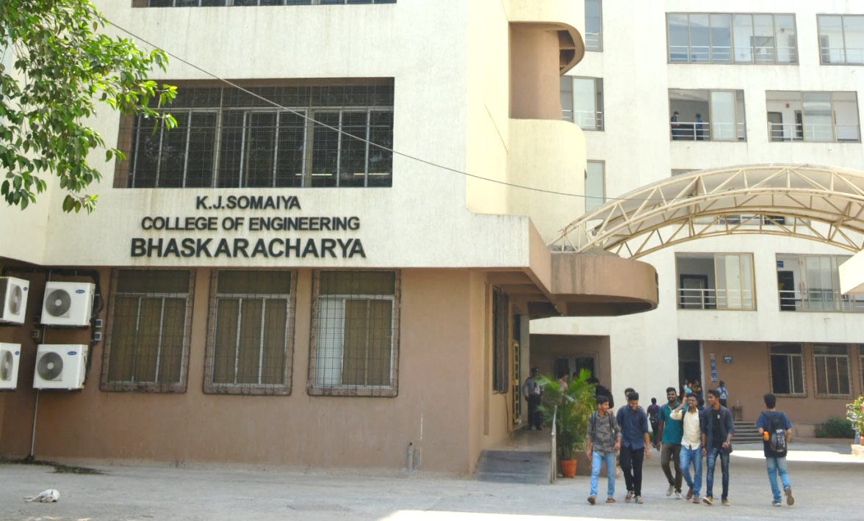
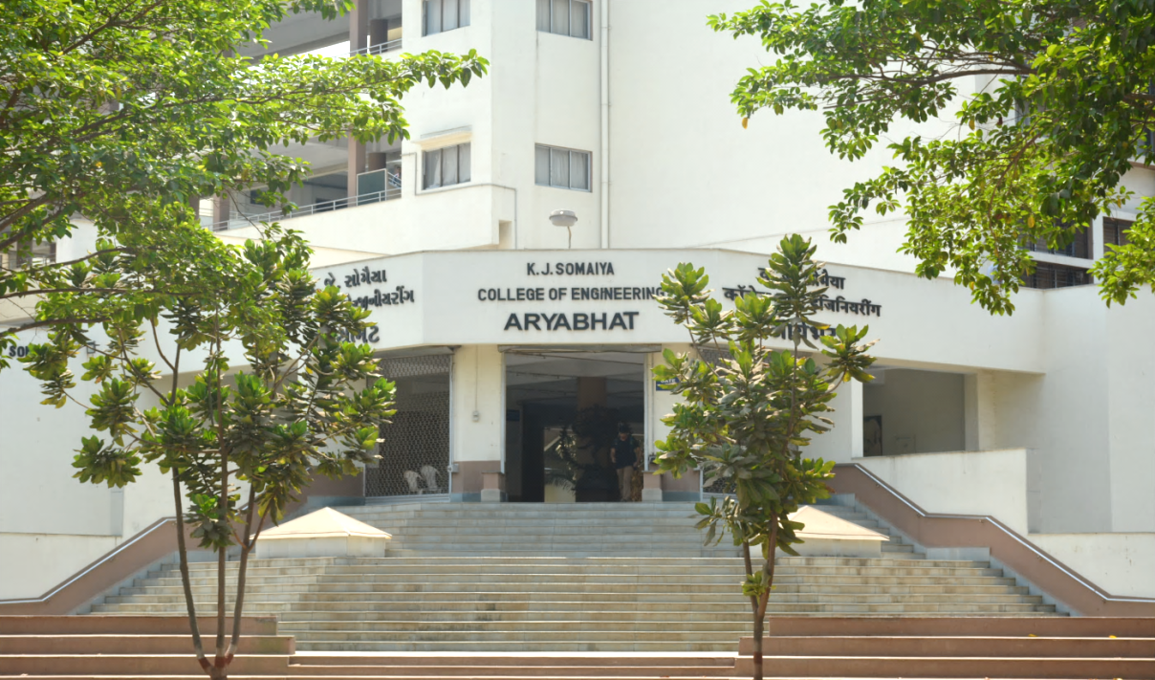
Engineering Mechanics
Kinetics of Particles

Slide 2
Kinetics of Particles III
Impulse and Momentum

Slide 3
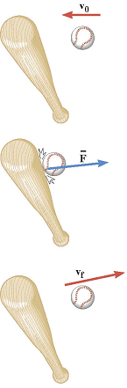
Impulse-Momentum Principle
When a net force acts on an object, the impulse of this force is equal to the change in momentum of the object:
Impulse
Final momentum
Initial momentum
Impulse=Change in momentum

Slide 4
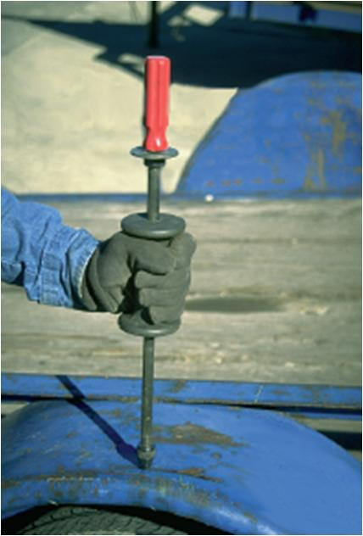
APPLICATIONS
A dent in an trailer fender can be removed using an impulse tool, which delivers a force over a very short time interval. To do so, the weight is gripped and jerked upwards, striking the stop ring.
How can we determine the magnitude of the linear impulse applied to the fender?
Could you analyze a carpenter’s hammer striking a nail in the same fashion?
Sure!

Slide 5
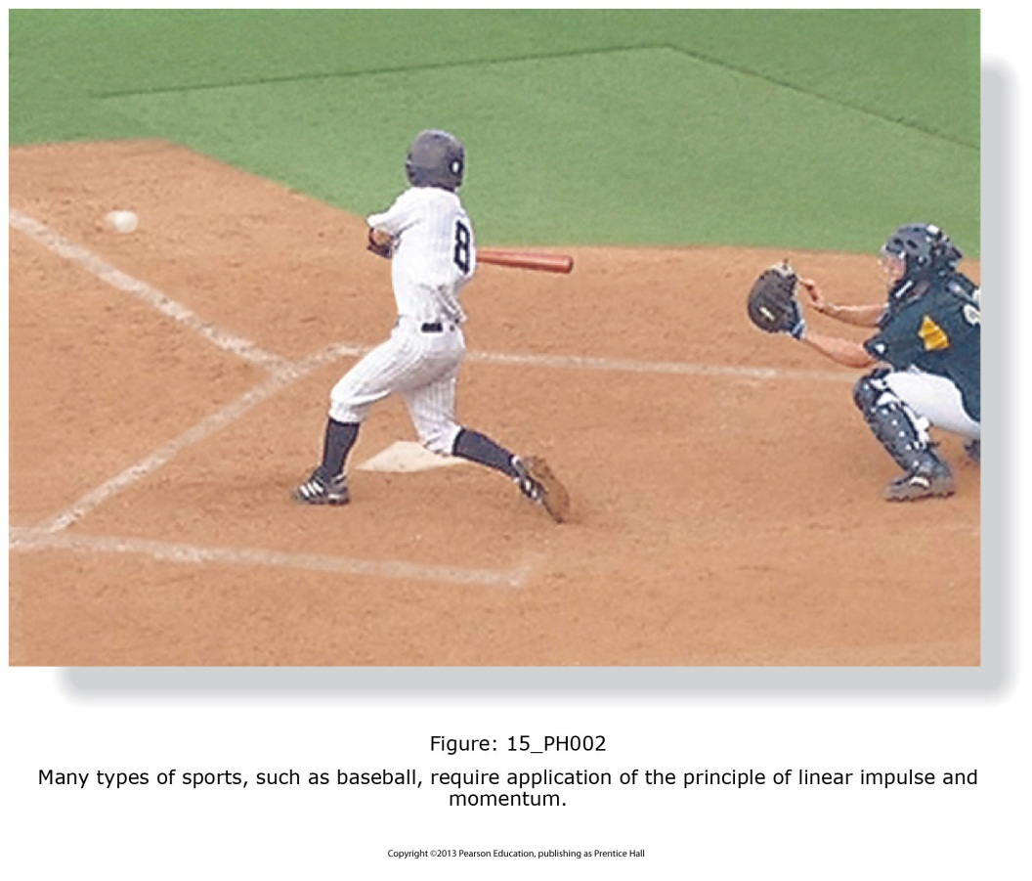
APPLICATIONS (continued)
A good example of impulse is the action of hitting a ball with a bat.
The impulse is the average force exerted by the bat multiplied by the time the bat and ball are in contact.
Is the impulse a vector? Is the impulse pointing in the same direction as the force being applied?
Given the situation of hitting a ball, how can we predict the resultant motion of the ball?

Slide 6
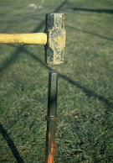
APPLICATIONS (continued)
When a stake is struck by a sledgehammer, a large impulse force is delivered to the stake and drives it into the ground.
If we know the initial speed of the sledgehammer and the duration of impact, how can we determine the magnitude of the impulsive force delivered to the stake?

Slide 7
PRINCIPLE OF LINEAR IMPULSE AND MOMENTUM
The next method we will consider for solving particle kinetics problems is obtained by integrating the equation of motion with respect to time.
The result is referred to as the principle of impulse and momentum. It can be applied to problems involving both linear and angular motion.
This principle is useful for solving problems that involve force, velocity, and time. It can also be used to analyze the mechanics of impact (taken up in a later section).

Slide 8
PRINCIPLE OF LINEAR IMPULSE AND MOMENTUM (continued)
The principle of linear impulse and momentum is obtained by integrating the equation of motion with respect to time. The equation of motion can be written
∑F = m a = m (dv/dt)
Separating variables and integrating between the limits v = v₁ at t = t₁ and v = v₂ at t = t₂ results in
t₂
v₂
∑
∫
F dt
=
m
∫
dv
=
mv₂ – mv₁
t₁
v₁
This equation represents the principle of linear impulse and momentum. It relates the particle’s final velocity (v₂) and initial velocity (v₁) and the forces acting on the particle as a function of time.

Slide 9
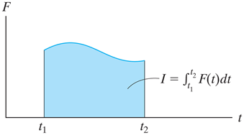
PRINCIPLE OF LINEAR IMPULSE AND MOMENTUM (continued)
Linear momentum: The vector mv is called the linear momentum, denoted as L. This vector has the same direction as v. The linear momentum vector has units of (kg·m)/s or (slug·ft)/s.
Linear impulse: The integral ∫F dt is the linear impulse, denoted I. It is a vector quantity measuring the effect of a force during its time interval of action. I acts in the same direction as F and has units of N·s or lb·s.
The impulse may be determined by direct integration. Graphically, it can be represented by the area under the force versus time curve. If F is constant, then
I = F (t₂ – t₁) .

Slide 10
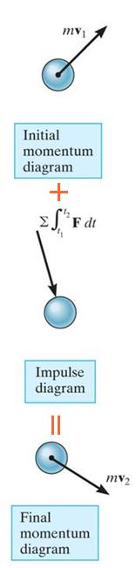
PRINCIPLE OF LINEAR IMPULSE AND MOMENTUM (continued)
The principle of linear impulse and momentum in vector form is written as
t₂
mv₁ +
∑
∫
F dt
= mv₂
t₁
The particle’s initial momentum plus the sum of all the impulses applied from t₁ to t₂ is equal to the particle’s final momentum.
The two momentum diagrams indicate direction and magnitude of the particle’s initial and final momentum, mv₁ and mv₂. The impulse diagram is similar to a free body diagram, but includes the time duration of the forces acting on the particle.

Slide 11
IMPULSE AND MOMENTUM: SCALAR EQUATIONS
Since the principle of linear impulse and momentum is a vector equation, it can be resolved into its x, y, z component scalar equations:
t₂
∫
m(v_{x})₁ + ∑ F_{x} dt = m(v_{x})₂
m(v_{y})₁ + ∑ F_{y} dt = m(v_{y})₂
m(v_{z})₁ + ∑ F_{z} dt = m(v_{z})₂
t₁
t₂
∫
t₁
t₂
∫
t₁
The scalar equations provide a convenient means for applying the principle of linear impulse and momentum once the velocity and force vectors have been resolved into x, y, z components.

Slide 12
PROBLEM SOLVING
• Establish the x, y, z coordinate system.
• Draw the particle’s free body diagram and establish the direction of the particle’s initial and final velocities, drawing the impulse and momentum diagrams for the particle. Show the linear momenta and force impulse vectors.
• Resolve the force and velocity (or impulse and momentum) vectors into their x, y, z components, and apply the principle of linear impulse and momentum using its scalar form.
• Forces as functions of time must be integrated to obtain impulses. If a force is constant, its impulse is the product of the force’s magnitude and time interval over which it acts.

Slide 13
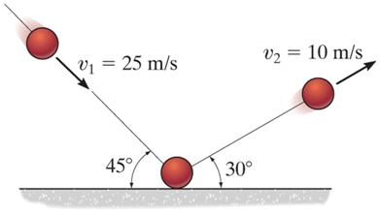
EXAMPLE I
Given: A 0.5 kg ball strikes the rough ground and rebounds with the velocities shown. Neglect the ball’s weight during the time it impacts the ground.
Find: The magnitude of impulsive force exerted on the ball.
Plan:
1) Draw momentum and impulse diagrams of the ball as it hits the surface.
2) Apply the principle of impulse and momentum to determine the impulsive force.
Notes:
Source : F15-1

Slide 14
EXAMPLE I (continued)
Solution:
1) Impulse and momentum diagrams can be drawn as:
∫ W dt ≈ 0
mv₂
+
=
30°
45°
mv₁
∫ F dt
∫ N dt ≈ 0
The impulse caused by the ball’s weight and the normal force N can be neglected because their magnitudes are very small as compared to the impulse from the ground.

Slide 15
EXAMPLE I (continued)
2) The principle of impulse and momentum can be applied along the direction of motion:
∫
t₂
mv₁ + ∑ F dt = mv₂
t₁
t₂
∫
0.5 (25 cos 45° i − 25 sin 45° j) + ∑ F dt
= 0.5 (10 cos 30° i + 10 sin 30° j)
⇒
t₁
The impulsive force vector is
I = ∑ F dt = (4.509 i + 11.34 j ) N⋅s
Magnitude: I = √ 4.509² + 11.34² = 12.2 N⋅s
t₂
∫
t₁

Slide 16
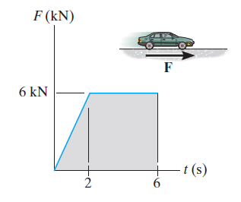
EXAMPLE II
Given: The wheels of the 1500 kg car generate a traction force F described by the graph.
Find: The speed of the car when t = 6 s if the car starts from rest.
Plan:
1) Draw the momentum and impulse diagrams of the car.
2) Apply the principle of impulse and momentum to determine the speed.
Notes:
Source : F15-4

Slide 17

EXAMPLE II (continued)
Solution:
1) The impulse and momentum diagrams can be drawn as:
∫ W dt
mv₂
mv₁ = 0
+
=
∫ F dt
∫ N dt
Why is the traction force F drawn acting to the right?
The impulse caused by the weight W and the normal force N can be canceled. Why?

Slide 18
EXAMPLE II (continued)
2) The principle of impulse and momentum can be applied along the direction of motion:
∫
t₂
+ →
mv₁ + ∑ F dt = mv₂
t₁
(1500 kg) (0 m/s) + 0.5 (6000 N) (2 s) + (6000 N) (4 s)
= (1500 kg) (v₂ m/s)
v₂ = 20 m/s

Slide 19
CONCEPT QUIZ
F
1. Calculate the impulse due to the force.
A) 20 kg·m/s B) 10 kg·m/s
C) 5 N·s D) 15 N·s
10 N
Force
curve
t
2 s
2. A constant force F is applied for 2 s to change the particle’s velocity from v₁ to v₂. Determine the force F if the particle’s mass is 2 kg.
A) (17.3 j) N B) (–10 i +17.3 j) N
C) (20 i +17.3 j) N D) ( 10 i +17.3 j) N
v₂=20 m/s
60°
v₁=10 m/s
Notes:
Answers:
1. B
2. C

Slide 20
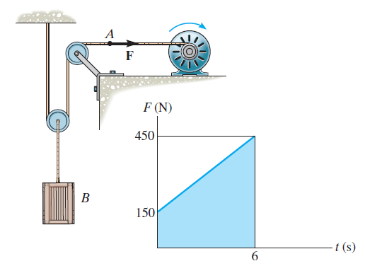
Example 3
Given: The 40 kg crate is moving downward at 10 m/s. The motor M pulls on the cable with a force of F, which has a magnitude that varies as shown on the graph.
Find: The speed of the crate when t = 6 s.
1) Draw the momentum and impulse diagrams of the crate.
2) Apply the principle of impulse and momentum to determine the speed.
Plan:
Notes:
Source : P15-18

Slide 21
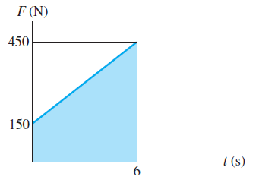
Example 3 (continued)
Solution:
1) The momentum and impulse diagrams are
∫ 2F dt
+
=
mv₂
mv₁
∫ W dt
The impulse due to cable force is:
+↑
∫
6
2 F dt = 2 [0.5 ( 150 + 450 ) 6 ] = 3600 N⋅s
0
The impulse due to weight is:
∫
6
+↑ (− W) dt = −40 (9.81) (6) = − 2354 N⋅s
0

Slide 22
Example 3 (continued)
2) Apply the principle of impulse and momentum to determine the velocity.
∫
t₂
mv₁ + ∑ F dt = mv₂
t₁
6
6
∫
∫
+ ↑ mv₁ − W dt + 2F dt = mv₂
0
0
40 (-10) − 2354 + 3600 = 40 v₂
⇒ v₂ = 21.1 m/s ↑

Slide 23
Principle of Linear Impulse and Momentum
Conservation of Linear Momentum
If the resultant force on a particle is zero during an interval of time, its linear momentum G remains constant. In this case, the linear momentum of the particle is said to be conserved. Linear momentum may be conserved in one direction, such as x, but not necessarily in the y- or z- direction.
This equation expresses the principle of conservation of linear momentum.

Slide 24
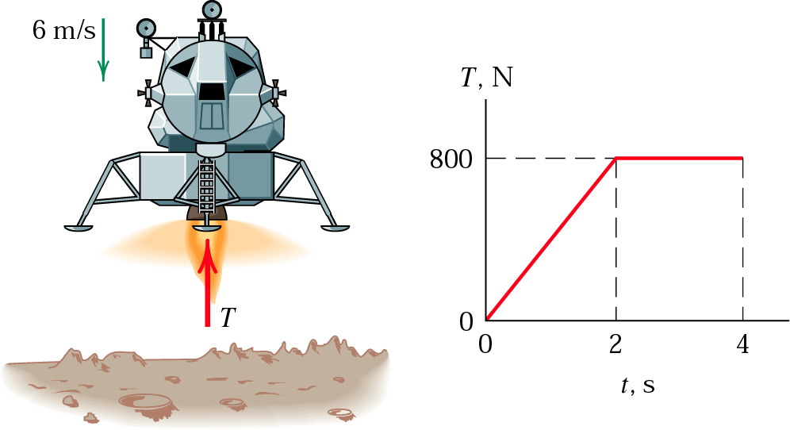
PROBLEMS
Principle of Linear Impulse and Momentum
4. The 200-kg lunar lander is descending onto the moon’s surface with a velocity of 6 m/s when its retro-engine is fired. If the engine produces a thrust T for 4 s which varies with the time as shown and then cuts off, calculate the velocity of the lander when t=5 s, assuming that it has not yet landed. Gravitational acceleration at the moon’s surface is 1.62 m/s².

Slide 25
SOLUTION
mg
motion
+
T

Slide 26
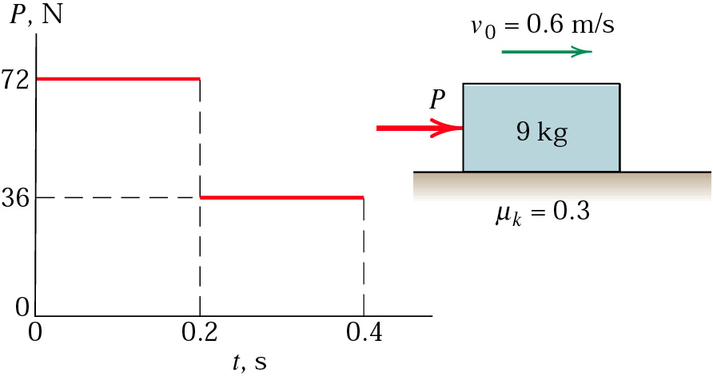
PROBLEMS
Principle of Linear Impulse and Momentum
5. The 9-kg block is moving to the right with a velocity of 0.6 m/s on a horizontal surface when a force P is applied to it at time t=0. Calculate the velocity v of the block when t=0.4 s. The kinetic coefficient of friction is μ_{k}=0.3.

Slide 27
SOLUTION
y
motion
x
W=mg
P
N
F_{f}=μ_{k}N

Slide 28
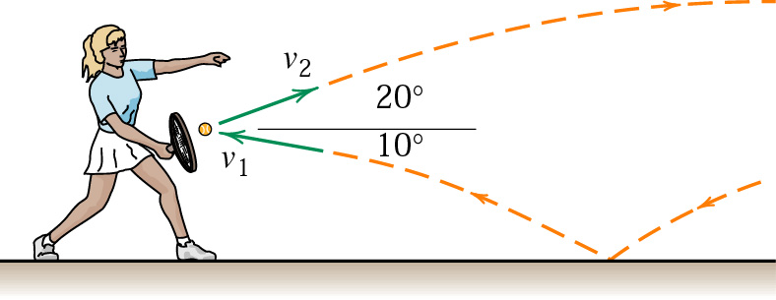
PROBLEMS
Principle of Linear Impulse and Momentum
6. A tennis player strikes the tennis ball with her racket while the ball is still rising. The ball speed before impact with the racket is v₁=15 m/s and after impact its speed is v₂=22 m/s, with directions as shown in the figure. If the 60-g ball is in contact with the racket for 0.05 s, determine the magnitude of the average force R exerted by the racket on the ball. Find the angle β made by R with the horizontal.

Slide 29
SOLUTION
y
in x direction
20°
10°
x
W=mg
in y direction
R_{x}
R
R_{y}
R_{y}
R
β
R_{x}

Slide 30
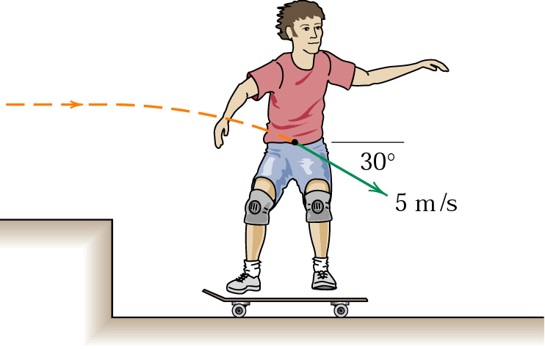
PROBLEMS
Principle of Linear Impulse and Momentum
7. The 40-kg boy has taken a running jump from the upper surface and lands on his 5-kg skateboard with a velocity of 5 m/s in the plane of the figure as shown. If his impact with the skateboard has a time duration of 0.05 s, determine the final speed v along the horizontal surface and the total normal force N exerted by the surface on the skateboard wheels during the impact.

Slide 31
PROBLEMS
Principle of Linear Impulse and Momentum
y
(m_{B}+m_{S})g
x
N
Linear momentum is conserved in x-direction;
in y direction

Slide 32
Example 8. A Well-Hit Ball
A baseball (m=0.14kg) has initial velocity of v₀=-38m/s as it approaches a bat. The bat applies an average force that is much larger than the weight of the ball, and the ball departs from the bat with a final velocity of v_{f}=+58m.
Determine the impulse applied to the ball by the bat.
Assuming time of contact is =1.6*10⁻³s, find the average force exerted on the ball by the bat.

Slide 33
(a)
= +13.4 kg.m/s
(b)

Slide 34
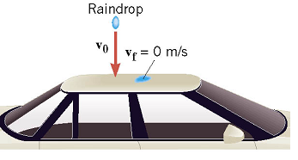
Example 9. A Rain Storm
Rain comes straight down with velocity of v₀=-15m/s and hits the roof of a car perpendicularly. Mass of rain per second that strikes the car roof is 0.06kg/s.
Assuming the rain comes to rest upon striking the car (v_{f}=0m/s), find the average force exerted by the raindrop.

Slide 35
= -(0.06kg/s)(-15m/s)=0.9 N
According to action-reaction law, the force exerted on the roof also has a magnitude of 0.9 N points downward: -0.9N

Slide 36
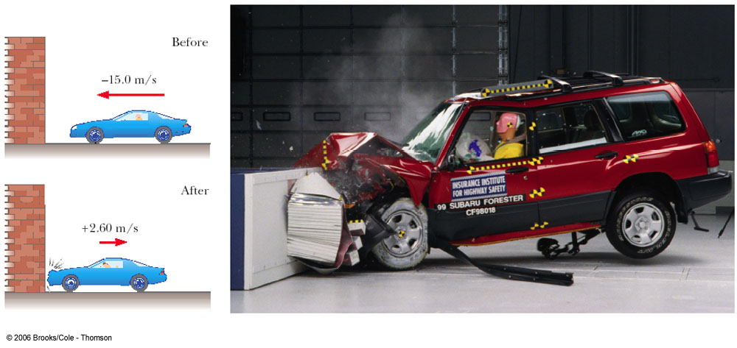
How Good Are the Bumpers?
In a crash test, a car of mass 1.510³ kg collides with a wall and rebounds as in figure. The initial and final velocities of the car are v_{i}=-15 m/s and v_{f} = 2.6 m/s, respectively. If the collision lasts for 0.15 s, find
(a) the impulse delivered to the car due to the collision
(b) the size and direction of the average force exerted on the car

Slide 37
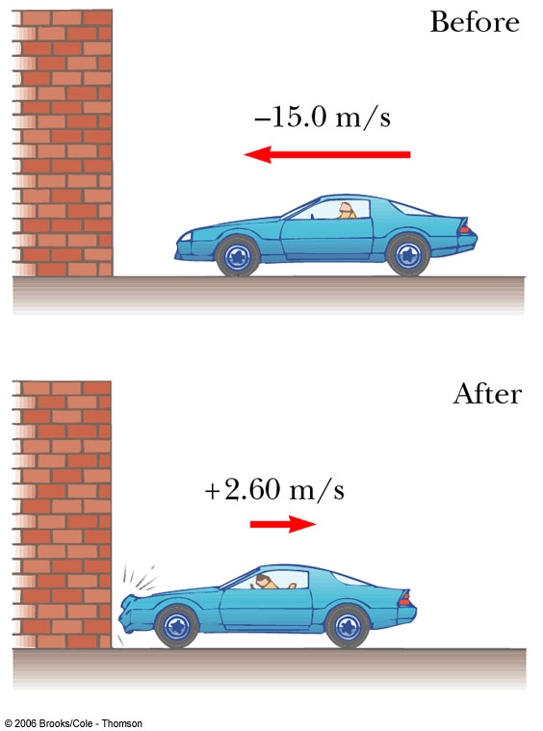
How Good Are the Bumpers?
In a crash test, a car of mass 1.510³ kg collides with a wall and rebounds as in figure. The initial and final velocities of the car are v_{i}=-15 m/s and v_{f} = 2.6 m/s, respectively. If the collision lasts for 0.15 s, find
(a) the impulse delivered to the car due to the collision
(b) the size and direction of the average force exerted on the car

Slide 38
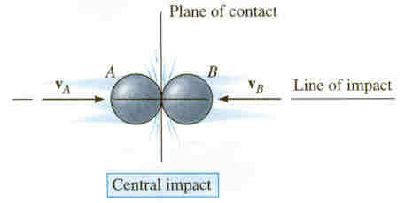
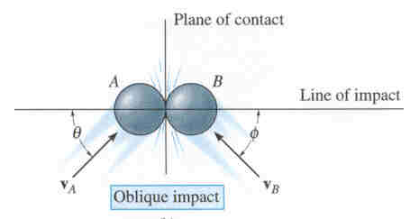
Impact Collision of Bodies
Impact occurs when two bodies collide during a very short time period, causing large impulsive forces to be exerted between the bodies. Common examples of impact are a hammer striking a nail or a bat striking a ball. The line of impact is a line through the mass centers of the colliding particles. In general, there are two types of impact:
Direct impact occurs when the directions of motion of the two colliding particles are along the line of impact.
Oblique impact occurs when the direction of motion of one or both of the particles is at an angle to the line of impact.

Slide 39
Direct Central impact
Central impact happens when the velocities of the two objects are along the line of impact (recall that the line of impact is a line through the particles’ mass centers).
v_{A}
v_{B}
Line of impact
Once the particles contact, they may deform if they are non-rigid. In any case, energy is transferred between the two particles.
There are two primary equations used when solving impact problems. The textbook provides extensive detail on their derivation.

Slide 40
Central impact (continued)
In most problems, the initial velocities of the particles, (v_{A})₁ and (v_{B})₁, are known, and it is necessary to determine the final velocities, (v_{A})₂ and (v_{B})₂. So the first equation used is the conservation of linear momentum, applied along the line of impact.
(m_{A} v_{A})₁ + (m_{B} v_{B})₁ = (m_{A} v_{A})₂ + (m_{B} v_{B})₂
This provides one equation, but there are usually two unknowns, (v_{A})₂ and (v_{B})₂. So another equation is needed. The principle of impulse and momentum is used to develop this equation, which involves the coefficient of restitution, or e.

Slide 41
Central impact (continued)
The coefficient of restitution, e, is the ratio of the particles’ relative separation velocity after impact, (v_{B})₂ – (v_{A})₂, to the particles’ relative approach velocity before impact, (v_{A})₁ – (v_{B})₁. The coefficient of restitution is also an indicator of the energy lost during the impact.
The equation defining the coefficient of restitution, e, is
(v_{B})₂ – (v_{A})₂
e =
(v_{A})₁ - (v_{B})₁
If a value for e is specified, this relation provides the second equation necessary to solve for (v_{A})₂ and (v_{B})₂.

Slide 42
Coefficient of restitution
In general, e has a value between zero and one. The two limiting conditions can be considered:
• Elastic impact (e = 1): In a perfectly elastic collision, no energy is lost and the relative separation velocity equals the relative approach velocity of the particles. In practical situations, this condition cannot be achieved.
• Plastic impact (e = 0): In a plastic impact, the relative separation velocity is zero. The particles stick together and move with a common velocity after the impact.
Some typical values of e are:
Steel on steel: 0.5 – 0.8 Wood on wood: 0.4 – 0.6
Lead on lead: 0.12 – 0.18 Glass on glass: 0.93 – 0.95

Slide 43
Impact: Energy losses
Once the particles’ velocities before and after the collision have been determined, the energy loss during the collision can be calculated on the basis of the difference in the particles’ kinetic energy. The energy loss is
∑ U₁₋₂ = ∑ T₂ - ∑ T₁ where T_{i} = 0.5m_{i}(v_{i})²
During a collision, some of the particles’ initial kinetic energy will be lost in the form of heat, sound, or due to localized deformation.
In a plastic collision (e = 0), the energy lost is a maximum, although it does not necessarily go to zero.

Slide 44
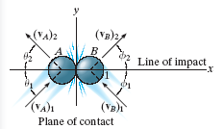
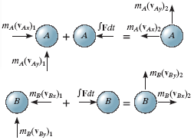
Oblique impact
In an oblique impact, one or both of the particles’ motion is at an angle to the line of impact. Typically, there will be four unknowns: the magnitudes and directions of the final velocities.
The four equations required to solve for the unknowns are:
Conservation of momentum and the coefficient of restitution equation are applied along the line of impact (x-axis):
m_{A}(v_{Ax})₁ + m_{B}(v_{Bx})₁ = m_{A}(v_{Ax})₂ + m_{B}(v_{Bx})₂
e = [(v_{Bx})₂ – (v_{Ax})₂]/[(v_{Ax})₁ – (v_{Bx})₁]
Momentum of each particle is conserved in the direction perpendicular to the line of impact (y-axis):
m_{A}(v_{Ay})₁ = m_{A}(v_{Ay})₂ and m_{B}(v_{By})₁ = m_{B}(v_{By})₂

Slide 45
Procedure of analysis
• In most impact problems, the initial velocities of the particles and the coefficient of restitution, e, are known, with the final velocities to be determined.
• Define the x-y axes. Typically, the x-axis is defined along the line of impact and the y-axis is in the plane of contact perpendicular to the x-axis.
• For both central and oblique impact problems, the following equations apply along the line of impact (x-dir.):
∑ m(v_{x})₁ = ∑ m(v_{x})₂ and e = [(v_{Bx})₂ – (v_{Ax})₂]/[(v_{Ax})₁ – (v_{Bx})₁]
• For oblique impact problems, the following equations are also required, applied perpendicular to the line of impact (y-dir.):
m_{A}(v_{Ay})₁ = m_{A}(v_{Ay})₂ and m_{B}(v_{By})₁ = m_{B}(v_{By})₂

Slide 46
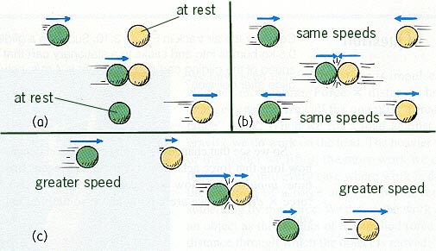
Types of Collisions
A situation where the objects DO NOT STICK is one type of collision
Notice that in EACH case, you have TWO objects BEFORE and AFTER the collision.

Slide 47
A “no stick” type collision
Σp_{before =}
Σp_{after}
-10 m/s

Slide 48
Types of Collisions
Another type of collision is one where the objects “STICK” together. Notice you have TWO objects before the collision and ONE object after the collision.

Slide 49
A “stick” type of collision
Σp_{before =}
Σp_{after}
5 m/s

Slide 50
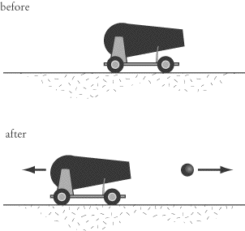
The “explosion” type
This type is often referred to as “backwards inelastic”. Notice you have ONE object ( we treat this as a SYSTEM) before the explosion and TWO objects after the explosion.

Slide 51
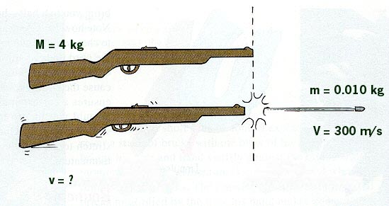
Backwards Inelastic - Explosions
Suppose we have a 4-kg rifle loaded with a 0.010 kg bullet. When the rifle is fired the bullet exits the barrel with a velocity of 300 m/s. How fast does the gun RECOIL backwards?
Σp_{before =}
Σp_{after}
-0.75 m/s

Slide 52
Collision Summary
Sometimes objects stick together or blow apart. In this case, momentum is ALWAYS conserved.
When 2 objects collide and DON’T stick
When 2 objects collide and stick together
When 1 object breaks into 2 objects
Elastic Collision = Kinetic Energy is Conserved
Inelastic Collision = Kinetic Energy is NOT Conserved

Slide 53
Elastic Collision
Since KINETIC ENERGY is conserved during the collision we call this an ELASTIC COLLISION.

Slide 54
Inelastic Collision
Since KINETIC ENERGY was NOT conserved during the collision we call this an INELASTIC COLLISION.

Slide 55
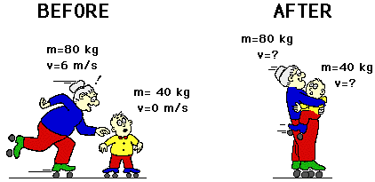
Example
Granny (m=80 kg) whizzes around the rink with a velocity of 6 m/s. She suddenly collides with Ambrose (m=40 kg) who is at rest directly in her path. Rather than knock him over, she picks him up and continues in motion without "braking." Determine the velocity of Granny and Ambrose.
How many objects do I have before the collision?
How many objects do I have after the collision?
2
1
4 m/s

Slide 56
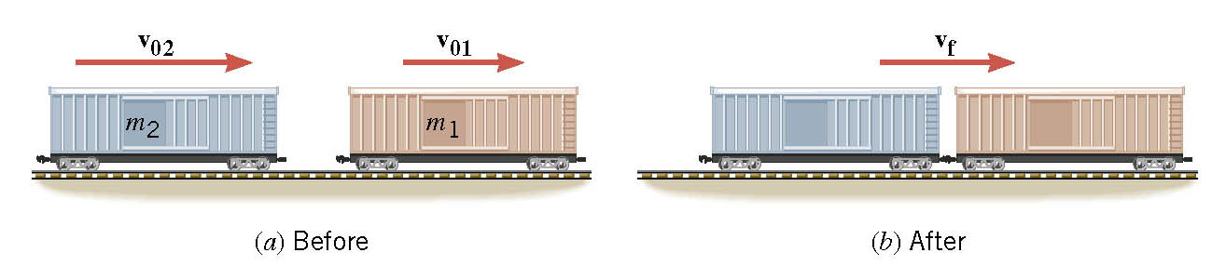
Example . Assembling a Freight Train
Car 1 has a mass of m₁=65*10³kg and moves at a velocity of v₀₁=+0.8m/s. Car 2 has a mass of m₂=92*10³kg and a velocity of v₀₂=+1.3m/s. Neglecting friction, find the common velocity v_{f} of the cars after they become coupled.

Slide 57
(m₁+m₂) v_{f} = m₁v₀₁ + m₂v₀₂
After collision
Before collision
=+1.1 m/s

Slide 58
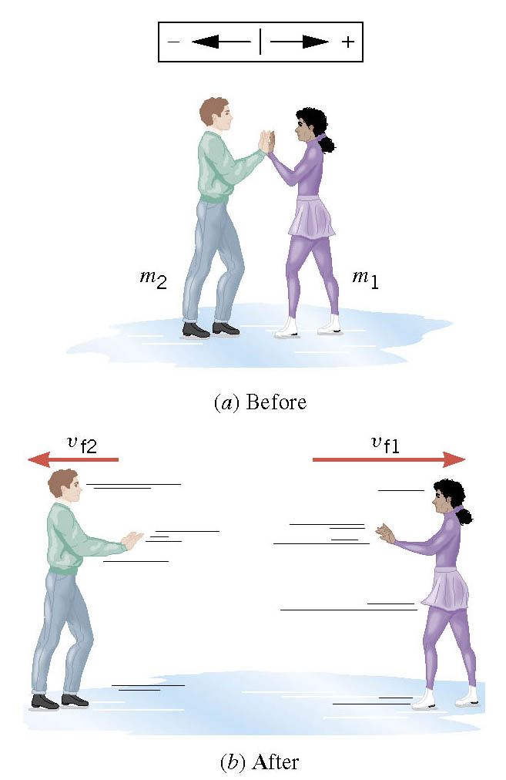
Example 6. Ice Skaters
Starting from rest, two skaters push off against each other on smooth level ice (friction is negligible). One is a woman (m₁=54kg), and one is a man(m₂=88kg). The woman moves away with a velocity of v_{f1}=2.5m/s. Find the recoil velocity v_{f2} of the man.

Slide 59
For the two skater system, what are the forces?
In horizontal direction
internal forces
system taken together 0
F₁₂
F₂₁
No external forces. isolated system
conservation of momentum

Slide 60
m₁v_{f1} + m₂v_{f2} = 0
after pushing
before pushing
It is important to realize that the total linear momentum may be conserved even when the kinetic energies of the individual parts of a system change.

Slide 61
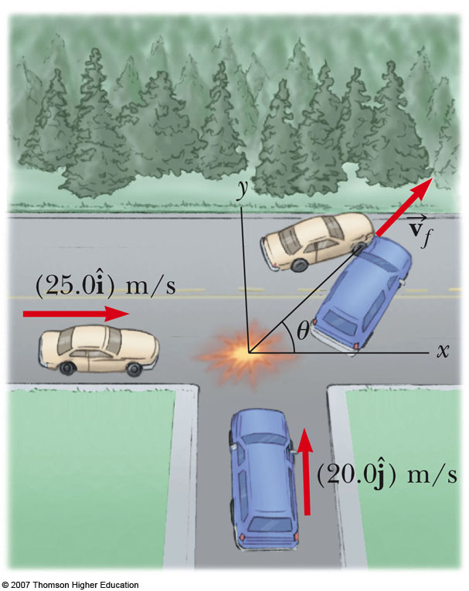
Collision at an Intersection
A car with mass 1.5×10³ kg traveling east at a speed of 25 m/s collides at an intersection with a 2.5×10³ kg van traveling north at a speed of 20 m/s. Find the magnitude and direction of the velocity of the wreckage after the collision, assuming that the vehicles undergo a perfectly inelastic collision and assuming that friction between the vehicles and the road can be neglected.

Slide 62
Collision at an Intersection

Slide 63
Collision at an Intersection

Slide 64
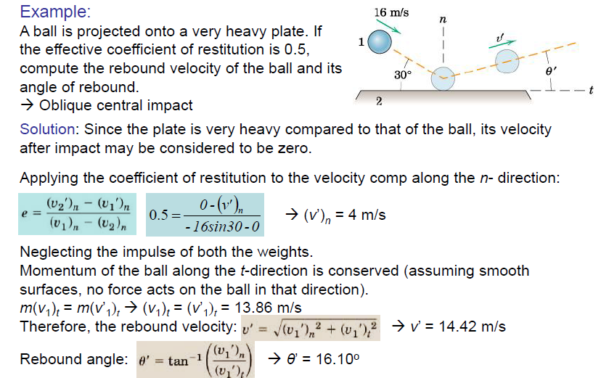

Slide 65
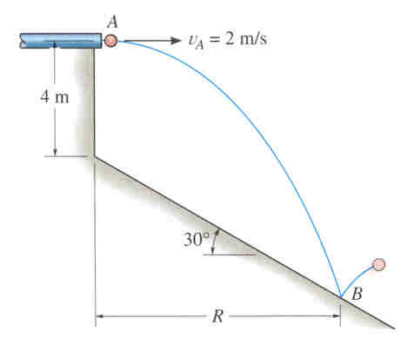
Example 1
Given: A 0.5 kg ball is ejected from the tube at A with a horizontal velocity v_{A} = 2 m/s. The coefficient of restitution at B is e = 0.6.
Find: The horizontal distance R where the ball strikes the smooth inclined plane and the speed at which it bounces from the plane.
Plan: 1) Use kinematics to find the distance R (projectile motion).
2) The collision at B is an oblique impact, with the line of impact perpendicular to the plane.
3) Thus, the coefficient of restitution applies perpendicular to the incline and the momentum of the ball is conserved along the incline.

Slide 66
Example 1 (continued)
Solution:
1) Apply the equations of projectile motion to determine R. Place the origin at A (x_{o} = y_{o} = 0) with the initial velocity of v_{yo} = 0, v_{xo} = v_{A} = 2 m/s:
x = x_{o} + v_{xo}t => R = 0 + 2t
y = y_{o} + v_{yo}t – 0.5gt² => -(4 + R tan30°) = 0 + 0 – 0.5(9.81)t²
Solving these equations simultaneously yields
t = 1.028 s and R = 2.06 m
It is also necessary to calculate the velocity of the ball just before impact:
v_{x} = v_{xo} = 2 m/s ( )
v_{y} = v_{yo} – gt = 0 – 9.81(1.028) = -10.0886 m/s ( )
=> v = 10.285 m/s 78.8°

Slide 67
Example 1 (continued)
2) Solve the impact problem by using x-y axes defined along and perpendicular to the line of impact, respectively:
v_{A1}
Denoting the ball as A and plane as B, the momentum of the ball is conserved in the y-dir:
m_{A}(-v_{Ay})₁ = m_{A}(-v_{Ay})₂
(v_{Ay})₂ = (v_{Ay})₁ = v_{A} cos48.8° = 6.77 m/s
y
48.8°
x
v_{A2}
30°
The coefficient of restitution applies in the x-dir and (v_{Bx})₁ = (v_{Bx})₂ = 0:
e = [(v_{Bx})₂ – (v_{Ax})₂]/[(v_{Ax})₁ – (v_{Bx})₁]
=> 0.6 = [0 - (v_{Ax})₂]/[-10.285 sin48.8° – 0]
=> (v_{Ax})₂ = 4.64 m/s
The speed is the magnitude of the velocity vector:
v_{A2} = ((v_{Ax})₂)² + ((v_{Ay})₂)² = 8.21 m/s

Slide 68
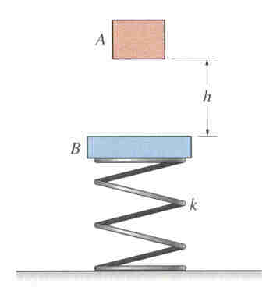
Example 2
Given: A 2 kg block A is released from rest, falls a distance h = 0.5 m, and strikes plate B (3 kg mass). The coefficient of restitution between A and B is e = 0.6, and the spring stiffness is k = 30 N/m.
Find: The velocity of block A just after the collision.
Plan: 1) Determine the speed of the block just before the collision using projectile motion or an energy method.
2) Analyze the collision as a central impact problem.

Slide 69
Example 2 (continued)
Solution:
1) Determine the speed of block A just before impact by using conservation of energy. Defining the gravitational datum at the initial position of the block (h₁ = 0) and noting the block is released from rest (v₁ = 0):
T₁ + V₁ = T₂ + V₂
0.5m(v₁)² + mgh₁ = 0.5m(v₂)² + mgh₂
0 + 0 = 0.5(2)(v₂)² + (2)(9.81)(-0.5)
v₂ = 3.132 m/s
This is the speed of the block just before the collision. Plate (B) is at rest, velocity of zero, before the collision.

Slide 70
Example 2 (continued)
2) Analyze the collision as a central impact problem.
(v_{A})₂
(v_{A})₁ = 3.132 m/s
Apply conservation of momentum to the system in the vertical direction:
A
B
+ m_{A}(v_{A})₁ + m_{B}(v_{B})₁ = m_{A}(v_{A})₂ + m_{B}(v_{B})₂
(2)(-3.132) + 0 = (2)(v_{A})₂ + (3)(v_{B})₂
(v_{B})₂
(v_{B})₁ = 0
Using the coefficient of restitution:
+ e = [(v_{B})₂ – (v_{A})₂]/[(v_{A})₁ – (v_{B})₁]
=> 0.6 = [(v_{B})₂ – (v_{A})₂]/[-3.132 – 0] => -1.879 = (v_{B})₂ – (v_{A})₂
Solving the two equations simultaneously yields
(v_{A})₂ = -0.125 m/s , (v_{B})₂ = -2.00 m/s
Both the block and plate will travel down after the collision.

Slide 71
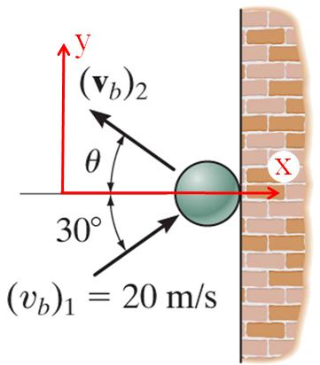
EXAMPLE
Given: The ball strikes the smooth wall
with a velocity (v_{b})₁ = 20 m/s. The coefficient of restitution between the ball and the wall is e = 0.75.
Find: The velocity of the ball just after the impact.
Plan:
The collision is an oblique impact, with the line of impact perpendicular to the plane (through the relative centers of mass).
Thus, the coefficient of restitution applies perpendicular to the wall and the momentum of the ball is conserved along the wall.

Slide 72
EXAMPLE (continued)
Solution:
Solve the impact problem by using x-y axes defined along and perpendicular to the line of impact, respectively:
The momentum of the ball is conserved in the y-dir:
m(v_{b})₁ sin 30° = m(v_{b})₂ sin θ
(v_{b})₂ sin θ = 10 m/s (1)

Slide 73
EXAMPLE (continued)
Solution:
The coefficient of restitution applies in the x-dir:
e = [ 0 – (v_{bx})₂ ] / [ (v_{bx})₁ – 0 ]
⇒ 0.75 = [ 0 – (-v_{b})₂ cos θ ] / [ 20 cos 30° – 0]
⇒ (v_{b})₂ cos θ = 12.99 m/s (2)
Using Eqs. (1) and (2) and solving for the velocity and θ yields:
(v_{b})₂ = (12.99²+10²)^{0.5} = 16.4 m/s
θ = tan⁻¹(10/12.99)=37.6°

Slide 74
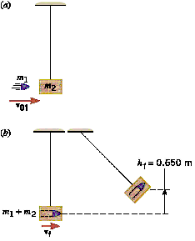
Example 8. A Ballistic Pendulum
The ballistic pendulum consists of a block of wood(mass m₂=2.5kg)suspended by a wire of negligible mass. A bullet(mass m₁=0.01kg)is fired with a speed v₀₁. After collision, the block has a speed v_{f} and then swings to a maximum height of 0.65m above the initial position. Find the speed v₀₁ of the bullet, assuming air resistance is negligible.

Slide 75

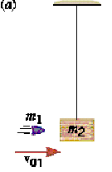
Just before collision
Just after collision
Is conservation of energy valid?
No (completely inelastic)
Is conservation of momentum valid?
m₁+m₂
Yes (no external forces )
v_{f}

Slide 76
Total momentum after collision
Total momentum before collision

Slide 77
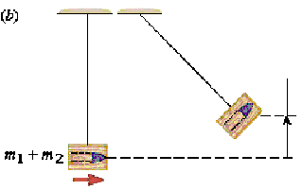
h_{f}=0.65 m
v_{f}
Applying conservation of energy
Total mechanical energy at top of swing, all potential
Total mechanical energy at bottom of swing, all kinetic

Slide 78



