Slide 1
Project Based Learning
Semester II
January – April 2026

Slide 2
3D PRINTING
Fused Deposition Modelling (FDM)

Slide 3
Contents
Introduction to Rapid Prototyping
Introduction to 3D printing
What is Fused Deposition Modelling (FDM)
How to use TinkerCAD
How to use CURA software
Activity on 3D printing (Paper weight model) (Pen stand model)

Slide 4
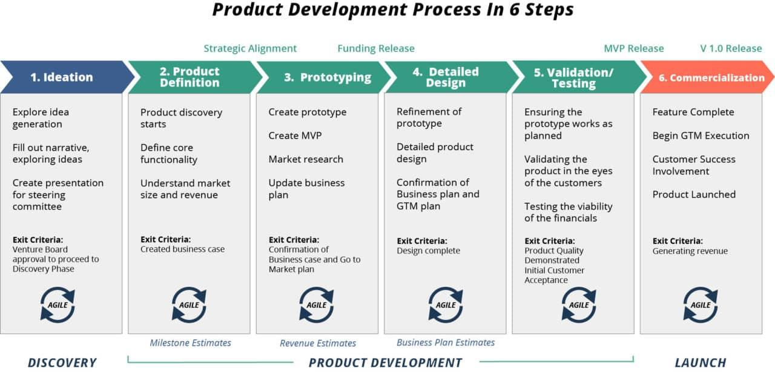
Product development process

Slide 5
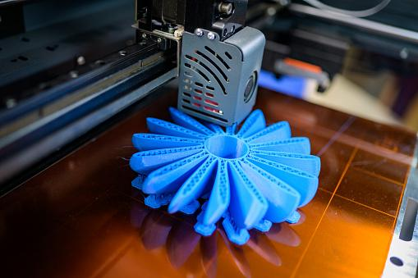
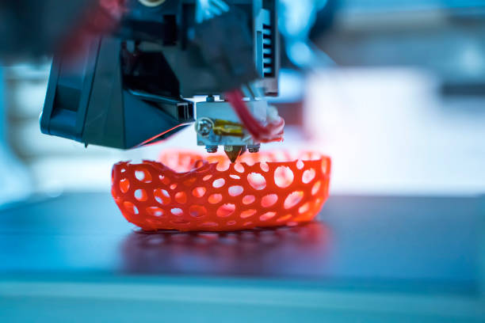
What is Rapid Prototyping?
Rapid prototyping is the fast fabrication of a physical part, model or assembly using 3D computer aided design (CAD).
The creation of the part, model or assembly is usually completed using additive manufacturing, or more commonly known as 3D printing.

Slide 6
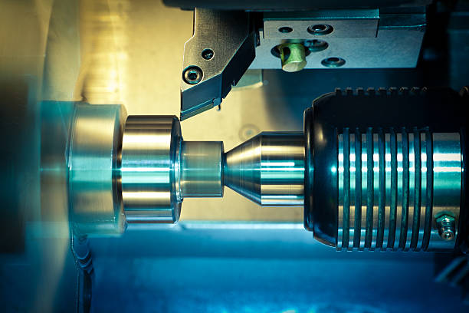
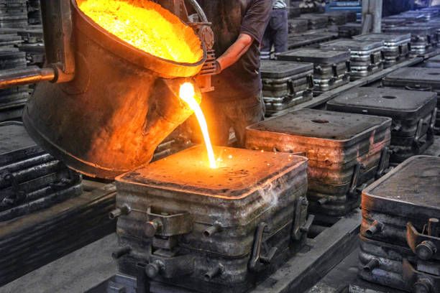
How Does Rapid Prototyping Work?
Rapid prototyping (RP) includes a variety of manufacturing technologies, although most utilize layered additive manufacturing.
However, other technologies used for RP include high-speed machining, casting, moulding and extruding.
While additive manufacturing is the most common rapid prototyping process, other more conventional processes can also be used to create prototypes.
These processes include:
Subtractive - whereby a block of material is carved to produce the desired shape using milling, grinding or turning.
Compressive - whereby a semi-solid or liquid material is forced into the desired shape before being solidified, such as with casting, compressive sintering or moulding.

Slide 7
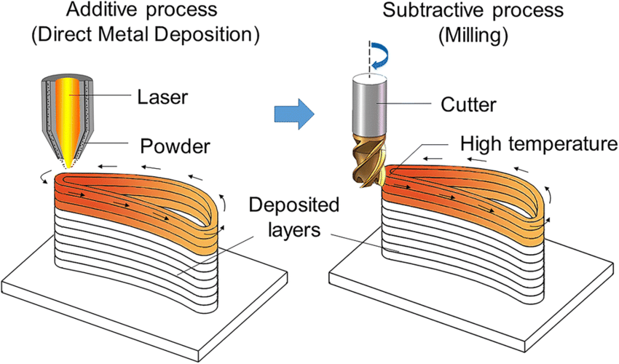

Slide 8
Why is Rapid prototyping important?
Companies need to develop and introduce new products faster to remain competitive in this fast-moving modern-day consumer market.
Since faster product development and technology innovation are vital to a company’s success, rapid prototyping becomes the most crucial element of new product development.
Rapid prototyping achieves the following objectives.
Faster new product development – Rapid prototyping plays a vital role in the process of creating successful products because it speeds up the new product development process
Early-stage design/concept validation of the form, fit, and function of the design
Final stage product verification against the technical requirement and business objectives
It allows functionality testing to test the objectives of the concept and to finalize the product specification
The prototype gives the end-user, client, customer, user participants hands-on user experience to get feedback

Slide 9
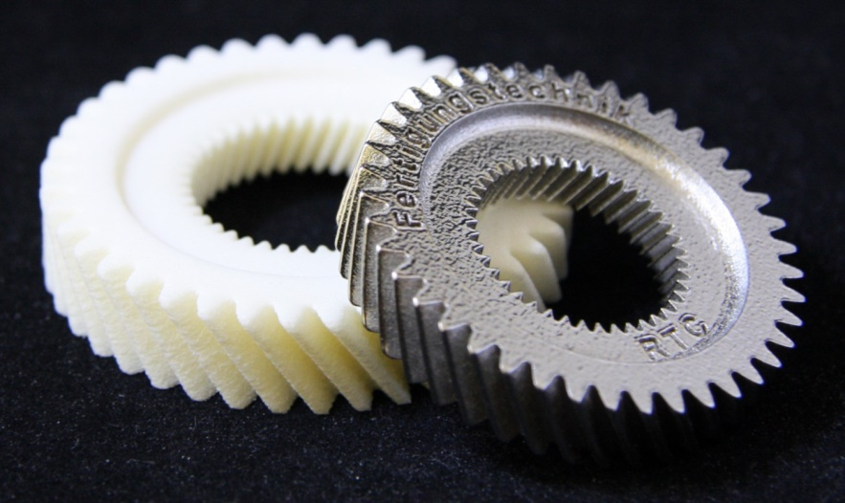
Advantages of rapid prototyping
Reduced design & development time
Reduced overall product development cost
Elimination or reduction of risk
Allows functionality testing at a fraction of the cost
Disadvantages of rapid prototyping
Lack of accuracy – If the function of the product relies heavily on the accuracy of the parts, then rapid prototype parts and assembly might not be able to f the same accuracy
Added initial costs – Rapid prototyping costs money due to technologies used and faster turnaround required.
Some rapid prototyping processes are still expensive and not economical
Reduced material properties like surface finish and strength
Rapid prototyping required skilled labour
Limited material range

Slide 10
Overview of Additive Manufacturing
Introduction to AM:
3D printing, also known as additive manufacturing (AM), is a method of creating a three dimensional object layer-by-layer using a computer created design.
The AM technology was originally referred to as rapid prototyping
Rapid prototyping : Creating a physical prototypes directly from digital data.
Opposite of subtractive manufacturing processes
Rapid prototyping (RP): Additive manufacturing = 3D Printing
Layer by layer fabrication of three dimensional physical models directly from a computer – aided design (CAD)
Printing the idea in 3D
Construct the objects by producing a very thin cross section.
Two dimensional slices being created and stacked together
For example: Sphere : various sized circles are built consecutively in RP machine to create sphere.

Slide 11
Generalized Additive Manufacturing Process Chain
AM Process Chain
CAD Design
Includes removal of parts from machine, support removal, finishing
Conceptualization and CAD
Conversion to STL
Transfer and manipulation of STL file on AM machine
Machine setup
Build
Part removal and cleanup
Post-processing of part
Application
Post Processing
STL File Format
The AM Process Chain
Standard Tessellation Language
Build Process
Preprocessing
Includes verifying the STL file, slicing, parameter setting
File Transfer
If the finished part meets the necessary requirements, the cycle is complete. Otherwise, iteration can be implemented in the CAD file and cycle is repeated

Slide 12
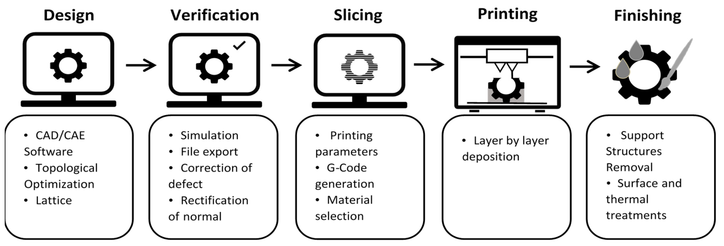
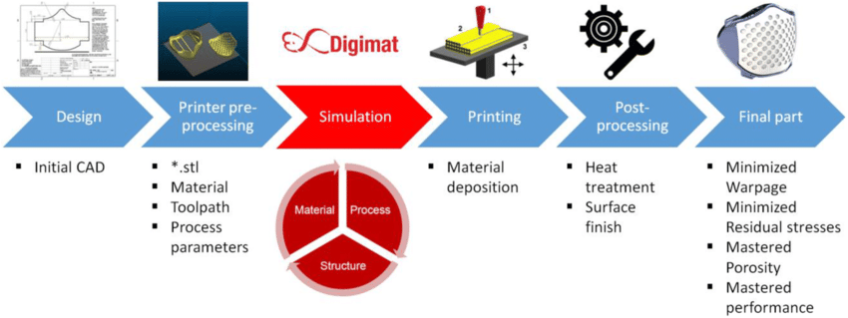

Slide 13
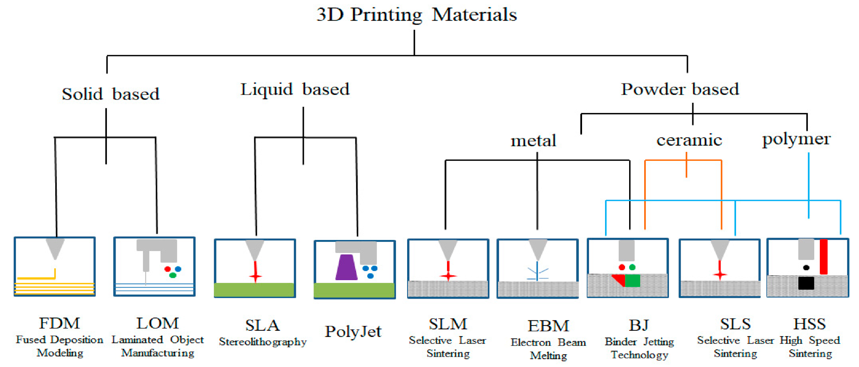
Fused Deposition Modeling (FDM)
Laminated Object Manufacturing (LOM)-(Involves gluing layers of material together to create an object
Stereolithography (SLA)
Selective Laser Sintering (SLS)
Digital Light Process (DLP)
Multi Jet Fusion (MJF)
PolyJet
Direct Metal Laser Sintering (DMLS)
Electron Beam Melting (EBM)

Slide 14
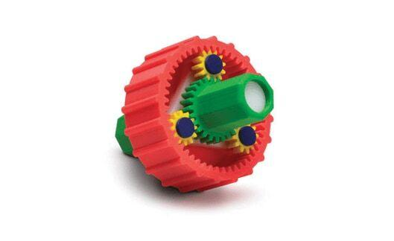
Fused Deposition Modeling (FDM)
What is Fused Deposition Modeling (FDM)?
Fused deposition modeling is an additive manufacturing technology that creates 3D components using a continuous thermoplastic or composite material thread in filament form.
An extruder feeds the plastic filament through an extruding nozzle, where it is melted and then selectively deposited layer by layer onto the build platform in a predetermined automated path.

Slide 15
Fused Deposition Modeling (FDM)
FDM, also known as Fused Filament Fabrication (FFF), is a material extrusion technology, one of the seven main types of additive manufacturing technologies.
FDM is the most widely used 3D printing technique, with the most 3D printer users globally, and is typically the first 3D printing technology to which people are exposed.
Scott Crump pioneered the process in the 1980s under the registered term fused deposition modelling (FDM).
Stratasys Inc, a business co-founded by Scott Crump, owns the trademark fused deposition modelling (FDM) and its abbreviation FDM.

Slide 16
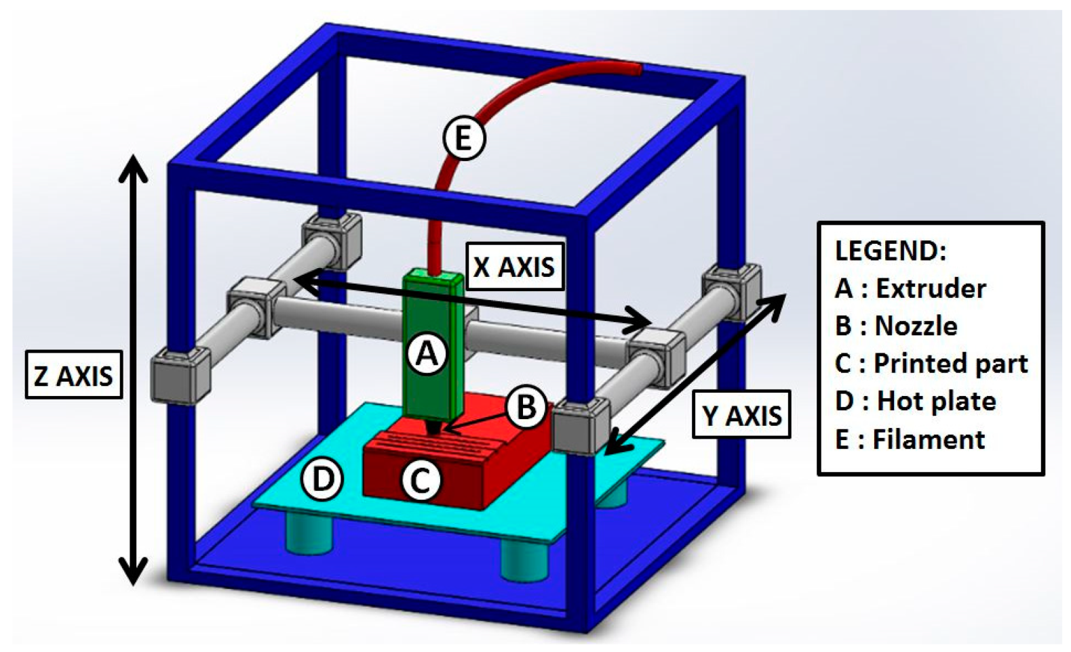
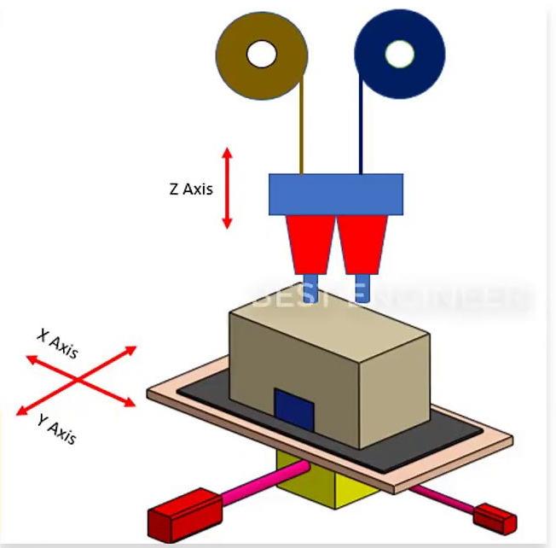
How does FDM work?
It consists of two extruding nozzles on linear slides, a build platform on another linear slide and supports for plastic filament spools.

Slide 17
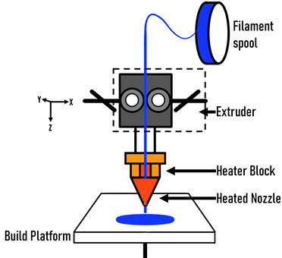
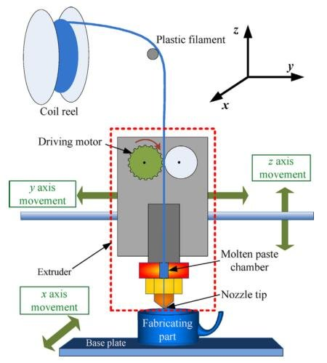
The extruders are called Model and Support extruders. As the name implies, the model extruder prints the material for the 3D shape while the support extruder prints the supports.
They can either have the same material or different materials.
Hobbyist printers have a single extruder and use the same material for both model and support.
Depending on the type and brand of FDM printer, the XYZ movement could come from the extruders and the build platform.
As the schematic shows, in this version, the extruder head gantry moves in X & Y while the build platform moves in Z-axis comes.
In some versions, the print head moves in X and Z while the build platform moves in Y.

Slide 18
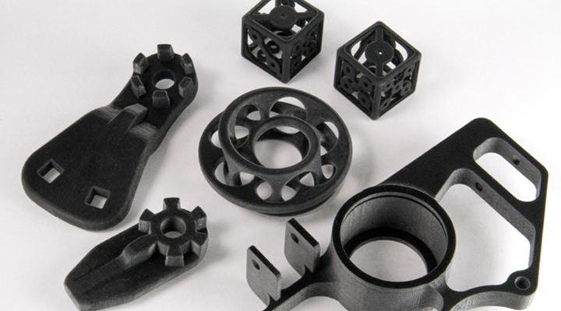
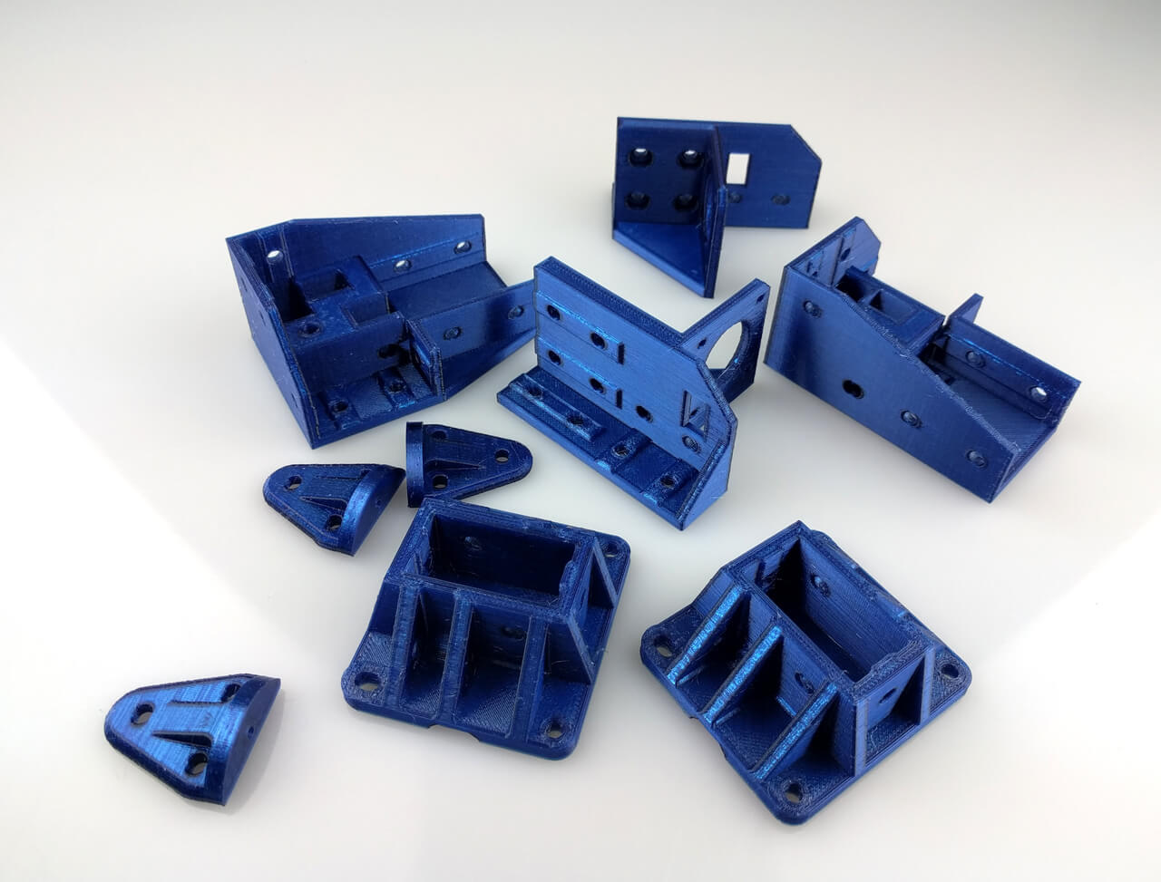

Slide 19
FDM process steps
Part preparation step
FDM machine set-up step
FDM printing step
FDM part removal
Post-processing
Characteristics and application of FDM
Temperature and build speed (The nozzle and build platform temperature, build speed, layer height and cooling fan speed are all adjustable in most FDM systems. )
Build volume (Upto 1000 x 1000 x 1000 mm)
Layer height (0.02 mm and 0.4 mm)
Layer Adhesion (good adhesion between the deposited layers is critical)
Support Structure (geometries with overhangs will require a support structure.)
Infill and Shell thickness
Warping

Slide 20
Advantages of FDM
FDM is the most cost-effective method of manufacturing customer specific thermoplastic components and prototypes.
Due to the lower cost FDM printers are wide availability, the lead times are minimal and cheaper than other additive manufacturing processes.
There is a large variety of thermoplastic materials available for prototyping as well as certain non-commercial practical. Most common injection moulding materials can be replicated using FDM
The technology is aesthetically pleasing, easy to use, and appropriate for the workplace.
Mechanical and environmental stability are provided by supported production-grade thermoplastics.
FDM technology makes complex shapes and voids that would otherwise be impractical possible.

Slide 21
Disadvantages of FDM
When compared to other 3D printing methods, FDM has the lowest dimensional accuracy and resolution, making it unsuitable for items with delicate features.
Because FDM items are prone to noticeable layer lines, post-processing is essential for a smooth finish.
Because of the layer adhesion technique, FDM components are inherently anisotropic.
Youtube link
https://www.youtube.com/watch?v=7xKe20Mb2eY

Slide 22
3D Modelling with TinkerCAD
●Tinkercad is a free-of-charge, online 3D modeling program that runs in a web browser.
●It is a popular platform for creating models for 3D printing as well as an entry-level introduction to constructive solid geometry

Slide 23
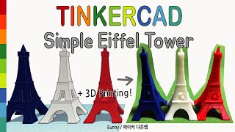
3D Modelling Example

Slide 24
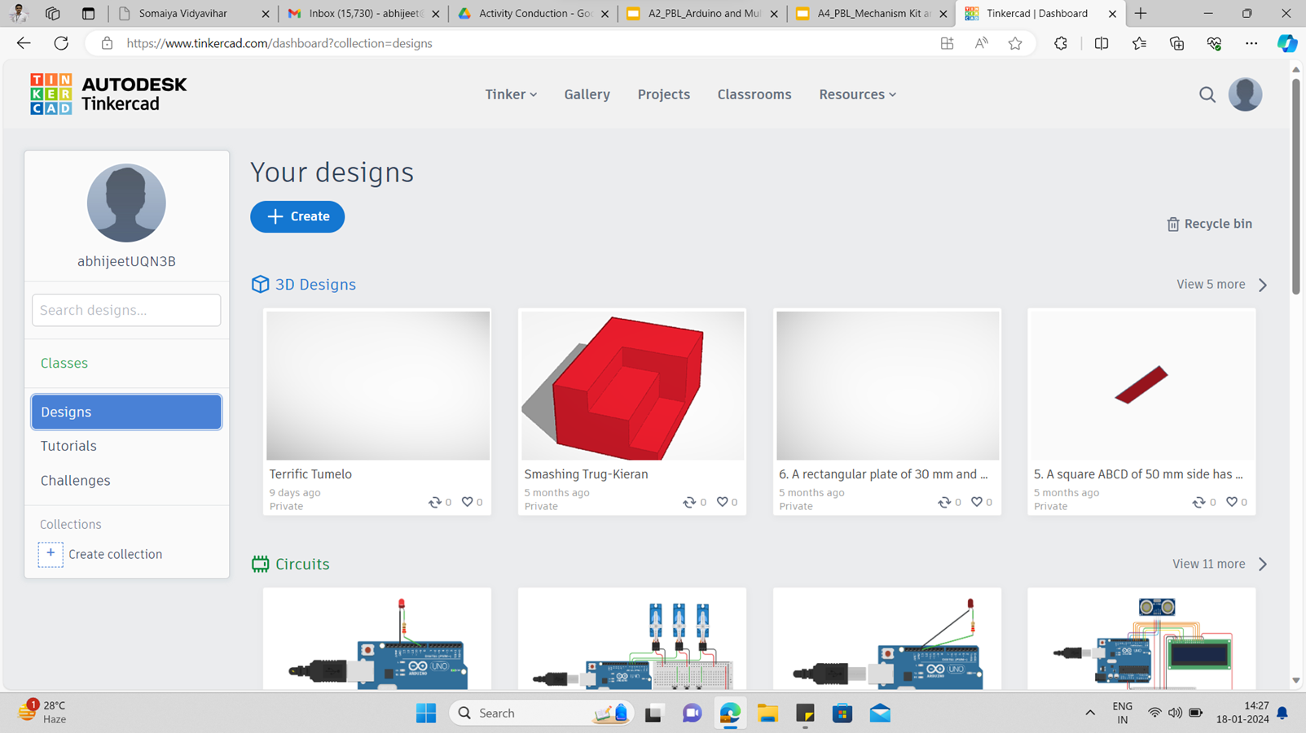
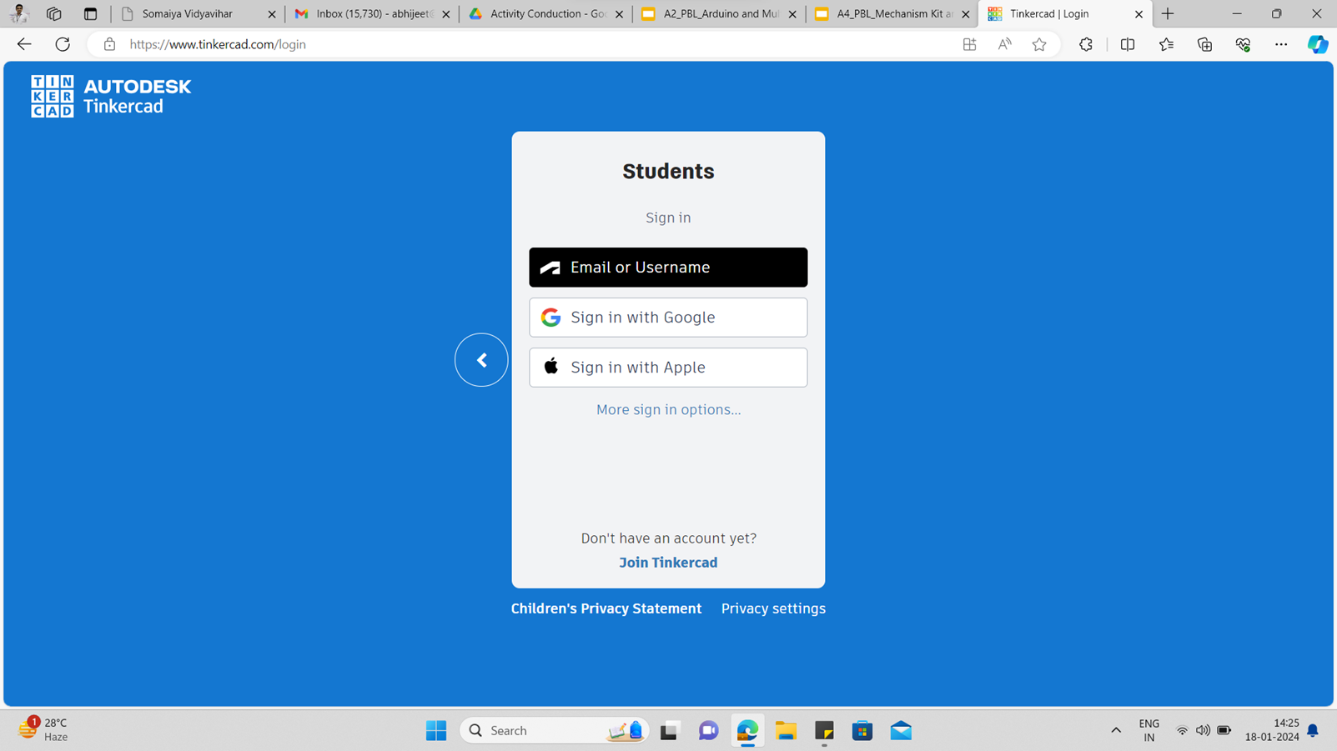
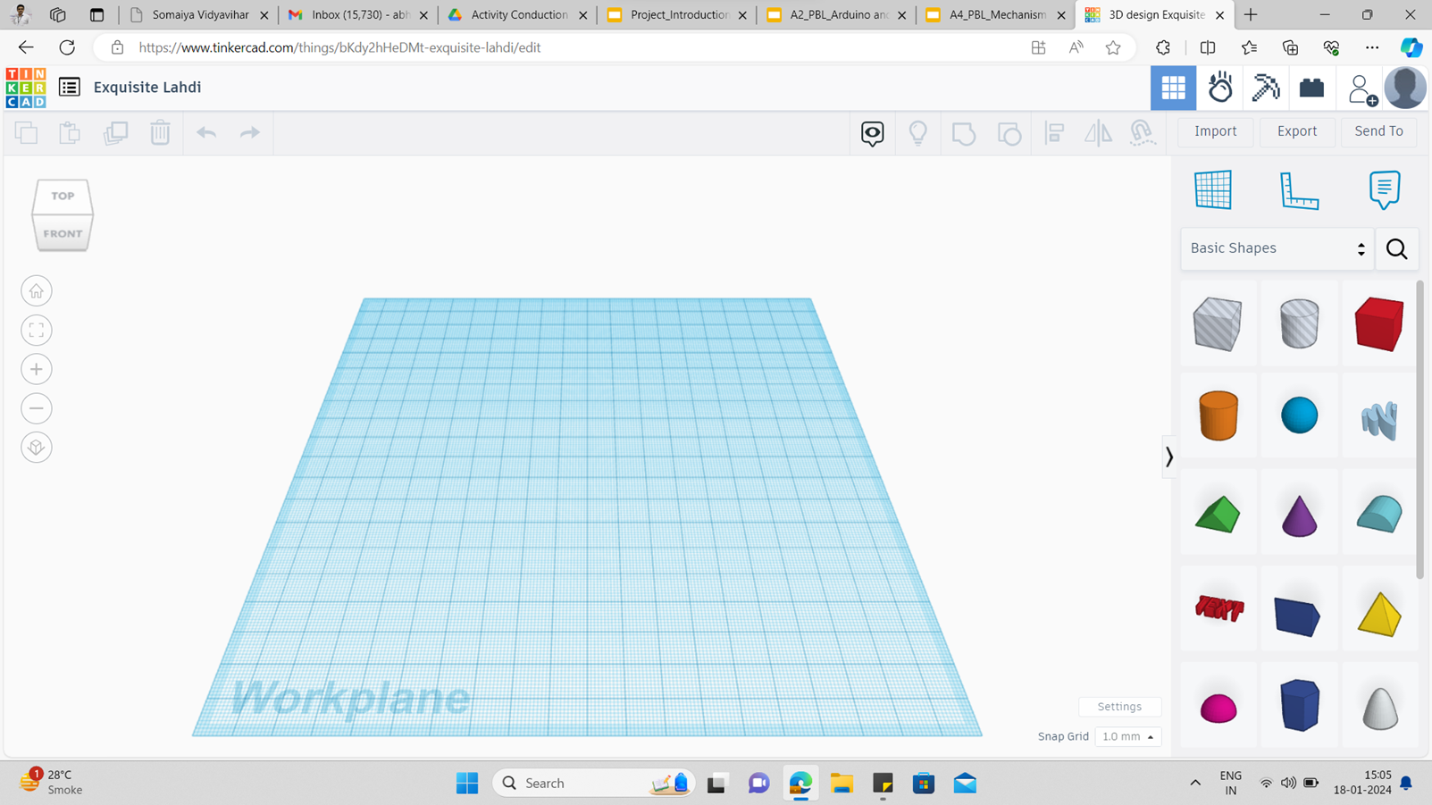
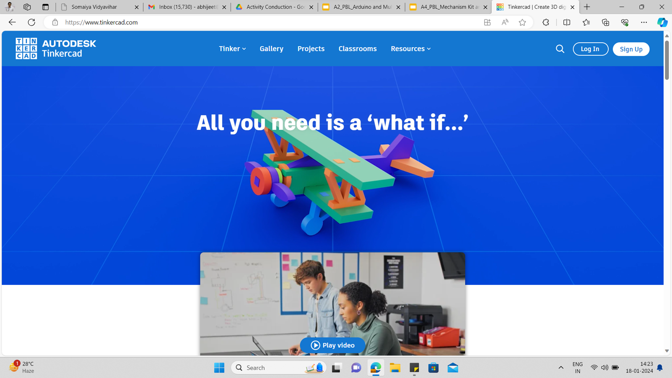

Using TinkerCAD
●Goto web address - www.tinkercad.com
●Log in / Sign up with somaiya email id as student account (By choosing Log In with Google Account)
●Once you log in/sign up go to Designs
●Click on Create and select 3D Design

Slide 25
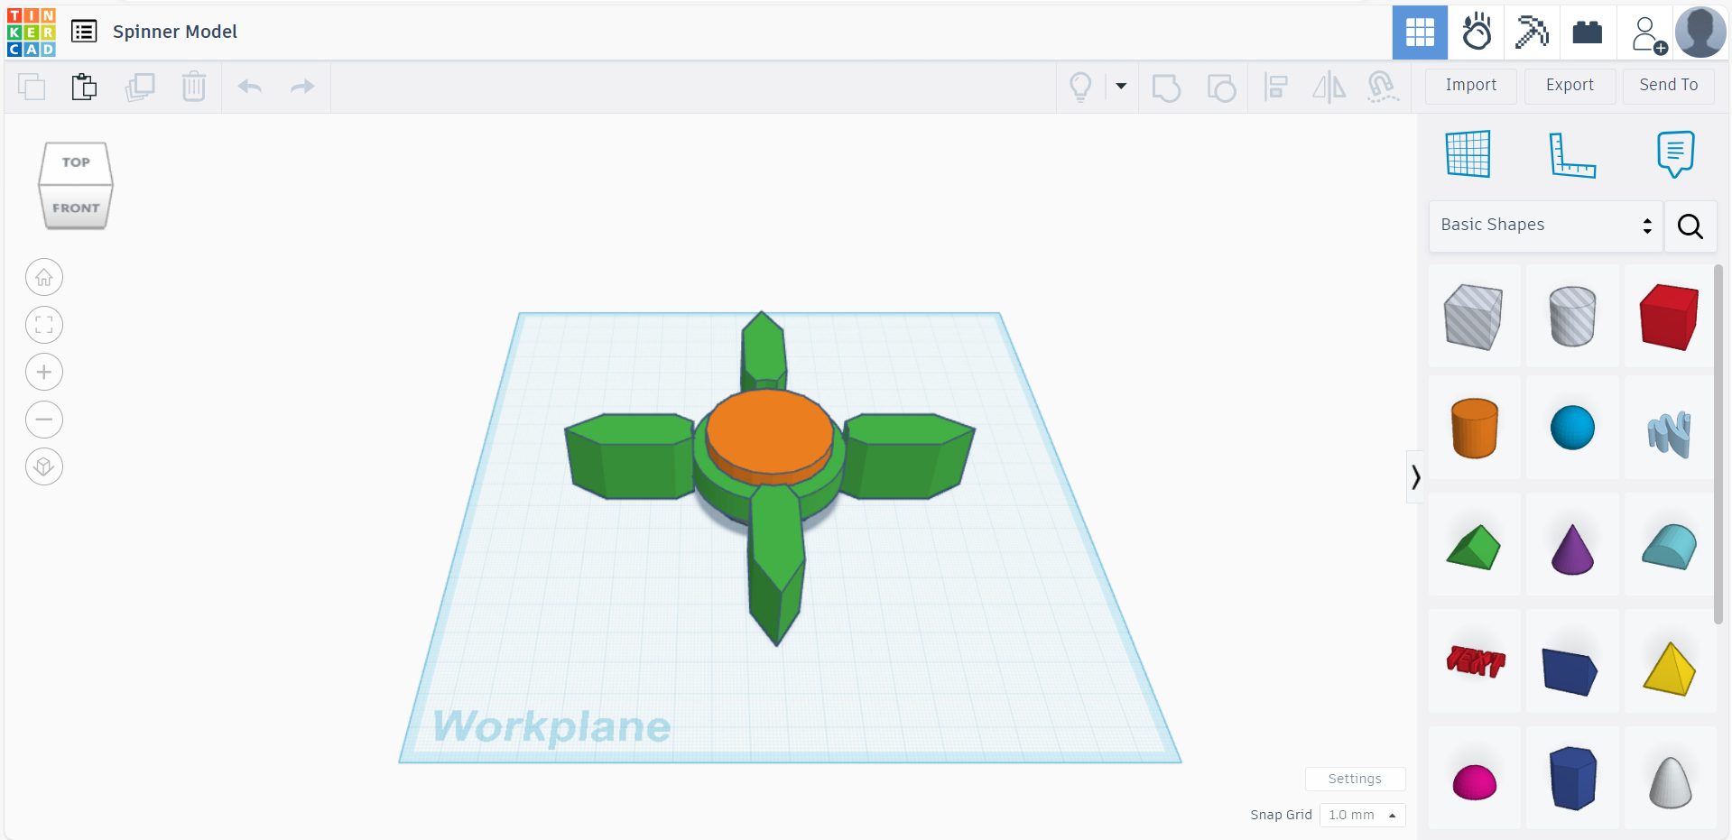
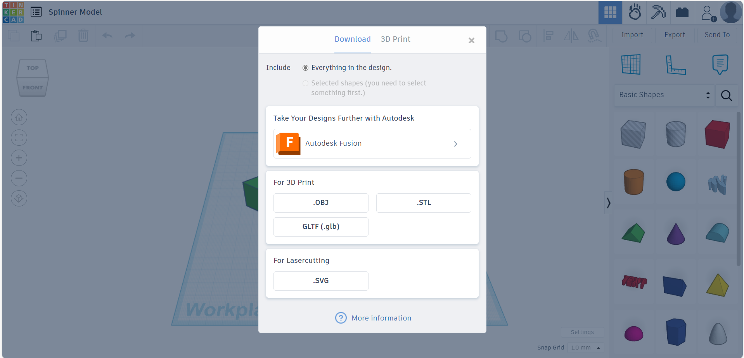
Generating .STL file
●Once design is ready, click on Export
●Click on .STL button to download the file in STL format
Click
Click

Slide 26
Generating .gcode file
●The downloaded .STL file can be opened with UltiMaker Cura Software
●Define print settings like
●Infill Density
●Infill Pattern
●Shell Thickness
●Support Type
●Support Placement
●Click on Slice to generate g code
●Save the file and upload on 3D Printer

Slide 27
3D Printing Steps
Prepare model in TinkerCAD
Export .STL file
Open Ultimaker CURA
Go to File - open file from disk
load .STL file
Click on Slice
save to disk (It generates G code file)
save G code file to SD card and start printing
(Material is Generic PLA)

Slide 28
Activity
Activity on 3D printing (Paper weight model) (Pen stand model)

