Slide 1


Project Based Learning
Semester II
January - April 2026

Slide 2
Outline
Input/ output ports on Arduino
Interfacing of sensors with Arduino board

Slide 3
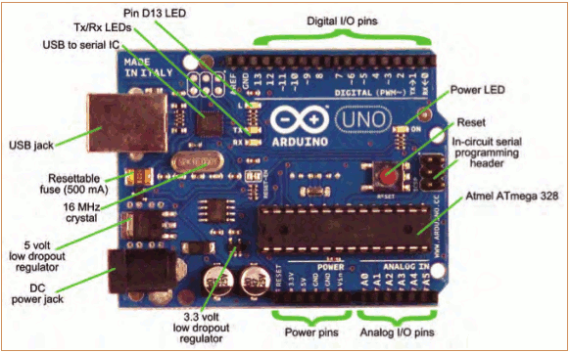


Introduction to Arduino UNO

Slide 4
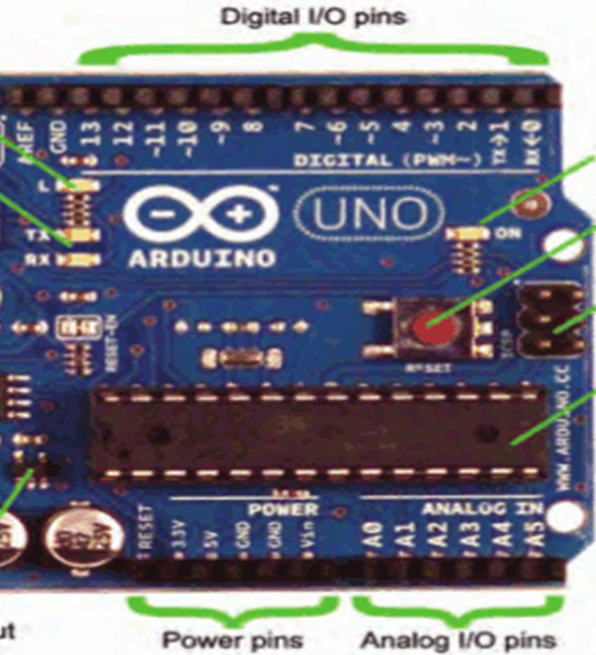

Data
Data has two ways of representation
Digital : only two valid values
Logic-0 : 0 V Logic-1: 5 V
Analog : continuous spectrum of values
Continuous Value 0.0 V to 5.0 V
The necessity of conversion of analog to Digital
Arduino ADC Size : 10 bit
so 2¹⁰ = 1024 Levels
Every level 0 to 5 V ≈ 4.89 mV

Slide 5
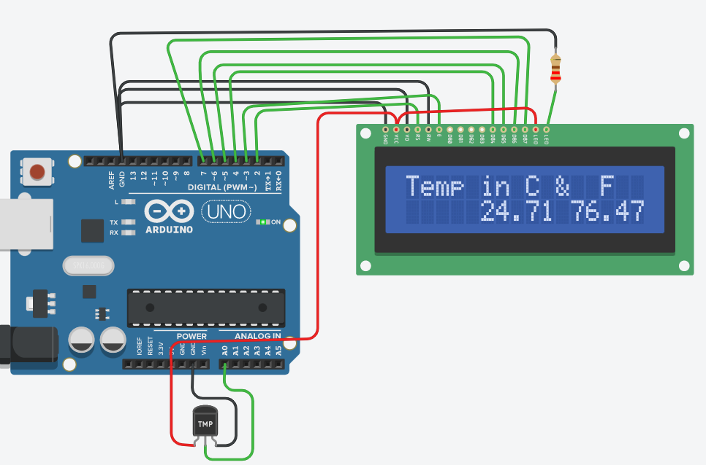
Interfacing of Sensors/input & actuators/output devices with Arduino
Actuators (Motors)
Output Devices
Data Processing
(Micro-controller)
Output Device (LCD)
Input Devices
(Switches, Keypads )
Sensors
Sensor (Temperature)

Slide 6
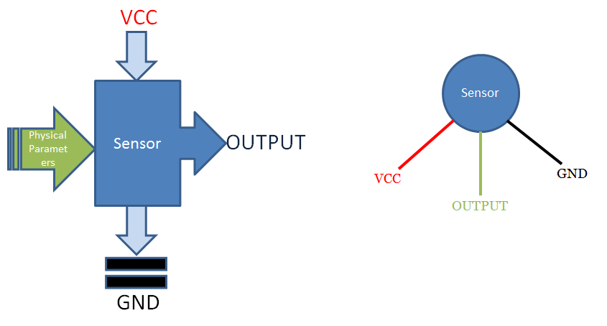
Sensors
Sensors convert physical quantity into electrical signal.
List of Sensors
Light sensor
Motion sensor
Temperature sensor
Magnetic fields sensor
Gravity sensor
Humidity sensor
Moisture sensor
Vibration sensor
Pressure sensor
Electrical fields sensor
Sound sensor
Position sensor
Why to Sense?
Connecting to the physical world
To quantify ( count in terms of numbers)
To monitor what is happening
To make decisions
Can we loop it?
Analog / Digital

Slide 7
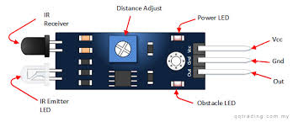
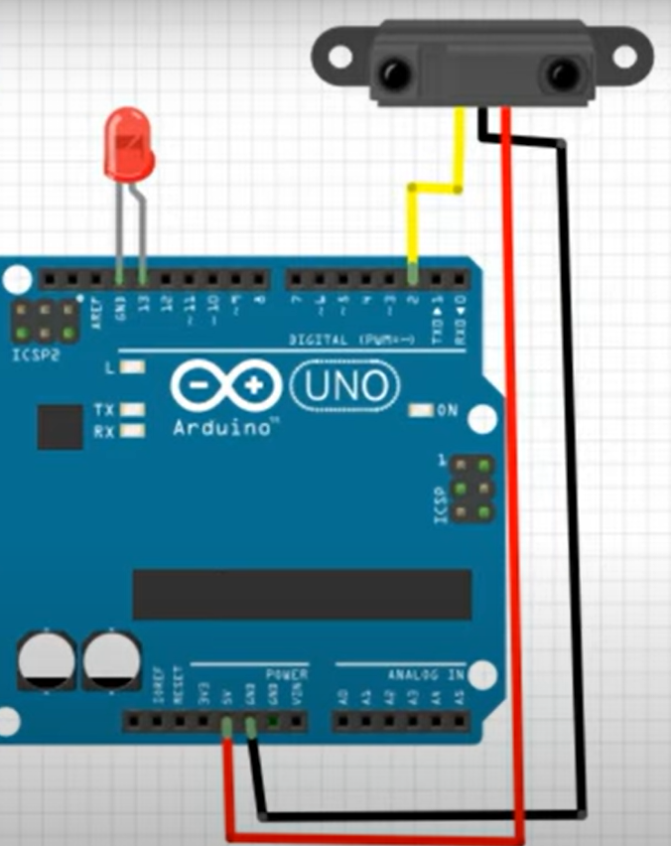
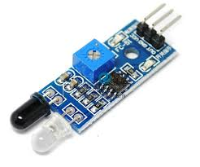
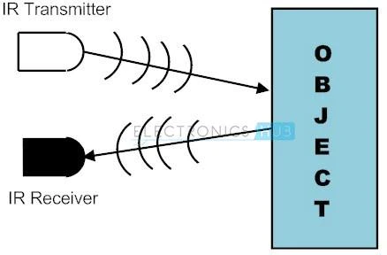
1. Proximity Sensors
1. Active IR Proximity sensor
Specifications
The operating voltage is 5VDC
I/O pins – 3.3V & 5V
Mounting hole
The range is up to 20 centimeters
The supply current is 20mA
The range of sensing is adjustable
Fixed ambient light sensor
Digital Output
Infrared (IR) has wavelengths: 780 nm and 1 mm, which corresponds to a frequency 300 GHz to 400 THz.

Slide 8
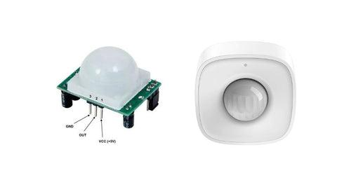

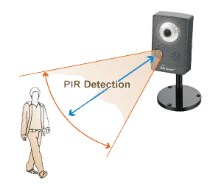
1. Proximity Sensors…
2. Passive IR (PIR) Proximity sensor
Detect movement of objects that radiate IR light (like human bodies).
Detect human movement or occupancy in security systems is very common.
Initial setup and calibration of these sensors takes about 10 to 60 seconds.
Two potentiometers on the board allow you to adjust the sensitivity and delay time after detecting a movement

Slide 9
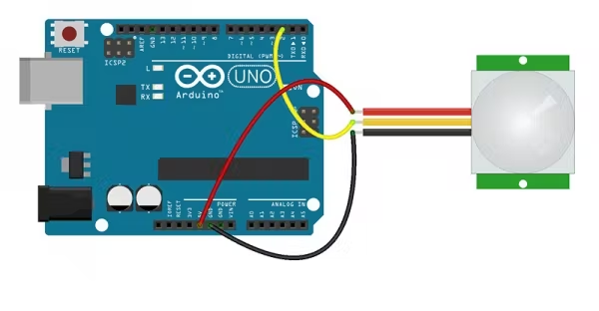
1. Proximity Sensors contd…
2. Passive IR (PIR) Proximity sensor
_{Specifications}
Wide Working Voltage Range: DC 4.5V- 20V
Current Drain: <60uA
Detection Angle: <140°
Detection Distance: 3 to 7m (can be adjusted)
Blockade time: 2.5s (Default)
Work temperature: -20-+80°C
Applications of IR sensors
Proximity Detector
Object counter
Radiation Thermometer
Gas Analysers

Slide 10
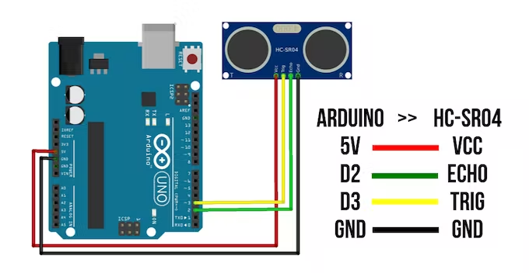
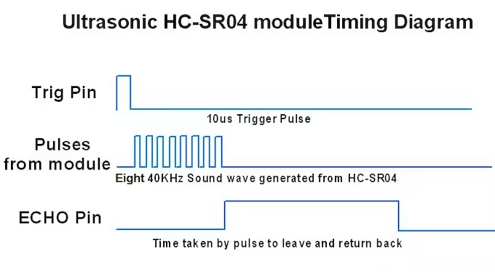
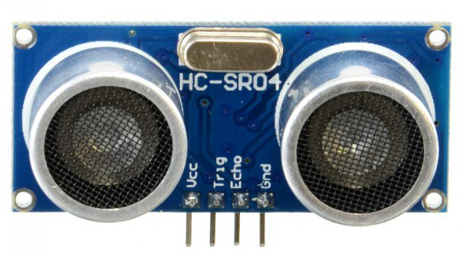
2. Distance Sensors
Ultrasonic Distance Sensor- HC SR 04
Transmits 40 KHz ultrasonic pulses and in case of object ,
received by receiver
Distance of object depends on time taken for detection
Distance= Speed * time of echo pulse
Can detect distance from 2cm to 400cm
Works on 5V

Slide 11
Criteria to choose a Sensor
Accuracy
Environmental condition – usually has limits for temperature/ humidity
Range – Measurement limit of sensor
Calibration – Essential for most of the measuring devices as the readings changes with time
Resolution – Smallest increment detected by the sensor
Cost
Repeatability – The reading that varies is repeatedly measured under the same environment

Slide 12
Graded Activity
Using an Arduino Uno, interface the IR sensor, PIR motion sensor, and Ultrasonic distance sensor.
Demonstrate how each sensor works and display the output on the Serial Monitor.
Submit the circuit connections, code, and output screenshots on LMS

