Slide 1



Project Based Learning
Semester II
January - April 2026

Slide 2
Motors interfacing with Arduino

Slide 3
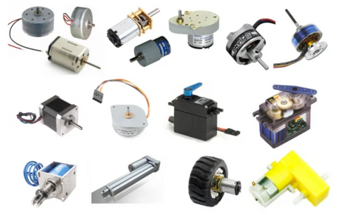
Electric Motors used as Actuators
Electrical machine that converts electrical energy into mechanical energy.
Works on interaction between the motor's magnetic field and electric current in a wire winding to generate force in the form of torque applied on the motor's shaft.
AC MOTOR
BRUSHED DC MOTOR
BRUSHLESS DC MOTOR
GEARED DC MOTOR
SERVO MOTOR
STEPPER MOTOR.

Slide 4
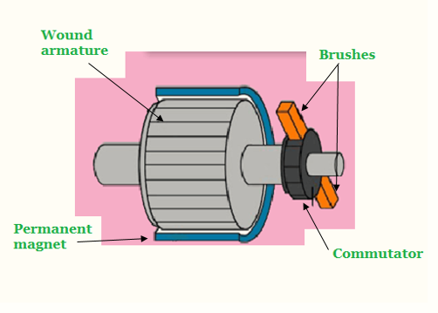
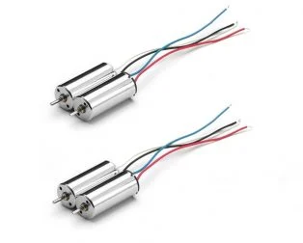
Motors used in Robotic Applications…
1. Brushed DC Motor
It typically consists of a pair of permanent magnets named as the stator and a motor coil named as the rotor connected to a commutator. In this motor, armature winding is on rotor and permanent magnets are always on the stator.
Limitations of Brushed DC motor
Less efficient , Electrically noisy due to switching action of the commutators
Lifespan: As they are in perpetual physical contact with the shaft, brushes and commutators wear out.

Slide 5
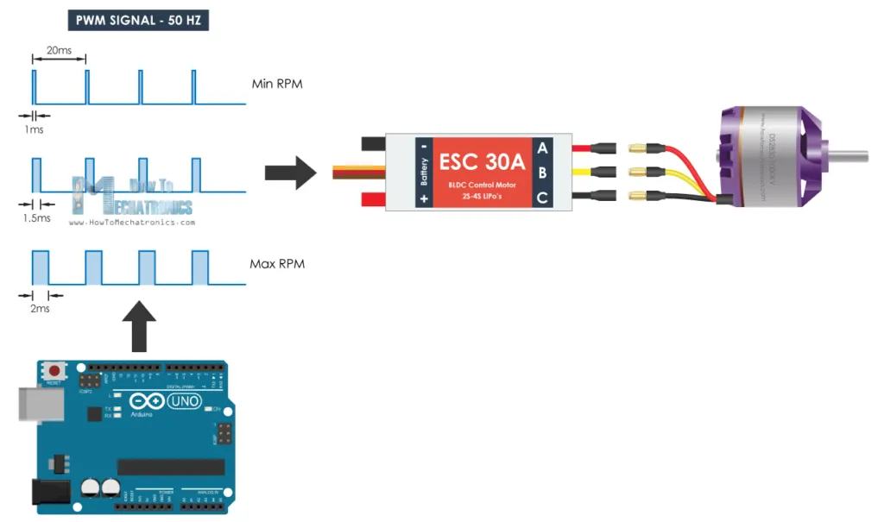
Motors used in Robotic Applications…
2. Brushless DC (BLDC)Motor
The brushless DC motor do not use brushes. the rotor is a permanent
magnet; the coils do not rotate, but are instead fixed in place on the stator.
Advantages of Brushed DC motor
High Efficiency, as these motors can control continuously at maximum rotational force (torque).
High durability , low electric noise generation , due to the lack of brushes.
Controlled using feedback mechanism, to deliver precisely the desired torque and rotation speed.

Slide 6
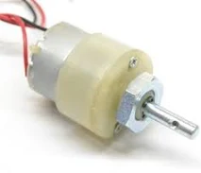
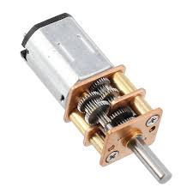
Motors used in Robotic Applications…
3. Geared DC Motor
Geared DC motors can be defined as an extension of DC motor.
A geared DC Motor has a gear assembly attached to the motor.
The gear assembly helps in increasing the torque and reducing the speed.
Using the correct combination of gears in a gear motor, its speed can be reduced to any desirable figure.
Specifications:DC Geared Motor, 12V, 100 RPM, Torque up to 2 Kg-cm
Motor Type : DC with Gear Box, Metal Gears
Base Motor : DC 3000 RPM
Shaft Type : Circular 6mm Dia with Internal Hole for coupling, 23 mm shaft Length
Maximum Torque: ~3 Kg-cm at 12V
RPM : 100 RPM at 12V
Weight : 130 Gms
Max Load Current: ~330mA at 12V

Slide 7
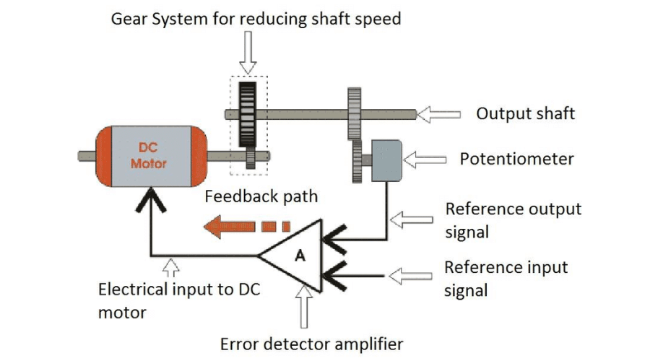
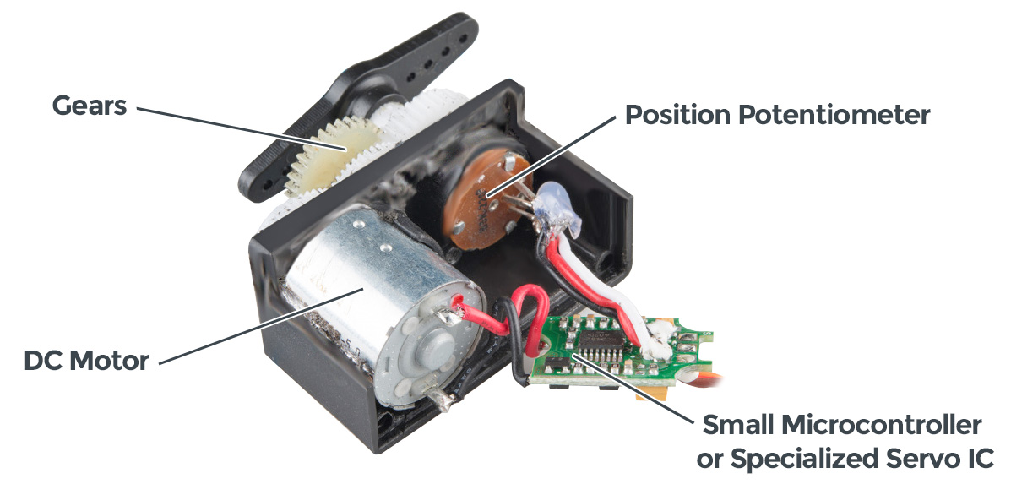
Motors used in Robotic Applications…
4. Servo motor
Closed-loop servomechanism that uses position feedback to control its motion and final position.
The input to its control is a signal (either analogue or digital) representing the position commanded for the output shaft.
The motor is paired with some type of position encoder to provide position and speed feedback..
If the output position differs from that required, an error signal is generated which then causes the motor to rotate in either direction, as needed to bring the output shaft to the appropriate position.
As the positions approach, the error signal reduces to zero and the motor stops.

Slide 8
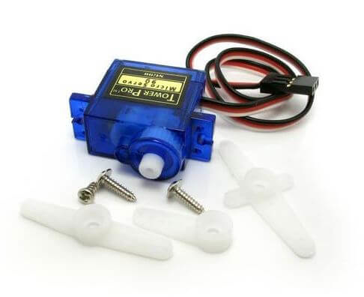
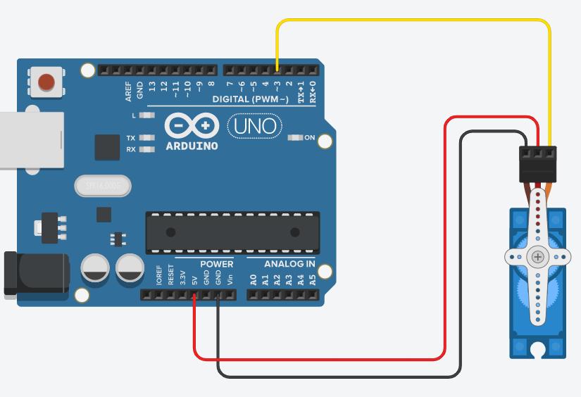
Motors used in Robotic Applications…
4. Servo motor..
Servo Motor SG90 Features
Working Frequency: 1520μs / 50hz
(RX) Required Pulse: 3.3 ~ 5 Volt Peak to Peak Square Wave
Operating Voltage: 4.8 ~ 6 V DC Volts
Operating Speed (4.8v):0.15 Sec/60 Degrees
Operating Speed (6v) 0.12 Sec/60 Degrees
Stall Torque (4.8v): 1.3kg/cm
Stall Torque (6v): 1.5kg/cm
Motor Type: Brushed DC Motor
Gear Type : Plastic Gears
Case Material: Plastic
Dimensions: 23 x 11.5 x 24mm
Weight: 9 grams

Slide 9
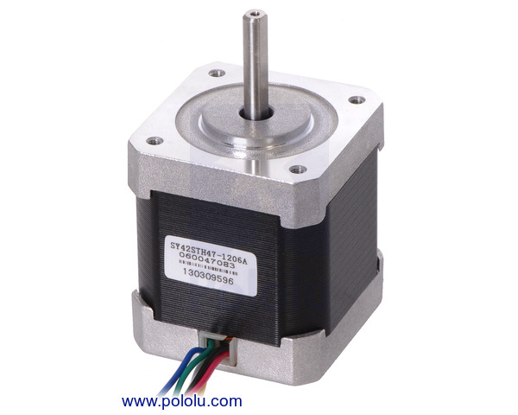
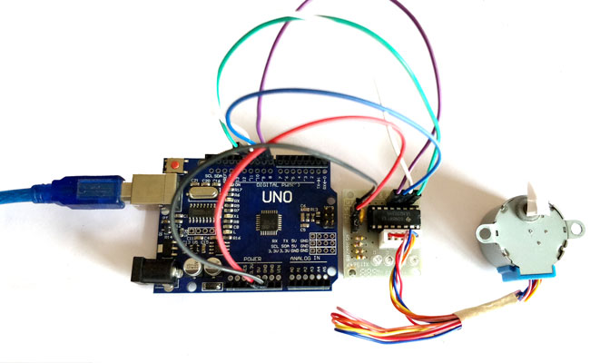
Motors used in Robotic Applications
5. Stepper motors
DC motors that divide a full rotation into a number of equal steps.
One pulse causes the motor to increment one precise angle of motion.
By energizing each step in sequence, the motor will rotate, one step at a time.
Increasing the current or pulse increases motor torque, and the higher the step frequency, the higher the motor speed.
The motor's position can be commanded to move and hold at one of these steps without any position sensor, as long as the motor is correctly sized to the application.
Typical Specifications
Size: 42.3 mm square × 48 mm
Weight: 350 g
Shaft diameter: 5 mm “D”
Steps per revolution: 200
Current rating: 1.2 A per coil
Voltage rating: 4 V
Resistance: 3.3 Ω per coil
Holding torque: 3.2 kg-cm
Inductance: 2.8 mH per coil

Slide 10
Electric Motors Types & Comparison
Motor Type | Pros | Cons | Applications
AC Motors | Robust, cost-effective, powerful | Speed control complexities | Industrial, Appliances
Brushed DC Motors | Simple, good speed control | Brush wear, noise, maintenance | Toys, declining use in automotive
Brushless DC | Long life, efficient, high power density | Complex control, more expensive | Drones, EVs, computer components
Geared DC Motors | High torque at low speeds, compact | Additional mechanical complexity | Robotics, winches
Servo Motors | Precise position control | Complex, expensive | Robotics, CNC
Stepper Motors | Precise open-loop control, holding torque | Limited speed, resonance issues | 3D printers, CNC

Slide 11
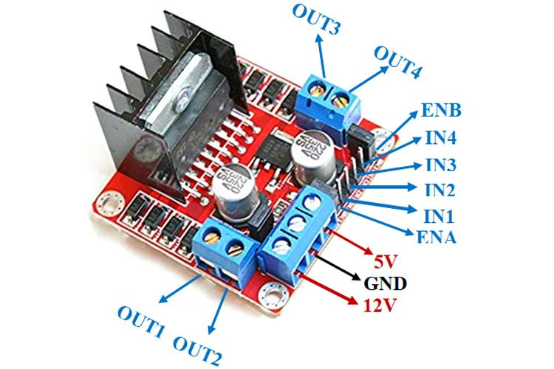
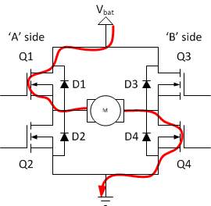


Motor Drivers
Can we connect the motor to arduino directly?
Need of a driver
L298 Motor Driver Module
Dual Bidirectional Motor Driver using H Bridge

Slide 12
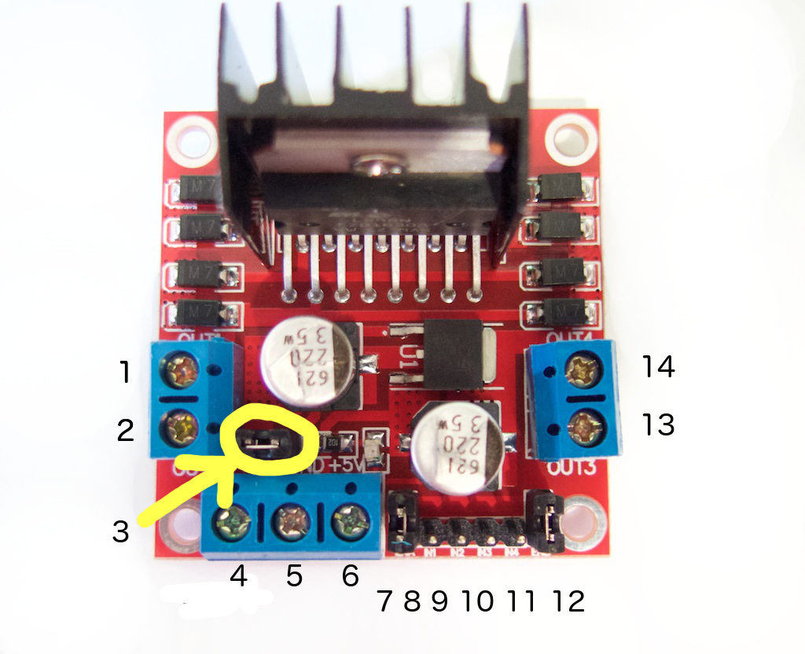
Interfacing Motor Driver
4:Module 5V (or Vcc) - Arduino 5V pin
5:Module GND - Arduino GND pin
6:Module 12V (or Vbat) - To external power source
Module output 1 & 2 - Connect dc motor A
Module output 13 & 14 - Connect dc motor B
7: Enable to Motor A
8:Module IN1
9:Module IN2
10:Module IN3
11:Module IN4
12: Enable to Motor B

Slide 13
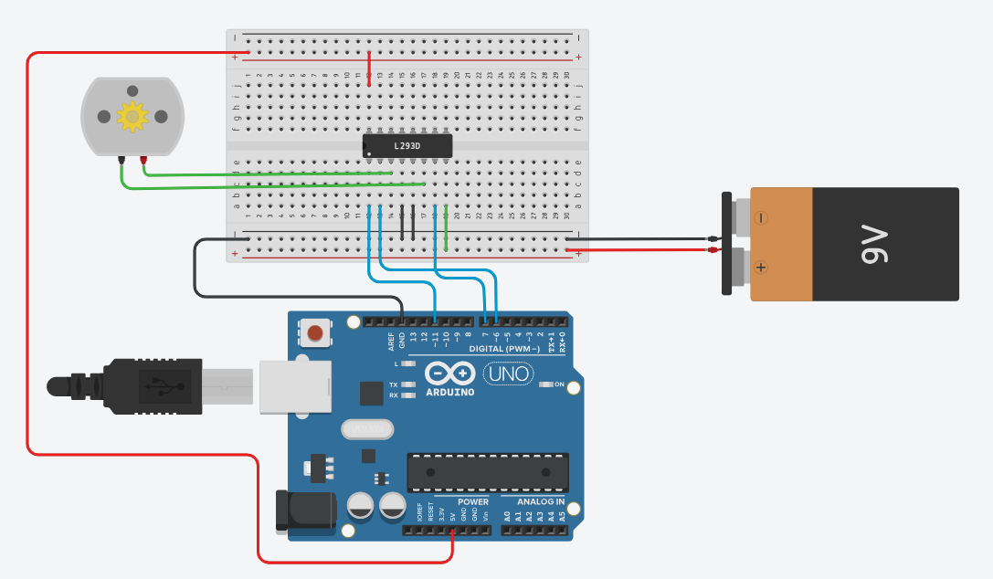
Speed and Direction Control of DC Motor
L 293 D Motor Driver IC
Pin Enable 1: Pin 11 of Arduino ( Analog Pin)
Input 1 : Pin 6 of Arduino
Input 2: Pin 7 of Arduino
Output 1: Motor
Outout 2: Motor
Gnd
Vcc
Activity
Create circuit on TinkerCAD
Simulate code in TinkerCAD for DC motor speed control and direction

Slide 14
Activity with Servo Motor
Tasks

