Slide 1
Non -Verbal Communication (Body Language)

Slide 2
What is non-verbal communication?
There are two methods of communication –Verbal and Non-Verbal.
Verbal Communication uses formal language.
Non-verbal communication is the process of sending or receiving wordless messages.

Slide 3
What is Body Language?
Using different parts of the body to convey messages is called Body Language. e.g. Use of:
Facial Expressions
Eye contact
Gestures
Postures
Appearance
Use of Space
Voice

Slide 4
Facial Expressions
Facial Expressions can indicate emotions like:
Anger
Excitement
Shyness
Depression
Boredom
Hatred
Happiness, etc.

Slide 5
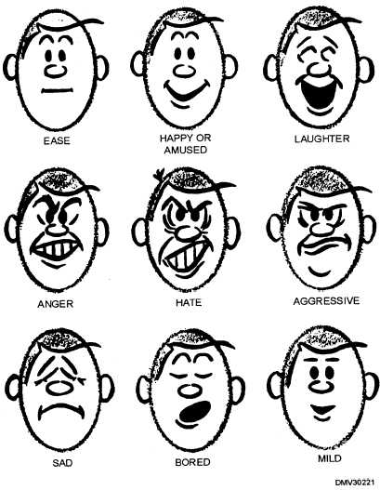

Slide 6
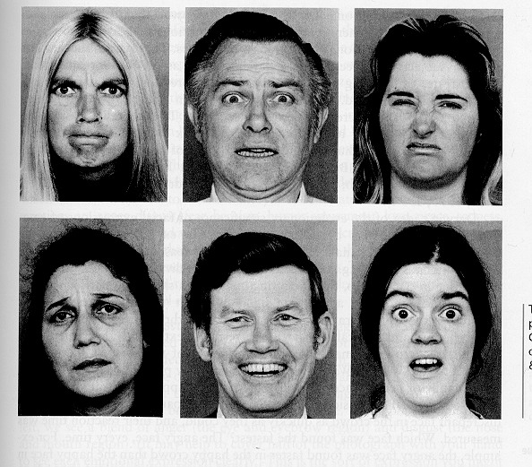
Facial Expressions

Slide 7


Slide 8
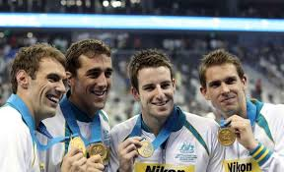

Slide 9
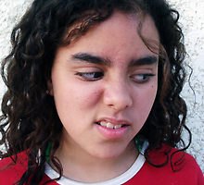

Slide 10
EYE CONTACT
The eyes are called ‘the windows of the soul’
Having direct eye contact shows honesty and confidence
Avoiding eye contact shows dishonesty
Look directly at the audience while giving presentations.

Slide 11
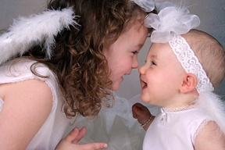

Slide 12
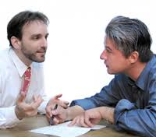

Slide 13


Slide 14
GESTURES
Gestures are movements of arms, hands and head.
The movement of the hands is most important
Many of these movements change their meaning in different cultures.

Slide 15
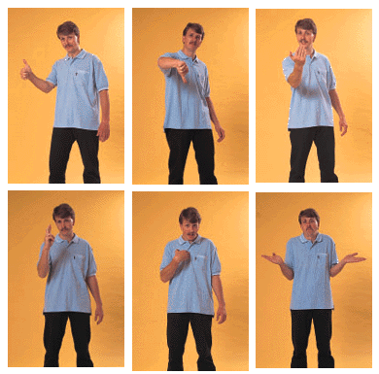

Slide 16


Slide 17


Slide 18


Slide 19
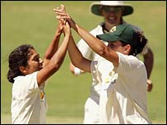

Slide 20
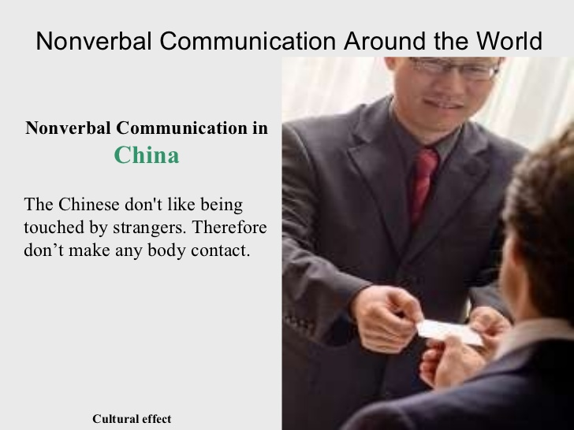

Slide 21
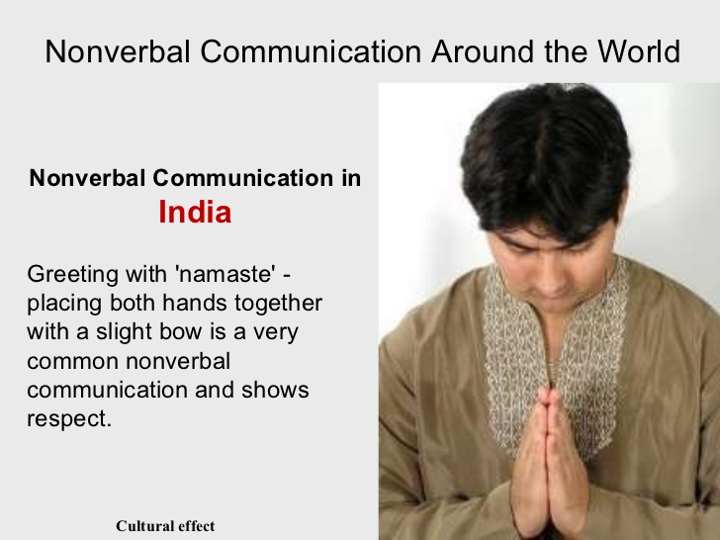

Slide 22
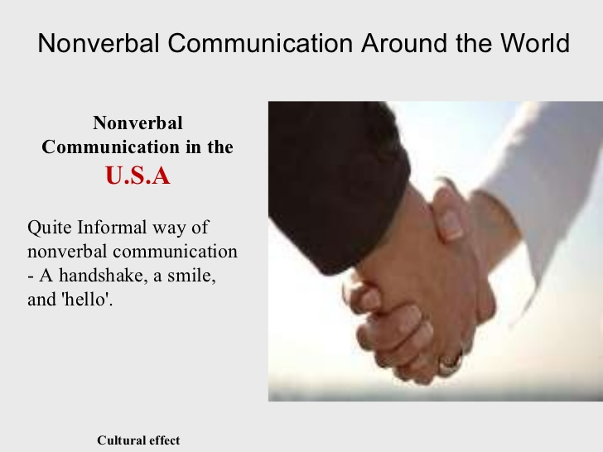

Slide 23
POSTURE
Posture is an important part of the general impression we make on others.
Our posture shows our attitudes and emotions.
Our posture should be natural.

Slide 24
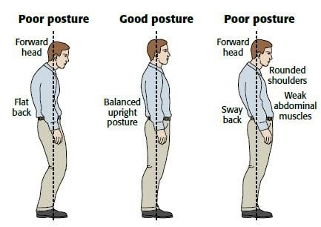

Slide 25
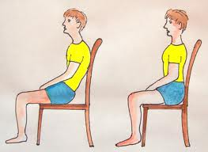

Slide 26
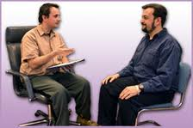

Slide 27
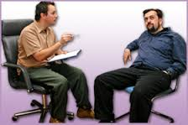

Slide 28
Appearance
By appearance we mean choice of clothes, cosmetics etc.
A well dressed person always gets better treatment than a badly dressed one.
The way we dress and look tells a lot about our mental make-up, attitude and emotional status.

Slide 29


Slide 30
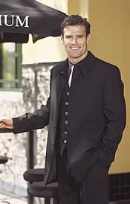

Slide 31
USE OF SPACE
Intimate zone—6’’—18”
Personal zone—18”--48”
Social zone—4ft—12ft
Public zone—beyond 12

Slide 32

Intimate Zone 6”—18”

Slide 33
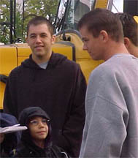
Personal Zone—18”—48”

Slide 34
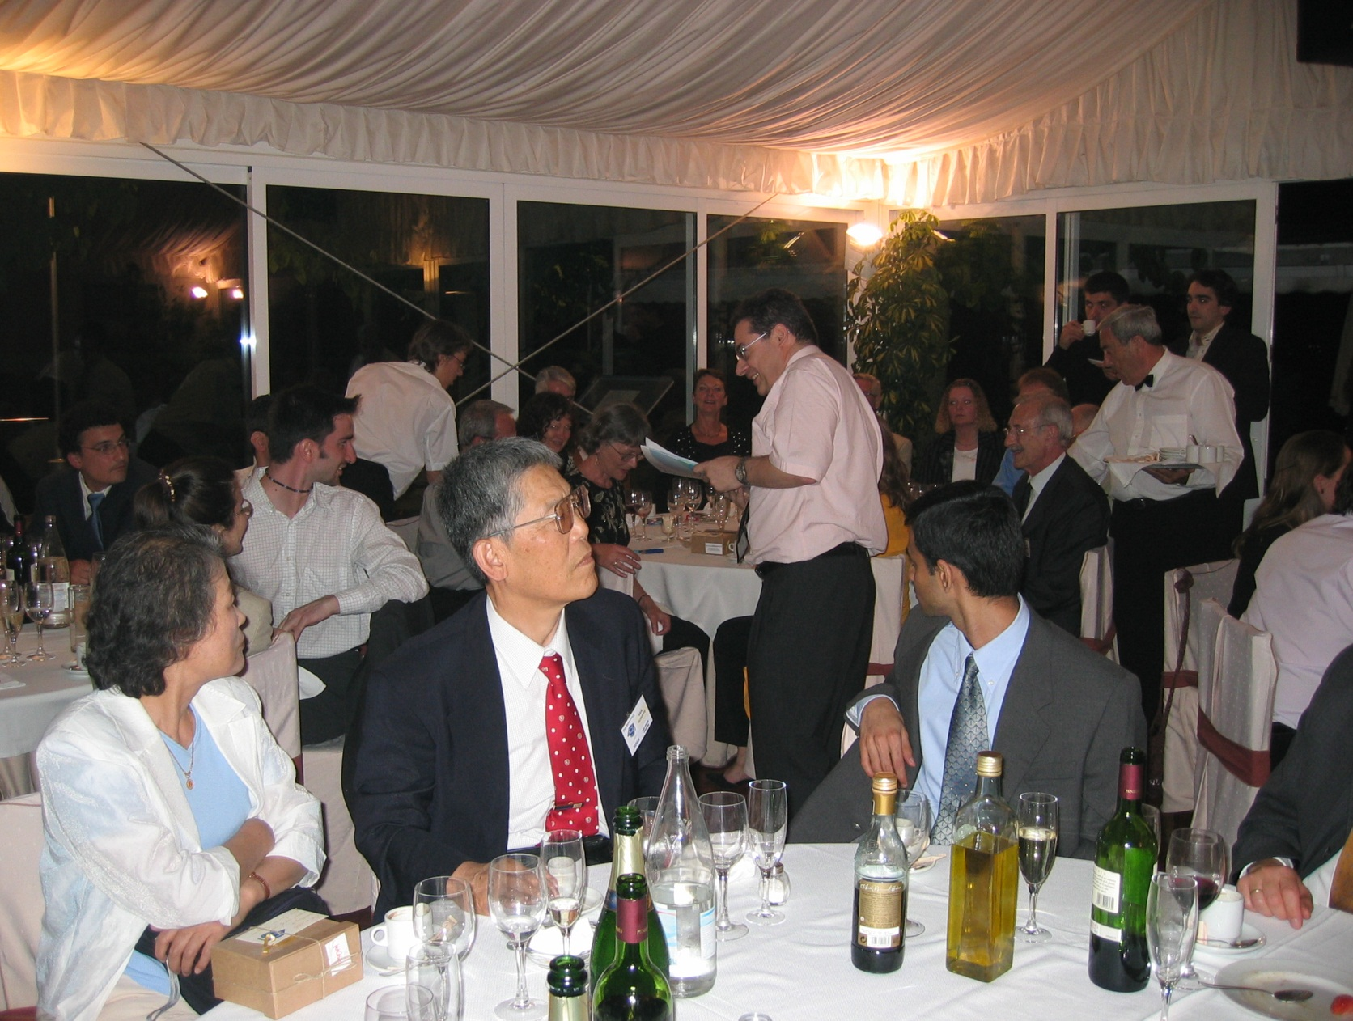
Social Zone-4ft.—12ft.

Slide 35
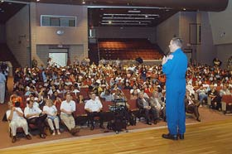
Public Zone—beyond 12 ft.

Slide 36
IMPORTANCE OF BODY LANGUAGE
Practically all the judgments we make are generally based on non-verbal comm
We look at people’s faces first, and then listen to their voices
Body language provides 55% of the force of any response

Slide 37
“The most important thing in communication is hearing what isn’t said”.

Slide 38
THANK YOU

Slide 39
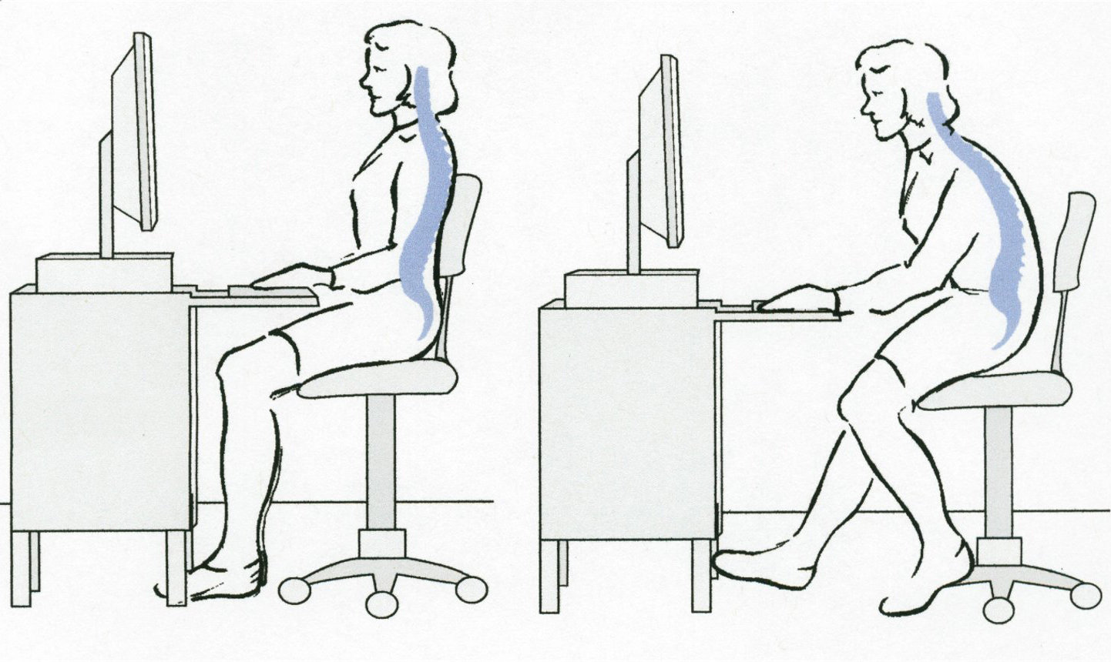

Slide 40
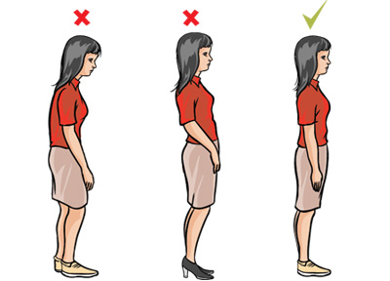

Slide 41
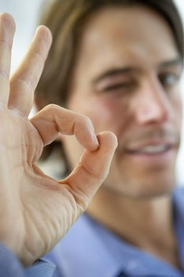

Slide 42


Slide 43
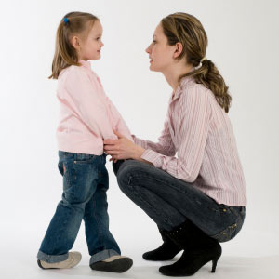

Slide 44
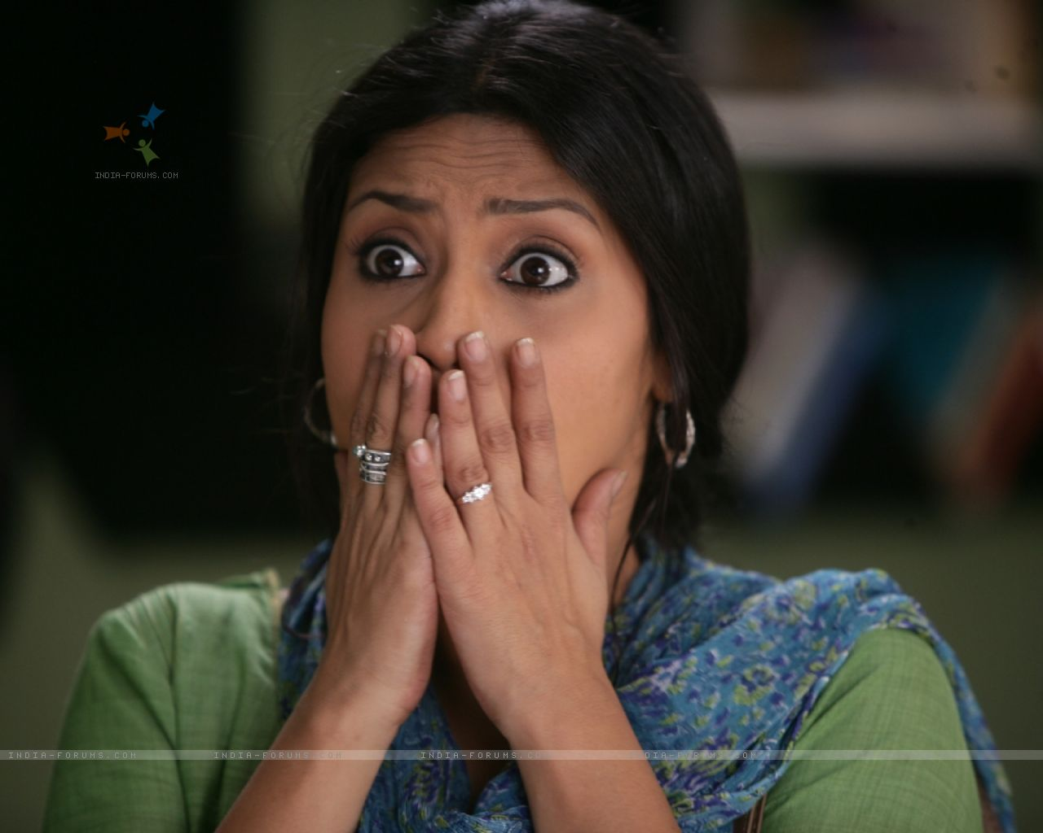

Slide 45
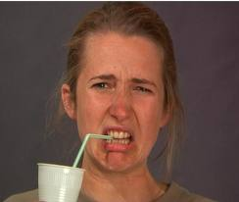

Slide 46


Slide 47
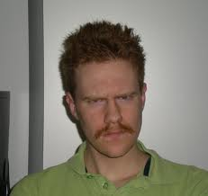

Slide 48
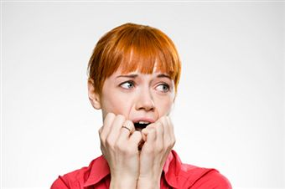

Slide 49


Slide 50
Thank You

