Slide 1
Introduction to Exploratory Data Analysis
Sharvari Deshmane
K J Somaiya School of Engineering
08-01-2026
Exploratory Data Analysis
1

Slide 2
Introduction to Exploratory Data Analysis (EDA)
08-01-2026
2

Slide 3
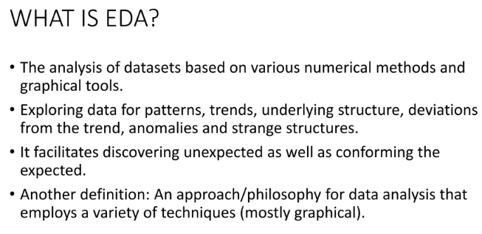
Introduction to Exploratory Data Analysis (EDA)
08-01-2026
3

Slide 4
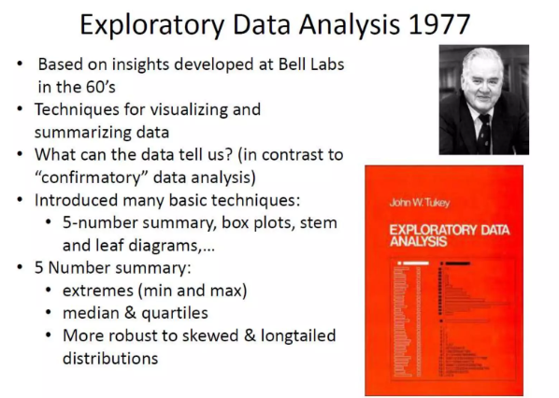

Slide 5
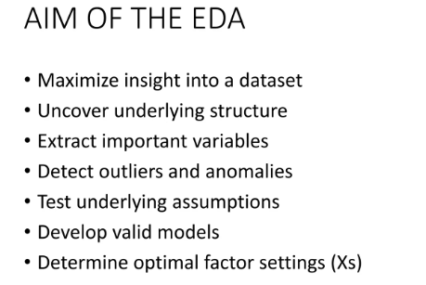

Slide 6
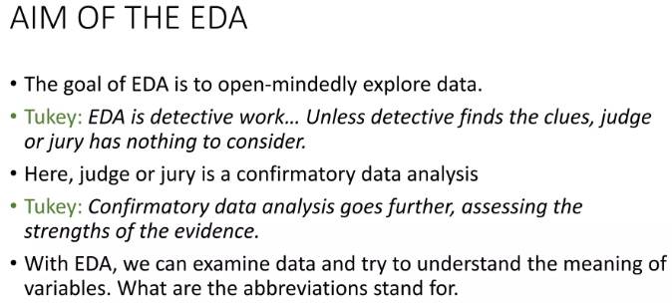

Slide 7
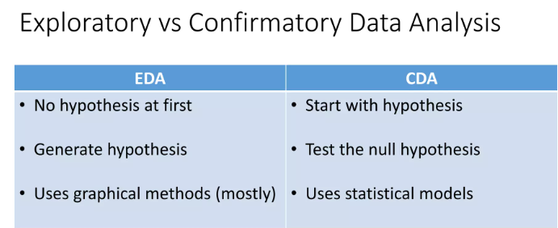

Slide 8
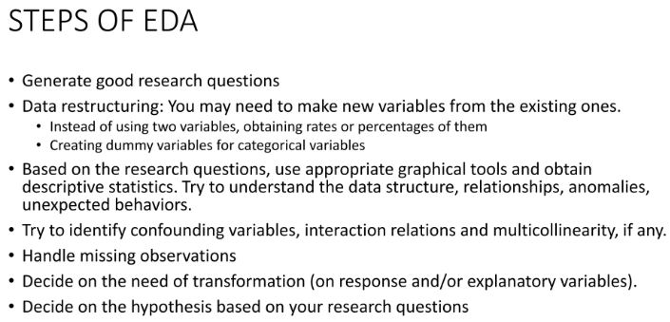

Slide 9
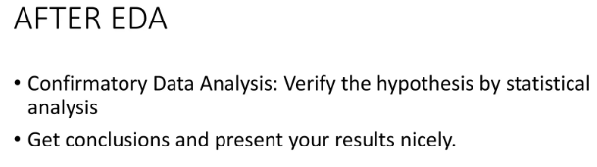

Slide 10
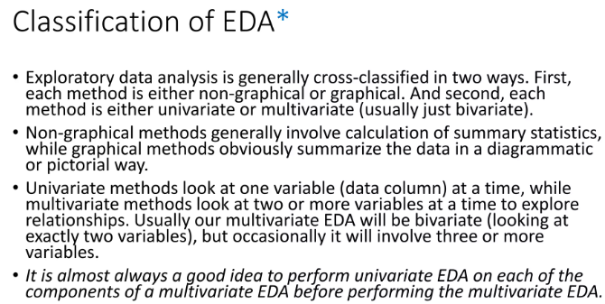

Slide 11
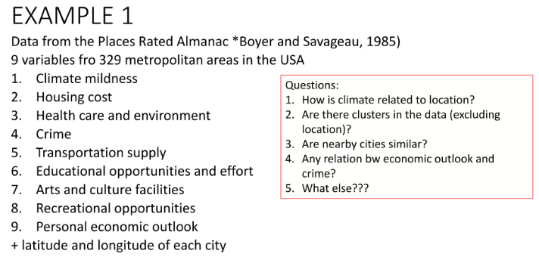

Slide 12
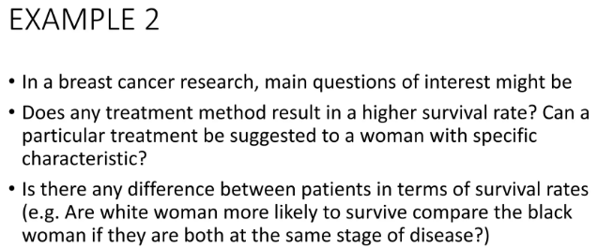

Slide 13
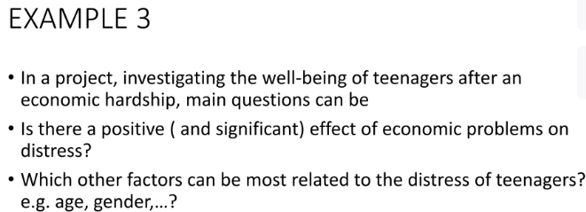

Slide 14
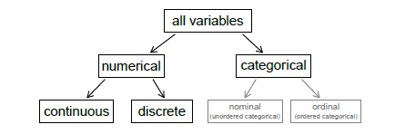
Types of variables

Slide 15
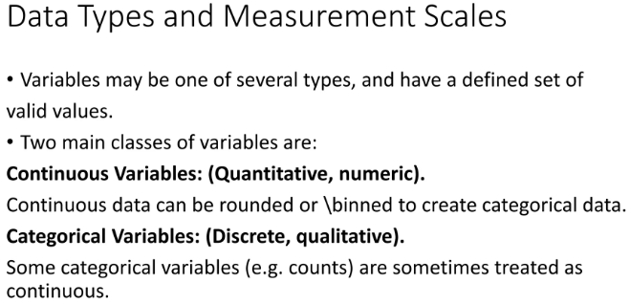


Slide 16
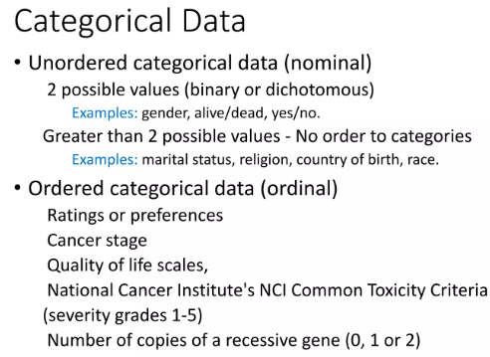

Slide 17
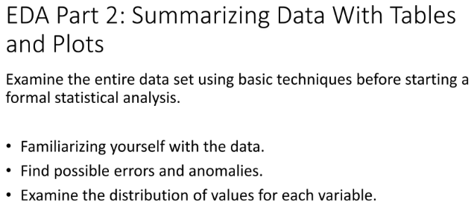

Slide 18
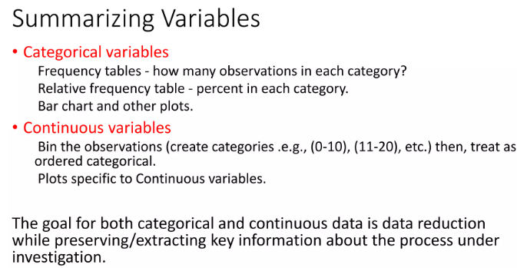

Slide 19
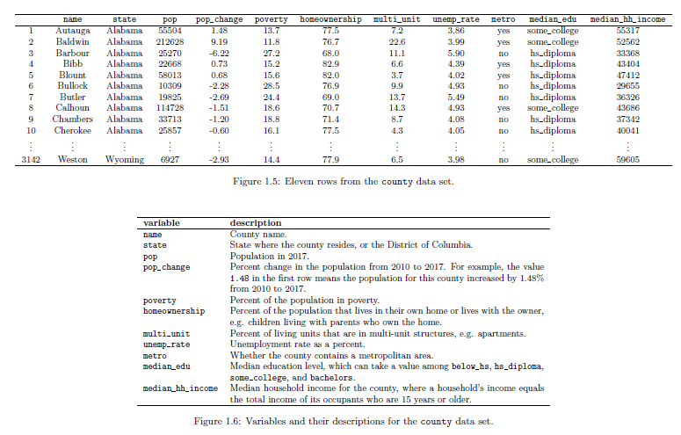

Slide 20
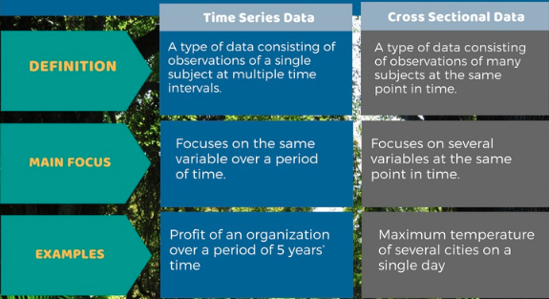

Slide 21
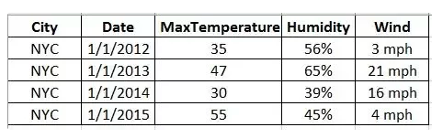
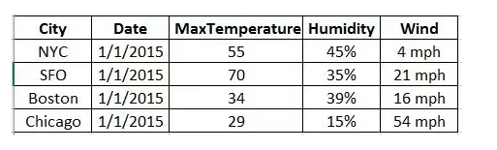
Time series Vs Cross-Sectional data

Slide 22
DESCRIBING DATA SETS
Frequency Tables and Graphs
Relative Frequency Tables and Graphs
Grouped Data
Histograms
Ogives
Stem and Leaf Plots

Slide 23
Frequency Tables
The marks awarded for an assignment set for a class of 20 students were as follows: 6 7 5 7 7 8 7 6 9 7 4 10 6 8 8 9 5 6 4 8
Present this information in a frequency table.

Slide 24
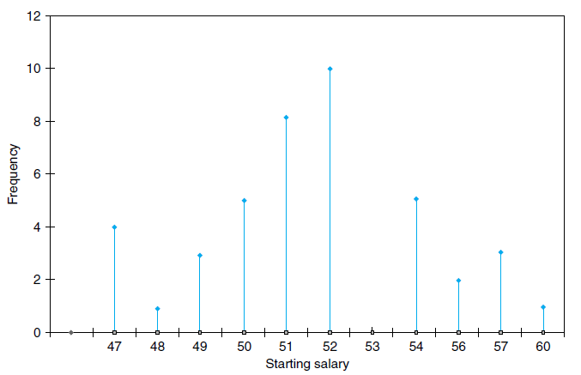
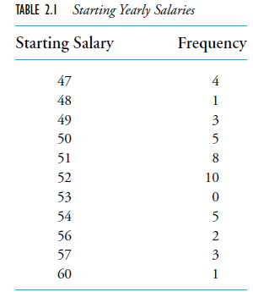
Line graph

Slide 25
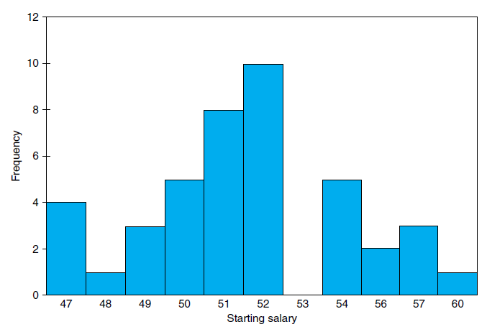
Bar graph

Slide 26
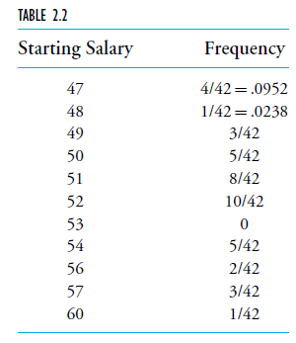
Relative Frequency Tables and Graphs
Consider a data set consisting of n values. If f is the frequency of a particular value, then the ratio f /n is called its relative frequency

Slide 27
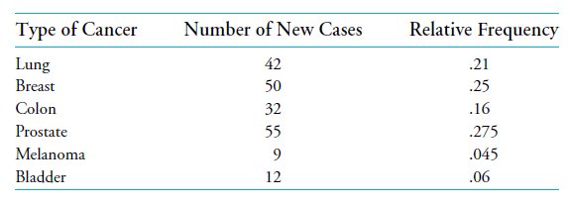
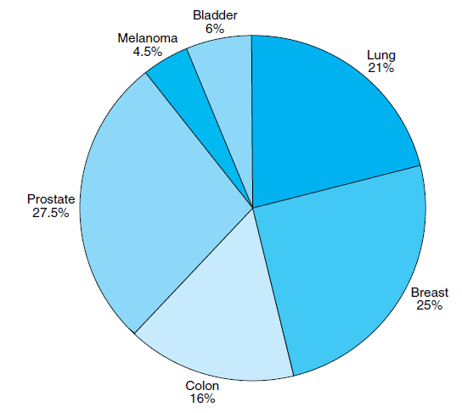
Pie Chart

Slide 28
Grouped Data, Histograms, Ogives, and Stem and Leaf Plots
Divide the values into groupings, or class intervals, and then plot the number of data values falling in each class interval
The endpoints of a class interval are called the class boundaries
We will adopt the leftend inclusion convention

Slide 29

Grouped Data
The number of calls from motorists per day for roadside service was recorded for the month of December 2003. The results were as follows:
Set up a frequency table for this set of data values
Notes:
http://www.mathsteacher.com.au/year8/ch17_stat/03_freq/freq.htm

Slide 30
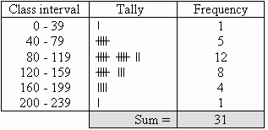
Grouped Data

Slide 31
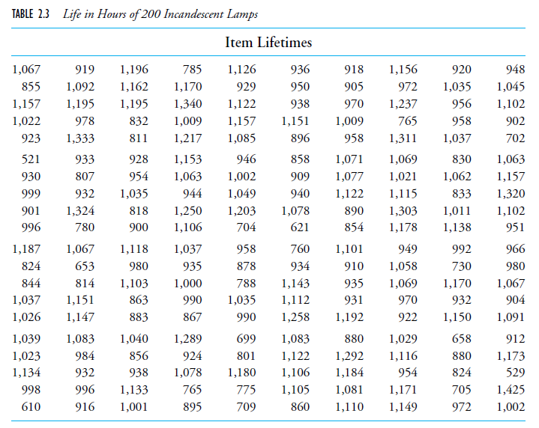

Slide 32
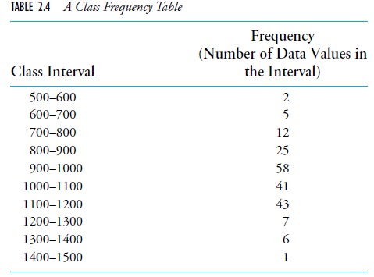
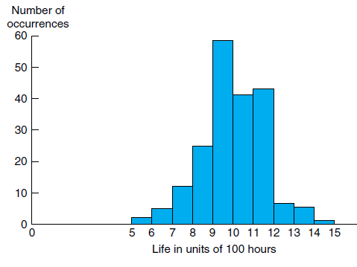
Histogram
Frequency histogram
Notes:
A bar graph plot of class data, with the bars placed adjacent to each other, is called a histogram

Slide 33
Stem and leaf plot
An efficient way of organizing a small- to moderate-sized data set
Thus, for instance, the value 62 is expressed as
Stem Leaf
6 2
and the two data values 62 and 67 can be represented as
Stem Leaf
6 2,7

Slide 34
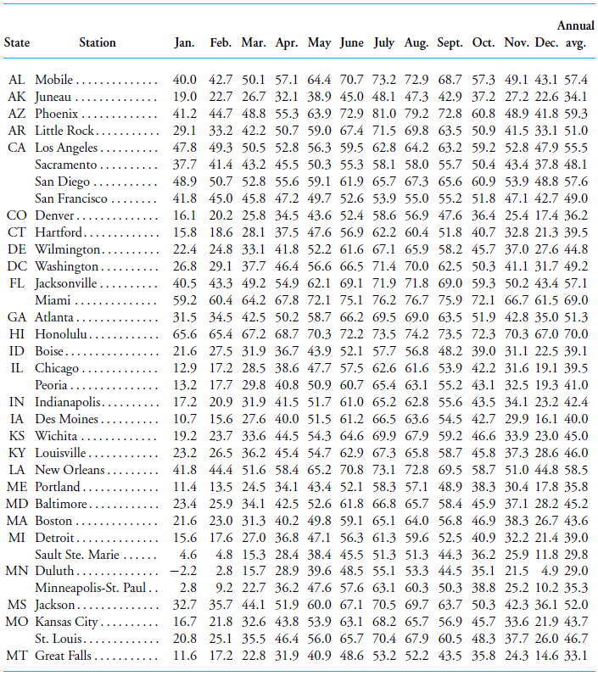

Slide 35
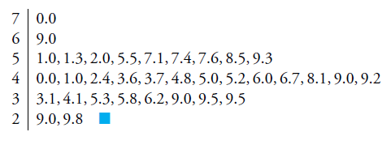
Stem and leaf plot

Slide 36
SUMMARIZING DATA SETS
Sample Mean, Sample Median, and Sample Mode
Sample Variance and Sample Standard Deviation
Sample Percentiles and Box Plots

Slide 37


Sample Mean
Suppose that we have a data set consisting of the n numerical values x1, x2, . . . , xn
The sample mean is the arithmetic average of these values

Slide 38
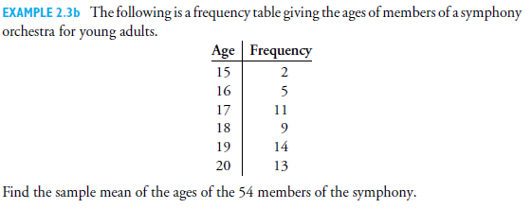


Slide 39
Sample Median
It is the middle value when the data set is arranged in increasing order
Procedure to find median
Order the values of a data set of size n from smallest to largest
if n is even, it is the average of the values in positions n/2 and n/2+1
If n is odd, the sample median is the value in position (n+1)/2

Slide 40
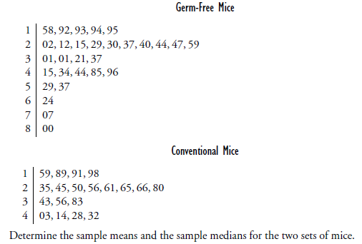

Slide 41
Solution
Germ-Free Mice sample mean = 344.07,
Conventional Mice sample mean = 292.32
The Germ-Free Mice sample median is the 15th largest data value, namely, 259
Sample median for the Conventional Mice is the 10th largest data value, namely, 265

Slide 42
Sample mode
Defined to be the value that occurs with the greatest frequency

Slide 43
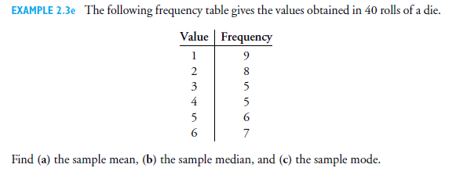

Slide 44

Solution

Slide 45

Sample Variance
Describe the spread or variability of the data values

Slide 46




Slide 47
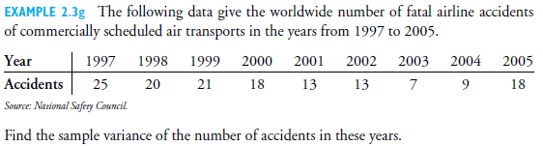
Ans : 34.75

Slide 48
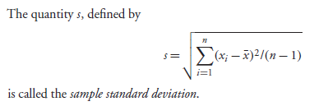
Sample Standard Deviation

Slide 49
Sample Percentiles
The sample 100p percentile is that data value such that 100p percent of the data are less than or equal to it and 100(1−p) percent are greater than or equal to it.
The sample 25 percentile is called the first quartile
The sample 50 percentile is called the sample median or the second quartile
The sample 75 percentile is called the third
quartile.

Slide 50
Sample Percentiles
To accomplish this:
First arrange the data in increasing order
If n is number of samples and p is the percentile to be calculated, then
if np is not an integer, then sample percentile is the smallest integer exceeding np
if np is an integer, then both the values in positions np and np+1 satisfy the preceding conditions, and so the sample 100p percentile is the average of these values.

Slide 51
Avg. Temperature of cities
Find sample 10 percentile
34*0.1=3.4, so 4th smallest value – 34.1

Slide 52

Solution:

Slide 53
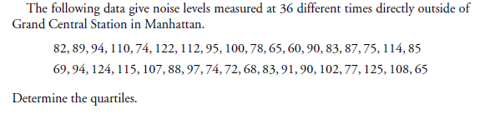
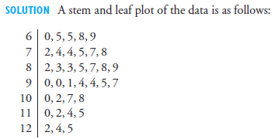

Slide 54
First quartile: 36*.25=9, avg of 9th and 10th smallest value=76
Second quartile: 36*.5=18, avg of 18th and 19th smallest value=89.5
Third quartile: 36*.75=27, avg of 27th and 28th smallest value=104.5

Slide 55

Box plot
Summarizing statistics of a data set
A straight line segment from the smallest to the largest data value is drawn on a horizontal axis
Imposed on the line is a “box,” which starts at the first and continues to the third quartile, with the value of the second quartile indicated by a vertical line

Slide 56
Box plot
60
125
76
89.5
104.5

Slide 57
PAIRED DATA SETS
Sets that consist of pairs of values that have some relationship to each other
Data set of paired values is to plot the data on a two dimensional graph,
The x-axis representing the x value of the data
The y-axis representing the y value. Such a plot is called a scatter diagram

Slide 58
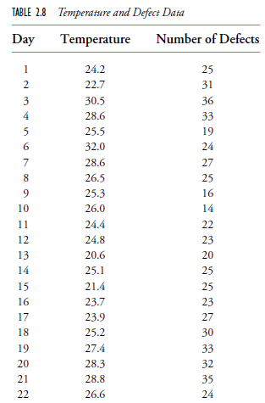

Slide 59
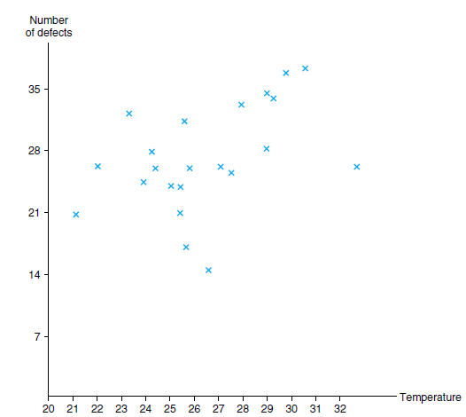
Scatter Diagram

Slide 60
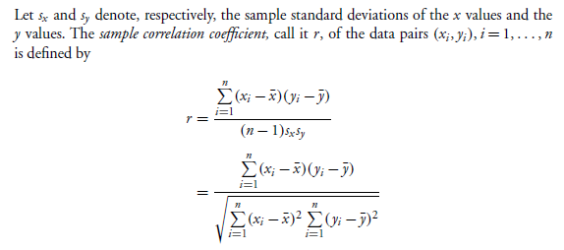
Sample correlation coefficient
When r >0 we say that the sample data pairs are positively correlated, and when r <0 we
say that they are negatively correlated.
When r >0 we say that the sample data pairs are positively correlated, and when r <0 we say that they are negatively correlated.

Slide 62
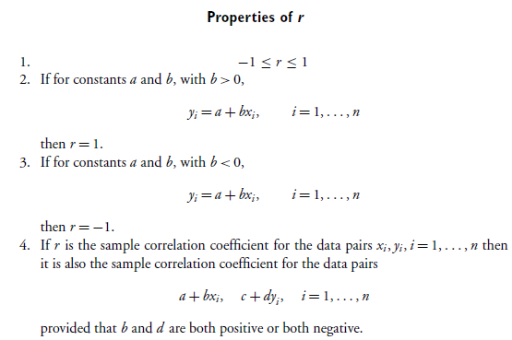

Slide 63
Sample correlation coefficient
The absolute value of the sample correlation coefficient r (that is, |r|, its value without regard to its sign) is a measure of the strength of the linear relationship between the x and the y values of a data pair
A value of |r| equal to 1 means that there is a perfect linear relation

Slide 64
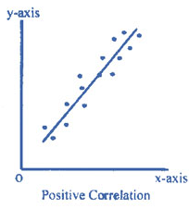
Sample correlation coefficient
The sign of r gives the direction of the relation
r is positive when the linear relation is such that smaller y values tend to go with smaller x values and larger y values with larger x values

Slide 65
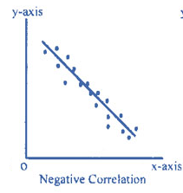
Sample correlation coefficient
r is negative when larger y values tend to go with smaller x values and smaller y values with larger x values

Slide 66
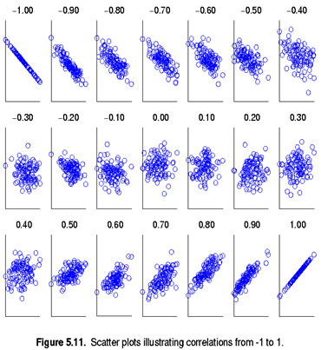

Slide 67
r =.4189

Slide 68

The following data give the resting pulse rates (in beats per minute) and the years of schooling of 10 individuals.

Slide 69
