Slide 1
Introduction to Microprocessor 8086
Savita C. Raut
EXTC Department

Slide 2
Contents :
Architecture of 8086 microprocessor
Register organization
8086 flag register and its functions
Addressing modes of 8086
Pin diagram of 8086
Minimum mode & Maximum mode system
Timing diagrams

Slide 3
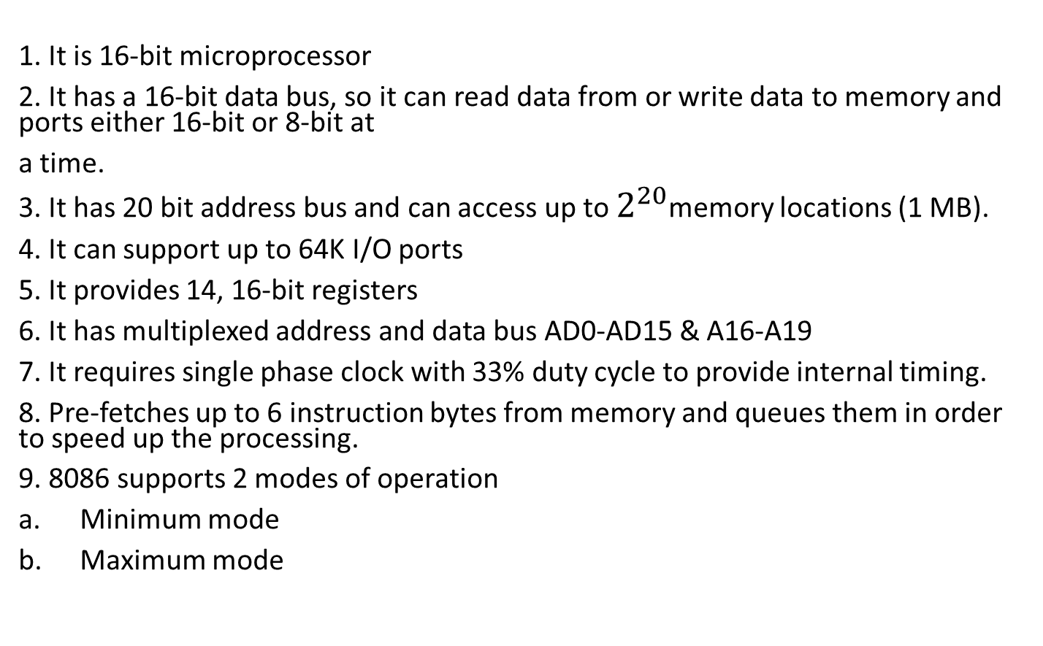
8086 Microprocessor features
1. It is 16-bit microprocessor
2. It has a 16-bit data bus, so it can read data from or write data to memory and ports either 16-bit or 8-bit at
a time.
3. It has 20 bit address bus and can access up to $2^{20}$memory locations (1 MB).
4. It can support up to 64K I/O ports
5. It provides 14, 16-bit registers
6. It has multiplexed address and data bus AD0-AD15 & A16-A19
7. It requires single phase clock with 33% duty cycle to provide internal timing.
8. Pre-fetches up to 6 instruction bytes from memory and queues them in order to speed up the processing.
9. 8086 supports 2 modes of operation
Minimum mode
Maximum mode

Slide 4
Architecture of 8086 microprocessor:
As shown in the below figure, the 8086 CPU is divided into two independent functional parts
o Bus Interface Unit(BIU)
o Execution Unit(EU)
Dividing the work between these two units’ speeds up processing.

Slide 5
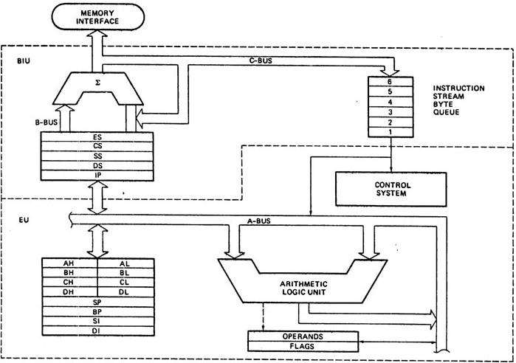
Architecture of 8086 microprocessor

Slide 6
The execution unit (EU)
The execution unit of the 8086 tells the BIU where to fetch instructions or data from, decodes instructions,and executes instructions.
The EU contains control circuitry, which directs internal operations.
A decoder in the EU translates instructions fetched from memory into a series of actions, which the EU carries out.
The EU has a 16-bit arithmetic logic unit (ALU) which can add, subtract, AND, OR, XOR, increment, decrement,complement or shift binary numbers.
The main functions of EU are:
Decoding of Instructions
Execution of instructions

Slide 7
Cntd..EU
The main functions of EU are:
o Decoding of Instructions
o Execution of instructions
Steps
▪ EU extracts instructions from the queue in BIU
▪ Decode the instructions
▪ Generates operands if necessary
▪ Passes operands to BIU & requests it to perform read or write bus cycles to memory or I/O
▪ Perform the operation specified by the instruction on operands

Slide 8
Bus Interface Unit (BIU)
The BIU sends out addresses, fetches instructions from memory, reads data from ports and memory, and writes data to ports and memory.
In simple words, the BIU handles all transfers of data and addresses on the buses for the execution unit.

Slide 9
8086 HAS PIPELINING ARCHITECTURE:
While the EU is decoding an instruction or executing an instruction, which does not require use of the buses,the BIU fetches up to six instruction bytes for the following instructions.
The BIU stores these pre-fetched bytes in a first-in-first-out register set called a queue.
When the EU is ready for its next instruction from the queue in the BIU. This is much faster than sending out an address to the system memory and waiting for memory to send back the next instruction byte or bytes.
Except in the case of JMP and CALL instructions, where the queue must be dumped and then reloaded starting from a new address, this pre-fetch and queue scheme greatly speeds up processing.
Fetching the next instruction while the current instruction executes is called pipelining.

Slide 10
Register organization:
8086 has a powerful set of registers known as general purpose registers and special purpose registers.
All of them are 16-bit registers.
General purpose registers:
These registers can be used as either 8-bit registers or 16-bit registers.
They may be either used for holding data, variables and intermediate results temporarily or for other purposes like a counter or for storing offset address for some particular addressing modes etc.
Special purpose registers:
These registers are used as segment registers, pointers, index registers or as offset storage registers for particular addressing modes.
The 8086 registers are classified into the following types:
General Data Registers
Segment Registers
Pointers and Index Registers
Flag Register

Slide 11
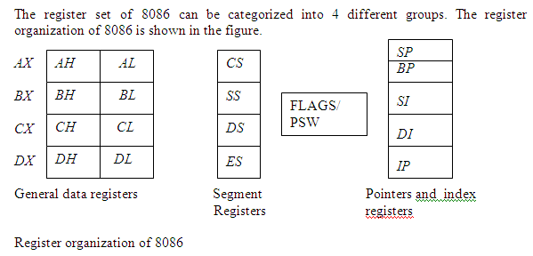

Slide 12
General Data Registers:
The registers AX, BX, CX and DX are the general purpose 16-bit registers.
AX is used as 16-bit accumulator. The lower 8-bit is designated as AL and higher 8-bit is designated as AH. ALcan be used as an 8-bit accumulator for 8-bit operation.
All data register can be used as either 16 bit or 8 bit. BX is a 16 bit register, but BL indicates the lower 8-bit of BX and BH indicates the higher 8-bit of BX.
The register BX is used as offset storage for forming physical address in case of certain addressing modes.
The register CX is used default counter in case of string and loop instructions.
DX register is a general purpose register which may be used as an implicit operand or destination in case of a few instructions

Slide 13
Segment Registers:
There are 4 segment registers:
o Code Segment Register(CS)
o Data Segment Register(DS)
o Extra Segment Register(ES)
o Stack Segment Register(SS)
The 8086 architecture uses the concept of segmented memory. 8086 able to address a memory capacity of 1 Megabyte and it is byte organized. This 1 megabyte memory is divided into 16 logical segments. Each segment contains 64 k bytes of memory.
Code segment register (CS): is used for addressing memory location in the code segment of the memory, where the executable program is stored.
Data segment register (DS): points to the data segment of the memory where the data is stored.

Slide 14
Segment Registers:
Extra Segment Register (ES) : also refers to a segment in the memory which is another data segment in the memory.
Stack Segment Register (SS): is used for addressing stack segment of the memory. The stack segment is that segment of memory which is used to store stack data.
While addressing any location in the memory bank, the physical address is calculated from two parts:
Physical address= segment address + offset address
The first is segment address, the segment registers contain 16-bit segment base addresses, related to different segment.
The second part is the offset value in that segment.

Slide 15
Pointers and Index Registers:
The index and pointer registers are given below:
o IP—Instruction pointer-store memory location of next instruction to be executed
o BP—Base pointer
o SP—Stack pointer
o IP—Instruction pointer
o SI—Source index
o DI—Destination index
The pointers registers contain offset within the particular segments.
The pointer register IP contains offset within the code segment.
The pointer register BP and SP contains offset within the stack segment.

Slide 16
Pointers and Index Registers…cntd..
The index registers are used as general purpose registers as well as for offset storage in case of indexed, base indexed and relative base indexed addressing modes.
The register SI is used to store the offset of source data in data segment.
The register DI is used to store the offset of destination in data or extra segment.
The index registers are particularly useful for string manipulation.

Slide 17
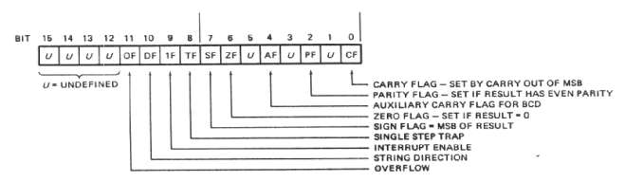
Flag registor

Slide 18
flag register and its functions:
The 8086 flag register contents indicate the results of computation in the ALU. It also contains some flag bits to control the CPU operations.
A 16 bit flag register is used in 8086. It is divided into two parts .
o Condition code or status flags
o Machine control flags
The condition code flag register is the lower byte of the 16-bit flag register. The condition code flag register is identical to 8085 flag register, with an additional overflow flag.
The control flag register is the higher byte of the flag register. It contains three flags namely direction flag (DF),interrupt flag (IF) and trap flag (TF).

Slide 19
Cntd.. Flag register
SF- Sign Flag: This flag is set, when the result of any computation is negative. For signed computations the sign flag equals the MSB of the result.
ZF- Zero Flag: This flag is set, if the result of the computation or comparison performed by the previous instruction is zero.
PF- Parity Flag: This flag is set to 1, if the lower byte of the result contains even number of 1’s.
CF- Carry Flag: This flag is set, when there is a carry out of MSB in case of addition or a borrow in case of subtraction.
AF-Auxilary Carry Flag: This is set, if there is a carry from the lowest nibble, i.e, bit three during addition, or borrow for the lowest nibble, i.e, bit three, during subtraction.

Slide 20
OF- Over flow Flag: This flag is set, if an overflow occurs, i.e, if the result of a signed operation is large enough to accommodate in a destination register. The result is of more than 7-bits in size in case of 8-bit signed operation and more than 15-bits in size in case of 16-bit sign operations, and then the overflow will be set.
TF- Trap Flag: If this flag is set, the processor enters the single step execution mode. The processor executes the current instruction and the control is transferred to the Trap interrupt service routine.

Slide 21
Cntd.. Flag register
IF- Interrupt Flag: If this flag is set, the mask able interrupts are recognized by the CPU, otherwise they are ignored.
D- Direction Flag: This is used by string manipulation instructions. If this flag bit is ‘0’, the string is processed beginning from the lowest address to the highest address, i.e., auto incrementing mode. Otherwise, the string is processed from the highest address towards the lowest address, i.e., auto decrementing mode.

Slide 22
Memory Segmentation
The memory in an 8086 based system is organized as segmented memory.
The CPU 8086 is able to access 1MB of physical memory. The complete 1MB of memory can be divided into 16 segments, each of 64KB size and is addressed by one of the segment register.
The 16-bit contents of the segment register actually point to the starting location of a particular segment. The address of the segments may be assigned as 0000H to F000h respectively.
To address a specific memory location within a segment, we need an offset address. The offset address values are from 0000H to FFFFH so that the physical addresses range from 00000H to FFFFFH.

Slide 23
Physical address is calculated as below:
Ex: Segment address ------- 1005H
Offset address ----------5555H
Segment address -------1005H ----- 0001 0000 0000 0101
Shifted left by 4 Positions------ 0001 0000 0000 0101 0000
+
Offset address --- 5555H ------ 0101 0101 0101 0101
Physical address -------155A5H 0001 0101 0101 1010 0101
Physical address = Segment address * 10H + Offset address.

Slide 24
The main advantages of the segmented memory scheme are as follows:
1. Allows the memory capacity to be 1MB although the actual addresses to be handled are of 16-bit size.
2. Allows the placing of code, data and stack portions of the same program in different parts (segments) of memory, for data and code protection.
3. Permits a program and/or its data to be put into different areas of memory each time the program is
executed, i.e., provision for relocation is done.

Slide 25
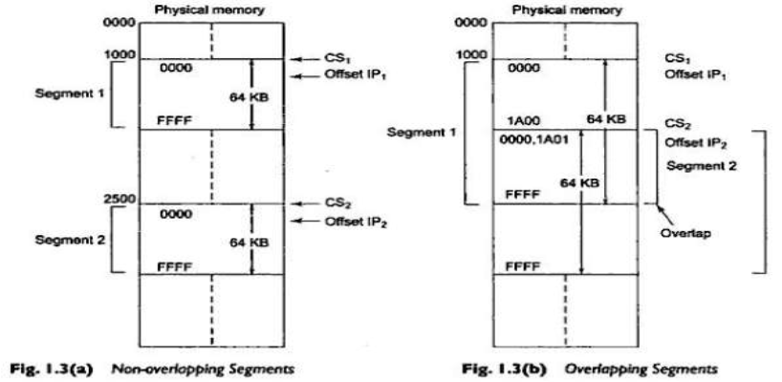
Overlapping and Non-Overlapping Segments

Slide 26
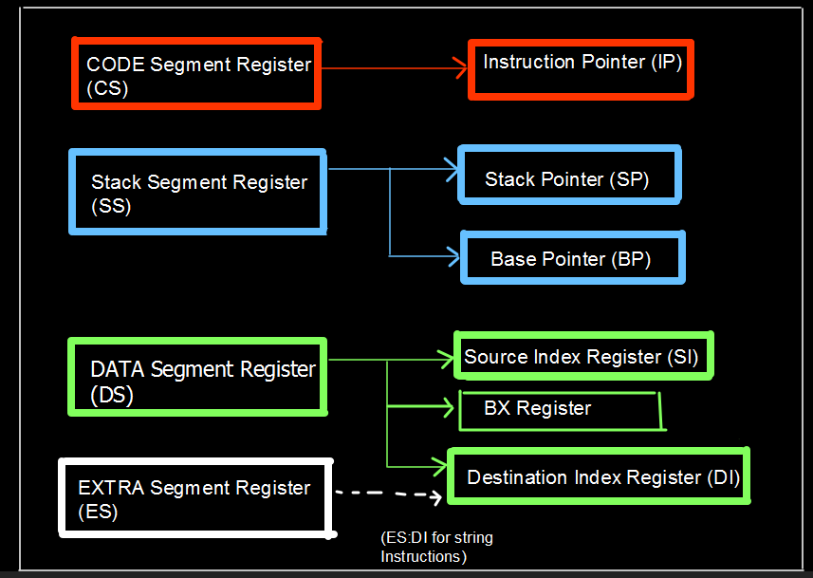
Segment register-Offset register pairs

