Slide 1
Addressing modes of 8086
Compiled by
Mrs. Savita C. Raut
EXTC Dept ,KJSCE

Slide 2
Address registers
The segment address is stored in the segment registers; CS,DS, ES ,SS registers.
The Offset address is stored in IP,SP , BP, SI, DI ,BX register.
The CS: IP pair gives the address of the next instruction to be executed in the program sequence
The SS:SP pair gives the address of the top of the stack (a temporary storage memory locations used by processor)
The SS:BP pair is used as a pointer into the stack,for random access of the stack.

Slide 3
Address registers
The DS:SI pair is used to access the memory locations in the data segment. Also register BX is used as memory pointer in the data segment with DS register(i,e.DS:BX)
DS: SI is used as a source pointer and ES: DI is used as destination pointer for string instructions . For all other instructions DI register is used with DS register.

Slide 4
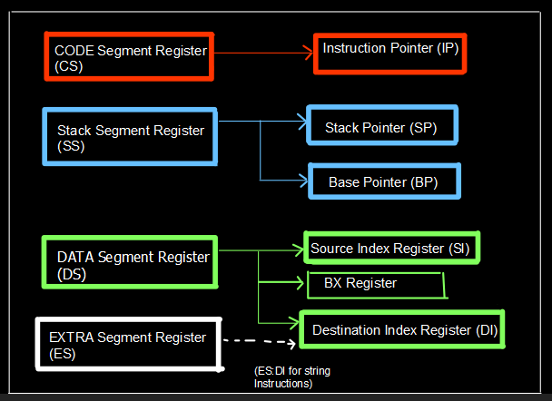
Default Segment Register and Offset pointer pairs

Slide 5
Addressing modes of 8086
When 8086 executes an instruction , it performs specific operation/function on data.The data is referred to as Operands.
Operands may be present in the registers or within the instruction itself or in memory or I/O ports.
The different methods of accessing (selecting) the Operands is referred to as Addressing modes .

Slide 6
Addressing modes of 8086….cntd
The Addressing Modes can be categorized as:
Register Addressing Mode
Immediate Addressing Mode
Memory Addressing Mode:
Direct
Indirect:
Register indirect
Based Indexed
Register Relative
Relative Based Indexed
String Addressing Mode
I/O Addressing Mode
Direct Port Addressing
Indirect Port Addressing
Implied Addressing Mode

Slide 7
Addressing modes of 8086….cntd
1.Register Addressing Mode
In register addressing mode, the data is stored in a register .
All the registers, except IP, may be used in this mode.
The registers may be 8 /16 bits
Ex: MOV BX, AX
ADD BX,CX

Slide 8
Addressing modes of 8086….cntd
2. Immediate Addressing Mode
In this type of addressing, source operand is a part of instruction and is known as immediate data and appears in the form of successive byte or bytes.
Immediate data can only be used as source operand.
Ex: MOV AX, 2345H
MOV CH,4A H
In the above example, 2345H is the immediate data. The immediate data may be 8-bit or 16-bit in size.

Slide 9
Addressing modes of 8086….cntd
Memory Addressing Mode:
Direct
Indirect:
Register indirect
Based Indexed
Register Relative
Relative Based Indexed
I.Direct Memory Addressing Mode:
In this mode ,the 16 bit Effective (Offset )address is directly specified in the instruction as a part of it.
DS register is default segment register for Direct addressing mode.
Ex: MOV AX, [2100H]
(The contents of memory location with physical address = DS*10 H + 2100 are copied to register AX)

Slide 10
Direct Memory addressing mode-
Ex: MOV AX, CS :[2100]
(The contents of memory location with physical address = CS*10 H + 2100 are copied to register AX)

Slide 11
Addressing modes of 8086….cntd Indirect Memory Addressing Mode
Register Indirect:
The address of the memory location, which contains data or operand, is determined in an indirect way, using the offset register. This mode of addressing is known as register indirect mode.
If registers BX or SI or DI are used as Effective Address register then the default segment register is DS .
If BP is used ,then SS is default segment register.
Programmer can use Segment override prefix to change the default segment register.
Ex: MOV AX, [BX]
MOV CX, [SI]
MOV BL,[DI]
MOV CL, ES: [SI]
(here ES is Segment override prefix)

Slide 12
Addressing modes of 8086….cntd Indirect Memory Addressing Mode
b.Based Indexed:
The effective address of data is formed, in this addressing mode, by adding content of a base register (any one of BX or BP) to the content of an index register (any one of SI or DI). The default segment register may be DS or ES.
Ex1: MOV AX, [BX][SI]
(Here, BX is the base register and SI is the index register the effective address is computed as 10H * DS + [BX] + [SI])
EX2: Mov [BP] [SI],AL
EX3: MOV CL, CS:[BX][DI]

Slide 13
Addressing modes of 8086….cntd Indirect Memory Addressing Mode
c. Register Relative:
In this addressing mode, the data is available at an effective address formed by adding an 8-bit or 16-bit displacement with the content of any one of the registers BX, BP, SI and DI in the default segment DS (or ES) segment.
Ex: MOV AX, [BX+12H]
(Here, the physical address is given as 10H *DS+BX+12H)
EX2: MOV AL, CS:[BP+23H]

Slide 14
Addressing modes of 8086….cntd Indirect Memory Addressing Mode
d. Relative Based Indexed:
The effective address is formed by adding an 8 or 16-bit displacement with the sum of the contents of any one of the base register (BX or BP) and any one of the index register, in a default segment.
Ex: MOV AX, [BX+SI + 50H]
(Here, 50H is an immediate displacement, BX is base register and SI is an index register the physical address of data is computed as: 10H * DS + [BX + SI+ 50H]
EX2:MOV AX, CS:[BX+SI + 50H]
(Segment override prefix)

Slide 15
Addressing modes of 8086….cntd
4.String Addressing Mode
When a string instruction is executed:
SI is assumed to point to the 1st byte or word of source string and DS is default segment register.
DI is assumed to point to the 1st byte or word of destination string and ES is default segment register.
In a repeated string operation , the processor automatically increments or decrements SI and DI to obtain subsequent byte or word (with the help of Direction Flag)
Ex : MOVSB
MOVSW

Slide 16
Addressing modes of 8086….cntd
5. I/O Addressing Mode:
i.Direct port addressing (Fixed port):
8-bit port address is specified in the instruction .
Allows access to port no. 0 to FF (256 ports only)
Ex1 : OUT 4B H ,AL or OUT 4B H , AX
EX2: IN AL , 4B H or IN AX , 4B H
ii. Indirect Port Addressing (variable ):
It is similar to register indirect addressing.
The port number (address)is specified in register Dx.
The addresses may range from 0000 to FFFF H.
EX 1 : OUT DX, AL or OUT DX, AX
EX2: IN AL, DX
IN AX, DX

Slide 17
Addressing modes of 8086….cntd
6. Implied Addressing Mode
In this addressing mode ,the instructions do not have operands
EX : CMC (compliment carry flag)
STC (Set carry Flag)
CLD (Clear direction flag)
CBW (Convert Byte to word)

