Slide 1
8051 Microcontroller
Compiled by
Prof. Mrs. Savita Raut

Slide 2
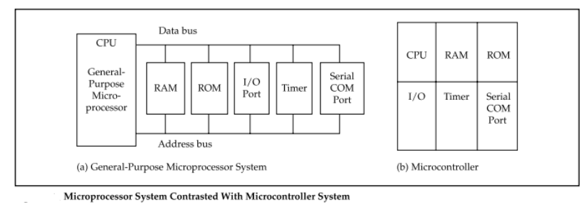
Microprocessor Vs Microcontroller

Slide 3
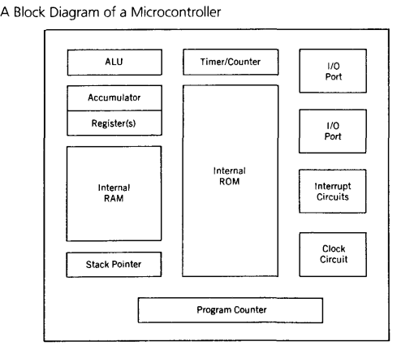
Generalized block diagram of microcontroller

Slide 4
Features of 8051 Microcontroller
4KB bytes on-chip program memory (ROM)
128 bytes on-chip data memory (RAM)
Four register banks
8-bit bidirectional data bus
16-bit unidirectional address bus
32 general purpose registers each of 8-bit
16 bit Timers (usually 2, but may have more or less)
Three internal and two external Interrupts
Four 8-bit ports,(short model have two 8-bit ports)
16-bit program counter and data pointer

Slide 5
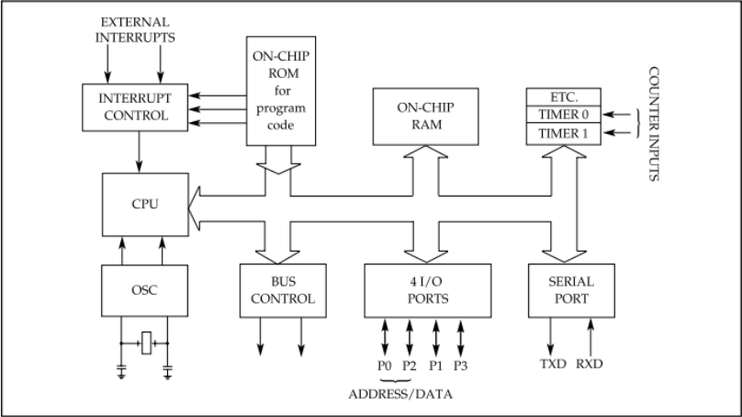

Slide 6
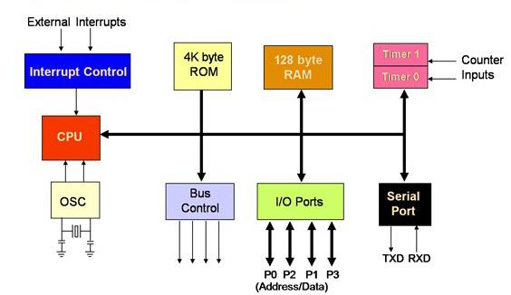

Slide 7
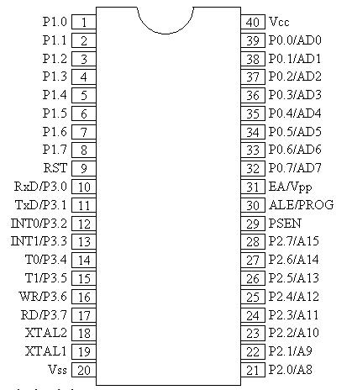
Pin Diagram of 8051

Slide 8
In 8051, I/O operations are done using four ports and 40 pins. The pin diagram shows the details of the 40 pins.
I/O operation port reserves 32 pins where each port has 8 pins.
The other 8 pins are designated as V_{cc}, GND, XTAL1, XTAL2, RST, EA (bar), ALE/PROG (bar), and PSEN.

Slide 9
I/O Ports and their Functions
The four ports P0, P1, P2, and P3, each use 8 pins, making them 8-bit ports.
Upon RESET, all the ports are configured as inputs, ready to be used as input ports. When the first 0 is written to a port, it becomes an output. To reconfigure it as an input, a 1 must be sent to a port.
Port 0 (Pin No 32 – Pin No 39)
It has 8 pins (32 to 39). It can be used for input or output. Unlike P1, P2, and P3 ports, we normally connect P0 to 10K-ohm pull-up resistors to use it as an input or output port being an open drain.
It is also designated as AD0-AD7, allowing it to be used as both address and data.

Slide 10
Port 1 (Pin 1 through 8)
It is an 8-bit port (pin 1 through 8) and can be used either as input or output. It doesn't require pull-up resistors because they are already connected internally.
Upon reset, Port 1 is configured as an input port.

Slide 11
Port 2 (Pins 21 through 28)
Port 2 occupies a total of 8 pins (pins 21 through 28) and can be used for both input and output operations. Just as P1 (Port 1), P2 also doesn't require external Pull-up resistors because they are already connected internally.
It must be used along with P0 to provide the 16-bit address for the external memory. So it is also designated as (A0–A7), as shown in the pin diagram. When the 8051 is connected to an external memory, it provides path for upper 8-bits of 16-bits address, and it cannot be used as I/O. Upon reset, Port 2 is configured as an input port.

Slide 12
Dual Role of Port 0 and Port 2
Dual role of Port 0 − Port 0 is also designated as AD0–AD7, as it can be used for both data and address handling. While connecting an 8051 to external memory, Port 0 can provide both address and data. The 8051 microcontroller then multiplexes the input as address or data in order to save pins.
Dual role of Port 2 − Besides working as I/O, Port P2 is also used to provide 16-bit address bus for external memory along with Port 0. Port P2 is also designated as (A8– A15), while Port 0 provides the lower 8-bits via A0–A7. In other words, we can say that when an 8051 is connected to an external memory (ROM) which can be maximum up to 64KB and this is possible by 16 bit address bus .
Port2 is used for the upper 8-bit of the 16 bits address, and it cannot be used for I/O and this is the way any Program code of external ROM is addressed.

Slide 13
Hardware Connection of Pins
V_{cc} − Pin 40 provides supply to the Chip and it is +5 V.
Gnd − Pin 20 provides ground for the Reference.
XTAL1, XTAL2 (Pin no 18 & Pin no 19) − 8051 has on-chip oscillator but requires external clock to run it. A quartz crystal is connected between the XTAL1 & XTAL2 pin of the chip. This crystal also needs two capacitors of 30pF for generating a signal of desired frequency. One side of each capacitor is connected to ground. 8051 IC is available in various speeds and it all depends on this Quartz crystal, for example, a 20 MHz microcontroller requires a crystal with a frequency no more than 20 MHz.

Slide 14
RST (Pin No. 9) − It is an Input pin and active High pin. Upon applying a high pulse on this pin, that is 1, the microcontroller will reset and terminate all activities. This process is known as Power-On Reset. Activating a power-on reset will cause all values in the register to be lost. It will set a program counter to all 0's. To ensure a valid input of Reset, the high pulse must be high for a minimum of two machine cycles before it is allowed to go low, which depends on the capacitor value and the rate at which it charges. (Machine Cycle is the minimum amount of frequency a single instruction requires in execution).
EA or External Access (Pin No. 31) − It is an input pin. This pin is an active low pin; upon applying a low pulse, it gets activated. In case of microcontroller (8051/52) having on-chip ROM, the EA (bar) pin is connected to V_{cc}. But in an 8031 microcontroller which does not have an on-chip ROM, the code is stored in an external ROM and then fetched by the microcontroller. In this case, we must connect the (pin no 31) EA to Gnd to indicate that the program code is stored externally.

Slide 15
PSEN or Program store Enable (Pin No 29) − This is also an active low pin, i.e., it gets activated after applying a low pulse. It is an output pin and used along with the EA pin in 8031 based (i.e. ROMLESS) Systems to allow storage of program code in external ROM.
ALE or (Address Latch Enable) − This is an Output Pin and is active high. It is especially used for 8031 IC to connect it to the external memory. It can be used while deciding whether P0 pins will be used as Address bus or Data bus. When ALE = 1, then the P0 pins work as Data bus and when ALE = 0, then the P0 pins act as Address bus.
I/O Ports and Bit Addressability

Slide 16
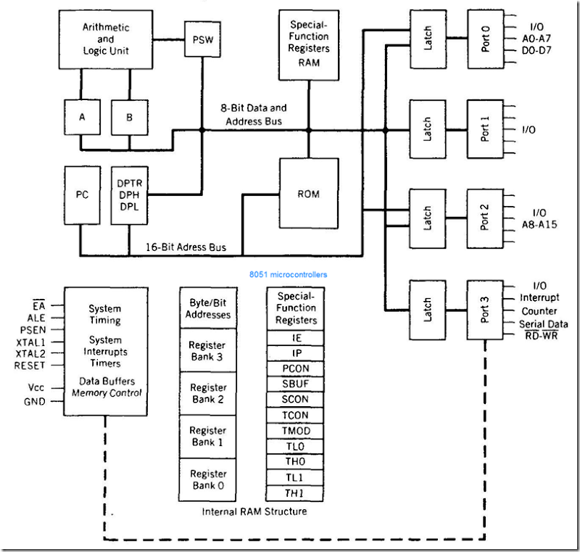
Internal block diagram of 8051

Slide 17
An 8051 microcontroller has the following 12 major components: 1. ALU (Arithmetic and Logic Unit) 2. PC (Program Counter) 3. Registers 4. Timers and counters 5. Internal RAM and ROM 6. Four general purpose parallel input/output ports 7. Interrupt control logic with five sources of interrupt 8. Serial data communication 9. PSW (Program Status Word) 10. Data Pointer (DPTR) 11. Stack Pointer (SP) 12. Data and Address bus.

Slide 18
ALU All arithmetic and logical functions are carried out by the ALU. Addition, subtraction with carry, and multiplication come under arithmetic operations. Logical AND, OR and exclusive OR (XOR) come under logical operations.
Registers
Registers are usually known as data storage devices. 8051 microcontroller has 2 registers, namely Register A and Register B. Register A serves as an accumulator while Register B functions as a general purpose register. These registers are used to store the output of mathematical and logical instructions. The operations of addition, subtraction, multiplication and division are carried out by Register A. Register B is used for multiplication and division operations. Register A also involved in data transfers between the microcontroller and external memory.

Slide 19
Registers
8051 microcontroller also has 7 Special Function Registers (SFRs). They are: 1. Serial Port Data Buffer (SBUF) 2. Timer/Counter Control (TCON) 3. Timer/Counter Mode Control (TMOD) 4. Serial Port Control (SCON) 5. Power Control (PCON) 6. Interrupt Priority (IP) 7. Interrupt Enable Control (IE)

Slide 20
Timers and Counters
The 8051 has two counters/timers which can be used either as timer to generate a time delay or as counter to count events happening outside the microcontroller.
The 8051 has two timers: timer0 and timer1. They can be used either as timers or as counters. Both timers are 16 bits wide. Since the 8051 has an 8-bit architecture, each 16-bit is accessed as two separate registers of low byte and high byte.
Timer 0 register is a 16 bits register and accessed as low byte and high byte. The low byte is referred as a TL0 and the high byte is referred as TH0. These registers can be accessed like any other registers.

Slide 21
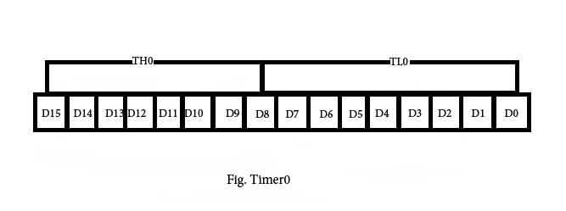
Timer 0

Slide 22
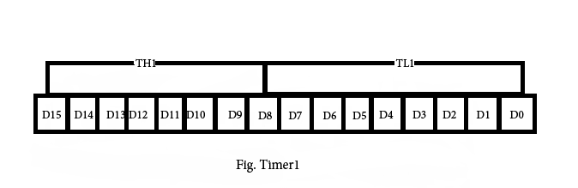
Timer 1
Timer1 registers is also a 16 bits register and is split into two bytes, referred to as TL1 and TH1.

Slide 23
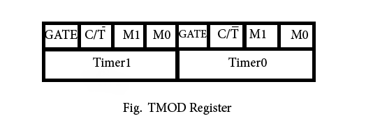
TMOD (timer mode) Register
This is an 8-bit register which is used by both timers 0 and 1 to set the various timer modes. In this TMOD register, lower 4 bits are set aside for timer0 and the upper 4 bits are set aside for timer1. In each case, the lower 2 bits are used to set the timer mode and upper 2 bits to specify the operation.

Slide 24
TMOD
1. In upper or lower 4 bits, first bit is a GATE bit. Every timer has a means of starting and stopping.
Some timers do this by software, some by hardware, and some have both software and hardware controls.
The hardware way of starting and stopping the timer by an external source is achieved by making GATE=1 in the TMOD register. And if we change to GATE=0 then we do not need external hardware to start and stop the timers.
2. The second bit is C/T bit and is used to decide whether a timer is used as a time delay generator or an event counter. If this bit is 0 then it is used as a timer and if it is 1 then it is used as a counter.

Slide 25


8051 Timer/Counter
OSC
÷12
TLx
(8 Bit)
THx
(8 Bit)
TFx
(1 Bit)
0
C/T~
1
TR
INTERRUPT
G
INT~

Slide 26
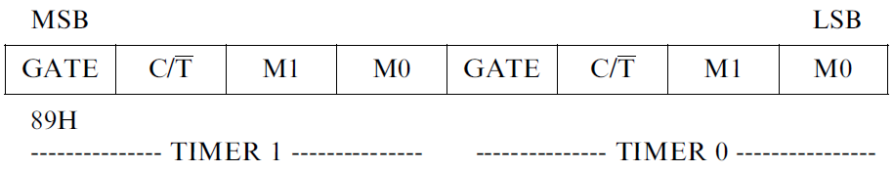
TMOD Register
GATE:
When set, timer/counter x is enabled, if INTx pin is high and TRx is set.
When cleared, timer/counter x is enabled, if TRx bit set.
C/T*:
When set, counter operation (input from Tx input pin).
When cleared, timer operation (input from internal clock).

Slide 27
TMOD
In upper or lower 4 bits, the last bits third and fourth are known as M1 and M0 respectively. These are used to select the timer mode.
M1 | M0 | Mode
0 | 0 | 0 | 13-bit timer mode, 8-bit timer/counter THx and TLx as 5-bit
0 | 1 | 1 | 16-bit timer mode, 16-bit timer/counters THx and TLx are cascaded
1 | 0 | 2 | 8-bit auto reload mode, 8-bit auto reload timer/counter; THx holds a value which is to be reloaded into TLx each time it overflows.
1 | 1 | 3 | Spilt timer mode.

Slide 28
8051 Timer Modes
8051 TIMERS
Timer 0
Timer 1
Mode 0
Mode 0
Mode 1
Mode 1
Mode 2
Mode 2
Mode 3

Slide 29
TIMER 0
OSC
÷12
TL0
TH0
TF0
INTERRUPT

Slide 30
TIMER 0 – Mode 0
13 Bit Timer / Counter
OSC
÷12
TL0
up 5 Bits
TH0
(8 Bits)
TF0
INTERRUPT
Maximum Count = 1FFFh (0001111111111111)

Slide 31
Mode 0
Mode 0
Mode 0 is exactly same like mode 1 except that it is a 13-bit timer instead of 16-bit. The 13-bit counter can hold values between 0000 to 1FFFH in TH-TL. Therefore, when the timer reaches its maximum of 1FFFH, it rolls over to 0000, and TF is raised.

Slide 32
Mode 1
Mode 1- It is a 16-bit timer; therefore it allows values from 0000 to FFFFH to be loaded into the timer’s registers TL and TH. After TH and TL are loaded with a 16-bit initial value, the timer must be started. We can do it by “SETB TR0” for timer 0 and “SETB TR1” for timer 1. After the timer is started. It starts count up until it reaches its limit of FFFFH. When it rolls over from FFFF to 0000H, it sets high a flag bit called TF (timer flag). This timer flag can be monitored. When this timer flag is raised, one option would be stop the timer with the instructions “CLR TR0“ or CLR TR1 for timer 0 and timer 1 respectively. Again, it must be noted that each timer flag TF0 for timer 0 and TF1 for timer1. After the timer reaches its limit and rolls over, in order to repeat the process the registers TH and TL must be reloaded with the original value and TF must be reset to 0

Slide 33
TIMER 0 – Mode 1
16 Bit Timer / Counter
OSC
÷12
TL0
(8 Bit)
TH0
(8 Bit)
TF0
INTERRUPT
Maximum Count = 0FFFFH

Slide 34
Mode 2
Mode 2- It is an 8 bit timer that allows only values of between 00 to FFH to be loaded into the timer’s register TH. After TH is loaded with 8 bit value, the 8051 gives a copy of it to TL. Then the timer must be started. It is done by the instruction “SETB TR0” for timer 0 and “SETB TR1” for timer1. This is like mode 1. After timer is started, it starts to count up by incrementing the TL register. It counts up until it reaches its limit of FFH. When it rolls over from FFH to 00. It sets high the TF (timer flag). If we are using timer 0, TF0 goes high; if using TF1 then TF1 is raised. When Tl register rolls from FFH to 00 and TF is set to 1, TL is reloaded automatically with the original value kept by the TH register. To repeat the process, we must simply clear TF and let it go without any need by the programmer to reload the original value. This makes mode 2 auto reload, in contrast in mode 1 in which programmer has to reload TH and TL.

Slide 35

TIMER 0 – Mode 2
8 Bit Timer / Counter with AUTORELOAD
OSC
÷12
TL0
(8 Bit)
TF0
INTERRUPT
Reload
TH0
(8 Bit)
Maximum Count = 0FFH (11111111)

Slide 36
Mode 3
Mode 3 is also known as a split timer mode. Timer 0 and 1 may be programmed to be in mode 0, 1 and 2 independently of similar mode for other timer. This is not true for mode 3; timers do not operate independently if mode 3 is chosen for timer 0. Placing timer 1 in mode 3 causes it to stop counting; the control bit TR1 and the timer 1 flag TF1 are then used by timer0.

Slide 37
TIMER 0 – Mode 3
Two - 8 Bit Timer / Counter
OSC
÷12
TL0
(8 Bit)
TF0
INTERRUPT
OSC
÷12
TH0
(8 Bit)
TF1
INTERRUPT

Slide 38
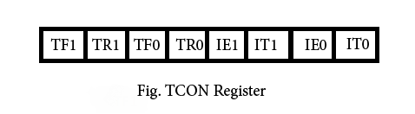
TCON register
TF1 : Timer1 over flow flag. Set when timer rolls from all 1s to 0. Cleared When the processor vectors to execute interrupt service routine Located at program address 001Bh.

Slide 39
TR1 :Timer 1 run control bit. Set to 1 by programmer to enable timer to count; Cleared to 0 by program to halt timer.
TF0 : Timer 0 over flow flag. Same as TF1.
TR0 : Timer 0 run control bit. Same as TR1.
IE1 : External interrupt 1 Edge flag. Not related to timer operations.
IT1 : External interrupt1 signal type control bit. Set to 1 by program to Enable external interrupt 1 to be triggered by a falling edge signal. Set to 0 by program to enable a low level signal on external interrupt1 to generate an interrupt.

Slide 40
IE0 : External interrupt 0 Edge flag. Not related to timer operations.
IT0 : External interrupt 0 signal type control bit. Same as IT0.

Slide 41
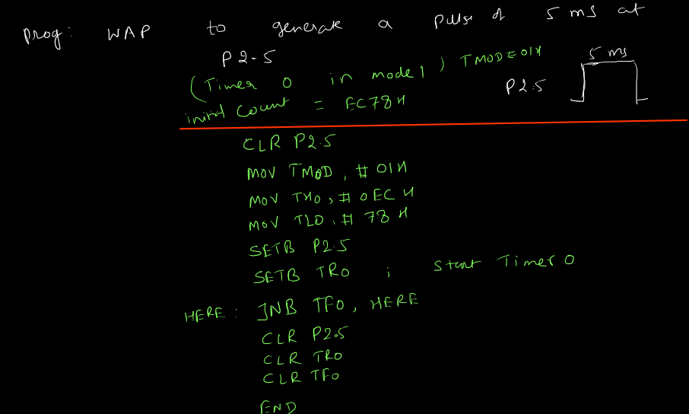
Timer program-Delay generation

Slide 42
Four General Purpose Parallel Input/Output Ports
The 8051 microcontroller has four 8-bit input/output ports. These are: PORT P0: When there is no external memory present, this port acts as a general purpose input/output port. In the presence of external memory, it functions as a multiplexed address and data bus. It performs a dual role. PORT P1: This port is used for various interfacing activities. This 8-bit port is a normal I/O port i.e. it does not perform dual functions. PORT P2: Similar to PORT P0, this port can be used as a general purpose port when there is no external memory but when external memory is present it works in conjunction with PORT PO as an address bus. This is an 8-bit port and performs dual functions. PORT P3: PORT P3 behaves as a dedicated I/O port

Slide 43
Internal RAM and ROM
ROM
A code of 4K memory is incorporated as on-chip ROM in 8051. The 8051 ROM is a non-volatile memory meaning that its contents cannot be altered and hence has a similar range of data and program memory, i.e, they can address program memory as well as a 64K separate block of data memory.Internal ROM address range is 0000 h to 0FFF h
RAM
The 8051 microcontroller is composed of 128 bytes of internal RAM. This is a volatile memory since its contents will be lost if power is switched off.
These 128 bytes of internal RAM are divided into 32 working registers which in turn constitute 4 register banks (Bank 0-Bank 3) with each bank consisting of 8 registers (R0 - R7). There are 128 addressable bits in the internal RAM.
The internal RAM address range is 00 h to FF h

Slide 44
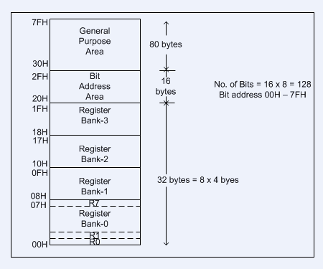
Internal RAM and ROM..cntd

Slide 45
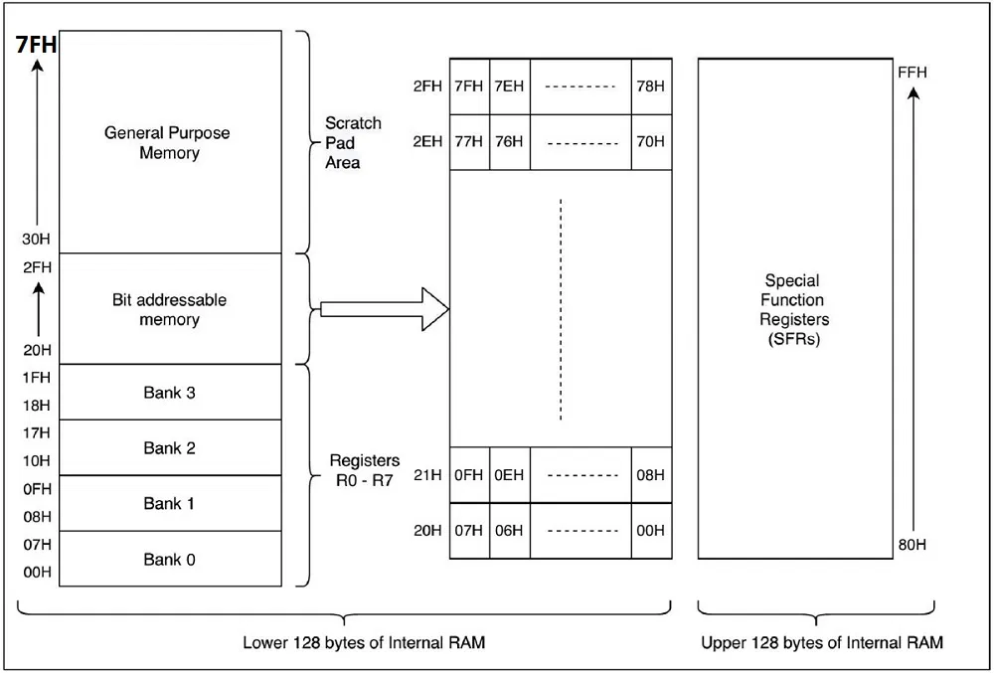
Data Memory Organization of 8051

Slide 46
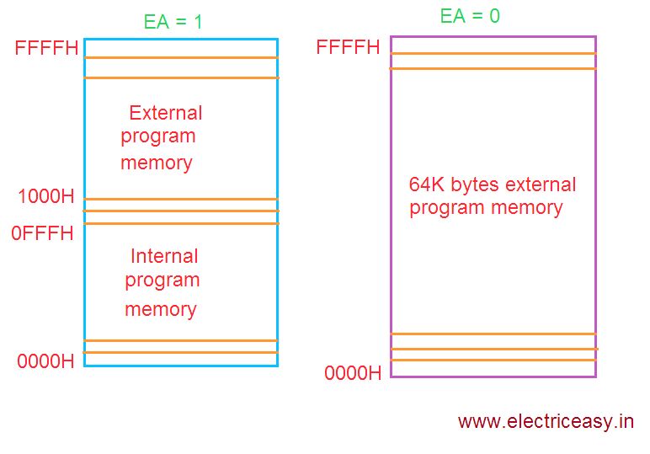
Program Memory Organization of 8051

Slide 47
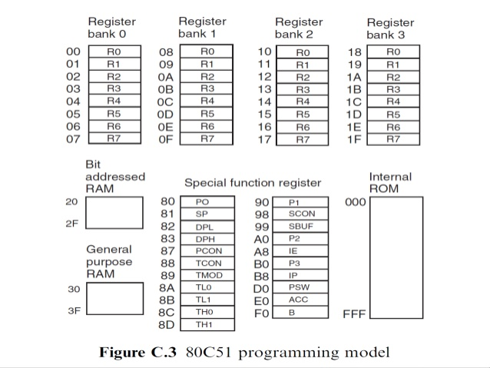

Slide 48
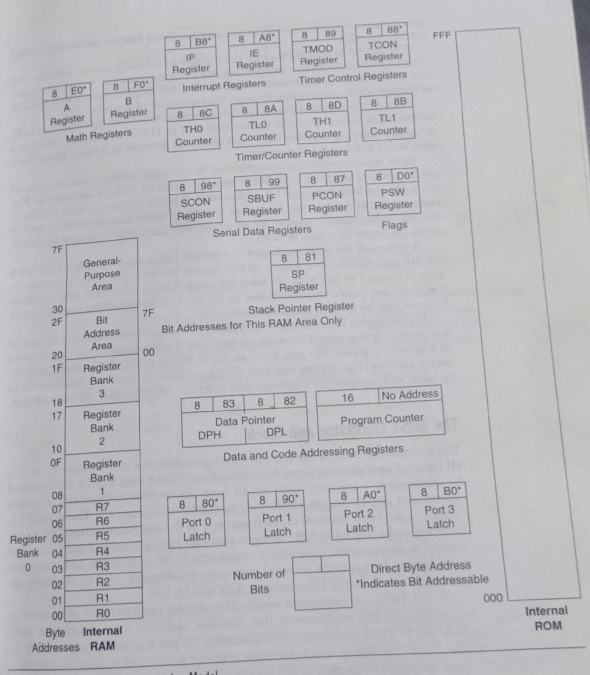
Programming model of 8051

Slide 50
Interrupt Control
There are two ways of giving interrupts to a microcontroller – one is by sending software instructions and the other is by sending hardware signals. The interrupt mechanism keeps the normal program execution in a "put on hold" mode and executes a subroutine program and after the subroutine is executed, it gets back to its normal program execution. This subroutine program is also called an interrupt handler. A subroutine is executed when a certain event occurs. In 8051, 5 sources of interrupts are provided. They are: a) 2 external interrupt sources connected through INT0 and INT1 b) 3 external interrupt sources- serial port interrupt, Timer Flag 0 and Timer Flag 1. The pins connected are as follows: 1. ALE (Address Latch Enable) - Latches the address signals on Port P0 2. EA (External Address) - Holds the 4K bytes of program memory 3. PSEN (Program Store Enable) - Reads external program memory 4. RST (Reset) - Reset the ports and internal registers upon start up

Slide 51
Serial Data Communication
A method of establishing communication among computers is by transmitting and receiving data bits is a serial connection network. In 8051, the SBUF (Serial Port Data Buffer) register holds the data; the SCON (Serial Control) register manages the data communication and the PCON (Power Control) register manages the data transfer rates. Further, two pins - RXD and TXD, establish the serial network. The SBUF register has 2 parts – one for storing the data to be transmitted and another for receiving data from outer sources. The first function is done using TXD pin and the second function is done using RXD pin. There are 4 programmable modes in serial data communication. They are: 1. Serial Data mode 0 (shift register mode) 2. Serial Data mode 1 (standard UART) 3. Serial Data mode 2 (multiprocessor mode) 4. Serial Data mode 3

Slide 52
PSW (Program Status Word)
Program Status Word or PSW is a hardware register which is a memory location which holds a program's information and also monitors the status of the program this is currently being executed. PSW also has a pointer which points towards the address of the next instruction to be executed. PSW register has 3 fields namely are instruction address field, condition code field and error status field. We can say that PSW is an internal register that keeps track of the computer at every instant. Generally, the instruction of the result of a program is stored in a single bit register called a 'flag'. The are7 flags in the PSW of 8051. Among these 7 flags, 4 are math flags and 3 are general purpose or user flags. The 4 Math flags are: • Carry (c) • Auxiliary carry (AC) • Overflow (OV) • Parity (P) The physical address of PSW starts from D0H. The individual bits are then accessed using D1, D2 … D7. The various individual bits are explained below.

Slide 53
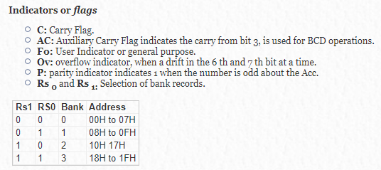
Program Status Word-PSW

Slide 54
Program Counter (PC)
A program counter is a 16-bit register and it has no internal address. The basic function of program counter is to fetch from memory the address of the next instruction to be executed. The PC holds the address of the next instruction residing in memory and when a command is encountered, it produces that instruction. This way the PC increments automatically, holding the address of the next instruction.
Data Pointer (DPTR)
The data pointer or DPTR is a 16-bit register. It is made up of two 8-bit registers called DPH and DPL. Separate addresses are assigned to each of DPH and DPL. These 8-bit registers are used for the storing the memory addresses that can be used to access internal and external data/code.
Stack Pointer (SP)
The stack pointer (SP) in 8051 is an 8-bit register. The main purpose of SP is to access the stack. As it has 8-bits it can take values in the range 00 H to FF H. Stack is a special area of data in memory. The SP acts as a pointer for an address that points to the top of the stack.

Slide 55
Data and Address Bus
A bus is group of wires using which data transfer takes place from one location to another within a system. Buses reduce the number of paths or cables needed to set up connection between components. There are mainly two kinds of buses - Data Bus and Address Bus Data Bus: The purpose of data bus is to transfer data. It acts as an electronic channel using which data travels. Wider the width of the bus, greater will be the transmission of data. Address Bus: The purpose of address bus is to transfer information but not data. The information tells from where within the components, the data should be sent to or received from. The capacity or memory of the address bus depends on the number of wires that transmit a single address bit.

