Slide 1
8051 Serial Communication
Compiled by
Savita C. Raut

Slide 2
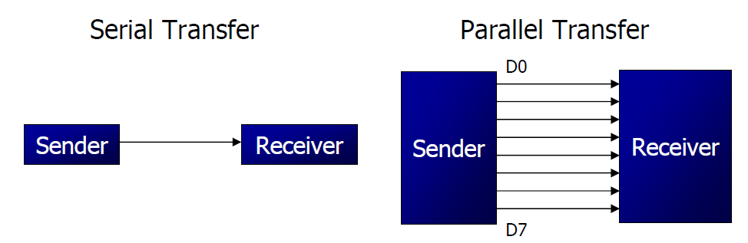
Basics of Serial Communication
Computers transfer data in two ways:
Parallel: Often 8 or more lines (wire conductors) are used to transfer data to a device that is only a few feet away.
Serial: To transfer to a device located many meters away, the serial method is used. The data is sent one bit at a time.

Slide 3
Basics of Serial Communication
Serial data communication uses two methods
Synchronous method transfers a block of data at a time
Asynchronous method transfers a single byte at a time
There are special IC’s made by many manufacturers for serial communications.
UART (universal asynchronous Receiver transmitter)
USART (universal synchronous-asynchronous Receiver-transmitter)

Slide 4
Asynchronous – Start & Stop Bit
Asynchronous serial data communication is widely used for character-oriented transmissions
Each character is placed in between start and stop bits, this is called framing.
Block-oriented data transfers use the synchronous method.
The start bit is always one bit, but the stop bit can be one or two bits
The start bit is always a 0 (low) and the stop bit(s) is 1 (high)

Slide 5
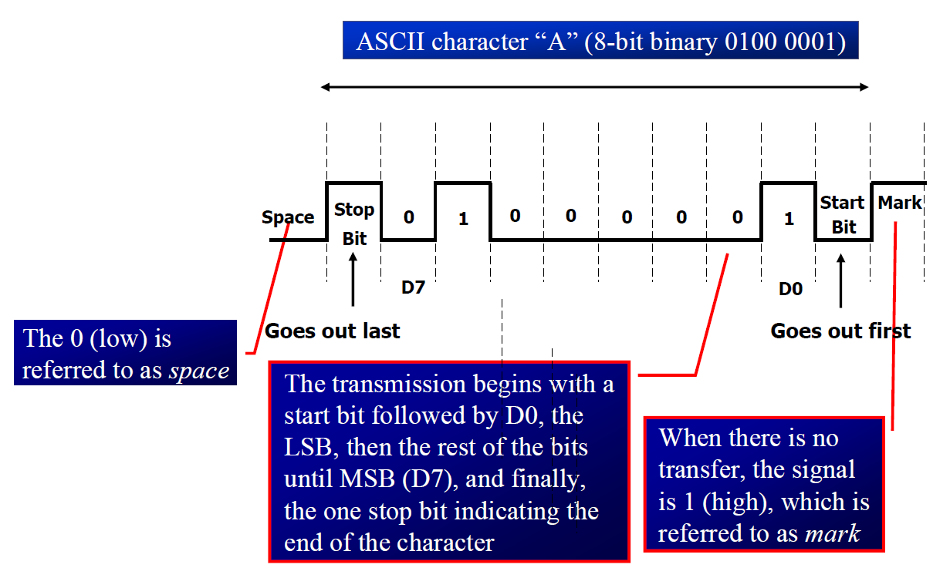
Asynchronous – Start & Stop Bit

Slide 6
Data Transfer Rate
The rate of data transfer in serial data communication is stated in bps (bits per second).
Another widely used terminology for bps is baud rate.(Baud rate is a MODEM terminology .baud rate and bps are not necessarily equal)
It is defined as time required to send one bit on transmission line in other words it is the number of signal changes per second.
In modems, there are occasions when a single change of signal transfers several bits of data
As far as the conductor wire is concerned, the baud rate and bps are the same.

Slide 7
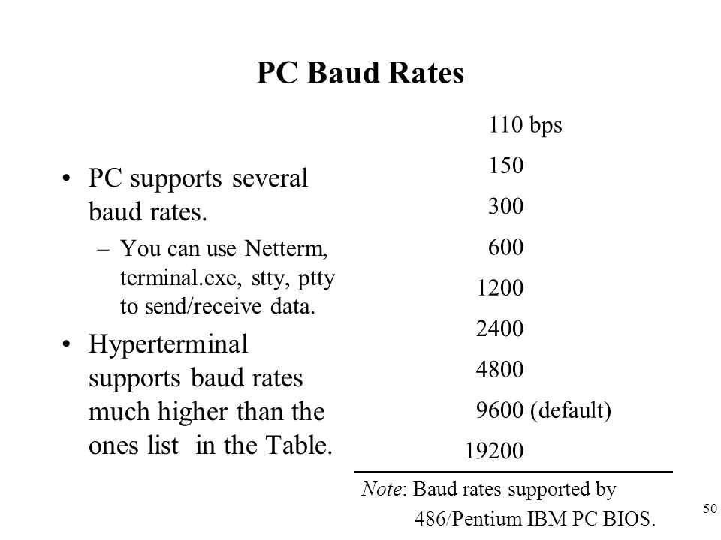
Data Transfer Rate..cntd
The data transfer rate of a given computer system depends on the communication ports incorporated into that system. For ex, the early IBM PC/XT used data transfer rate 100 to 9600 bps.
However Pentium based PCs transfers the data at high rates upto 56K bps
In Asynchronous serial data communication , the Baud rate is limited to 100,000 bps.

Slide 8
8051 Serial Port
Synchronous and Asynchronous methods
SCON Register is used to Control
Data Transfer through TXd (P3.1)& RXd (P3.0)pins
Some time - Clock through TXd Pin
Four Modes of Operation:
Mode 0 :Synchronous Serial Communication
Mode 1 :8-Bit UART with Timer Data Rate
Mode 2 :9-Bit UART with Set Data Rate
Mode 3 :9-Bit UART with Timer Data Rate

Slide 9
Registers related to Serial Communication
SBUF Register
SCON Register
PCON Register

Slide 10
SBUF Register
SBUF is an 8-bit register used solely for serial communication.
For a byte data to be transferred via the TxD line, it must be placed in the SBUF register.
The moment a byte is written into SBUF, it is framed with the start and stop bits and transferred serially via the TxD line.
SBUF holds the byte of data when it is received by 8051 RxD line.
When the bits are received serially via RxD, the 8051 deframes it by eliminating the stop and start bits, making a byte out of the data received, and then placing it in SBUF.

Slide 11

SBUF Register

Slide 12
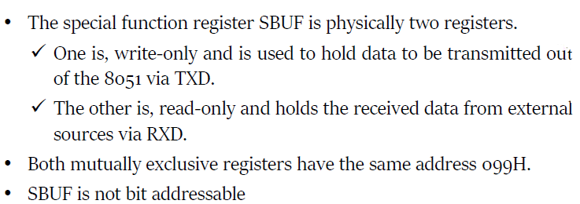
SBUF Register …cntd

Slide 13
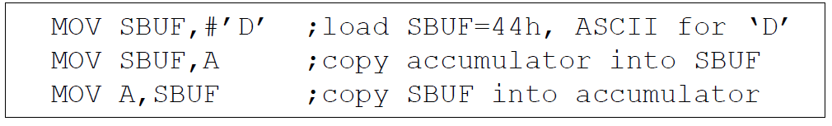
SBUF Register
Sample Program:

Slide 14
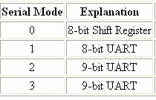
SCON Register
SM0 SM1 SM2 REN TB8 RB8 TI RI
Set when a Cha-
ractor received
Set to Enable
Serial Data
reception
Set when Stop bit Txed
Enable Multiprocessor
Communication Mode
9th Data Bit
Sent in Mode 2,3
9th Data Bit
Received in Mode 2,3

Slide 15
8051 Serial Port – Mode 0
The Serial Port in Mode-0 has the following features:
Serial data enters and exits through RXD
TXD outputs the clock
8 bits are transmitted / received
The baud rate is fixed at (1/12) of the oscillator frequency

Slide 16
8051 Serial Port – Mode 1
The Serial Port in Mode-1 has the following features:
Serial data enters through RXD
Serial data exits through TXD
On receive, the stop bit goes into RB8 in SCON
10 bits are transmitted / received
Start bit (0)
Data bits (8)
Stop Bit (1)
Baud rate is determined by the Timer 1 over flow rate.
CNT =(-(2^{SMOD} *F_{CLK})/(32*BR*12))

Slide 17
8051 Serial Port – Mode 2
The Serial Port in Mode-2 has the following features:
Serial data enters through RXD
Serial data exits through TXD
9th data bit (TB8) can be assign value 0 or 1
On receive, the 9th data bit goes into RB8 in SCON
11 bits are transmitted / received
Start bit (0)
Data bits (9)
Stop Bit (1)
Baud rate is programmable

Slide 18
8051 Serial Port – Mode 3
The Serial Port in Mode-3 has the following features:
Serial data enters through RXD
Serial data exits through TXD
9th data bit (TB8) can be assign value 0 or 1
On receive, the 9th data bit goes into RB8 in SCON
11 bits are transmitted / received
Start bit (0)
Data bits (9)
Stop Bit (1)
Baud rate is determined by Timer 1 overflow rate.

Slide 19
Serial mode 1 is widely used
Other 3 modes are rarely used today.
When serial mode1 is chosen , the data framing is 8-bits,1 stop bit and 1 start bit,which makes it compatible with the COM port of PCs.
More important, serial mode 1 allows the baud rate to be variable and it is set by Timer1 of 8051.

Slide 20
Programming Serial Data Transmission
1. TMOD register is loaded with the value 20H, indicating the use of timer 1 in mode 2 (8-bit auto-reload) to set baud rate.
2. The TH1 is loaded with one of the values to set baud rate for serial data transfer.
3. The SCON register is loaded with the value 50H, indicating serial mode 1, where an 8- bit data is framed with start and stop bits.
4. TR1 is set to 1 to start timer 1
5. TI is cleared by CLR TI instruction
6. The character byte to be transferred serially is written into SBUF register.
7. The TI flag bit is monitored with the use of instruction JNB TI, xx to see if the character has been transferred completely.
8. To transfer the next byte, go to step 5

Slide 21
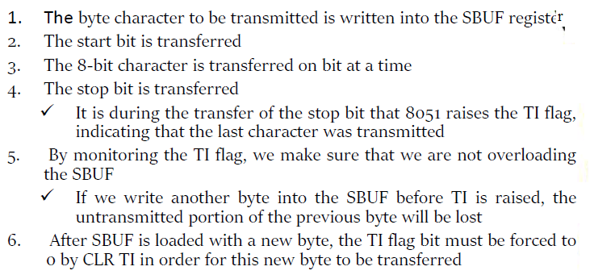
Steps involved in Serial Data Transmission

Slide 22
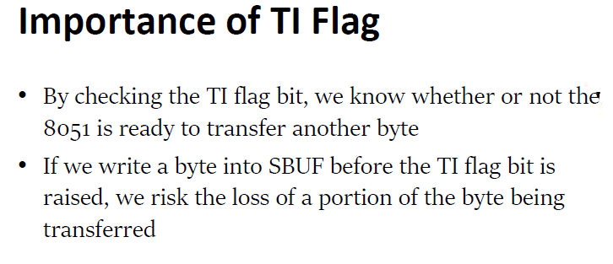

Slide 23
Programming Serial Data Reception
1. TMOD register is loaded with the value 20H, indicating the use of timer 1 in mode 2 (8-bit auto-reload) to set baud rate.
2. TH1 is loaded to set baud rate
3. The SCON register is loaded with the value 50H, indicating serial mode 1, where an 8- bit data is framed with start and stop bits.
4. TR1 is set to 1 to start timer 1
5. RI is cleared by CLR RI instruction
6. The RI flag bit is monitored with the use of instruction JNB RI, xx to see if an entire character has been received yet
7. When RI is raised, SBUF has the byte, its contents are moved into a safe place.
8. To receive the next character, go to step 5.

Slide 24
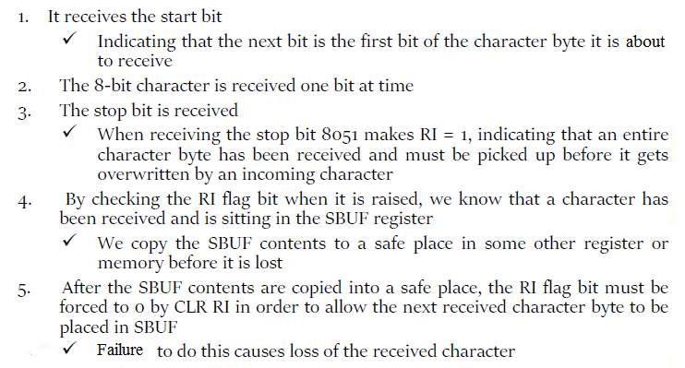
Steps involved in Serial Data Reception

Slide 25
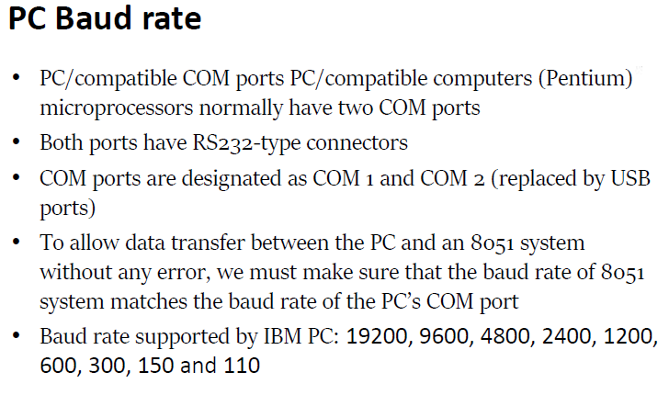

Slide 26
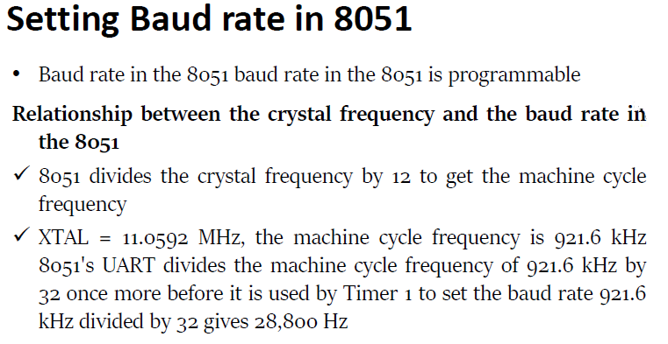
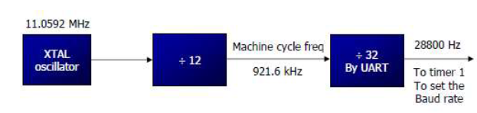

Slide 27
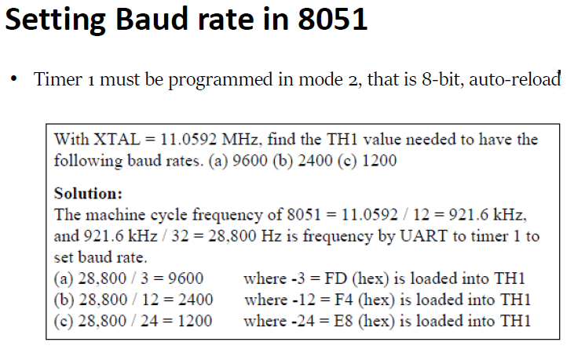

Slide 28
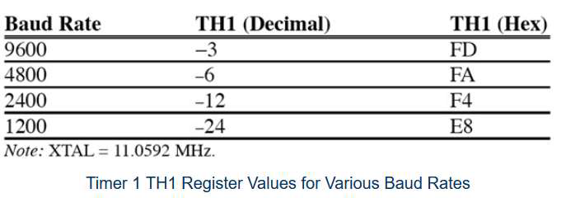
TH1 register values for various Baud rate

Slide 29
Doubling Baud Rate
There are two ways to increase the baud rate of data transfer
By using a higher frequency crystal
By changing a bit in the PCON register
PCON register is an 8-bit register.
When 8051 is powered up, SMOD is zero
We can set it to high by software and thereby double the baud rate.

Slide 30

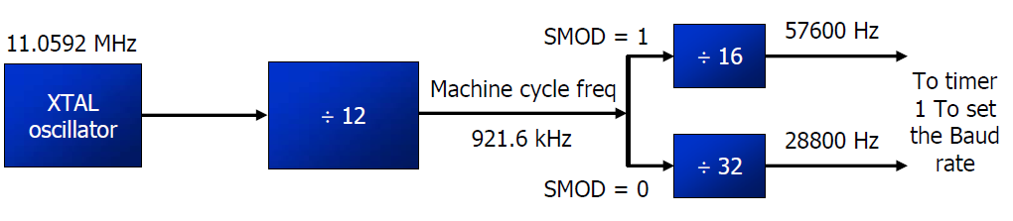
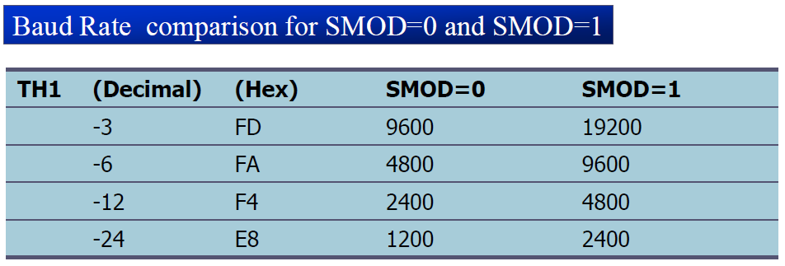
Doubling Baud Rate (cont…)

Slide 31
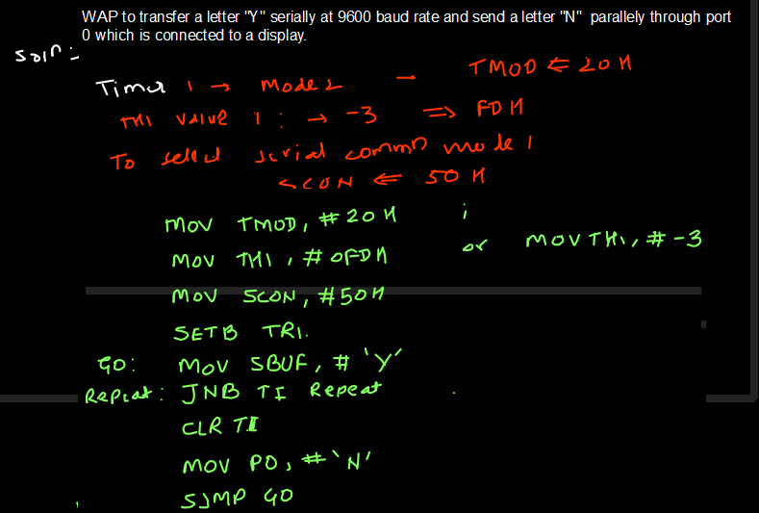
Programming-Serial Communication

Slide 32
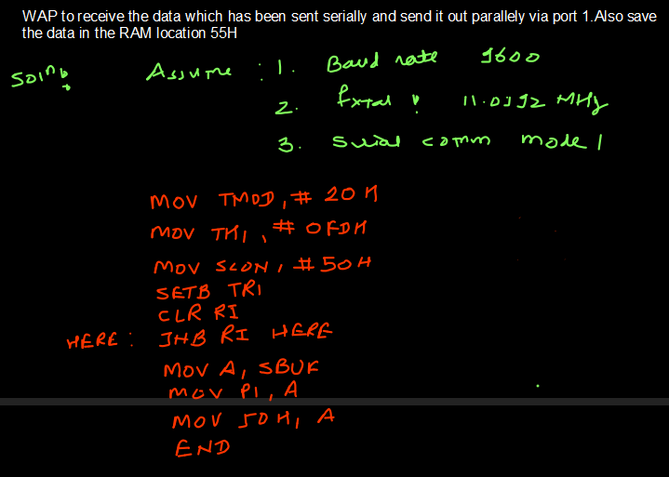
Programming- serial communication

Slide 33
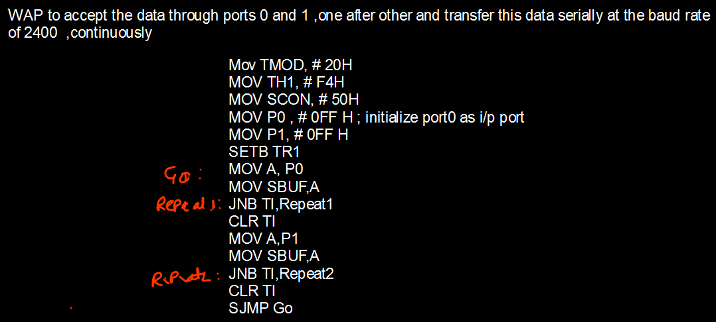
Programming -serial communication

Slide 34
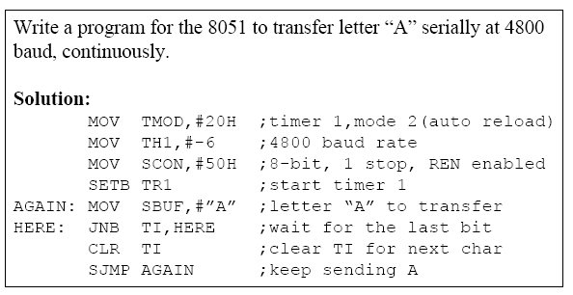
Program to transfer serially at the baud rate of 4800

Slide 35
Program to receive serially at the baud rate of 4800

Slide 36
Programming- serial communication

Slide 37

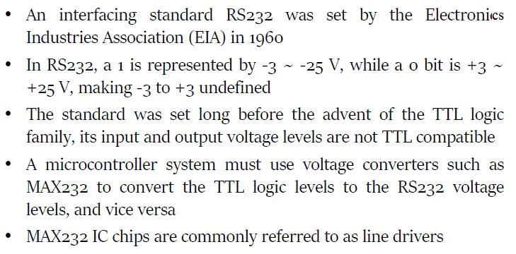

Slide 38
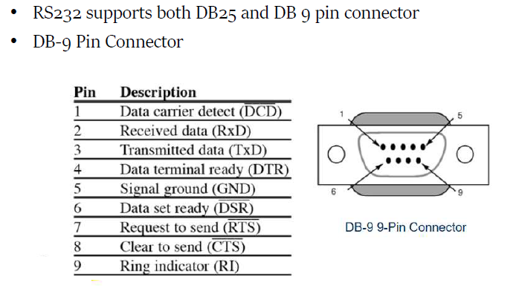
DB-9 pin Connector

Slide 39
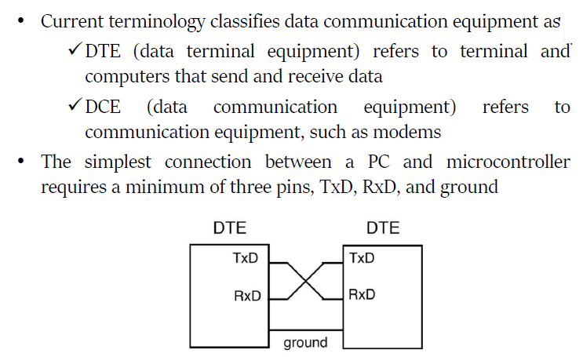
Data Communication Classification

Slide 40
Handshaking signals in RS232
To ensure fast and reliable data transmission between two devices, the data transfer must be coordinated.
Just as in the case of printer,since the receiving device in serial communication may not have a room for the data ,there must be some way to inform the sender to stop sending the data.

Slide 41
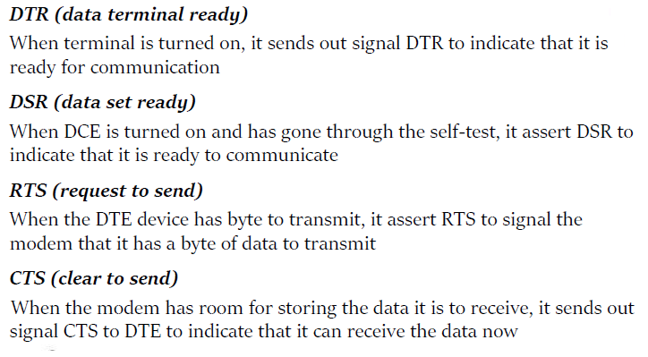
Handshaking signals in RS232..cntd

Slide 42
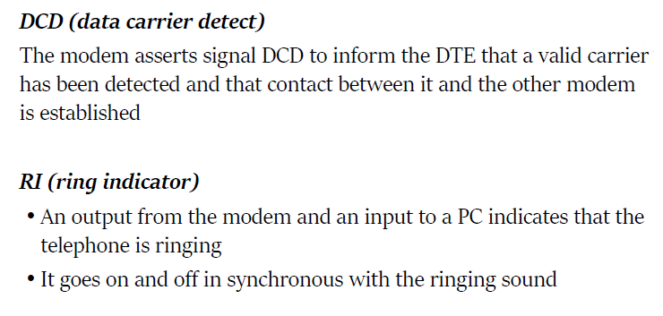
Handshaking signals in RS232..cntd

Slide 43
8051 connection to RS232
The RS232 standard is not TTL compatible; therefore, it requires a line driver such as the MAX232 chip to convert RS232 voltage levels to TTL levels, and vice versa. The interfacing of 8051 with RS232 connectors via the MAX232 chip is done to connect RS 232 to 8051.
RxD and TxD pins in the 8051 The 8051 has two pins that are used specifically for transferring and receiving data serially. These two pins are called TxD and RxD and are part of the port 3 group (P3.0 and P3.1). Pin 11 of the 8051 (P3.1) is assigned to TxD and pin 10 (P3.0) is designated as RxD. These pins are TTL compatible; therefore, they require a line driver to make them RS232 compatible. One such line driver is the MAX232 chip.

Slide 44
8051 connection to RS232…cntd
MAX232 Since the RS232 is not compatible with today’s microprocessors and microcontrollers, we need a line driver (voltage converter) to convert the RS232′s signals to TTL voltage levels that will be acceptable to the 8051 ‘s TxD and RxD pins. One example of such a converter is MAX232 from Maxim Corp. (www.maxim-ic.com). The MAX232 converts from RS232 voltage levels to TTL voltage levels, and vice versa. One advantage of the MAX232 chip is that it uses a +5 V power source which, is the same as the source voltage for the 8051. In other words, with a single +5 V power supply we can power both the 8051 and MAX232, with no need for the dual power supplies that are common in many older systems.

Slide 45
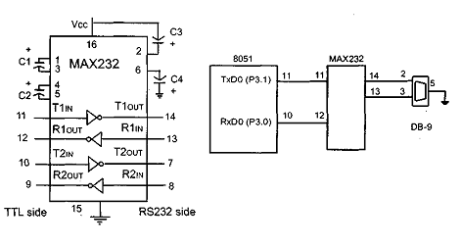
8051 connection to RS232…cntd
The MAX232 has two sets of line drivers for transferring and receiving data, as shown in Figure below:
The line drivers used for TxD are called T1 and T2,
Figure :(a) Inside MAX232 and (b) its Connection to the 8051 (Null Modem)

Slide 46
8051 connection to RS232…cntd
The line drivers used for TxD are called T1 and T2, while the line drivers for RxD are designated as Rl and R2. In many applications only one of each is used. For example, Tl and Rl are used together for TxD and RxD of the 8051, and the second set is left unused. Notice in MAX232 that the Tl line driver has a designation of Tlin and Tlout on pin numbers 11 and 14, respectively. The Tlin pin is the TTL side and is connected to TxD of the microcontroller, while Tlout is the RS232 side that is connected to the RxD pin of the RS232 DB connector. The Rl line driver has a designation of Rlin and Rlout on pin numbers 13 and 12, respectively. The Rlin (pin 13) is the RS232 side that is connected to the TxD pin of the RS232 DB connector, and Rlout (pin 12) is the TTL side that is connected to the RxD pin of the microcontroller.
Figure :(a) Inside MAX232 and (b) its Connection to the 8051 (Null Modem)

Slide 47
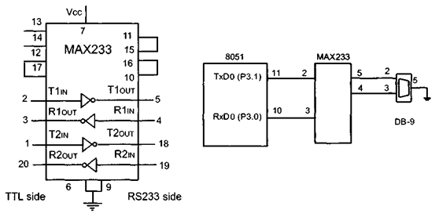
8051 connection to RS232..cntd
To save board space, some designers use the MAX233 chip from Maxim. The MAX233 performs the same job as the MAX232 but eliminates the need for capacitors.
However, the MAX233 chip is much more expensive than the MAX232. Notice that MAX233 and MAX232 are not pin compatible. You cannot take a MAX232 out of a board and replace it with a MAX233. See Figure 10-8 for MAX233 with no capacitor used.

