Slide 1
Exp-1
TITLE: - Overview on MSP430G2 Launchpad & IDE AIM: -1) To understand features and on chip peripherals MSP430 G2LP 2) Understand tools of Code composer IDE

Slide 2
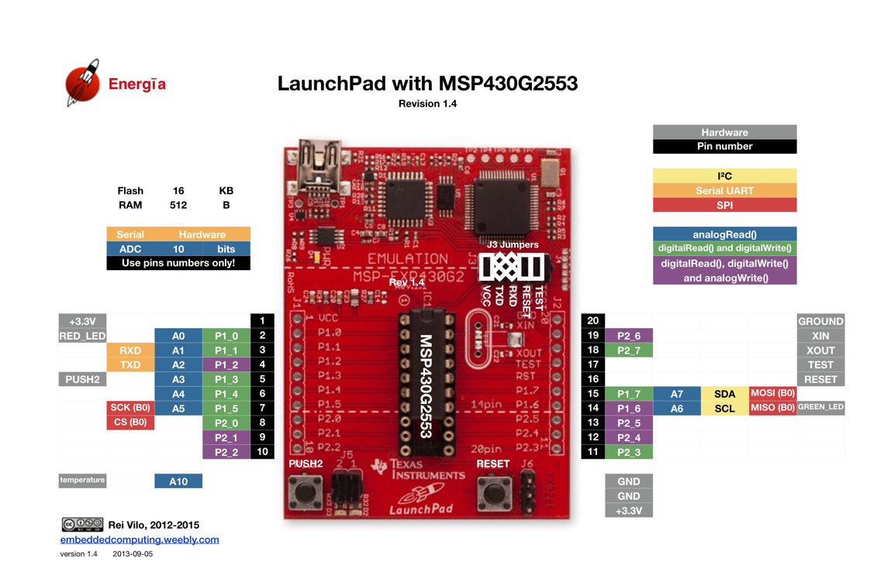

Slide 3
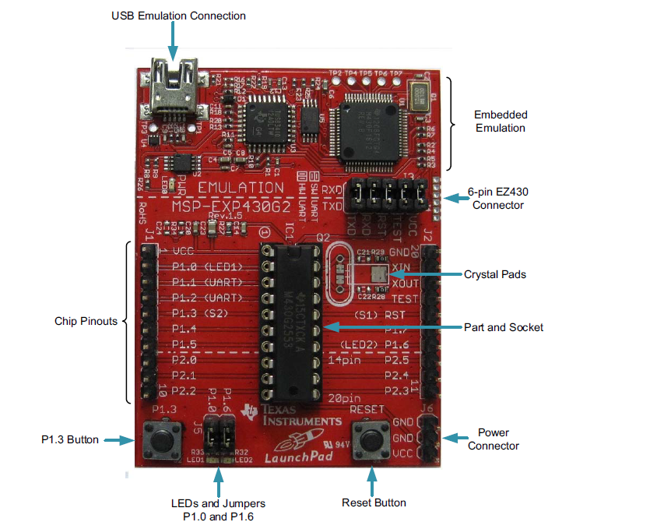
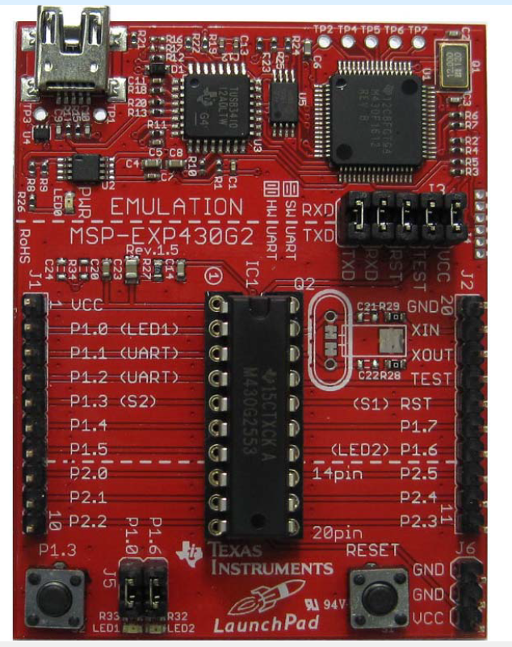
MSP430 LP

Slide 4
MSP MCU’s
The MSP microcontrollers (MCUs) from Texas Instruments (TI) are 16-bit and 32-bit RISC-based, mixed signal processors designed for ultra-low power applications.

Slide 5
MSP430
MSP stands for:-Mixed-Signal Processor
MSP family – mixed-signal processor:-MSP microcontrollers can handle both digital signals and analog (real-world) signals on the same chip.

Slide 6
MSP430 family
The MSP430 device features a powerful 16-bit RISC CPU, 16-bit registers.
The MSP430 instruction set consists of 27 core instructions that make it easy to program in assembler or in C.

Slide 7
MSP applications
MSP ultra-low-power microcontrollers are ideal for applications where the majority of the microcontroller life is spent in standby.
Typical applications of these processors include low-cost sensor systems, Digital watches, medical devices, battery opertaed IOT systems.

Slide 8
MSP-EXP430G2
MSP-EXP430G2 is the LaunchPad development board for MSP430G2 series microcontrollers.
it’s a small board that makes it easy to use the MSP430 without extra circuits.
It includes everything you need to start programming:-
MSP430G2553 chip (the main microcontroller)
USB connector for power and programming
Emulation circuit (program/debug the MSP430)
LEDs and push buttons for testing
Headers/pins to connect sensors and other devices

Slide 9
Purpose of MSP-EXP430G2
Program the MSP430 using a PC
Test and debug code easily
Learn and prototype projects with microcontrollers.

Slide 10
MSP FEATURES
1. The CPU (the “brain”)
The MSP430G2553 has a 16-bit CPU
It is a RISC processor 👉 That means it uses simple instructions that run fast.
It has 16 registers 👉 Registers are very small, very fast memory locations inside the CPU.
Almost all instructions work only on registers.

Slide 11
MSP FEATURES
2. Memory types (two kinds of memory)
Program Memory (Flash / ROM)
Stores your program (code)
Code stays even when power is OFF
Data Memory (RAM)
Stores variables and temporary data
Data is lost when power is OFF
👉 This separation means the MSP430 uses a modified Harvard architecture.
MSP430G2553 (G2 Series):-Flash: up to 16 KB
RAM: 512 bytes

Slide 12
MSP FEATURES
3. Memory buses (how data moves)
Think of buses as roads inside the chip.
MAB (Memory Address Bus) → Tells where to read or write
MDB (Memory Data Bus) → Carries the actual data

Slide 13
MSP FEATURES
4.Clock system (chip’s heartbeat)
Runs up to 16 MHz
Has different clocks:
MCLK → CPU clock
SMCLK → peripherals
ACLK → low-power clock (32 kHz crystal)
Simple idea:-Clocks decide how fast things happen inside the chip.

Slide 14
MSP FEATURES
5.Input / Output Ports (pins)
Port P1: 8 pins
Port P2: 8 pins
Port P3: 8 pins (only on larger packages)
Each pin can:-Be input or output

Slide 15
MSP FEATURES
6. ADC (Analog-to-Digital Converter)
10-bit ADC
8 channels
Simple idea:-Converts real-world signals (like voltage, temperature) into numbers the CPU understands

Slide 16
MSP FEATURES
7. Timers-Two 16-Bit Timer_A With Three Capture/Compare Registers.
Timer0_A
Timer1_A
Each timer has:
3 capture/compare registers
Used for:
Delays
Counting
PWM (motor speed, LED brightness)

Slide 17
MSP Features
8.Communication (talking to other devices)
Built-in communication (USCI-Universal Serial Communication Interface)
Allows the microcontroller to talk to other devices
Supports:
UART (serial communication)
SPI
I²C
Used to connect sensors, displays, PCs, or other controllers.

Slide 18
9.Watchdog Timer (WDT+)
Automatically resets the chip if software gets stuck
Can also generate timed interrupts
Simple idea:
A safety guard that restarts the system if something goes wrong

Slide 19
10. Brown-Out Protection
Detects low power voltage
Resets the chip to prevent wrong operation

Slide 20
11.Emulation (Debugging)
Supports JTAG / Spy-Bi-Wire
Used to:
Load programs
Debug (run, stop, step)

Slide 21
MSP430G2553
Analog comparator
Compares two voltages
Decides which one is higher

Slide 22
MSP430G2553
Built-in communication (USCI-Universal Serial Communication Interface)
Allows the microcontroller to talk to other devices
Supports:
UART (serial communication)
SPI
I²C
Used to connect sensors, displays, PCs, or other controllers.

Slide 23
MSP430G2553
I²C is a communication method that lets a microcontroller talk to other chips using just two wires.
SPI -Serial Peripheral Interface is a fast communication method that lets a microcontroller talk to other devices using multiple wires.

Slide 24
MSP430G2553
UART is a communication method that sends and receives data one bit at a time without using a clock signal.
Supports up to two I2C, four SPI and two UART
Interfaces.

Slide 25
UART
TX (Transmit) – sends data RX (Receive) – receives data
Asynchronous”?-
No separate clock line
Sender and receiver agree on a baud rate (speed) beforehand

Slide 26
UART | SPI | I²C
2 wires | 4 wires | 2 wires
No clock | Has clock | Has clock
Simple | Fast | Saves pins

Slide 27
MSP430G2553
The microcontroller can adjust its internal working voltage using a built-in PWM system to save power or increase performance.
16-bit RISC Architecture.
ADDRESS BUS 16 BIT
MSP430G2553 is available in a 20-pin DIP package as well as higher pin-count packages.

Slide 28
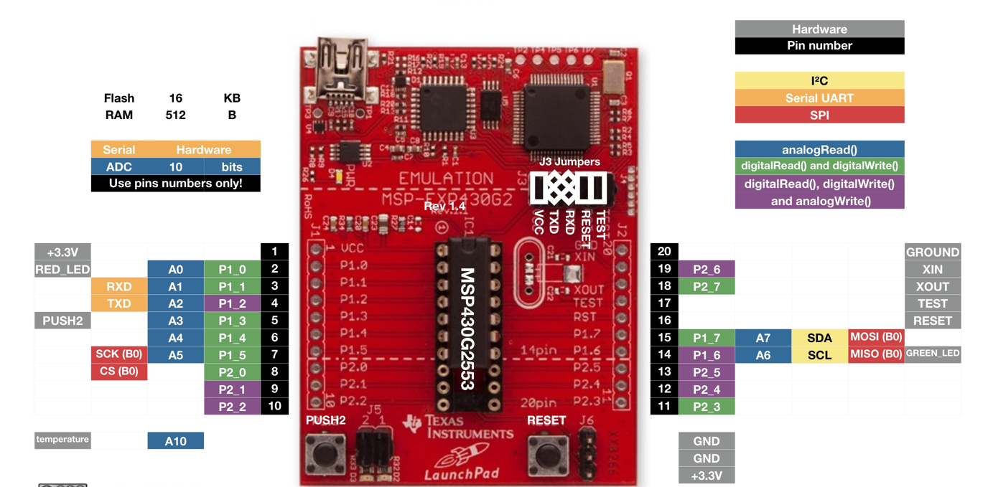
MSP-EXP430G2

Slide 29
Code Composer Studio-IDE
Its an IDE.
IDE stands for Integrated Development Environment.
Simple explanation:It’s a software tool where you can write, edit, compile, and debug programs all in one place.

Slide 30
Tools included: Compiler, Assembler, Linker, Debugger, BIOS, Simulator
Functional parts:
Compiler: C → Assembly
Assembler: Assembly → Machine code (object files)
Libraries: ANSI functions, I/O, Floating-point, Utilities
Linker: Combines object + library + BIOS → Executable (.out)
Debugger:-Helps you find and fix errors in your program.

Slide 31
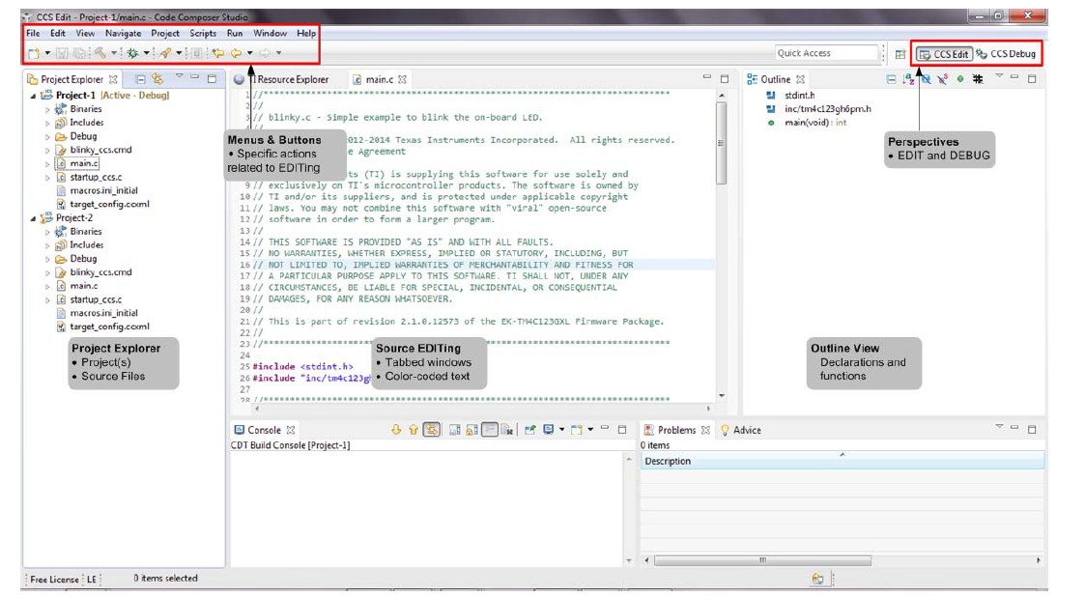
Edit perspective

Slide 32
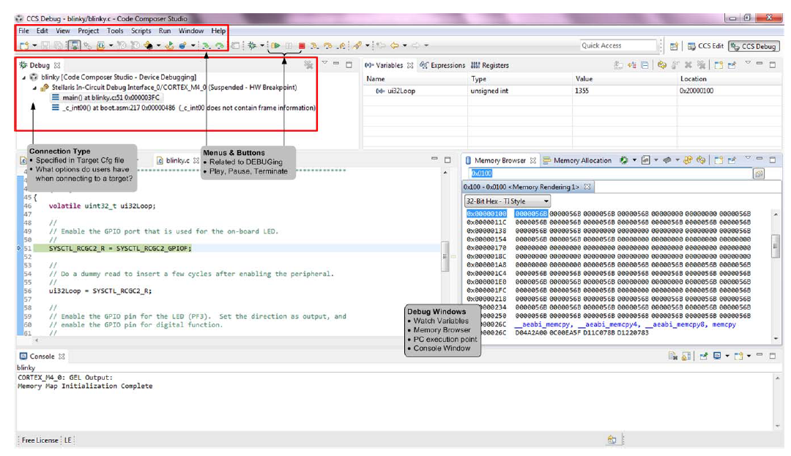

Slide 33
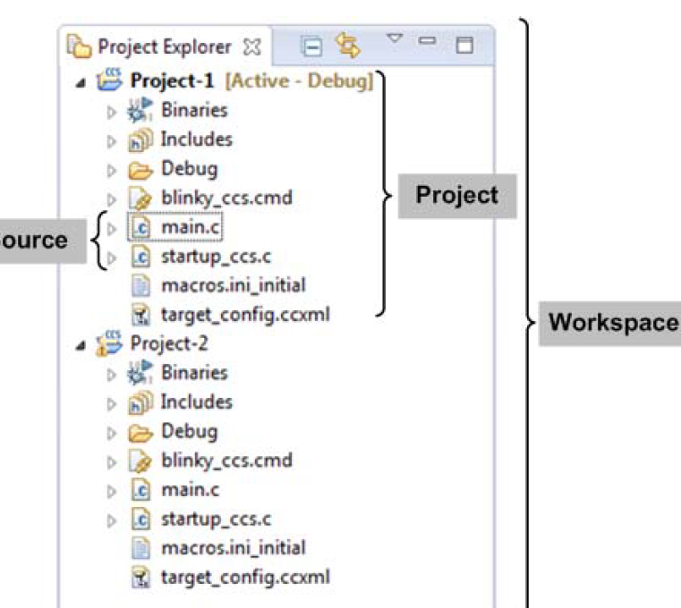

Slide 34
Project Creation and Build
A project contains all the files you will need to develop an executable output file (.out) which can be run on
the MSP430 hardware. To create a new project:
1. Click File New CCS Project
2. Type in your Project name and make the selections shown below (your dialog may look slightly different
than this one).
3. If you are using the MSP430G2553, make the appropriate choices for that part. Make sure to click
Empty Project (with main.c) and then click Finish.
4. If you are writing an Assembly Code, select Empty Assembly-only Project.

Slide 35
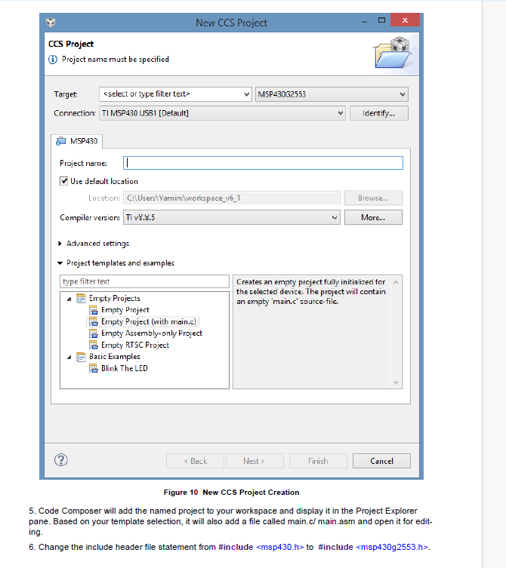

Slide 36
7. Type in your program code in the main.c / main.asm file and save it.
8. CCS can automatically save modified source files, build the program, open the debug perspective view,
connect and download it to the target (flash device), and then run the program to the beginning of the main
function. To do this, click on the "Debug" button. .
9. When the Ultra-Low-Power Advisor (ULP Advisor) appears, click the Proceed button.
10. When the download completes, CCS is in the Debug perspective. Notice the Debug tab in the upper
right-hand corner indicating that we are now in the "CCS Debug" view.
11. Click and drag the perspective tabs to the left until you can see all of both tabs. You can observe that
the program has run through the C-environment initialization routine in the runtime support library and
stopped at main() in main.c.

Slide 37
Debug Environment
After completion of target download, CCS enters the Debug perspective. Notice the Debug tab in the upper
right-hand corner indicating that we are now in the "CCS Debug" view (See Figure 7). Click and drag the
perspective tabs to the left until you can completely see both tabs.
The basic buttons that control the debug environment are located at the top of the Debug pane. If the pane
is closed accidentally, the Debug controls will disappear. To bring back the debug controls, click
View Debug on the menu bar.
Figure 11 Debug Environment
You can explore each button by clicking on it to see its function. At this point, your code should be at the
beginning of main (). Look for a small blue arrow left of the opening brace of main() in the middle window
as shown in Figure 11. The blue arrow indicates where the Program Counter (PC) is pointing to.
Click the Resume button to run the code.
Click Suspend to stop code execution in the middle of the program.
To single-step into the code, click Step Into to help in debugging the program and check if each line
of code is producing the desired result.
Click Reset CPU and you should be back at the beginning of main().
The Terminate button will terminate the active debug session, close the debugger and return CCS to
the "CCS Edit" perspective. It also sends a reset to the LaunchPad board.

Slide 38
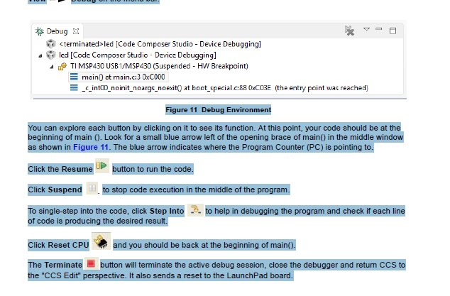

Slide 39
