Slide 1
3. Network Layer

Slide 2
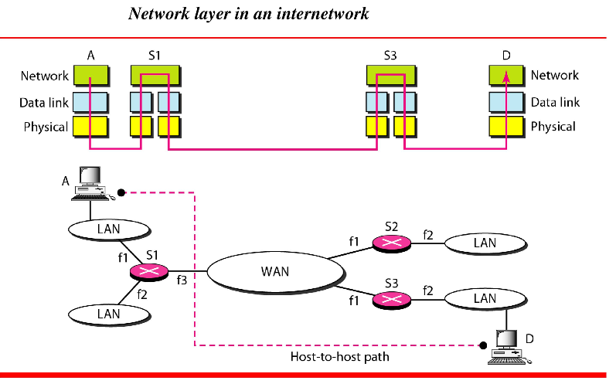

Slide 3
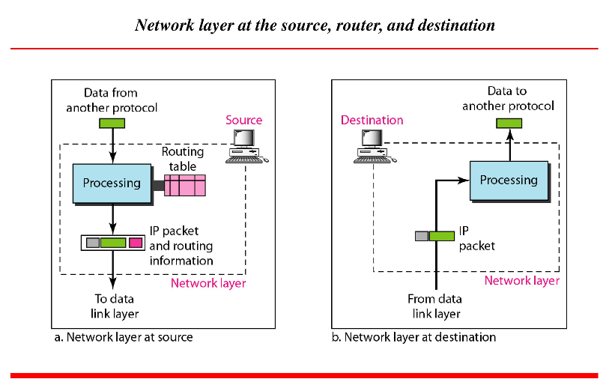

Slide 4
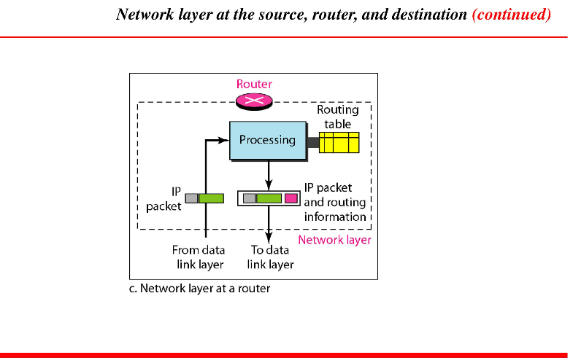

Slide 5
Function of Network Layer
The network layer internet layer is also known as an Internet layer or IP Layer.
The main responsibility of the internet layer is to send the packets from any network, and they arrive at the destination irrespective of the route they take.
Important Protocols in N/W Layer:
IP
ARP
ICMP

Slide 6
Function of Network Layer
The network layer internet layer is also known as an Internet layer or IP Layer.
The main responsibility of the internet layer is to send the packets from any network, and they arrive at the destination irrespective of the route they take.
Important Protocols in N/W Layer:
IP
ARP
ICMP

Slide 7
IP Protocol
IP protocol is used in this layer, and it is the most significant part of the entire TCP/IP suite.
Following are the responsibilities of this protocol:
IP Addressing: This protocol implements logical host addresses known as IP addresses. The IP addresses are used by the internet and higher layers to identify the device and to provide internetwork routing.
Host-to-host communication: It determines the path through which the data is to be transmitted.

Slide 8
..cntd..IP
Data Encapsulation and Formatting: An IP protocol accepts the data from the transport layer protocol. An IP protocol ensures that the data is sent and received securely, it encapsulates the data into message known as IP datagram.
Fragmentation and Reassembly: The limit imposed on the size of the IP datagram by data link layer protocol is known as Maximum Transmission unit (MTU). If the size of IP datagram is greater than the MTU unit, then the IP protocol splits the datagram into smaller units so that they can travel over the local network. Fragmentation can be done by the sender or intermediate router. At the receiver side, all the fragments are reassembled to form an original message.

Slide 9
…cntd..IP
Routing: When IP datagram is sent over the same local network such as LAN, MAN, WAN, it is known as direct delivery. When source and destination are on the distant network, then the IP datagram is sent indirectly. This can be accomplished by routing the IP datagram through various devices such as routers.

Slide 10
ARP:
ARP stands for Address Resolution Protocol.
ARP is a network layer protocol which is used to find the physical address from the IP address.
The two terms are mainly associated with the ARP Protocol:
  ARP request: When a sender wants to know the physical address of the device, it broadcasts the ARP request to the network.
  ARP reply: Every device attached to the network will accept the ARP request and process the request, but only recipient recognize the IP address and sends back its physical address in the form of ARP reply. The recipient adds the physical address both to its cache memory and to the datagram header

Slide 11
ICMP
ICMP stands for Internet Control Message Protocol.
It is a mechanism used by the hosts or routers to send notifications regarding datagram problems back to the sender.
A datagram travels from router-to-router until it reaches its destination. If a router is unable to route the data because of some unusual conditions such as disabled links, a device is on fire or network congestion, then the ICMP protocol is used to inform the sender that the datagram is undeliverable.

Slide 12
ICMP…
An ICMP protocol mainly uses two terms:
  ICMP Test: ICMP Test is used to test whether the destination is reachable or not.
  ICMP Reply: ICMP Reply is used to check whether the destination device is responding or not.
The core responsibility of the ICMP protocol is to report the problems, not correct them. The responsibility of the correction lies with the sender.
ICMP can send the messages only to the source, but not to the intermediate routers because the IP datagram carries the addresses of the source and destination but not of the router that it is passed to.

Slide 13
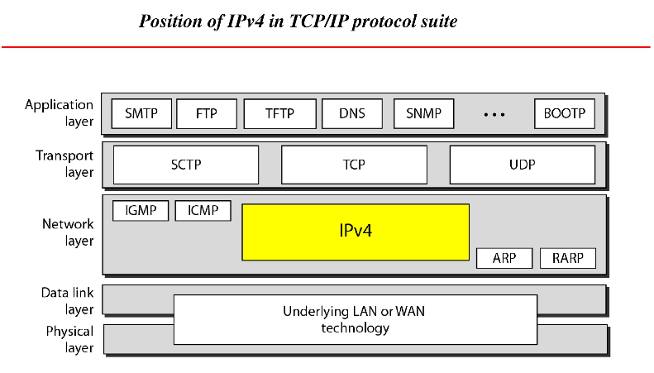

Slide 14
Internet Protocol(IPv4)
Objectives
Upon completion you will be able to:
Understand the format and fields of a datagram
Understand the need for fragmentation and the fields involved
Understand the options available in an IP datagram
Be able to perform a checksum calculation
Understand the components and interactions of an IP package

Slide 15
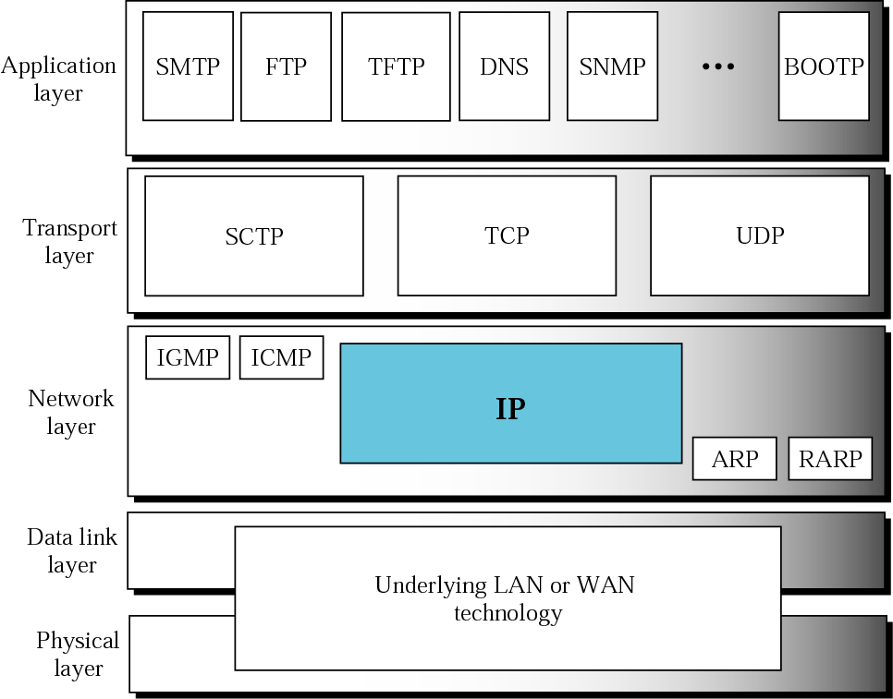
Position of IP in TCP/IP protocol suite

Slide 16
DATAGRAM
A packet in the IP layer is called a datagram, a variable-length packet consisting of two parts: header and data. The header is 20 to 60 bytes in length and contains information essential to routing and delivery.

Slide 17
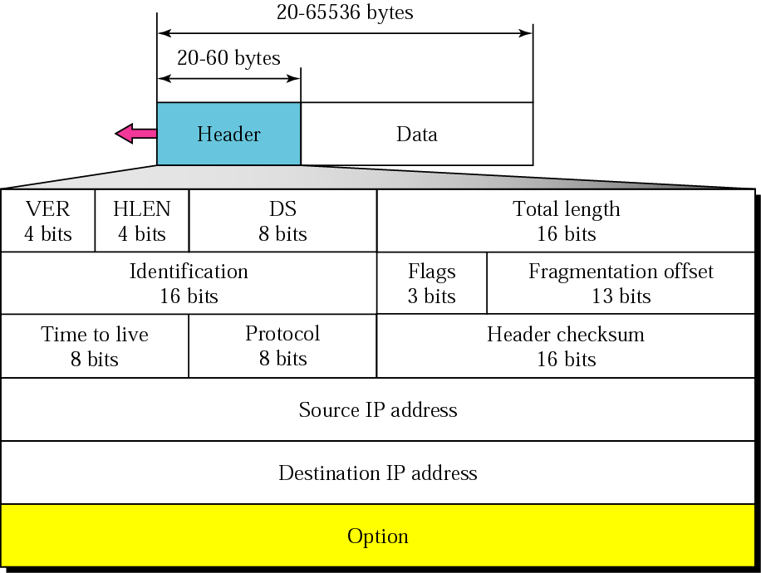
IP datagram

Slide 18
Following are various components/fields of IP packet header
Version: The first IP header field is a 4-bit version indicator. In IPv4, the value of its four bits is set to 0100, which indicates 4 in binary. However, if the router does not support the specified version, this packet will be dropped.
Header Length: Internet header length, shortly known as IHL, is 4 bits in size. It is also called HLEN (Header Length). This IP component is used to show how many 32-bit words are present in the header.
Type of Service: Type of Service is also called Differentiated Services Code Point or DSCP. This field is provided features related to the quality of service for data streaming or VoIP calls. The first 3 bits are the priority bits. It is also used for specifying how you can handle Datagram.

Slide 19
Total length: The total length is measured in bytes. The minimum size of an IP datagram is 20 bytes and the maximum, it can be 65535 bytes (as total length field is 16 bits) . HLEN and Total length can be used to calculate the dimension of the payload.
Identification: Identification is a packet that is used to identify fragments of an IP datagram uniquely. Some have recommended using this field for other things like adding information for packet tracing, etc.
IP Flags: Flag is a three-bit field that helps you to control and identify fragments.The following can be their possible configuration:
Bit 0: is reserved and has to be set to zero
Bit 1: means do not fragment
Bit 2: means more fragments.

Slide 20
Fragment Offset: Fragment Offset represents the number of Data Bytes ahead of the particular fragment in the specific Datagram. It is specified in terms of the number of 8 bytes, which has a maximum value of 65,528 bytes.
Time to live: It is an 8-bit field that indicates the maximum number of hops (routers) visited by datagram.When a source host sends the datagram , it stores a number in this field.This value is approximately 2 times the number of routers between any two hosts. Each router that processes the datagram and decrements this number by 1.When this becomes zero , the datagram is discarded by the router.
Protocol: This IPv4 header is reserved to denote that internet protocol is used in the latter portion of the Datagram. For Example, 6 number digit is mostly used to indicate TCP, and 17 is used to denote the UDP protocol.

Slide 21
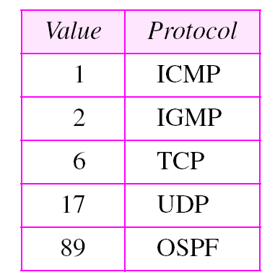
Header Checksum: The next component is a 16 bits header checksum field, which is used to check the header for any errors. The IP header is compared to the value of its checksum. When the header checksum is not matching, then the packet will be discarded.
Source Address: The source address is a 32-bit address of the source used for the IPv4 packet.
Destination address: The destination address is also 32 bit in size stores the address of the receiver.

Slide 22
IP Options: It is an optional field of IPv4 header used when the value of IHL (Internet Header Length) is set to greater than 5. They are used for network testing and debugging. It contains values and settings related with security, record route and time stamp, etc.
Data: This field stores the data from the protocol layer, which has handed over the data to the IP layer.

Slide 23
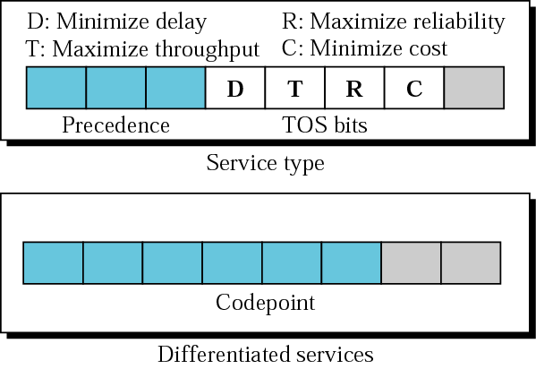
Figure 8.3 Service type or differentiated services

Slide 24
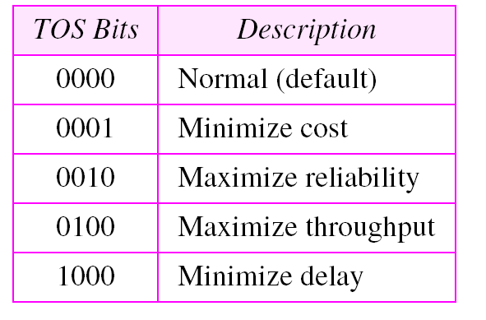
Table 3.1 Types of service

Slide 25
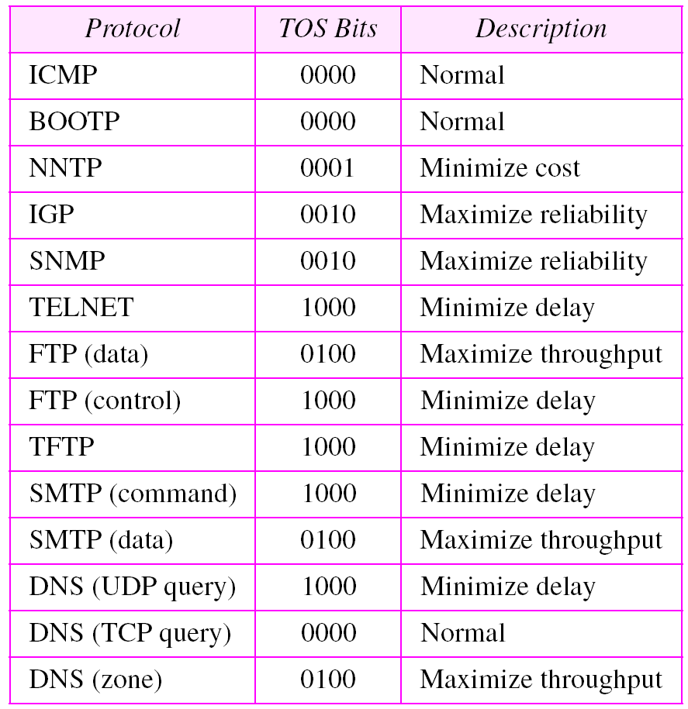
Table 3.2 Default types of service

Slide 26
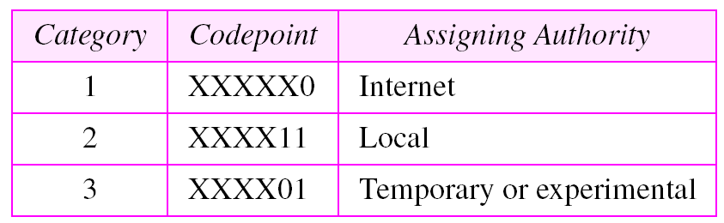
Table 3.3 Values for codepoints

Slide 27
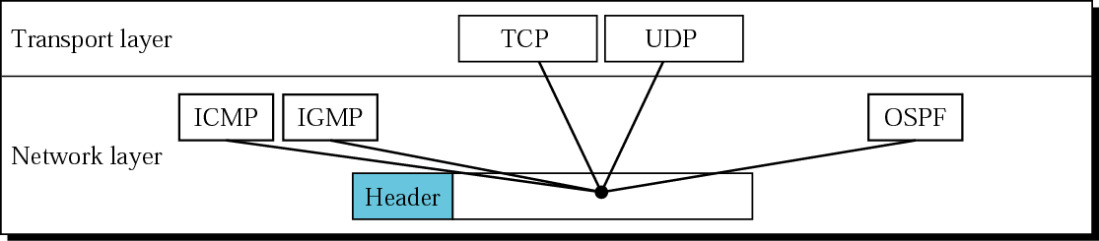
Figure 3.5 Multiplexing

Slide 28
Table 3.4 Protocols

Slide 29
Example 1
An IP packet has arrived with the first 8 bits as shown:
01000010
The receiver discards the packet. Why?
Solution
There is an error in this packet. The 4 left-most bits (0100) show the version, which is correct. The next 4 bits (0010) show the header length; which means (2 × 4 = 8), which is wrong. The minimum number of bytes in the header must be 20. The packet has been corrupted in transmission.

Slide 30
Example 2
In an IP packet, the value of HLEN is 1000 in binary. How many bytes of options are being carried by this packet?
Solution
The HLEN value is 8, which means the total number of bytes in the header is 8 × 4 or 32 bytes. The first 20 bytes are the base header, the next 12 bytes are the options.

Slide 31
Example 3
In an IP packet, the value of HLEN is 5₁₆
and the value of the total length field is 0028₁₆ . How
many bytes of data are being carried by this packet?
Solution
The HLEN value is 5, which means the total number of bytes in the header is 5 × 4 or 20 bytes (no options). The total length is 40 bytes, which means the packet is carrying 20 bytes of data (40 − 20).

Slide 32
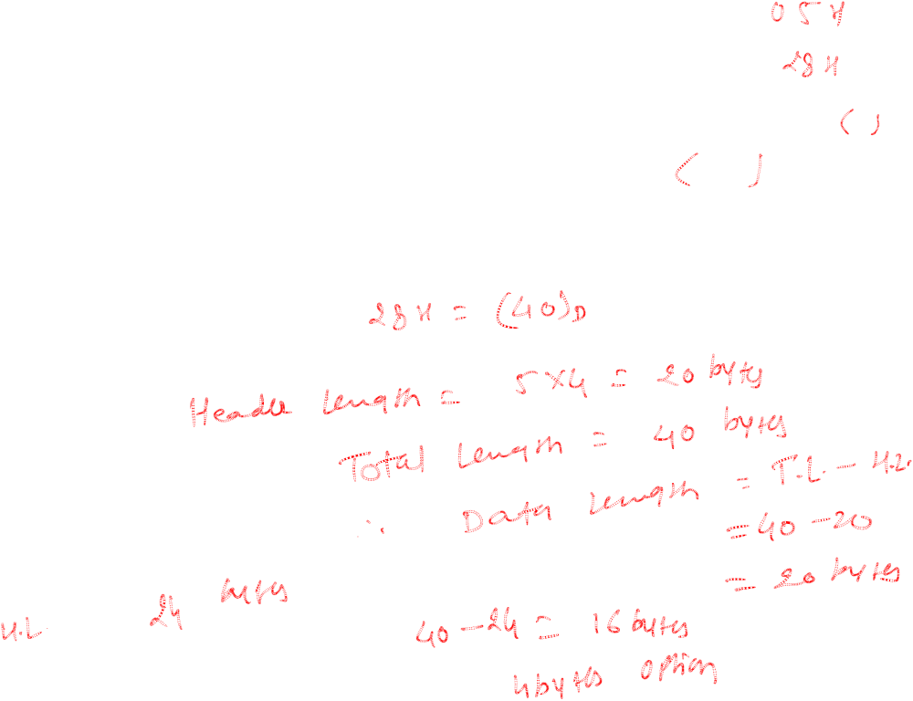

Slide 33
Example 4
An IP packet has arrived with the first few hexadecimal digits as shown below:
45000028000100000102 . . .
How many hops can this packet travel before being dropped? The data belong to what upper layer protocol?
Solution
To find the time-to-live field, we skip 8 bytes (16 hexadecimal digits). The time-to-live field is the ninth byte, which is 01. This means the packet can travel only one hop. The protocol field is the next byte (02), which means that the upper layer protocol is IGMP (see Table 8.4).

Slide 34
Example 4
An IP packet has arrived with the first few hexadecimal digits as shown below:
45000028000100000102 . . .
How many hops can this packet travel before being dropped? The data belong to what upper layer protocol?
Solution
To find the time-to-live field, we skip 8 bytes (16 hexadecimal digits). The time-to-live field is the ninth byte, which is 01. This means the packet can travel only one hop. The protocol field is the next byte (02), which means that the upper layer protocol is IGMP (see Table 8.4).

Slide 35
3.2 FRAGMENTATION
The format and size of a frame depend on the protocol used by the physical network. A datagram may have to be fragmented to fit the protocol regulations.
The topics discussed in this section include:
Maximum Transfer Unit (MTU)
Fields Related to Fragmentation

Slide 36
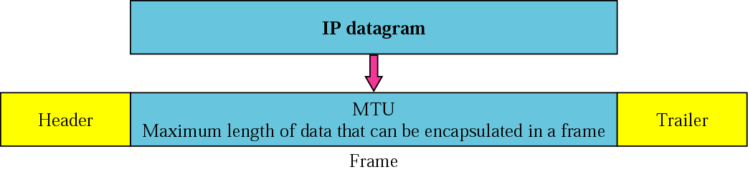
Figure 3.6 MTU

Slide 37
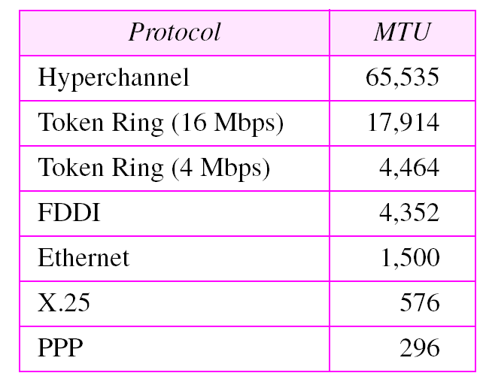
Table 3.5 MTUs for some networks

Slide 38
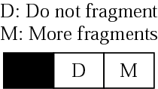
Figure 3.7 Flags field

Slide 39
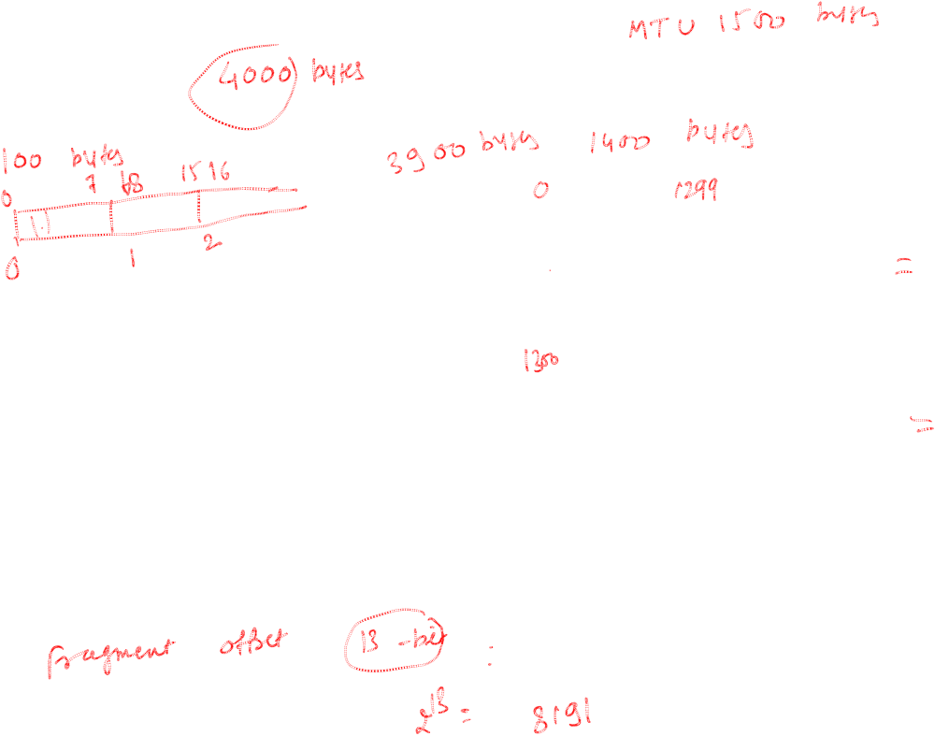
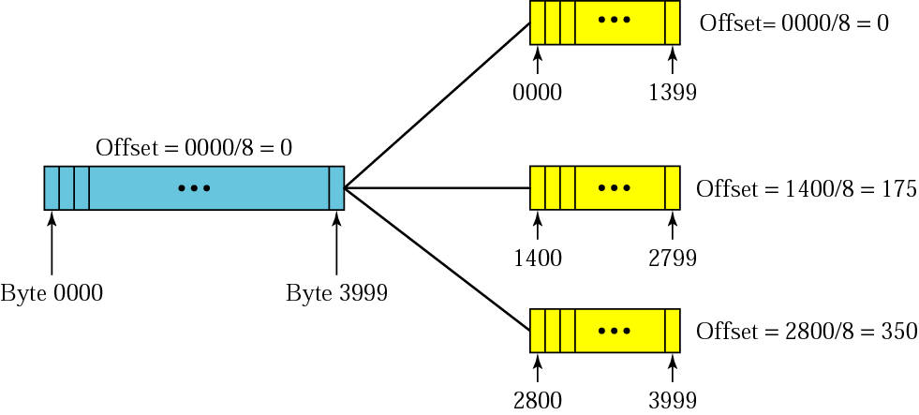
Figure 3.8 Fragmentation example

Slide 40
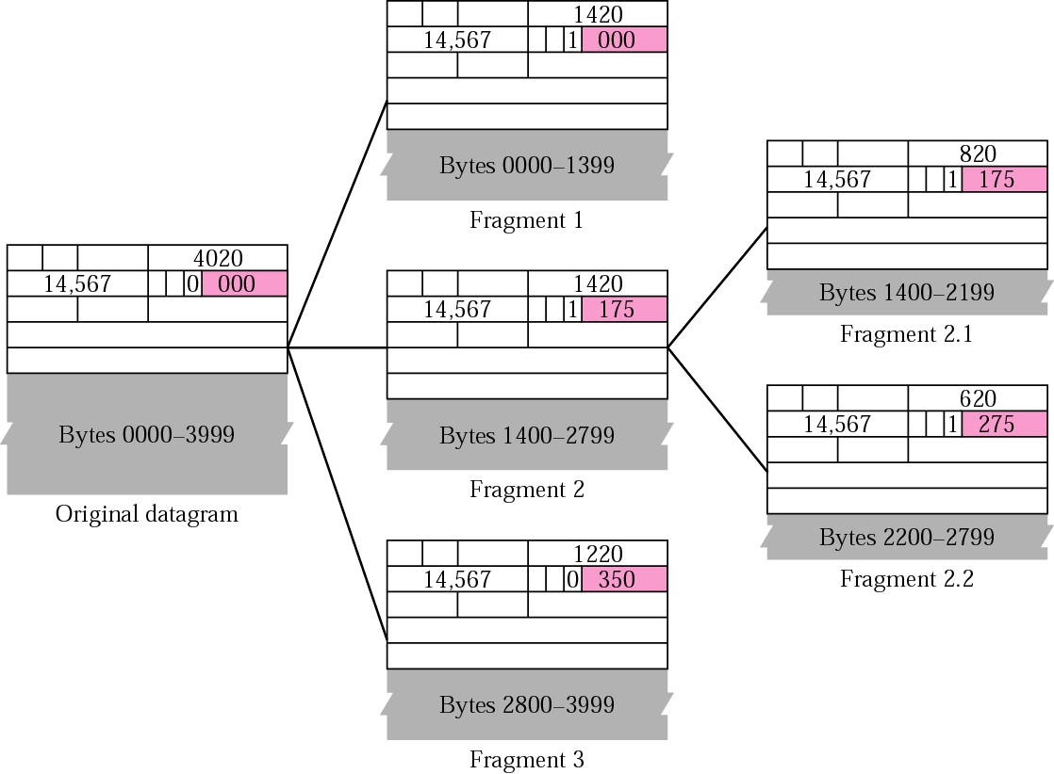
Figure 3.9 Detailed fragmentation example

Slide 41
A router receives an IP packet containing 600 data bytes and has to forward the packet to a
network with maximum transmission unit of 200 bytes. Assume that IP header is 20 bytes long.
What are fragment offset values for divided packets?

Slide 42
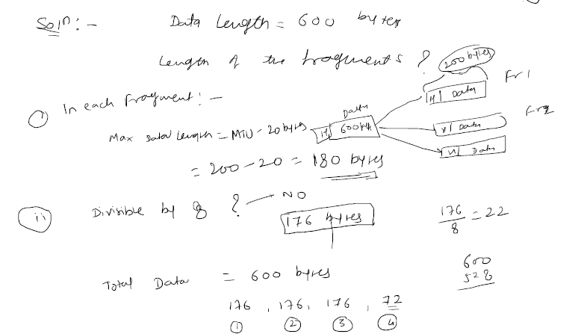
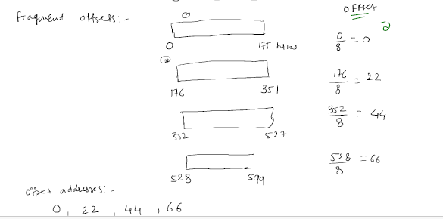

Slide 43
Example 5
A packet has arrived with an M bit value of 0. Is this the first fragment, the last fragment, or a middle fragment? Do we know if the packet was fragmented?
Solution
If the M bit is 0, it means that there are no more fragments; the fragment is the last one. However, we cannot say if the original packet was fragmented or not. A nonfragmented packet is considered the last fragment.

Slide 44
Example 6
A packet has arrived with an M bit value of 1. Is this the first fragment, the last fragment, or a middle fragment? Do we know if the packet was fragmented?
Solution
If the M bit is 1, it means that there is at least one more fragment. This fragment can be the first one or a middle one, but not the last one. We don’t know if it is the first one or a middle one; we need more information (the value of the fragmentation offset). See also the next example.

Slide 45
Example 7
A packet has arrived with an M bit value of 1 and a fragmentation offset value of zero. Is this the first fragment, the last fragment, or a middle fragment?.
Solution
Because the M bit is 1, it is either the first fragment or a middle one. Because the offset value is 0, it is the first fragment.

Slide 46
Example 8
A packet has arrived in which the offset value is 100. What is the number of the first byte? Do we know the number of the last byte?
Solution
To find the number of the first byte, we multiply the offset value by 8. This means that the first byte number is 800. We cannot determine the number of the last byte unless we know the length of the data.

Slide 47
Example 9
A packet has arrived in which the offset value is 100, the value of HLEN is 5 and the value of the total length field is 100. What is the number of the first byte and the last byte?
Solution
The first byte number is 100 × 8 = 800. The total length is 100 bytes and the header length is 20 bytes (5 × 4), which means that there are 80 bytes in this datagram. If the first byte number is 800, the last byte number must be 879.

Slide 48
CHECKSUM
The error detection method used by most TCP/IP protocols is called the checksum. The checksum protects against the corruption that may occur during the transmission of a packet. It is redundant information added to the packet.
The topics discussed in this section include:
Checksum Calculation at the Sender
Checksum Calculation at the Receiver
Checksum in the IP Packet

Slide 49

Note:
To create the checksum the sender does the following:
❏ The packet is divided into k sections, each of n bits.
❏ All sections are added together using 1’s complement
arithmetic.
❏ The final result is complemented to make the
checksum.

Slide 50
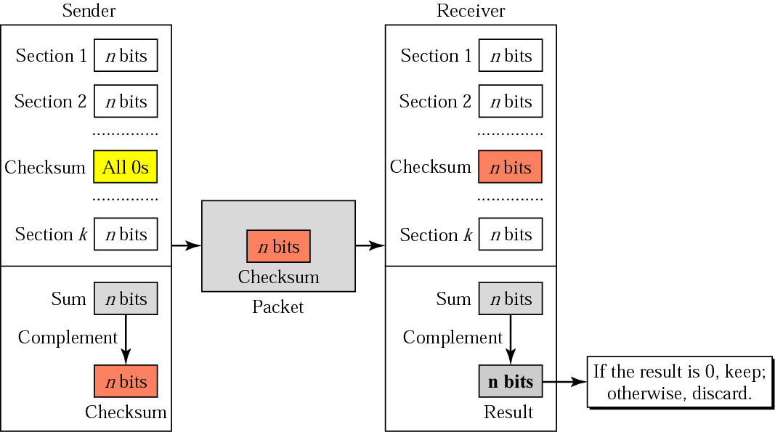
Figure 3.22 Checksum concept

Slide 51
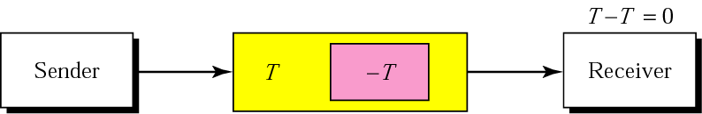
Figure 3.23 Checksum in one’s complement arithmetic

Slide 52
Example 17
Figure 8.24 shows an example of a checksum calculation for an IP header without options. The header is divided into 16-bit sections. All the sections are added and the sum is complemented. The result is inserted in the checksum field.
See Next Slide

Slide 53
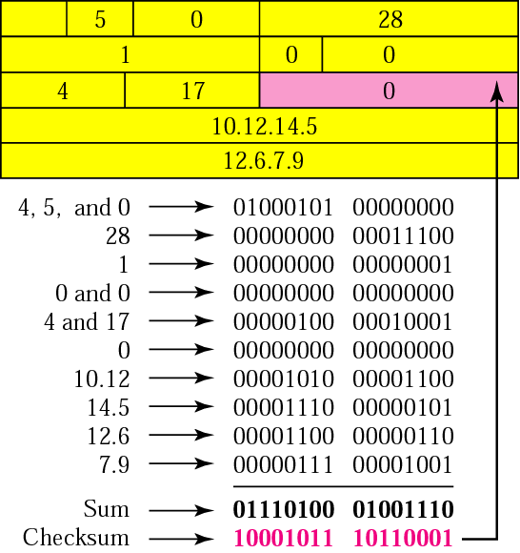
Figure 8.24 Example of checksum calculation in binary

Slide 54
Example 18
Let us do the same example in hexadecimal. Each row has four hexadecimal digits. We calculate the sum first. Note that if an addition results in more than one hexadecimal digit, the right-most digit becomes the current-column digit and the rest are carried to other columns. From the sum, we make the checksum by complementing the sum. However, note that we subtract each digit from 15 in hexadecimal arithmetic (just as we subtract from 1 in binary arithmetic). This means the complement of E (14) is 1 and the complement of 4 is B (11). Figure 8.25 shows the calculation. Note that the result (8BB1) is exactly the same as in Example 17.
See Next Slide

Slide 55
IP Addressing
An IP address (internet protocol address) is a numerical representation that uniquely identifies a specific interface on the network.
Addresses in IPv4 are 32-bits long. This allows for a maximum of 4,294,967,296 (2³²) unique addresses. Addresses in IPv6 are 128-bits, which allows for 3.4 x 10³⁸ (2¹²⁸) unique addresses.
IP addresses are binary numbers but are typically expressed in decimal form (IPv4) or hexadecimal form (IPv6) to make reading and using them easier for humans.
IPv4 addresses are actually 32-bit binary numbers, consisting of the two sub-addresses (identifiers) which identify the network ID and host ID, with an imaginary boundary separating the two.
An IP address is, as such, generally shown as 4 octets of numbers from 0-255 represented in decimal form instead of binary form.
For example, the address 168.212.226.204 represents the 32-bit binary number 10101000.11010100.11100010.11001100.

Slide 56
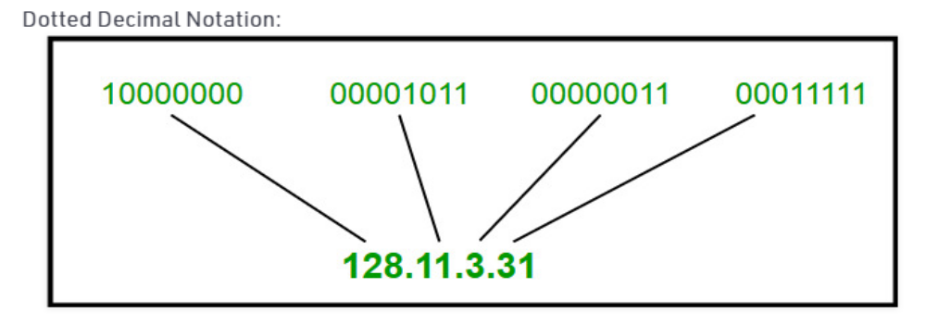
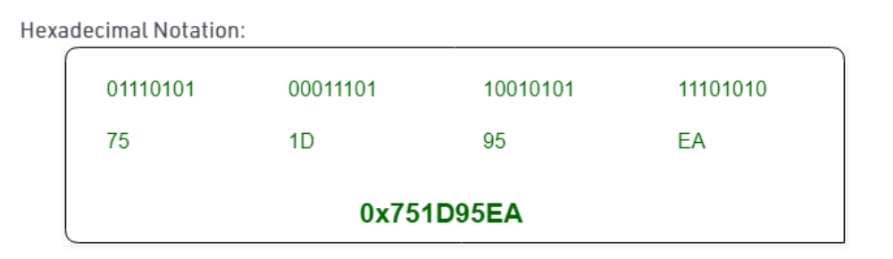
IP address notation:

Slide 57
Classful Addressing:
Introduced in 1981, with classful routing, IP v4 addresses were divided into 5 classes(A to E).
Classes A-C: unicast addresses
Class D: multicast addresses
Class E: reserved for future use

Slide 58
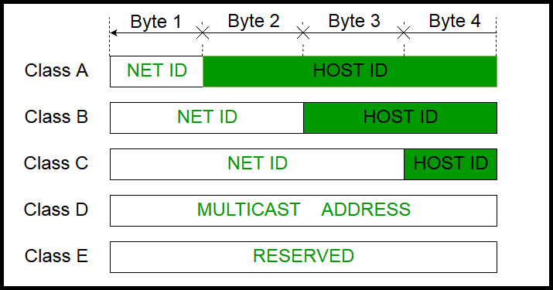

Slide 59
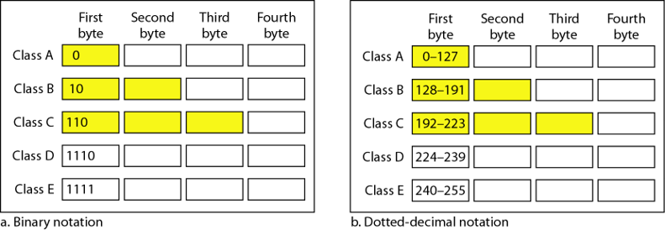

Slide 60
Class A
In a class A address, the first bit of the first octet is always ‘0’.
Thus, class A addresses range from 0.0.0.0 to 127.255.255.255(as 01111111 in binary converts to 127 in decimal).
The first 8 bits or the first octet denote the Network ID and the rest 24 bits or the 3 octets belong to the Host ID.
Example: 10.1.1.1

Slide 61

Exception: Class A
The address 127.X.X.X is reserved for loopback.
And 0.X.X.X is reserved for default network
Therefore, the actual range of class A addresses is: 1.0.0.0 to 126.255.255.255

Slide 62
Class B:
In a class B address, the first octet would always start with ’10’.
Thus, class B addresses range from 128.0.0.0 to 191.255.255.255.
The first 16 bits or the first two octets denote the Network ID and the remaining 16 bits or two octets belong to the Host ID.
Example: 172.16.1.1

Slide 63
Class C:
In a class C address, the first octet would always start with ‘110’.
Thus, class C addresses range from 192.0.0.0 to 223.255.255.255.
The first 24 bits or the first three octets denote the network ID and the rest 8 bits or the remaining one octet belong to the Host ID.
Example: 192.168.1.1

Slide 64
Class D:
Class D is used for multicast addressing .
In a class D address the first octet would always start with ‘1110’.
Thus, class D addresses range from 224.0.0.0 to 239.255.255.255.
Example: 239.2.2.2
Class D addresses are used by routing protocols like OSPF, RIP, etc.

Slide 65
Class E:
Class E addresses are reserved for research purposes and future use.
The first octet in a class E address starts with ‘1111’.
Thus, class E addresses range from 240.0.0.0 to 255.255.255.255.

Slide 67
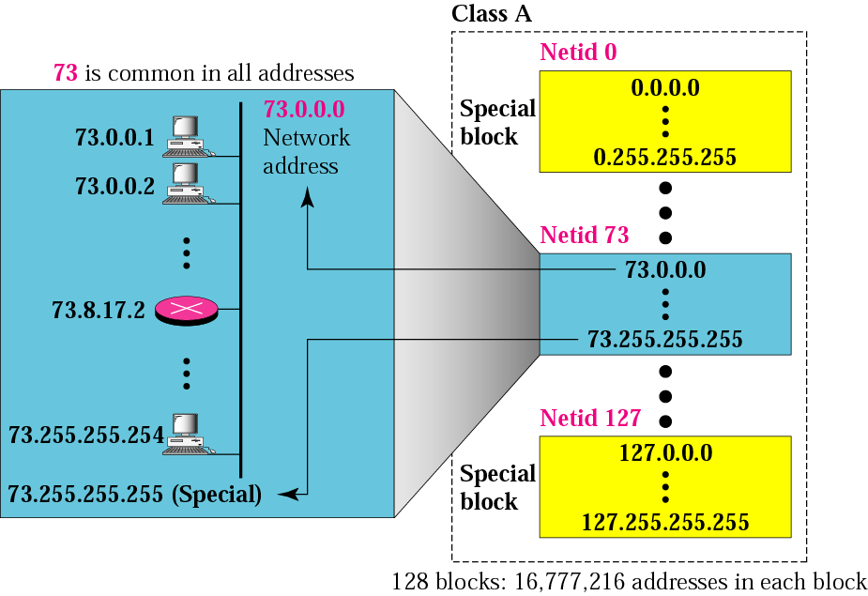
Figure 4.7 Blocks in class A

Slide 68
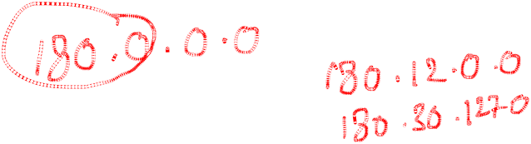
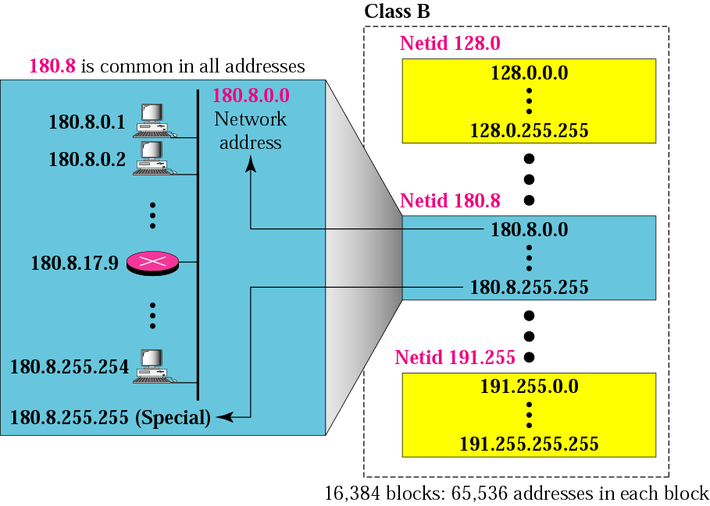
Figure 4.8 Blocks in class B

Slide 69

Figure 4.9 Blocks in class C

Slide 70

Example 9
Given the network address 17.0.0.0, find the class, the block, and the range of the addresses.
Solution
The class is A because the first byte is between 0 and 127. The block has a netid of 17. The addresses range from 17.0.0.0 to 17.255.255.255.

Slide 71
Example 10
Given the network address 132.21.0.0, find the class, the block, and the range of the addresses.
Solution
The class is B because the first byte is between 128 and 191. The block has a netid of 132.21. The addresses range from 132.21.0.0 to 132.21.255.255.

Slide 72

Example 11
Given the network address 220.34.76.0, find the class, the block, and the range of the addresses.
Solution
The class is C because the first byte is between 192 and 223. The block has a netid of 220.34.76. The addresses range from 220.34.76.0 to 220.34.76.255.

Slide 73
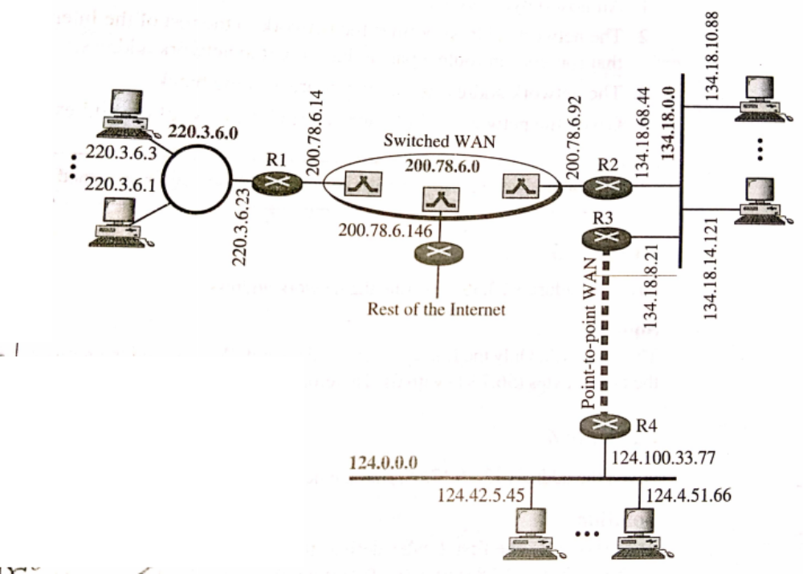
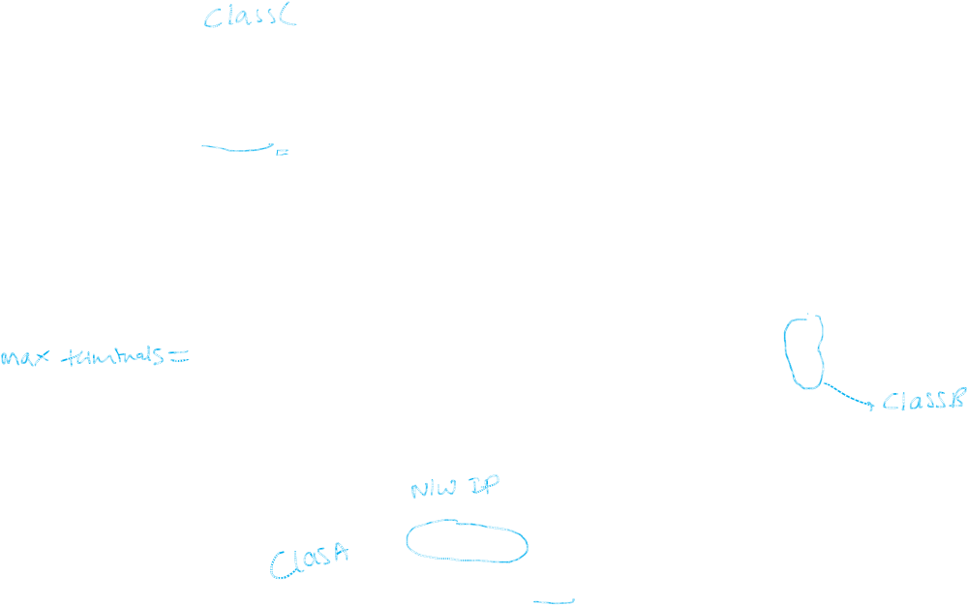
Sample Internet :

Slide 74
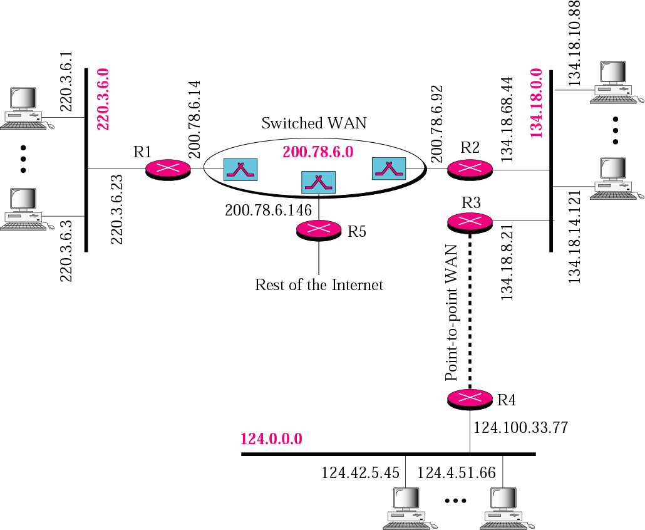
Figure 4.19 Sample internet

Slide 75
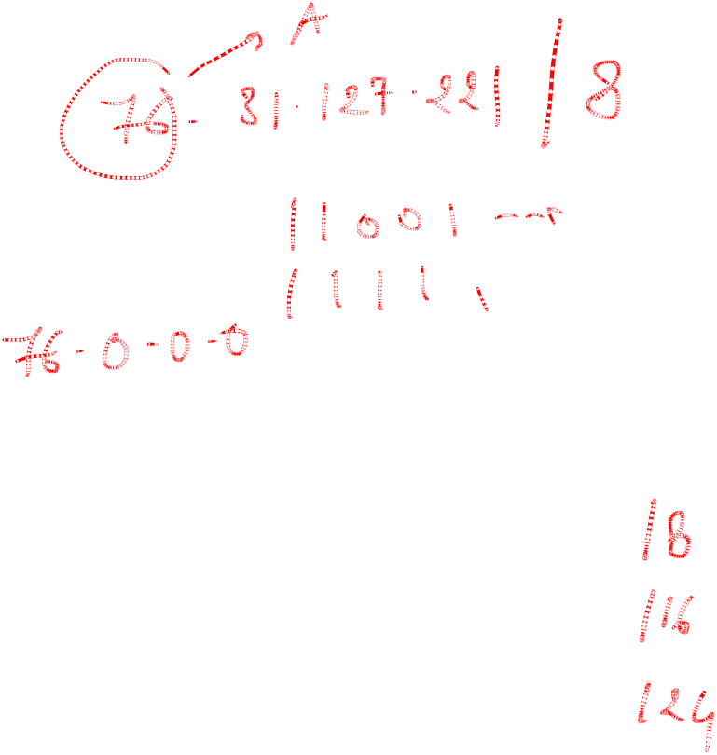
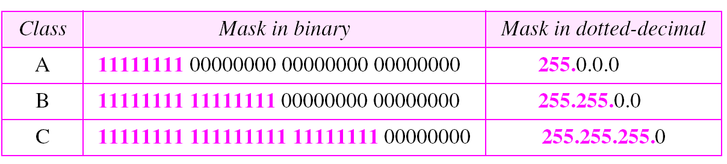
Network Masks
A network mask helps you know which portion of the address identifies the network and which portion of the address identifies the node.
Class A, B, and C networks have default masks, also known as natural masks, as shown here:
Class A: 255.0.0.0
Class B: 255.255.0.0
Class C: 255.255.255.0

Slide 76
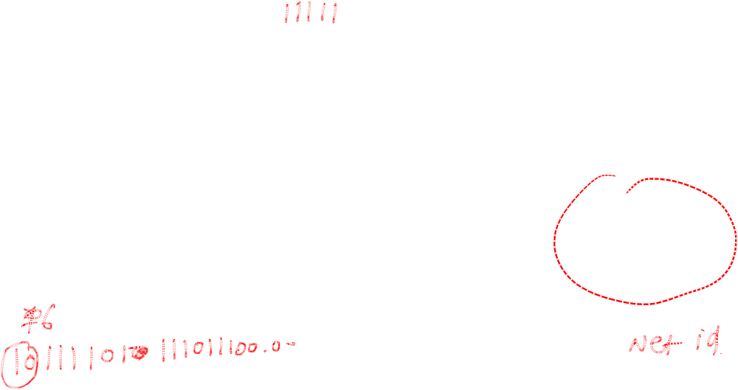
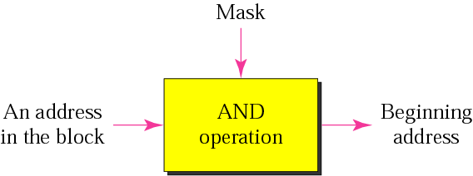
Masking concept

Slide 77
Example 12
Given the address 23.56.7.91, find the beginning address (network address). (00010111.00111000 .00000111 .01011011)
Solution
The default mask is 255.0.0.0, which means that only the first byte is preserved and the other 3 bytes are set to 0s. The network address is 23.0.0.0.

Slide 78
Example 13
Given the address 132.6.17.85, find the beginning address (network address). (100000100.00000110.00010001.01010101)
Solution
The default mask is 255.255.0.0, which means that the first 2 bytes are preserved and the other 2 bytes are set to 0s. The network address is 132.6.0.0.

Slide 79
Example 14
Given the address 201.180.56.5, find the beginning address (network address).
Solution
The default mask is 255.255.255.0, which means that the first 3 bytes are preserved and the last byte is set to 0. The network address is 201.180.56.0.

Slide 80
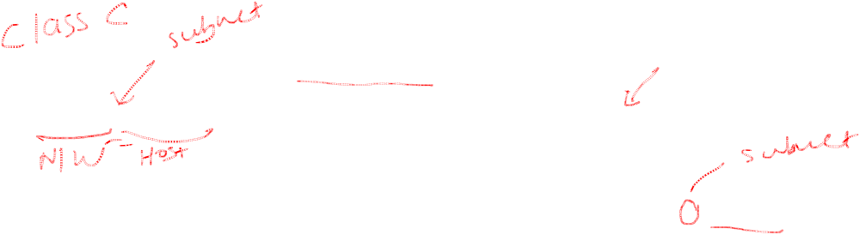
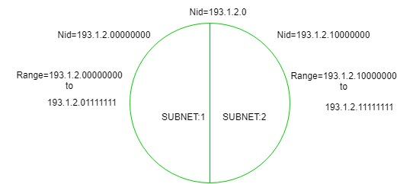
Subnetting :
When a bigger network is divided into smaller networks, in order to maintain security, then that is known as Subnetting. so, maintenance is easier for smaller networks.

Slide 81
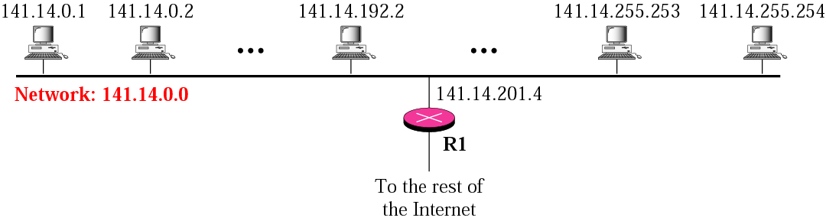

Figure 4.20 A network with two levels of hierarchy (not subnetted)

Slide 82
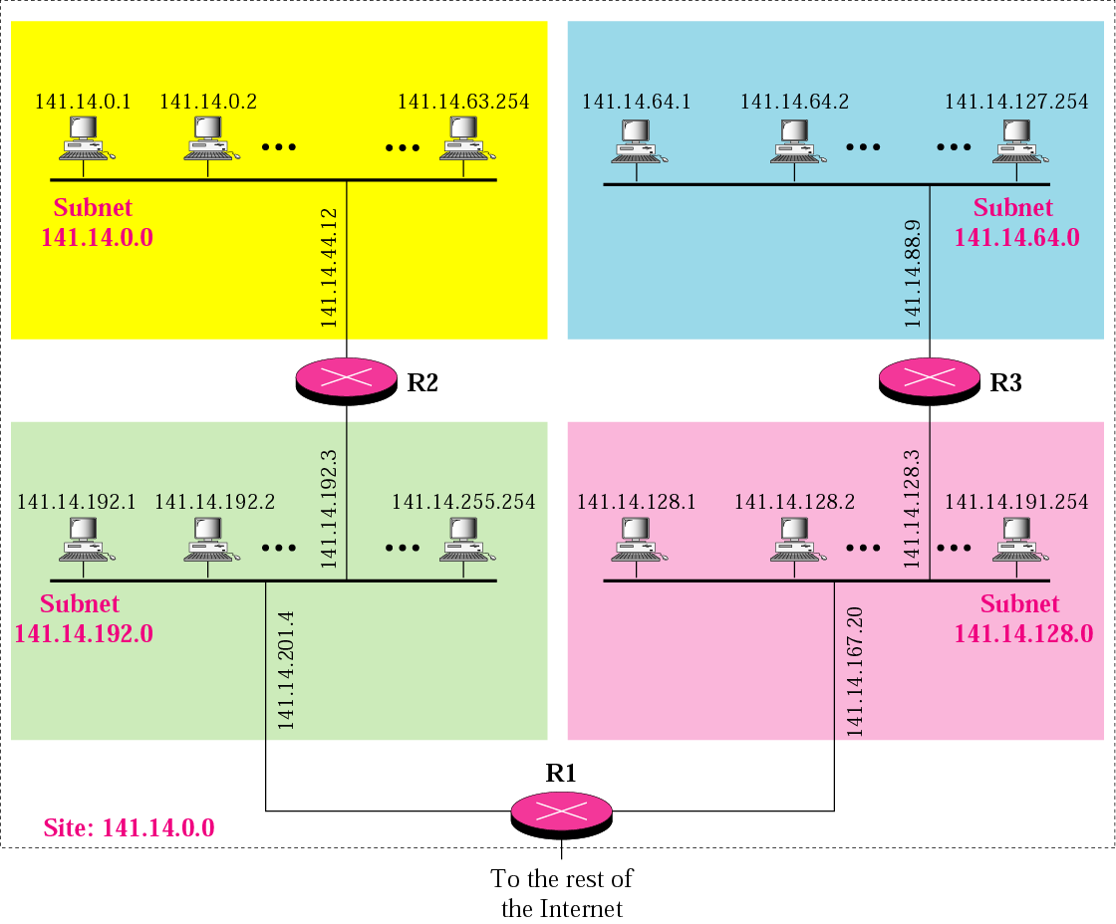
Figure 4.21 A network with three levels of hierarchy (subnetted)

Slide 83
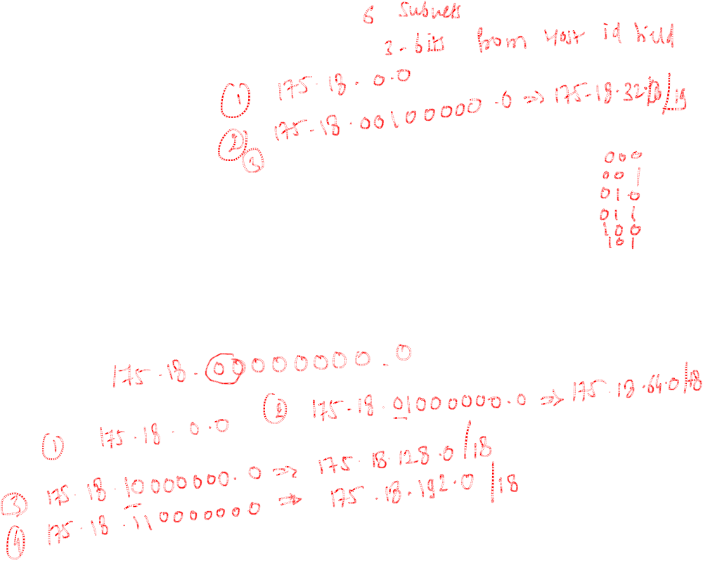
Subnetting:
Example:
Consider-We have a big single network having IP Address 175.18.0.0
We want to do subnetting and divide this network into 4 subnets.

Slide 84
Private IP Address Ranges
Private IP addresses are reserved for use within private networks. These addresses are not routable over the public internet and allow organizations to create internal networks without requiring globally unique IPs.
IP Range | Class | Subnet Mask | Usage
10.0.0.0 - 10.255.255.255 | A | 255.0.0.0 (/8) | Large private networks
172.16.0.0 - 172.31.255.255 | B | 255.240.0.0 (/12) | Medium-sized private networks
192.168.0.0 - 192.168.255.255 | C | 255.255.0.0 (/16) | Small private networks
Home networks typically use 192.168.x.x. Enterprises may use 10.x.x.x for larger internal networks.

Slide 85
Reserved IP addresses
Range | Purpose
10.0.0.0 - 10.255.255.255 | Private networks (Class A)
172.16.0.0 - 172.31.255.255 | Private networks (Class B)
192.168.0.0 - 192.168.255.255 | Private networks (Class C)
127.0.0.0 - 127.255.255.255 | Loopback (localhost)
169.254.0.0 - 169.254.255.255 | Link-local (automatic assignment)
224.0.0.0 - 239.255.255.255 | Multicast
240.0.0.0 - 255.255.255.254 | Experimental

