Slide 1
Getting Data in the Lab
ME5990
Spring 2016
Jason D. Sommerville
Copyright © 2016 UPVI, LLC. Redistribution is prohibited.

Slide 2
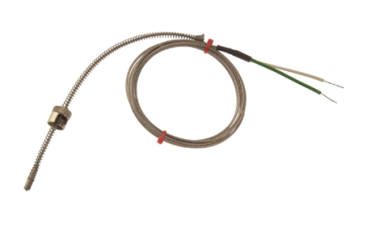
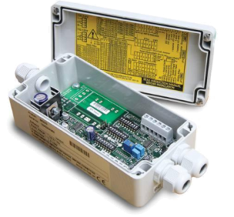
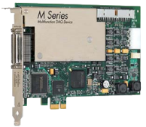
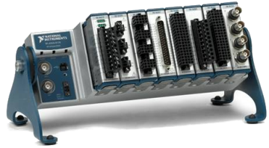
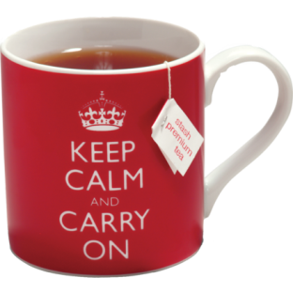
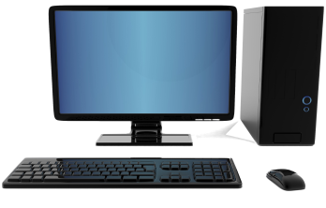

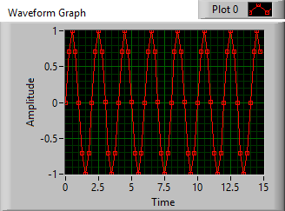






Transducer
Signal Conditioner
DAQ Hardware
Thermocouple
Amplifier, Low pass filter
NI CompactDAQ
Computer
Brought to you by IT
Phenomenon
Plotting
Software Basics
Cooling of Tea
Thesis/
Dissertation
Graduate!
Analysis
Curve fitting
DAQ
Storing Data
Analog Input
HDF5 Files
2

Slide 3
Software Development from 30,000 ft
Why do we develop software?
To interface with the real world via hardware
For flexibility
For extensibility
To enable us to acquire and process more than we could by hand
What do we need?
A problem
A plan (1)
A computer
A language (3)
Other tools
Editor or integrated development environment
Documentation tools (e.g. word processor)
Source code control (2)
Issue tracking database
Notes:
Whiteboard why
Whiteboard what we need

Slide 4
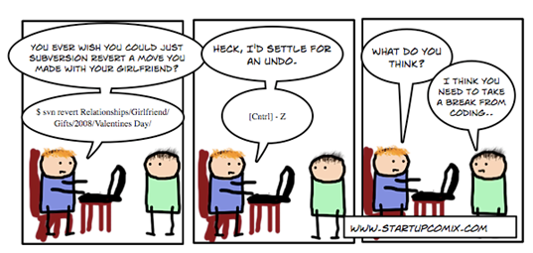
Source Code Control (SCC)
Also called Revision Control System (RCS) or Version Control system (VCS)
Keeps track of edits to code
Allows for review of history
Allows for global, long-term undo
Allows multiple people to work on code simultaneously
With minimal conflicts!
Allows for branching and merging
Notes:
Whiteboard branching and merging

Slide 5
NI 401 Past
https://web.archive.org/web/20130405041937/http://www.ni.com/news/releases/april9801.htm
https://web.archive.org/web/20130405041937/http://www.ni.com/news/releases/april901.htm
Notes:
Whiteboard branching and merging

Slide 6
Laboratory Software Choices
Language | Ease of Language | Development Environment | Data Acquisition | Instrument Control | Analysis Capabilities | Debugging Capabilities | UI Development Ease | UI Development Capabilities | Initial Cost
C/C++ | 1 | 5 | 3 | 4 | 2 | 5 | 1 | 5 | Low
Matlab | 3 | 4 | 2 | 3 | 5 | 3 | 3 | 2 | Med
Python | 4 | 2 | 2 | 4 | 4 | 4 | 4 | 4 | Free
LabVIEW | 5 | 4 | 5 | 5 | 4 | 4 | 5 | 3 | Med
My opinion on the effectiveness of the languages for laboratory usage. Scale of 1 = worst to 5 = best.
Notes:
With what languages is the class familiar?

Slide 7
What is LabVIEW?
Programming language
Graphical
General purpose (but…)
Data flow
Great for
Data acquisition
Data storage
Instrumentation control
Simple to moderately complex UIs
Rapid prototyping of complex software
Programming real time systems and FPGAs*
Okay for
Data analysis and plotting
Not so good for
Complex UIs
Embedded systems not supported by NI
*Provided you are programming an NI or compatible RT or FPGA system

Slide 8
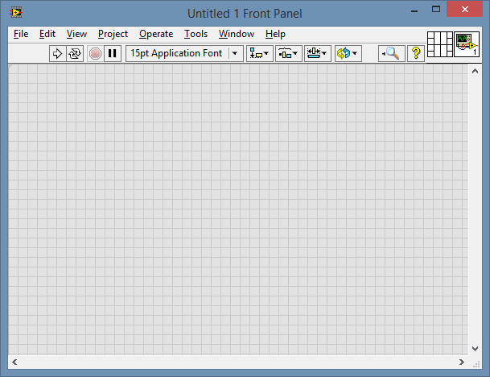
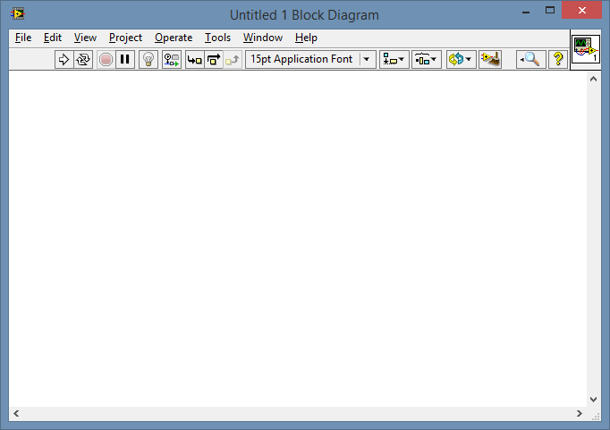
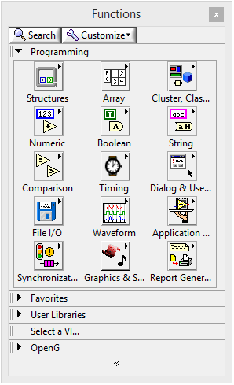
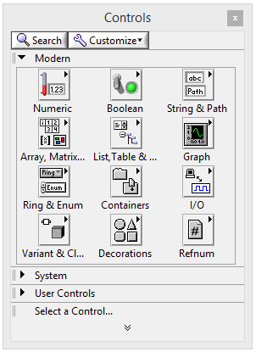

LabVIEW Environment
Front Panel
User interface goes here
Block Diagram
Code goes here
Function Palette
(BD Only)
Control Palette
Tools Palette
(FP Only)
Notes:
Palettes turn on and off from view menu
Also, right click and ctrl+right click

Slide 9
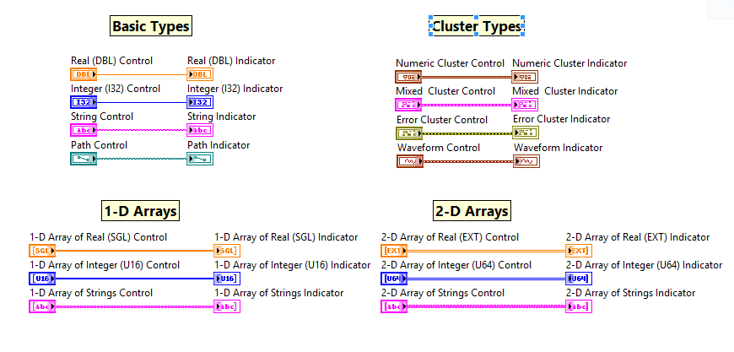
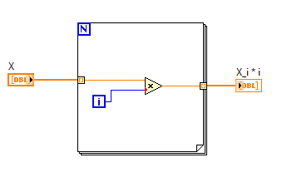
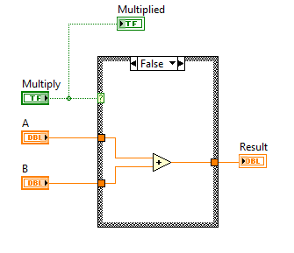
Coding Elements
Data types
Flow control
Loops
Shift registers
Auto-indexing/building
Parallel loops
Case statements
Event structure
Error Handling

Slide 10
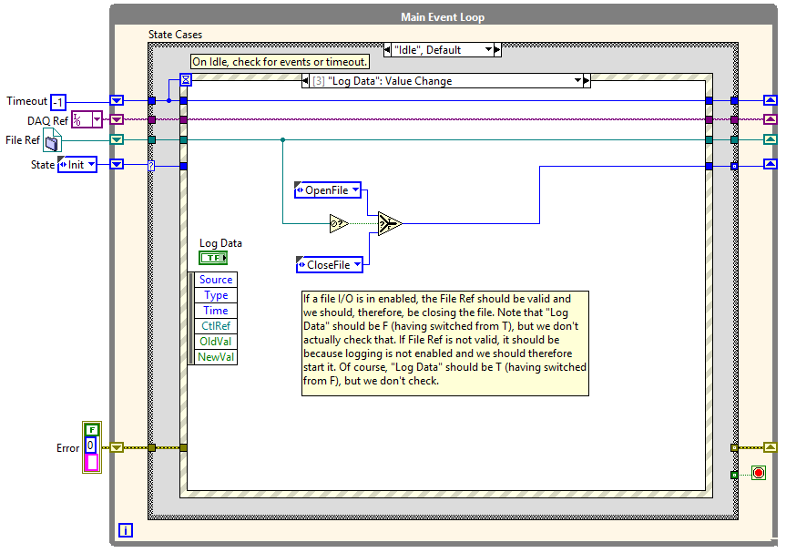
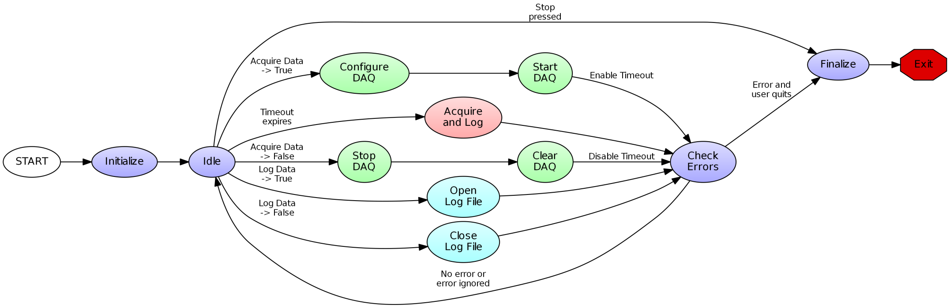
Design Patterns
Using SubVIs
State Machine
Master-Slave
Producer-Consumer
Message Handler

Slide 11
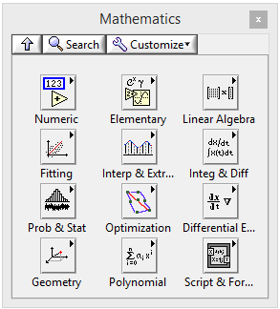
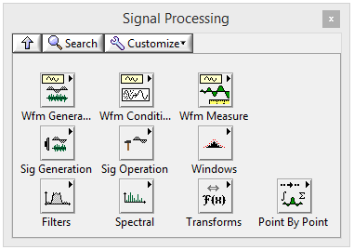
Analysis
LabVIEW has numerous functions for analyzing data
May not be the best choice for all analysis
Is your analysis simple, consisting of only a few steps?
Does your analysis need to be online during your acquisition?
Do you know exactly what you want to do to analyze your data?
Other choices:
Diadem
Igor
Matlab
SciPy + NumPy + Python
It is possible to incorporate analysis functions from Diadem or Matlab into LabVIEW
Some of the palettes with analysis functions
Notes:
ChartsAndGraphs.vi

Slide 12
Saving Data
What to save?
Dataset: The raw data (if feasible)
Intermediate results (standard deviations and other simple processing)
Attributes (aka properties, metadata):
Date
Time
Purpose of data (comments)
Acquisition information (instrumentation, settings)
You can’t save too many details!
You never know what you’ll wish you had recorded latter
Saving processed results?
Best to save in separate files
Use attributes to describe the raw data source and processing methods
Notes:
ChartsAndGraphs.vi

Slide 13
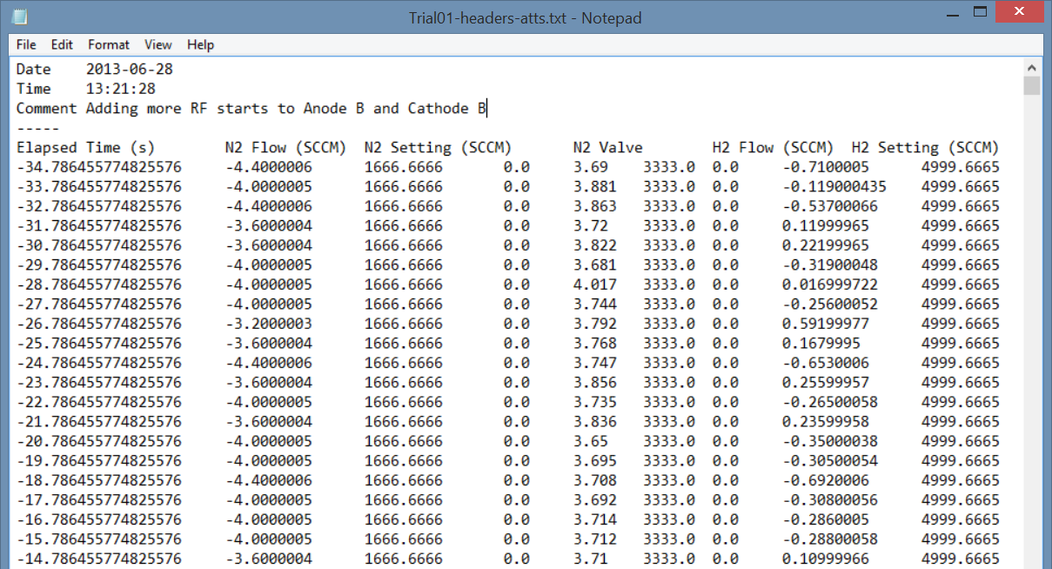

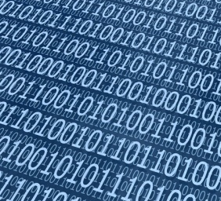


Saving Data: What Format?
File I/O
Text, CSV
Raw binary
Self-describing formats
TDMS
NetCDF
HDF5
Etc.
Databases
Use Simple Query Language (SQL) to write, search, etc.
Data organized in cross-linked tables
MySQL, postgresql, SQLite, Access, Oracle, etc.
ASCII Text
Raw
Binary
TDMS
Notes:
ChartsAndGraphs.vi

Slide 14
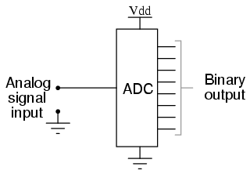
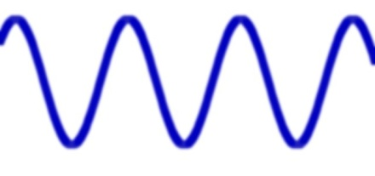
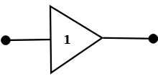

Types of DAQ: Signal Acquisition
Analog Input
Convert analog voltage signals into digital data
Single-shot or timed measurements
Use an analog-to-digital converter
Examples: temperature, sounds, voltage
101110110100 101110100101 011001100101
110011000101 011100101010 110110001000
Digital Input
Counter/Timers
Single-shot or timed
Single bit or bus
Example: proximity sensor, photointerrupter
Count events
Time events
Examples: encoders, pulse train timing, delay timing, delay generation
555
4, 5, 6, …
1 or 0
10 ms
Buffer
Counter/Timer
10 ms

Slide 15
Types of DAQ: Generation
Analog Output
Convert digital data into analog waveforms
Single-shot or timed generation
Use a digital-to-analog converter
Examples: sound, system excitation, motor control
101110110100 101110100101 011001100101
110011000101 011100101010 110110001000
Digital Output
Counter/Timers
Single-shot or timed
Single bit or bus
Generating a slow trigger, controlling an LED, controlling a bus
Control timing
Examples: Pulse train generation, delay generation
555
4, 5, 6, …
1 or 0
10 ms
Counter/Timer
10 ms
Buffer

Slide 16
How to chose a transducer
What type of measurement do you need to make?
Calibration Curve
Range
Input range (25 – 300 ºC, 1 – 100 mN, etc.)
Output range (0 to 10V, -5 to 5 V, 4 to 20 mA, etc.)
Sensitivity—How well can change be detected?
How good is the measurement?
Accuracy (±1 ºC, ±0.1 mN, etc.)
Precision (repeatability)
Linearity—can be handled in software
Drift—Change in calibration over time
Hysteresis—is it the same going up as coming back down?
Timing
Response time
Bandwidth (1 Hz, 100 kHz – 1 MHz, etc.)
Other considerations
Analog or digital
Analog: voltage, current, impedance, etc.
What signal conditioning or excitation/power does it require?
How will I connect it to my DAQ system?
Environmental isolation
Voltage, temperature, noise, vacuum, water, etc.
Ruggedness
Cost
Q: Where do I find this stuff?
A: All this info should be on the transducer’s datasheet or specification sheet
(which should be available from the manufacturer’s website)

Slide 17
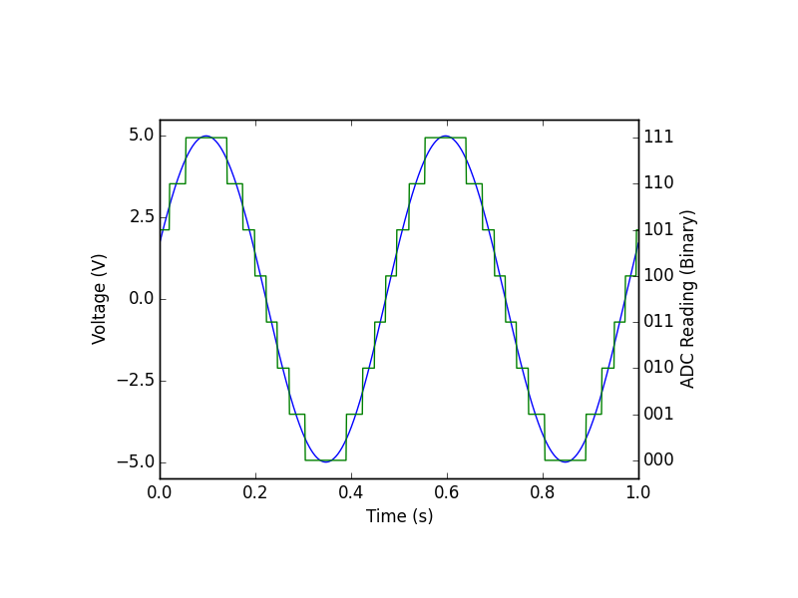
How to choose DAQ hardware
What type of signals do you need to acquire/generate?
How many channels of each type?
After external conditioning, what will the polarity and range of your signal be?
DI/SE?
What resolution do you need across that range?
What bandwidth do you need?
At what rate do you need to acquire/generate the data?
Note that bandwidth ≠ sampling frequency, but related
How precise are you timing requirements? Can you use software timing?
How much time-skew is acceptable?
Memory depth if signals cannot be transferred to system memory
Connectors
Form factor
Computer interface (e.g. PCIe, PXI, USB, etc.)
Software interface
Front panel controls
Cost

Slide 18

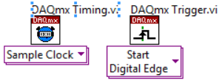

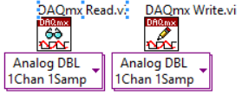


The Mantra
Create
Configure
Start
Read/Write
Stop
Clear

Slide 19
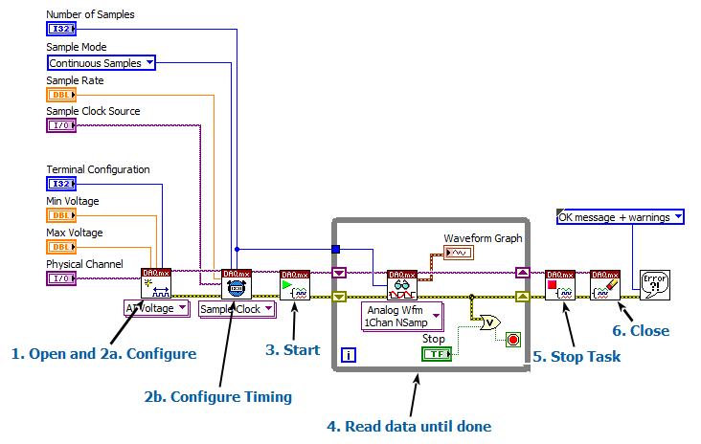
Continuous Sampling
Acquiring data forever
But how will I graduate?
Specify number of samples to read.
Defaults to “all available.”
See also NI Example: Voltage – Continuous Input.vi
Notes:
Modify Finite into Continuous

Slide 20
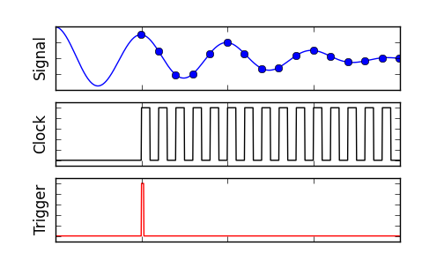
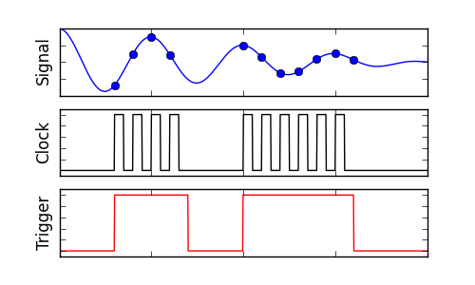
Other DAQ Topics Covered
Analog Output, DIO, Counter-Timers
Triggering
External Clocking to synchronize acquisition between devices
Integrating DAQ with design patterns

Slide 21
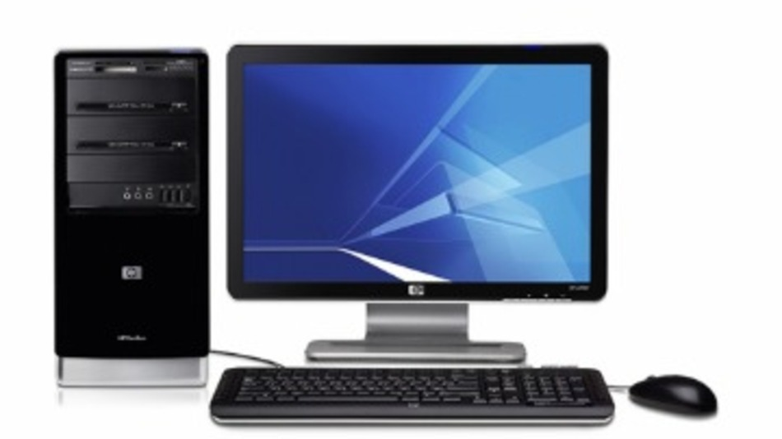

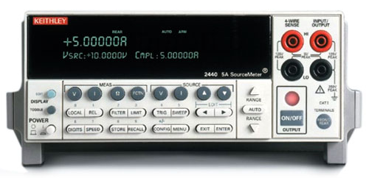
Instrument Control
There are several communication links: GPIB, USB, Serial, etc.
Serial is the most common, but also the biggest hassle.
Make sure to configure your instruments for the communication link
Find an instrument driver
If you can’t, or you need to modify the driver you find:
Many instruments use text, “message-based” protocols such as SCPI
Get the protocol documentation
Use string functions to format and parse messages
Communication
Interface
Measurement,
etc.

Slide 22
Much more to explore
Real-time DAQ and LabVIEW RT
LabVIEW FPGA, esp. with compactRIO
Designing and implementing control systems (MEEM 5750)
Calling external code libraries
LabVIEW code optimization
LabVIEW’s threading and priority system
Signal conditioning design: filters, isolation, etc.
Signal processing, data analysis, etc. (MEEM 5700)
Image acquisition and processing
Motion control
Network communications
Remote systems
Inter-VI communciation
Dynamic VI calls
DAQ/Instrument Control from other languages
Python
C/C++
Matlab
Etc
Embedded measurement systems
Tracking down noise problems
Designing experiments to be statistically valid (MEEM 5670)

Slide 23
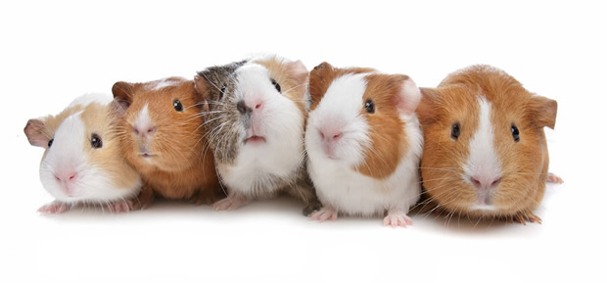
Thanks for being my guinea pigs!
I hope you found the experiment successful

