Slide 1
Instrument Control
ME5990
Spring 2016
Jason D. Sommerville
Copyright © 2016 UPVI, LLC. Redistribution is prohibited.

Slide 2
Notes
This lecture is “bottom-up”
The easiest stuff to use (from a software perspective) is mostly discussed last, e.g. Instrument Drivers
However, bottom-up better explains what the higher-level tools are based on so that they are easier to understand and easier to debug.

Slide 3
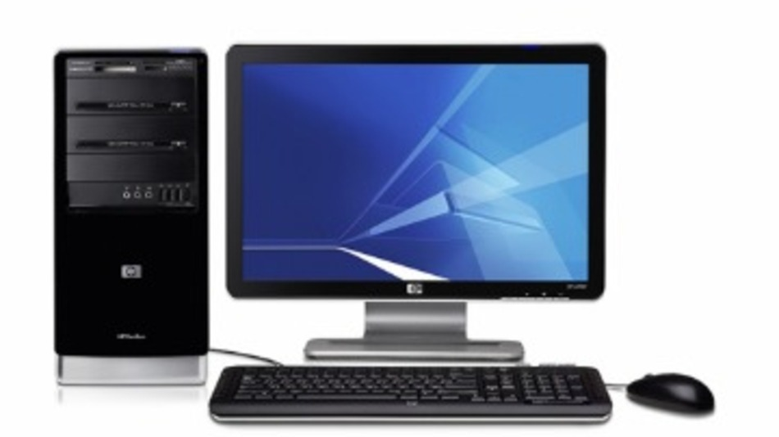

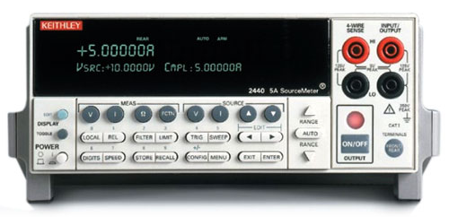
What is Instrument Control?
What’s an “Instrument”?
A device external to the computer designed to make measurements or control systems, or perform some other function
Typically it’s a “box instrument” meaning—it’s in a box.
What’s “Control”?
Telling the instrument to do stuff
Typically with an electronic communication interface
Communication
Interface
Measurement,
etc.

Slide 4
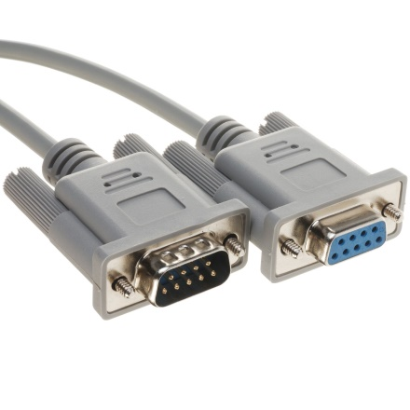
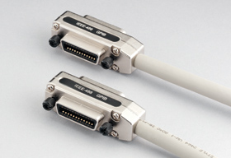
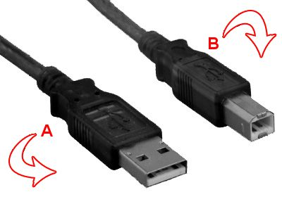
Common Communication Links
RS-232/RS-422 cable
RS-232
RS-422
RS-485
GPIB/HPIB (IEEE-488)
USB
Ethernet/LAN
WLAN
Other specialty interfaces:
SPI (Low-level electronics)
I2C (Low-level electronics)
MIL-STD-1553 (Avionics)
CAN (Automotive)
GPIB Cable
USB Cable

Slide 5
Some Terminology
Device: (or “terminal”) a device on the link capable of sending and/or receiving commands and data. Just like a (road) bus terminal, this is where data gets on or gets off the link
Controller: (or “host” or “master”) a single device which is responsible for organizing communication on the link and ensuring all devices on the link can receive their messages
Bus: a link capable of supporting more than two terminals with one controller
Network: a link capable of supporting multiple devices with shared/negotiated control
Bandwidth: the rate at which data may be transferred over the link. Usually in bits-per-second (not bytes!)

Slide 6
Communication links by category
Terminal: (or “device”) a device on the link capable of sending and/or receiving commands and data. Just like a (road) bus terminal, this is where data gets on or gets off the link
Controller: or “host” or “master” a (usually) single terminal which is responsible for organizing communication on the link and ensuring all devices on the link can receive their messages
Bus: a link capable of supporting more than two terminals
Address: a unique identifier on a bus of a particular terminal
Actual address techniques vary from standard to standard
Protocol: an agreed upon format for data exchange on a comm link. Several levels of protocol may exist.

Slide 7
What do we need?
Typically, the PC is going to be the host controller, but…
My computer doesn’t have a ________ interface!
In the old days, computers at least had an RS-232 “serial” interface.
Modern computers typically have USB, Ethernet and PCI/PCIe (desktops only).
So, the first thing you need is a USB/PCI <-> ______ interface
The interface will provide a software library with which you can send and receive data to/from terminals via the host interface
Examples…

Slide 8
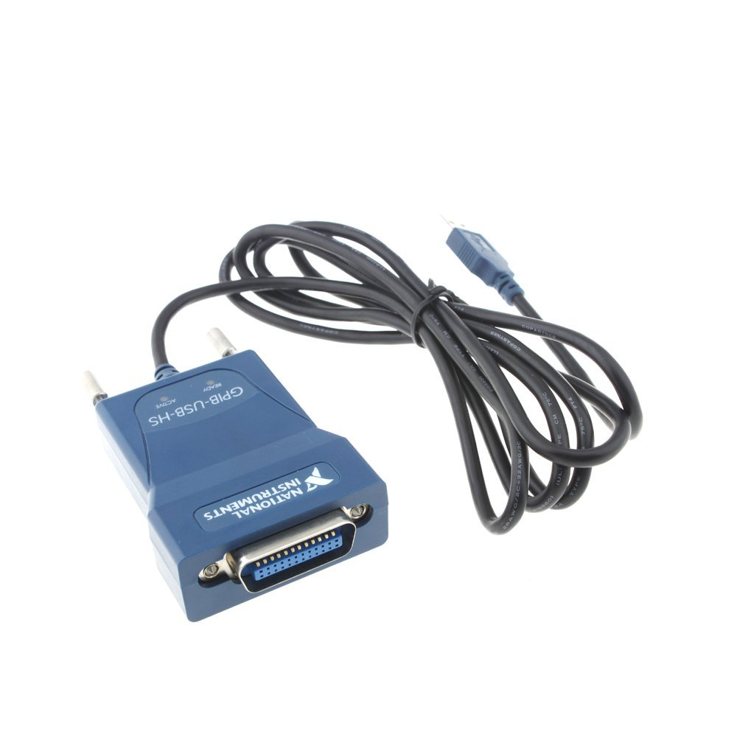
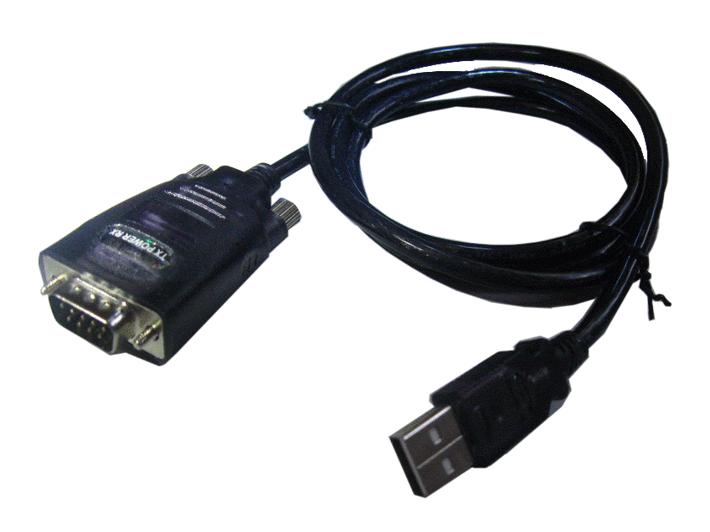
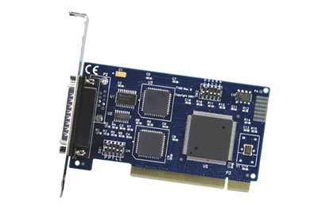
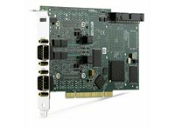
Host Interface Examples
USB to RS-232
USB to GPIB
$10-$25
PCI to RS-232/422/485
$665
PCI to CAN
$1800
$165

Slide 9
Configuring your GPIB Bus
Connect all the devices with one or more cables
Every device on a GPIB bus must be assigned a unique address.
A number 0 – 31
Usually the controller is 0
Obviously this limits the number of devices on a bus
Assignment is typically done through the instrument front panel
Occasionally it is done with dip switches or pins (mostly older equipment)
That’s it

Slide 10
Configuring your TCP/IP Network
Connect all the devices with one or more cables and/or routers or hubs
Make sure that every device gets assigned a unique IP address
Instruments may be less advanced than your typical computer and may need to have an IP address assigned manually
You may have more than one network with more than one interface.
Talk to your local IT professional to get help, if absolutely necessary.
Network 0: Internet
Network 1: Lab Devices
That’s it

Slide 11
Configuring your USB Devices
Plug your device(s) in
That’s it

Slide 12
Configuring your RS-232/422/485
Or, a brief introduction to why you should use any other interface if you can
GPIB, USB, Ethernet and CAN are all busses or networks
Bus: One controller, many devices
Network: Many devices, shared/negotiated control
RS-232/422 is point-to-point—two devices only.
There is RS-485 is multi-drop, which acts like a bus, kind of.
GPIB, USB, Ethernet, CAN are all self-configuring to one degree or another.
Unfortunately, just because you have two devices that support a serial interface (e.g. RS-232) doesn’t mean that they will work out-of-the-box.
Why?

Slide 13
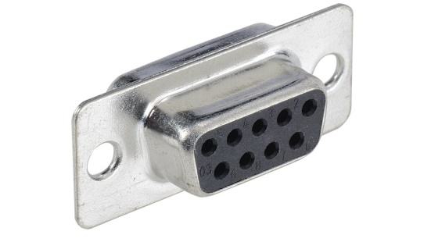
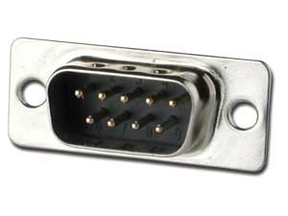
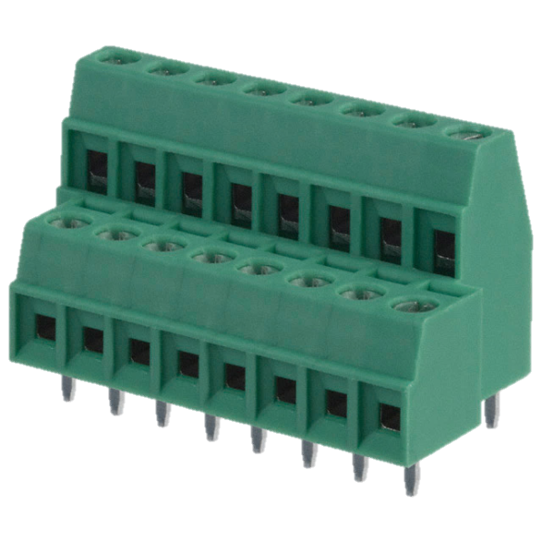
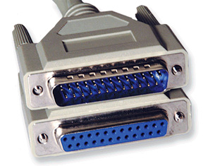
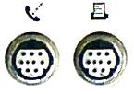
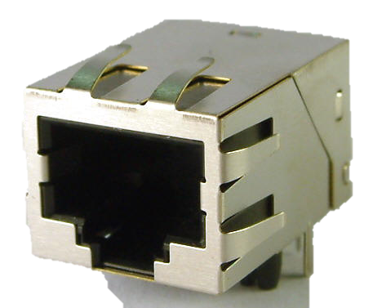
Serial Connectors
I’ve seen all these and more used for RS-232

Slide 14
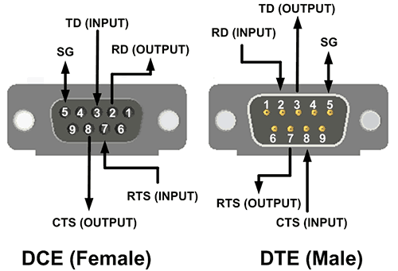
DTE vs. DCE
DTE: Data Terminal Equipment—the controller (usually)
DCE: Data Communications Equipment—the device (usually)
Think “modem” if this means anything to you
DTE
Most common configuration:
Computer/interface is DTE
Interface is male DB-9
Device is DCE
Device connector is female DB-9
DCE
Straight-through cable

Slide 15
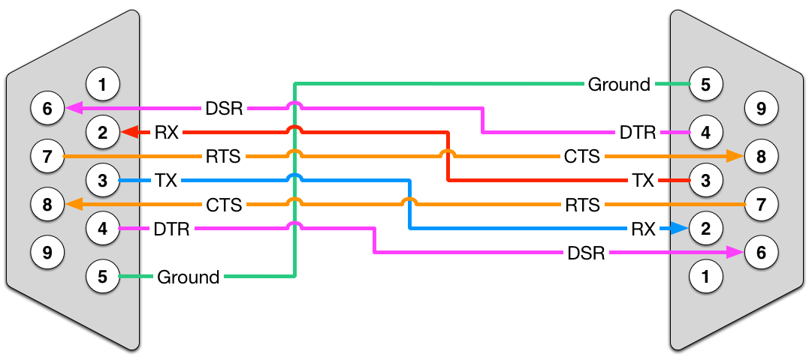
DTE vs. DCE
What if you want to connect DTE to DTE or DCE to DCE?
Use a “null modem” cable
https://www.decisivetactics.com/support/img/cable_null_hs.png

Slide 16
Okay, cable is right. Now what?
Get your UART settings matched up
Baud/bit rate: How many bits-per-second (bps) sent?
Controls the maximum rate data can be sent
Standard options (bps):1200, 2400, 9600, 19.2k, 57.6k
Note: 8 bits per byte, 1 byte per character
Compare RS-232 to USB 2.0 at 480 Mbps
Data bits: How many bits per byte (character)?
Typically 7 or 8
Parity: A limited error check
Options: Even, Odd, Mark, Space, None
Stop bits: How to signify the end of each character
Typical options: 1, 1.5 or 2
Flow Control: Help the interface manage communication
Options: None, XON/XOFF, RTS/CTS, DTR/DSR
Most common configuration:
9600-8-N-1, No Flow Control
Bit-rate
Data bits
Parity
Stop Bits

Slide 17
Most Import RS-232 Lessons
Do you have the right cable?
Just because you can plug it in doesn’t mean it’s right.
Use a continuity check (voltmeter) if necessary to determine cable pinout
Are you using the same UART settings on both ends?

Slide 18
Okay, let’s assume everything is hooked up right…

Slide 19
What are we going to do?
Open the communication channel
Write commands to the device
Read responses from the device
Or, sometimes we listen for the device to initiate communication with the host
Close the communication channel
Looks a lot like the DAQ Mantra!
But, we need interface software for our interface hardware…

Slide 20
Host Interface Software
Each host interface needs a software library so that our software can send and receive data over the interface
Library may be vendor-specific or may be common to all or most vendors.
Typically, if it’s common, there’s a software standard and…
It’s built into most operating systems

Slide 21



Host Interface Software
Interface | Driver | LabVIEW VIs
RS-232 RS-422 RS-485 | OS COM port interface VISA
Ethernet WLAN | OS TCP/IP stack VISA
USB | Instrument-specific driver VISA | Device Specific
GPIB | NI-GPIB (or other vendor interface) VISA

Slide 22
Notes about RS-232/422/485
The RS protocols are so basic that all operating systems inherently know how to handle these.
Windows: “COM” ports
Linux: /dev/ttyS0, /dev/ttyS1, etc.
Any Mac people know what they are on Mac?
Driver software for USB/PCI -> Serial will create COM ports for your interface(s) when it is installed
VISA can also be used for serial communication. More on that later…

Slide 23
Special Note about USB
USB is so complicated that devices connected by USB typically have their own, dedicated software library
Imagine “DAQmx” except for your device.
However, many scientific instruments communicate via the VISA INSTR protocol. More on that later…

Slide 24
Special Note about Ethernet and WLAN
Instruments that communicate via Ethernet and WLAN typically use the TCP/IP or UDP protocol (the same protocols used by the world-wide web and other Internet protocols).
Modern operating systems all have a TCP/IP “stack” or interface library.
Think “DAQmx” for TCP/IP. It enables you to write software for sending and receiving data.
VISA can also be used for TCP/IP instruments. Again, more later…

Slide 25
You keep talking about VISA
Stay away from my wallet!
VISA: Virtual Instrument Software Architecture
It is an Abstraction Layer
It makes all reads and writes to instruments look the same
Regardless of the actual communication bus
You can write one VI that communicates with the instrument regardless of the communication interface used
Learn only one interface
Except: usually the commands to open up the communication with the device are link specific. See, e.g. VISA Configure Serial Port.vi

Slide 26
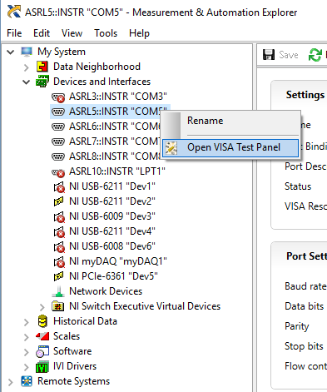
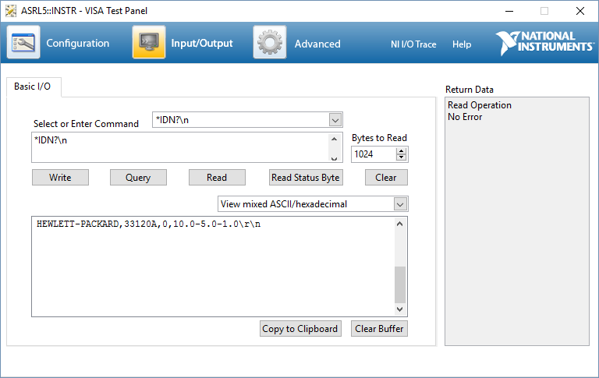
Testing Communication
Once again, MAX and it’s test panels can be a big help in setup.
Right-click on the interface and select “Open VISA Test Panel”

Slide 27
So, what data should I read/write?
To determine what to read/write, you’ll need the instrument’s protocol documentation.
Many (most?) instruments communicate with a message-based protocol
ASCII string commands are sent according to an instrument-specific protocol
The protocol defines the expected message responses
Most often, message-based instruments will not send data to the controller except as a response to a command

Slide 28
Message-based Protocol
Host sends command “*IDN?”
Device responds “HEWLETT-PACKARD,33120A,0,10.0-5.0-1.0”
Host processes response “Yup, that’s the instrument we’re expecting”

Slide 29
SCPI
Standard Commands for Programmable for Instruments
Defines a common protocol that many instruments use
Commands/queries separated into functional hierarchy
Each level separated by a “:”
Queries end in “?”
New line (\n, 0x10) characters end the commands
Command | Description
Waveform Generator Commands
:FUNCtion <SINe | SQUare | … > | Generate a sine wave
:FUNC? | Query the current waveform
:FREQ:STARt <frequency> | Start of frequency sweep
:FREQ:STOP <frequency> | End of frequency sweep
Oscilloscope Commands
:CHANnel<n>:RANGe <value> | Set the range of input channel n to command
:ACQuire:POINts <value> | Set the number of data points to acquire when triggered
:WAVeform:DATA? <start>, <stop> | Return a previously acquired trace
See specifications at: http://www.ivifoundation.org/specifications/default.aspx

Slide 30
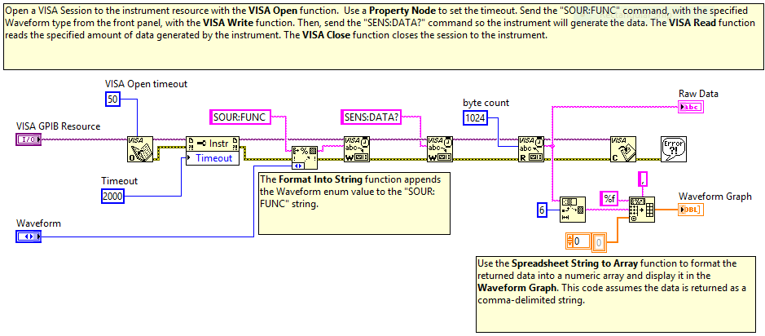

Communicating with an Instrument
NI Example: GPIB with VISA Functions.vi

Slide 31
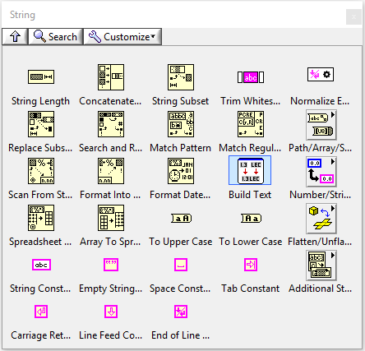
Useful Functions for Instr. Comm.
The main task in communicating with an instrument is to convert data into text and back
Just like text file I/O!
String Palette functions, esp.
Format Into String
Scan From String
Spreadsheet String to Array
Array to Spreadsheet String

Slide 32
Command Example
Build 33120 Configure Standard Waveform.vi

Slide 33
Binary Data Example
Investigate 33120 Create Arbitrary Waveform.vi

Slide 34
Instrument Driver Network
Contains NI provided, vendor provided and user provided drivers
On the web at http://www.ni.com/downloads/instrument-drivers/
Tools Menu -> Instrumentation -> Find Instrument Drivers..

Slide 35
IDN: Caveat Emptor
You get what you pay for
Not every driver is complete, accurate, functioning
Not every instrument obeys its own specifications
Summary: You may have to edit the instrument drivers to make it work. You may find that you might as well start from scratch.

Slide 36
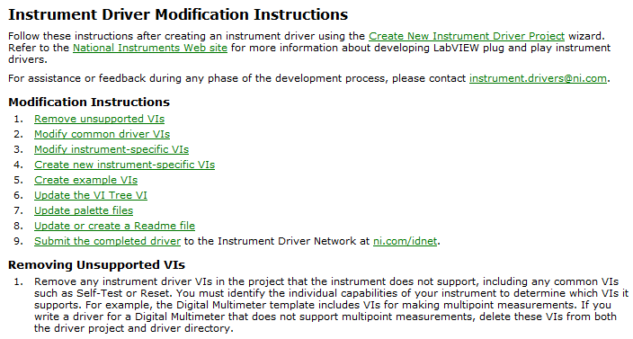
Building Your Own Instrument Driver
LabVIEW provides a template for building instrument drivers
Tools -> Instrumentation ->Create Instrument Driver Project…
Then follow the instructions
Demonstrate

Slide 37
Instrumentation Conclusion
There are several communication links: GPIB, USB, Serial, etc.
Serial is the most common, but also the biggest hassle.
Make sure to configure your instruments for the communication link
Find an instrument driver
If you can’t, or you need to modify the driver you find:
Many instruments use text, “message-based” protocols such as SCPI
Get the protocol documentation
Use string functions to format and parse messages
Good luck!

